Slide 1
CUSTOMER CHURN
By Mark Chiuri

Slide 2
OVERVIEW
This presentation is divided into :
Business understanding
Data understanding
Data Analysis
Data Modelling

Slide 3
BUSINESS UNDERSTANDING

Slide 4
In the telecommunications industry,customer churn is a major challenge. Retaining existing customers is more cost effective than acquiring new ones, making it essential to understand why customers leave. By analyzing customer behavior, usage patterns and interactions with service plans,we can identify the key factors driving churn. These insights will help the company develop proactive strategies to improve retention thus enhance customer satisfaction and reduce revenue loss.

Slide 5
OBJECTIVES
1.To develop an accurate and reliable customer churn prediction model with an accuracy of 85%
2.To identify key factors contributing to customer churn
3.To formulate targeted customer retention strategies
4.Utilize machine learning models to accurately predict potential churn and take proactive measures.
5.Streamline processes using data analytics to improve decision-making and resource allocation.

Slide 6
METHODS USED FOR ANALYSIS
Data Collection
Explanatory data analysis
Data Visualisation
Data Modelling
Feature selection
Hyperparameter tuning

Slide 7
DATA UNDERSTANDING

Slide 8
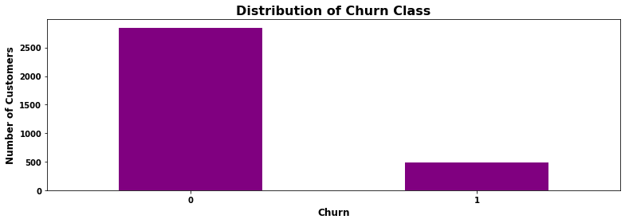

Slide 9
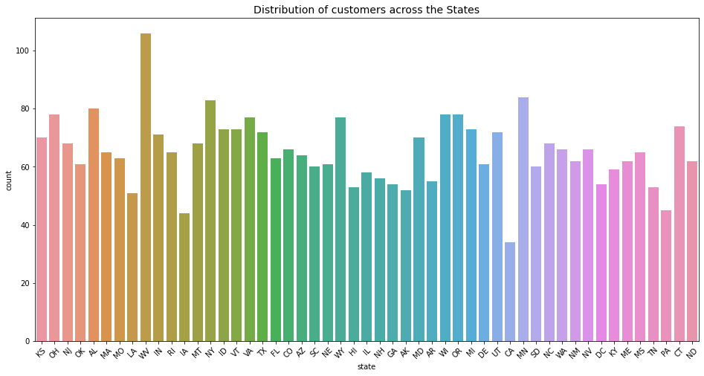

Slide 10
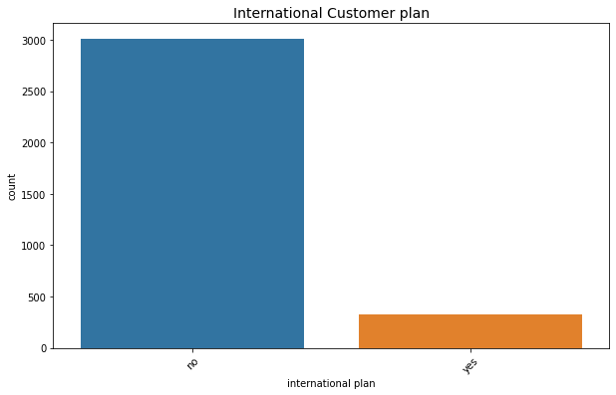
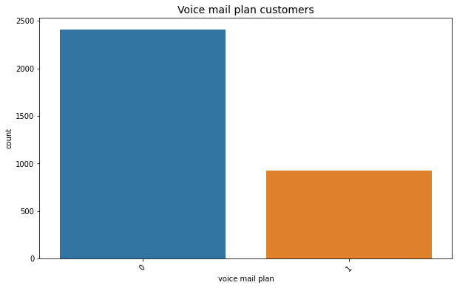
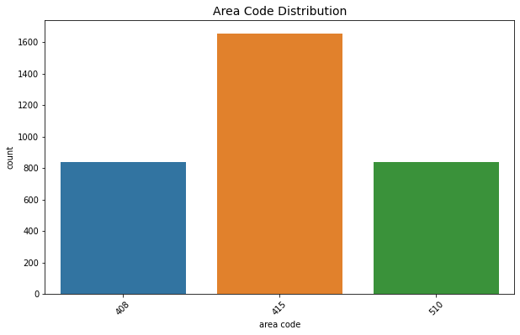

Slide 11
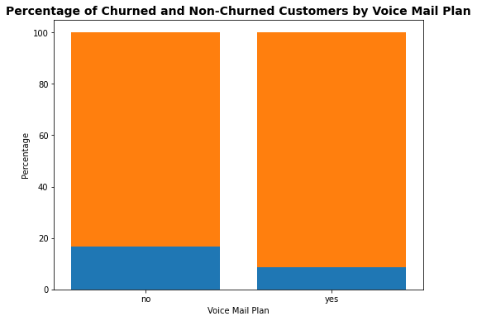
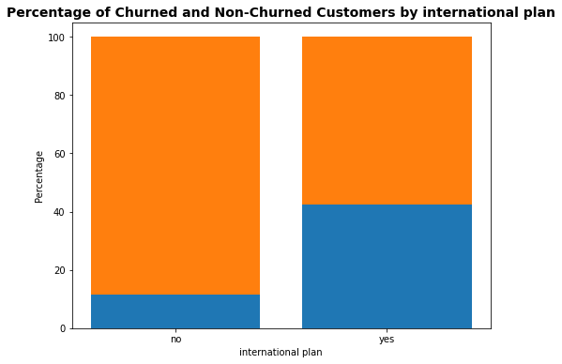

Slide 12
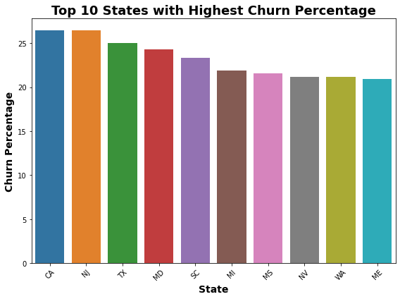
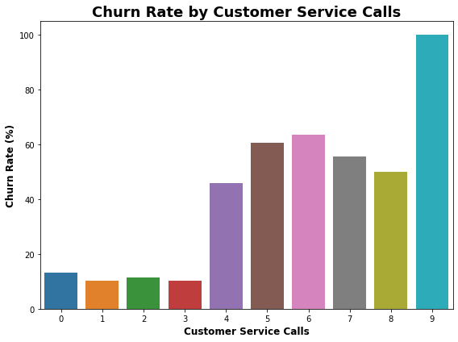

Slide 13
DATA ANALYSIS

Slide 14
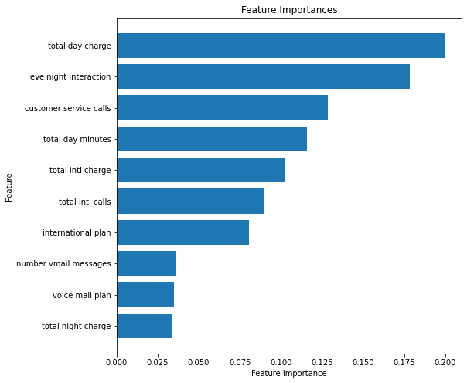

Slide 15
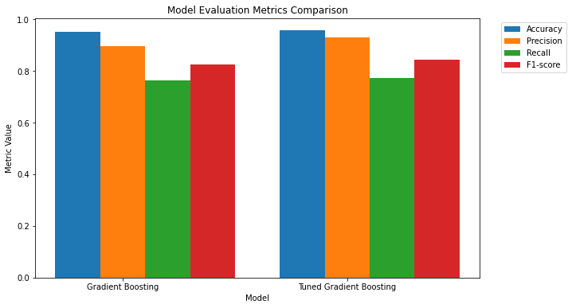

Slide 16
CONCLUSION
To effectively reduce churn, boost growth, and enhance customer satisfaction, the telecom company should focus on leveraging data-driven insights and advanced machine learning models. A seamless data flow, combined with an expanded B2B approach and a proactive collection of customer feedback, will help shape tailored retention strategies. Regularly monitoring churn rates, crafting targeted marketing campaigns, and improving network performance are crucial steps to keep customers engaged and boost profitability. Additionally, fine-tuning pricing, offering personalized plans, and assessing international calling options can help attract and retain customers while staying competitive in the market. By implementing these strategies, the company can not only tackle churn head-on but also create a better customer experience and achieve substantial revenue retention and cost savings.

