Slide 1
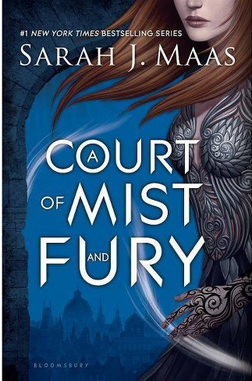
Chapter 54

Slide 2


Slide 3
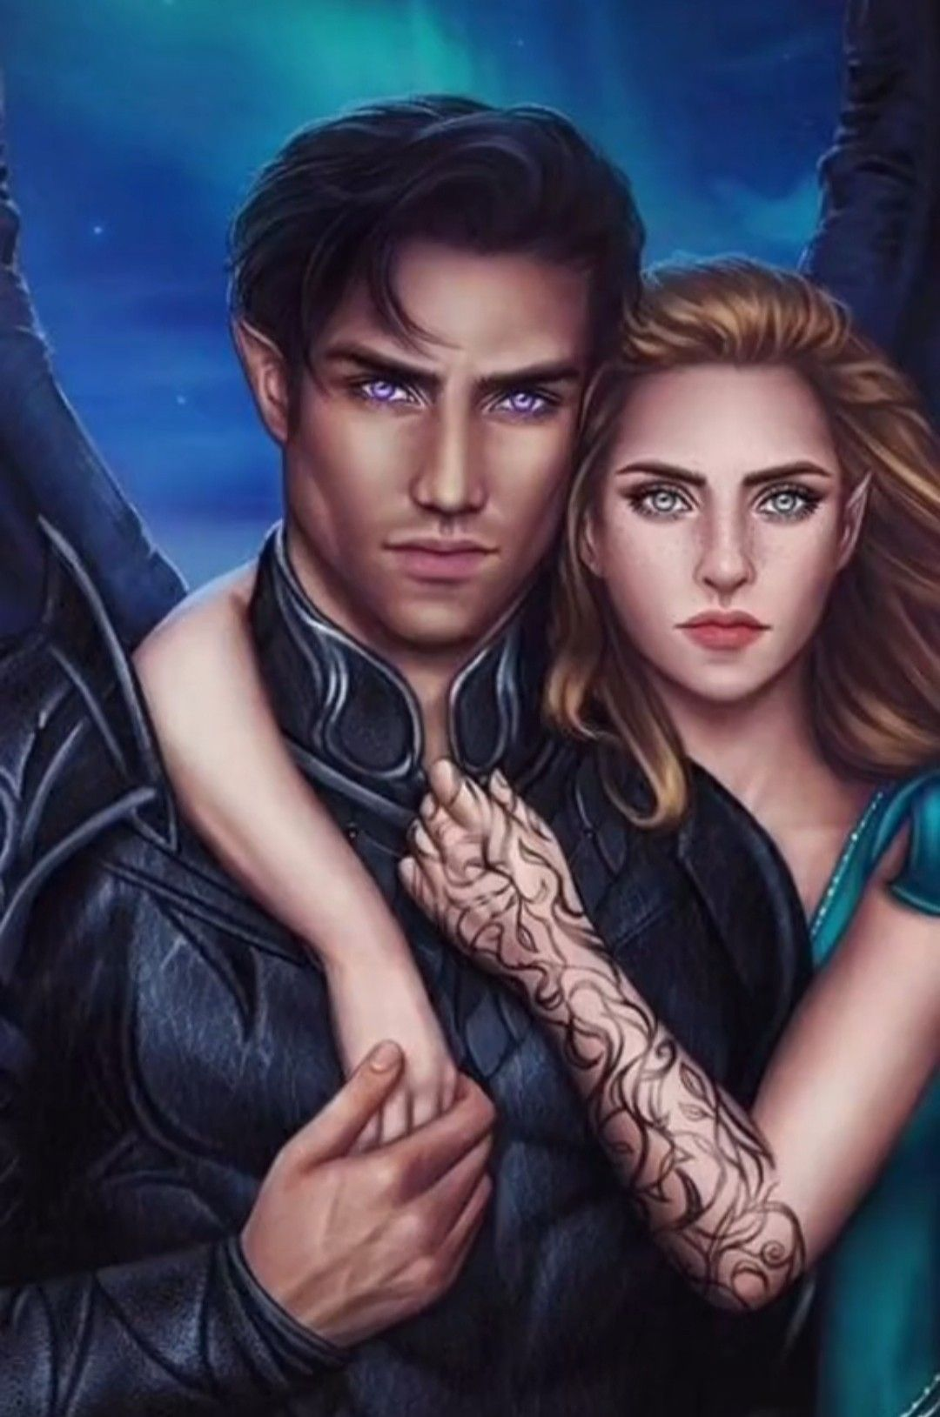
It’s a Love Story…
What were the biggest parts of their love story to this point?
What had the greatest impact on Rhysand and Feyre?

Slide 4
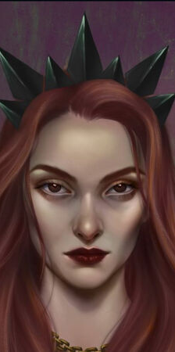
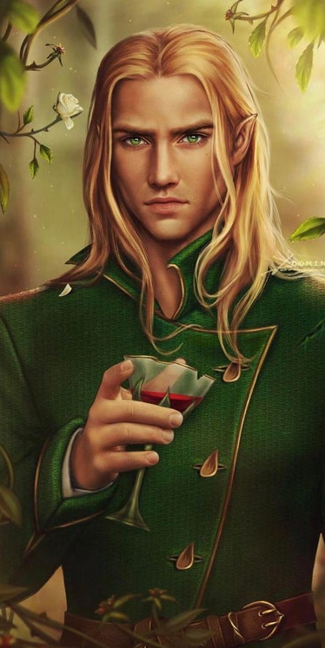
The Villains
Amarantha mentioned 23 times
Tamlin mentioned 14 times

Slide 5
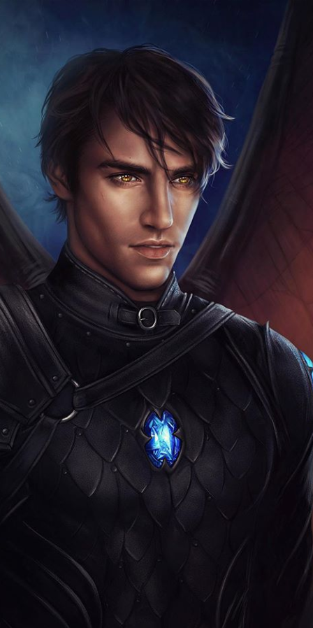
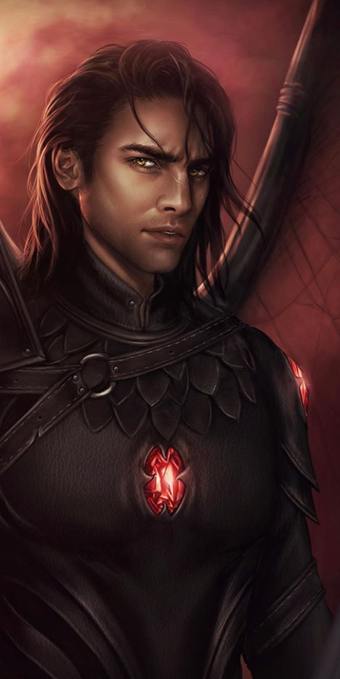
Bat Boys
Azriel only mentioned 7 times
Cassian only mentioned 6 times

Slide 6
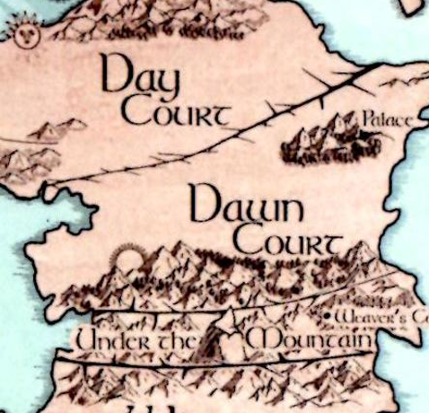
Stop Words
Under
My
Once
Him
Me
Before

