Slide 1
Ghid audio

Slide 2
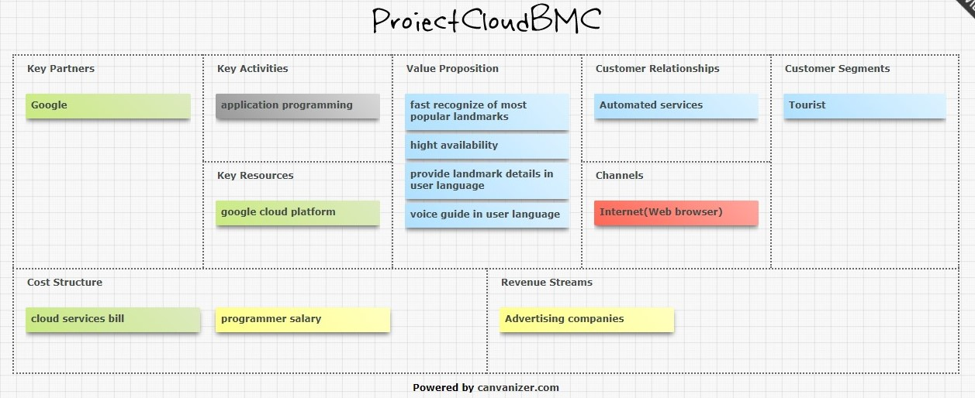
Business Model Canvas

Slide 3
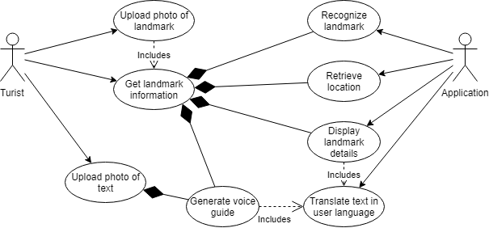
Use case diagram

Slide 4
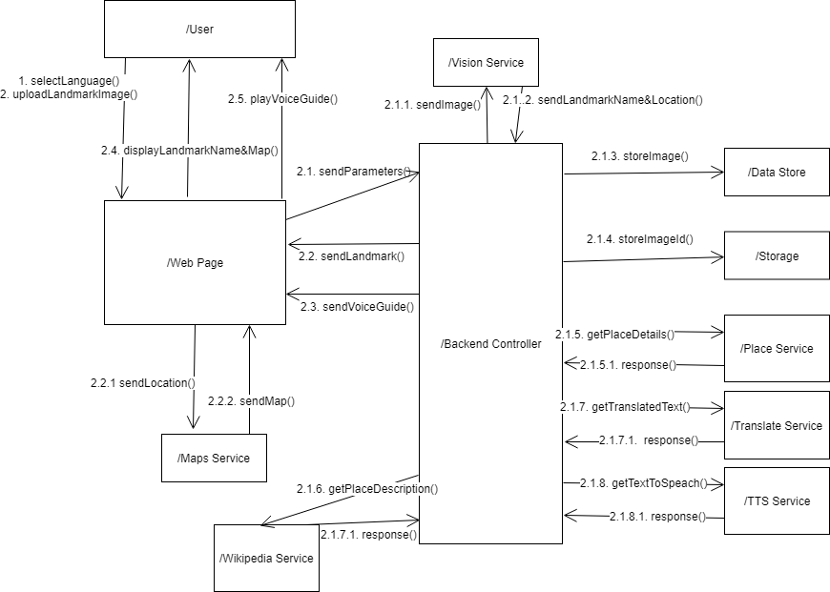
Diagrama de comportament

