Slide 1
All data in a few lines of code – Scraping from the Web
Michael Ganslmeier | DPhil Student
Michael.ganslmeier@spi.ox.ac.uk

Slide 2



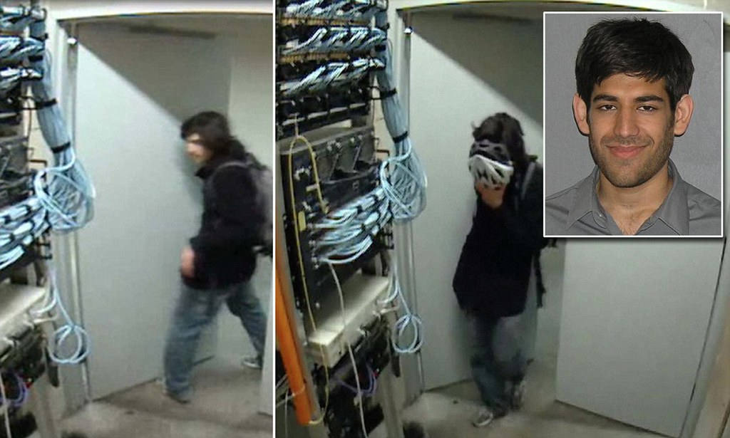
Examples of Famous Scrapers
Zuckerberg’s Facemash Scandal at Harvard in 2003
Aaron Schwartz’ JSTOR Scandal at MIT in 2010

Slide 3
Outline
The Art of Scraping
HTML Programming Language
Example: Scraping the Natlex legislation database
Some notes on legal stuff
Summary

Slide 4
1. The Art of Scraping
What the web is: a huge collection of linked HTML documents/files lying on servers all over the world
What the browser does: Request these HTML files and transfer/render the HTML code to put it into a nice user-interface
Web Scraping: a technique to request these HTML websites without any human-browser interaction on large scale basis
Which ingredients are needed:
URL
HTML Knowledge
RStudio and the “rvest” package

Slide 5
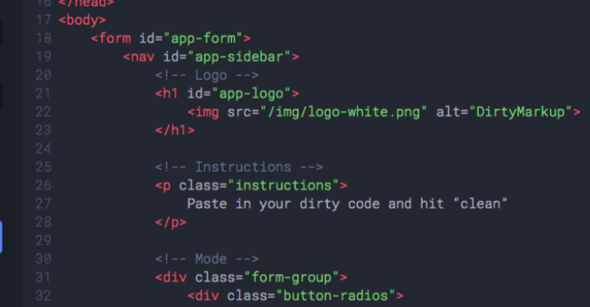
2. HTML Programming Language
HTML Code consists of tags: <body>, <div>, <p>, <img>, <h1>, <form>, ...
Each of these tags can contain attributes: class=”container” => select with “.class” id=“container_1” => select with “#id”
Each of these attributes has a value, e.g.: for class=“container”, “container” is the attribute value for href=”www.google.com”, “www.google.com” is the attribute value

Slide 7
3. Static Websites
1. Inspect the Website with the Developer Inspector (on a Mac: Option + Command + I)
2. Download the HTML code into R: read_html(url) 3. Extract the HTML object: html_nodes(”CSS SELECTOR”) 4. Extract what you want from the HTML object: - if you want the text: html_text() - if you want the link: html_attr(”href”) - if you want the title: html_attr(“title”)
In short: paragraph = read_html(url) %>% html_nodes(‘.container’) %>% html_text()
Extract what you want from the HTML Object
Download the HTML Code
Extract the HTML Object

Slide 8
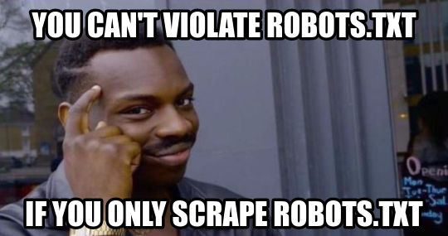
4. Some notes on legal stuff
Websites usually do not like if you rebuild/download their entire databases (that’s their USP)
Thus, you might get blocked if you make 1mio requests in 30 seconds or so...
Advices:
be kind and slow down the number of requests per second
be aware of the legal issues of crawling social media platforms
check out the robot.txt file of the website you are scraping
Legal Cases: LinkedIn has sued hundreds of crawlers for quite a lot of money

Slide 9
5. Summary
Crawling can be fun and replace a lot of boring RA work
The theory behind is simple: Inspect -> Download -> Extract -> Scale
In practice, things can become difficult, especially when there are obstacles along the way

Slide 10

Thank you for your attention
Contact Details:
michael.ganslmeier@spi.ox.ac.uk
www.michael-ganslmeier.com
https://github.com/MGanslmeier

