Slide 1
Associative Memory: A Network Approach
Research Workshop
Group 2: Massimiliano Garzoni, Peter Uhrin, Mickey Fraanje, Alena Clim, Niklas Limacher

Slide 2
Contents
Introduction
Methods
Results
Discussion

Slide 3

Introduction
Background: Categorical Perception
Labels; Features; Themes
“Objects within-group are harder to distinguish than objects between-groups”
Motivation: One category split into two “random” subgroups
No labels; similar features; same theme
RQ: Will people correctly create categories to distinguish between the two “random” subgroups?
Hypothesis: Yes, within-group vs. between-group discrimination will result in a significant difference.

Slide 4
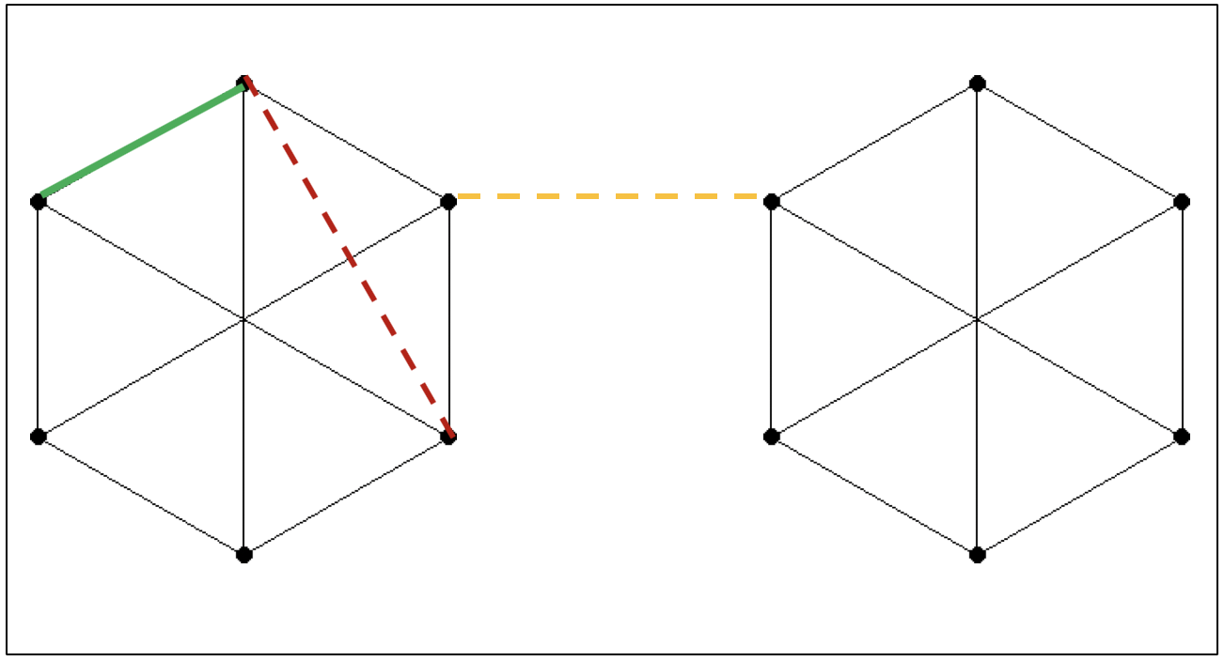
Methods
Research design
Participants were asked to memorize pairs of objects, and subsequently asked whether a pair appeared in the training set
IV: 3 types of pairs: yes (50%), no-within (25%), no-between (25%)
Part 1 → Training phase
Part 2 → Testing phase
What we measured
Judgements whether a pair appeared in the training set (correct/incorrect)
Response times
Demographic data (age, gender)
Technical tools
The graphs were generated by a python script
The experiment was mage with the psychopy
toolkit and run online on pavlovia.org

Slide 5
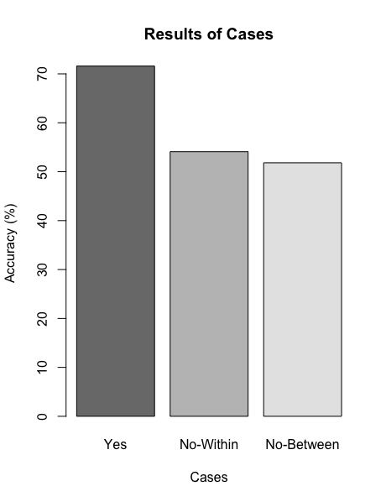
Results
Statistical analysis:
22 participants in total (N = 22)
M = 71.60 (SD = 0.15) of correct responses (real nodes, column ‘Yes’)
M = 54.10 (SD = 0.23) for fake-within nodes (‘No-Within’ column)
M = 51.82 (SD = 0.23) for fake-between nodes (‘No-Between’ column)
Conducted a Fisher’s Exact Test to check the statistical difference between the no-within and no-between results
Outcomes of study:
Difference was statistically insignificant, with p = 0.138 (DF = 21)
Notes:
So what about the results? The most juicy part.
Only 22 participants successfully completed our experiment. It is worth to mention that the experiment was accessed online, but not completed, around 200 times. As Mickey and Alena will tell you in the discussions, this seems to be one of the reasons for the outcome of the study.
First, we ran descriptive statistics to obtain an overview of the overall performance of the participants. As you can see in the figure, around 70% of people remembered correctly; around 54% remembered the fake-within nodes and around 51% remembered the fake-between nodes.
We then ran a Fisher’s Exact Test to assess the statistical significance between the fake-within and fake-between results, namely column 2 and 3.
Contrary to our expectations, the test proved to be statistically not significance, with a p-value of 0.138.

Slide 6
Discussion
No significant effect was found. This might be due to:
Limited sample size
Lack of consolidation period
206 participants started the study; only 22 finished it
Length & difficulty of experiment might have demotivated participants
No mobile functionality
Future studies:
Create subgroups with objects that have at least one feature in common (instead of completely random)
Adding the condition with fully-informed participants.
More controlled setting
Adding a potential control group: only one graph.

Slide 7
References
Clapper, J. P. (2012). The effects of prior knowledge on incidental category learning. Journal of Experimental Psychology: Learning, Memory, and Cognition, 38(6), 1558–1577. https://doi.org/10.1037/a0028457
Foroni, F., & Rothbart, M. (2011). Category Boundaries and Category Labels: When Does A Category Name Influence the Perceived Similarity of Category Members? Social Cognition, 29(5), 547–576. https://doi.org/10.1521/soco.2011.29.5.547
Gibson, J. J., & Gibson, E. J. (1955). Perceptual learning: Differentiation or enrichment? Psychological Review, 62(1), 32–41. https://doi.org/10.1037/h0048826
Harnad, S. (1987). Categorical perception: The groundwork of cognition. New York: Cambridge University Press.

