Slide 1
Emotion detection and ethnicity bias
Pattern Recognition Project Presentation - January 2022
Ignacio Montes Álvarez, Florian Gaeremynck, Sander Kaspers, Diana Gyurjiyan, Massimiliano Garzoni di Adorgnano, German Savchenko
Notes:
sander

Slide 2
Goal & motivation
Idea & Goal
Face recognition with different data sets and biases
Evaluate bias towards ethnicity learned during training
Motivation
Examining state of facial recognition models unbiased towards ethnicity
Can be used in various applications (e.g. mental health or violence recognition)
Notes:
sander

Slide 3
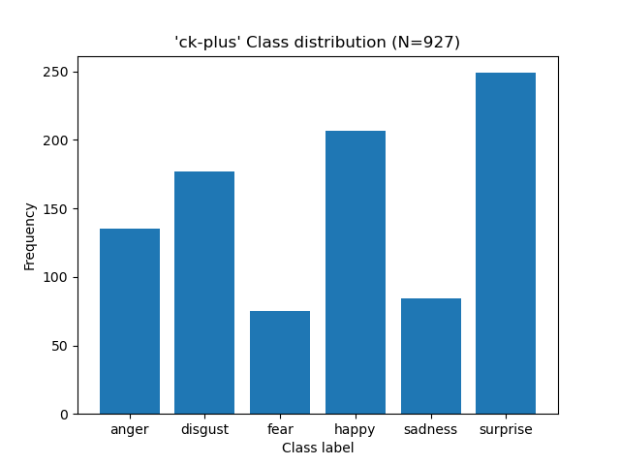
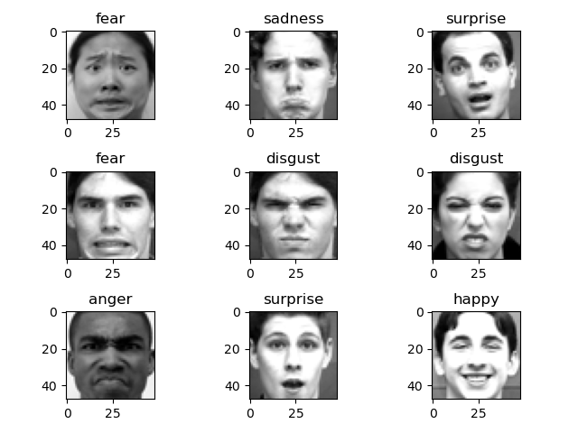
Datasets
Western-Caucasian: Cohn-Kanade (CK+) dataset for facial expression recognition
N = 981 images of caucasian people
Facial expressions relating to 7 emotions (classes):
anger, disgust, fear, happiness, sadness, surprise and contempt
Notes:
max

Slide 4
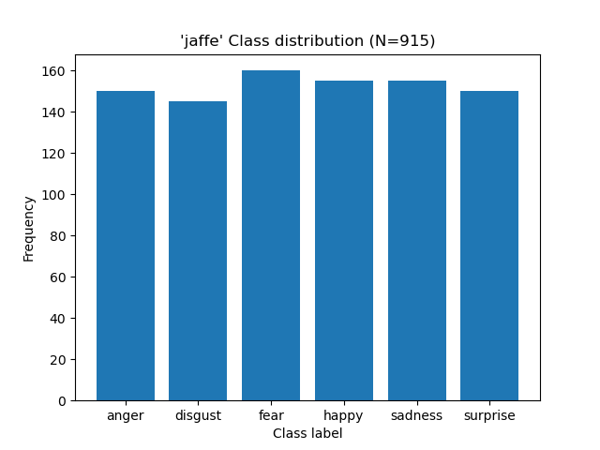
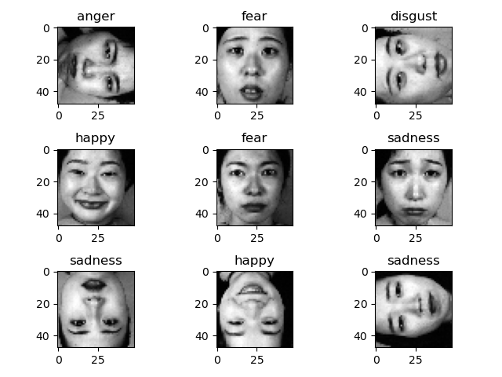
Datasets
Eastern-Asian: The Japanese Female Facial Expression (JAFFE) Dataset
N = 213 images of japanese females
Facial expressions relating to 7 emotions (classes):
anger, disgust, fear, happiness, sadness, surprise and neutralness
Notes:
max

Slide 5
Datasets
Issues:
Additional asian data either not accessible for retrieval or simply non-existent
Huge distribution imbalance
Mitigated by augmenting asian set with 702 images
Data augmentation (OpenCV)
Left and right flips
90º clockwise, counterclockwise and 180º rotations
Resized images in JAFFE because of irrelevant features (e.g. neck, shirt)
Gender imbalance, JAFFE contains only faces of women
Notes:
max

Slide 6
Modeling approach: CNN (I)
Conv2D (32 filters 3x3)
MaxPooling2D (Filter of size 2x2)
Dropout
Conv2D (64 filters 3x3)
MaxPooling2D (Filter of size 2x2)
Dropout
Flatten
Dense (64 units)
Dropout
Dense (number of classes = 6)
Softmax activation layer
Notes:
nacho

Slide 7
Modeling approach: CNN (II)
Hyper-parameter search with Keras Tuner
Activations (ReLU, tanh, sigmoid)
Dropout rates (0-0.5)
Optimizers (adam, adagrad, rmsprop, sgd)
Learning rate (0.001-0.01)
Approaches to counteract overfitting
Dropout layers
Early stopping with patience of 3 epochs (change on loss of 0.075)
Notes:
nacho

Slide 8
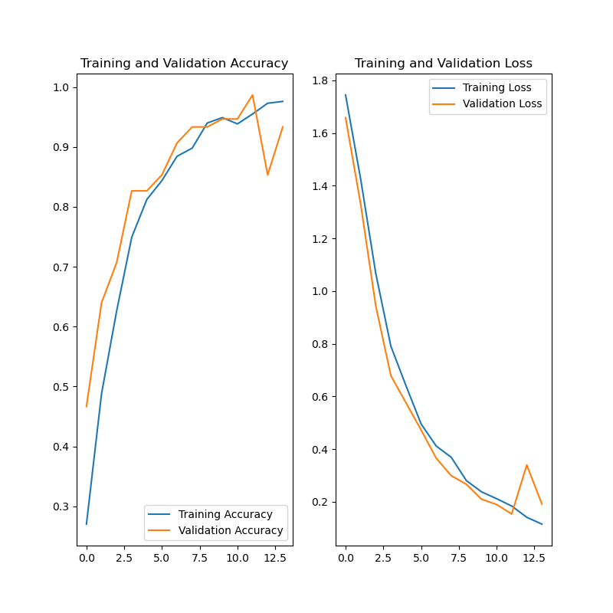
Results: CK+ (Training)
Training set accuracy: 97.8%
Notes:
max

Slide 9
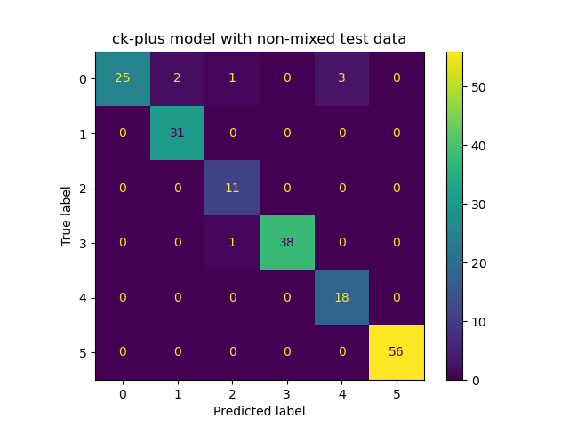
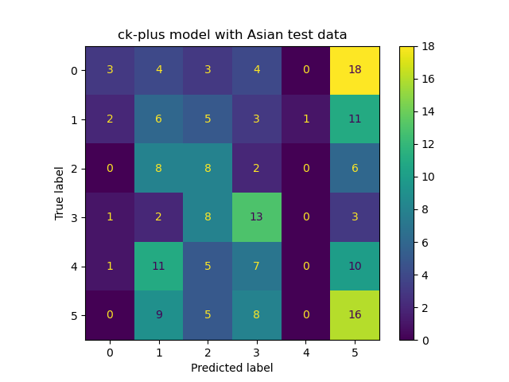
Results: CK+ (Testing)
CK-Plus model on CK-Plus test set
96.2% accuracy
CK-Plus model on JAFFE test set
25.1% accuracy
Notes:
max

Slide 10
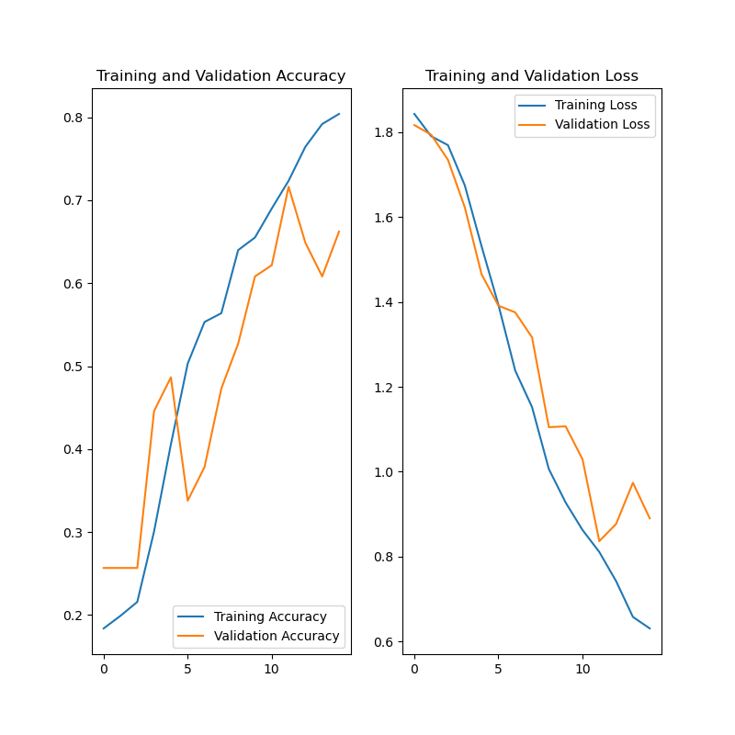
Results: JAFFE (Training)
Training set accuracy: 84%
Notes:
max

Slide 11
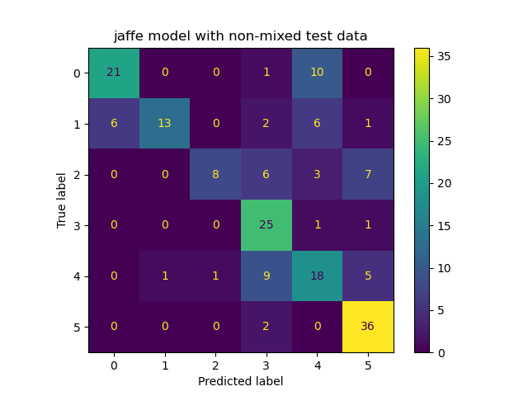
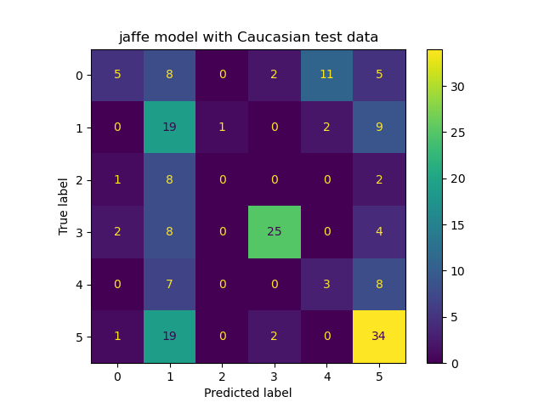
Results: JAFFE (Testing)
JAFFE model on JAFFE test set
66.1% accuracy
JAFFE model on CK-Plus test set
46.2% accuracy
Notes:
max

Slide 12
Discussions
CK-plus
Most frequent wrongly predicted emotion is: surprise
Possibly caused by unbalanced dataset distribution
JAFFE
Using JAFFE gives not as a good performance as the CK-plus data
Low testing performance on caucasian set:
High performance labels: disgust, happy and surprise
CK-plus most wrongly classified the labels as “surprise”, while this was not the case for JAFFE
Unsure whether a bias in gender rather than ethnicity
Notes:
german

Slide 13
Discussions
Notes:
german

Slide 14
Conclusions
Difficulty of emotions detection
The emotions on the images were extreme, emotions in reality can be more subtle, therefore these data sets are not representable and can not be used in real-life situations
Recommendation for future work
JAFFE is a female-only data set: use a mixed gender data set
Use more complex images (e.g. high resolution or colours instead of grey-scaled)
Notes:
german

Slide 15
Thank you. Questions?

