Slide 1
Classification of EEG signals into sleep stages: A Deep Learning Approach
Massimiliano Garzoni di Adorgnano, U662083
Enrico Vermeltfoort, U343642

Slide 2
Deep Learning Architectures
Implemented manually using Keras
CNN
RNN
Model hyperparameters selection using Genetic Algorithm (GA)
Only CNN
Interpolation using GA
Compared with random interpolation
Notes:
For this task, we decided to focus on the implementation of two main DL architectures, meaning convolutional Neural Networks and Recurrent Neural Networks. The main rationale for this was the nature of the data: time-series information from EEG signals which were then converted to spectrograms. With the aim of classifying such signals into the correct sleep stages, we chose to experiment with these types of networks given their ability to deal with and process sequential inputs.
Convolutional neural networks were trained using the Genetic algorithm, each argument in the standard keras 2d conv layer and dense layer was a parameter to be optimized by the genetic algorithm. Filter/neural Furthermore the genetic algorithm optimized the number of of 2d conv layers and dense layers
Finally, Interpolation was used to reduce model uncertainty. Interpolation was applied on different combinations of 15 models from the best models that the GA provided.

Slide 3
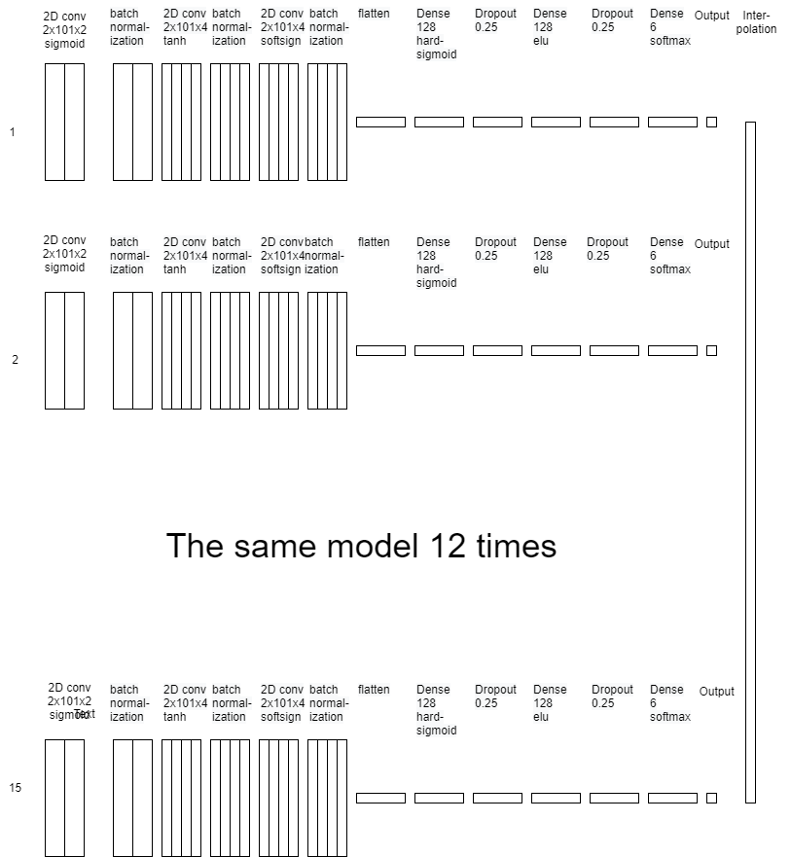
Diagram of the proposed solution
Notes:
The best combination of models, from interpolation, was the same model 15 times. While all models have the same structure. The direction of gradient descent differs between models. And thus, all 15 models predictions differ from each other.
Each model consists of three 2d convolutional layers, each followed by a batch normalization layer. The first conv layer has 2 channels, the second and third have 4 channels each. The output of the last batch normalization layer is flattened, followed by 2 dense layers with 128 neurons each and dropout. Then a softmax layer with 6 neurons, one for each of the 6 possible sleep stages. and finally the output, which is the maximum value of the softmax layer.
Applying interpolation of the 15 models gave the final output

Slide 4
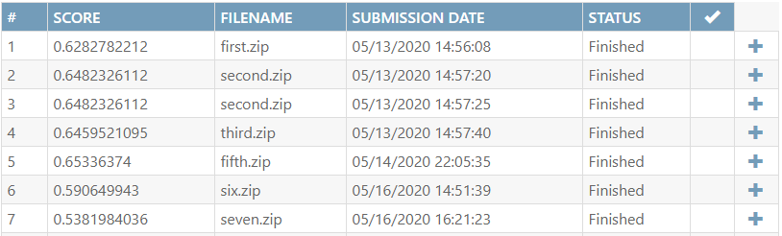
Results
Second.zip was our proposed solution
Notes:
While our Fifth model scores best in the codalab competition, we propose the second model as our final solution. The complexity of the fifth model adds a lot of computational overhead in both training and inference, as it was based on 150 different models 11 interpolation layers. This makes the model unrealistic for practical uses. The second model achieved a final score of 0.648 on the codalab test set.

Slide 5
Discussion
Combining models with different preprocessed data
RNN’s, 1D conv networks etc.
Apply Principle Component Analysis
Did not update RNN’s hyperparameter in GA
Try more extensive experimentation with different recurrent layers
Long Short-Term Memory or Gated Recurrent Units
Try different layer types
Only 2d convolution, batch normalization and dense layers were used
Notes:
We could have combined different models with different preprocessed data, such as add RNN’s 1D conv networks etc. As well as models trained where the input representations (vectors) is scaled or a dimensionality reduction technique, such as Principal Component Analysis is applied.
Should have ran the GA also for finding the best values for the RNN’s hyperparameters.
Could have tried a more extensive experimentation with recurrent layers such as LSTM and GRU.
Try different layer types:
For an exhaustive search for the best model, different type of layers should be used as well. Such as depthwise separable convolution layers, pooling layers, advanced activation layers.
This was not done to keep the genetic algorithm complexity to a minimum, in case of different type of convolution layers, or because literature indicated that certain layers work better in general, in case of batch normalization versus pooling layers spatial dropout layers.

