Slide 1


Hourly historical weather data analysis for all Saudi Arabia
Presented by: Mohammed Almalki
As (EDA) Project of
SDAIA Data Science Bootcamp
Under the supervision of : Dr.Mejdal
Notes:
Photo by The Creative Exchange on Unsplash - feel free to change!

Slide 2
Introduction:
Renewable energy contributes to preserving the environment from pollution, and in the future the world will dispense with traditional energy.
The Saudi Ministry of Energy seeks to achieve the Kingdom's Vision 2030, including the use of clean energy.
Quastions: what is the best regions for the establishment of renewable energy projects (solar energy and wind energy)?

Slide 3
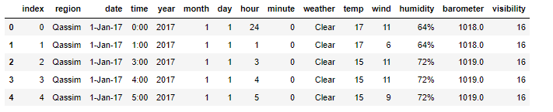
Data Structure:
This dataset provide hourly historical weather data for all Saudi Arabia cities from 2017 to 2019 . Included a date for which you would like to see weather history such as temperature, wind, humidity, barometer, and visibility.
Number of rows= 249023
Number of columns= 15

Slide 4
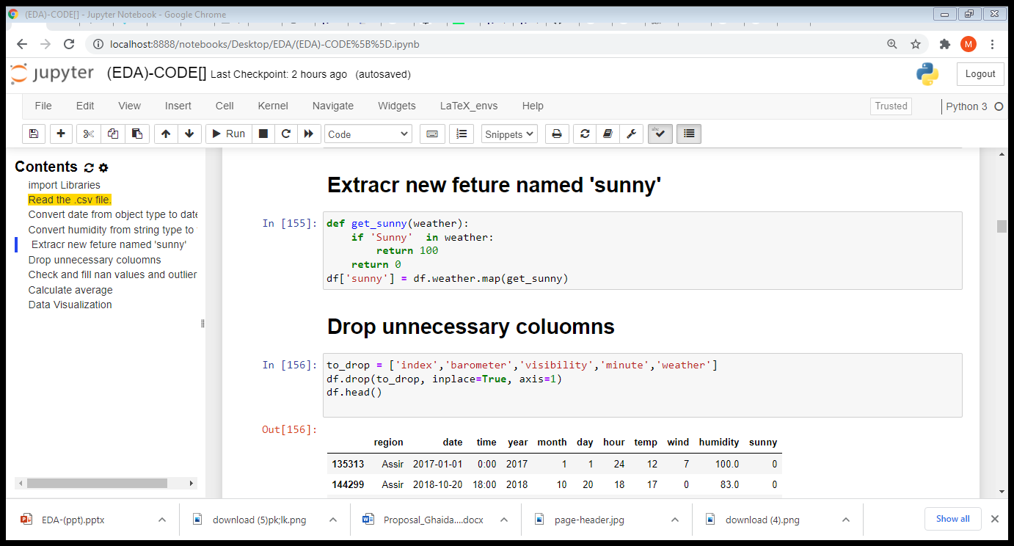
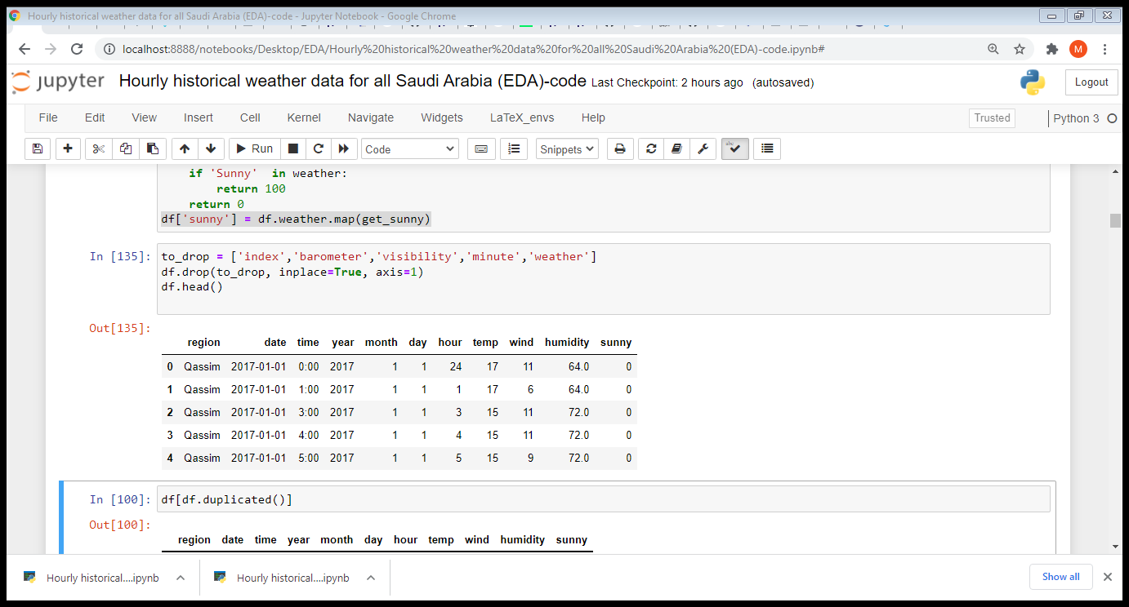
Data Cleaning:
-Remove unnecessary columns , change (date) to datetime,change (humidity) to float and extract column named (sunny)

Slide 5
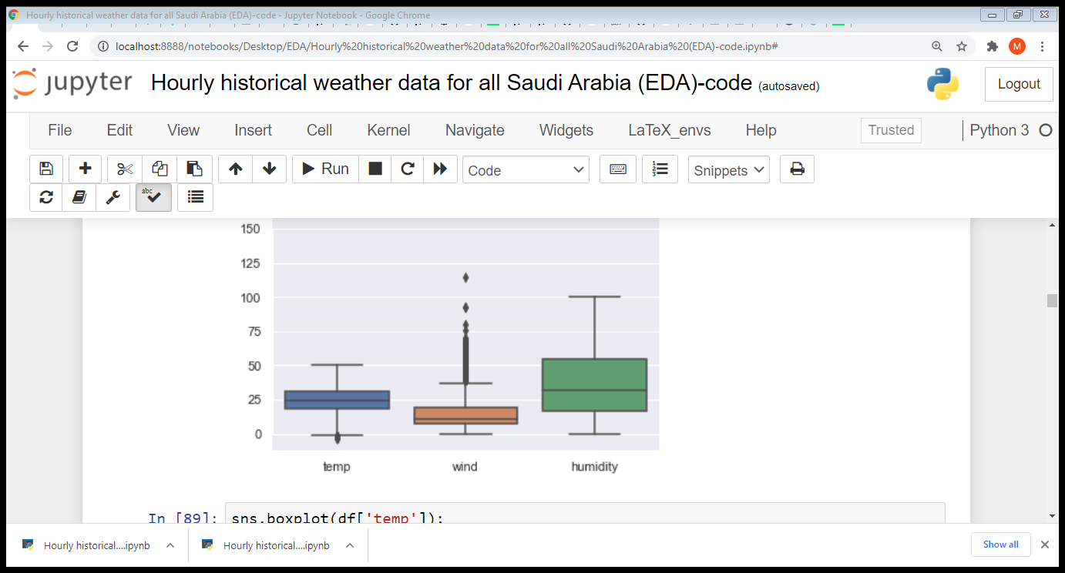
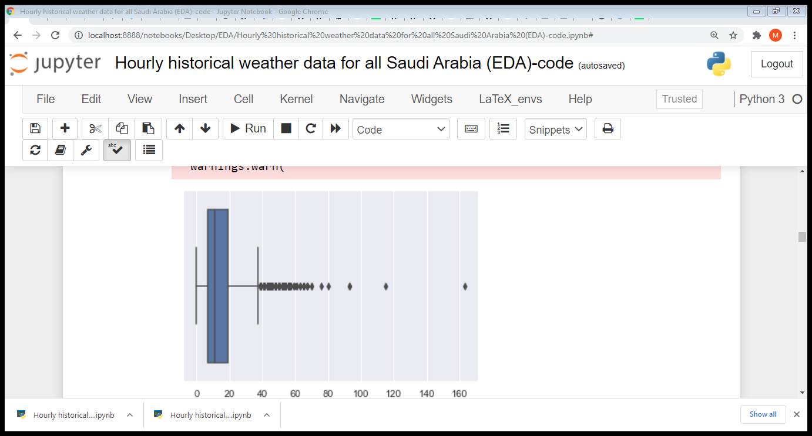
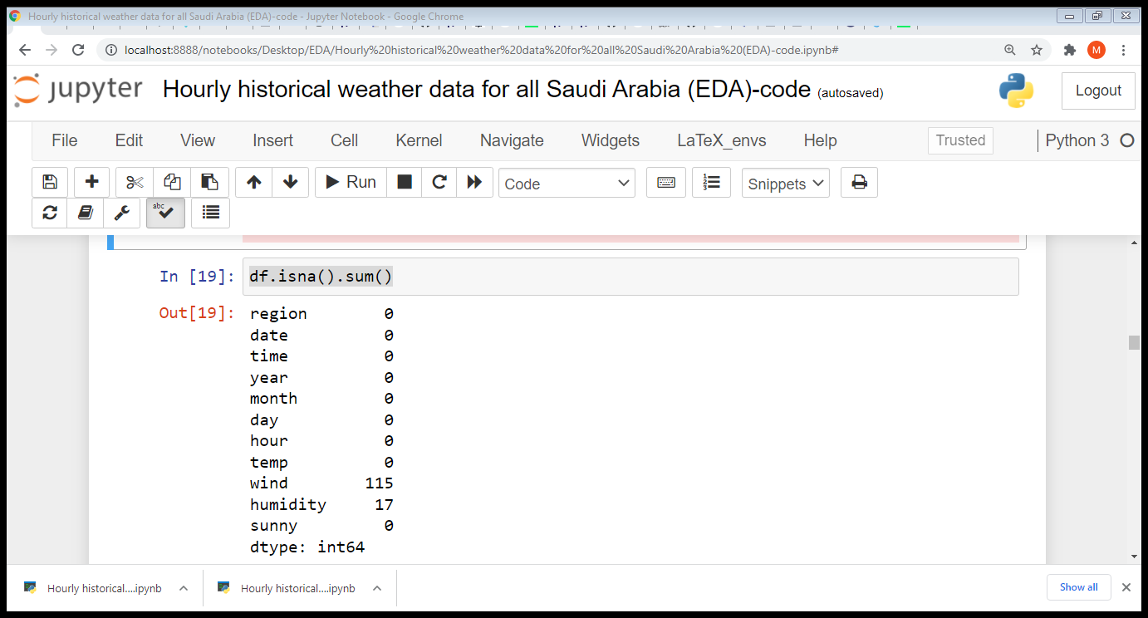
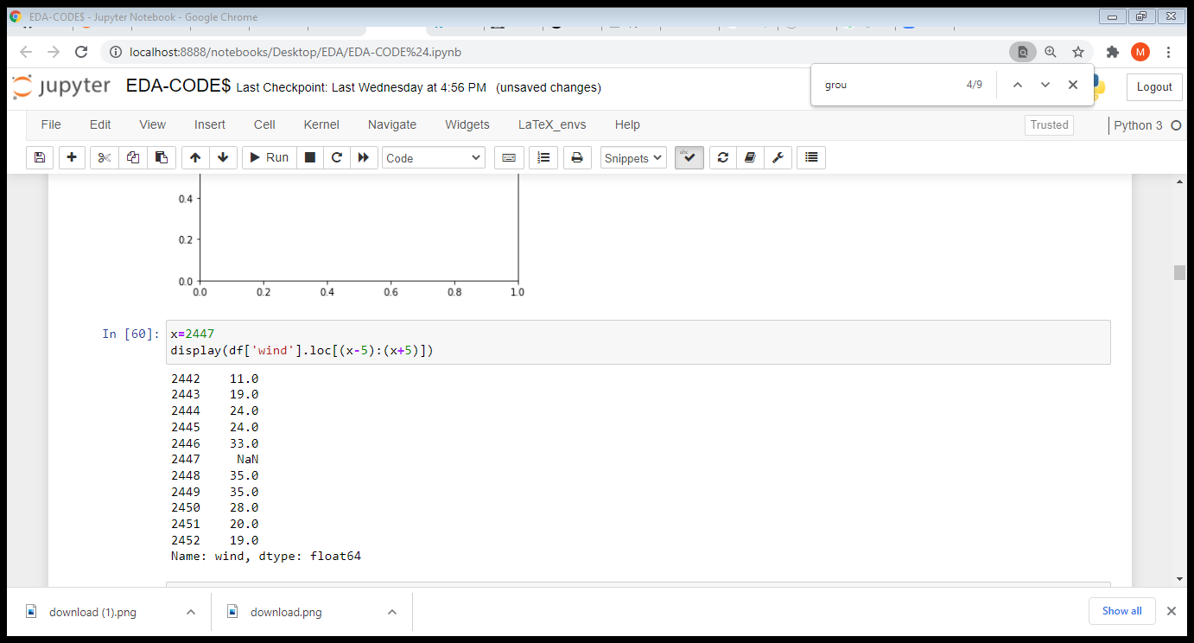
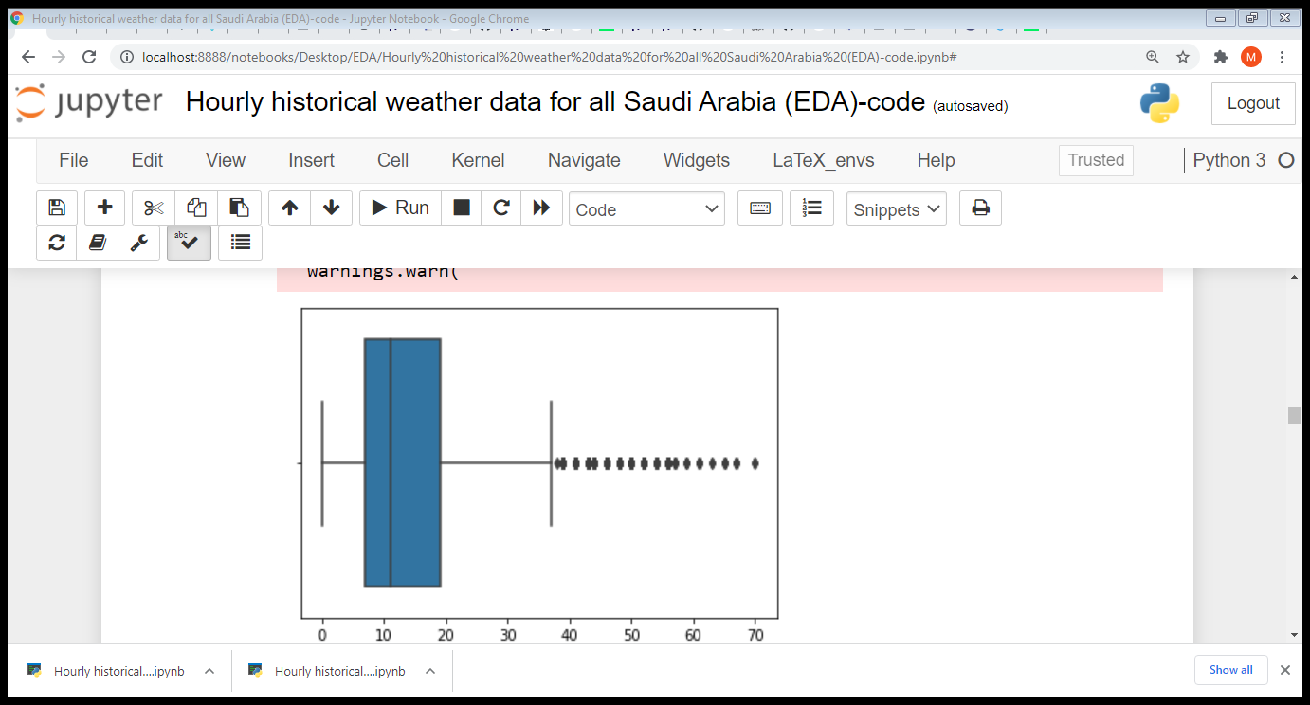
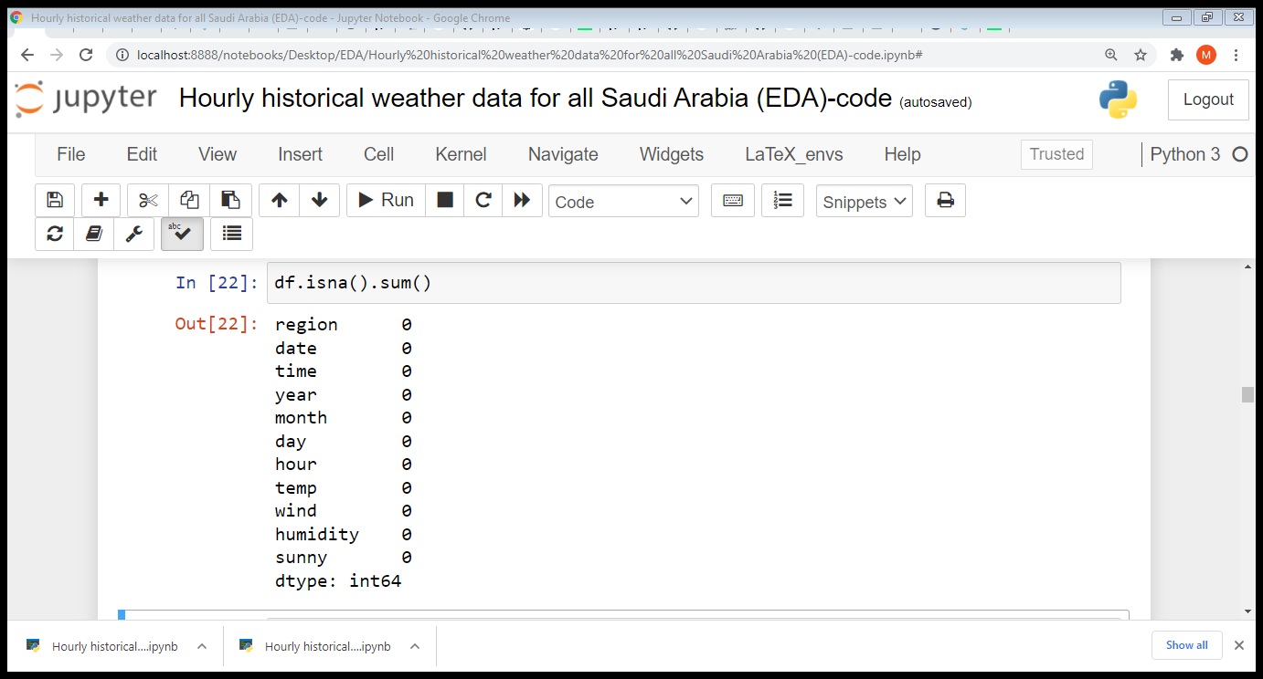
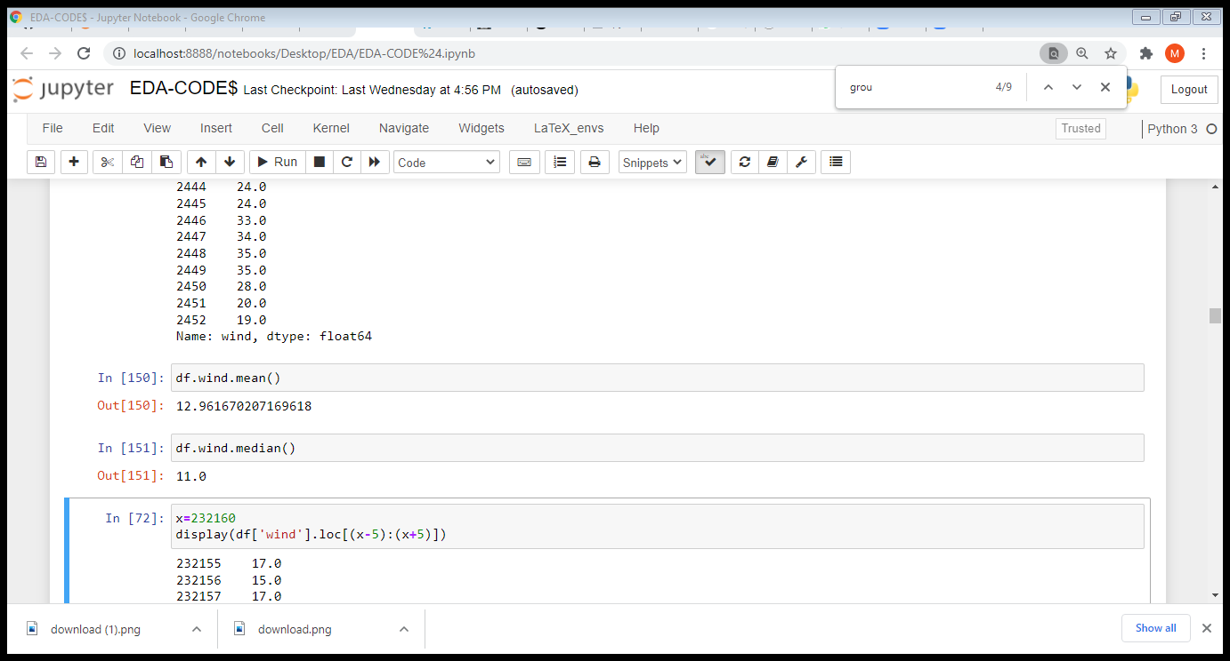
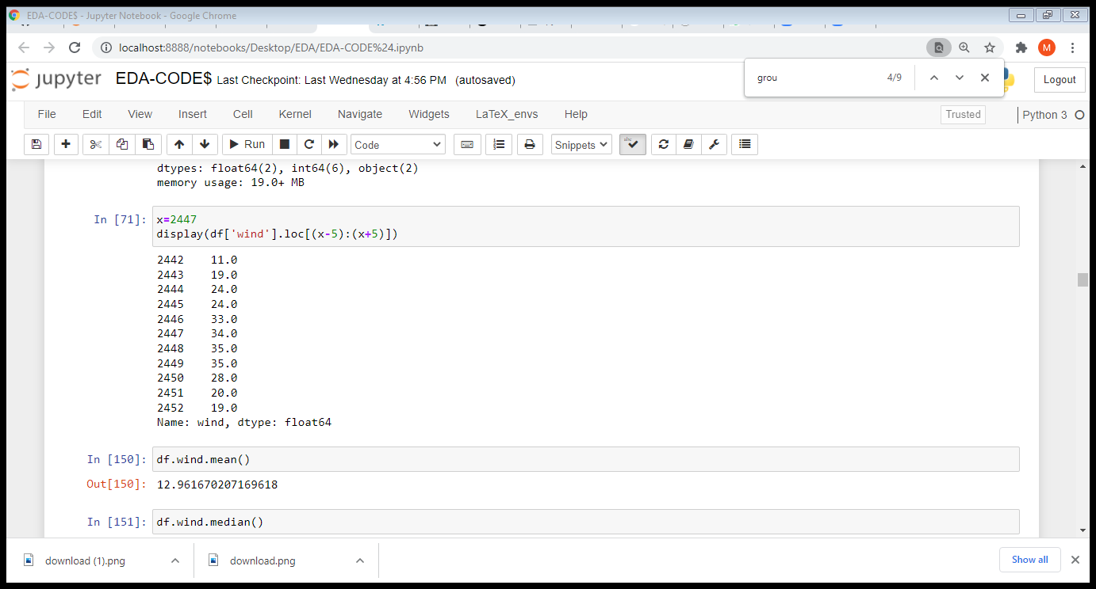
Find outliear in wind and temp and we will replace wind outlier > 70 to NaN values by using this code df.wind[df.wind >70]=None.
use interpolate to fill nan of outlier and missing values.
df=df.interpolate(method='linear’)

Slide 6
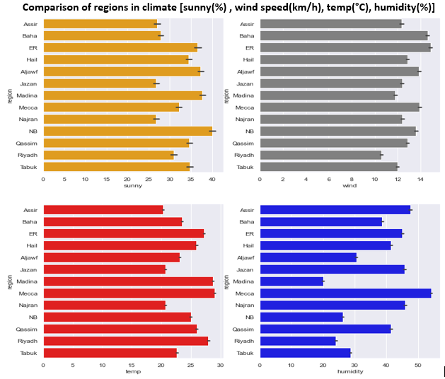
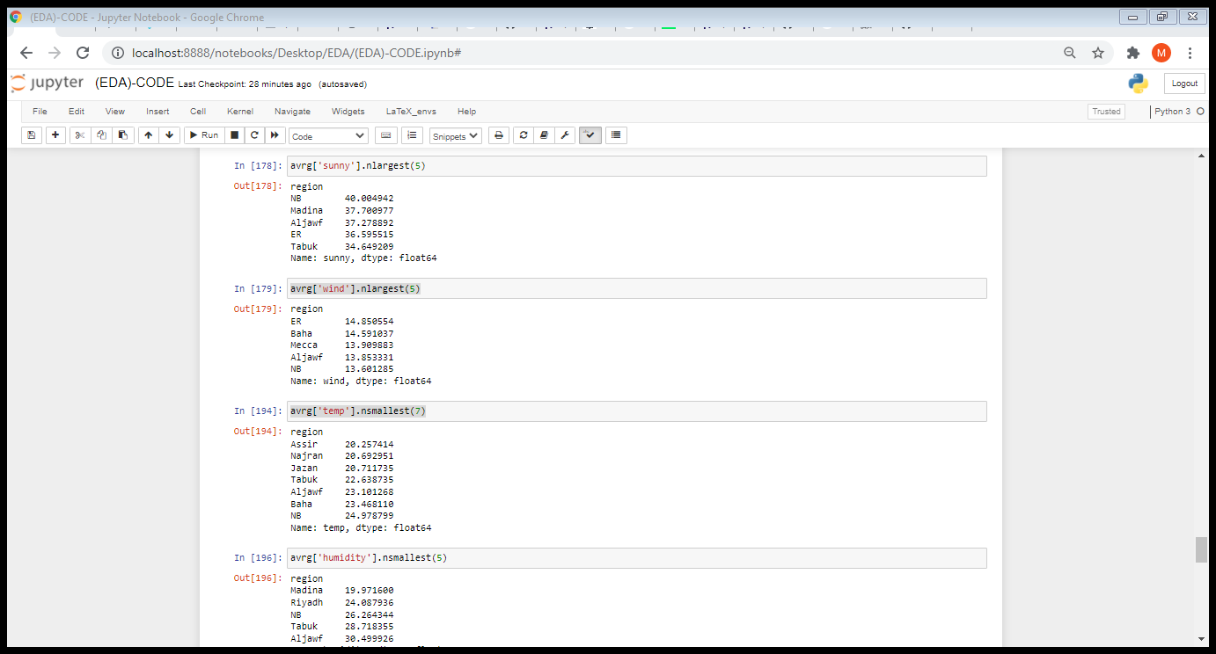
Data Analysis:
- Find average of each climate factor then we compare in order to choose the right places:

Slide 7
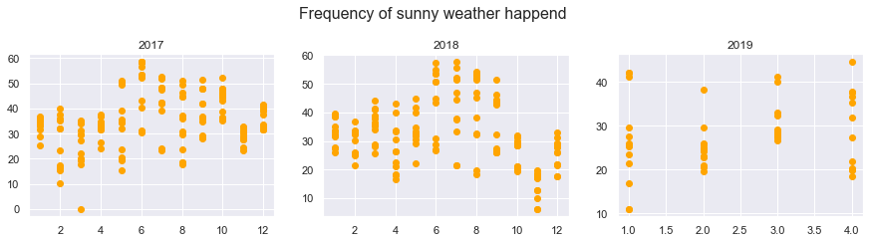
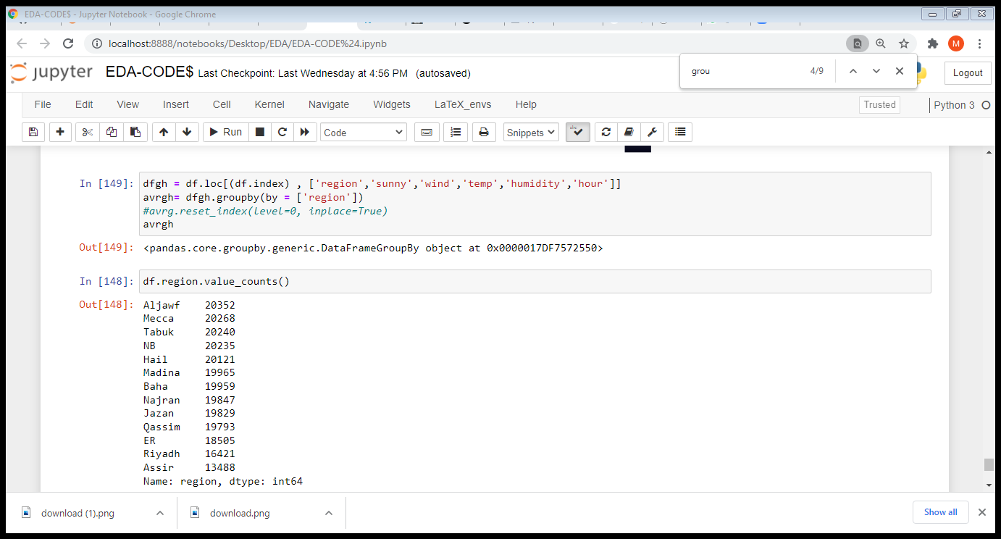
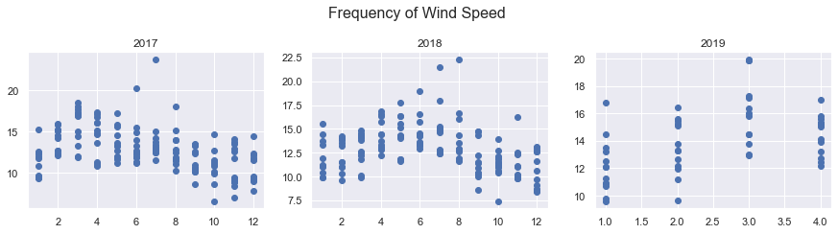
-We want to know the frequency of sunny and wind by scatter plot:
From this fig we notice that the percentage of change in the
sunny weather is acceptable.
We need to move turbine at leaest wind speed=13km/h,
we need more analysis to choose the best regions for wind speed.

Slide 8
Consclusion:
If I have complete data, I will study the connection of electric renewable power generation networks to the insurance.
We are conducting a detailed analysis to study the best types of turbines that can contribute to covering the low air speed.
Analysis of the possibility of building floating solar power plants.
Analysis of the possibility of building offshore wind power plants.
Analysis wind speed and frequency in mountainous areas, which I think will be suitable for wind energy.

Slide 9

Thank You!

