Slide 1
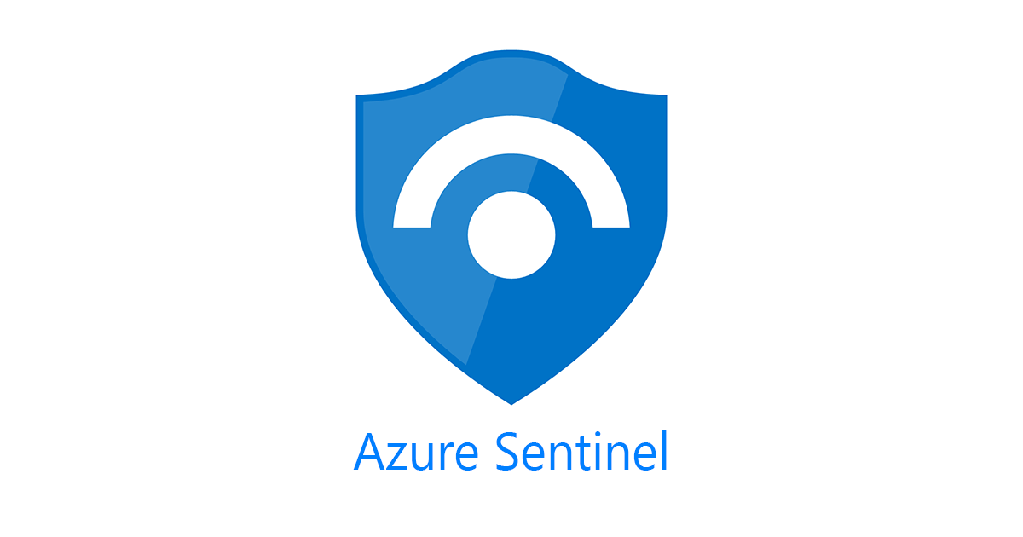
What The Hack Challenge-01
From Zero to Go In 90 Minutes

Slide 2

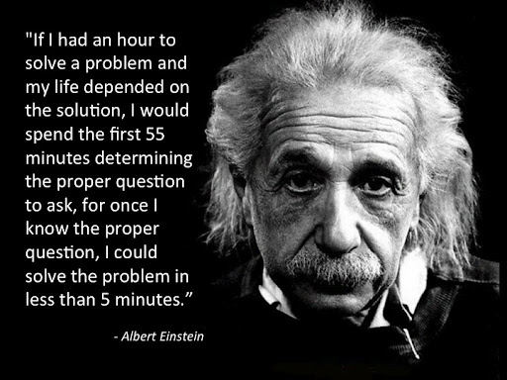

Slide 3
Agenda
Introduction to Sentinel (10 mins)
Architecture (10 mins)
Challenge 1 – Setup Check lab environments (5 mins)
Interface Walkthrough (10 mins)
Challenge 2 - Installing the “Security Events” data connector (10 mins)
Create events (2 mins)
Checking data ingestion (3 mins)
Break (5 mins)
Creating a Kusto event / incident (15 mins)
Managing an incident (10 mins)
Q&A

Slide 4
Common Terms
SIEM: Security Information and Event Management
A centralized log management tool that integrates with your different applications, systems, servers, etc. to take in data from each service.
SOAR: Security Operations, Automation and Response
Threat management (help mitigate vulnerabilities), incident response (managing and coordinating response to a security incident) and security operations automation (overall orchestration of workflows, policy execution and reporting).
SOC: Security Operations Center
A centralized location run by a security operations (SecOps) team that continuously monitors, analyzes and responds to security incidents.

Slide 5
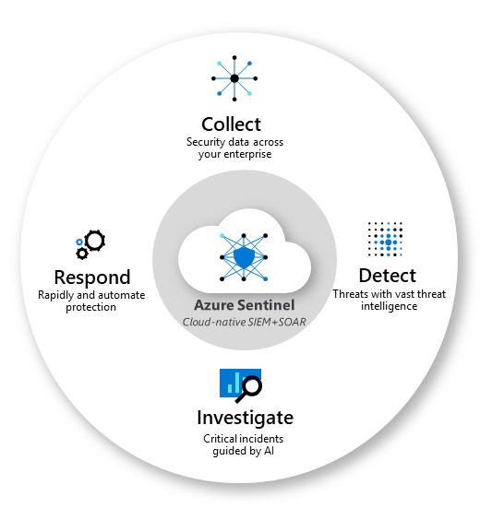
What is Sentinel
Collect data at cloud scale
Detect previously undetected threats
Investigate threats with artificial intelligence
Respond to incidents rapidly
Notes:
across all users, devices, applications, and infrastructure, both on-premises and in multiple clouds.
and minimize false positives using Microsoft's analytics and unparalleled threat intelligence.
and hunt for suspicious activities at scale, tapping into years of cyber security work at Microsoft.
with built-in orchestration and automation of common tasks.

Slide 6
Common Terms
Event:
A change in the normal behavior of a given system, Examples: process, environment or workflow. Recorded through the creation of a log.
Alert:
Notification of an event requiring an action. Examples: to act on an alert may create an incident.
Incident
An incident is a change in a system that negatively Examples: impacts the organization and results in material loss or loss of public image.
Someone logs in to a device
Potential password spray
A server goes offline unexpectedly
An RDP brute force attack
Anomalous account creation
Malicious credential theft tool detected
SAP priv. user adds priv. to another user.
Unexpected exfiltration of data
Malicious credential theft tool detected
Notes:
Why would someone logging into a device be interesting?
By itself, it is not, so it’s just an event, however if the user has requested a password change then doesn’t log in with 10 minutes, that may be an indicator of a compromise. (Example of government security environment) Automated response to disable the account.
Password spray can be as simple as someone forgetting they changed it and are using their old password four or five times in a short period of time.
Several password spray events at the same time may indicated an RDP brute force Alert.
A successful login after several failed logins when multiple RDP ‘alerts’ are being generated can create an incident .
A single alert on a “Malicious credential theft tool detected’ will immediately generate an Incident.

Slide 7
Sentinel Capabilities, Two Examples
Solorigate: (Trojan)
This threat can allow remote sophisticated attackers to gain access and perform backdoor commands on an affected device. It is a modified DLL component of a legitimate software.
SolarWinds Post-Compromise Hunting with Azure Sentinel - Microsoft Tech Community
Ransomware: (Malware)
A type of malicious software designed to block access to a computer system until a sum of money is paid.
Azure Sentinel Fusion Detection for Ransomware (microsoft.com)
Notes:
Similar to the SAP alert identified on the previous slide, one of the hunting components of our Solorigate solution is to look for changes in privileged accounts, either adding new ones, or activities that are abnormal by existing accounts.

Slide 8

Costs
Ingestion vs. Retention
Table Level Retention
Playbooks
Blog storage
Notes:
Sentinel Customer pay for
Log analytics data ingestion
Azure Sentinel data analysis
Log Analytics data retention
There are discount rates for storage costs based on tiers of retention 100GB , 200GB etc.
There are additional costs for Logic Apps, Notebooks, Functions
Data for 90 days is free, then at standard log analytics prices. Vs. 30 days for log analytics.
Plan and manage costs for Azure Sentinel | Microsoft Docs

Slide 9
Getting Started Scenarios
3 Scenarios
New SIEM customer – wants this capability
Migration to Sentinel from QRadar/Splunk/etc.
Mature customer looking for operational assistance
Get the use cases
If it's unclear which data connectors will best serve the environment, start by enabling all free data connectors.
Map existing alerts and incidents to equivalent Sentinel capabilities and/or create custom Kusto queries.
TAXII, Fusion notebook development (opp to refer MCS)
Notes:
Azure Activity Logs.
Office 365 Audit Logs, including all SharePoint activity, Exchange admin activity, and Teams.
Microsoft Defender alerts, including alerts from Azure Defender, Microsoft 365 Defender,
Microsoft Defender for Office 365,
Microsoft Defender for Identity, and
Microsoft Defender for Endpoint.
Azure Security Center and
Microsoft Cloud App Security (MCAS) alerts. NOTE However, raw logs for some Microsoft 365 Defender, MCAS, Azure Active Directory (Azure AD), and Azure Information Protection (AIP) data types are paid.
Call out the 1 to many Andrew Nathan delivered

Slide 10
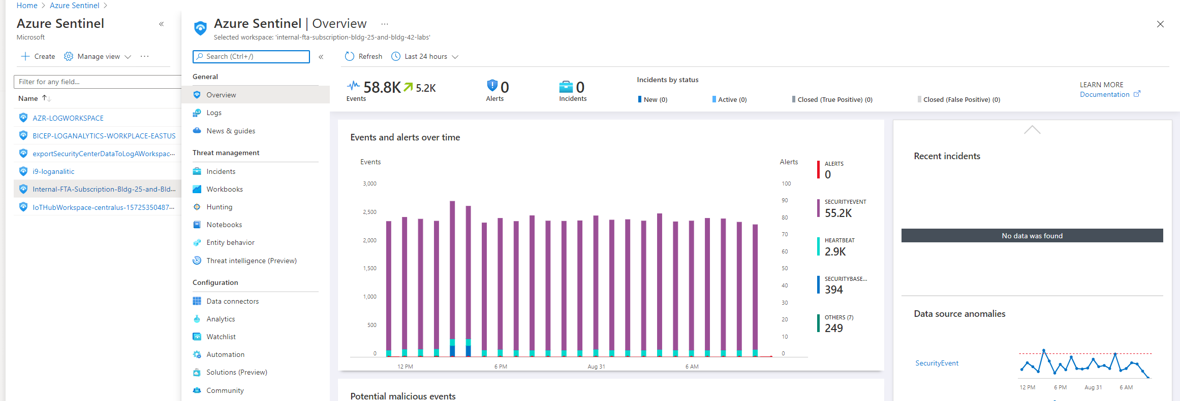
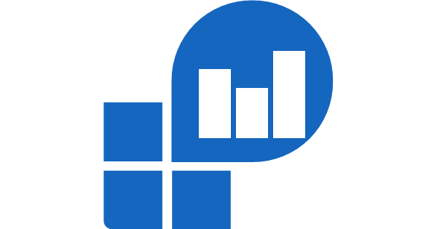
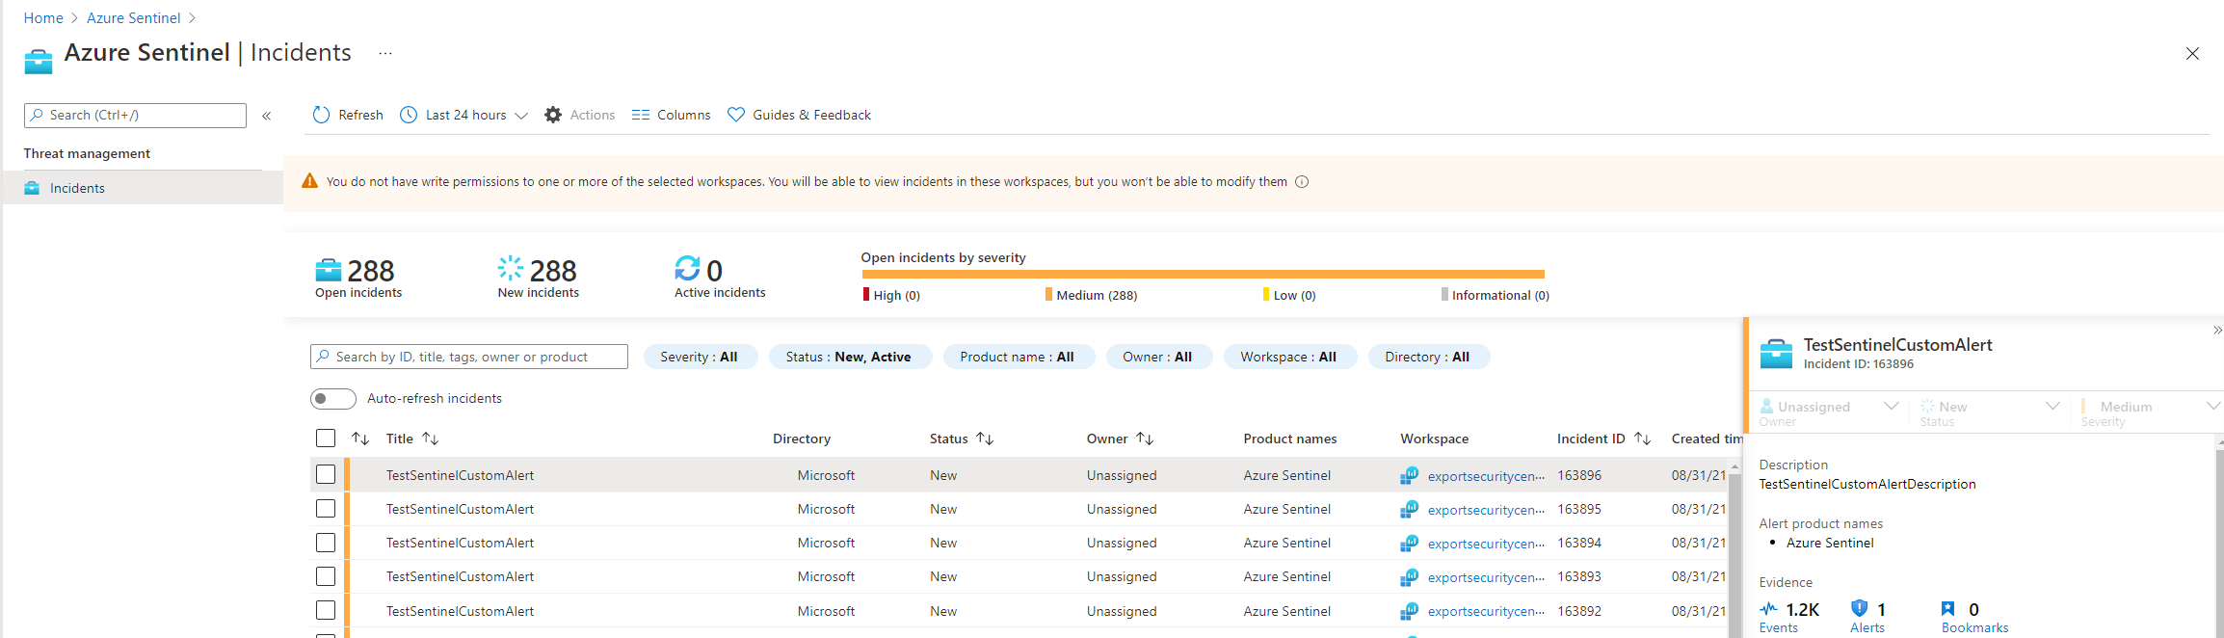
Architecture/Configuration
Log Analytics
Full Sentinel Screen Experience
Other Log Analytics Workspaces
Incident Only View
Notes:
Recommended – as much as possible consolidate into a single log analytics workspace.
Azure Sentinel-specific roles
The following are the three dedicated, built-in Azure Sentinel roles:
Reader: This role can review data, incidents, workbooks, and other Azure Sentinel resources.
Responder: This role has all the permissions of the Reader role. Plus, it can manage incidents by assigning or dismissing them.
Contributor: This role has all the permissions of the Reader and Responder roles. Also, it can create and edit workbooks, analytics rules, and other Azure Sentinel resources. To deploy Azure Sentinel on your tenant, you need Contributor permissions for the subscription where the Azure Sentinel workspace is deployed.

Slide 11
Example Query Across Two Workspaces
workspace() expression :
workspace("customer-A's-hard-to-remember-workspace-name").SecurityEvent as a function called SecurityEventCustomerA
workspace("customer-B's-hard-to-remember-workspace-name").SecurityEvent as a function called SecurityEventCustomerB
You can then write queries as SecurityEventCustomerA | where ...
union operator :
union workspace(“hard-to-remember-workspace-name-1”).SecurityEvent, workspace(“hard-to-remember-workspace-name-2”).SecurityEvent
You can then write a query across both workspaces by beginning with unionSecurityEvent | where ... .

