Slide 1

#GCDigital Design System
Update for January 24, 2018

Slide 2
Mission Statement
Make a design system for the Government of Canada’s digital collaboration tools that can also be reused and applied to other public or internal digital services and products.
This system will help to ensure a seamless experience for users across platforms, will be easy to use, and quick for developers and designers to implement. The design system will provide a basic framework with guiding principles and components, with the ability to be adapted to other brands and needs.

Slide 3
Guiding Principles
Simple and flexible
Fun to use
Re-usable
Diverse
Technology agnostic
Open
Notes:
Simple and flexible: a lightweight system that allows individual teams to adapt branding and other design elements to suit a specific project. The system will provide guidelines for all necessary elements without being restrictive.
Fun to use: the system itself will have a pleasing design that is easy for developers and designers to navigate and adapt to their needs. Using the system will make their jobs easier rather than add an extra burden or obligations to follow.
Re-usable: all components and principles included in the design system are generic enough to suit a variety of needs for multiple teams. Code and design elements can easily be extracted to create new products. Communications guidelines are easy to understand and follow.
Diverse: The design system will cover a variety of needs and types of products. The system will also cover necessary government obligations such as official languages and accessibility.
Technology agnostic: the design system is applicable regardless of which technology framework the team decides to use for their project.
Open: the design system will be open and accessible to anyone who wishes to use it. All code is open source, and other guidelines and elements are free to copy.

Slide 4
Phase I:
First prototype. Visuals and basic elements.
Basic elements required for designing any application.
Includes elements that are useful to all partners.
Phase II
Second draft of design system.
Includes second priority items, more layouts and editorial elements.
Design elements more specific to GCTools rebuild.
Phase II
Includes third level priority items (nice to haves)
More focus on process and guidelines
Full website/application where documentation is housed.
Ongoing:
Continuous improvement/updates to design system
Promoting/pitching system to other users
Opportunity for extended partnerships

Slide 5
Project Timeline
Research, concept building, planning
Sprint 1
Sprint 2: Visuals
Sprint 3: Content
Sprint 4: Forms
Sprint 5: Forms Continued
Sprint 6: Navigation
Sprint 7: Data Visualizations
Sprint 8: Putting it all together
Coding and Website Building
User Research and Testing
Nov 2017 --- Jan. 10-------------------------------------------------------------------------------------- May 2 ------------- July 1, 2018
Notes:
First sprint started on Jan. 10
7 core sprints, last sprint is to review and clean up content
Last sprint is set to end on May 2. By this point we will have a UI kit for prototyping and documentation
From May – July (estimated) we will be working on putting the pieces together to create some sort of website.

Slide 6
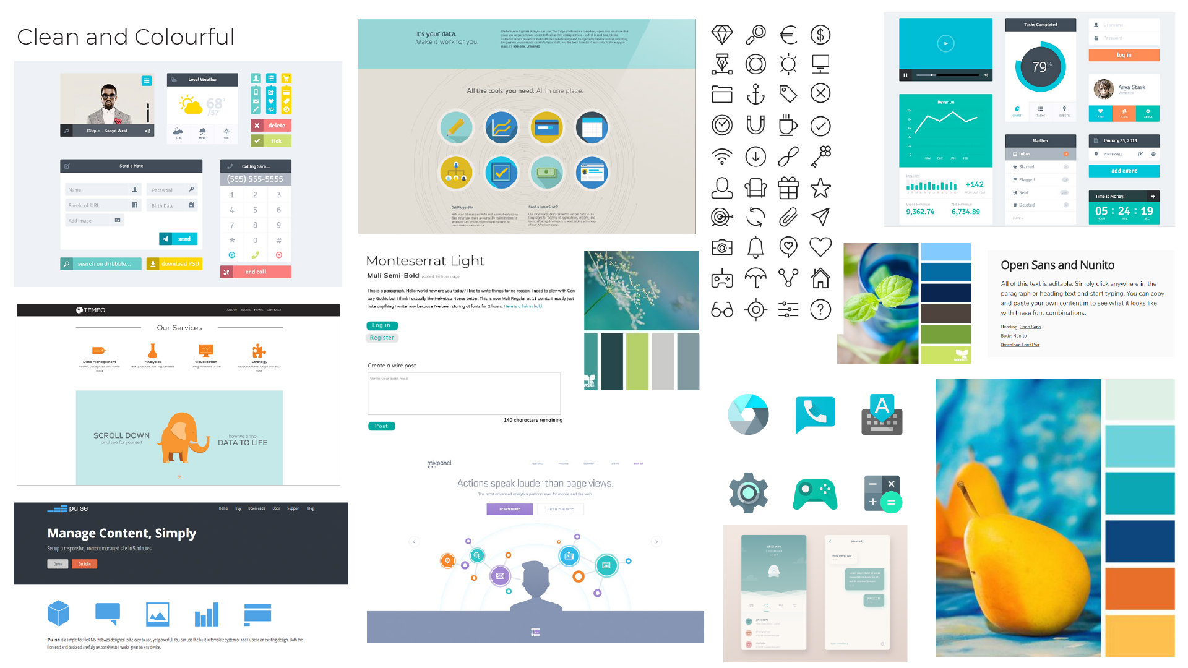
Notes:
Combination of minimalist and colour and graphics
Becky is leading research on the testing of these 3 mood boards
will be online testing using Lime Survey, and GCTools team members are welcome to participate

Slide 7
Documentation
Notes:
Nick to talk about documentation

Slide 8
https://gctools-outilsgc.gitbooks.io/-gcdigital-design-system/content/

Slide 9
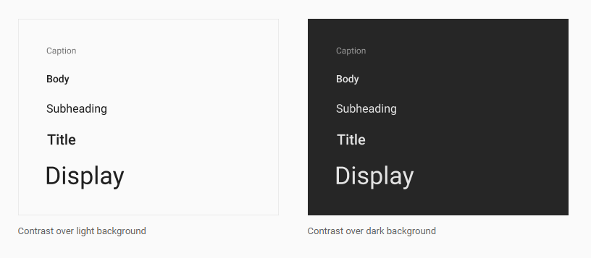
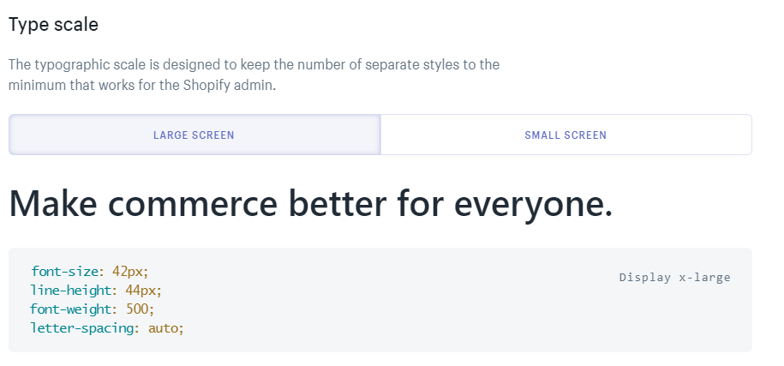
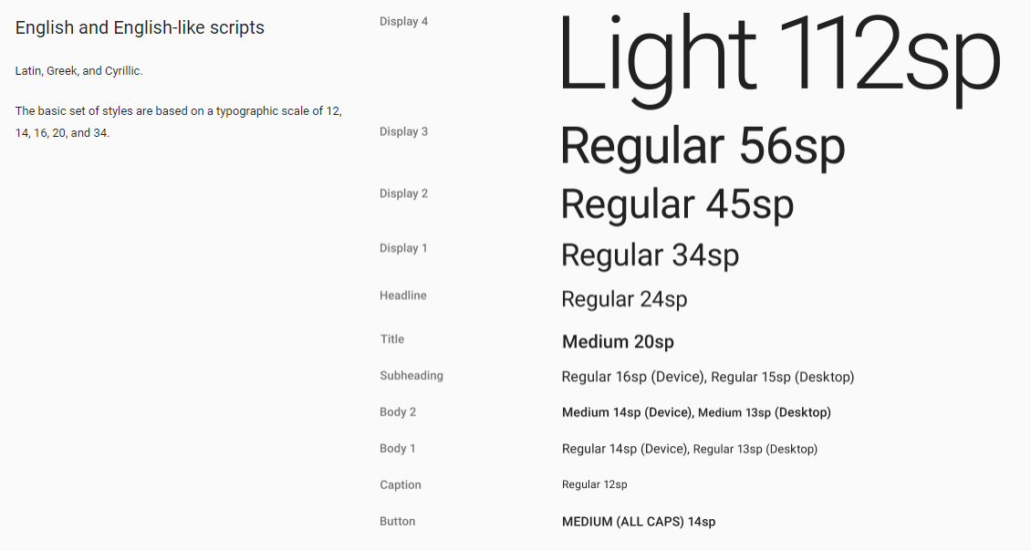
Examples
Google Material Design: Typography
Microsoft Typography
Shopify Polaris: Typography
Semantic.ui: Typography
Notes:
Documentation will eventually live on a “site” that will include images, examples, do’s and don’ts, download files, and code.
Some examples on right, show how each element looks on its own as well as how it looks used in an application.
Provides a brief summary of the section. Comprehensive, even if someone only looked at typography for example, and not buttons, they would still know how to use type on buttons.

Slide 10
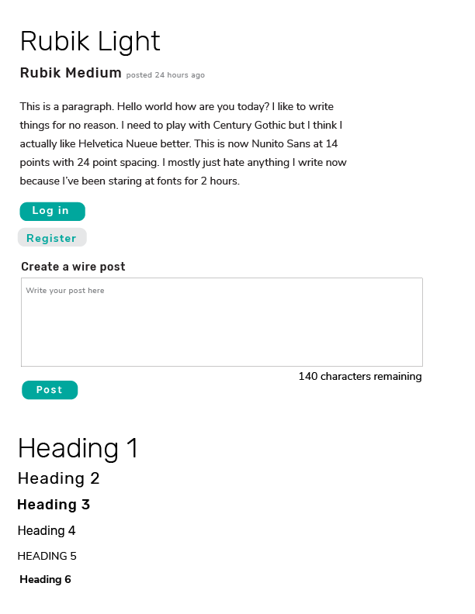
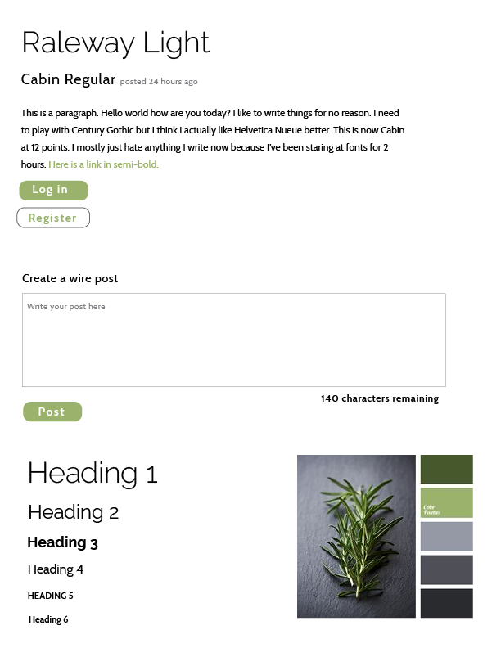
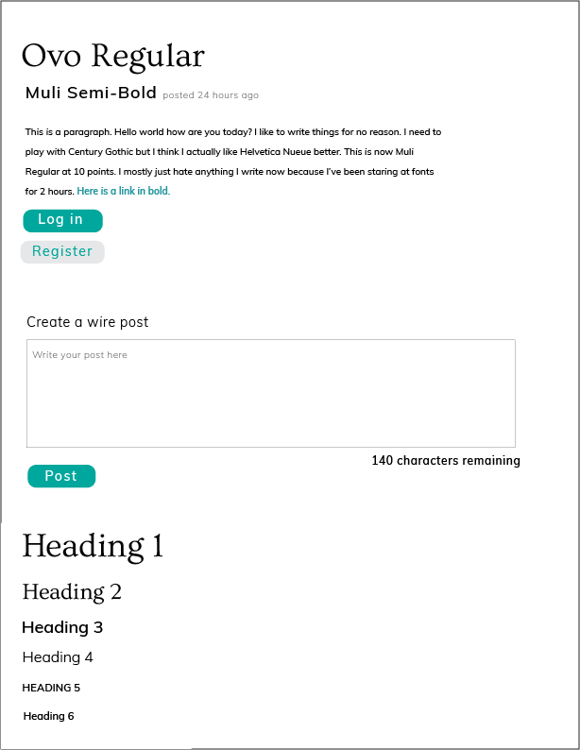
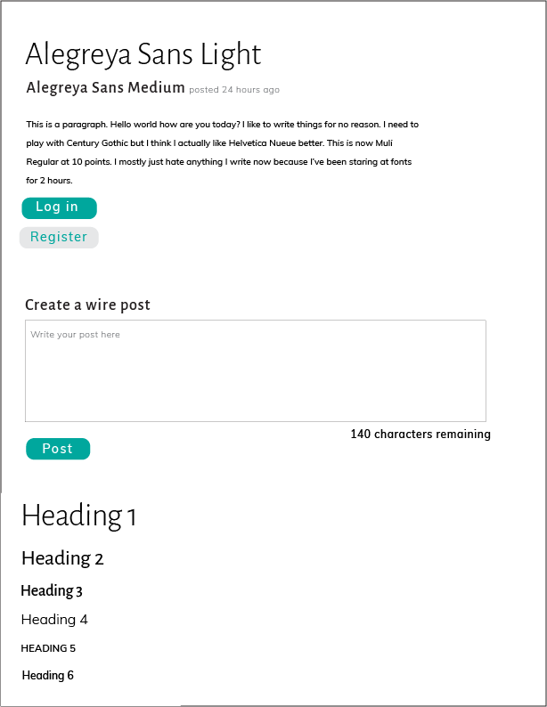
Design Process
Notes:
Brief explanation of design process and how we work with partners.
Start with research, mock-ups, then bring in partners to help solve key problems.
E.g. for typography, I created mock-ups but wasn’t happy with the body font/style. Brought in partners to help me solve this problem.
In working meeting we compared mock-ups, provided feedback, modified as necessary and chose a final mock-up to work with.

Slide 11
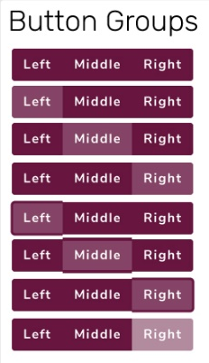

Notes:
Ethan to talk about buttons? Process.

Slide 12
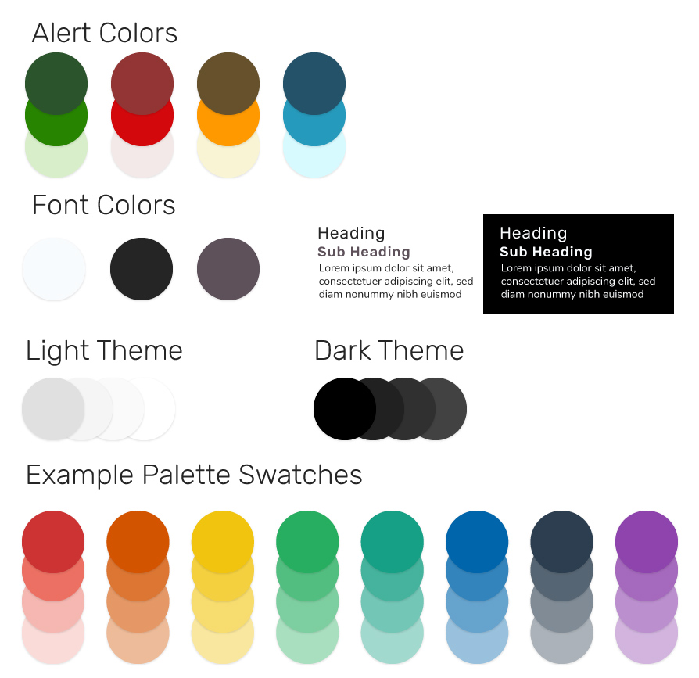
Colour
Notes:
Nick to talk a bit about colours, esp. integrationg/use of WET framework

Slide 13
What’s next?
Will be considering feedback and applying to any new mock-ups and elements we make.
Writing documentation, research on what needs to go in documentation.
Continuing to move ahead with sprints. We are going to start building elements based on a theme (i.e. forms)
Official updates and presentations are going on GCpedia, mock-up files and documentation will be available on Github.
Subtle promotion via partners, Sierra’s blog post, Twitter etc.

Slide 14

Questions?

