Slide 1

OSHA Most Frequently Cited Serious Violations
General Industry - FY-2006

Slide 2
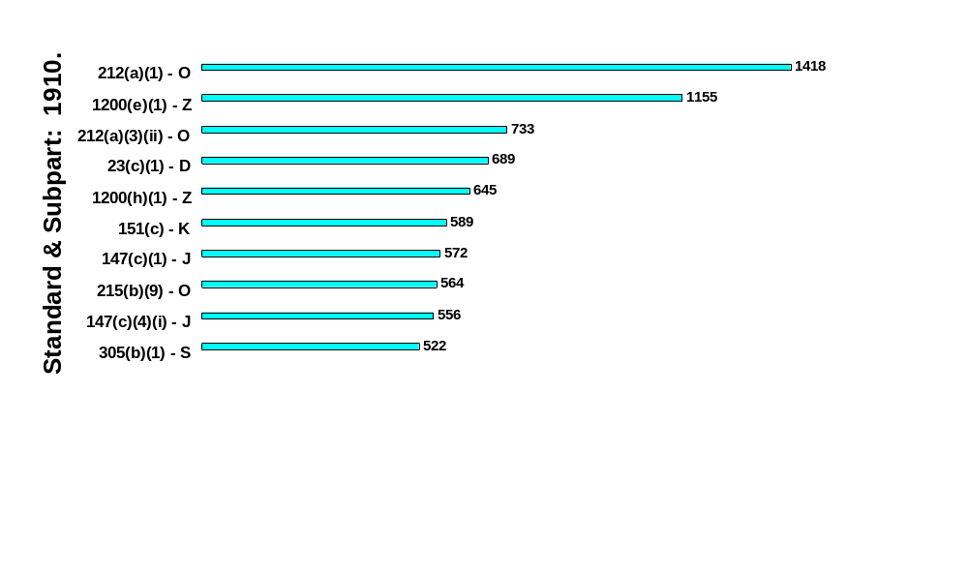

Most Frequently Cited Serious Violations in General Industry
FY 2006
Machine Guards - General
Hazard Communication – Written Program
Point of Operation
Open-Sided Floors
Hazard Communication – Information & Training
Eye & Body Flushing Facilities
Lockout/Tagout - Program
Grinders-Tongue Guards
Lockout/Tagout - Procedures
Conductors Entering Cabinets/Boxes/Fittings Protected from Abrasion
Note: There were also 1222 Section 5(a)(1) General Duty Clause violations cited for all inspections during this period.

Slide 3
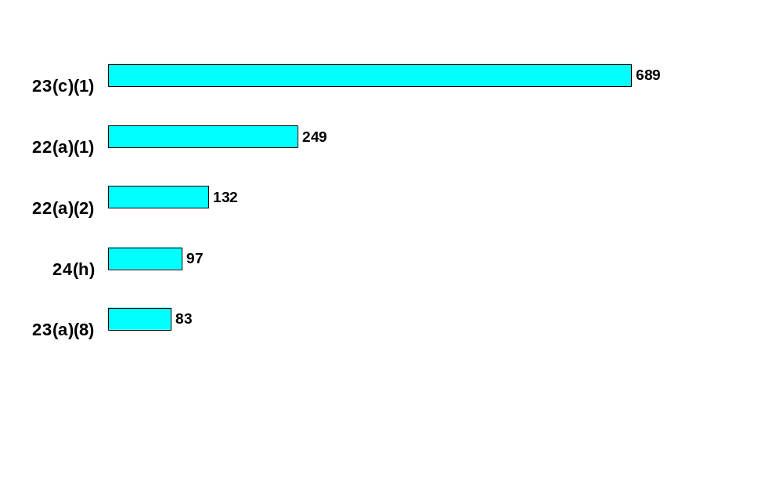

Subpart D - Walking/Working Surfaces (1910.21 - 30)
Open-sided floors
Housekeeping
Wet floors
Standard: 1910.
Stair railings
Floor holes

Slide 4
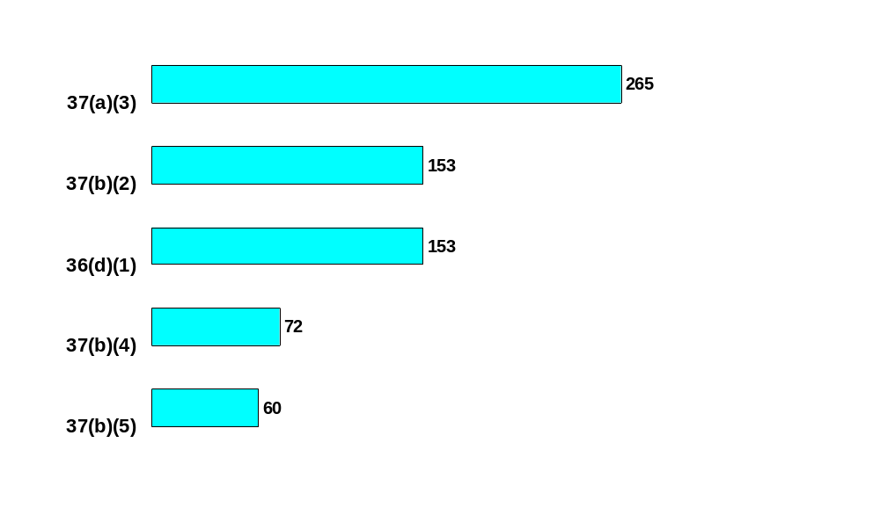

Subpart E – Exit Routes, Emergency Action Plans, and Fire Prevention Plans
(1910.33 - 39)
Exit routes free & unobstructed
Exit marking
Exit route doors unlocked
Standard: 1910.
Exit access signs
“Not an Exit” signs

Slide 5
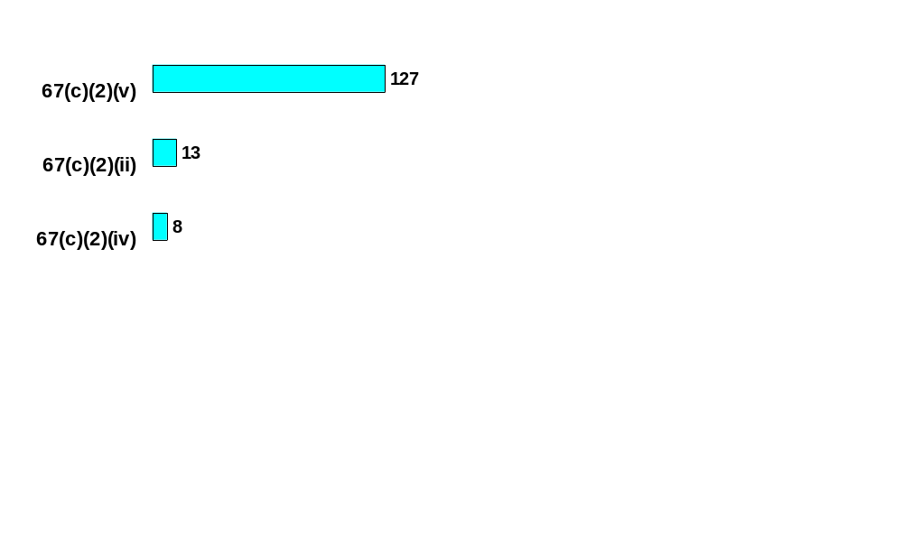
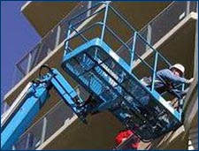
Subpart F - Powered Platforms
(1910.66 - 68)
Body belt & lanyard when working from aerial lift
Trained operators for aerial lift
Secure work position for employees in basket
Standard: 1910.

Slide 6
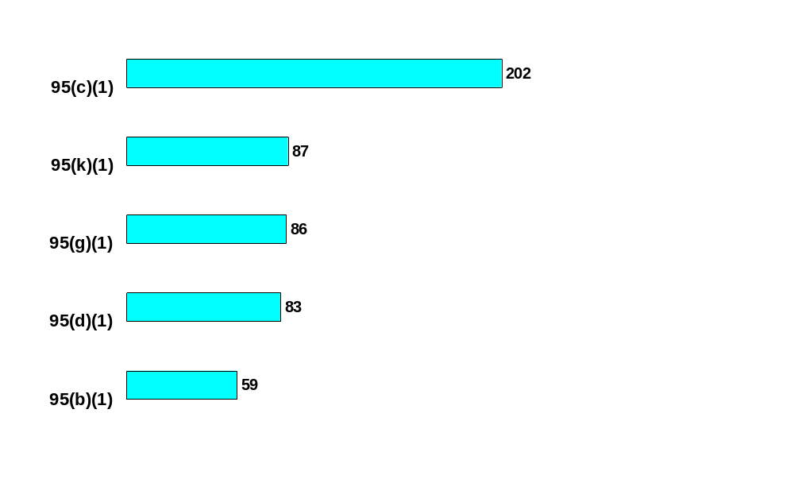

Subpart G - Occupational Health
(1910.94 - 98)
Hearing conservation program
Administrative/Engineering controls
Audiometric testing program
Standard: 1910.
Training program
Monitoring program

Slide 7
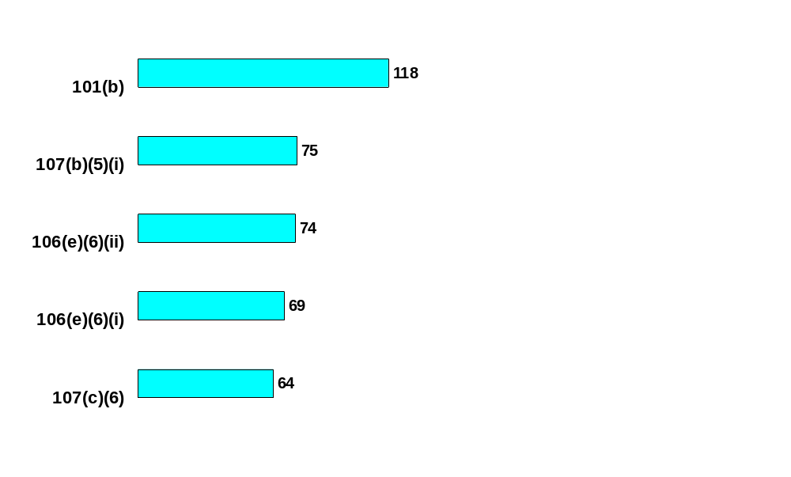
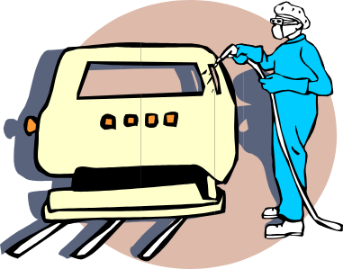
Subpart H - Hazardous Materials
(1910.101 - 126)
Compressed gases - Handling, storage & use
Spray booth – Air velocity
Class I liquids - Dispensing
Standard: 1910.
Sources of ignition - Precautions
Spray areas – Approved wiring & equipment

Slide 8
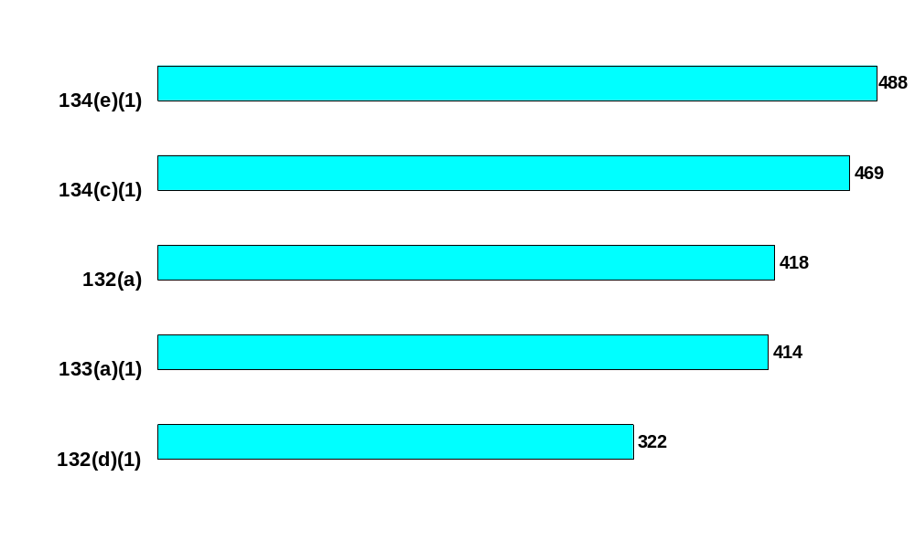

Subpart I - Personal Protective Equipment (1910.132 - 139)
Medical evaluation to determine employee’s ability to use respirator
Written respiratory protection program
Personal protective equipment
Standard: 1910.
Eye & face protection
PPE hazard assessment

Slide 9
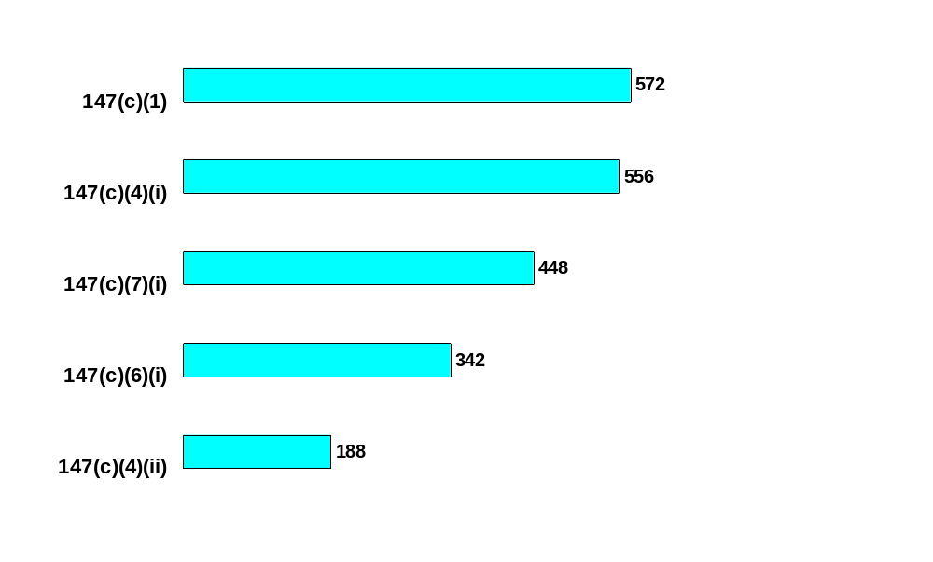

Subpart J - General Environmental Controls (1910.141 - 147)
Lockout/Tagout - Program
Lockout/Tagout - Procedures
Lockout/Tagout - Training
Standard: 1910.
Lockout/Tagout procedure - Periodic inspection
Lockout/Tagout - Content of energy control procedures

Slide 10
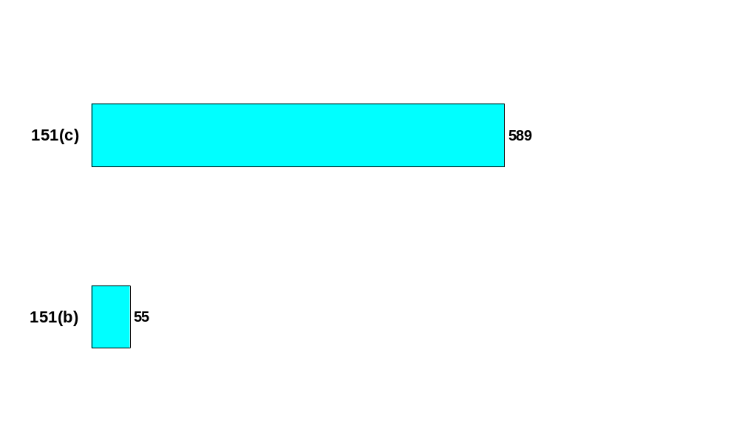

Subpart K - Medical & First Aid
(1910.151 - 152)
Eye & body flushing facilities
Standard: 1910.
First aid

Slide 11
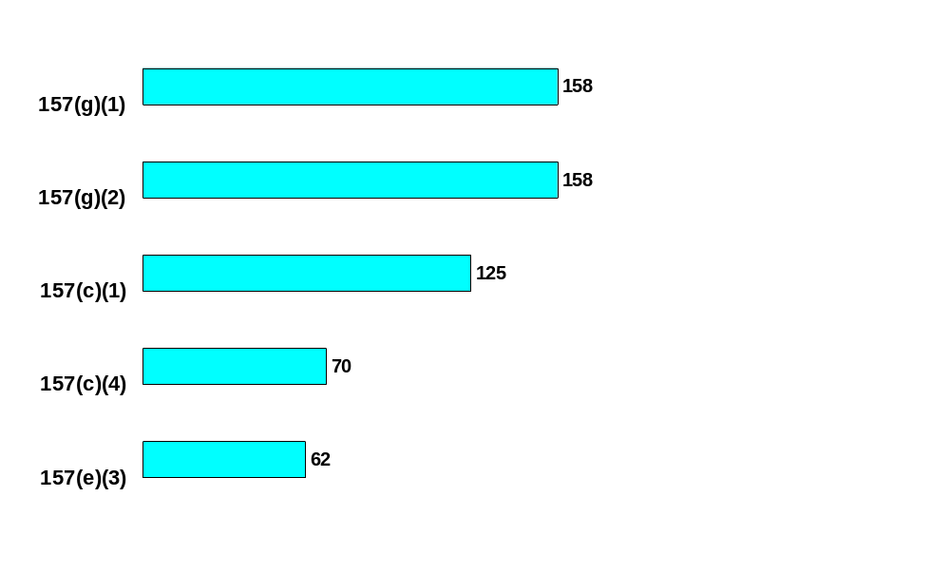
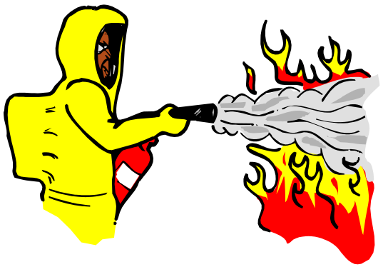
Subpart L - Fire Protection
(1910.155 - 165)
Extinguishers - Training program
Extinguishers - Initial & annual training
Extinguishers - Provided & accessible
Standard: 1910.
Extinguishers – Charged & operable
Extinguishers - Annual checks

Slide 12

Subpart M - Compressed Gas & Air Equipment (1910.166 - 169)
Pressure gage/safety valve
Standard: 1910.
Safety valves tested

Slide 13
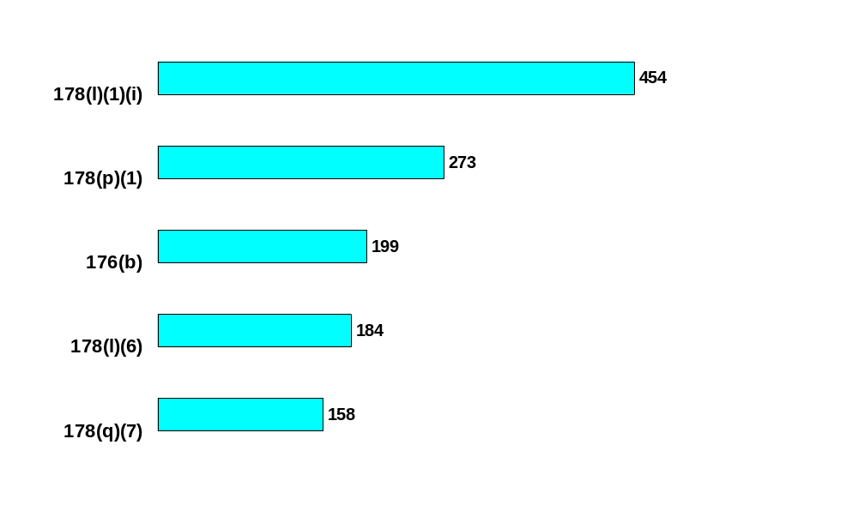

Subpart N - Materials Handling & Storage (1910.176 - 184)
Powered Industrial Trucks – Operator competency
Powered Industrial Trucks – Safe operating condition
Secure storage
Standard: 1910.
Powered Industrial Trucks – Operator certification
Powered Industrial Trucks – Examination for defects

Slide 14
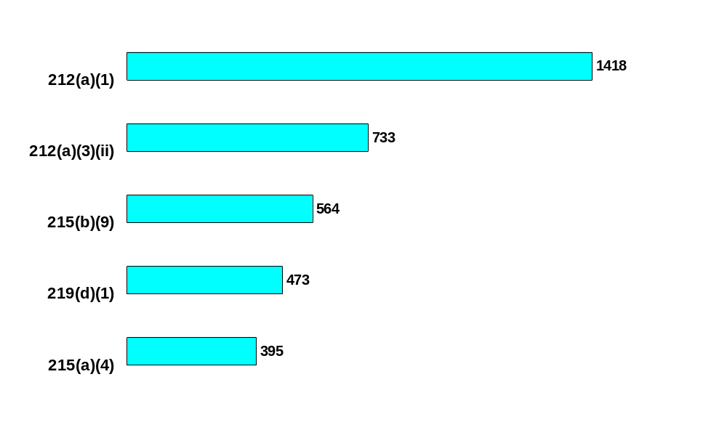

Subpart O - Machinery & Machine Guarding (1910.211 - 219)
Machine guards - General
Point of operation
Grinders - Tongue guards
Standard: 1910.
Pulleys
Grinders - Work rests

Slide 15
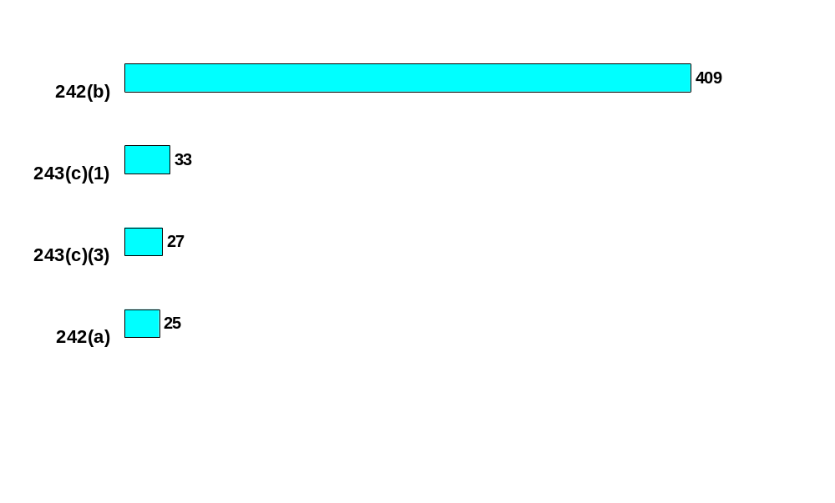

Subpart P - Hand & Portable
Powered Tools (1910.241 - 244)
Compressed air for cleaning
Portable grinders - General
Portable grinders - Guards
Standard: 1910.
Condition of tools & equipment

Slide 16
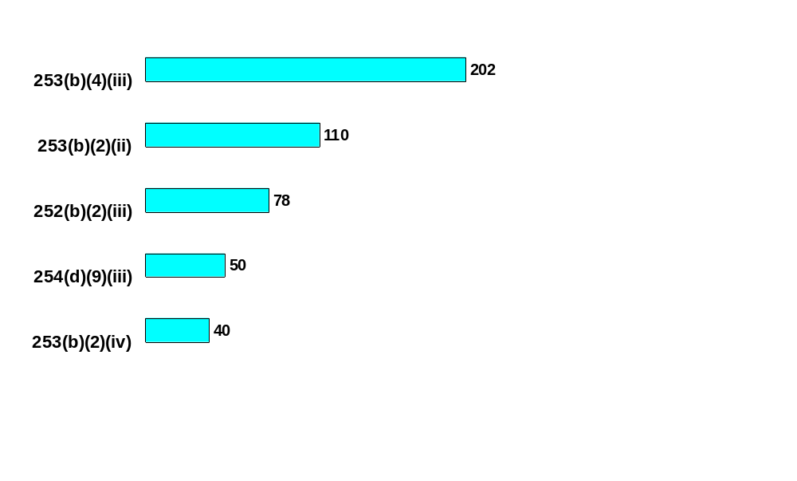

Subpart Q - Welding, Cutting & Brazing (1910.251 - 255)
Oxygen cylinder storage - Separation
Protection from arc welding rays
Cylinder storage - Inside of buildings
Standard: 1910.
Arc welding/cutting - Maintenance of cables
Valve caps in place

Slide 17
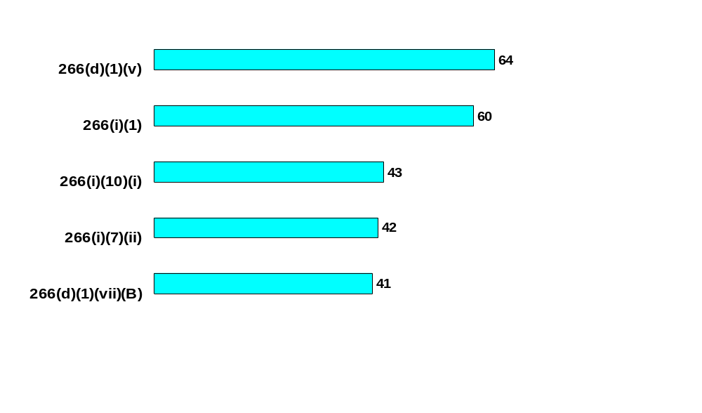
Subpart R - Special Industries
(1910.261 - 272)
Logging – Employee training
Logging – Foot protection
Logging - First aid/CPR training current
Standard: 1910.
Logging – Written certification of training
Logging – Face protection

Slide 18
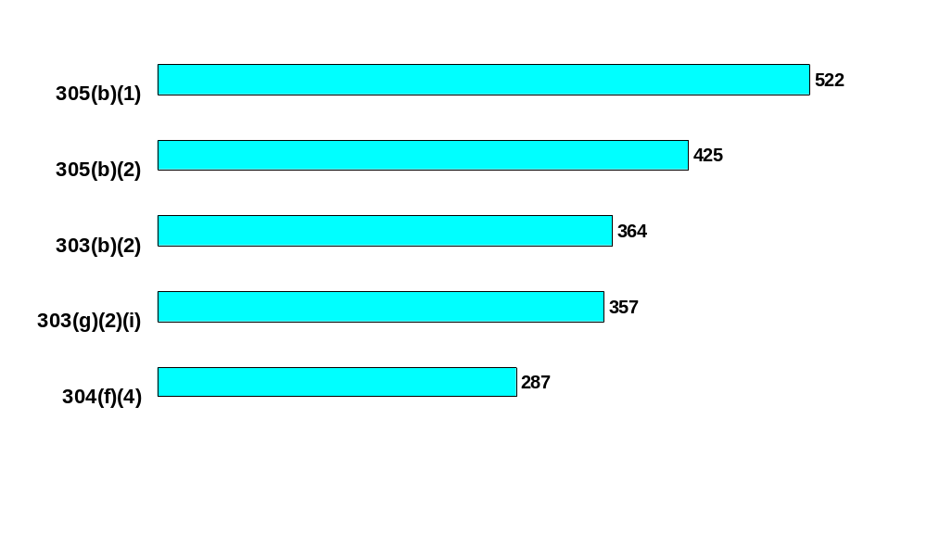

Subpart S - Electrical
(1910.301 - 399)
Conductors entering cabinets/boxes/fittings protected from abrasion
Electrical box covers
Proper installation & use of equipment
Standard: 1910.
Live parts
Grounding path

Slide 19
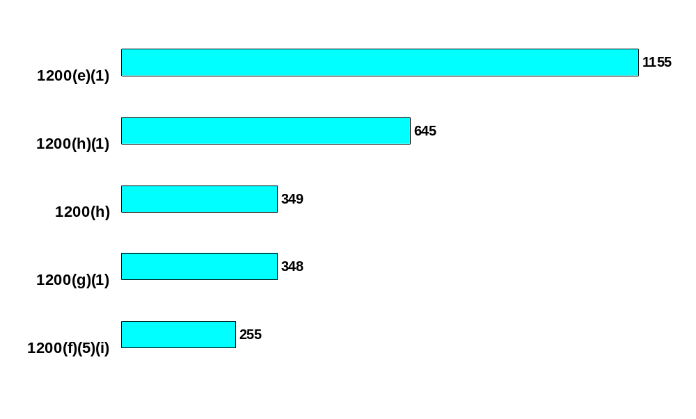

Subpart Z - Toxic & Hazardous Substances (1910.1000 - 1450)
Hazard Communication - Written program
Hazard Communication - Information & training
Hazard Communication - Training initially & for new hazards
Standard: 1910.
Hazard Communication - Material Safety Data Sheets
Hazard Communication - Label identification

