Slide 1
Repeat Feature Analysis
G.pennsylvanicus compared to G.firmus

Slide 2
Hierarchy of Comparisons
Genome
Chromosomes
X Chromosome + Chromosome 1:14
Left out Unplaced chromosomes, for some analysis because they are aggregated which throws off calculations
Chromosome <Feature>
Features == Class (i.e SINE, LINE, etc.)
Features == Class_Family (i.e. LTR/Gypsy)

Slide 3
Big Takeaway!
Having shared the same evolution time and being sister species…
there is not massive structural differences.
Though there are some smaller differences. Just have to test them statistically.

Slide 4
What are we trying to measure?
Localization
Where are repeats located?
What are there spatial trends?
Dense? Evenly Distrusted?
Divergence
How old are various repeats?
~ 0-5% considered young (little time for mutations to accumulate)
~ 20% + considered old/ancestral (time to diverge from the consensus sequence)
Correlation between Localization and Divergence
(i.e. Are locally dense groups also younger?)
Magnitude…

Slide 5
Comparisons Scale Combinatorially
2 Species X 15 Chromosomes X ~95 Class/Families = A lot of plots…
Luckily, most comparisons are not that different. Still there is a large sea of potential results to parse through.

Slide 6
One Approach
Slide Window Approach
Cut genome/chromosomes up into fixed width windows and then compared features present in the window
Chosen: 1 Mb window
I believe you could vary the window size to give more or less resolution depending on your features of interest.

Slide 7
Putting it on a plot
Visual is key to understanding the data
Disclaimer: I did the iterative approach first and then tried to summarize…
Big Picture Idea: (2 Species Scenario)
X axis = Genomic Position ( Windows of 1 Mb)
Y axis = Difference in Density
Net = Gfirm.elementDensity – Gpenn.elementDensity
Overlapping windows only.
Element Density = Number of Features in each 1 mb window
Feature = RepeatMasker *.out class_family classification

Slide 8
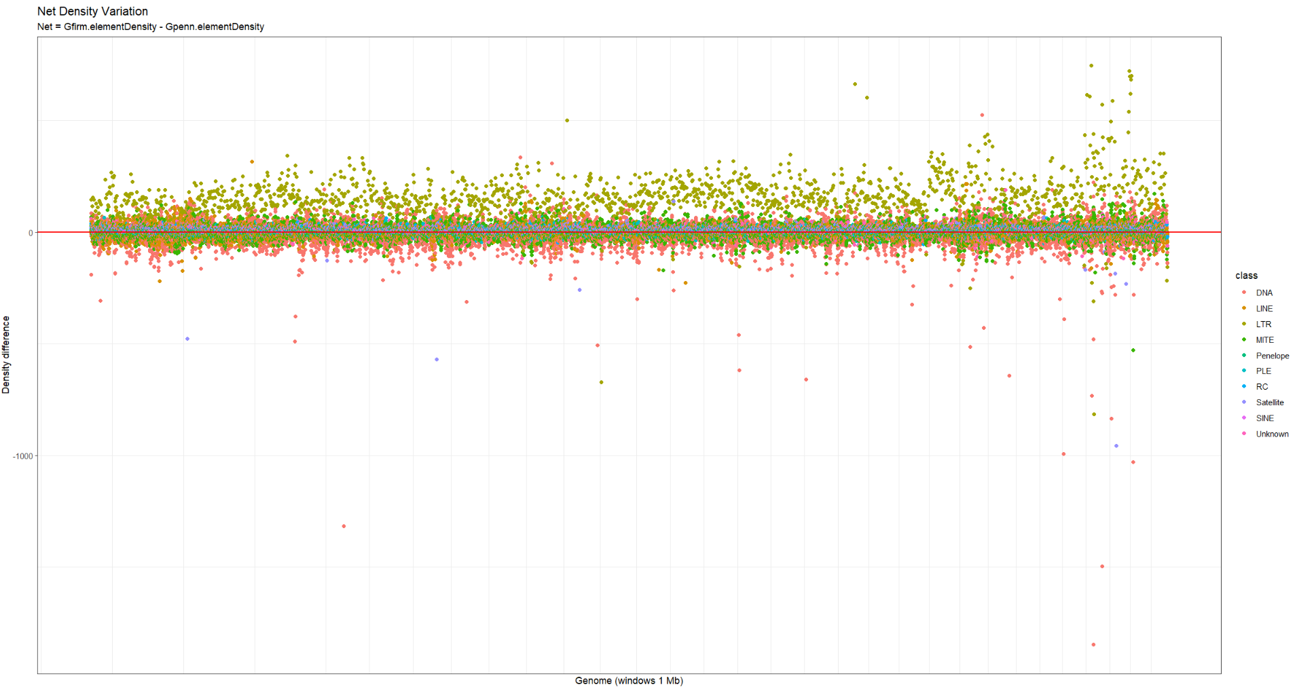

Slide 9
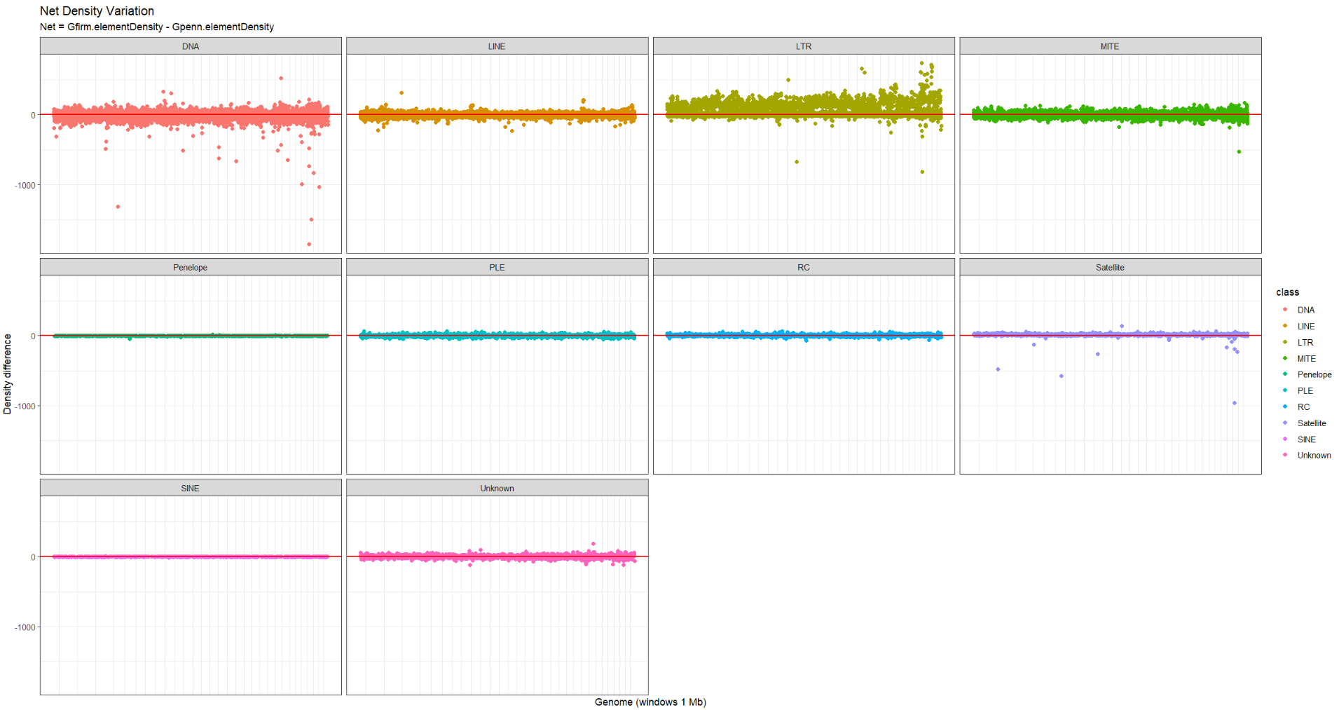

Slide 10
Interpretation
> 0 : Gfirm is more dense in that region
< 0 : Gpen is more dense in that region
= 0 : No difference in density at that region
Indicative of broad trends (differences)
At this scale, absolute magnitude is not super informative.

Slide 11
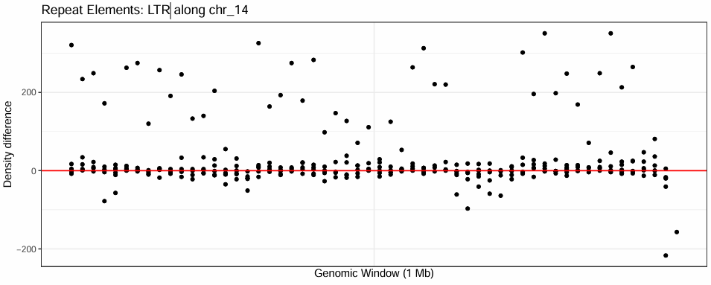
Vision for a Paper Figure
Could also be rows of heatmap if we want to highlight more features

Slide 12
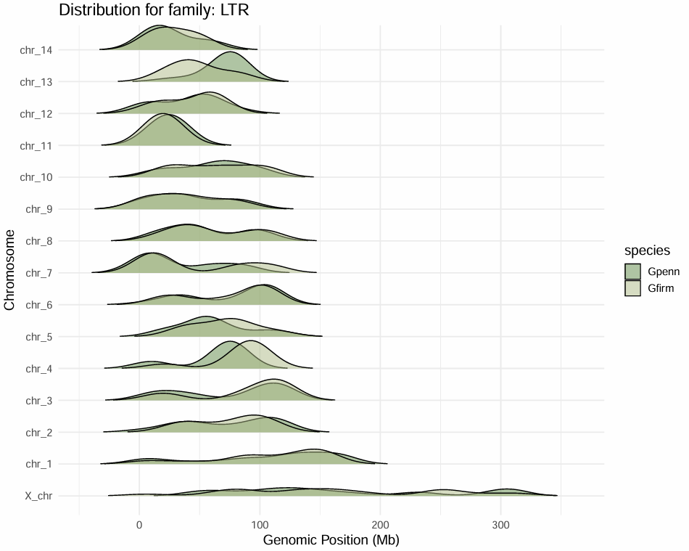

Slide 13
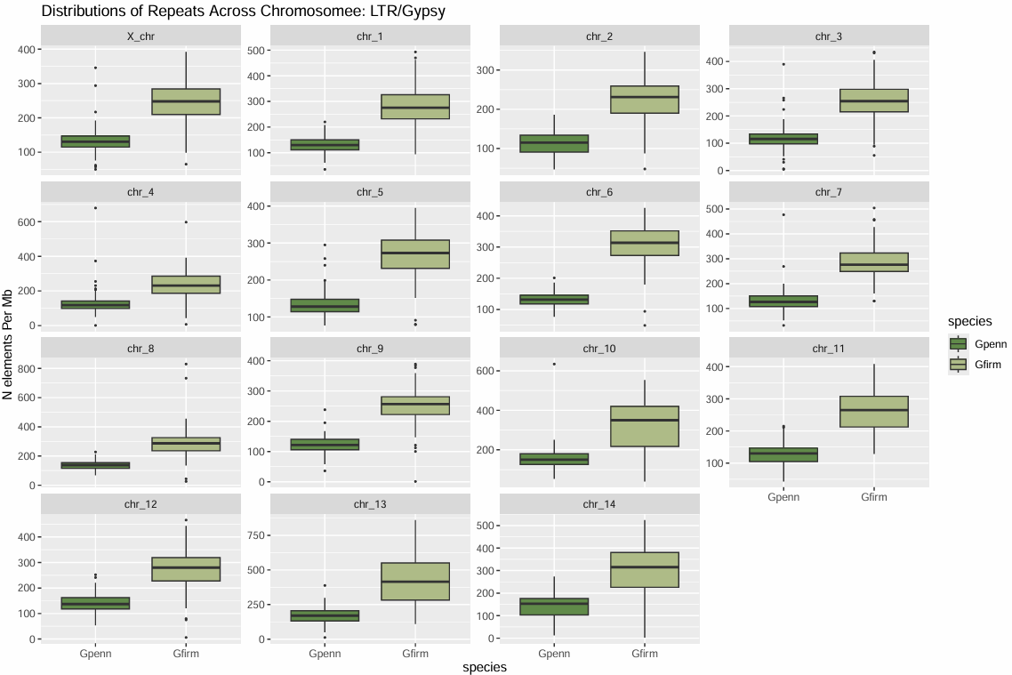

Slide 14
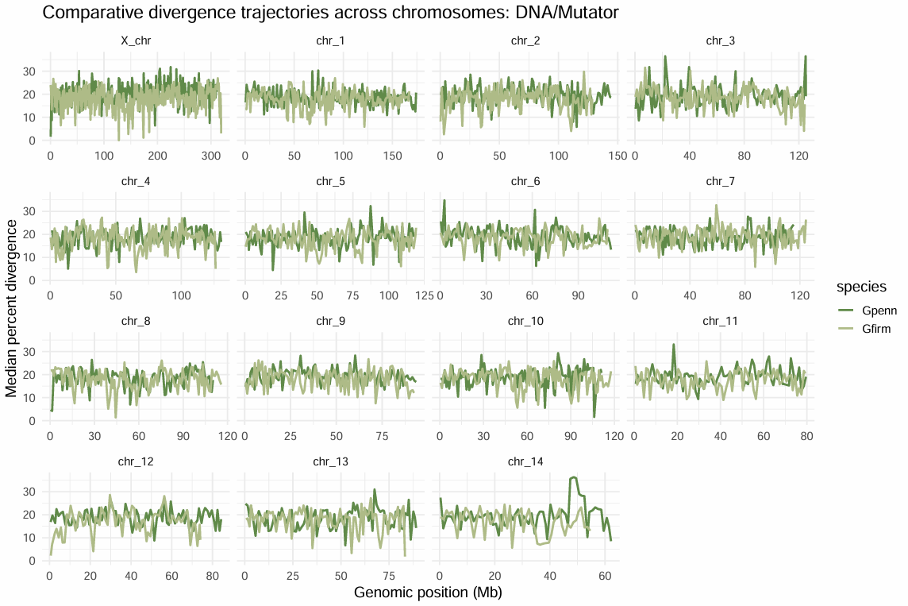

Slide 15
Stats See Results.md

Slide 16
Future Directions
Look for regions of syntenic breaks and investigate those areas specifically
Synteny analysis coming from alberto
Incorporate G.assimilis and G.bimaculatus repeat annotations
Reached out to authors for *.out files
Confirm stats test, and center self to narrow down results

