Slide 1
A Simple Model
to predict House Price

Slide 2
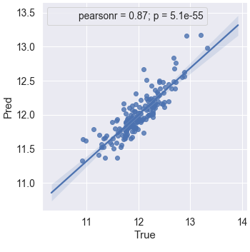
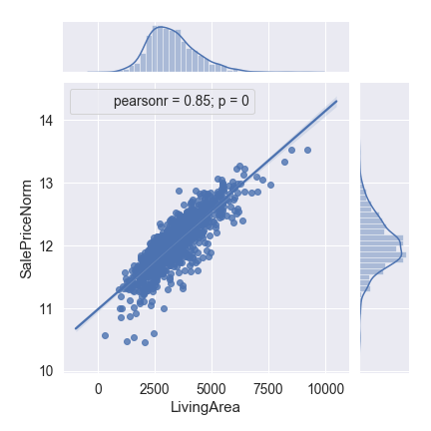
Base Model: Sale Price Vs Area
How big is the House (in sq foot)
This feature is a combination of all the information related to the size of the living quarter
Area of each floor+ Basement Area+ Garage Area + Porch (internal an external)+ Wood Area
 | score test | score train | MSE
Base Model | 0.749545 | 0.728518 | 0.04

Slide 3
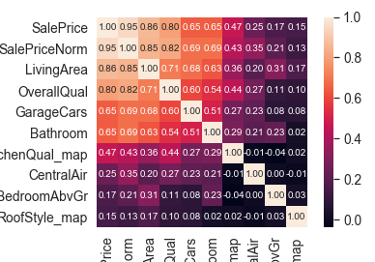
More Information To improve Predictions
#Features | score test | score train | MSE
1 | 0.749545 | 0.728518 | 0.04
2 | 0.839009 | 0.821356 | 0.03
3 | 0.838195 | 0.827793 | 0.03
4 | 0.846125 | 0.845491 | 0.03
5 | 0.841438 | 0.847241 | 0.03
6 | 0.859046 | 0.860756 | 0.02
7 | 0.858892 | 0.860774 | 0.02
8 | 0.859309 | 0.861049 | 0.02

Slide 4
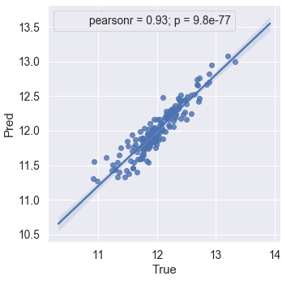
Best Fit Model
 | #Features | score test | score train | MSE
Base Model | 1 | 0.749545 | 0.728518 | 0.04
Best Model | 8 | 0.859309 | 0.861049 | 0.02

Slide 5
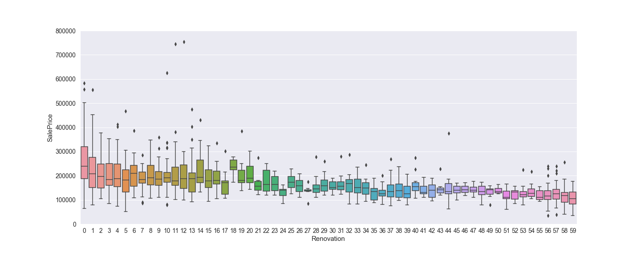
Future: Extend to Non Linear Features
Renovation: Time passed between the renovation and the year sold

Slide 6
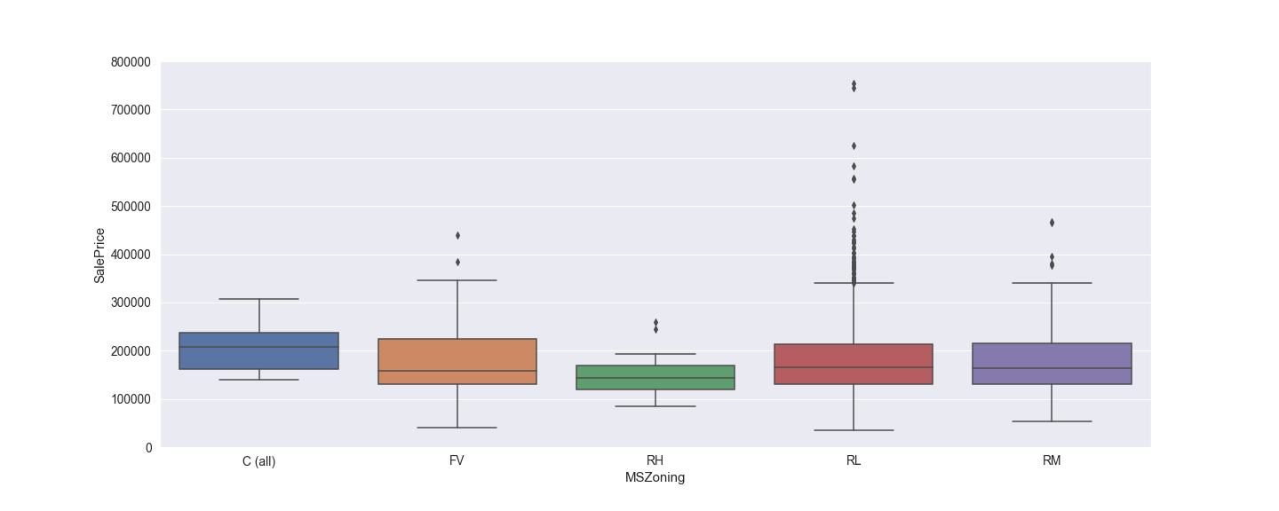
General zoning classification of the sale.

Slide 7
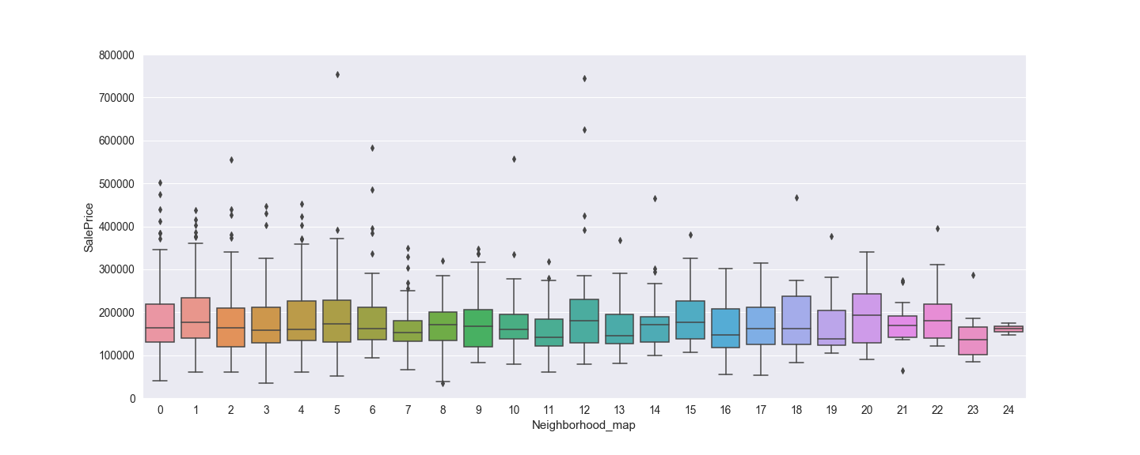
Neighborhood

