Slide 1
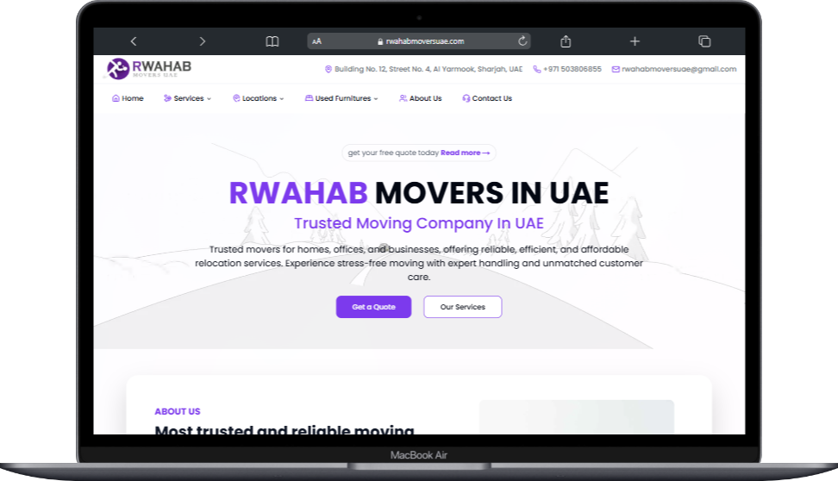
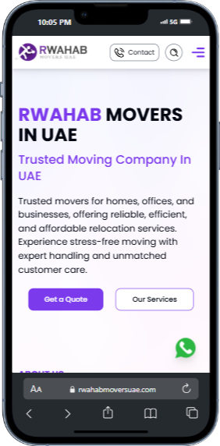
Website Development Report
Website URL: https://rwahabmoversuae.com/
Introduction
This report provides an easy-to-understand summary of the completed website for Rwahab Movers UAE. The main goal of the website is to help people find moving and packing services in different parts of the UAE quickly and easily. The website is professional, simple to use, and designed to show up in Google searches.

Slide 2
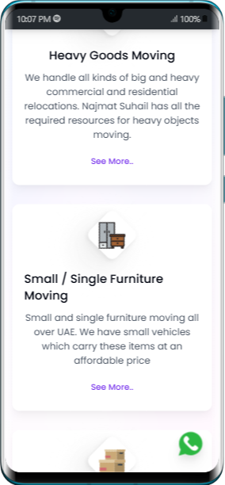
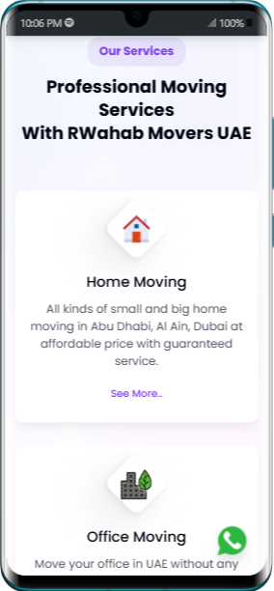
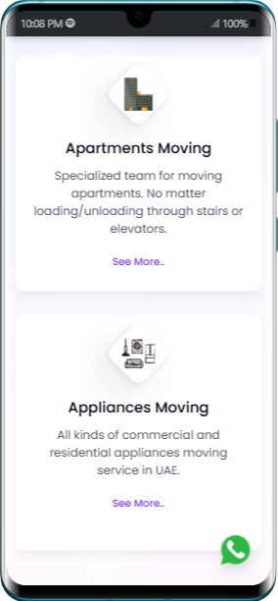
2. Website Structure (Sitemap)
Think of the website like a map with all the important pages listed. Here’s how it’s organized:
Home Page: The main page where users start.
Locations:
Movers and Packers in Dubai
Movers and Packers in Abu Dhabi
Movers and Packers in Sharjah
Movers and Packers in Ajman
Movers and Packers in Ras Al Khaimah
Movers and Packers in Umm Al Quwain
Services:
Apartment Moving
Home Moving
Office Moving
Heavy Goods Moving
Small Furniture Moving
Appliances Moving
Buy/Sell Used Furniture: For people buying or selling furniture in Dubai, Abu Dhabi, and other cities.
About Us: Information about the company.
Contact Us: A page where users can get in touch with the company.

Slide 3
3. What Each Page Does
Home Page
This is the main page where visitors land. It introduces the company and gives quick access to services and contact options.
Location Pages
Each page is dedicated to a city in the UAE (e.g., Dubai or Abu Dhabi). These pages make it easy for customers in those areas to find relevant moving services.
Service Pages
These pages explain the different services offered, like moving apartments or offices, or transporting heavy goods.
Buy/Sell Furniture Pages
These pages allow users to buy or sell second-hand furniture in their city. It’s a useful feature for people moving homes.
About Us
This page tells visitors more about the company’s history, values, and mission.
Contact Us
A simple page where customers can fill out a form or find the company’s contact details.

Slide 4
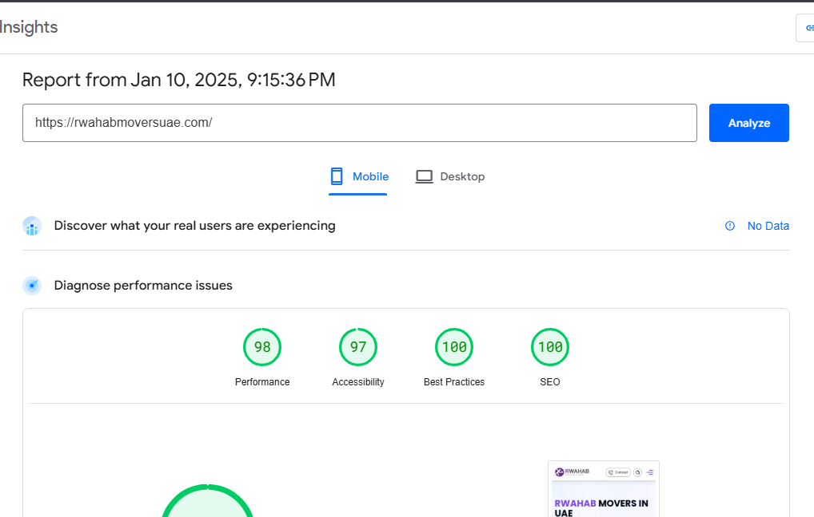
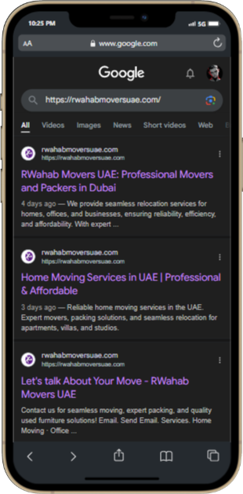
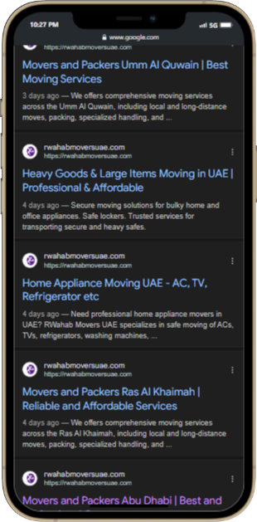
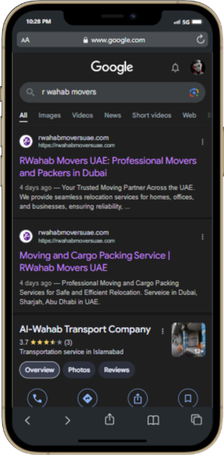
4. Key Features of the Website
Easy to Use
The design is simple and works well on phones, tablets, and computers.
Clear navigation so users can quickly find what they need.
Fast and Reliable
Pages load quickly because of optimized images and smart coding.
Visible on Google
The website is set up to rank well on Google searches, helping more people find it online.
Interactive Forms
Visitors can easily contact the company using forms on the website.

Slide 5
Additional Information
The domain name has been registered for 2 years at a cost of PKR 5818. For future management, maintenance, and ongoing SEO optimization of the website, I propose a one-time payment of 200 AED. This will ensure the website stays updated, secure, and competitive in search rankings.
Prepared by: Mashal Huraira Date: Friday, 10 January 2025

