Slide 1
PROJECT UPDATE · AUGUST 2026
Where Does the Performance Come From?
The new scope of the bruxism paper (v8): from selling an audio–EMG classifier to auditing the whole pipeline — what changed since the Scientific Reports submission, why, and where it goes next
M. H. (Kye) Farhadi · Electrical, Computer & Biomedical Engineering, University of Rhode Island
Sources: main_v8.tex (26 Aug) · advisor briefing (19 Aug) · audit notes cause.md and audio.md · Scientific Reports decision (3 Jul) · venue facts checked 28 Aug 2026. No number here is new.
Notes:
Good afternoon. This is a short update on where the bruxism paper stands and why it looks so different from the manuscript we sent to Scientific Reports.
The one-sentence version: we set out to sell an audio-plus-EMG classifier for bruxism-related activities, and along the way we found that two things nobody had measured were defective: the signal entering the model, and the microphone channel itself. The EMG survived. The paper now audits the whole pipeline, prices every stage, and tells readers how to do the same on their own data.
I will go through: where we were, the three audits, the two defects, with the microphone evidence in some detail, the new scope and results, the advice we give readers, what this means for the group and the NIH direction, venues with their dates and impact factors, and the decisions I need today. About twenty minutes, then discussion.
Everything I quote is from v8 of the manuscript (26 Aug), the advisor briefing (19 Aug) and the audit notes; nothing here is a new number.

Slide 2
WHERE WE WERE
v1–v3 sold a fusion classifier for bruxism
v1 — submitted to Scientific Reports
v2–v3 — the resubmission draft (Jul–Aug 2026)
“Sensor-based Bruxism Detection with Dual-Branch Wavelet CNNs and Audio–EMG Data Fusion”
Claimed 85.0% accuracy / 80.3% F1 on four classes (movement, clench, grind, chew) — no resting class
Audio fusion credited with +17.4 points; “real-time”, ~15,000 parameters, 12 ms per window
Framed as clinical screening: “bruxism detection”
Added quiet rest → five classes; nested leave-one-subject-out; participant-level metrics; clinical terminology sections written for R2
Still the same story: audio + EMG fusion, 82.1% accuracy / 73.6% macro-F1 / 0.962 AUC for the fused model
RQ2 “how much does audio add?” and RQ3 “does the dual-branch CNN beat the baselines?” remained the spine
Every number came from a filter chain and a microphone channel nobody had measured
Rejected 3 Jul 2026 — 2 of 4 reviewers critical
R2 (clinician): tooth-contact-only definition is outdated; phenotype unspecified; discuss STAB, the biopsychosocial model and TMD standard of care
R4 (technical): chewing inflates the headline; no resting class, so it is not detection; “generalises to unseen individuals” over-claims N = 5; events emulated, not natural
The pitch rested on two things nobody had measured: the signal entering the model and the microphone channel. Both turned out to be defective. The EMG survived.
Bruxism paper · scope update · August 2026
2 / 18
Notes:
Where we were. The submitted manuscript, v1, was a detection story. It claimed 85 percent accuracy and an 80 percent F1 across four activities, movement, clenching, grinding and chewing, with no resting class, and it credited the microphone with a seventeen-point gain. It called itself real-time.
Scientific Reports rejected it on 3 July. Two reviewers were positive, two were not, and the editor sided with the two critics. Reviewer 2 is a bruxism clinician: the definition we used, bruxism equals tooth contact, is outdated; the phenotype was unspecified; and they wanted the STAB tool, the biopsychosocial model and TMD standard-of-care discussed. Reviewer 4 was technical and, frankly, correct: chewing is easy and inflates the headline; without a resting class it is not detection; the sentence about generalising to unseen individuals over-claims from five people; and the events were emulated.
Versions 2 and 3 were the resubmission draft. They fixed the protocol problems, added quiet rest, nested leave-one-subject-out, participant-level metrics, and wrote the clinical sections Reviewer 2 asked for. But the story was still fusion: the fused model at 82.1 percent accuracy, and RQ2, how much does audio add, and RQ3, does our dual-branch network beat the baselines, were still the spine.
What none of those versions had done was measure the signal or the channel the whole story rested on.

Slide 3
HOW WE GOT HERE
Three audits, six weeks, one surviving modality
3 Jul
27–28 Jul
3 Aug
7–10 Aug
12 Aug
15–17 Aug
19 Aug
25–26 Aug
Scientific Reports rejects v1
Prototype rebuilt as a package
Mains-harmonic defect found
Confirmatory runs, corrected chain
Microphone audit
v4–v7: mic dropped, pipeline framing
Advisor briefing
v8: general framing, 20 pp
Code audit · 27–28 Jul
Signal audit · 3 Aug
Channel audit · 12 Aug
Prototype used the held-out subject for early stopping and checkpoint selection, then reported it as the test score
Window-level K-fold on 50%-overlapping windows; focal-loss and wavelet-band bugs
The published 85% matrix is irreproducible: its total counts 595 rest windows it does not contain
Rebuilt: sealed outer folds, 196 tests, every number regenerated from a saved prediction ledger
Acquisition hardware had already notched 60 Hz; interference sat at 180 / 300 / 420 Hz
The textbook chain notched 60 Hz — the one frequency that was absent — and passed the rest
91–99.8% of in-band quiet-rest power was mains; two participants were unclassifiable
Fix: constant-width notch bank at every harmonic, selected on an interference criterion, not on score
Fingerprint of every channel of every recording: EMG 100/100 distinct, microphone 37/100
83 recordings carry another participant’s audio, rotated — LOSO never held out the audio
Cause: buffer reuse in the acquisition path; no second copy exists (.avi has no audio stream)
Outcome: microphone dropped from the paper in v5 (15 Aug), put to the advisor 19 Aug; the acoustic hypothesis is untested, not refuted
Bruxism paper · scope update · August 2026
3 / 18
Notes:
How we got here, in six weeks and three audits.
First, the code audit at the end of July. When we rebuilt the prototype as a proper package, we found the held-out subject had been used for early stopping and checkpoint selection and then reported as the test score. There was window-level K-fold on overlapping windows, a focal-loss bug, mislabelled wavelet bands. And the published 85 percent confusion matrix cannot be reproduced under any labelling policy: its total equals the count including 595 rest windows that the matrix does not contain. The rebuild seals the outer fold structurally, has 196 tests, and regenerates every number from a saved prediction ledger.
Second, the signal audit on 3 August. The acquisition hardware had already notched 60 hertz. The interference that survived sat at 180, 300 and 420. Our textbook chain notched 60, the one frequency that was absent, and passed everything else. In the quiet-rest recordings, 91 to 99.8 percent of in-band power was mains.
Third, the channel audit on 12 August, which I will show in detail: the microphone column is 37 waveforms replayed across 100 recordings.
The versions after that, v4 to v8, are the paper being rewritten around what the data can actually support: the microphone came out in v5 on 15 August, and the advisor briefing on 19 August put that direction, with the evidence, to the advisor.

Slide 4
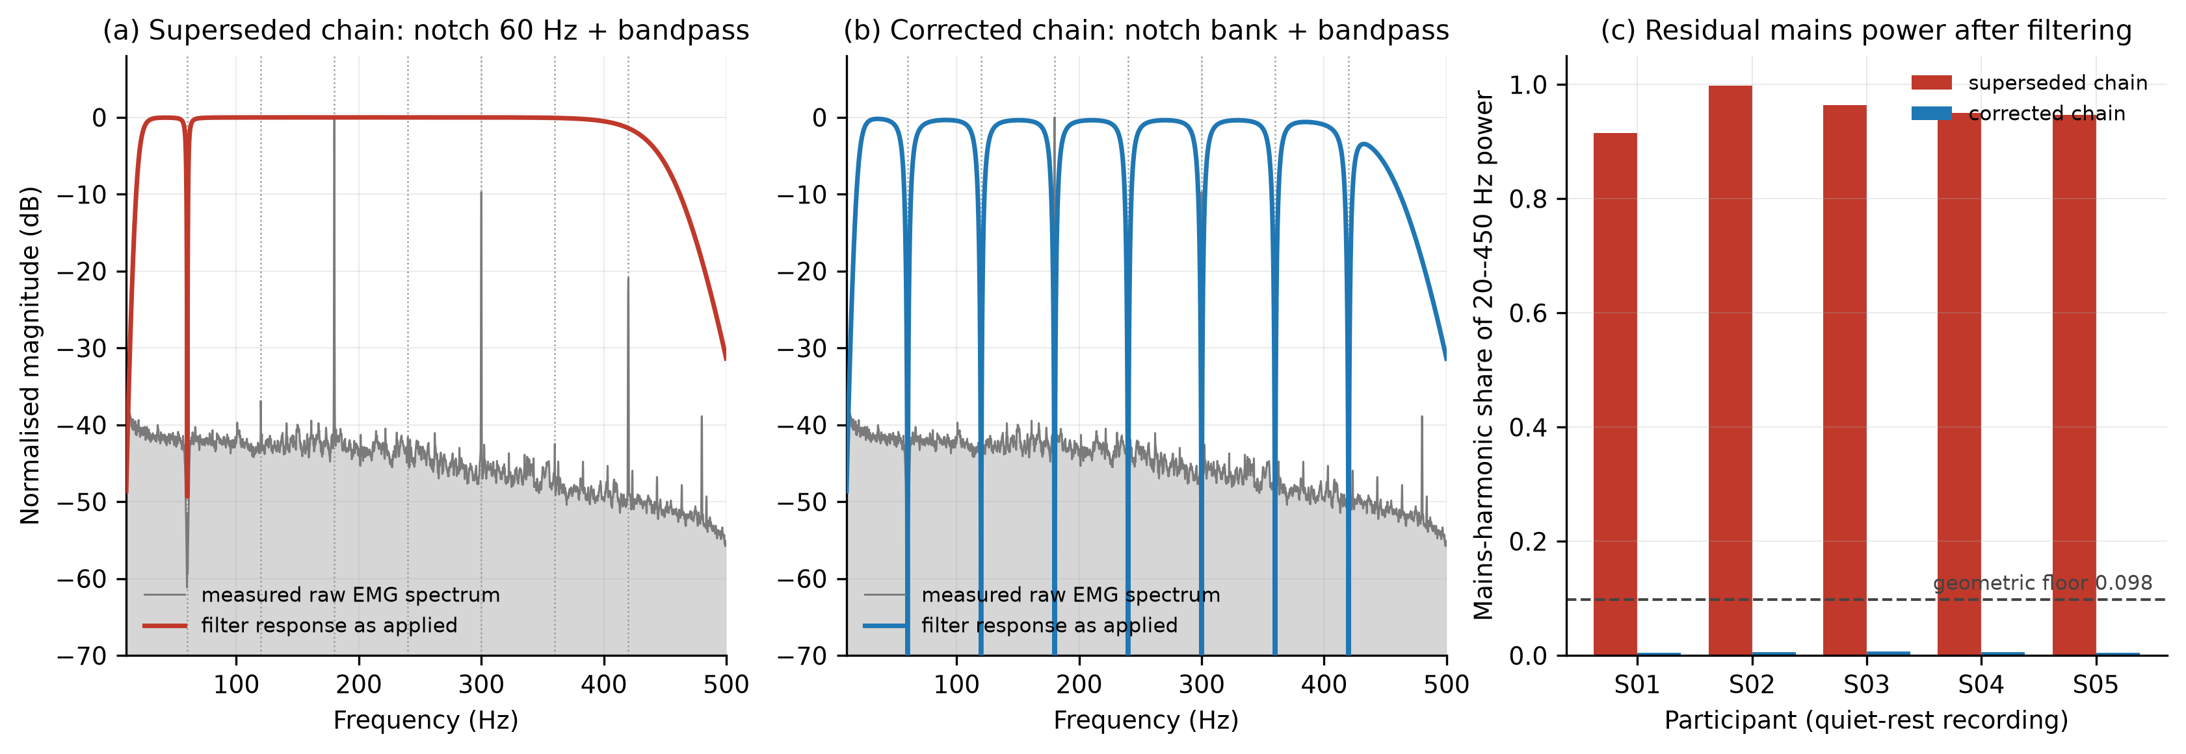
DEFECT 1 — THE EMG FILTER CHAIN
The 60-Hz notch removed the one frequency that was already gone
+29.3 pts
macro-F1, 43.5% → 72.8%, same windows, folds and labels
30.2% → 6.1%
quiet-rest windows misread as clenching or grinding
2 of 5 → 0 of 5
participants at or below chance before (P1 18%, P2 5% macro-F1)
The chain looked textbook-correct on its own response plot; the defect appeared only when the response was drawn over the measured spectrum of the recordings
It presented as between-participant heterogeneity — the most familiar failure mode in this literature — not as a signal problem
Three estimators of very different capacity moved 22–29 points on the same windows: a ceiling, not a model effect
Now a pipeline stage: the residual-mains statistic is published beside every accuracy, and a band-inside-passband guard refuses to run
Bruxism paper · scope update · August 2026
4 / 18
Notes:
Defect one, in one figure. Panel a is the superseded chain drawn over the measured spectrum of the recordings. The notch lands at 60 hertz, where the hardware had already removed everything, and the spikes at 180, 300 and 420 pass straight through. Panel b is the corrected chain, seven constant-width notches on the harmonics. Panel c is the residual mains share per participant: above 0.9 before, under 0.01 after.
What it was worth: the matched network went from 43.5 to 72.8 percent macro-F1 on byte-identical windows, folds and labels, 29.3 points. Quiet-rest windows misread as clenching or grinding fell from 30 percent to 6. And two participants who had been at or below chance, P1 at 18 and P2 at 5 percent macro-F1, are now in the 61 to 82 range with everyone else.
Two things to stress. The chain looked correct on its own response plot; the defect only appeared when the response was drawn over the data. And it did not look like a signal problem; it looked like between-participant heterogeneity, which is the most familiar failure mode in this literature and the one that motivates transfer learning and bigger cohorts. That is why the check is now a pipeline stage that refuses to run, not a review step.

Slide 5
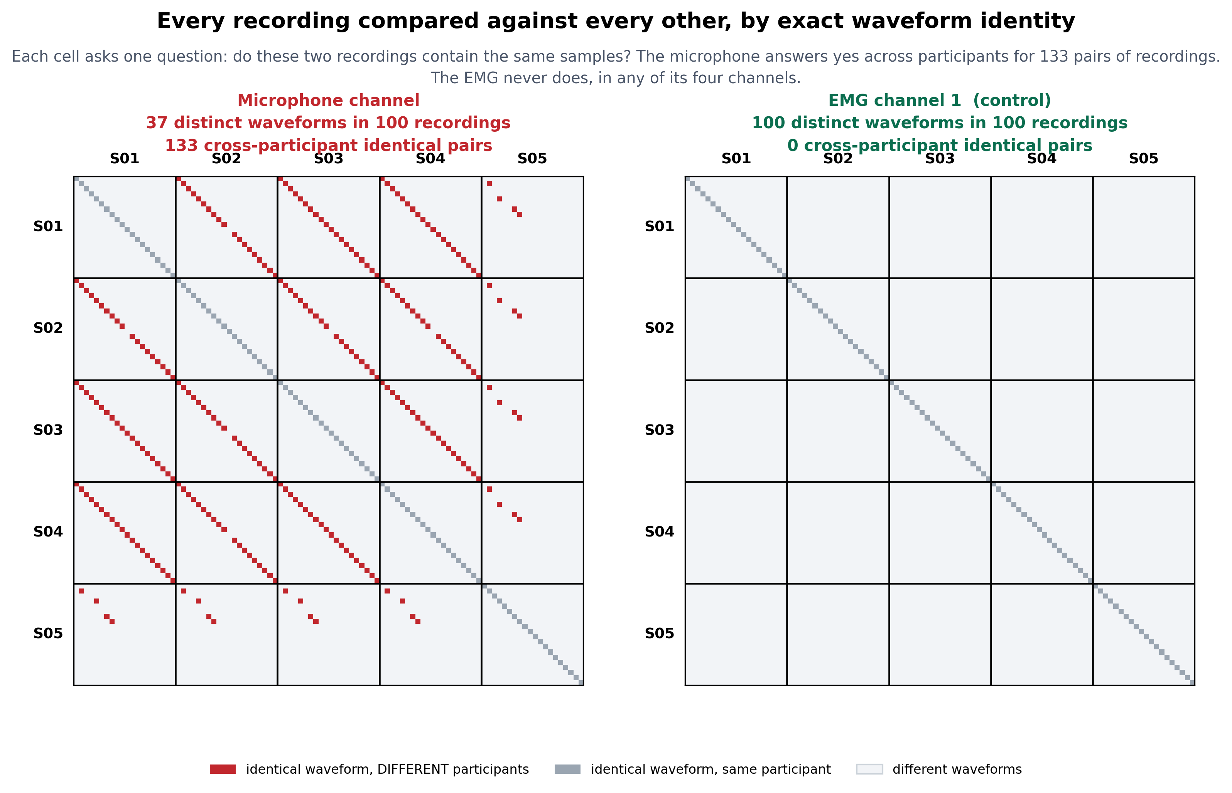
DEFECT 2 — THE MICROPHONE CHANNEL (1 OF 6)
The microphone column is not per-participant audio
Measured from the raw CSVs (recomputed 19 Aug)
37 distinct waveforms in 100 recordings; 83 recordings share a waveform with a different participant; 63 of 63 tested pairs are exact circular rotations (residual 0)
All four EMG channels: 100 of 100 distinct, zero sharing — every EMG result stands
LOSO never held out the audio: the old fusion and audio-only numbers scored training data
Not audio even if unique: 96% of power below 10 Hz, 1-count quantisation, clenching quieter than silent rest (0.30×)
Not repairable: the .avi files carry no audio stream; the .npy companions have an all-zero mic column
What we did
Dropped the microphone from every result; RQ2 recorded as untested, not refuted
Kept the check: a rotation-invariant fingerprint of every channel on every manifest build; a run is refused if a held-out participant’s signal is in its own training set
Every recording against every other, by exact waveform identity. Red: identical samples under two different participants. Left, the microphone; right, EMG channel 1 from the same files.
Bruxism paper · scope update · August 2026
5 / 18
Notes:
Defect two, starting with the whole finding in one picture. The figure compares every recording against every other by exact waveform identity. Left is the microphone, right is EMG channel 1 from the same 100 files. Red means two recordings contain the same samples and belong to different people. The microphone panel is striped with red across every participant boundary; the EMG panel has nothing off the diagonal.
The numbers: 37 distinct waveforms in 100 recordings; 83 recordings share a waveform with a different participant; of 63 pairs we tested, all 63 are exact circular rotations, the largest residual after alignment is zero. All four EMG channels are 100 out of 100 distinct, so every EMG result stands.
The consequence is that leave-one-subject-out never held out the audio. The next four slides show what that looks like in the signals themselves, what broke, what it did to the numbers, and why the channel would not have been usable audio even if it were unique.
The decision at the end of it: we dropped the microphone from every result, recorded RQ2 as untested rather than refuted, and kept the check, a rotation-invariant fingerprint of every channel on every manifest build that refuses a run if a held-out participant's signal is in its own training set.

Slide 6
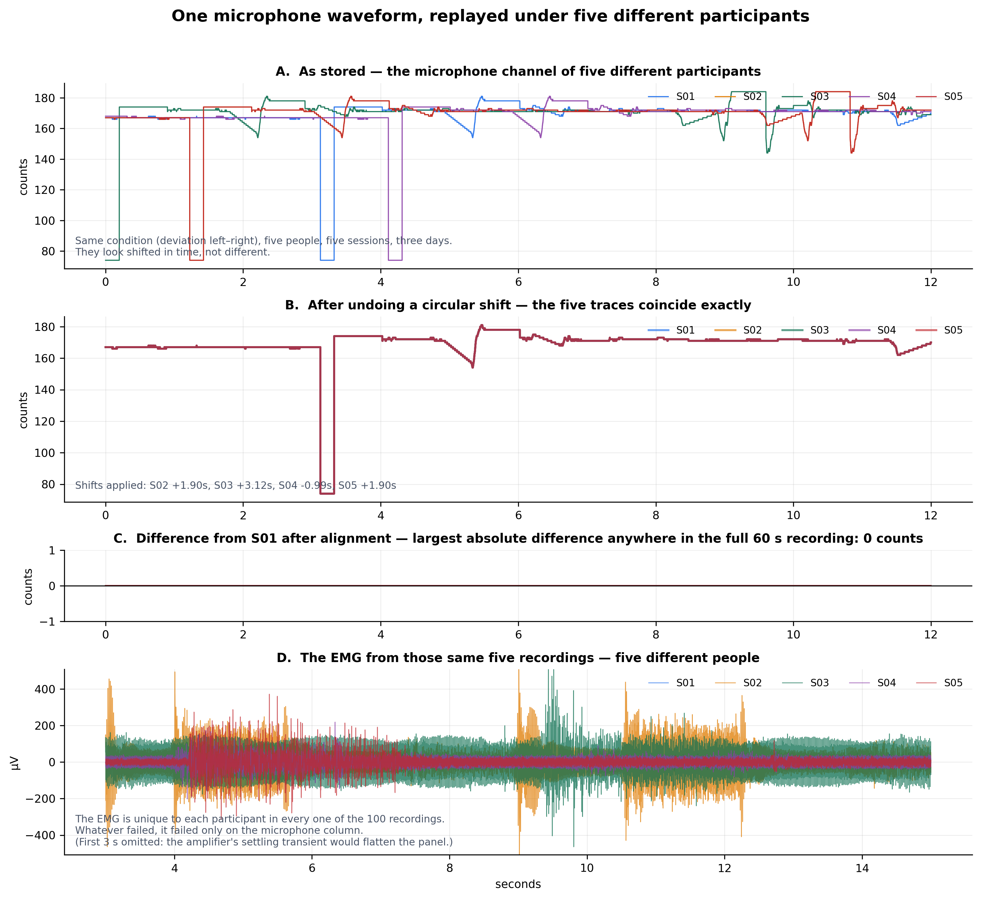
DEFECT 2 — THE MICROPHONE CHANNEL (2 OF 6)
One microphone waveform, replayed under five different participants
A · As stored. The deviation-left-right condition from five people, five sessions, three days (4–7 Aug 2025). The traces look shifted in time, not different.
B · After undoing a circular shift (S02 +1.90 s, S03 +3.12 s, S04 −0.99 s, S05 +1.90 s) the five traces coincide exactly.
C · Difference from S01 after alignment: 0 counts anywhere in the full 60-s recording. Not correlated, not similar — identical, bit for bit.
D · The EMG from the same five files is five clearly different people. Whatever failed, failed only on the microphone column.
Same +1.90 s for S02 and S05: what a direct copy of S02’s column into S05’s files would produce. The audit confirms it — S05’s four duplicated recordings carry S02’s exact sample offsets (5,586 / 69,009 / 2,279 / 69,728).
Bruxism paper · scope update · August 2026
6 / 18
Notes:
This is the strongest single exhibit, and it is the one to linger on if anyone doubts the finding.
Panel A is the microphone channel as stored, for the deviation-left-right condition, from five different people, recorded in five sessions across three days in August 2025. Look at the shapes: the same dropout, the same bumps, just displaced in time. They look shifted, not different.
Panel B undoes a circular shift for each trace, 1.90 seconds for S02, 3.12 for S03, minus 0.99 for S04, 1.90 for S05, and the five collapse onto one line.
Panel C is the difference from S01 after alignment. The largest absolute difference anywhere in the full 60-second recording is zero counts. Not correlated. Not similar. Identical, every sample, bit for bit.
Panel D is the EMG from those same five files: five clearly different people. Whatever failed, failed only on the microphone column.
One more detail worth saying out loud: S02 and S05 needed the same 1.90-second shift. That is what you would see if S02's column had been copied directly into S05's files, and the audit confirms it: S05's four duplicated recordings carry S02's exact sample offsets.

Slide 7
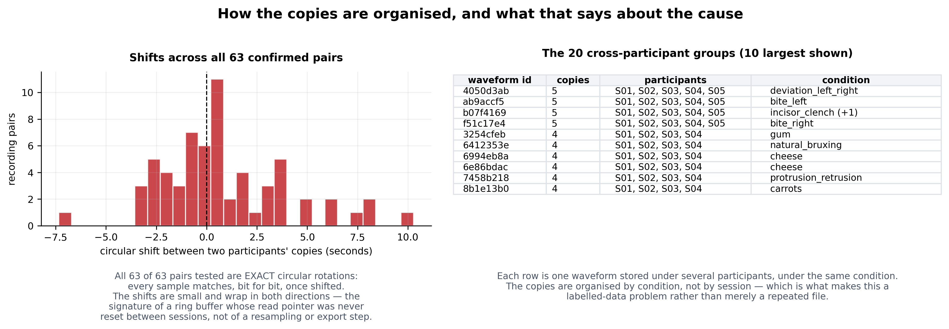
DEFECT 2 — THE MICROPHONE CHANNEL (3 OF 6)
What broke: ring-buffer offsets, copies grouped by condition
Exact rotations, small offsets
Grouped by condition, not session
Nothing to recover from
All 63 tested pairs match bit for bit once shifted. Shifts run −7.5 to +10 s and wrap both ways around zero: a ring buffer whose read pointer was never reset between sessions, not a resampling or export step.
Four waveforms sit under all five participants and sixteen under four, always under the same condition — which makes it a labelled-data problem, not a repeated file.
The three .npy companions (S01) match the CSV on EMG and trigger and hold an all-zero mic column; all 100 .avi files carry zero audio streams.
Bruxism paper · scope update · August 2026
7 / 18
Notes:
What broke, mechanically. We can say more than the files are duplicated, and the advisor will ask whether this could recur.
Left: the shifts across all 63 confirmed pairs. They are small, mostly within a few seconds, and they wrap in both directions around zero. A resampling or export bug does not produce circular rotations; a buffer whose read pointer is not reset between sessions does. That is a ring-buffer trace.
Right: how the copies are organised. Each row is one waveform stored under several participants, under the same condition. Four waveforms appear under all five people; sixteen more under four. The copies are grouped by condition, not by session, which is what turns a duplicated file into a labelled-data problem: the model sees the same audio under the same label in training and in test.
Corroboration from outside the CSVs: the three numpy companions we have, all from S01, match the CSV exactly on EMG and trigger and have an all-zero microphone column, so the acquisition array held no microphone data. And all 100 video files parse to one video stream and zero audio streams. There is nothing to recover the true audio from.
The requirements for the next collection follow directly: audio in its own file on its own clock, never a shared buffer, a hardware sync marker on both streams, and a fingerprint check at ingest.

Slide 8
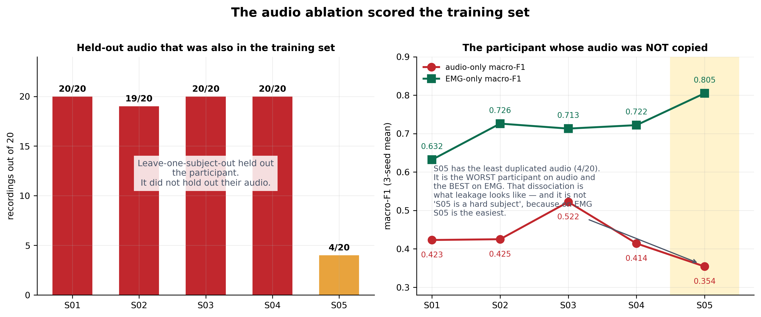
DEFECT 2 — THE MICROPHONE CHANNEL (4 OF 6)
The audio ablation scored the training set
Held out | Mic dup. | Audio F1 | EMG F1
S01 | 20 / 20 | 0.423 | 0.632
S02 | 19 / 20 | 0.425 | 0.726
S03 | 20 / 20 | 0.522 | 0.713
S04 | 20 / 20 | 0.414 | 0.722
S05 | 4 / 20 | 0.354 | 0.805
Ablation ledger modality_and_no_chewing_…cead62e4, five-class task, three-seed means (audio.md §1.6). Dup.: recordings whose mic waveform also appears under another participant.
LOSO held out the participant, not their audio: for S01–S04 essentially every held-out audio window was also in training under the same label; the four S01–S04 rest recordings share one waveform
S05 — the only participant whose audio was mostly not copied — is the worst on audio and the best on EMG: the dissociation leakage predicts, not a hard subject
The one cross-condition swap behaves as predicted: S05’s protrusion recording carries the incisor-clench waveform; its 63 audio-only predictions were clench, grind or rest — 0 movement
Withdrawn: the audio-only and fusion rows of the old Table 4, the “audio helps rest” reading, and 3–4 screening points from seven microphone features. The bias is not uniform in direction, so no corrected number can be stated
Bruxism paper · scope update · August 2026
8 / 18
Notes:
What it did to the results. Left: for each held-out participant, how many of their 20 recordings carry a microphone waveform that was also in the training set. S01, S03 and S04: all twenty. S02: nineteen. S05: four. Leave-one-subject-out held out the participant; it did not hold out their audio. For the four S01-to-S04 rest recordings, which share a single waveform, every fold had already been trained on the exact rest audio three times.
Right: S05 is the control nobody designed. It is the only participant whose audio was mostly not copied, and it is the worst participant on audio-only macro-F1, 0.354, while being the best on EMG-only, 0.805. If S05 were simply a hard subject it would be bad on both. That dissociation is the signature of leakage.
The table gives the per-participant numbers from the ablation ledger. And the one cross-condition swap behaves as predicted: S05's protrusion recording carries the incisor-clench waveform, and its 63 audio-only predictions across three seeds were clenching, grinding and rest, never movement.
So the audio-only and fusion rows of the old Table 4 are withdrawn, along with the reading that the microphone helped separate quiet rest from tooth contact, and three to four screening points that came from seven microphone features. The direction of the bias is not even uniform, so we cannot say the true value is lower; we can only say the number is not what its name says.

Slide 9
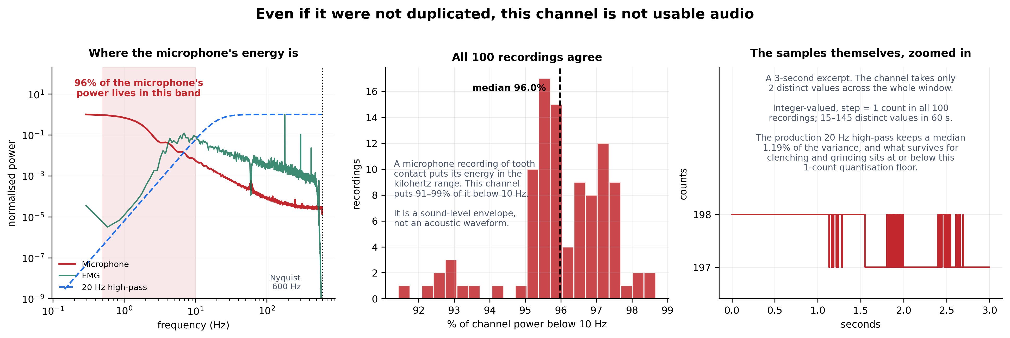
DEFECT 2 — THE MICROPHONE CHANNEL (5 OF 6)
Even if it were not duplicated, this channel is not usable audio
Where the energy is
What the pipeline kept
What the samples are
96% of the microphone’s power (median; 91–99% across all 100 recordings) lies below 10 Hz. Tooth contact radiates in the kilohertz range; at 1200 Hz the Nyquist limit is 600 Hz, so that band does not exist in these files.
The production 20-Hz high-pass retains a median 1.19% of the channel’s variance — it removes the only band that carried condition information and keeps the band that does not.
Integer-valued with a 1-count step; 15–145 distinct values per minute. After the high-pass, clenching and grinding sit at or below the quantisation floor: the audio branch was reading converter dither.
Bruxism paper · scope update · August 2026
9 / 18
Notes:
Could we still use it as audio if it were not duplicated? No, and this slide is why.
Left: where the microphone's energy is. Ninety-six percent of its power lies below 10 hertz, the shaded band. The EMG, for comparison, is broadband to 450. The production 20-hertz high-pass, the dashed line, throws away almost everything the channel contains: a median 1.19 percent of the variance survives.
Middle: all 100 recordings agree, 91 to 99 percent of power below 10 hertz in every one. A microphone recording of tooth contact puts its energy in the kilohertz range; at a 1200-hertz sampling rate the Nyquist limit is 600, so that range does not exist in these files. This is a sound-level envelope, not an acoustic waveform.
Right: the samples themselves. Integer-valued, one-count steps, 15 to 145 distinct values in a minute; a three-second excerpt here takes two values. After the high-pass, what survives for clenching and grinding sits at or below the one-count quantisation floor, so for the two classes the study exists to measure the audio branch was being fed converter dither.

Slide 10
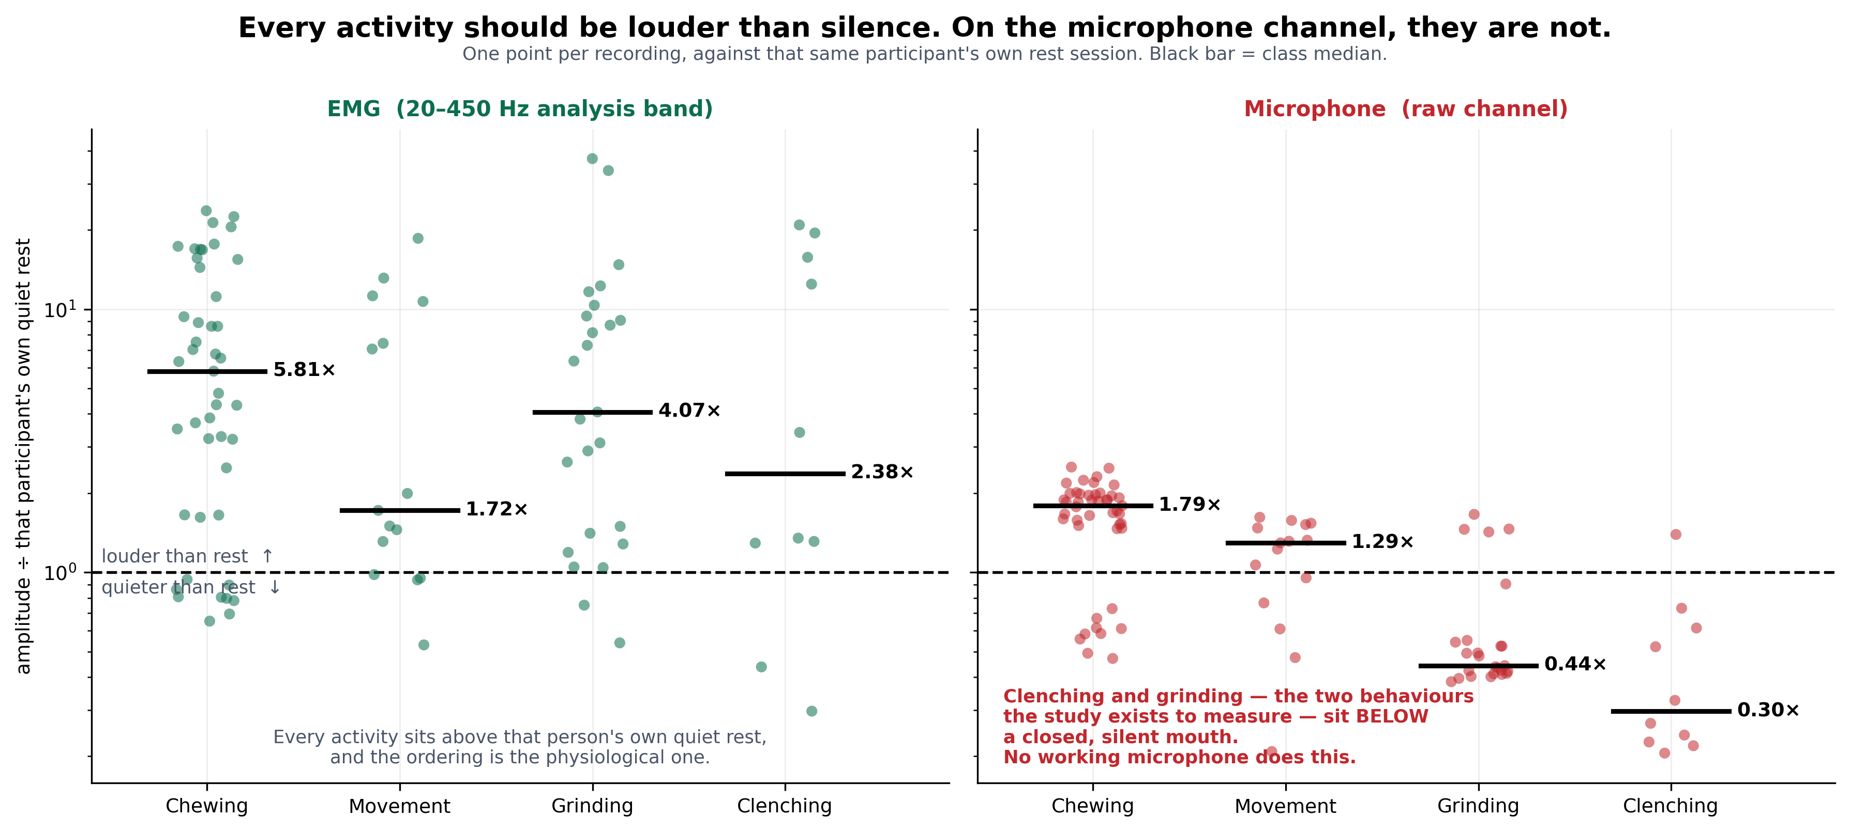
DEFECT 2 — THE MICROPHONE CHANNEL (6 OF 6)
Every activity should be louder than silence; on the microphone, two are not
One point per recording: each activity’s amplitude divided by that same participant’s own quiet-rest session. Above the line is louder than rest.
EMG (left): every activity sits above that person’s rest, in the physiological order — chewing 5.8×, grinding 4.1×, clenching 2.4×, movement 1.7×.
Microphone (right): chewing 1.8×, movement 1.3× — then grinding 0.44× and clenching 0.30×. The two behaviours the study exists to measure register quieter than a closed, silent mouth. No working microphone does that.
Why it matters: this needs no signal-processing background, uses identical recordings for both channels, and is the first check to run on any new collection.
Bruxism paper · scope update · August 2026
10 / 18
Notes:
This is the version that needs no signal-processing background, and the one I would show a clinician.
One point per recording: each activity's amplitude divided by that same participant's own quiet-rest session, on a log scale. Above the dashed line is louder than rest; below it is quieter.
Left, the EMG in the analysis band: every activity sits above that person's own quiet rest, and the ordering is the physiological one, chewing 5.8 times, grinding 4.1, clenching 2.4, movement 1.7.
Right, the raw microphone channel: chewing 1.8 times, movement 1.3, and then grinding at 0.44 and clenching at 0.30. Clenching and grinding, the two behaviours the study exists to measure, register quieter than a closed, silent mouth. No working microphone does that.
That contrast, side by side on identical recordings, is the fastest way to see that the column is not what it was labelled as, and it is the check we would run first on any new collection.

Slide 11
THE NEW SCOPE (V8)
From “does our classifier work?” to “where does the performance come from?”
Where Does the Performance Come From? A Stage-by-Stage Analysis of a Biosignal Classification Pipeline, with Surface-EMG Jaw-Activity Recognition as the Case Study
KEPT
Five-class EMG task with quiet rest · nested LOSO, 3 seeds, participant-level metrics
Compact wavelet CNN (5,901 parameters) as the characterised reference
The dataset and protocol — now foregrounded, with why they had to be collected
Pipelines are reported through a summary accuracy and a block diagram. We vary one stage at a time on identical windows, folds and labels, and price every stage on one scale.
GONE
RQ1 How much of what the classifier learns is physiology, and how much is mains interference?
RQ2 Can four EMG channels separate quiet rest from four instructed jaw activities on an unseen participant?
RQ3 Which part of the model does the work: representation, architecture, or parameter count?
RQ4 How do those compare with choices fixed before training: window length, temporal context, normalisation scope?
Audio–EMG fusion and the microphone · “bruxism detection” and real-time claims
RQ2-as-fusion and RQ3-as-“our model wins”
The clinical / STAB / TMD sections written for Reviewer 2 (engineering venue)
NEW
RQ1 filter contrast on identical windows · architecture sweep: representation vs. size
RQ4 pre-model choices · the budget table (main result) · guards that refuse to run
Positioning table (10 prior studies) · why-own-data section · a procedure that transfers to EEG / ECG / IMU
Bruxism paper · scope update · August 2026
11 / 18
Notes:
The new scope. The title is now "Where does the performance come from? A stage-by-stage analysis of a biosignal classification pipeline, with surface-EMG jaw-activity recognition as the case study."
The thesis is simple. Pipelines are reported through a summary accuracy and a block diagram, which says how well a pipeline scored and nothing about which stage earned it. We vary one stage at a time on identical windows, folds and labels, and put every stage on one scale.
Four research questions. RQ1: how much of what the classifier learns is physiology and how much is mains. RQ2: can four EMG channels separate quiet rest from four instructed jaw activities on an unseen participant. RQ3: which part of the model does the work, representation, architecture or parameter count. RQ4: how do those compare with choices fixed before training, window length, temporal context, normalisation scope.
On the right, what is kept, gone and new. Kept: the five-class EMG task with rest, the nested LOSO protocol, the compact wavelet CNN, and the dataset, which is now foregrounded with a section on why it had to be collected. Gone: fusion and the microphone, the detection and real-time claims, and the clinical sections we wrote for Reviewer 2, because the target venue is engineering. New: the filter contrast, the architecture sweep, the pre-model choices, the budget table, guards that refuse, a positioning table against ten prior studies, and a procedure section that transfers to EEG, ECG and inertial pipelines.

Slide 12
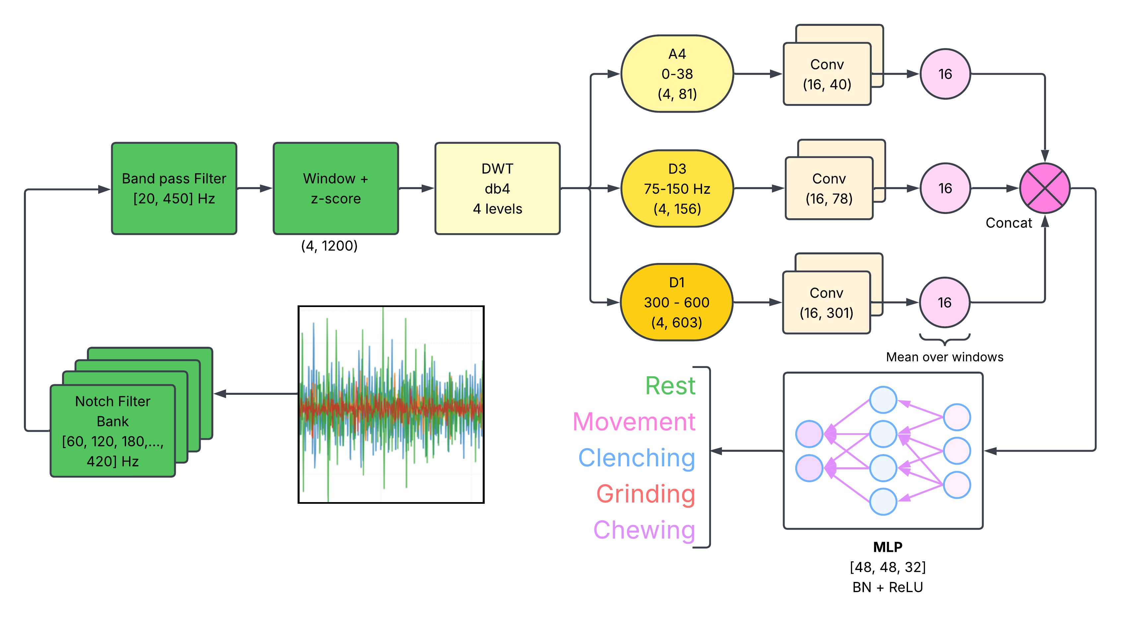
WHAT STANDS
EMG alone, on participants the model never saw
81.7%
72.0%
0.958
accuracy
macro-F1
macro AUC
Nested LOSO · 5 held-out participants × 3 seeds · 6,173 windows · participant-level means
Class (windows) | F1 | Recall | AUC
Rest (590) | 83.6% | 91.4% | 0.958
Movement (333) | 46.0% | 69.8% | 0.937
Clenching (799) | 68.1% | 66.0% | 0.936
Grinding (816) | 68.6% | 69.5% | 0.928
Chewing (3,635) | 91.1% | 85.8% | 0.981
7.7% of quiet-rest windows land on the tooth-contact side — the closest thing to a false-alarm rate this design allows.
Notch bank → 20–450 Hz band-pass → 1-s windows z-scored on training participants → db4 wavelet (A4, D3, D1) → three small CNN branches → MLP. 5,901 parameters, ~1 ms per window on a CPU.
Architecture sweep — identical inputs, 3 seeds | Params | Macro-F1 | AUC | Forward
Wavelet CNN, extended (time axis kept + rhythm head) | 17,981 | 75.0 ± 1.3 | 0.974 | 2.21 ms
Wavelet CNN, compact — the reference model | 5,901 | 72.2 ± 1.5 | 0.954 | 1.02 ms
Early-fusion CNN on the raw signals | 19,029 | 68.9 ± 1.5 | 0.949 | 0.20 ms
Bidirectional LSTM | 10,053 | 60.2 ± 2.6 | 0.898 | 1.16 ms
Both wavelet models above both raw-signal models; the largest model placed third. The extended model is the reference with its time axis kept — reported as secondary (2.8 points, on three of five participants).
Bruxism paper · scope update · August 2026
12 / 18
Notes:
What stands. The pipeline is ordinary on purpose: notch bank, band-pass, one-second windows z-scored with training-participant statistics, a db4 wavelet decomposition, three small convolutional branches on the A4, D3 and D1 bands, and an MLP. 5,901 parameters, about a millisecond per window on a CPU.
On participants it never saw, nested LOSO with three seeds: 81.7 percent accuracy, 72.0 macro-F1, 0.958 macro AUC, on 6,173 windows. Rest is the best-recalled class at 91 percent. Movement is the weak one, and it is a precision problem: it is the smallest class and absorbs chewing windows. Clenching and grinding are the hard pair, as they should be.
The number I would point the clinicians at: 7.7 percent of quiet-rest windows land on the tooth-contact side. Most work in this area classifies activities against each other and cannot say anything about false alarms; this is the closest analogue our design can produce.
The architecture sweep at the bottom answers Reviewer 4's question about baselines. Both wavelet models placed above both raw-signal models, and the largest model placed third. The extended model, which is our model with the time axis kept and a rhythm head, is the strongest at 75.0, but the 2.8-point edge rests on three of five participants, so it is reported as secondary and the compact model stays the characterised reference.

Slide 13
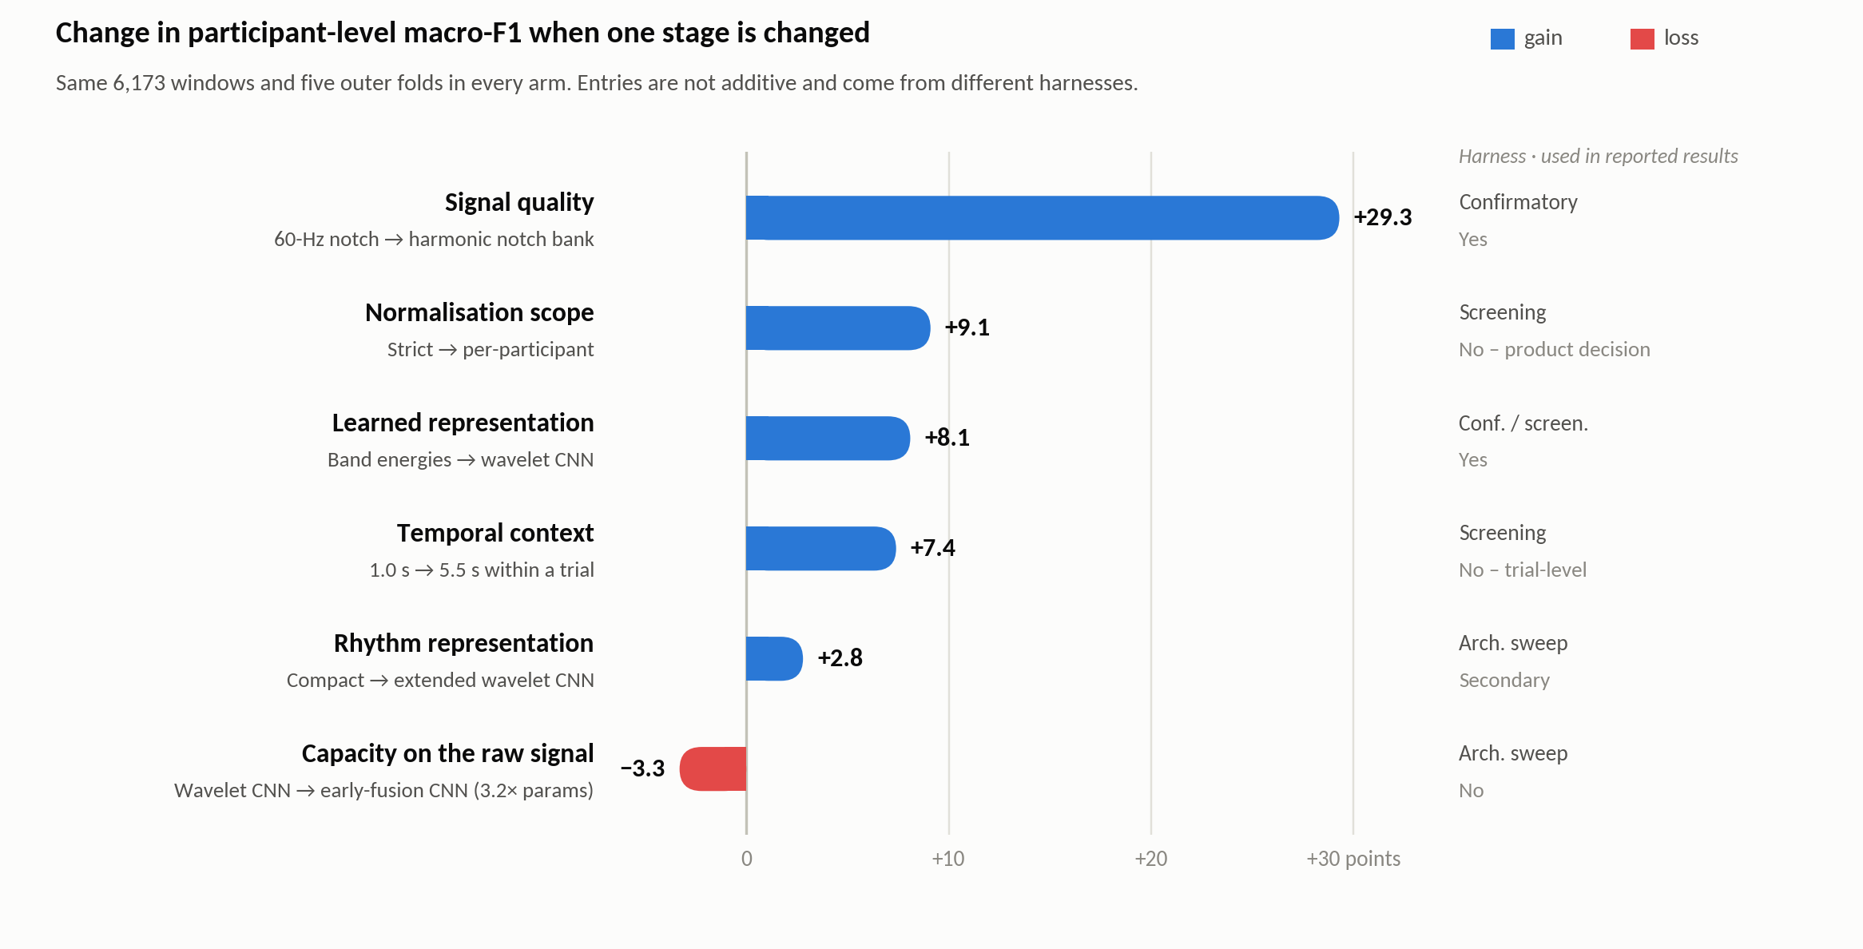
THE MAIN RESULT — TABLE 8 OF V8, THE BUDGET
Signal quality sets the ceiling; representation beats size
Below the ceiling nothing helps. Through the superseded chain the best model scored 43.5% — under the 61.3% the weakest baseline reaches on the corrected signal.
Representation beat size. The two wavelet models placed first and second; 3.2× the parameters on the raw waveform lost 3.3 points.
Two choices fixed before training — temporal context (+7.4) and normalisation scope (+9.1) — are worth as much as the architecture (+8.1) or more. Neither is a modelling decision.
Caveats, stated in the paper: entries are not additive; three rows are screening estimates, optimistic in level; the magnitudes belong to this cohort. The ordering and the procedure are what transfer.
Table 8 of main_v8.tex, redrawn. Sources: modality_and_no_chewing_…cead62e4, baselines_emg_only_20260816, outputs/screening/emg_only_*.json
Bruxism paper · scope update · August 2026
13 / 18
Notes:
This is the main result of the paper: the budget. Six choices priced on the same 6,173 windows and five folds, in points of participant-level macro-F1.
Signal quality sets the ceiling at 29.3 points. Below that ceiling nothing helps: through the superseded chain the best model scored 43.5, which is lower than the 61.3 the weakest baseline reaches on the corrected signal. No architecture could recover what the filter passed through.
Above the ceiling, what a model can represent mattered more than how big it was: the learned wavelet representation beats the band energies it is built from by 8.1 points; an explicit rhythm representation adds 2.8; and 3.2 times the parameters on the raw waveform loses 3.3.
And two choices fixed before any model was trained, temporal context at 7.4 and normalisation scope at 9.1, are worth as much as the architecture or more. Neither is a modelling decision.
The caveats are in the paper and I will say them here too: the entries are not additive; three rows are screening estimates, optimistic in level; and the magnitudes belong to this cohort and this lab. What transfers is the ordering and the practice of measuring it.

Slide 14
WHAT WE TELL READERS
Audit your pipeline before you compare models — the five-step procedure
1
2
3
4
5
Audit the signal against what the analysis assumes
Fix the data, vary one stage
Price the choices made before training
Report a budget beside the accuracy
Keep a prediction ledger
Draw every filter response over the measured spectrum of your recordings. Fingerprint every channel of every recording. Publish the interference statistic beside the accuracy.
Same windows, same folds, same labels in every arm — verified ledger to ledger — then change one stage at a time.
Window length, temporal context, normalisation scope, label source. Here two of them were worth more than the architecture.
One scale, one row per stage, each naming its harness and its baseline. Say what is not additive.
Every number and figure regenerated from saved held-out predictions, so a figure cannot disagree with the table it depicts.
Guards that refuse rather than warn: the leakage assertion on every fold · a branch may not read a band its own filter deleted · a run may not train on a held-out participant’s own waveform.
Cost: one pass over the data. Both of our defects had the same shape — a correct check scoped one step too narrowly: to the filter rather than the data, to the file rather than the dataset.
Bruxism paper · scope update · August 2026
14 / 18
Notes:
This is the advice we give readers, and it is the part that generalises. Five steps, none specific to EMG or bruxism.
One: audit the signal against what the analysis assumes, on the recordings you have. Draw every filter response over the measured spectrum, not alone. Fingerprint every channel of every recording. Publish the interference statistic beside the accuracy.
Two: fix the data, meaning the windows, folds and labels, verify that they are identical ledger to ledger, and vary one stage at a time.
Three: price the choices made before training: window length, temporal context, normalisation scope, label source. Here two of them were worth more than the architecture, and nobody in this literature prices them.
Four: report a budget beside the accuracy, one row per stage, naming its harness and its baseline, and say what is not additive.
Five: keep a prediction ledger and regenerate every number and figure from it, so a figure cannot disagree with the table it depicts.
And build guards that refuse rather than warn: the leakage assertion on every fold, the check that no branch reads a band its own filter deleted, and the check that no run trains on a held-out participant's own waveform. The whole thing costs one pass over the data.
Both of our defects had this shape: a correct check, scoped one step too narrowly, to the filter rather than the data, to the file rather than the dataset.

Slide 15
WHAT IT MEANS FOR THE GROUP
The EMG-only paper is stronger, and the audit helps the NIH direction
Why the reframe is the right call
Why the audit strengthens a mic + EMG grant
A LOSO number on a channel that was not held out is the kind of result that gets papers corrected; a caveat cannot fix a mislabelled number
The EMG paper has a clear question, a quantified answer, and a method other groups can adopt in one pass over their own data
Two independent measurement-chain defects found and fixed in one dataset — with the checks that catch them — is a contribution, not a confession
The v8 draft is complete: 26 pp, references from p. 20, every number traced to a saved artifact
Nothing here refutes the acoustic hypothesis: these files contain no usable audio, so it is untested
It removes a latent leakage artifact before it could sit in a Preliminary Studies section
Concrete rigor-and-reproducibility evidence: a measurement, a versioned policy, automated tests, an ingest gate that refuses flagged data
It turns “we will collect audio” into a protocol-plus-validation aim; the nine-requirement spec is already written (Code/docs/audio_collection_spec.md)
PROPOSAL
1
Publish the EMG-only pipeline paper now — v8 is drafted
2
Audio re-collection pilot, n ≈ 5–10, against the spec: ≥ 16 kHz WAV on its own clock, hardware sync marker, fingerprint check at ingest
3
The pilot becomes the preliminary data for the grant’s audio aim — with the failure analysis as the justification
Bruxism paper · scope update · August 2026
15 / 18
Notes:
What this means for the group, and for the NIH direction, which I know is the real concern.
Why the reframe is right. A leave-one-subject-out number on a channel that was not held out is the specific kind of result that gets papers corrected. A caveat cannot fix it, because the number is mislabelled, not merely uncertain. The EMG-only paper has a clear question, a quantified answer, and a method others can adopt. And finding two measurement-chain defects in one dataset, with the checks that catch each, reads as a group that measures its own instruments. The bad version of this story is the one where someone else finds it.
Why it helps a microphone-plus-EMG grant. Nothing here refutes the acoustic hypothesis; these files contain no usable audio, so it is untested. It removes a latent leakage artifact before it could sit in a Preliminary Studies section. It is concrete rigor-and-reproducibility evidence: a measurement, a versioned policy, tests, an ingest gate, which reviewers score. And it converts "we will collect audio" into a protocol-plus-validation aim; the nine-requirement acquisition spec already exists in the repo.
The proposal: publish the EMG paper now; run a small audio re-collection pilot, five to ten people, against that spec, with audio at 16 kilohertz or better in its own file on its own clock, a hardware sync marker, and a fingerprint check at ingest; and let that pilot be the grant's preliminary data. It gives a better audio aim than the contaminated data ever could, for the cost of one pilot.

Slide 16
VENUES 1 OF 2 — JOURNALS · IMPACT FACTORS JCR 2025 · CHECKED 28 AUG 2026
Where to submit: journals first
Journal | JIF | Model · fee | Speed (publisher-stated) | Why it fits | Read
IEEE J. Biomedical & Health Informatics | 7.7 | hybrid | n.s. | Sensor-to-decision pipelines with rigorous validation; the EMBS readership | ★ first choice
IEEE Trans. Biomedical Engineering | 4.4 | hybrid | n.s. | Strongest line on a CV; lead with the measurement-validity contribution | selective, slow
Physiological Measurement (IOP / IPEM) | 2.5 | hybrid | 49 d to first decision (median) | Scope is “new methods of measurement and their validation” — the audit framing | good fit
IEEE Open J. Eng. in Medicine & Biology | 3.1 | OA · US$2,160 | n.s. (“fast”) | EMBS-branded, deliberately fast; citable before the grant is written | speed play
IEEE Access | 4.2 | OA · US$2,160 | n.s. | Broad, fast, no page limit (≤ 20 pp advised); less selective | speed play
Computers in Biology and Medicine (Elsevier) | 6.3 (2024) | OA · US$3,080 | n.s. | Computational-methods audience; pipelines and validation in scope | good fit
Biomedical Signal Processing and Control (Elsevier) | 5.7 | hybrid | n.s. | Filter / spectrum finding and the wavelet comparison squarely in scope | strong second
J. Electromyography & Kinesiology (Elsevier) | 2.7 | hybrid | n.s. | EMG-methods readership — where the harmonic-notch finding lands hardest | if EMG leads
Also considered (JIF 2025): Computer Methods and Programs in Biomedicine 6.4 · Medical & Biological Engineering & Computing 3.1 (an MBEC draft exists) · IEEE Sensors Journal 4.5 (8.8 wk to e-publication) · Journal of Oral Rehabilitation 3.8 (8 d to first decision; strategic — the advisor’s community; needs reframing). Journals take rolling submissions: there is no deadline to hit.
JIF = Clarivate Journal Impact Factor, JCR 2025 (released 17 Jun 2026), cross-checked against publisher pages where shown; CBM’s 2025 value was not yet listed at the check date. Fees are 2026 open-access charges (IEEE: −5% members, −20% society members). “n.s.” = not stated by the publisher.
Bruxism paper · scope update · August 2026
16 / 18
Notes:
Where to submit, starting with journals, because the recommendation is a journal first: rolling submission, no location constraint, and a methods-and-audit paper suits twenty pages better than six. The impact factors are the 2025 Journal Citation Reports values released in June, cross-checked against the publishers' own pages where those show them; fees are the 2026 open-access charges.
First choice is JBHI, impact factor 7.7: it publishes exactly this kind of sensor-to-decision pipeline work and values the leakage-free protocol. TBME, 4.4, if we want the strongest line on a CV and can wait. Physiological Measurement, 2.5, is a genuinely good fit for the audit framing; its scope statement is literally the development and validation of methods of measurement, and it states a median 49 days to first decision. If we need something citable before the grant is written, OJEMB at 3.1 and IEEE Access at 4.2 are the fast, open-access options at 2,160 dollars each for 2026, less with IEEE or EMBS membership. Computers in Biology and Medicine, 6.3, Biomedical Signal Processing and Control, 5.7, and the Journal of Electromyography and Kinesiology, 2.7, are the methods-and-signal alternatives; JEK is where the notch finding would land hardest with EMG people.
Below the table: Computer Methods and Programs in Biomedicine at 6.4, MBEC at 3.1, IEEE Sensors Journal at 4.5, and the Journal of Oral Rehabilitation at 3.8, which remains the strategic option if we want the work visible to the clinical community, but would need reframing.

Slide 17
VENUES 2 OF 2 — CONFERENCES · CHECKED 28 AUG 2026
Conference calendar: none in New England; the US options and their deadlines
Conference | Next edition | Where | Paper deadline | Proceedings | Against the three conditions
IEEE EMBS BHI 2027 | Nov 2027 | USA, city TBD | expected Jun 2027 (2026: 12 Jun → 3 Jul) | IEEE Xplore | watch — US confirmed, city TBD
IEEE EMBS BSN 2027 | TBA (2026: 10–12 Oct, Porto) | TBA | expected Jun 2027 (2026: 15 Jun) | IEEE Xplore, 4 pp | watch — 2024 Chicago, 2025 LA
IEEE/ACM CHASE 2027 | TBA (2026: 4–6 Aug, Pittsburgh) | US historically | expected Feb 2027 (2026: 16 Feb) | IEEE / ACM DL | watch
MLHC 2027 | TBA (2026: 12–14 Aug, Baltimore) | US historically | expected Apr 2027 (2026: 17 Apr) | PMLR | watch
NEBEC 2027 (Northeast Bioeng. Conf.) | Apr 2027, host TBA (2026: Temple) | Northeast rotation | expected Feb 2027 (2026: 20 Feb) | abstracts in recent years | watch — fails “papers” as run
AMIA 2027 Amplify | 12–15 Apr 2027 | Atlanta | 3 Sep 2026 — open now | archived proceedings | US ✓ · New England ✗
AMIA 2027 Annual Symposium | 6–10 Nov 2027 | San Diego | expected Mar 2027 | archived proceedings | US ✓ · New England ✗
IEEE SPMB 2027 | Dec 2027 (2026: 5 Dec) | Philadelphia (Temple) | expected Jul 2027 (2026: 1 Jul) | IEEE Xplore | US ✓ · New England ✗
IEEE EMBC 2027 | 11–15 Jul 2027 | Singapore | expected Jan–Feb 2027 | IEEE Xplore | outside the US
IEEE EMBS NER 2027 | 7–10 Sep 2027 | Milan | expected Jun 2027 (2025: 10 Jun) | IEEE Xplore | outside the US
IEEE I2MTC 2027 | 17–20 May 2027 | Chongqing | expected Nov 2026 | IEEE Xplore | outside the US
IEEE MeMeA 2027 | 2027, dates TBA | Rome | 24 Jan 2027 | IEEE Xplore | outside the US
IEEE EMBS BHI 2026 | 12–15 Dec 2026 | Hong Kong | closed (3 Jul 2026) | IEEE Xplore | outside the US
IEEE SENSORS 2026 | 25–28 Oct 2026 | Rotterdam | closed | IEEE Xplore | outside the US
ML4H 2026 (with NeurIPS) | 6–7 Dec 2026 | Sydney | ~Sep 2026 (confirm) | PMLR | outside the US
Conditions: US · New England · full papers in proceedings. None announced for 2026–27 meets all three. “Expected” deadlines are inferred from the previous edition and must be confirmed against the 2027 call. Also checked and outside the US or region: BSN ’26 Porto, BioCAS ’26 Incheon, ICHI ’26 Minneapolis, CHIL ’26 Seattle, MLSP ’26 Atlanta, BIBM ’26 Dallas, ICMLA ’26 Michigan, CBMS ’26 Cyprus, SenSys ’26 Saint-Malo, UbiComp ’26 Shanghai, BIOSTEC ’27 Malta, HPEC ’26 Boston (HPC), URTC ’26 Cambridge (undergraduates only).
Bruxism paper · scope update · August 2026
17 / 18
Notes:
Conferences, with dates and deadlines. I applied three conditions: in the US, in New England, and full papers published in proceedings rather than abstracts. As of the check date, nothing announced for 2026 or 2027 meets all three.
The top block is the watch-list. BHI 2027 is the best fit: confirmed for the US in November 2027, city to be announced, full papers in Xplore, and on this year's pattern the deadline will fall around June 2027. BSN 2027 has not been announced; it was Chicago in 2024 and Los Angeles in 2025 before Porto, so a US edition is plausible. CHASE and MLHC are US-based with deadlines around February and April. NEBEC rotates through the Northeast, but it has run on abstracts in recent years, so it fails the full-paper condition unless the 2027 host changes the format.
The middle block is US but not New England. AMIA Amplify in Atlanta is the only deadline open right now, 3 September, and the fit is moderate. SPMB in Philadelphia closed on 1 July.
The bottom block is everything else we checked, all outside the US: EMBC in Singapore, NER in Milan, I2MTC in Chongqing, MeMeA in Rome with a January deadline, BHI 2026 in Hong Kong, SENSORS in Rotterdam, ML4H in Sydney.
The practical reading: submit to a journal this fall, and hold BHI 2027 as the conference target once its call appears.

Slide 18
DECISIONS
What I need from this meeting
1
Approve the v8 framing and title
A general stage-by-stage analysis with EMG jaw activity as the case study. 26 pp, references from p. 20; every number traces to a saved artifact.
2
Pick the target journal
Recommendation: IEEE JBHI (JIF 7.7). OJEMB (3.1) or IEEE Access (4.2) if being citable before the grant matters more than the venue.
3
Approve the audio re-collection pilot and its acceptance criteria
The grant’s audio aim rests on it; the nine-requirement spec is written and each requirement traces to an observed failure.
4
Close the open items before submission
Hardware, gain and ADC documentation (Q3) · the IRB identifier (records carry conflicting values, Q10) · data-release scope (Q11) · co-author sign-off on the dropped microphone and clinical sections.
Nothing in the EMG results changes if the answers are “yes”. Everything in the microphone story changes if the pilot is not run.
Bruxism paper · scope update · August 2026
18 / 18
Notes:
Four decisions I need from this meeting.
One: approve the v8 framing and title, the general stage-by-stage analysis with EMG jaw activity as the case study. It is 26 pages with references from page 20, and every number traces to a saved artifact.
Two: pick the journal. My recommendation is JBHI; OJEMB or IEEE Access if being citable before the grant matters more than the venue.
Three: approve the audio re-collection pilot and its acceptance criteria. The grant's audio aim rests on it, and the spec is already written.
Four: close the open items before submission. The hardware, gain and ADC documentation, which the paper currently reports as undocumented; the IRB identifier, where the records carry conflicting values; the data-release scope; and co-author sign-off on the dropped microphone and clinical sections.
Nothing in the EMG results changes if the answers are yes. Everything in the microphone story changes if the pilot is not run. Thank you; questions.

