Slide 1
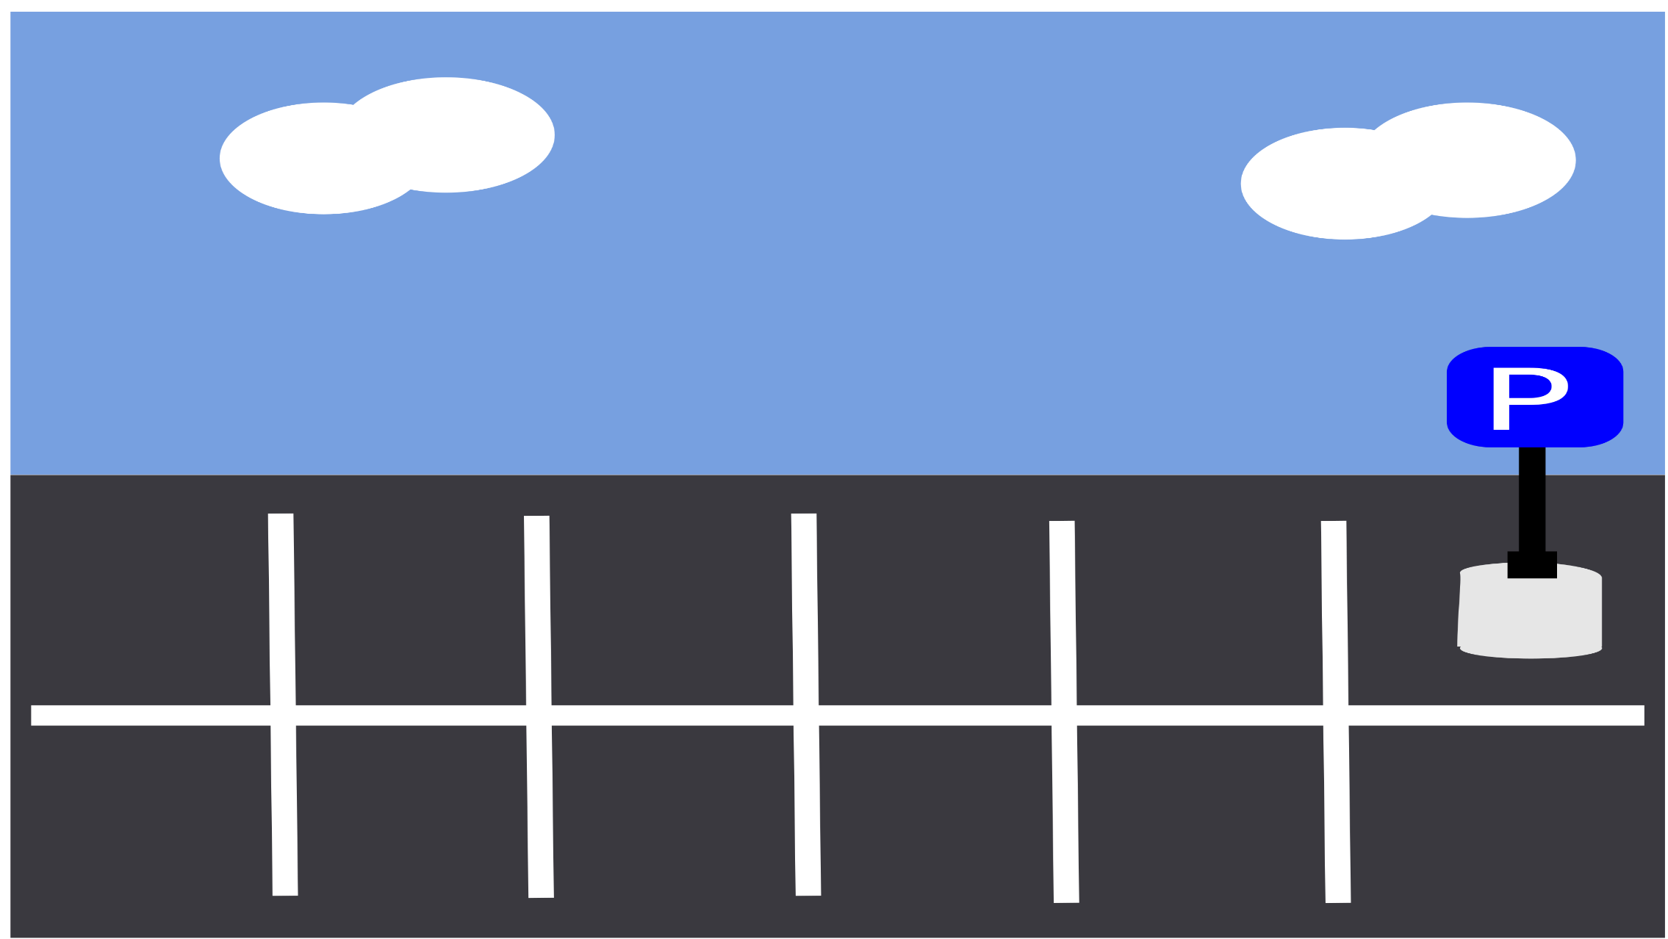
Smart Car Parking System
A Step towards Smart City

Slide 2
Presentation Overview
What is Smart Parking System?
Why do we Need “Smart Parking System” ?
Working Procedure
Limitations
Future implementation
Question & Answer

Slide 3
What is Smart Parking System?

Slide 4
Smart Car Parking System
Smart Car parking system is a vehicle parking system that uses sensors in each parking space to detect the presence or absence of a vehicle in that space and helps the drivers finding a vacant parking spot. Smart parking is one of the most adopted and quickest developing smart city solutions over the world. Smart Parking includes the use of low-cost sensors, real-time data, and applications that enable users to monitor available and unavailable parking spots

Slide 5
Why do we Need “Smart Parking System” ?

Slide 6
Advantages
1
Save time during parking .
2
As vehicle travel is reduced , pollution can be reduced by decreasing vehicle emission (air pollutant) in the air .
3
Parking space is efficiently used .
4
Reduce traffic jam
To predict parking patterns .
5

Slide 7
Working Procedure

Slide 8
Working Layout
1
Sensing the situation(Sensors )
2
Analyze the situation(Programming algorithm)
Make adaptive decisions based on the available data(transmitting Elements)
3
A vehicle parking system mobile application that helps drivers find a vacant spot.
4
Using sensors in each parking space that detect the presence or absence of a vehicle signs direct incoming drivers to available location
5

Slide 9
Infographic Layout
Uploading Sensors data and decision
to online
Analyzing sensors data
Publish in an App
Sensors
Data

Slide 10
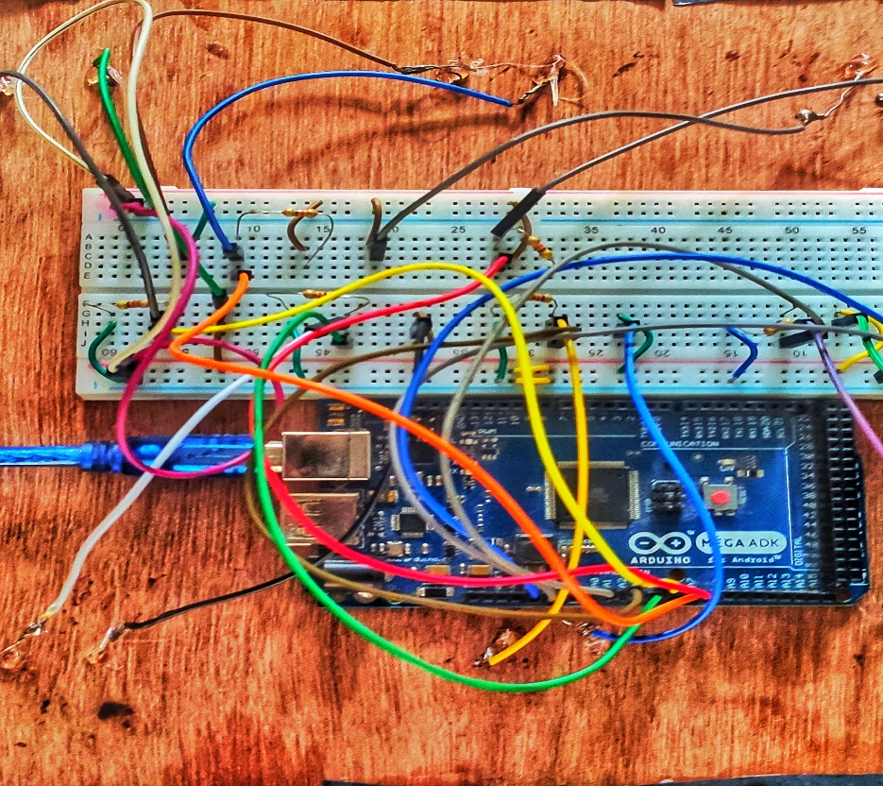
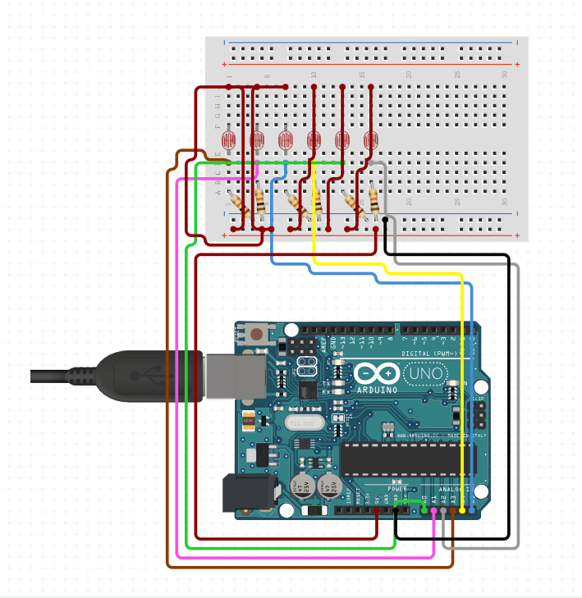
Circuit Diagram
모바일 이미지

Slide 11

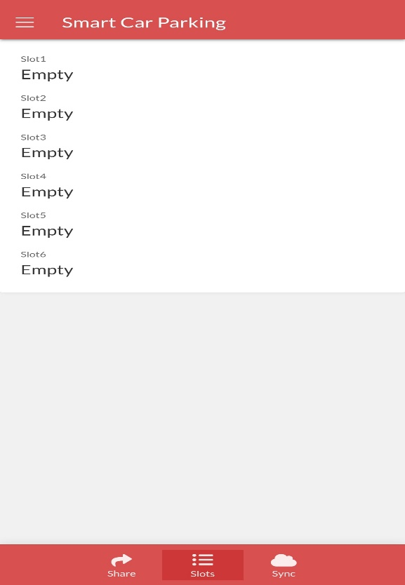

Implementation
6
5
4
1
2
3

Slide 12
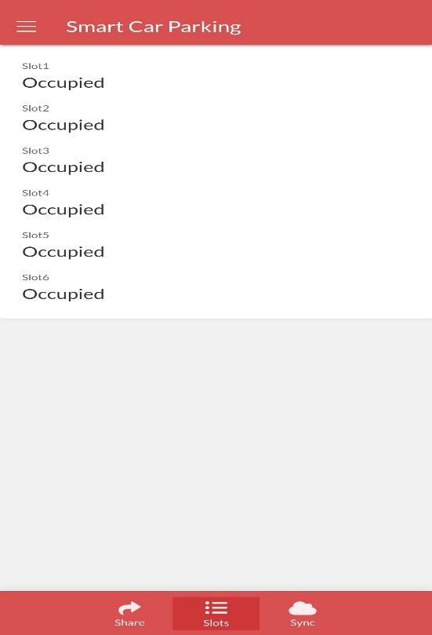
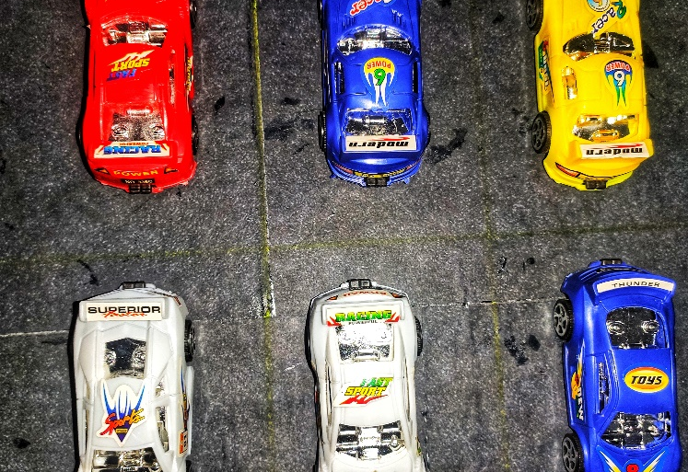
Implementation
6
5
4
1
2
3

Slide 13
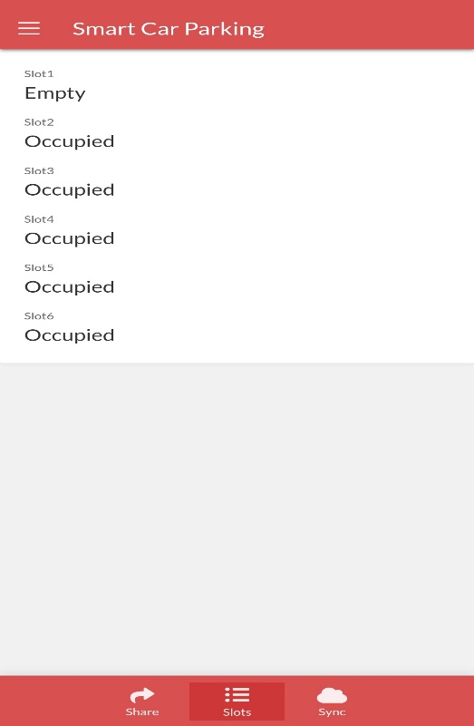
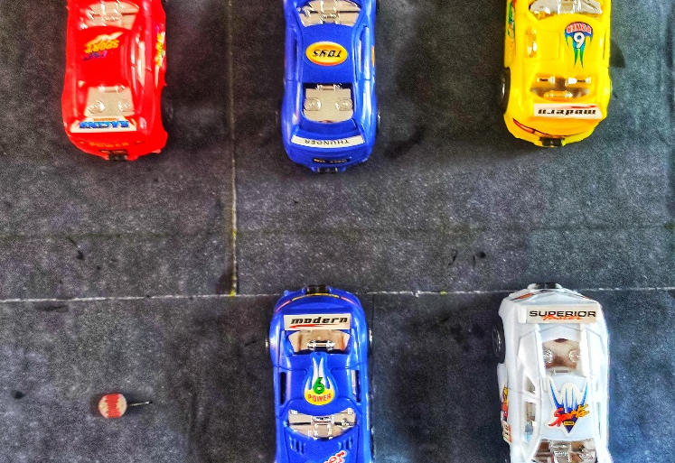
Implementation
5
4
6
1
2
3

Slide 14
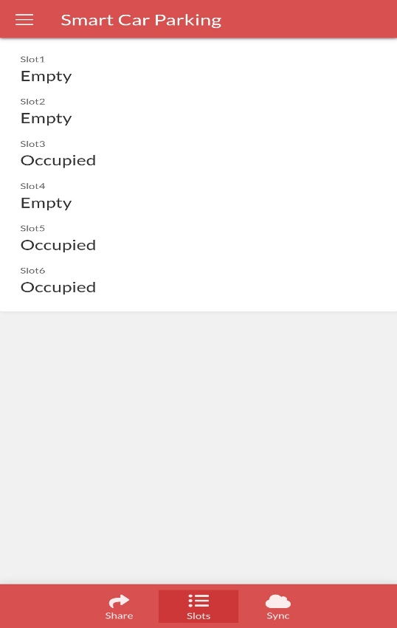
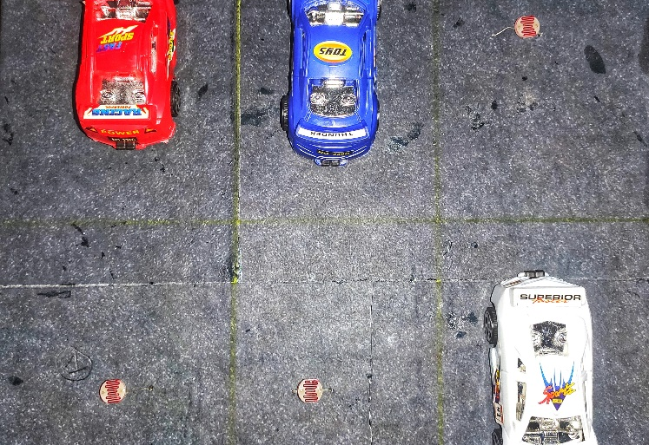
Implementation
6
5
4
1
2
3

Slide 15
Limitations

Slide 16
Limitations
We used light sensor to take analog data . System accuracy depends
on the intensity of light . In case of low light condition, the values may not be as expected introducing some error.
1
2
We developed the app for only android operating system,not for iOS, Windows and other operating system.
3
Updating Data is not instantaneous , there is a transition period of 5 s between a action and update.

Slide 17
Future implementation

Slide 18
Future Implementation
1
Adding weight sensors .
2
Include parking map to the software.
3
All the parking area are included in a single software.
4
Add the software to the automated driving .

Slide 19
Question & Answer

Slide 20
Thank you

