Slide 1
Mini program
bY xu han && shuhao xia

Slide 2
Technical stack
WXML and WXSS
MySQL database on Azure
.Net Core Web API on Azure

Slide 3

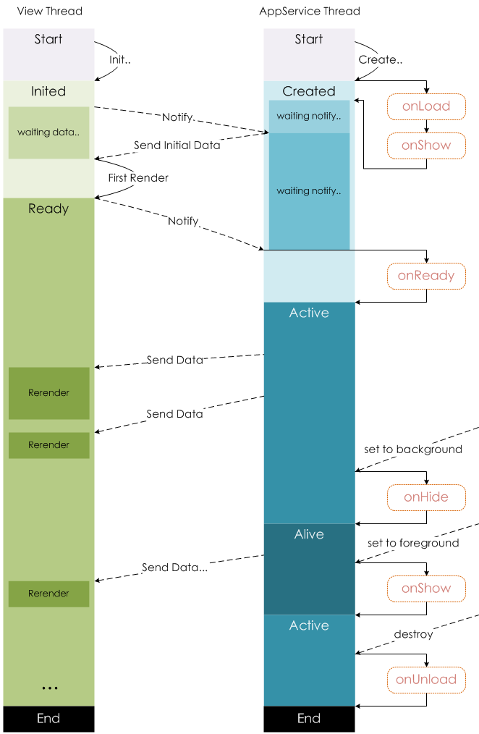
View layer with logic layer

Slide 4
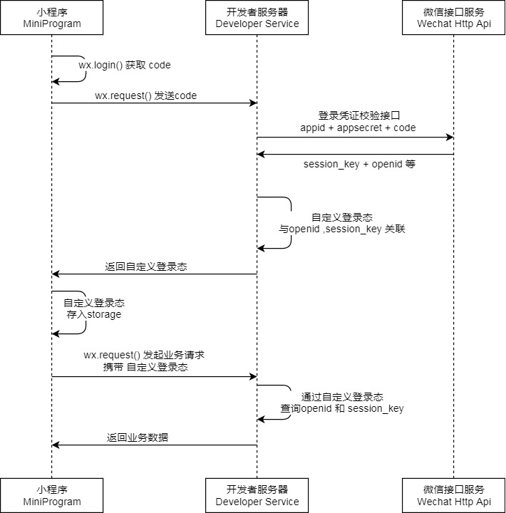
Get encrypted data flow

Slide 5
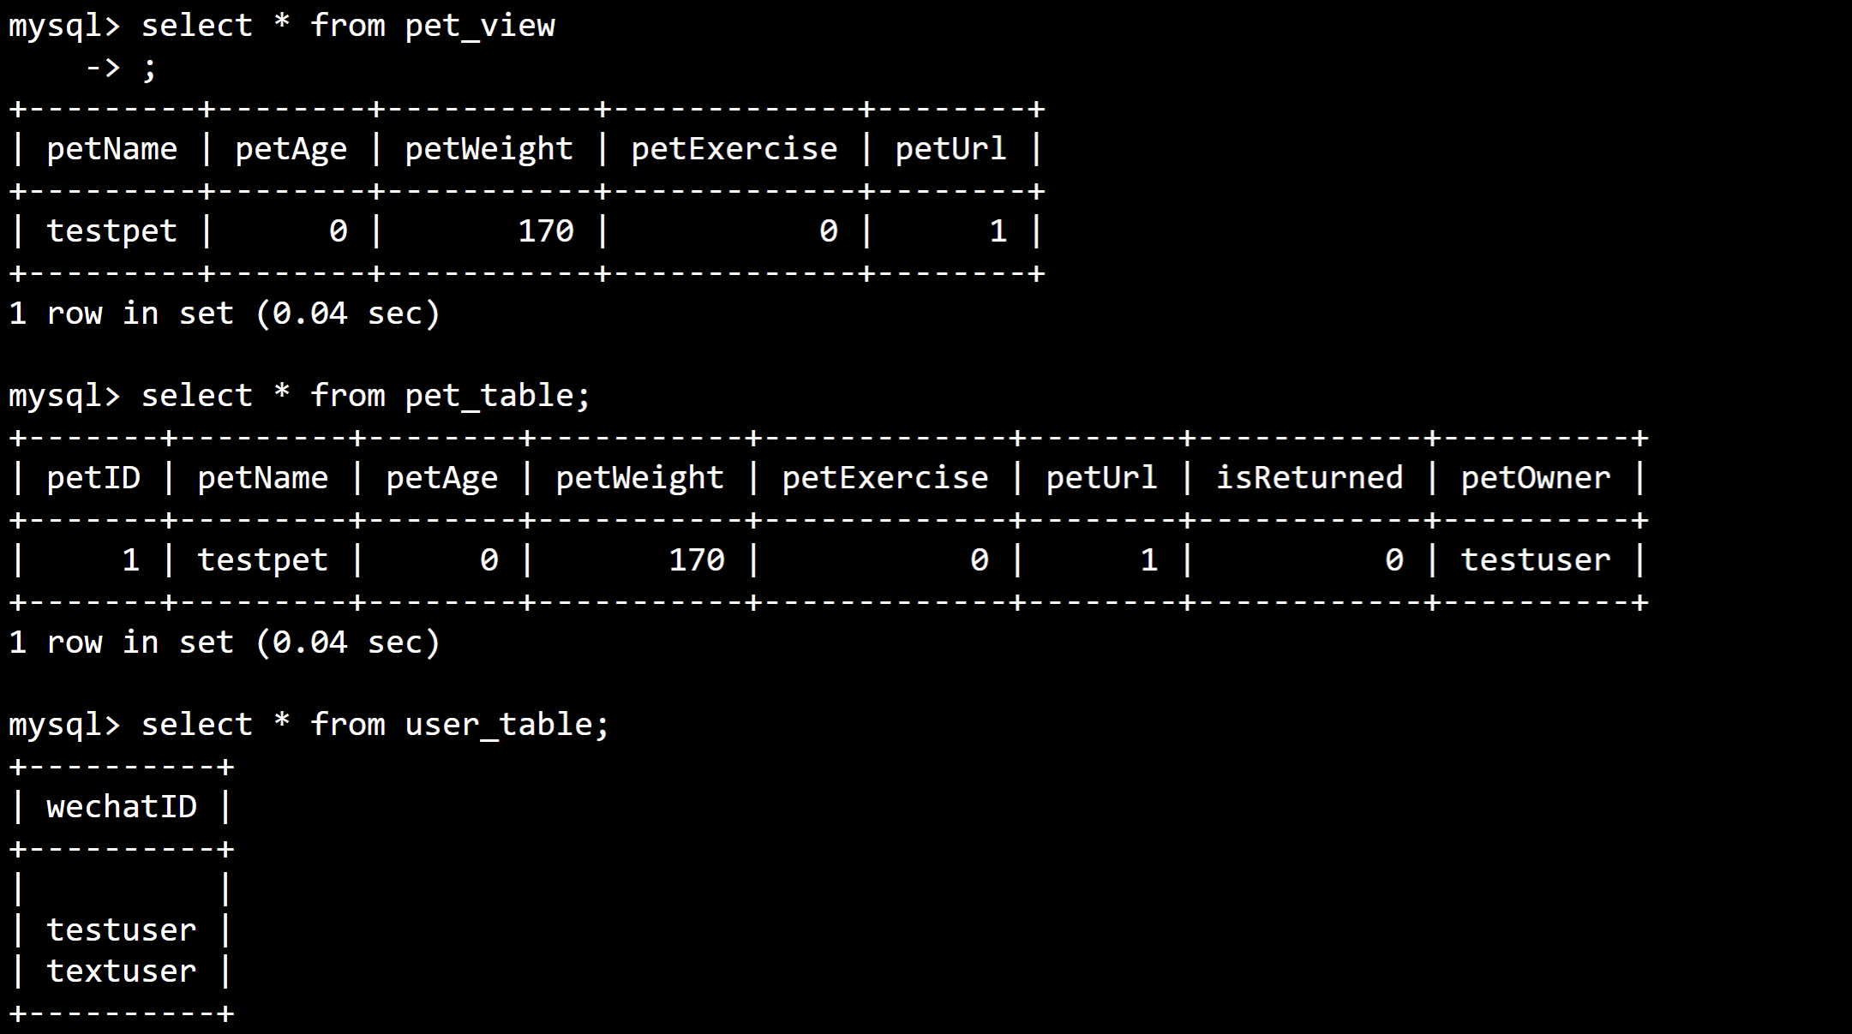
Databese structure

Slide 6
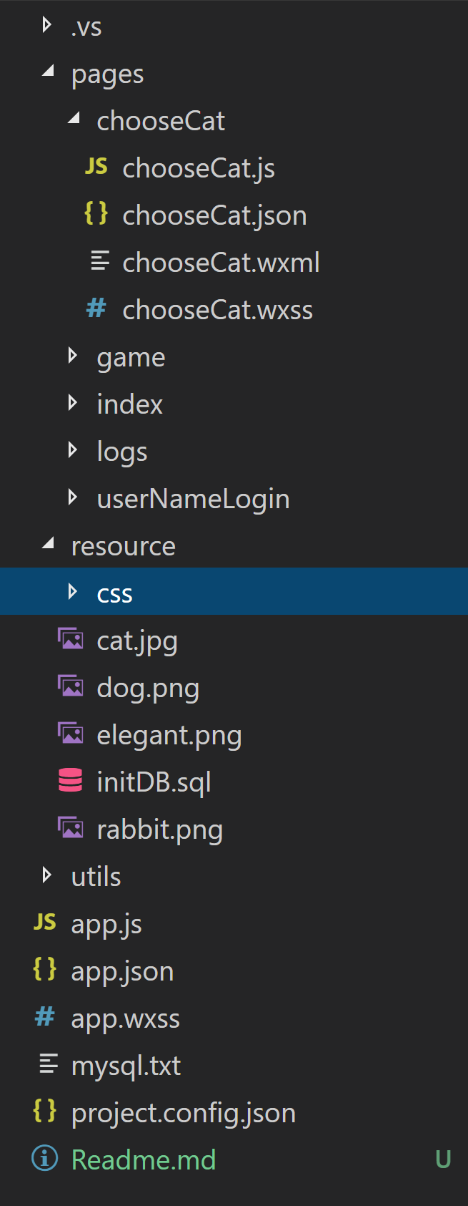
Index structre

Slide 7

Thanks you

