Slide 1
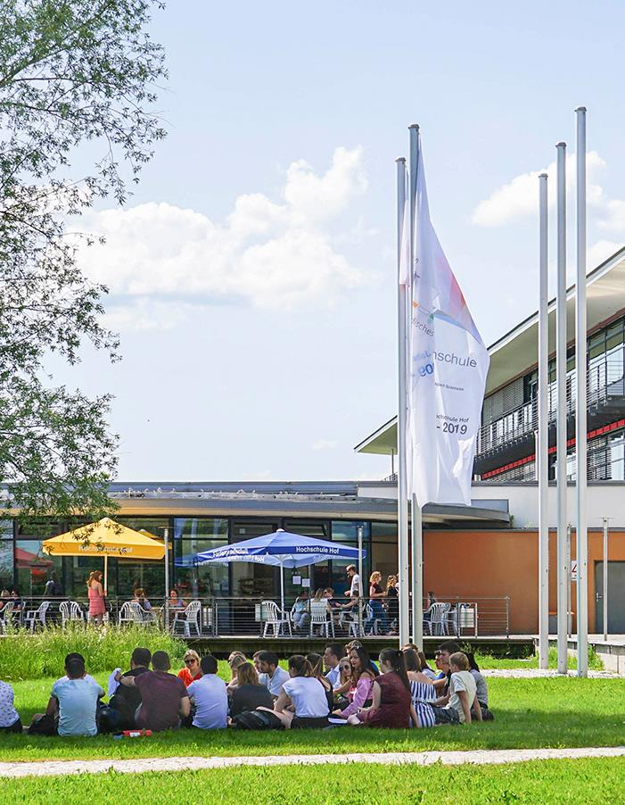
Vegetation Health Maps
via
DJI Pro Mini 4
Berkay Gök

Slide 2

Agenda
Overview | 3
System Architecture | 4
Project Structure | 5
Setup & Dependencies & Usage | 6
Model Details | 7
Outputs | 8
Validation & Results | 9
Contributors | 10
End | 11

Slide 3



Overview
This project implements a complete data processing pipeline for generating Vegetation Health Maps from drone video footage. It processes raw video and SRT metadata to calculate health indices (like VARI, ExG, TGI) using a Pixelwise Machine Learning Model (SGDClassifier).

Slide 4
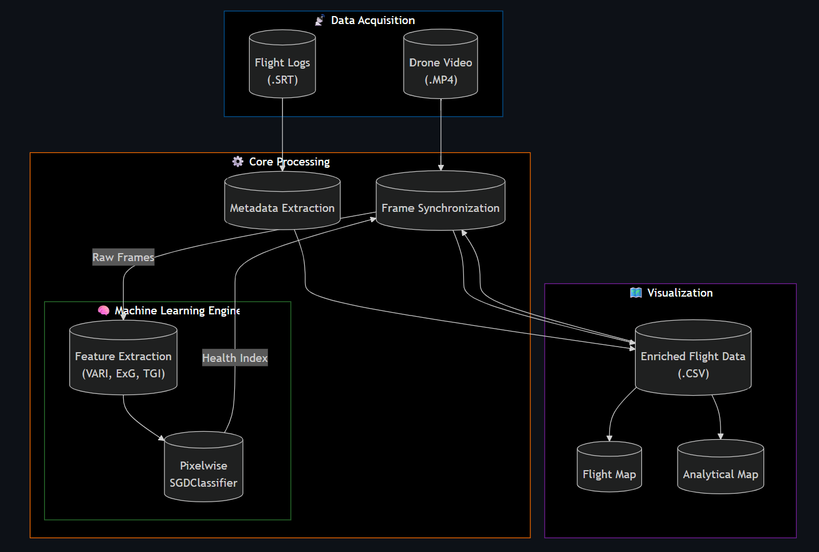
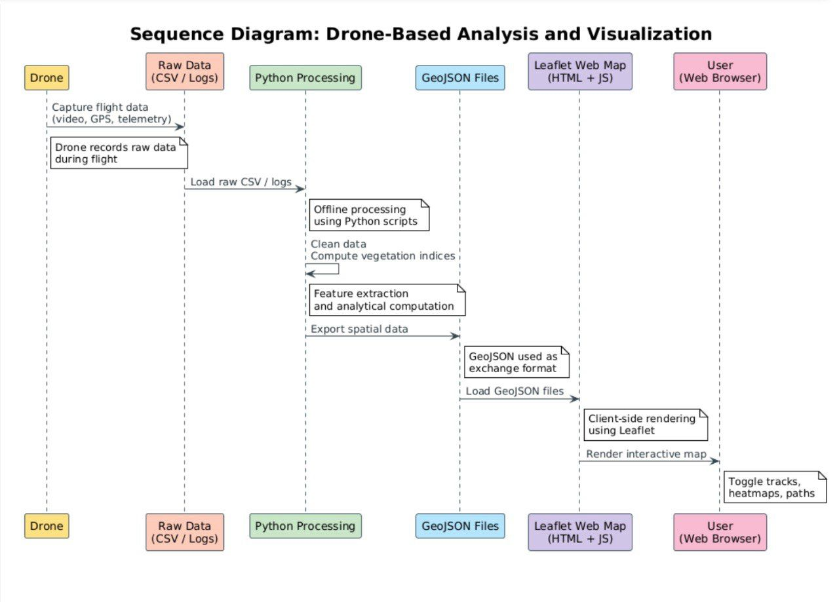
System Architecture

Slide 5

Project Structure
The workspace is organized modularly:
main.py
maps/
analytical_map
flight_map
datasets/
PlantVillage/
DatasetDrone/
Flights/
src/
ingestions/
models/
processing/
visualization/
data/
models/
processed/

Slide 6
Usage
You can run the entire pipeline or individual steps using main.py.
Run Full Pipeline To process all flight data found in datasets/flights/ and generate maps:
Individual Steps
Train Model (if needed) Trains the SGDClassifier using PlantVillage and Drone date
Extract Metadata Parses .srt files from datasets/flights/ into CSVs in data/processed/
Calculate Health (Sync) Applies the trained model to video frames,adding health indices
Generate Maps #Generates flight path map #Generates health heatmap
python main.py pipeline
Setup & Requirements
python main.py train
Environment: Ensure you are using the project's virtual environment.
Dependencies:
opencv-python
numpy
pandas
scikit-learn
joblib
folium
branca
matplotlib
python main.py extract
source venv/bin/activate
python main.py sync
python main.py map-flight
python main.py map-analytical

Slide 7

Model Details
Type: SGDClassifier (Stoachastic Gradient Descent)
Features: Pixel-level extraction of:
VARI (Visible Atmospherically Resistant Index)
ExG (Excess Green)
TGI (Triangular Greenness Index)
Training Data: Mixed dataset of PlantVillage (labeled leaves) and DatasetDrone (drıne frames with weak labeling)
*https://medium.com/@juanc.olamendy/sgdclassifier-the-powerhouse-for-large-scale-classification-9ae2369d57fb

Slide 8
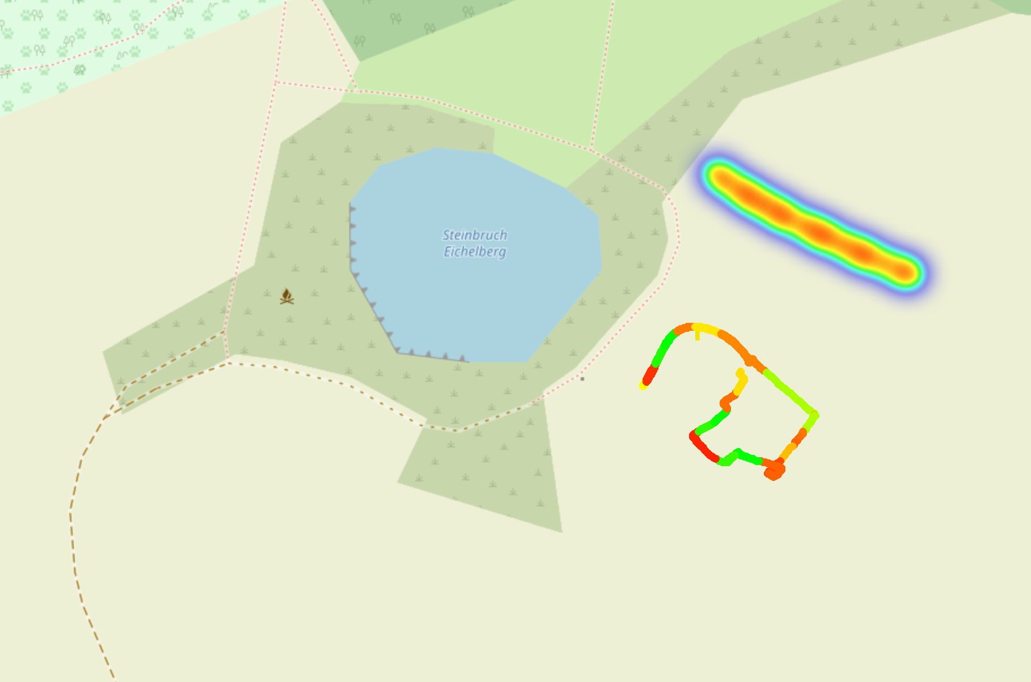
Outputs
After running the pipelinei find your maps in maps/:
maps/flight_map.html: Shows the drone’s path and altitude.
maps/analytical_map.html: Interactive Health Map containing
Global Heatmap: Interpolated view of vegetation health (Green=Healthy, Red=Unhealthy
Per-Track Layers: Toggleable layers for individual flights, showing heatmap, specific points, and flight paths.
Satellite Base: Esri World Imagery background.

Slide 9
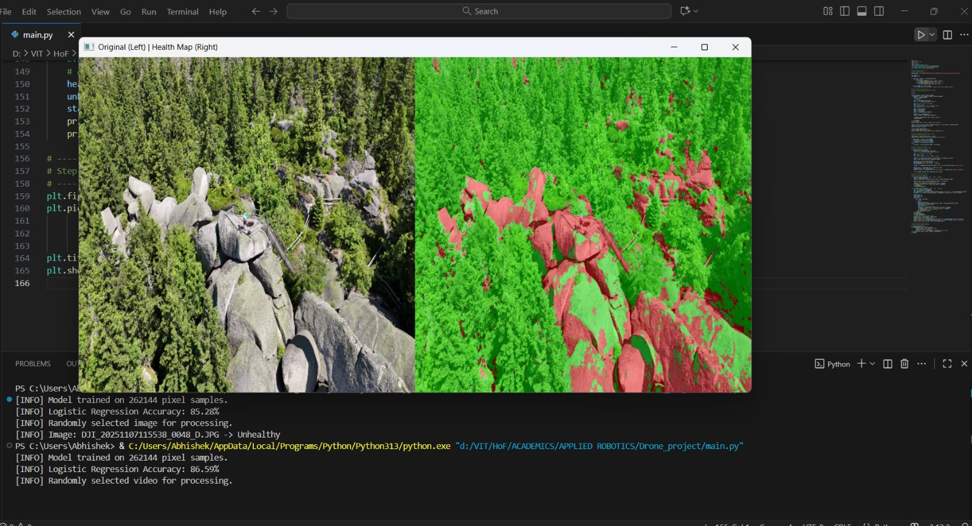
BILDSEITE
Validation & Results
Visual Proof (Segmentation) The model successfully differentiates between healthy vegetation (Green) and non-vegetation/stressed areas (Red/Black), specifically ignoring dirt paths.
Quantitative Accuracy
Evaluated on 6,200 unseen images (Test Set)
Figure: Left - Original Frame; Right - Health Mask Overlay.
Metric | Score | Note
Accuracy | 83.1% | Overall correct classification
Disease Recall | 94.0% | Ability to detect unhealthy plants
Note: Our model is designed as a pessimistic detector (High Recall for Unhealthy), prioritizing the detection of potential issues over minimizing false alarms.

Slide 10
Contributors
Member | Role | Key technical Contribution
Matheus | Lead & Integration | Pipeline Architecture, Sync Logic, Validation Scripts
Zihad | Mapping (Fronted) | Leaflet/Folium Visualization, UX/UI, Custom CSS
Berkay | Mapping (Backend) & Drone Usage Leader & General Debugger | IDW Interpolation Logic, Color Scale Algorithms
Yevhenii | Streaming | RTMP Architecture Design, Latency Profiling
Sultan | Hardware/Ops | Lab Testing, GPU Environment, Video Link Validation
Roma | QA/Testing | System Robustness Testing, Demo Recording
Abhishek | ML Optimization | SGDClassifier Hyperparameters, Model Explainability
Aditya | Data Engineering | Dataset Curation, Normalization Pipelines
Aseem | Analytics | Validation Metrics, Error Analysis

Slide 11
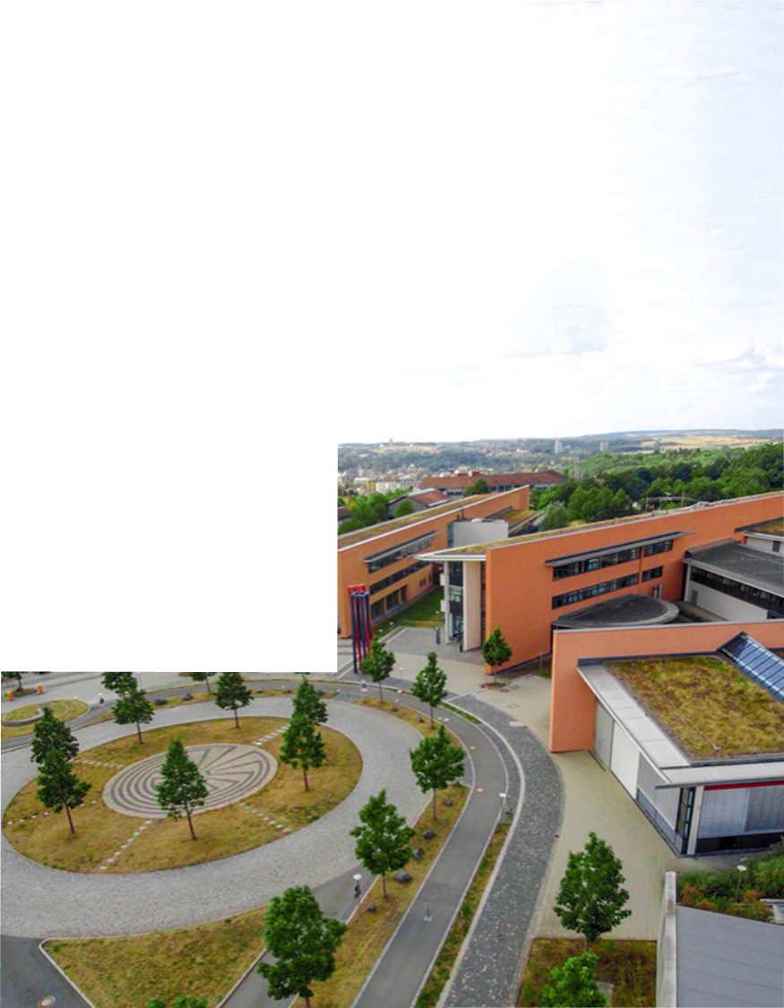
The End
95028 Hof
Alfons-Goppel-Platz 1 Phone +49 1522 399-0183
bgoek@hof-university.de www.hof-university.de

