Slide 1

Discovering and controlling A2Bot
Find the robot, connect to it, and drive it — start to finish.
Workshop session
·
<date>
A2BOT
Notes:
Goal for the session: everyone finds their robot, logs into it, sees its ROS 2 topics, and drives it. Ask who has used a terminal before.

Slide 2

www.centex-sarawak.my
YOUR MAIN REFERENCE
Everything is in the documentation
These slides walk you through the session. The documentation site is the reference you keep open — 23 pages covering the whole course, and every screen here points back into it.
mhd-01.github.io/A2Bot-Docs
↵
Where today's material lives
In any browser, on your laptop or your phone.
Part 0 — Discovering and Controlling A2Bot Toolkit — IP Addresses & Your Network Toolkit — SSH & Remote Access Part 3 — Setup 2, Laptop Part 3 — Bringup & Driving Appendices — Troubleshooting Index
→
When a slide says see the docs , it names the page. Stuck on anything not covered here, start at Appendices → Troubleshooting Index , which is organised by symptom.
Notes:
Say this plainly: the slides are a guided tour, the documentation is the source of truth. Everything here has a fuller page there, including troubleshooting. Ask them to open it now and keep it open all session.

Slide 3
www.centex-sarawak.my
TODAY
From an unopened laptop to a driving robot
1
2
3
4
5
6
Prepare your laptop
Get on the same network
SSH into the robot
Match ROS 2
Drive it
Exercise
A terminal on the Raspberry Pi.
Domain ID and DDS, then verify.
Keyboard teleop over /cmd_vel .
Drive it from the dashboard instead.
SSH client and Cyclone DDS.
By WiFi, or by Ethernet cable.
→
You are connected when ros2 topic list on your own laptop prints the robot's topics. You are finished when the robot moves.
Notes:
Read the arc once so nobody is lost mid-way. Step 2 is where the deck forks: WiFi or Ethernet. Everything after that is the same either way.

Slide 4
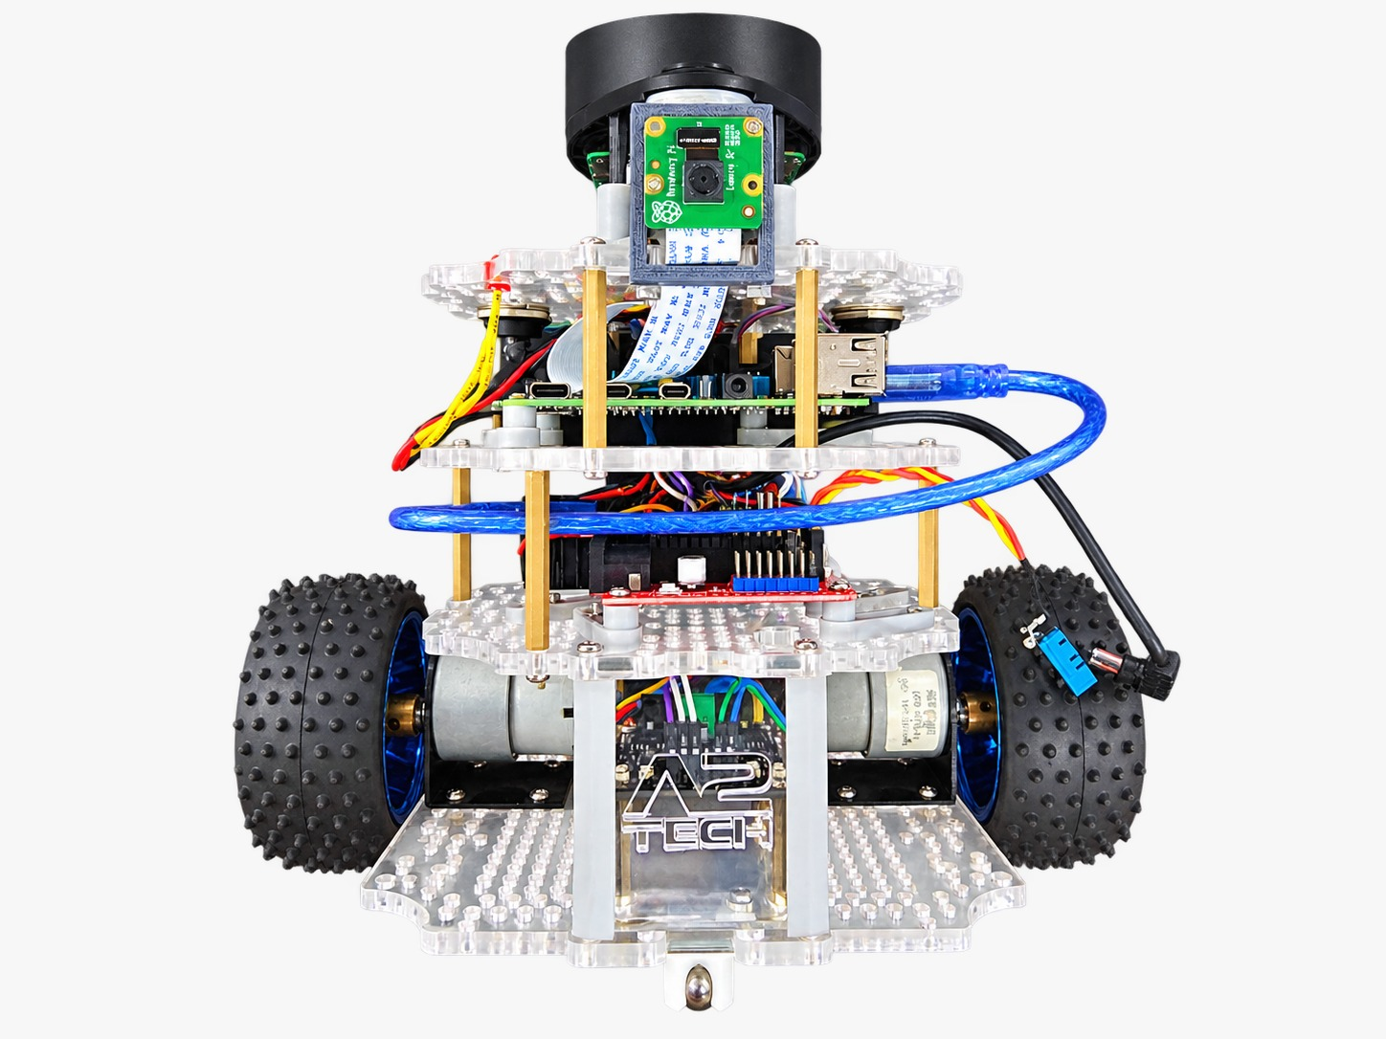
www.centex-sarawak.my
KNOW YOUR HARDWARE
The robot, part by part
1
Lidar
2
Raspberry Pi
Spins on top. Publishes
The brain. This is what you SSH into.
/scan
.
3
Arduino Nano
4
IMU
Drives the motors, reads the encoders.
Accelerometer and gyro, fused into the pose.
5
Motors and wheels
6
Battery
Two driven wheels — differential drive.
Powers everything. Check it before you start.
7
WiFi reset button
8
QR label
Hold it to force the setup hotspot back.
Holds the robot's IP and SSH password.
Notes:
Hold a robot up, or walk it around the bench. Name the WiFi reset button and the QR label out loud — both come back later. Recognition is enough for today; the electronics are Part 2.

Slide 5
www.centex-sarawak.my
NAMING
Every robot has a number
IDENTIFIER
PATTERN
IF YOU HAVE A2BOT5
Hostname
a2botX-host.local
a2bot5-host.local
SSH login
a2botX@a2botX-host
a2bot5@a2bot5-host
Setup hotspot
a2botX-setup
a2bot5-setup
Robot IP on its hotspot
10.42.0.X
10.42.0.5
Robot IP over Ethernet
10.0.0.10X
10.0.0.105
Your laptop over Ethernet
10.0.0.250
10.0.0.250
ROS_DOMAIN_ID
X
5
Docs
Part 0 — Discovering and Controlling A2Bot · Toolkit — IP Addresses & Your Network
Notes:
This is the slide to photograph. One number sets all seven values. A mismatch — A2Bot5's hotspot with domain ID 3 — is the most common lost-time bug in the room. Keep the domain ID between 0 and 101; above that collides with ephemeral ports.

Slide 6
www.centex-sarawak.my
READ THE BADGES
Two machines, two terminals
Every command today runs on one of two computers. The badge above each block tells you which.
Your device
A2Bot — Raspberry Pi
Your Ubuntu laptop
The robot's Raspberry Pi
Where you write code, run RViz2 and Gazebo, and drive the robot. Its prompt looks like <you>@<laptop>:~$.
Reached over SSH. Runs the drivers, the lidar and the dashboard in the background. Its prompt looks like a2botX@a2botX-host:~$.
Notes:
Every command block from here carries one of these two badges. When a command fails, the first question is always: which machine did you type it on? Purple is your Ubuntu laptop, black is the robot.

Slide 7
www.centex-sarawak.my
STEP 1 · PREPARE YOUR LAPTOP
Install the SSH client
SSH gives you a terminal on the robot. You need the client; the robot already runs the server.
Your device
Already installed? This prints a version.
$ ssh -V
Your device
Only if that printed nothing
$ sudo apt update
$ sudo apt install openssh-client
Docs
Toolkit — SSH & Remote Access
Notes:
Most Ubuntu installs already carry the SSH client — the check prints a version. Nobody installs openssh-server today; the robot already runs the server side. Do this before anything else.

Slide 8
www.centex-sarawak.my
STEP 1 · PREPARE YOUR LAPTOP
Install Cyclone DDS
Both machines must use the same DDS implementation to find each other, and the robots already use Cyclone.
Your device
Install it, make it active permanently, then check
$ sudo apt install ros-humble-rmw-cyclonedds-cpp
$ echo "export RMW_IMPLEMENTATION=rmw_cyclonedds_cpp" >> ~/.bashrc
$ source ~/.bashrc
$ ros2 pkg list | grep cyclonedds # should print the package
!
A mismatched DDS is a silent failure — no error, just an empty topic list. If topics never appear later, come back here first.
Docs
Part 3 — Setup 2, Laptop · step 2
Notes:
Why it matters: ROS 2 can run on several DDS implementations, and two machines must use the same one to discover each other. The robots are already on Cyclone. A mismatch is a silent failure with no error message — topics simply never appear. Both exports go in .bashrc so every new terminal inherits them.

Slide 9
www.centex-sarawak.my
STEP 2 · GET ON THE SAME NETWORK
Two ways to reach the robot
ROS 2 only works when both machines are on the same network. Pick a route — everything after this point is identical either way.
A
Over WiFi
B
Over an Ethernet cable
Join the robot's own hotspot, open its dashboard, and use the dashboard to move the robot onto a real network — then join your laptop to that same network.
Plug a cable straight between laptop and robot, and give both ends a fixed address on the same private network. No router, no WiFi involved.
Nothing to configure on your laptop. Depends on the WiFi behaving.
Ten minutes to set up once, then the most reliable option there is.
Notes:
This is the fork. Explain the trade-off honestly: WiFi is what you will use day to day and needs no configuration on the laptop; Ethernet takes ten minutes to set up once and then never fails. If the room's WiFi is unreliable, send everyone down route B.

Slide 10

www.centex-sarawak.my
A
ROUTE A · FIRST
Join the robot's own WiFi
With no known network around, the robot broadcasts its own. Open the WiFi menu on your laptop the way you always do — top-right corner of the Ubuntu desktop — and pick it from the list.
WI-FI NETWORKS
a2botX-setup
connect
CENTEXS-Lab
The password follows the robot's name — usually a2botXXX . It is also on the QR label, or ask the instructor. No terminal needed here.
<your phone>
Guest-WiFi
→
A phone works just as well for this step and the dashboard — join the hotspot and open the page in the phone's browser.
Your WiFi menu, with the robot's network showing up like any other.
!
Not in the list? The robot still remembers another network — hold the WiFi reset button until the LED blinks.
Notes:
No terminal here — this is the ordinary WiFi menu. If a2botX-setup is missing, the robot is already on a network it remembers from a previous session: press and HOLD the WiFi reset button about five seconds, until the LED blinks, to clear saved networks and force hotspot mode. Password is on the robot's QR label or from me.

Slide 11
www.centex-sarawak.my
THE DASHBOARD
One robot, two web pages
The robot serves two different pages on two different ports. Same address, different number after the colon.
:8888
:7777
Connection page
Control panel
Shows the robot's current network and carries the Connect to WiFi form. This is the one you use to get the robot onto a network, and it shows the SSH command afterwards.
A web interface that drives the robot from the browser — no terminal involved. This is what you use in the exercise at the end of the session.
http://<robot-ip>:8888
http://<robot-ip>:7777
→
The robot's address depends on how you reached it: 10.42.0.X on its own hotspot, 10.0.0.10X over Ethernet, or a DHCP address on real WiFi.
Notes:
Two pages on two ports, on the same robot. 8888 is the connection page you use to get the robot online. 7777 is the control panel you will use in the exercise at the end. Same IP, different port — whatever address the robot currently has.

Slide 12



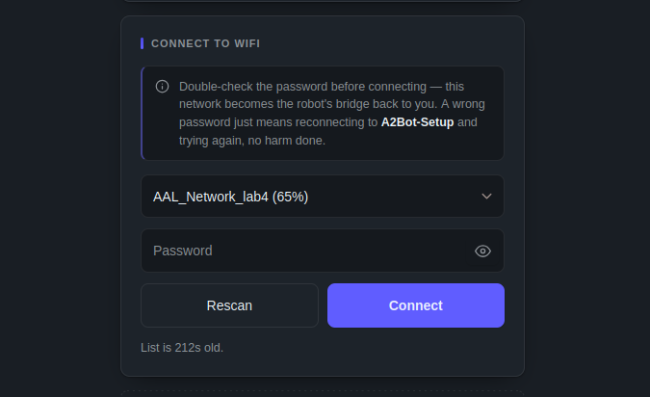

www.centex-sarawak.my
A
ROUTE A · THEN
Open the connection page
Type the address in Firefox or Chrome, or scan the QR label on the robot. Both reach the same page.
Firefox
Chrome
Your device
In the browser address bar
http://10.42.0.X:8888
!
The page loads only while a2botX-setup is your device's only connection. Turn mobile data off and unplug other networks first.
Notes:
Over the hotspot the dashboard only loads while a2botX-setup is the device's ONLY active connection — mobile data off. That trips up most of the room. Scanning the QR label reaches the same page.

Slide 13

www.centex-sarawak.my
A
ROUTE A · FINALLY
Move the robot onto a real network
Use the Connect to WiFi form to join the robot to your phone's hotspot or the lab network — then join your laptop to that same network.
1 Turn the network on
Your phone's hotspot, or the lab WiFi.
!
The page will likely fail after you submit. That is expected — the robot just left the hotspot your browser was using to talk to it.
2 Pick it in the form and submit
Type the password exactly as it is.
3 Not listed? Press rescan
You will lose the page — rejoin a2botX-setup and reopen it.
→
On iPhone this may come up: the phone may not hold your personal hotspot and a2botX-setup at once. If so, run the hotspot on the phone and do the dashboard from your laptop.
4 Join your laptop to it too
Both machines on one network is the whole point.
Notes:
Two warnings. If your network is not listed, press rescan — the robot drops its own hotspot to scan, so you lose the page and rejoin afterwards. And the connect request appears to FAIL with a network error: that is the expected shape of success, the robot switched networks out from under the request. Then join your own laptop to that same network.

Slide 14

www.centex-sarawak.my
B
ROUTE B · THE PLAN
A private network over one cable
No router hands out addresses on a direct cable — set both ends yourself, on the same 10.0.0.0/24 network.
A2Bot — Raspberry Pi
Your device
10.0.0.10X
10.0.0.250
100 plus the robot's own number, matching its hostname and domain ID. A2Bot5 takes 10.0.0.105.
A fixed address reserved for laptops, chosen to sit outside the .100–.201 range robot numbers occupy, so it never collides.
!
Do not set a gateway here — it makes the Pi route internet traffic down a dead-end cable.
Docs
Toolkit — IP Addresses & Your Network · Direct Ethernet link
Notes:
A direct cable has no DHCP, so nothing hands out addresses — you set both ends by hand. Both must be on the same /24: first three numbers identical, last number different. Do not set a gateway on this link, or the Pi tries to route internet traffic down a dead-end cable.

Slide 15
www.centex-sarawak.my
B
ROUTE B · STEP 1
Find your Ethernet port's name
Linux names network ports by hardware, not by a fixed eth0 . You want a name starting with en — never wl , which is the WiFi radio.
Your device
Look for the row where TYPE is ethernet
$ nmcli device status
→
Before the cable is in, that row reads unavailable. Plug both ends in and run it again — it flips to connecting or disconnected. That is your interface.
!
Two ethernet rows, from a built-in port plus a USB dongle? Unplug, re-run, plug back in — whichever row changes is yours.
Notes:
Linux no longer names ports eth0/wlan0 — you want an en* name, never wl*. Before the cable is in, the ethernet row shows unavailable; plug both ends in and it flips to connecting or disconnected. If two ethernet rows appear, unplug, re-run, plug back in and compare which row changes.

Slide 16
www.centex-sarawak.my
B
ROUTE B · STEP 2
Give each end its address
Your device
Do not paste as-is — replace the highlighted name
$ sudo nmcli connection add type ethernet con-name robot-link ifname <the en… name from the last slide> \
ipv4.method manual ipv4.addresses 10.0.0.250/24 connection.autoconnect yes
$ sudo nmcli connection up robot-link
A2Bot — Raspberry Pi
Already done on classroom robots — this is what is on the other end
$ sudo nmcli connection add type ethernet con-name eth0-static ifname eth0 \
ipv4.method manual ipv4.addresses 10.0.0.10X/24 connection.autoconnect yes
$ sudo nmcli connection up eth0-static
!
After ifname goes your own en… name from the last slide — pasted unchanged this fails. con-name robot-link is only a label; leave it. Then test with ping 10.0.0.10X.
Notes:
Robots in the classroom already have the Pi side done — show it so they know what is on the other end. Substitute the interface name from the previous slide. If the laptop uses its Ethernet port on other networks, set autoconnect no so this profile does not grab the interface elsewhere.

Slide 17

www.centex-sarawak.my
STEP 3 · GET A TERMINAL ON THE ROBOT
SSH into the Raspberry Pi
Your device
Password from the dashboard or QR label
A2Bot — Raspberry Pi
First time only — this is normal
$ ssh a2botX@a2botX-host.local
The authenticity of host 'a2bot5-host.local
(10.42.0.5)' can't be established.
ED25519 key fingerprint is SHA256:....
Are you sure you want to continue
connecting (yes/no/[fingerprint])? yes
Your device
If the .local name will not resolve, use the IP
$ ssh a2botX@10.0.0.10X
→
Not an error. SSH has no record of this robot yet and is asking you to confirm it is the right machine. Type yes — the full word — and press Enter. You will not be asked again for that robot.
!
Password rejected? Check the username first — a wrong robot number is far more common than a wrong password.
Docs
Toolkit — SSH & Remote Access
Notes:
First connection asks about host authenticity — that is not an error, it is SSH telling you it has no record of this machine yet. Type the full word yes, not y. After that it remembers. Password comes from the dashboard's post-connect panel or the QR label; if the password is rejected, re-check the username first — wrong robot number is the usual cause.

Slide 18
www.centex-sarawak.my
WORTH KNOWING
Ask the robot for its own address
On a phone hotspot or the lab WiFi the address is handed out by the network, not fixed. Ask the robot directly.
A2Bot — Raspberry Pi
Run this on the robot — prints every address it holds
a2botX@a2botX-host:~$ hostname -I
10.42.0.5 192.168.43.117
→
Write it down — that address plus a port is your way back in to the dashboard.
Notes:
hostname -I runs ON THE ROBOT and prints every address it currently holds. On a phone hotspot or classroom WiFi the address is DHCP-assigned, not the fixed patterns from the table — so this is how you find the real one. Note it down; you need it for the dashboard and for the exercise.

Slide 19
www.centex-sarawak.my
STEP 4 · MATCH ROS 2
Set your ROS domain
Two machines can ping and SSH each other perfectly and still see none of each other's topics. The domain ID is what decides which ROS 2 processes are willing to find each other.
Your device
Substitute your robot's number for X
$ echo "export ROS_DOMAIN_ID=X" >> ~/.bashrc
$ source ~/.bashrc
$ echo $ROS_DOMAIN_ID $RMW_IMPLEMENTATION # both should print
→
Not sure of the number? Over SSH on the robot, echo $ROS_DOMAIN_ID tells you exactly what it is using.
Docs
Part 3 — Setup 2, Laptop · step 4 · Toolkit — ~/.bashrc
Notes:
ROS_DOMAIN_ID is not a networking concept — two machines can ping and SSH each other fine and still see none of each other's topics if this number does not match. You already set RMW_IMPLEMENTATION in step 1; this adds the domain. Substitute the real number for X.

Slide 20

www.centex-sarawak.my
PROOF
Check that it actually works
You should see the robot's real topics — /odom, /scan, /joint_states — not an empty list.
Your device
The checks that prove the whole chain
$ ros2 node list
$ ros2 topic list
$ ros2 topic hz /odom # is data really flowing?
!
A service reporting active (running) does not mean it is working — its ROS nodes can fail silently and publish nothing. Test the graph, not the process.
Docs
Appendices — Troubleshooting Index · Toolkit — systemd & Services
Notes:
Key teaching point: systemctl showing active only proves the process started, not that its ROS nodes initialised — a service can be active and publishing nothing. Always cross-check functionally: node list, topic list, topic hz. check_services.py in the repo runs both and reports 'running but not functional' when they disagree.

Slide 21
www.centex-sarawak.my
STEP 5 · THE PAYOFF
Drive it from the keyboard
With the robot's topics visible, the stock ROS 2 teleop node drives it by publishing /cmd_vel . Nothing about this is A2Bot-specific.
Your device
Run this from your laptop, not the robot
$ ros2 run teleop_twist_keyboard teleop_twist_keyboard
!
Keep that terminal focused — click into it and leave it there, or the keys go nowhere. Follow its on-screen key legend, and start slow with space around the robot.
Docs
Part 3 — Bringup & Driving · for smoother, acceleration-limited driving
Notes:
This is the payoff. teleop_twist_keyboard is stock ROS 2 — nothing A2Bot-specific about it; it just publishes /cmd_vel. The terminal must stay FOCUSED or the keys go nowhere. Start slow, put the robot on the floor with space around it, and be ready to release the keys.

Slide 22

www.centex-sarawak.my
EXERCISE · YOUR TURN
Drive it from the browser instead
Same robot, no terminal. Get to the robot's web control panel and drive it from there.
1 Find your robot's current IP address
Not the one from the table — the one it holds right now.
You already have what you need
Two earlier slides carry the answer — the one about the robot's two web pages , and the one about asking the robot for its own address.
2 Open the control panel in your browser
Same address, the other port.
3 Drive the robot with the on-screen controls
Your laptop and the robot must still be on the same network.
Then explain what the page is publishing to make it move.
→
Finished early? Compare what the browser sends with what the keyboard teleop sends — ros2 topic echo /cmd_vel while you drive.
Notes:
Hand this over and stop talking. They have everything they need: hostname -I for the address, and the port. Deliberately not telling them the port number or the command — that is the exercise. Walk the room. Anyone stuck goes to the slides on ports and on hostname -I.

Slide 23

www.centex-sarawak.my
TROUBLESHOOTING
If the robot is not responding
No topics, a dead dashboard, or teleop doing nothing — start on the robot and ask what is running.
A2Bot — Raspberry Pi
First — what is actually up?
a2botX@a2botX-host:~$ services_report
A2Bot — Raspberry Pi
Then — restart all four together
$ sudo systemctl restart a2bot-robot.service a2bot-rosbridge.service \
a2bot-webui.service a2bot-dashboard.service
!
Restart all four, not just the broken one — they depend on each other. Wait ~15s, then re-run the report.
Docs
Appendices — Troubleshooting Index
Notes:
Give them this before they need it. services_report is the one command that tells you what is actually up — it checks the ROS graph functionally, not just whether systemd says active. If a service is down or 'running but not functional', restart all four together; they depend on each other, so restarting one alone often does not help. Give it fifteen seconds and re-run the report.

Slide 24

www.centex-sarawak.my
CHECKLIST
Before the next session
You know your robot number
X
— and that every address follows from it.
ROS_DOMAIN_ID
and
RMW_IMPLEMENTATION
are in your
~/.bashrc
.
You can reach the Pi in one command:
ssh a2botX@a2botX-host.local
.
ros2 topic list
on your own laptop is not empty.
You have driven the robot — once from the keyboard, once from the browser.
Everything here, in more detail: mhd-01.github.io/A2Bot-Docs
Notes:
Close here. Anyone whose topic list is still empty stays five minutes. The next session starts inside a workspace, so the environment has to already work. Point at the docs once more.

