Slide 1

Peak Calling with MACS2

Slide 2
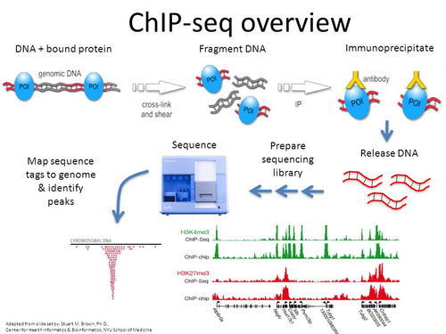
Chip-seq
Chip-seq is used to study the interactions between DNA and proteins
Captures DNA targets for transcription factors or histone modifications across the entire genome of any organism
Defines transcription factor binding sites

Slide 3
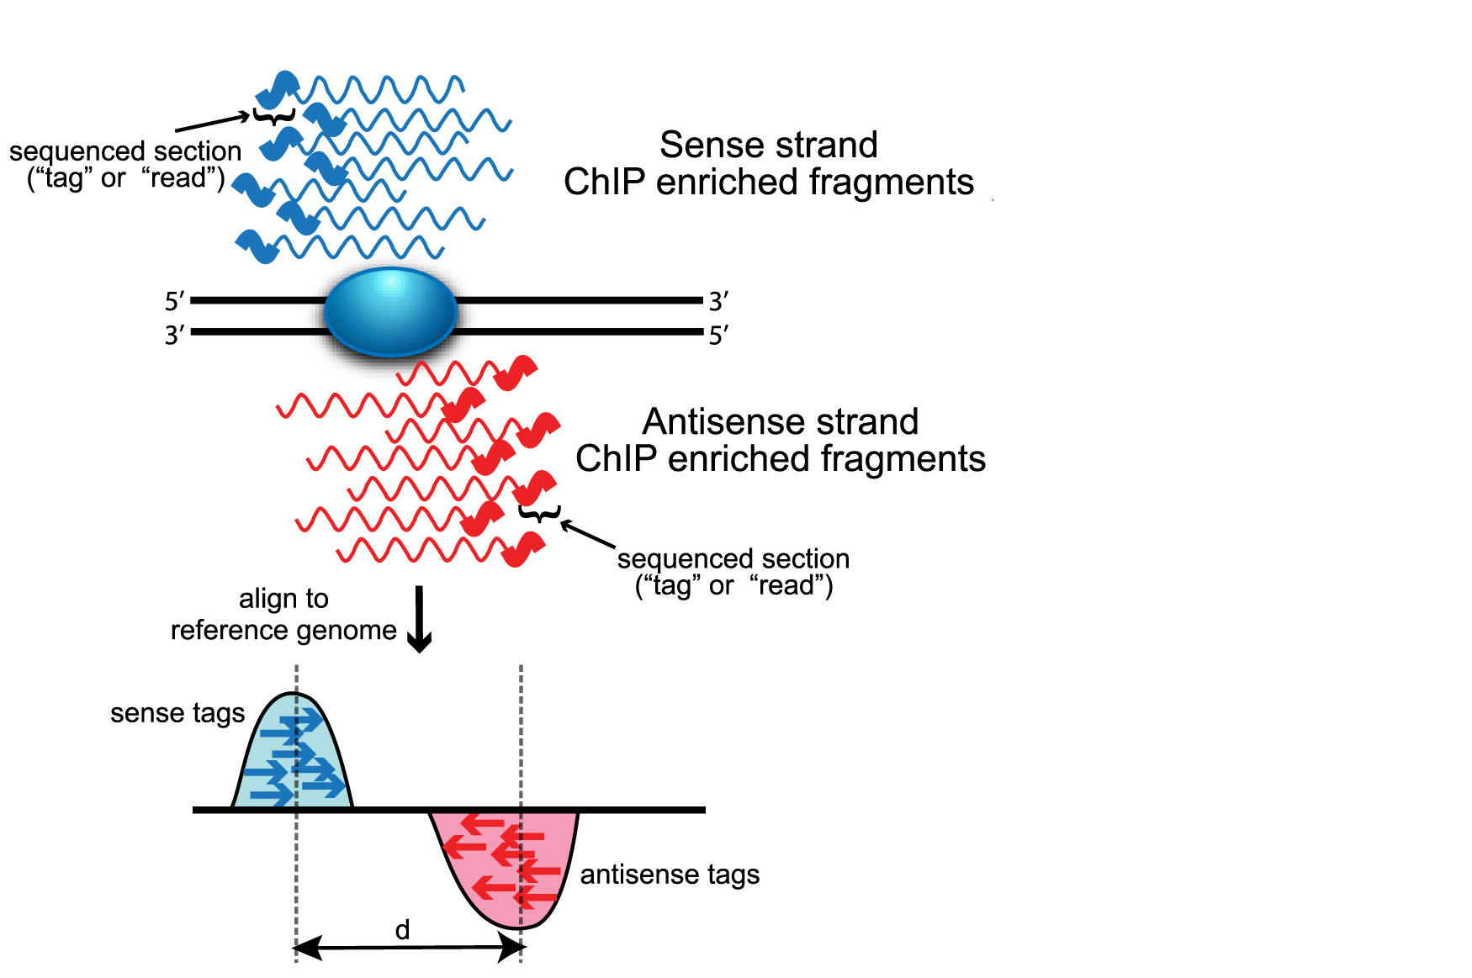
Peak calling

Slide 4
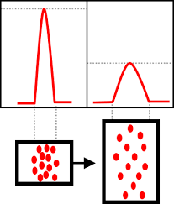
Broad peaks & Narrow peaks

Slide 5
What is MACS2?
it is a non-interactive command line tool that can also be applied to any "DNA enrichment assays"
When available, data from input control experiments are used by most peak callers to represent the background levels of signal but control data is optional

Slide 6
MACS2
Basic syntax is as follows:
macs2 {callpeak,bdgpeakcall,bdgbroadcall,bdgcmp,bdgopt,cmbreps,bdgdiff,filterdup,predictd,pileup,randsample,refinepeak}

Slide 7
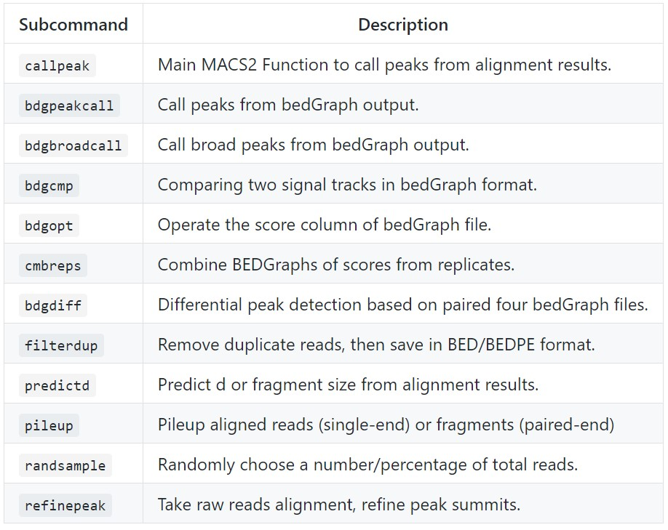
Subcommands

Slide 8
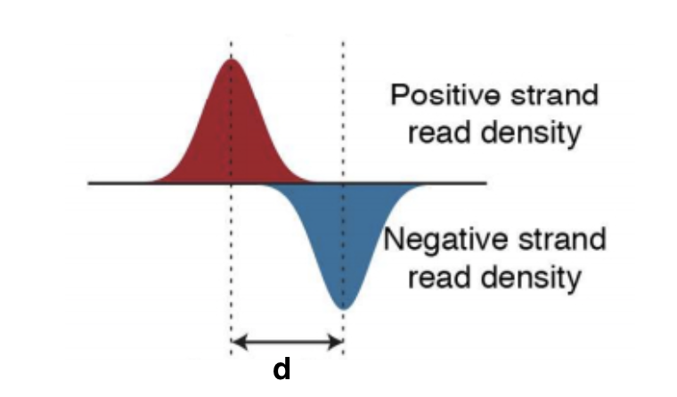
Modeling the shift size

Slide 9
Linear Scaling
Macs linearly scales library size For experiments in which sequence depth differs between input and treatment samples.

Slide 10
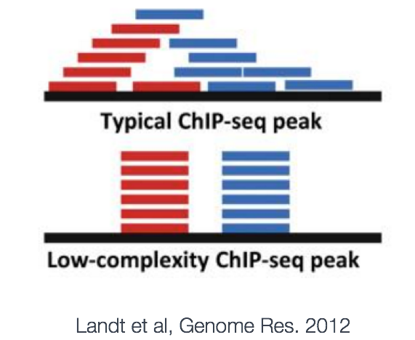
Duplicates Removal

Slide 11
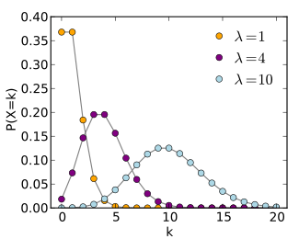
Peak detection
λlocal = max(λBG, [λ1k,] λ5k, λ10k).

Slide 12

NOW LET’S TRY IT!

Slide 13
-t/--treatment FILENAME
This is the only REQUIRED parameter for MACS. The file can be in any supported format specified by --format option. If you have more than one alignment file, you can specify them as -t A B C. MACS will pool up all these files together.

Slide 14
-c/--control
The control or mock data file, same rules must be followed as the –t option

Slide 15
-n/--name
The name string of the experiment. MACS will use this string NAME to create output files like NAME_negative_peaks.xls, NAME_peaks.bed , NAME_summits.bed, NAME_model.r

Slide 16
--outdir
MACS2 will save all output files into the specified folder for this option.

Slide 17
-f/--format FORMAT
Format of reads file can be ELAND, BED, ELANDMULTI, ELANDEXPORT, ELANDMULTIPET (for pair-end tags), SAM, BAM, BOWTIE, BAMPE or BEDPE.

Slide 18
-g/--gsize
It's the mappable genome size or effective genome size which is defined as the genome size which can be sequenced. The default ‘hs’ is a shortcut for human (2.7e9)is recommended for human genome.

Slide 19
-s/--tsize
The size of sequencing reads. If you don't specify it, MACS will try to use the first 10 sequences from your input treatment file to determine the read size. Specifying it will override the automatically determined read size.

Slide 20
-q/--qvalue
The q-value cutoff to call significant regions. Default is 0.05.

Slide 21
-p/--pvalue
The p-value cutoff. If -p is specified, MACS2 will use p-value instead of q-value.

Slide 22
--min-length, --max-gap
specifying the minimum length of a called peak and the maximum allowed a gap between two nearby regions to be merged

Slide 23
NAME_peaks.xls
a tabular file which contains information about called peaks
- chromosome name
- start position of peak
- end position of peak
- length of peak region
- absolute peak summit position
- pileup height at peak summit
….

Slide 24
NAME_peaks.narrowPeak
is BED6+4 same as a BED file but with extra 4 columns

Slide 25
NAME_summits.bed
is in BED format, which contains the peak summits locations for every peak

Slide 26
NAME_model.r
` is an R script which you can use to produce a PDF image of the model based on your data

Slide 27

Thank you For your Attention

