Slide 1
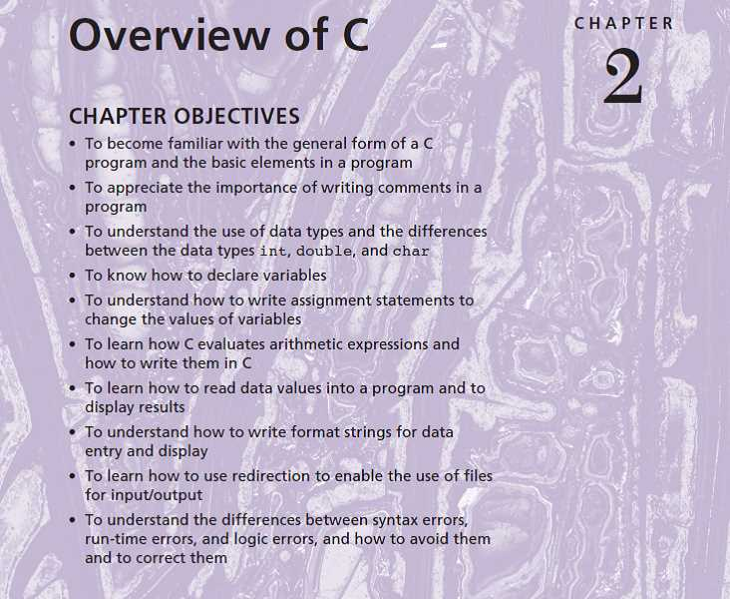

Slide 2
This chapter introduces C, a high-level programming language developed in 1972 by Dennis Ritchie at AT&T Bell Laboratories. Because C was designed as a language in which to write the UNIX® operating system, it was originally used primarily for systems programming. Over the years, however, the power and flexibility of C, together with the availability of high-quality C compilers for computers of all sizes, have made it a popular language in industry for a wide variety of applications.
This chapter describes the elements of a C program and the types of data that can be processed by C. It also describes C statements for performing computations, for entering data, and for displaying results.

Slide 3
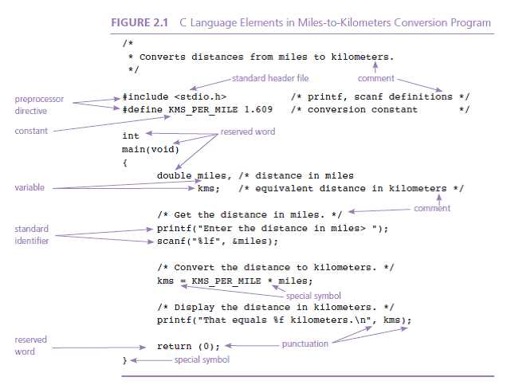
Preprocessor directives
Main function

Slide 4
Variable Declarations
Variables: values stored in variables can changes
Variables Declarations:
What kind of information will be stored in each variable
How that information will be represented in memory
SYNTAX:
int variable_list;
double variable_list;
char variable_list;
EXAMPLES:
int count,large;
double x, y, z;
char first_initial;
char ans;

Slide 5
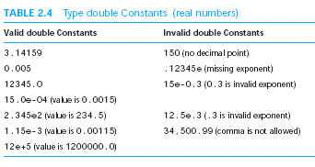
Data Types
int
Range : -32767 ~ + 32767 --- in ANSI C
-10500 435 +15 -25 32767
double
char
‘A’ ‘a’ ‘z’ ‘2’ ‘9’ ‘*’ ‘?’

Slide 6
Executable Statements
Program in Memory
Assignment Statements
Input/Output Operations and Functions

Slide 7
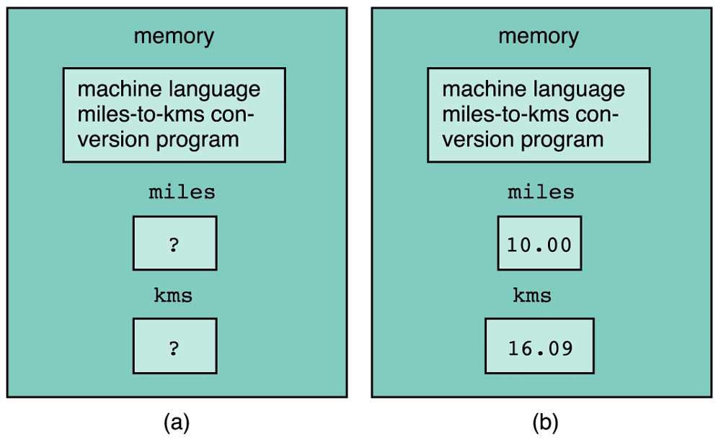
Assignment Statements
Memory(a) Before and (b) After Execution of a Program

Slide 8
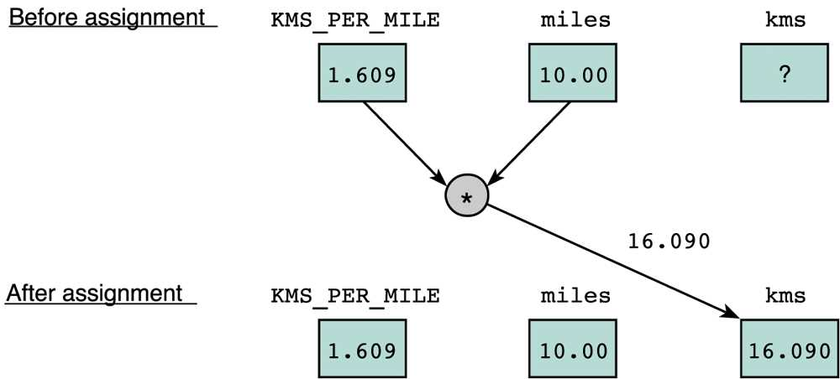
Before and After Assignment of a variable
kms = KMS_PER_MILE * miles;

Slide 9
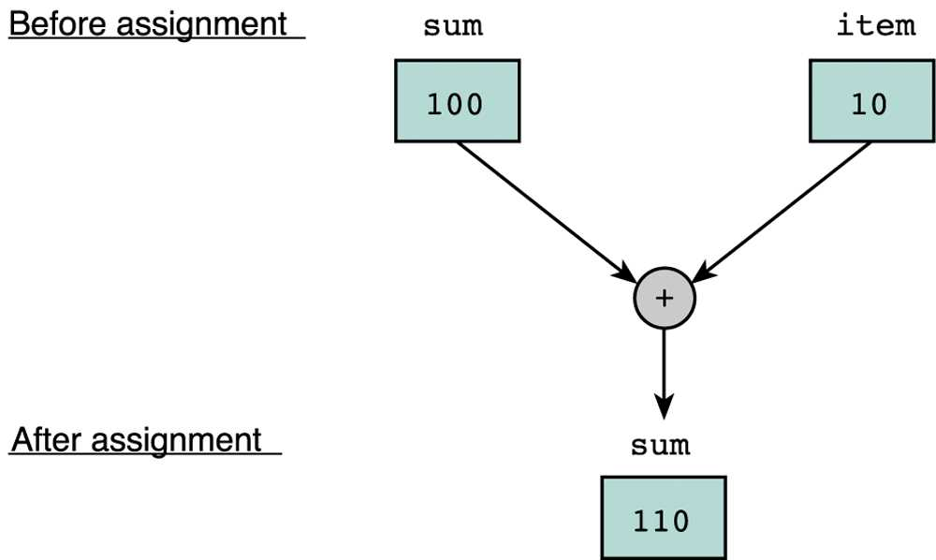
Before and After Assignment of a variable
sum = sum + item;

Slide 10
Input and Output Operations and Functions
Operations
Functions
#include <stdio.h>
C function: printf
C function: scanf

Slide 11
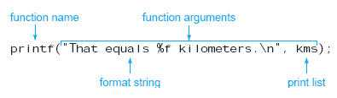
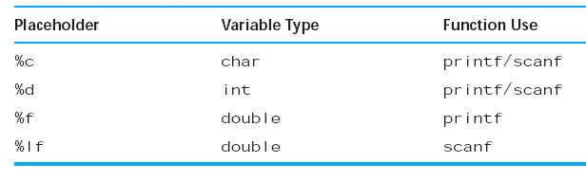
Function: printf
TABLE 2.8 Placeholders in Format Strings

Slide 12
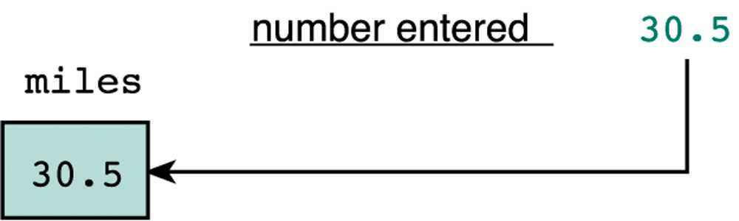
Function: scanf
scanf("%lf", &miles);

Slide 13
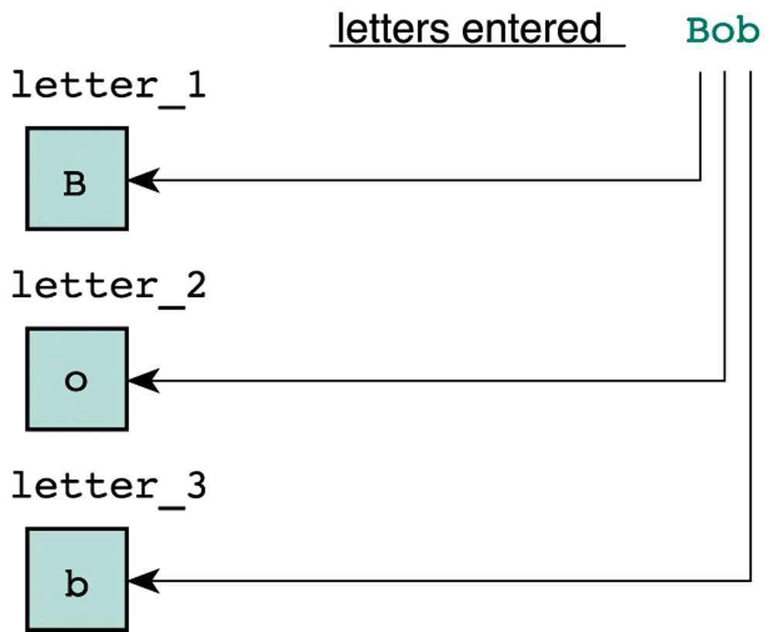
scanf
scanf("%c%c%c", &letter_1, &letter_2, &letter_3 );

Slide 14
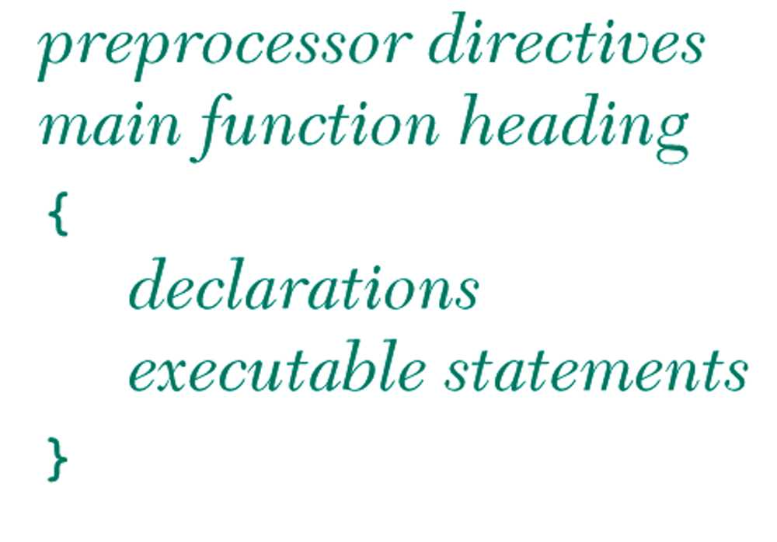
General Form of a C program
#include, #define
Any used variable should be declared before the usage.

Slide 15
Arithmetic Expressions
Arithmetic Operators
Mixed-Type Assignment Statement
Expression with Multiple Operators

Slide 16
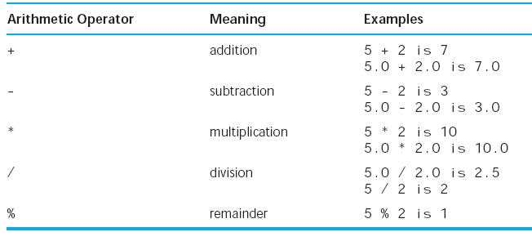
Arithmetic Operators
TABLE 2.9 Arithmetic Operators

Slide 17
Mixed-Type Assignment Statement

Slide 18
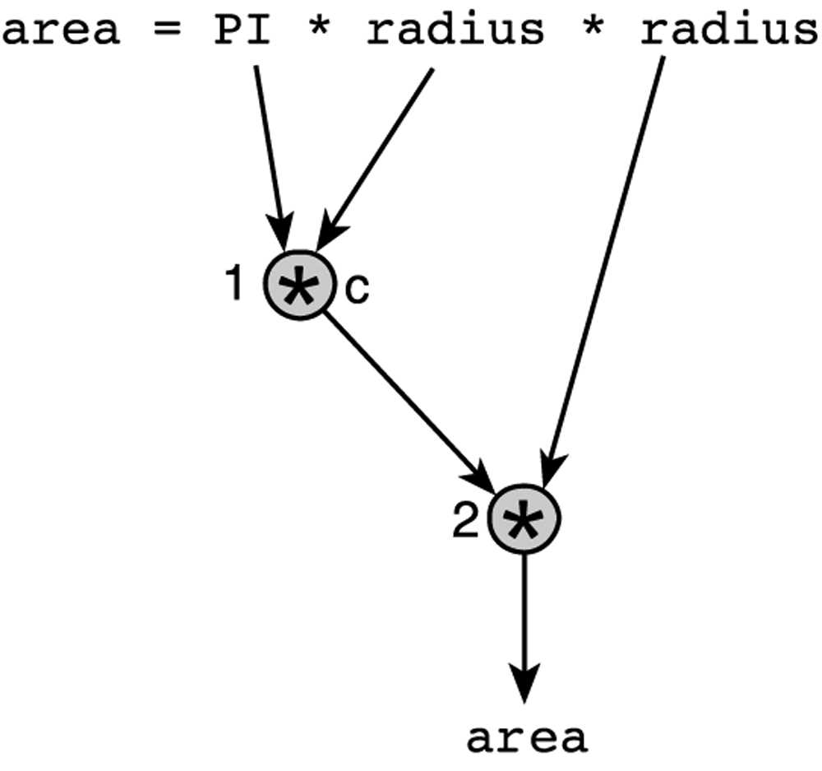
Execution of Multiple Operators
Can be expressed as an Evaluation Tree.
area = PI * radius * radius;

Slide 19
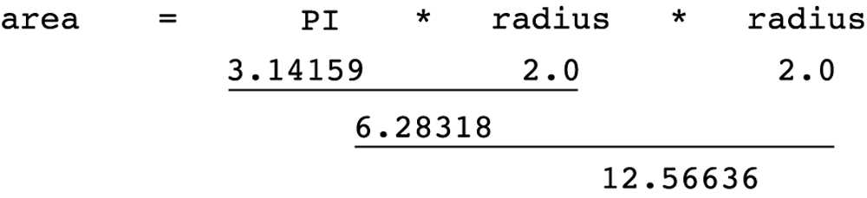
Step by Step Expression Evaluation

Slide 20
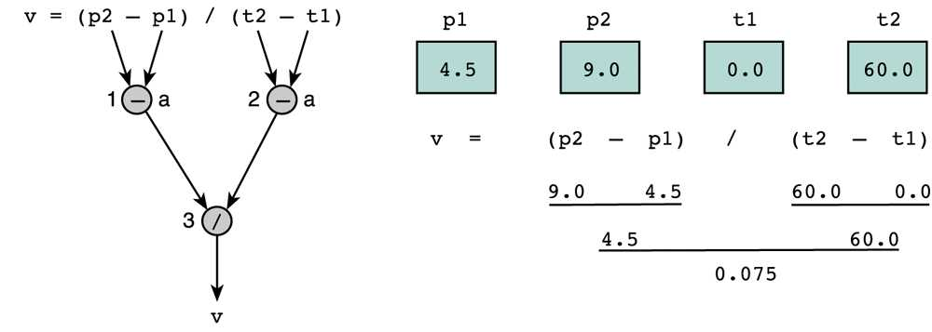
Evaluation Tree (1)
v = (p2 - p1) / (t2 - t1);

Slide 21
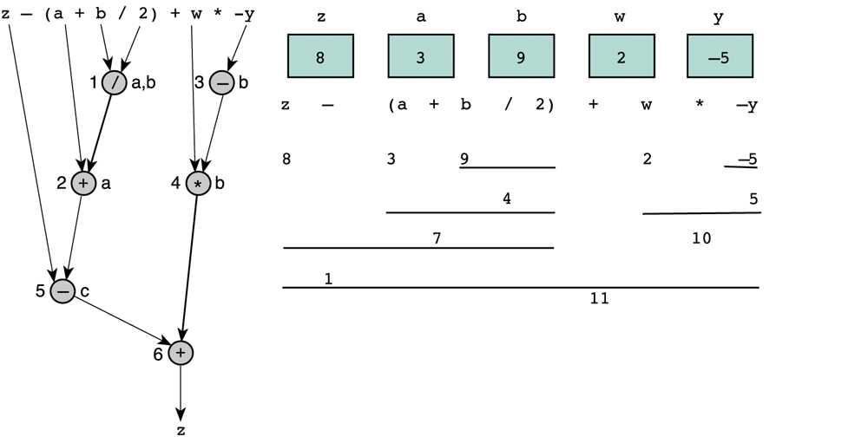
Evaluation Tree (2)
z - (a + b / 2) + w * -y

Slide 22

Homework #2
Programming Project 3 (Textbook. Page 91)
due: 2017/9/12
Write a program that estimates the temperature in a freezer (in Centigrade) given the elapsed time (hours) since a power failure.

Slide 23
Case Study
Write a program to determine the value of a collection of coins
E.g., quarters, dimes, nickels and pennies.
The algorithmic flow:
Get and display the customer’s initials.
Get the count of each kind of coin.
Compute the total value in cents
Find and display the value in dollars and change.

Slide 24
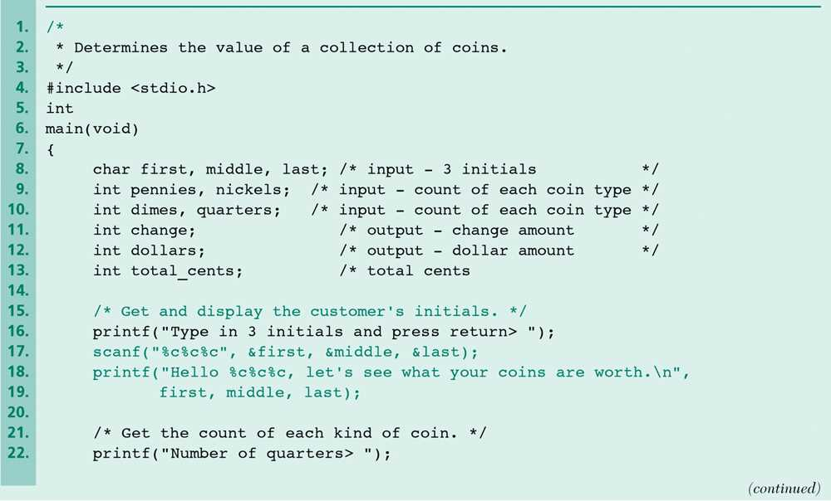
Finding the Value of Coins

Slide 25
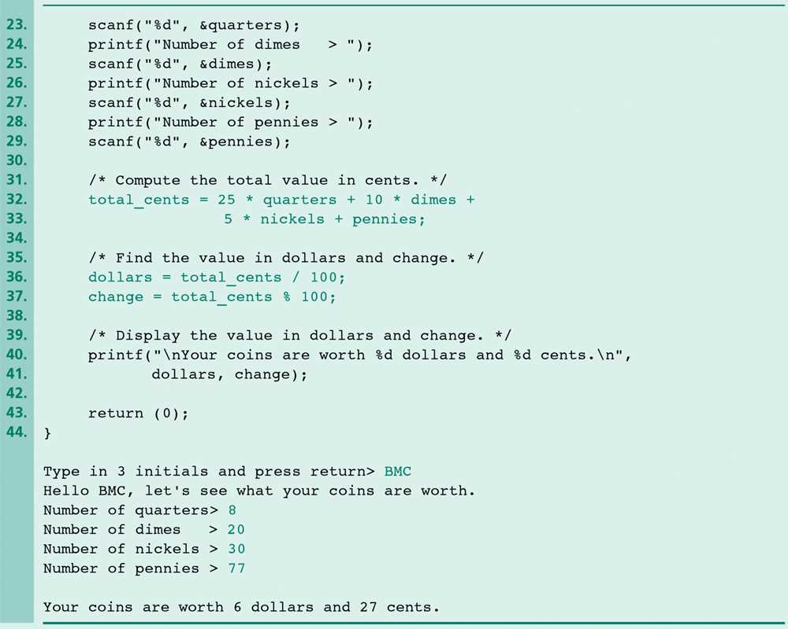
Finding the Value of Coins (cont’d)

Slide 26
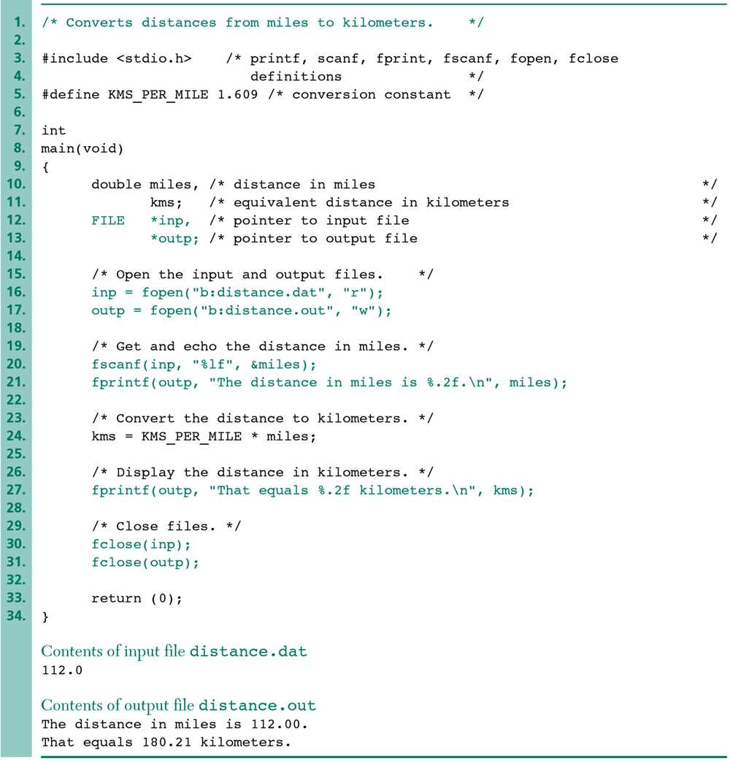
Interactive Mode vs. Batch Mode
Program-Controlled Input and Output Files

Slide 27
Common Programming Errors
Syntax Errors
Run-Time Errors
Undetected Errors
Logic Errors

Slide 28
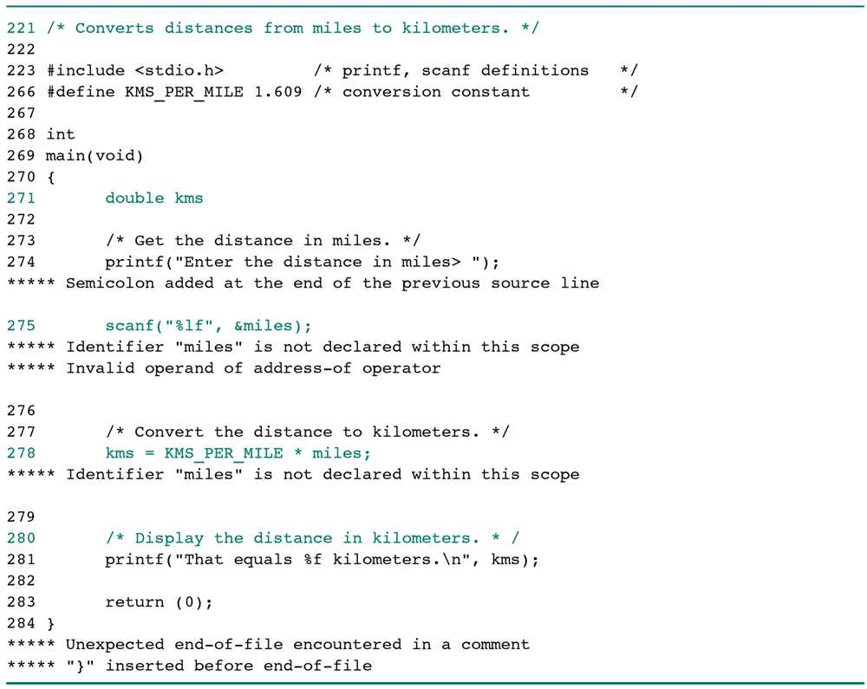
Syntax Errors

Slide 29
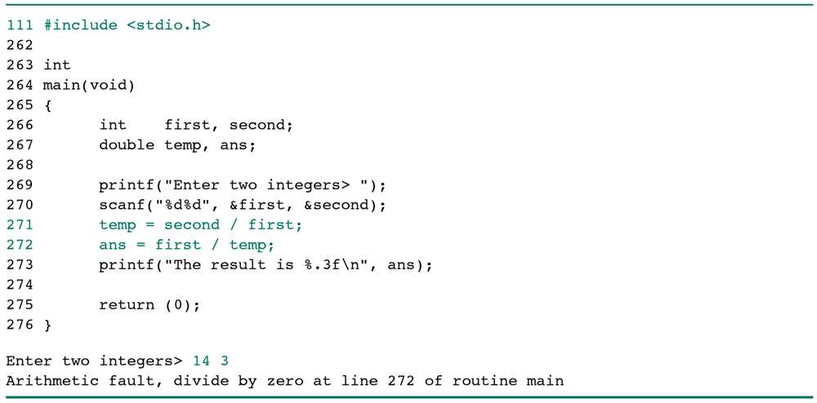
Run-Time Error

Slide 30
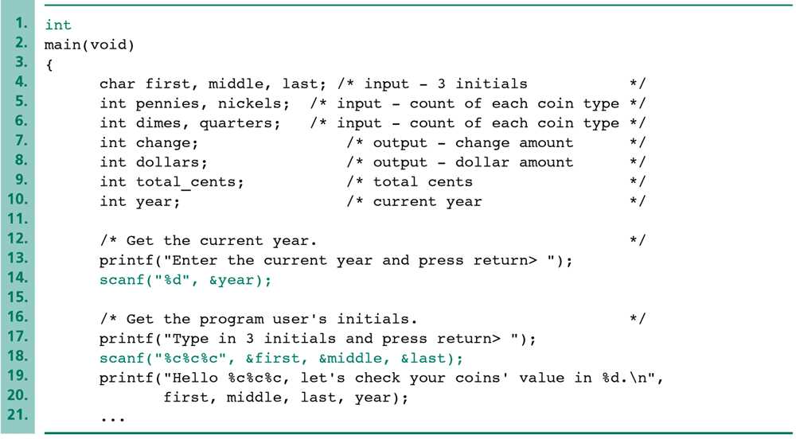
Undetected Error (1/2)
Revised Start of main Function for Coin Evaluation

Slide 31
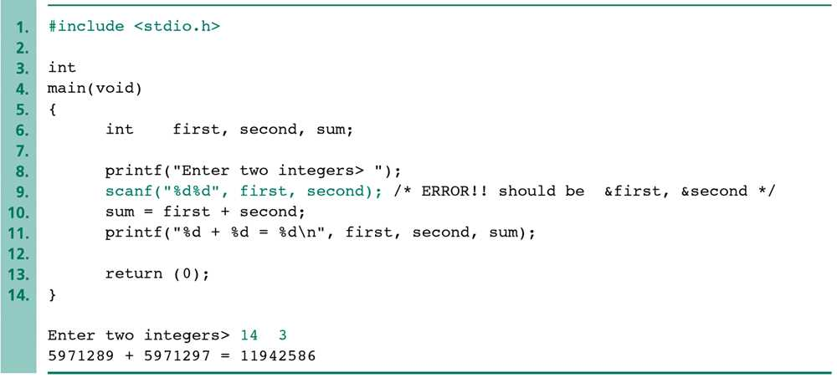
Undetected Error (2/2)
A Program That Produces Incorrect Results Due to & Omission

Slide 32
Logic Error

Slide 33
Summary
Structure of simple C programs
Simple data types int, double, and char.
Input/output functions printf and scanf.
Preprocessor directives #include and #define
Comments
Assignment statement along with the basic arithmetic operators
Case Study
Common Errors

