Slide 1
Chapter 12
Files
(reference: Deitel’s chap 11)

Slide 2
Introduction of File
Data files
  Can be created, updated, and processed by C programs
  Are used for permanent storage of large amounts of data
    Storage of data in variables and arrays is only temporary

Slide 3
The Data Hierarchy
Data Hierarchy:
  Bit – smallest data item
    Value of 0 or 1
  Byte – 8 bits
    Used to store a character
      Decimal digits, letters, and special symbols
  Field – group of characters conveying meaning
    Example: your name
  Record – group of related fields
    Represented by a struct or a class
    Example: In a payroll system, a record for a particular employee that contained his/her identification number, name, address, etc.

Slide 4
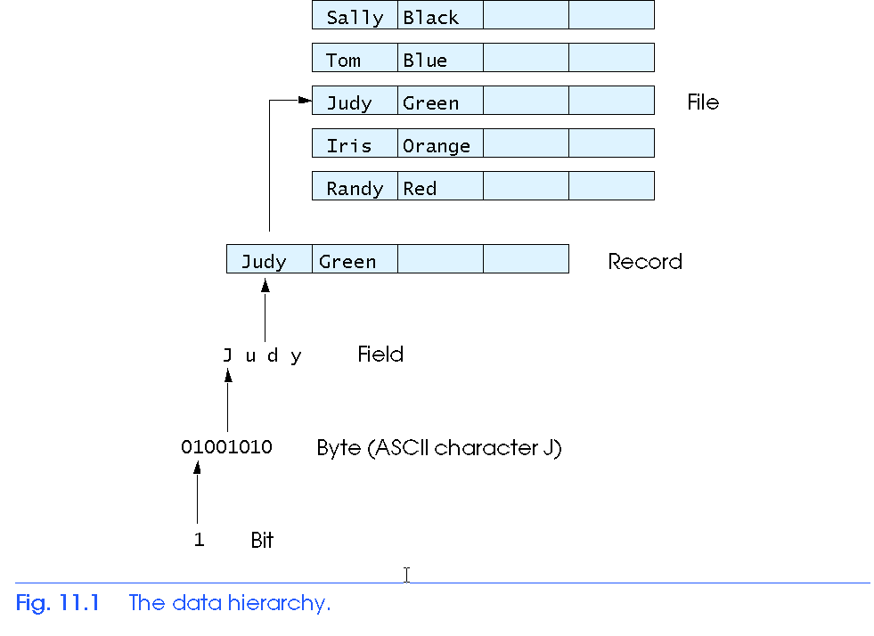
The Data Hierarchy
Data Hierarchy (continued):
  File – group of related records
    Example: payroll file
  Database – group of related files

Slide 5
The Data Hierarchy
Data files
  Record key
    Identifies a record to facilitate the retrieval of specific records from a file
  Sequential file
    Records typically sorted by key

Slide 6
Files and Streams
C views each file as a sequence of bytes
  File ends with the end-of-file marker
    Or, file ends at a specified byte
Stream created when a file is opened
  Provide communication channel between files and programs
  Opening a file returns a pointer to a FILE structure
    Example file pointers:
    stdin - standard input (keyboard)
    stdout - standard output (screen)
    stderr - standard error (screen)

Slide 7
Files and Streams
FILE structure
  File descriptor
    Index into operating system array called the open file table
  File Control Block (FCB)
    Found in every array element, system uses it to administer the file

Slide 8
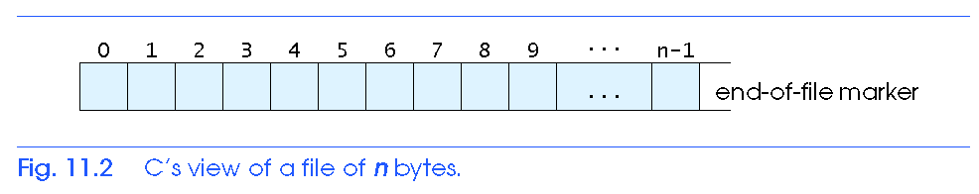
Files and Streams

Slide 9
Files and Streams
Read/Write functions in standard library
  fgetc
    Reads one character from a file
    Takes a FILE pointer as an argument
    fgetc( stdin ) equivalent to getchar()
  fputc
    Writes one character to a file
    Takes a FILE pointer and a character to write as an argument
    fputc( 'a', stdout ) equivalent to putchar( 'a' )
  fgets
    Reads a line from a file
  fputs
    Writes a line to a file
  fscanf / fprintf
    File processing equivalents of scanf and printf

Slide 10
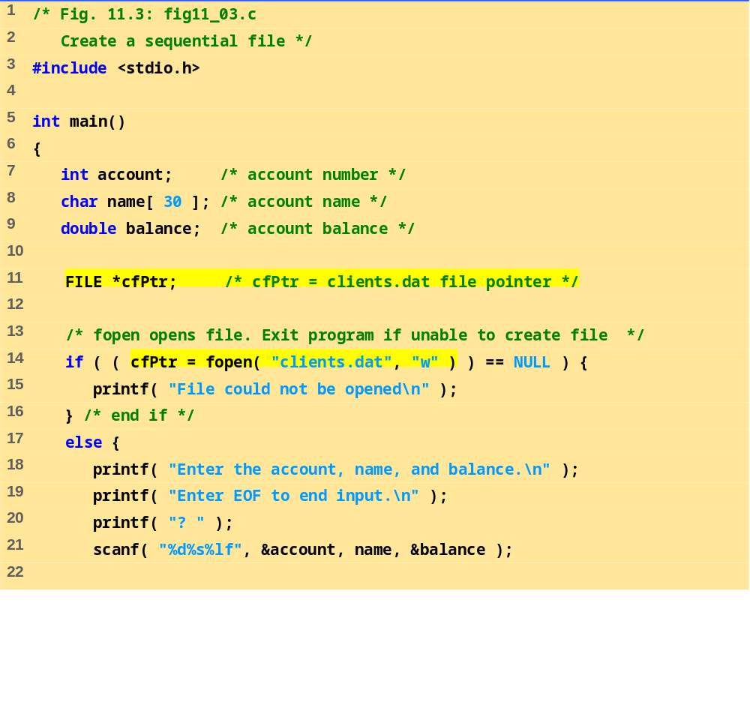
fig11_03.c (1 of 2)

Slide 11
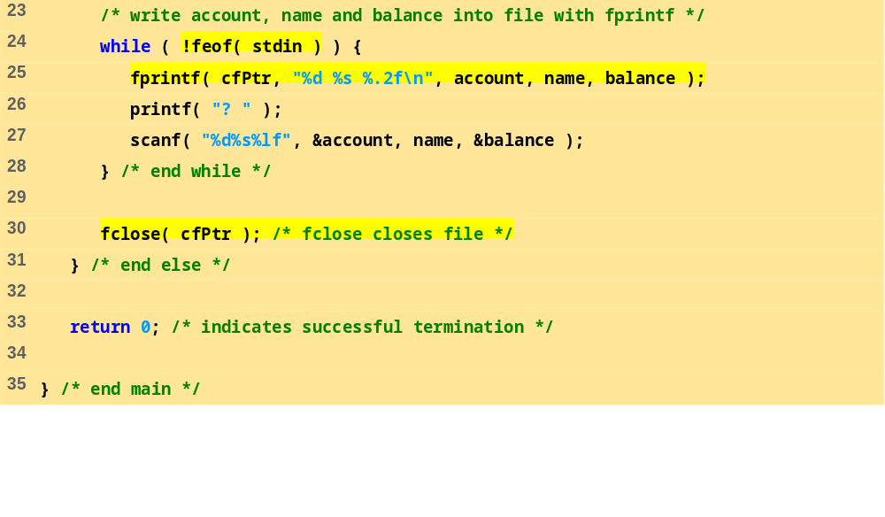
fig11_03.c (2 of 2)
Program Output
Enter the account, name, and balance.
Enter EOF to end input.
? 100 Jones 24.98
? 200 Doe 345.67
? 300 White 0.00
? 400 Stone -42.16
? 500 Rich 224.62
? ^Z

Slide 12
Creating a File
C imposes no file structure
  No notion of records in a file
  Programmer must provide file structure
Creating a File
  FILE *cfPtr;
    Creates a FILE pointer called cfPtr
  cfPtr = fopen(“clients.dat", “w”);
    Function fopen returns a FILE pointer to file specified
    Takes two arguments – file to open and file open mode
    If open fails, NULL returned

Slide 13
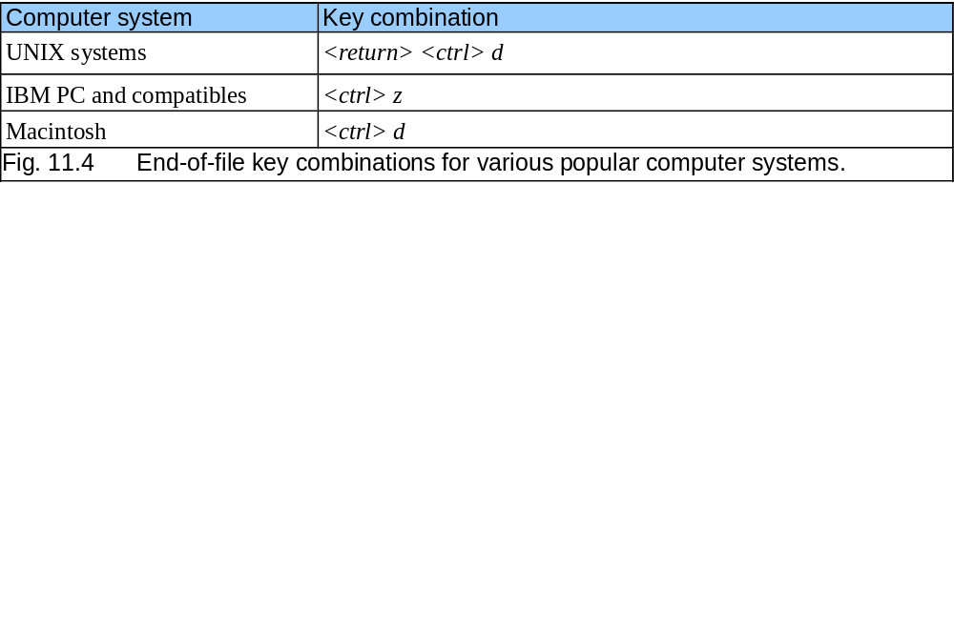
Creating a File

Slide 14
Creating a File
  fprintf
    Used to print to a file
    Like printf, except first argument is a FILE pointer (pointer to the file you want to print in)
  feof( FILE pointer )
    Returns true if end-of-file indicator (no more data to process) is set for the specified file
  fclose( FILE pointer )
    Closes specified file
    Performed automatically when program ends
    Good practice to close files explicitly
Details
  Programs may process no files, one file, or many files
  Each file must have a unique name and should have its own pointer

Slide 15
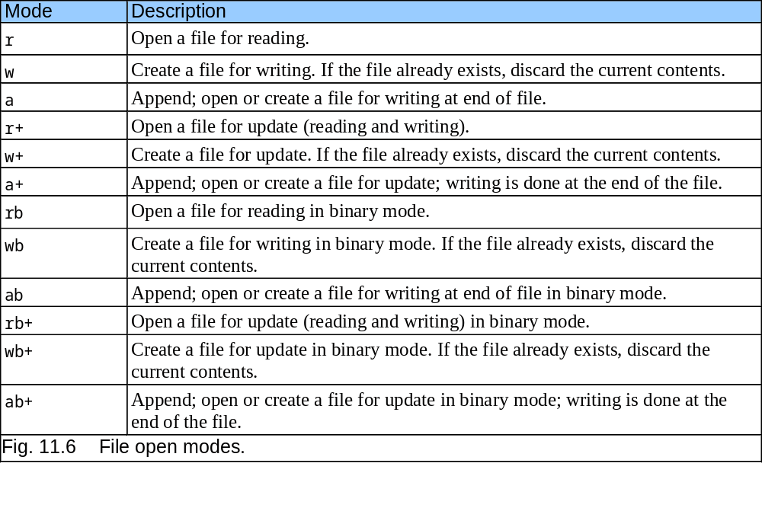
Creating a File

Slide 16
Reading Data from a File
Reading a sequential access file
  Create a FILE pointer, link it to the file to read
    cfPtr = fopen( “clients.dat", "r" );
  Use fscanf to read from the file
    Like scanf, except first argument is a FILE pointer
    fscanf( cfPtr, "%d%s%f", &accounnt, name, &balance );
  Data read from beginning to end
  File position pointer
    Indicates number of next byte to be read / written
    Not really a pointer, but an integer value (specifies byte location)
    Also called byte offset
  rewind( cfPtr )
    Repositions file position pointer to beginning of file (byte 0)

Slide 17
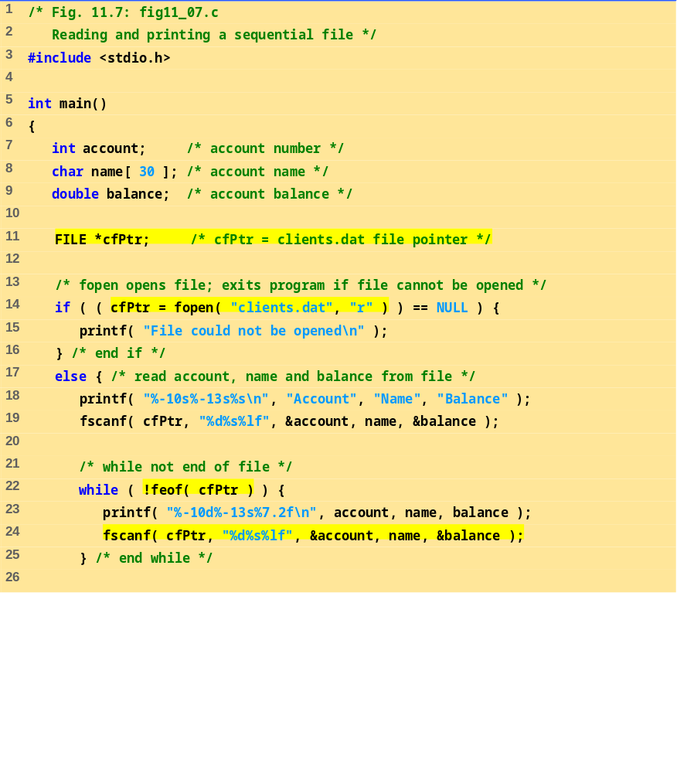
fig11_07.c (1 of 2)

Slide 18
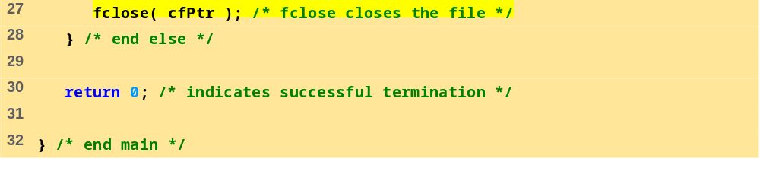
fig11_07.c (2 of 2)
Account Name Balance
100 Jones 24.98
200 Doe 345.67
300 White 0.00
400 Stone -42.16
500 Rich 224.62

