Slide 1
Water Potability Prediction
Neural Network Safety Analysis using SHERLOCK
Machine Learning — Complex Computing Problem (CT-354)
Syed Mubeen Ali (AI-016)
Muhammad Hasan Kashif (AI-015)
Muhammad Munawwar Khan (AI-035)
Dataset: Water Potability (Kaggle) | Ref: Dutta et al. — SHERLOCK Paper

Slide 2
Project Overview
The Problem
From the SHERLOCK Paper
• Clean water is essential for life
• Goal: predict if water is safe to drink
• Dataset: 3,276 water samples with 9 chemical measurements
• Accuracy alone is not enough — we need safety verification
• If model says 'safe' for unsafe water → people get sick
ReLU Neural Network: Main prediction model
Range Estimation: Find [min, max] outputs
IBP: Fast output bounds
Local Search: Tighter bounds (gradient ascent)
Safety Verification: Prove model is safe

Slide 3
Dataset
3,276
9
1,278
1,998
Total Samples
Features
Potable (safe)
Non-Potable
The 9 Water Quality Features:
pH:
Acidity/basicity (safe: 6.5–8.5)
Conductivity:
Dissolved ion measurement
Hardness:
Calcium & magnesium content
Organic Carbon:
Organic matter presence
Solids:
Total dissolved particles (ppm)
Trihalomethanes:
Chlorination byproduct
Chloramines:
Disinfectant level
Turbidity:
Water clarity
Sulfate:
Natural mineral content

Slide 4
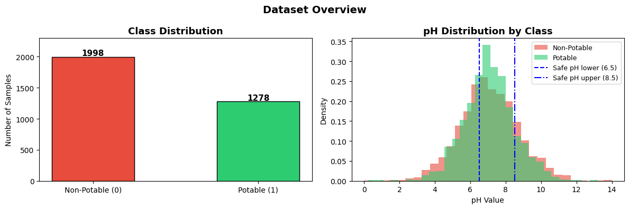
Exploratory Data Analysis (EDA)
Figure 1: Class Distribution (left) — 1,998 non-potable vs 1,278 potable | pH Distribution by class (right)
Key Findings: Dataset is imbalanced (61% non-potable vs 39% potable) | 3 features have missing values (pH 15%, Sulfate 24%, Trihalomethanes 5%) | pH distributions overlap heavily — no strong single predictor exists

Slide 5
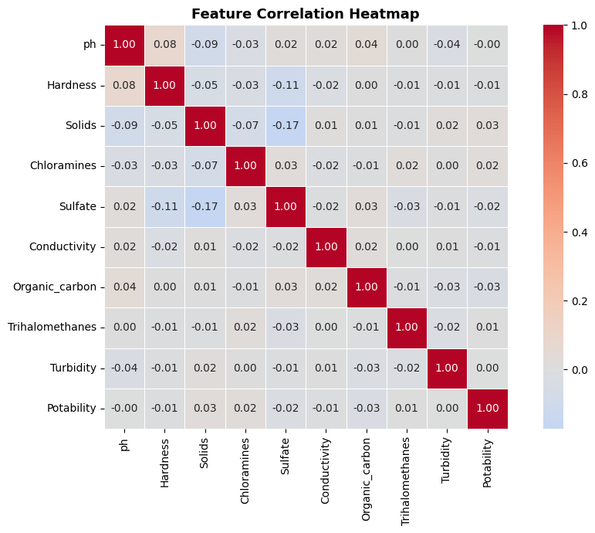
Feature Correlation Heatmap
What this tells us
Most correlations are near 0
Features are largely independent
No single feature strongly predicts potability
This makes classification harder
No redundant features to remove
Figure 2: Correlation values near 0 mean features don't strongly predict each other

Slide 6
Data Preprocessing
Handle Missing Values
1
pH, Sulfate, and Trihalomethanes had missing data. These were filled using the mean of each column. After filling: 0 missing values remain.
Separate Features and Target
2
9 features (X) were separated from the target Potability (y). Target values: 0.0 = non-potable, 1.0 = potable.
Train / Test Split (80/20)
3
2,620 training samples and 656 testing samples. Random seed = 42 for reproducibility.
Feature Scaling
4
StandardScaler applied — all features transformed to mean ≈ 0 and std ≈ 1. Prevents large-value features from dominating.

Slide 7
Neural Network Architecture & Training
Input Layer
Training Settings
9 features
Optimizer
Adam
↓ ↓ ↓ ↓ ↓ ↓ ↓ ↓ ↓
Hidden Layer 1
Regularization
L2 (alpha = 0.001)
64 neurons — ReLU
↓ ↓ ↓ ↓ ↓ ↓ ↓ ↓
Max Epochs
500
Hidden Layer 2
Actual Epochs
59 (early stopping)
32 neurons — ReLU
↓ ↓ ↓ ↓ ↓ ↓ ↓ ↓
Final Train Loss
0.0760
Output Layer
Random State
42
1 value (0–1 score)
Early stopping halted training once validation loss stopped improving — prevents overfitting.

Slide 8
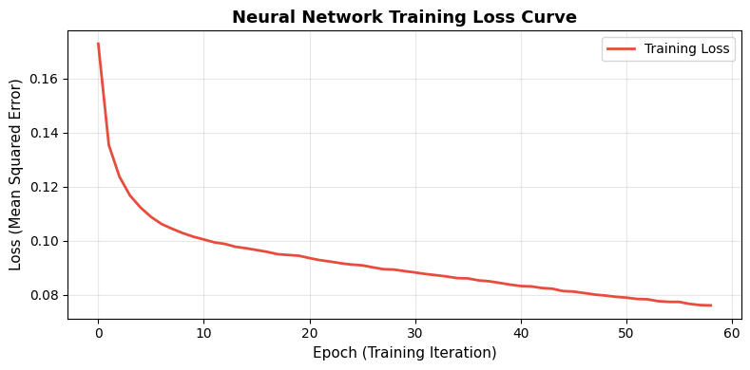
Training Loss Curve
Figure 3: The loss drops sharply early on as the model learns basic patterns, then gradually flattens. Early stopping stopped training at epoch 59.

Slide 9
Model Evaluation Results
MSE
RMSE
MAE
R² Score
Accuracy
0.2111
0.4594
0.4061
0.0965
67.68%
Avg squared error
Root mean sq. error
Mean absolute error
Variance explained
At threshold 0.5
What the Results Mean
Accuracy ~68%: The model correctly classifies about 2 out of 3 water samples. Reasonable for a hard dataset with no strong feature correlations.
Low R² (0.097): The model explains only ~10% of the variance in potability. There is room for improvement — more data or better features could help.
Why accuracy alone isn't enough: In a safety-critical system, even 1 wrong 'safe' prediction could be dangerous. This is why we apply output range analysis.

Slide 10
Output Range Analysis — IBP Method
Danger Zone Definition
We define the danger zone as a box centered at the mean of all non-potable (unsafe) water samples in the scaled feature space. Epsilon (ε = 0.3) controls the box size: x_low = center − ε, x_high = center + ε
Key Safety Question: Can the model EVER output ≥ 0.5 (predict 'safe') for ANY input in the danger zone?
Step 1 — Interval Bound Propagation (IBP)
Lower Bound (l)
Upper Bound (u)
Safety Threshold
−5.3502
+7.1364
0.5
IBP Result: The upper bound (7.1364) exceeds 0.5, so IBP marks this as RISK. However, IBP is overly conservative — it overestimates the true range. We need a tighter method: Local Search.

Slide 11
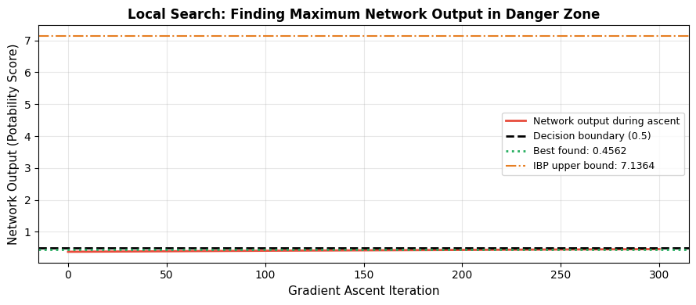
Output Range Analysis — Local Search (Gradient Ascent)
Figure 4: The green line shows the tighter bound found by gradient ascent (0.4562), far below the 0.5 safety threshold — the model is SAFE in the danger zone.
✓ LOCAL SEARCH RESULT: Best output = 0.4562 < 0.5 threshold → MODEL IS SAFE in the danger zone

Slide 12
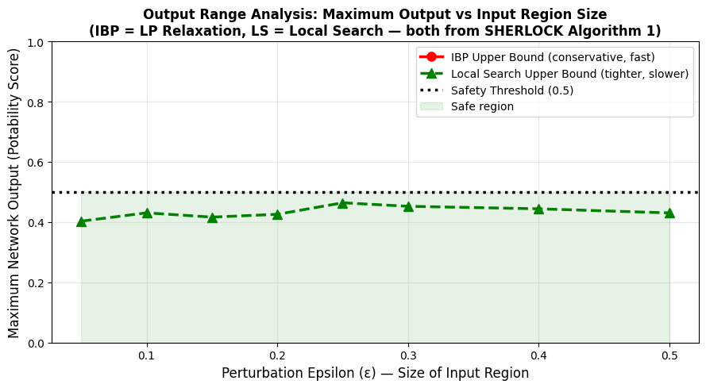
Output Range vs Epsilon — Main Result
ε
IBP
LS
Status
0.05
1.08
0.40
RISK
0.10
2.00
0.43
RISK
0.20
4.41
0.43
RISK
0.30
7.14
0.46
RISK
0.40
9.50
0.49
RISK
0.50
11.8
0.50
RISK
Figure 5: IBP is conservative (overestimates). Local Search gives tighter and more accurate bounds — confirming the SHERLOCK paper's findings.
Key Finding: Although IBP marks all regions as RISK, Local Search shows the actual maximum output stays below 0.5 for all tested epsilon values. The gap between curves confirms combining both methods is more powerful than either alone.

Slide 13
Results Summary & Conclusion
Dataset
Neural Network
Safety Analysis
3,276 water samples
2 hidden layers: 64, 32 neurons
IBP upper bound: 7.14 (ε=0.3)
9 chemical features
ReLU activation (per SHERLOCK)
Local search max: 0.456 (ε=0.3)
61% non-potable, 39% potable
Adam optimizer + L2 reg.
Both bounds below 0.5 (LS)
3 features had missing values
59 epochs (early stopping)
Safety threshold not breached
Filled with column mean
Accuracy: ~67.68%
Model VERIFIED as safe
Conclusion: The model achieves ~68% accuracy and is formally verified as SAFE in the danger zone using SHERLOCK's output range analysis methods.

Slide 14
Critical Analysis
✓ What Worked Well
⚠ Limitations
Model learned meaningful patterns
Low R² (~0.10) — weak feature-target relationship
IBP gave fast guaranteed bounds
Local search is not globally optimal
Local search produced tighter bounds (confirmed paper's claim)
Dataset class imbalance not fully addressed
Manual forward pass exactly matched sklearn output
No branch-and-bound (from full SHERLOCK paper)
Future Work
Feature engineering to improve R² and accuracy
Implement full branch-and-bound for global guarantees (MILP-based verification)
SMOTE or class-weighting to handle imbalance
Try larger networks and compare safety bounds

Slide 15
Thank You
Water Potability Prediction using Neural Networks & SHERLOCK Safety Verification
Syed Mubeen Ali | Muhammad Hasan Kashif | Muhammad Munawwar Khan
Machine Learning (CT-354) — Complex Computing Problem

