Slide 1
Comparison of Machine Learning Models to Predict Heart Diseases
Presentation Muzammal Hussain

Slide 2
Heart Diseases
Cardiovascular diseases (CVDs) are the leading cause of death globally, taking an estimated 17.9 million lives each year. CVDs are a group of disorders of the heart and blood vessels and include coronary heart disease, cerebrovascular disease, rheumatic heart disease and other conditions. More than four out of five CVD deaths are due to heart attacks and strokes, and one third of these deaths occur prematurely in people under 70 years of age.

Slide 3
Problem Statement
Limited data set availability
Big Data to produce good accuracy.
Which machine learning models to choose?

Slide 4
Proposed solutions
Data augmentation
Comparison of three top performing models
Accuracy as the metrics.

Slide 5
Aims and Objectives
Data Preprocessing
Model Training
Evalutaion
Merge data
Prediction

Slide 6
Models used
Three models were selected
Random Forest (RF)
Neural Network (NN)
XGBoost

Slide 7
Dataset
The dataset was downloaded from the Kaggle.com
4 different countries
ML models requires more data
All the data was simply merged to form a larger dataset

Slide 8
Data Set Features
No | Features Explanations
1 | Age (Age in the year)
2 | sex: sex (1 = male; 0 = female)
3 | cp (chest pain type): [0:asymptomatic, 1: atypical angina, 2: non-anginal pain, 3: typical angina]
4 | trestbps (resting blood pressure in mm/hg )
5 | chol ( Serum Cholesterol in mg/dl )
6 | Fps (fasting blood sugar > 120 mg/dl ) : [ 0 = no, 1 = yes]
7 | Restecg ( Resting ECG ) : [ 0 : shown probable or definite left ventricular]
8 | Thalach ( maximum heart rate achieved )
9 | Exang (Exercise induced angina) : [1 = yes, 0 = no]
10 | Oldpeak ( ST depression induced by exercise relative to test
11 | Slope ( the slope of the peak exercise ST segment ) : [ 0: downsloping; 1: flat; 2: upsloping ]
12 | Ca [ number of major vessels ( 0 - 3 )
13 | Thal [ 1: normal, 2 : fix defect, 3: reversible defect ]
14 | Target: [0 = disease, 1 = no disease]
Table 1 Features explanation

Slide 9
Missing/Null values in the dataset
Identify the Missing/Null values
Remove those values
Since it creates inaccuracies and biasness.

Slide 10
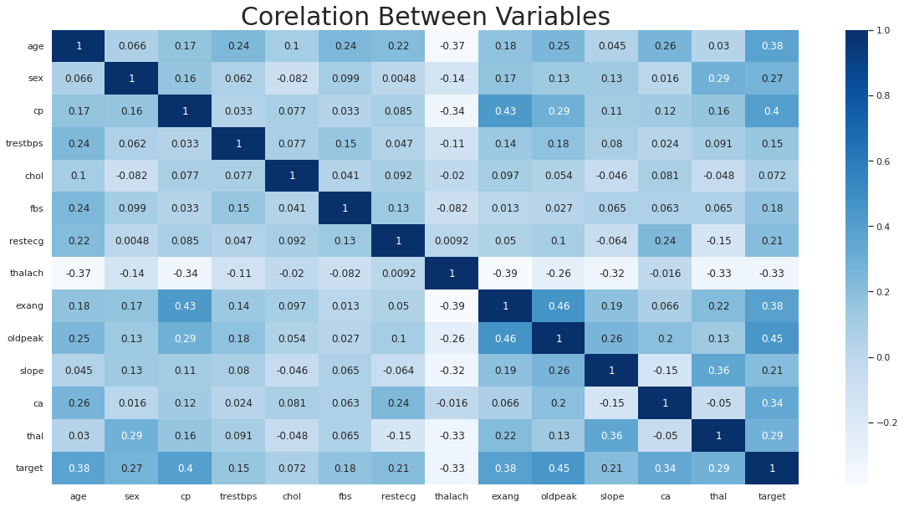
Correlation between variables

Slide 11
Correlation
The "oldpeak" and "cp" show a good relationship with target. "thalach" shows a negative correlation with target and "fbs", "chol", "trestbps" and "restecg" show low correlation with target

Slide 12
Neural Network
Inspired by the human brain
Contains 3 types of layers
Neural networks rely on training data to learn and improve their accuracy over time.

Slide 13
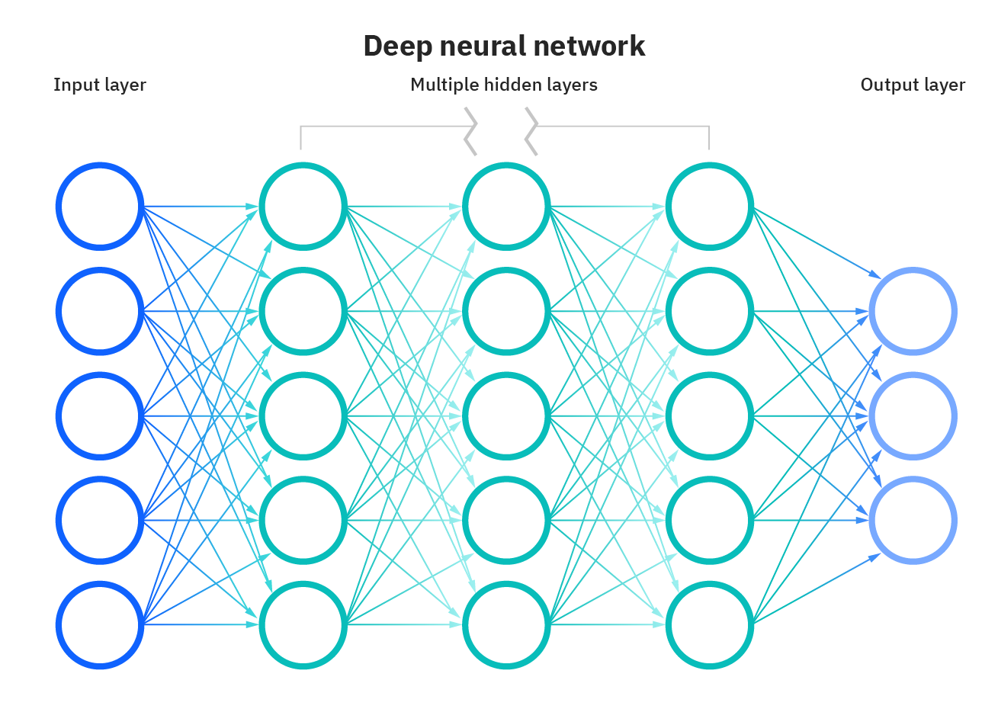

Slide 14
Accuracies
Accuracy | Optimizer | LR
0.6156 | Adam | 0.0001
0.189 | Adam | 0.01
0.736 | Adam | 0.001
0.216 | Adamax | 0.001
0.50 | SGD | 0.001

Slide 15
16 and 84 dense hidden layers were used to increase the depth and complexity
epochs=100, batch_size=5, verbose = 1
Optimizers:
Adam (adaptive moment estimation)
Adamax
SGD (stochastic gradient descent)

Slide 16
XGBoost
Accuracy | Depth | Learning Rate
0.82 | 8 | 0.001
0.81 | 8 | 0.0001
0.81 | 5 | 0.01
0.86 | 10 | 0.01
0.86 | 8 | 0.01

Slide 17
The model was trained on different parameters to find the optimum accuracy that is neither underfit nor overfit. A depth of 8, 5 and 10 was tested along with a learning rate of 0.001, 0.0001 and 0.01.
So the model performed best on the learning rate 0.01 and the max depth of 8 but!
Training time was taken under consideration.

Slide 18
Random Forest
The Random Forest Classifier() function compares the performance and accuracy of train data over time. This approach is more suitable for real-time problems for heart disease prediction. For finding the optimum parameters the depth of 5, 10, 11 and 15 was tested for RF. Table below shows the accuracy along with depth.
Accuracy | Depth
0.78 | 5
0.908 | 15
0.910 | 10
0.918 | 11

Slide 19
Results of all models compared
Models | Accuracy | Parameters
Neural Network | 0.7707231040564374=77% | (Adam, LR: 0.001, Batch: 5, Epoch: 100)
XG-Boost | 86% | (LR: 0.01, Depth: 8)
Random Forest | 0.92=92% | (Depth: 11)

