Slide 1

.
School of Computing, Engineering, and Build Environment, Glasgow Caledonian University, Glasgow
Topic
Multiclass Image Classification
for Lung Diseases with Deep Neural Networks
.
Presented By
Muzammal Hussain
Supervised By
Dr. Sajid Nazir
School of Computing, Engineering, and Build Environment

Slide 2
.
Agenda
Introduction Background Problem statement Aims and objectives Literature Review Methodology Dataset Lung disease classes | Model used Process flow diagram ResNet Model Results MobileNet Model Results VGGNet Model Results Results comparison Conclusion
.
School of Computing, Engineering, and Build Environment

Slide 3
.
Introduction
.
Lung diseases are a leading cause of death worldwide. Early diagnosis and treatment of lung diseases can improve patient outcomes and reduce mortality.
Lung disease is related to a broad category of diseases that impair lung function and cause a variety of signs and symptoms.
The lungs are essential organs for exchanging oxygen and carbon dioxide in the human body.
Lung diseases may vary from acute infections to chronic conditions, and they can have a significant impact on a person's ability to breathe.
School of Computing, Engineering, and Build Environment

Slide 4
.
Background
The World Health Organization reports that
  Pneumonia is an acute respiratory disease that develops rapidly and impairs lung function.
  Viruses or bacteria trigger lung disease.
  Viruses or bacteria may cause lung infections and manifest as tuberculosis, pneumonia, or other conditions.
  This disease is more likely to affect children than adults.
  In 2017, 808,000 children under age 5 died from pneumonia.
.
School of Computing, Engineering, and Build Environment

Slide 5
.
Problem statement
The world is still dealing with the consequences of the COVID-19 epidemic, and lung infections are still prevalent. Lung infections can be viral or bacterial, resulting in tuberculosis, pneumonia, and other diseases.
Existing techniques work on small datasets and maximum classify only six diseases of the lungs.
Timely and accurate diagnosis of lung diseases is crucial to effective treatment.
Deep neural networks (DNN) have shown state-of-the-art performance in image classification. Through transfer learning, the learning of the models can be applied to another domain achieving good results.
This project will utilize transfer learning with state-of-the-art DNN models for lung disease classification on chest X-ray images.
.
School of Computing, Engineering, and Build Environment

Slide 6
.
Aims and Objectives
Enhancing early detection and intervention for lung diseases, ultimately leading to better healthcare outcomes and improved patient care.
Aims to classify the maximum class of lung disease.
Providing a reliable diagnostic tool for healthcare professionals to aid in accurate and efficient diagnosis of lung diseases.
Reducing the risk of misdiagnosis and unnecessary procedures by improving the accuracy of lung disease diagnosis.
Supporting the development of personalized treatment plans for patients based on their specific lung disease classification.
.
School of Computing, Engineering, and Build Environment

Slide 7
.
Literature Review
Paper | Focused of Study | Classes | Total images | Dataset Availability | Model | Accuracy | Limitation
(Nageshbabu Dasari, 2023) | Interstitial Lung Diseases using Multi-scale CNN | Five classes of ILD disorders | 315 HRCT images | Yes | D NN | 90.67% | They use an unbalanced dataset containing only 315 images and classify only five classes of ILD disorders.
(Balaji Annamalai, 2023). | Auction-based optimization algorithm with CNN for pulmonary disease prediction | Classify 4 lung disease classes | 112,118 X-ray images | Yes | ABOA-CNN | 96.3% | They classify only four classes of lung disease.
(Goram Mufarah M. Alshmrani a, 2023) | Fully-Connected Network with three blocks of Convolutional Neural Networks | Classify 6 lung disease classes | 80,000 CXR image | Yes | VGG19 + CNN | 96.48% | They classify only six classes of lung disease.
.
School of Computing, Engineering, and Build Environment

Slide 8
.
Literature Review (cont.…)
(Yunfeng Chen, 2022) | Generative Adversarial Networks (GAN) | Normal, Mild COVID-19 ,Severe COVID-19 disease | 6200 CT medical images | Yes | MI-GAN | 93.85% | They classify only three classes of lung disease on small dataset.
(Muhammad Arnaldo, 2022) | Multiclass Segmentation of Pulmonary Diseases using CNN | Classify 4 Pulmonary disease classes | 1303 images dataset from MosMedData | Yes | Mask-RCNN architecture | 93.75% | They classify only four classes of Pulmonary disease on small dataset.
(Rashid, 2021) | Multi-class picture Classification | Classify 4 lung disease classes | 14,220 pictures of chest X-rays | Yes | VGG16, MobbileNetV2, ResNet50, and Xception | 92.67% | They classify only four classes of lung disease
.
School of Computing, Engineering, and Build Environment

Slide 9
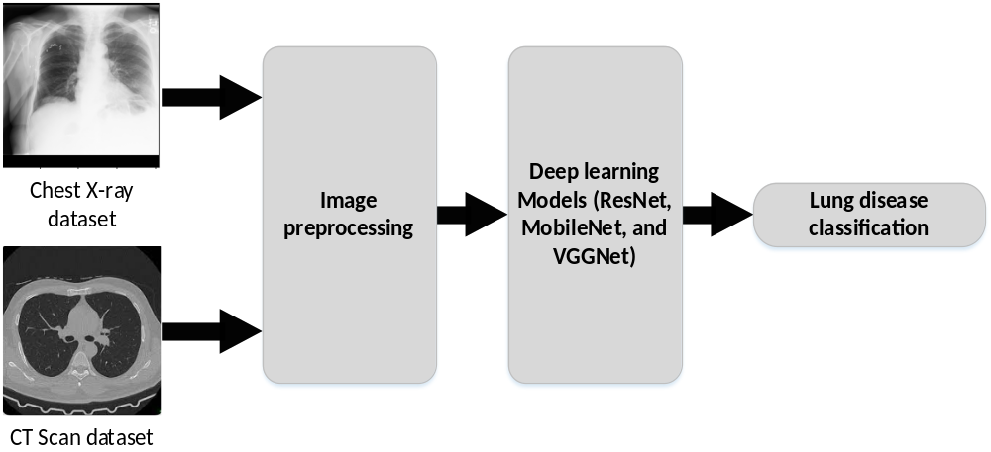
.
Methodology
.
School of Computing, Engineering, and Build Environment

Slide 10
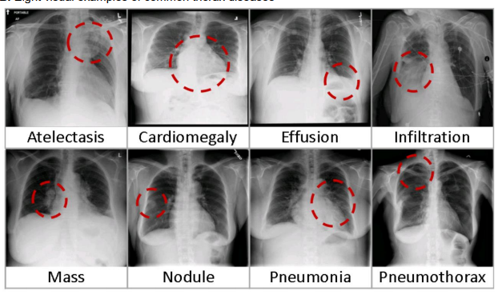
.
Dataset
The dataset was downloaded from kaggle.com
Number of chest X-ray images are 112,120
Chest X-ray images was collected from 30,805 distinct patients
Dataset contains 14 classes of lung disease
.
School of Computing, Engineering, and Build Environment

Slide 11
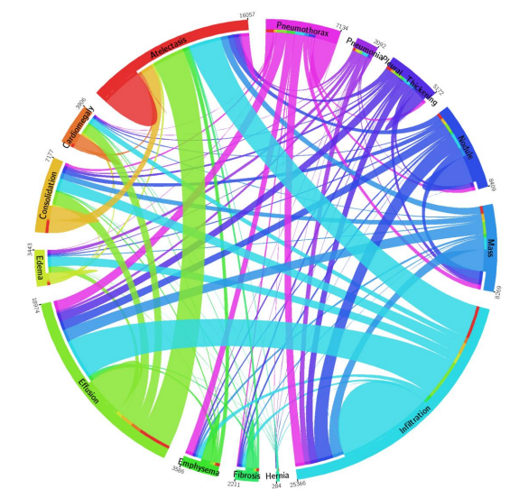
.
Lung disease classes
.
Name of lung disease with different colors
Name of lung disease 14 classes
Atelectasis | Pneumothorax
Cardiomegaly | Consolidation
Effusion | Edema
Infiltration | Emphysema
Mass | Fibrosis
Nodule | Pleural thickening
Pneumonia | Hernia
School of Computing, Engineering, and Build Environment

Slide 12
.
Model used
.
Models we used for lung disease classification are:
  ResNet model
  MobileNet model
  VGGNet model
School of Computing, Engineering, and Build Environment

Slide 13
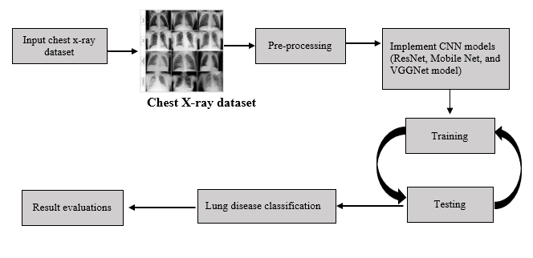
.
Process flow diagram
.
School of Computing, Engineering, and Build Environment

Slide 14
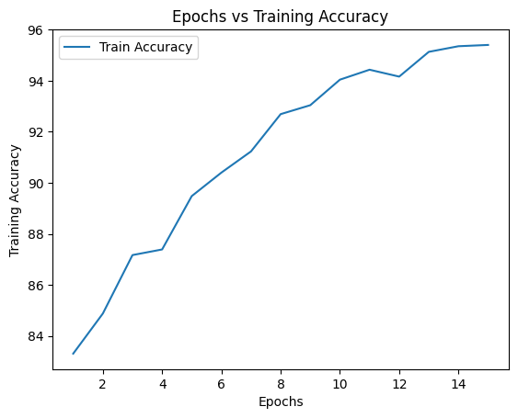
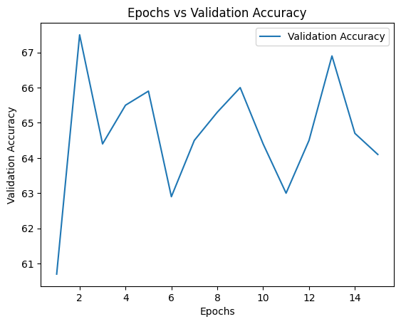
.
ResNet Model results
Accuracy
ResNet model training accuracy is 95.4%, and validation accuracy is 64.1% on chest X-ray images for lung disease classification.
.
School of Computing, Engineering, and Build Environment

Slide 15
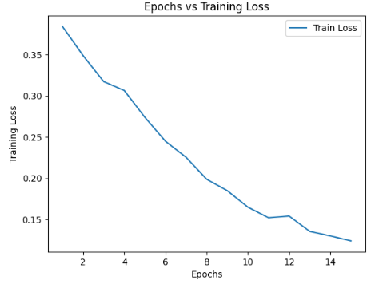
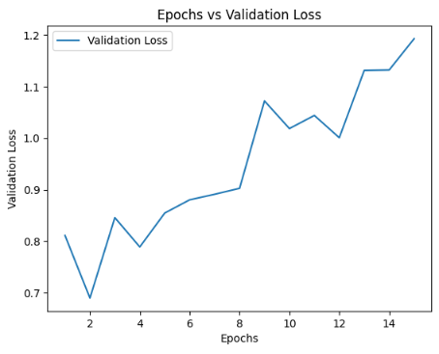
.
ResNet Model results(cont…)
Loss
ResNet model training loss is 0.124%, and validation loss is 1.193% on chest X-ray images for lung disease classification.
.
School of Computing, Engineering, and Build Environment

Slide 16
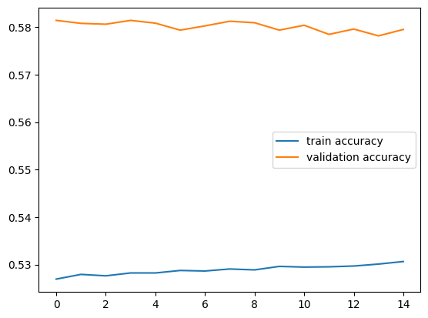
.
MobileNet Model Results
Accuracy
MobileNet model training accuracy is 52.90%, and validation accuracy is 58.14% on chest X-ray images for lung disease classification.
.
School of Computing, Engineering, and Build Environment

Slide 17
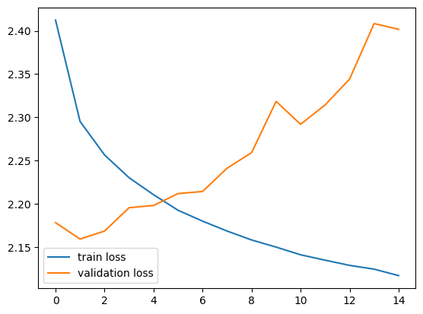
.
MobileNet Model Results(cont…)
Loss
MobileNet model training loss is 2.16%, and validation loss is 2.26% on chest X-ray images for lung disease classification.
.
School of Computing, Engineering, and Build Environment

Slide 18
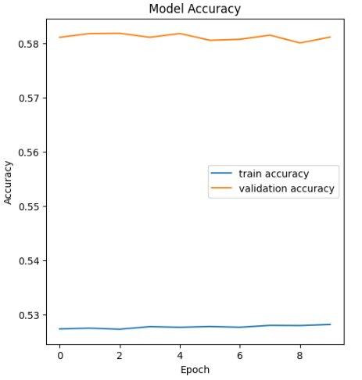
.
VGGNet Model Results
Accuracy
VGGNet model training accuracy is 52.82%, and valdation accuracy is 58.11% on chest X-ray images for lung disease classification.
.
School of Computing, Engineering, and Build Environment

Slide 19
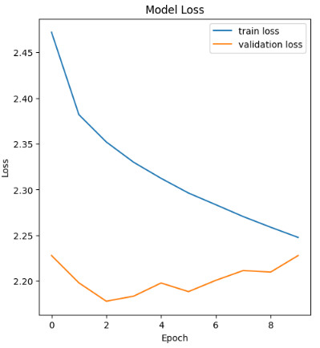
.
VGGNet Model Results(cont…)
Loss
VGGNet model training loss is 2.25%, and validation loss is 2.23% on chest X-ray images for lung disease classification.
.
School of Computing, Engineering, and Build Environment

Slide 20
.
Results comparison
Model name | Training accuracy | Validation accuracy | Training loss | Validation loss
ResNet Model | 95.4% | 64.1% | 0.124% | 1.93%
MobileNet Model | 52.90% | 58.14% | 2.16% | 2.26%
VGGNet Model | 52.82% | 58.11% | 2.25% | 2.23%
.
School of Computing, Engineering, and Build Environment

Slide 21
.
Conclusion
Our objective was to develop accurate diagnostic tools for lung disease classification using deep learning models.
We trained various models on our dataset to extract intricate features and patterns from complex chest X-ray data.
ResNet model Demonstrated exceptional performance on the chest X-ray dataset, showcasing its effectiveness in identifying lung diseases.
MobileNet and VGGNet Models achieved lower accuracy rates compared to ResNet.
Our findings represent significant progress in developing accurate and efficient diagnostic tools for lung disease classification.
The ResNet model's high accuracy demonstrates its potential for improving patient outcomes and healthcare practices.
.
School of Computing, Engineering, and Build Environment

Slide 22
.
Future work
Develop a Software Application: in the future, we will create a user-friendly and reliable software application that utilizes trained models for automatically diagnosing lung diseases using chest X-ray and CT scan images.
The application will efficiently process large volumes of data and complex algorithms. This will help to Quick and accurate classification leads to improved patient outcomes and efficient healthcare procedures.
.
School of Computing, Engineering, and Build Environment

Slide 23

.
.
Thank You
School of Computing, Engineering, and Build Environment

