Slide 1

School of Computing, Engineering, and Build Environment, Glasgow Caledonian University, Glasgow, United Kingdom
Dissertation Presentation
Alzheimer Detection Using Deep Learning Approach
Presented By
Ubaid Ur Rehman
S---
Supervised
By
Professor

Slide 2

Road Map
Introduction
        Literature Review
        Problem Statement
        Research Objective
        Research Question
Methodology
        Tools
        Research Framework
        Algorithm Flow chart
        Pre-processing
        Transfer Learning Technique
Results
        Confusion Metric
        Accuracy and Loss graph
Discussion
        Limitation and Future Work
        Conclusion

Slide 3
Alzheimer Disease (Intro...)
Alzheimer’s disease is the major cause of dementia. In Alzheimer’s disease patient loss their memory and face other brain disorders. Doctors don't still completely know what cause AD in mostly people. But there are probably some major causes, including the environment, age factor, brain changes, genetics and lifestyle. The importance of these factors varies from person to person.
We distinguished Alzheimer’s disease in the following stages:-
Pre-clinical AD
Mild Cognitive Impairment
Dementia due to Alzheimer’s
Major cause of AD And Symptom
The major cause of Alzheimer’s is protein build-up around the brain cell.
When the brain cell effect it also impacts on chemical messenger knowns as neurotransmitter.
Due to AD different part of brain declines across the time.
AD damages memory related part. so, the first symptom may be vision, language and memory problem.

Slide 4
Importance of Deep learning in Alzheimer’s Detection
Deep learning: In artificial intelligence, deep learning is a subclass of machine learning that replicates how the human brain processes data and recognises patterns in order to address challenging decision-making issues.
Deep learning is the best technique to perform automatic early detection of Alzheimer’s disease from MRI data.
Modern deep learning techniques have a possible growth in the computing capacity of Graphics processing units (GPUs).
Deep learning techniques have emergency performance in a variety of fields, including audio categorization, object identification, detection, and tracking.
The deep learning studies in medicine have benefitted to successfully categorising 2D natural images.

Slide 5
Literature of Review
No. of images | Input method | Prediction and model | Accuracy | Remarks
830 | MRI | AD using CNN and RNN | 92% | Deploying 3D CNN for each time and use GM density map for the classification of deep convolution Al neural network.
416 | OASIS(MRI) | Resnet, CNN,inceptionv4,AD NET | 93% | These models can distinguish between different stage of Alzheimer
Include 1800 subjects with both males and females in three databases (ADNI, ADNI GO, ADNI 2 and ADNI | MRI | convolutional neural networks and transfer learning using freeze weight. | VGG19- SVEM 99.27%, VGG16 98.89% | Used pre-trained models i.e., AlexNet, GoogLeNet, ResNet,DenseNet,Inceptionv3 and InceptionResNet with the classification layer of SVM

Slide 6
Literature of Review
ADNI Dataset | MRI | CNN (DEM NET) | Overall accuracy=91.85% AD vs HC=98.33% MCI vs HC=91.67% AD vs MCI=93.89% | To create 2D convolutional network, called DemNet, based on VGGNet that accept slices as input.
OASIS (150) | Images | Support vector machine, Logistic regression, Random forest, Ad Boosting, | Accuracy=97.58% | It isdatacentric classification technique by involving of both boosting and supervised models and comparing and detect best model.
ADNI, OASIS | MRI | SVM | Accuracy=79.9% Sensitivity=83.2% | It can use for automatic detection of AD using EEG waves.

Slide 7
Problem Statement
Alzheimer’s is a neurological disease that causes the gradual loss of cognitive functions over time. Therefore, the primary goal of the available treatments is to slow the disease's development to its later, more severe stages. Therefore, the early diagnosis of Alzheimer's disease is important for the purpose of improving patients' quality of life. Deep learning autonomous systems are required to precisely detect the symptoms of Alzheimer’s in its early birth stages.

Slide 8
Research Objective
The aim of my report is to propose DL models that effectively detect Alzheimer’s disease on the base of MRI data using a deep learning approach.
The main objectives of this study are as follows:
•Image classification for detecting Alzheimer’s disease on the base of MRI.
•Implementation of Transfer learning while using pre-trained models (i.e., VGG16, Mobile Net and DenseNet121)
•Implementation of a CNN model from scratch.
•Comprehensive study and comparison of results between all the models

Slide 9
Research Question
R.Q.-How to achieve better performance of the deep learning models for detecting Alzheimer disease using MRI Images.
Answer : By using deep learning approach first I use pre-processing on dataset and using transfer learning with pre-trained model.

Slide 10
Simulation Tools
(Hardware/ Software)
Hardware
Intel i5 CPU (8cores)
16 Gb Ram (DDR 4)
Software
Google Colab
Tensor Flow
Python Libraries
Good connection of Internet
Google Derive

Slide 11
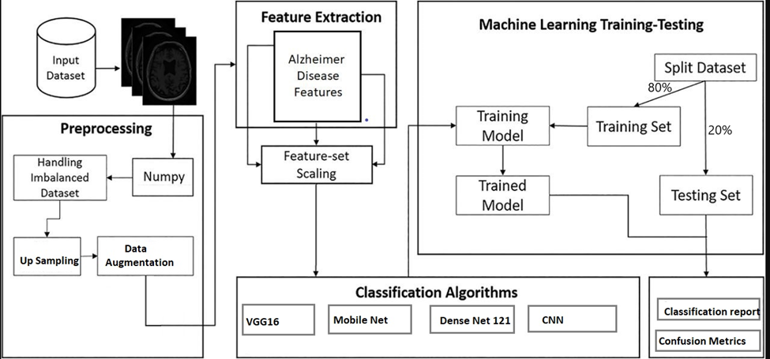
Research Framework

Slide 12
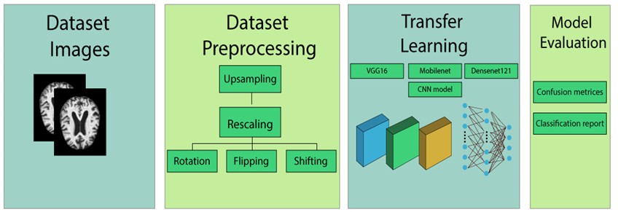
Algorithm’s Flowchart

Slide 13
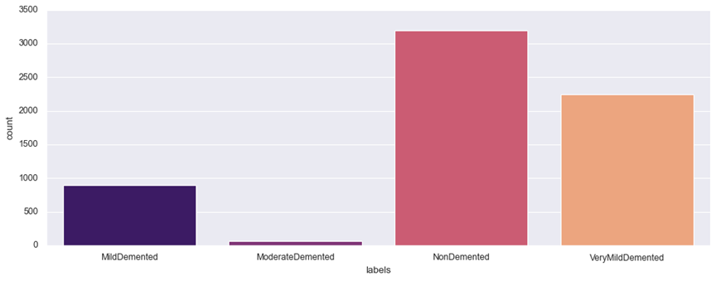
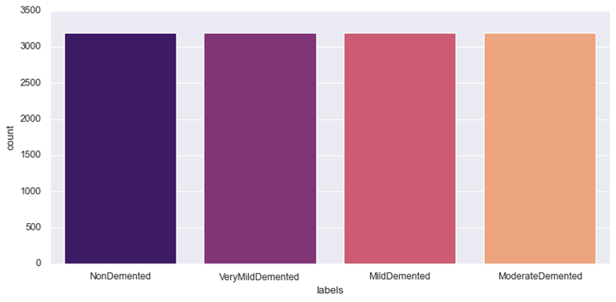
Data Pre-processing
Dataset before Up Sampling
Data Pre-processing is the Preparing of data for activities like data mining, machine learning, deep learning, and other data science tasks that allows us to utilise it more quickly and efficiently to get correct results.
Up Sampling: The dataset was imbalanced thus, to overcome this issue we have used up sampling of the images to balance the number of images in each class. Up sampling injects artificially produce data point according to minority class in to dataset. After this the number of each group almost equal, and model don’t tend to favour of majority class.
Dataset after Up Sampling

Slide 14
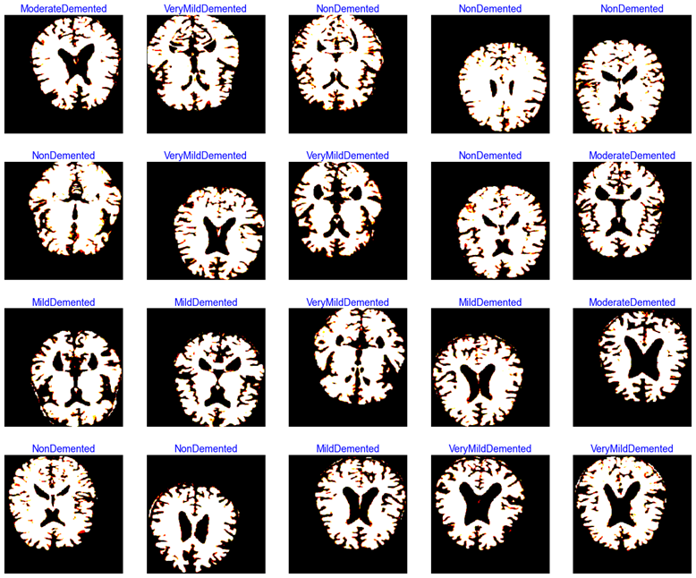
Data Augmentation
Data augmentation is a process of transferring images to create same pattern of images for the purpose training ML models. It’s crucial phase in dataset construction because the modern ML algorithms are quite strong .
Dataset After Augmentation

Slide 15
Data Splitting
In machine learning the data splitting is widely used to divide data in to test, train and validation. When the dataset split in two or more subset, the two part topically use to analyse test data and other use for train the model. In data science the data splitting especially use to construct data driven models.
Classes | Train | Valid | Test
Mild Demented | 1920 | 640 | 640
Moderate Demented | 1920 | 640 | 640
Non-Demented | 1920 | 640 | 640
Very Mild Demented | 1920 | 640 | 640
Dataset After Splitting

Slide 16
Transfer learning Technique for Deep learning Approach
One area of machine learning that has seen a lot of use in computer vision and data mining is transfer learning. Finding and obtaining useful knowledge from related learning domains in order to enhance performance in the intended learning area is known as transfer learning. There are several benefits of transfer learning.
Reusing pre-existing knowledge domain data, which leaves a significant amount of work undone.
It is not required to spend a significant price to receive and evaluate large amounts of new data.
With transfer learning good results can also be obtained with small data sets.
They may be rapidly translated and used to other sector that are emerging quickly to demonstrate responsive advantages.

Slide 17
Model Summary
The model summary for each model has been shown below, which contains the information of the shape of input layers, output layer, total parameters, trainable parameters and Non trainable parameters.
Models | Input shape | Output Layer | Total parameters | Trainable parameters | Non Trainable parameters
VGG16 | 224,224,3 | 4,1 | 27,829,060 | 13,112,324 | 14,716,736
Mobile net | 224,224,3 | 4,1 | 34,643,012 | 32,381,444 | 2,261,568
Densenet121 | 224,224,3 | 4,1 | 32,998,980 | 25,958,404 | 7,040,576
CNN model | 224,224,3 | 4,1 | 2,371,716 | 2,370,756 | 960

Slide 18
Model Training
Models have been trained on total fifty epochs, using both the training dataset and the validation dataset. Because of this, while the models were being trained, we monitored their values for training loss, training accuracy, validation loss, and validation accuracy.
Model | Epochs | Train loss | Valid loss | Train accuracy | Valid accuracy
Mobile net | 1 | 0.902 | 0.832 | 69.24 | 71.42
 | . | . | . | . | .
 | . | . | . | . | .
 | 49 | 0.342 | 0.103 | 94.61 | 93.32
 | 50 | 0.111 | 0.118 | 94.53 | 95.63
VGG16 | 1 | 0.652 | 0.714 | 78.31 | 73.68
 | . | . | . | . | .
 | . | . | . | . | .
 | 49 | 0.111 | 0.114 | 95.23 | 95.87
 | 50 | 0.009 | 0.122 | 97.52 | 96.88
Densenet121 | 1 | 0.712 | 0.722 | 69.54 | 70.23
 | . | . | . | . | .
 | . | . | . | . | .
 | 49 | 0.121 | 0.112 | 93.71 | 93.32
 | 50 | 0.112 | 0.141 | 95.83 | 95.65
CNN model | 1 | 0.812 | 0.922 | 49.54 | 52.12
 | . | . | . | . | .
 | . | . | . | . | .
 | 49 | 0.172 | 0.112 | 93.31 | 92.25
 | 50 | 0.192 | 0.131 | 92.33 | 94.26

Slide 19
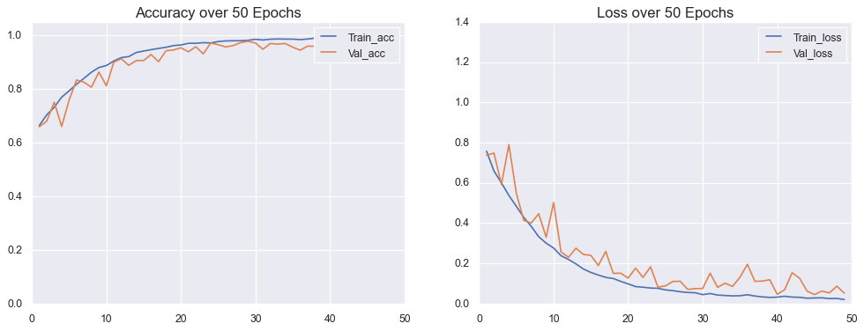
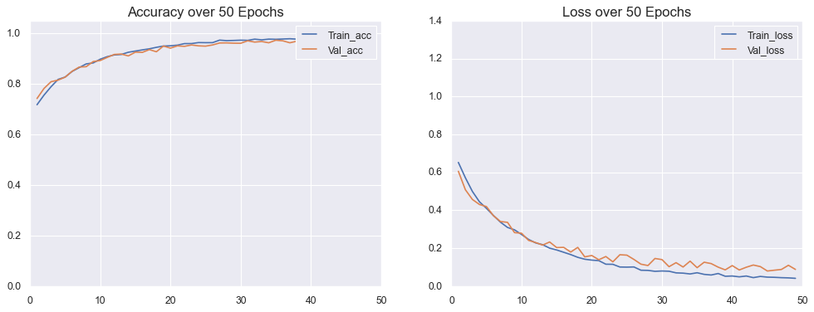
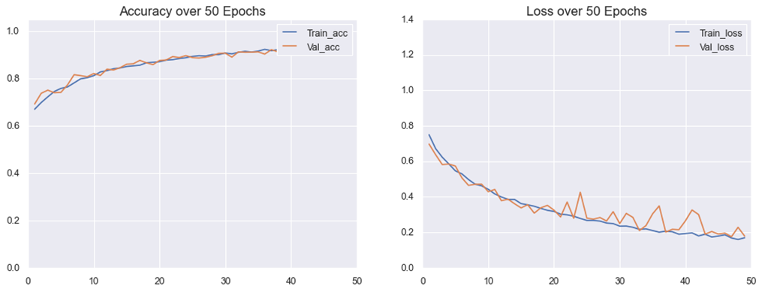
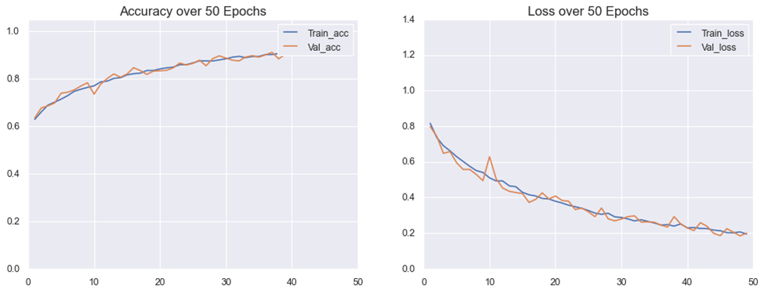
Loss Vs Accuracies Graph
The accuracy and loss curve are one of the most often used for evaluation development of neural networks. It is clear anyone use accuracy and loss curves for deep learning model knowledge.
CNN Model
VGG-16
Mobile Net Model
Dense Net 121

Slide 20
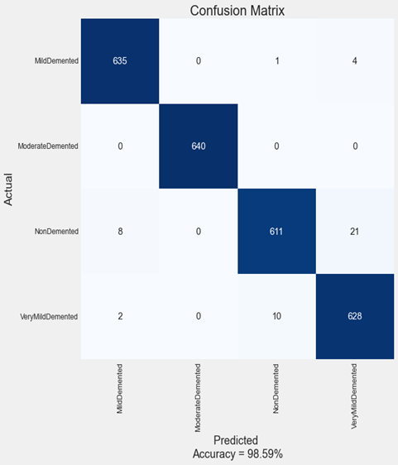
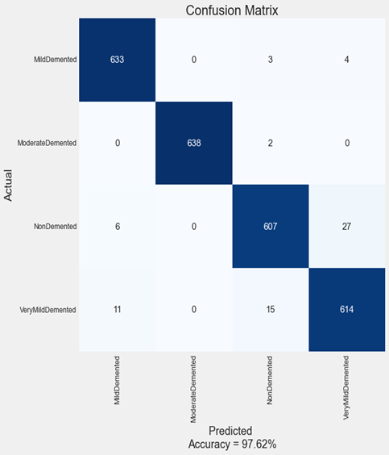


Confusion Metric
A confusion matrix is constructed from the results of prediction attempts made on a classification problem. Count values are utilised in order to describe the number of correct and incorrect predictions for each category. This is the key to deciphering the confusion matrix. Confusion matrices have been developed in order to classify post-training data as either true positives, true negatives, false positives, or false negatives.
CNN
VGG-16
Mobile Net
Dense Net121

Slide 21
Limitations
Data collected from single source, when tested with different source data, the model will not perform good
Model training has been done on limited number of epochs with limited number GPU resources.
Only three pre-trained model has been used, further models could be used where the each performance will vary accordingly to dataset.

Slide 22
Future Work
This research offers a lot of potential for the future of the healthcare sector since it primarily focuses on Alzheimer's disease detection. Given the circumstances, the following may be categorised as possible future paths.
1)- Training of model from various different sources dataset.
2)- Proposing an optimized dataset of Alzheimer’s which can be used for effective model training and testing phases.
3)- Optimizing the computational requirements for detection algorithm

Slide 23

Thank You

