Slide 1

IoT SAFE
Researcher: Mohammad Hossein Shafiee

Slide 2
Introduction
In this lecture, we will delve into the foundational elements of securing Internet of Things (IoT) applications through key cryptographic techniques outlined in the GSM Association’s “IoT.04 - Common Implementation Guide.” This guide underscores the use of SIM technology as a ‘Root of Trust’ for enhancing IoT security. We will explore the processes of key generation and Key Derivation Functions (KDF), both crucial for developing secure cryptographic keys, alongside the Advanced Encryption Standard (AES), a vital encryption protocol ensuring data confidentiality. Furthermore, practical scenarios will illustrate the IoT SAFE flow, showcasing how entities like MeterCo, SIMco, and EnergyCo use secure elements and key management to maintain secure communications in IoT environments. Through this comprehensive framework, we gain insights into leveraging existing infrastructure to fortify IoT systems against modern cybersecurity threats.

Slide 3
Key Generation
Choosing Key Size
Key Generation Methods
  Random Key Generation
  Password-Based Key Generation like PBKDF2, bcrypt, scrypt or HKDF.

Slide 4
Random Key Generation
Statistical Independece
Uniform Distribution
Unpredictability

Slide 5
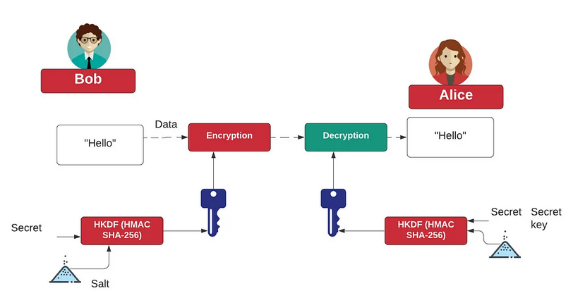
HKDF (HMAC-based Extract-and-Expand Key Derivation Function)
HMAC-based Extract-and-Expand Key Derivation Function (HKDF) is a method used to derive keys from a source of initial key material. It is designed to split, expand, or transform a given key into several additional cryptographic keys, each suitable for specific cryptographic operations. HKDF is widely used in protocols like TLS and various other security systems.

Slide 6


HKDF Phases
Extract Phase:
  Purpose: This phase extracts randomness from the initial key material to produce a fixed-length pseudorandom key.
  Method: Uses a Hash-based Message Authentication Code (HMAC) to process the initial keying material together with an optional salt (a non-secret random value).
  Output: A pseudorandom key (PRK), which can then be used in the expand phase.
  PRK is the pseudorandom key.
  HMAC is the HMAC function using a chosen hash algorithm (e.g., SHA-256).
  Salt is an optional but highly recommended random value.
  IKM is the initial key material.
Expand Phase:
  Purpose: Expands the pseudorandom key into multiple cryptographic keys.
  Method: Uses the PRK and additional context information (info) to derive a series of output keys of desired length.
  Output: The derived keys are used in cryptographic operations.
  OKM is the output key material.
  PRK is the pseudorandom key from the extract phase.
  Info is optional context and application-specific information.
  L is the length in bytes of the output key material.

Slide 7
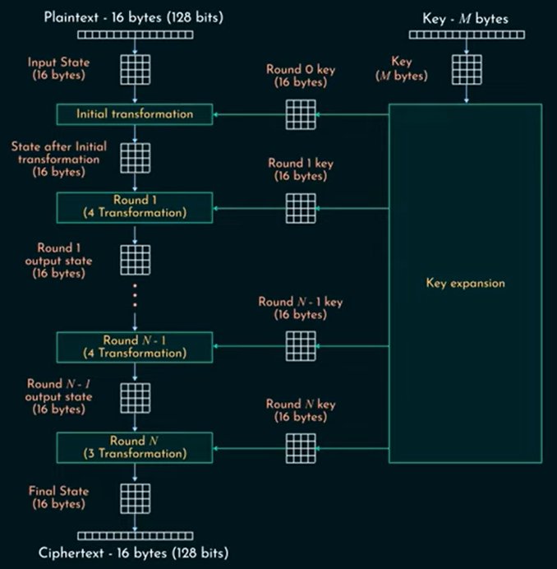
AES
AES (Advanced Encryption Standard) is one of the most widely used symmetric-key encryption algorithms. It’s employed globally for securing sensitive data, including in fields like banking, communication, government, and more.

Slide 8
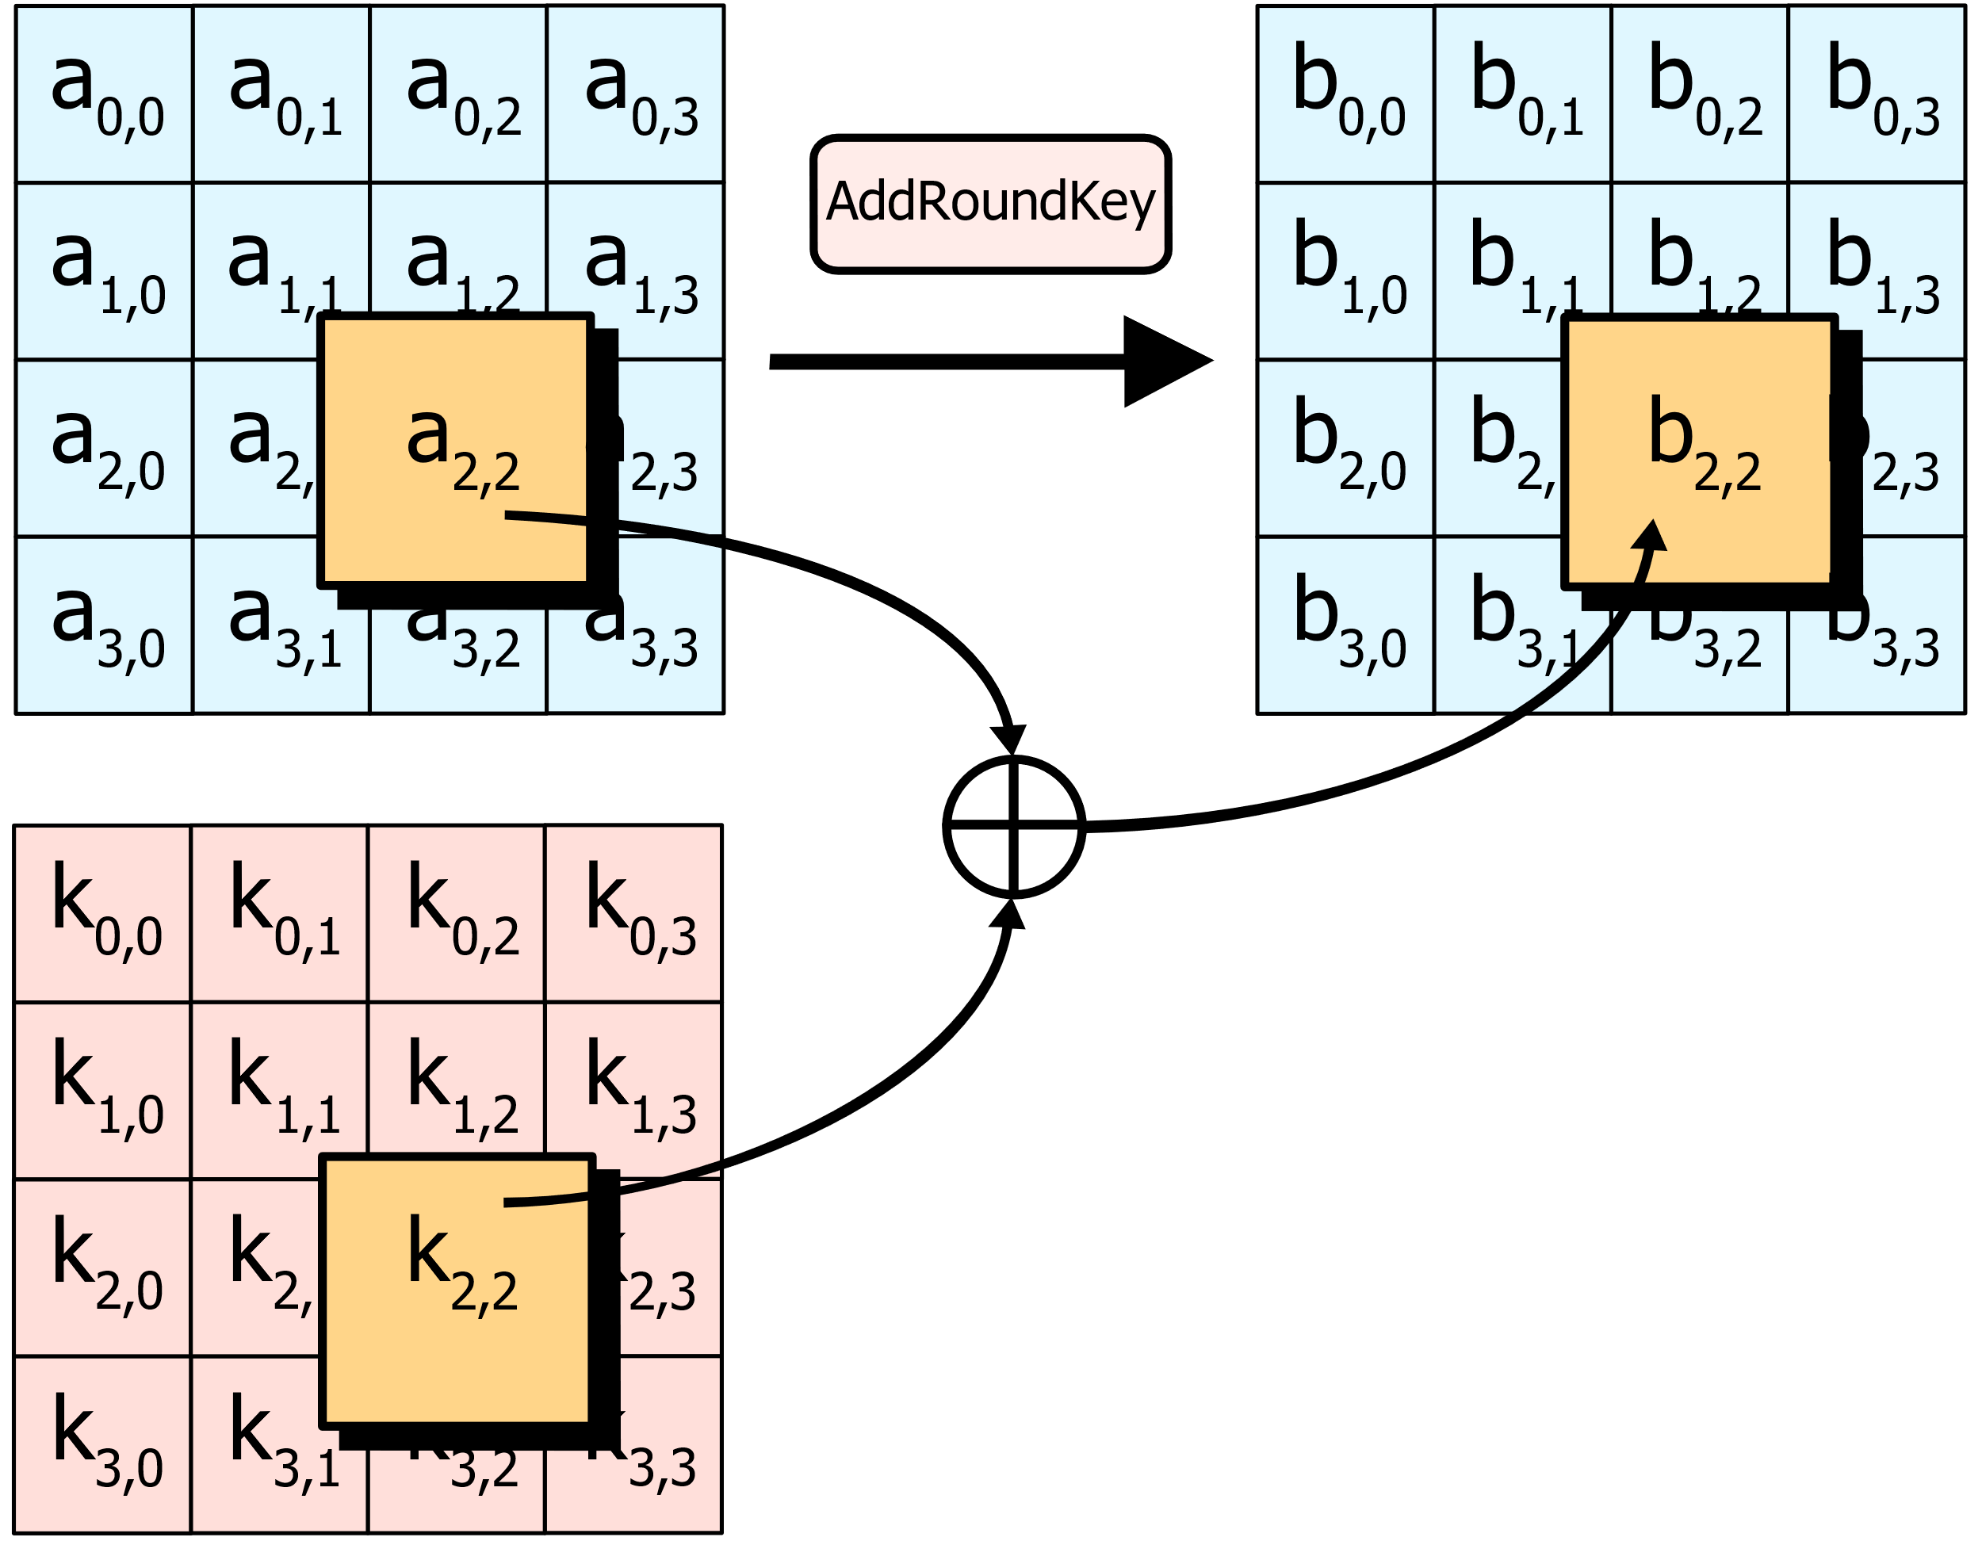
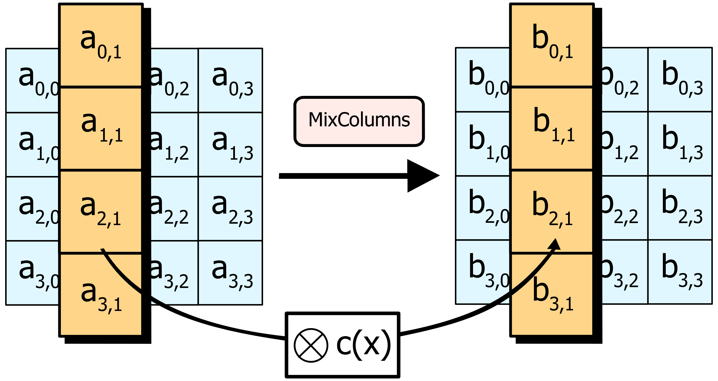
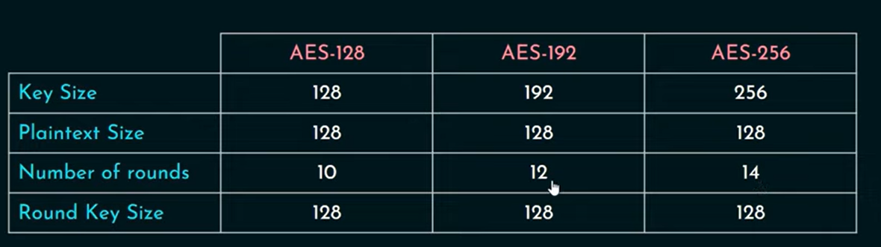
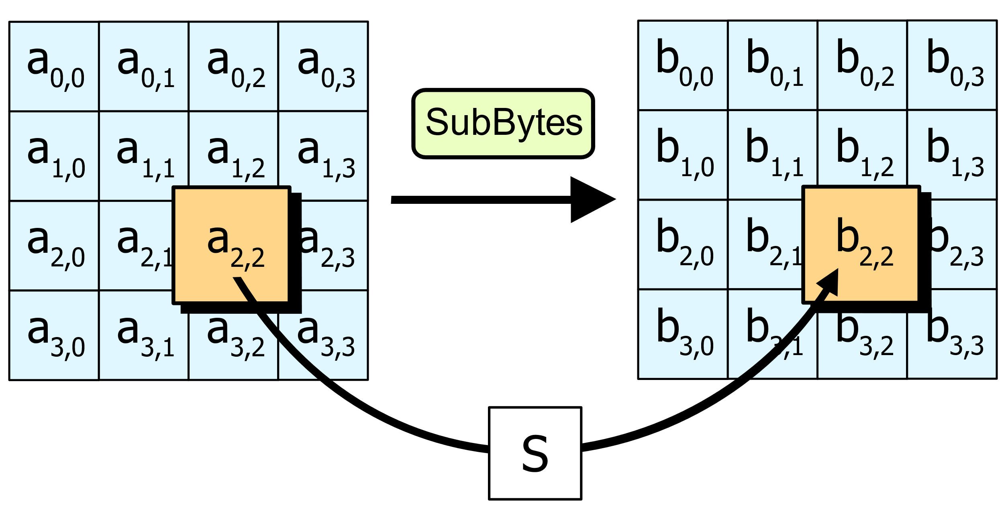
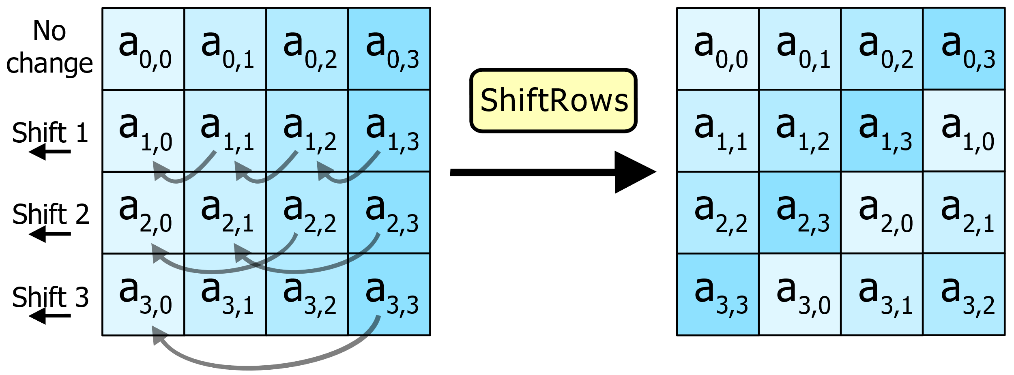
How AES Works?

Slide 9
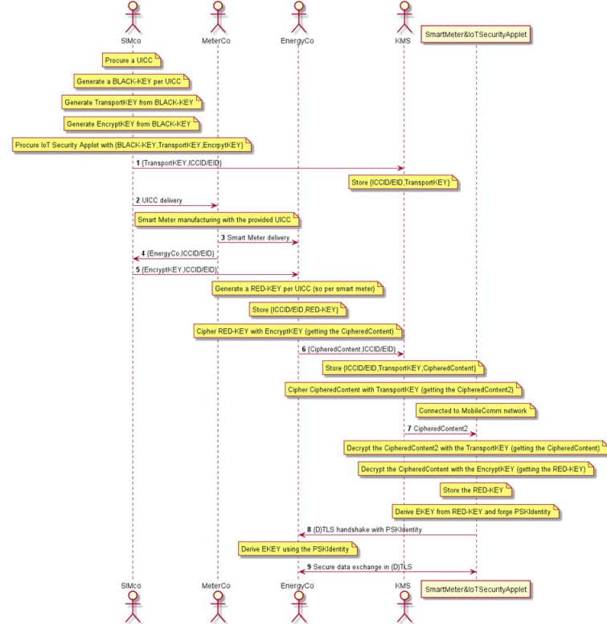
Scenario 3 (PSK#1: UICC manufactured and pre-loaded with set of keyloading keys for application owner to manage their own keys

