Slide 1

Verification Algorithms
Researcher: Mohammad Hossein Shafiee

Slide 2
Explanation of the problem
In OTA communication, a SIM card needs to send data, such as a generated string, to a server securely. However, SIM cards often lack a real-time clock, meaning timestamps cannot be used to verify the freshness or authenticity of the message. This raises a critical question: how can the server ensure that the message it receives is both untampered and genuinely sent by the specific SIM, without relying on timestamps? Additionally, the solution must prevent replay attacks, where an attacker might resend previously intercepted valid messages to deceive the server.

Slide 3
Challenges
HMAC (Hash-based Message Authentication Code), defined in RFC 2104, ensures message integrity and authenticity by combining a secret key with a message using a hash function like SHA-256. While its core structure is fixed, elements like the hash function, key management, and MAC truncation can be customized. HMAC does not rely on timestamps, making it suitable for systems like SIM cards without real-time clocks, but it requires other mechanisms, such as nonces or sequence numbers, to prevent replay attacks. Altering HMAC’s design is discouraged, as it may weaken security or cause compatibility issues.

Slide 4
Basic Components in the Scenario
Shared Secrets: Key that is pre-configured between the SIM and the server.
SIM Card: Contains unique identifiers like IMSI, phone number, and shared secrets.
Server: Verifies the authenticity of the messages sent by the SIM.
Nonces: a Random generated number for each communication.

Slide 5
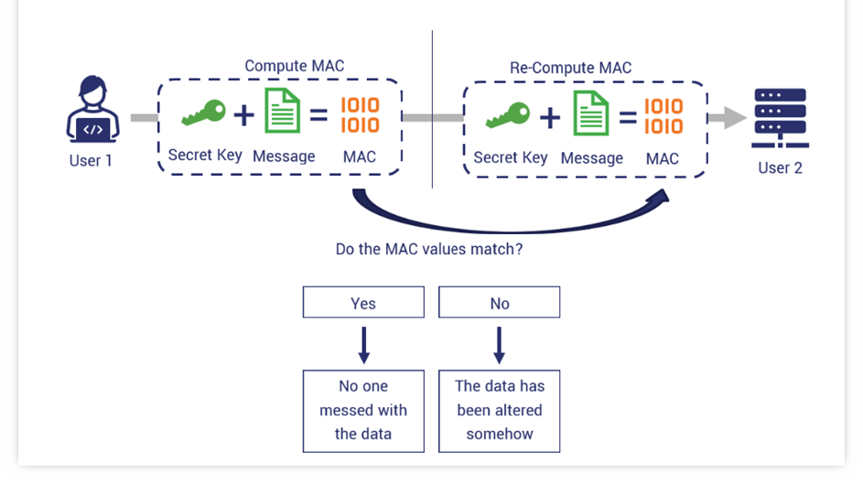
Message Authentication Code (MAC)
A Message Authentication Code (MAC) ensures a message’s integrity and authenticity using a secret key. The sender generates the MAC, and the receiver verifies it with the same key, protecting against tampering and unauthorized changes.

Slide 6
MAC Algorithms
HMAC (Hash-based MAC)
  HMAC combines a cryptographic hash function (e.g., SHA-256) with a secret key to generate a secure authentication code. It is widely used for its simplicity, flexibility, and strong integrity guarantees, appearing in protocols like TLS and securing API requests. HMAC is efficient and suitable for both software and hardware.
CBC-MAC (Cipher Block Chaining MAC)
  CBC-MAC uses a block cipher (e.g., AES) in CBC mode to authenticate messages. The final block of the ciphertext serves as the MAC. It is secure for fixed-length messages but requires extra precautions for variable-length ones. CBC-MAC is efficient where block ciphers are already in use.

Slide 7
MAC Algorithms
CMAC (Cipher-based MAC)
  CMAC improves CBC-MAC by securely handling variable-length messages using additional key transformations. Based on block ciphers like AES, CMAC is efficient, secure, and standardized, making it suitable for protocols like wireless communication and DRM.
PMAC (Parallelizable MAC)
  PMAC is a block cipher-based MAC designed for parallel processing, allowing faster computation compared to CBC-MAC. It securely handles variable-length messages and is ideal for high-performance applications that support parallelism.

Slide 8
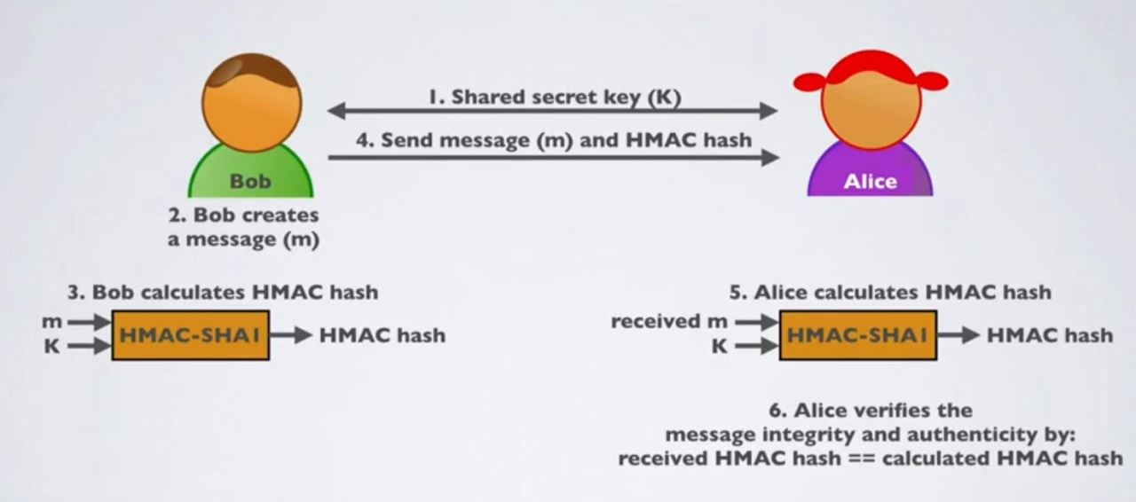
Hash based Message Authentication Code (HMAC)

Slide 9
Nonces in HMAC
Nonces in HMAC are unique, one-time values included in the message to prevent replay attacks by ensuring each message is distinct, even if the content is repeated. A nonce can be generated by either the sender (e.g., SIM) or the receiver (e.g., server) and is typically included as part of the message before the HMAC calculation. The receiver verifies the nonce to ensure it hasn’t been reused, maintaining the integrity and freshness of the communication. Proper management of nonces, such as storing them to detect reuse or using them in conjunction with timestamps or counters, is critical to securing the system against attacks.

