Slide 1
SOFTWARE DESIGN PATTERN · LAB FINAL · AUGUST 2026
MartFlow
Supershop Retail Management Suite
POS
Inventory
Purchasing
Loyalty
Returns
NBR VAT Reports
Presented by MD Mahamudul Hasan · Sumya Soma · Alfa Sany
github.com/MHMITHUN/MartFlow-Supershop-POS
Notes:
Good morning, everyone. We are presenting MartFlow — a complete Supershop Retail Management Suite, built for Bangladeshi supershops like Shwapno, Meena Bazar, and Unimart. MartFlow handles POS billing, inventory, purchasing, loyalty, returns, and NBR VAT reports in one system — and it is powered by eighteen Gang-of-Four design patterns doing real work in the money path, verified by 176 automated tests. I am Mahamudul Hasan, and with me are Sumya Soma and Alfa Sany.

Slide 2
SLIDE 02 · THE TEAM
Three Voices, Fifteen Minutes
One product story told in three acts — product, patterns, payoff.
MD Mahamudul Hasan
SLIDES 1–10 · THE PRODUCT
Lead Developer & System Architect
The real-life problem, the live screens, four roles & three security layers, the tech stack.
Sumya Soma
SLIDES 11–20 · THE ENGINE ROOM
All 18 GoF design patterns — grouped by the story they power: checkout, pricing, payments, inventory, reports.
Alfa Sany
SLIDES 21–30 · THE PAYOFF
Uniqueness, business value, quality engineering, the live demo plan and the close.
30 slides · 15 minutes · 18 GoF patterns · 176 automated tests · 1 product
MartFlow · Supershop Retail Management Suite
02 / 30 · MD Mahamudul Hasan
Notes:
Here is our roadmap for the next fifteen minutes, split into three parts. I will walk you through the product — the real-life problem, the live screens, the roles, and the tech stack. Then Sumya will take you into the engine room and explain all eighteen design patterns, each mapped to a real feature it powers. Finally, Alfa will show what makes MartFlow unique, its business value, our quality engineering, and the live demo plan. Together, the story is simple: a patterns lab that became a real product.

Slide 3
SLIDE 03 · THE PROBLEM
Running a Supershop on a Patchwork
The Shwapno / Meena Bazar / Unimart class — plus hundreds of mid-size local chains.
✗ Imported POS software
— doesn't understand Bangladesh VAT law or NBR slabs
✗ Spreadsheets for purchasing
— supplier dues, POs and real costs tracked by hand
THE RESULT
"The owner finds out weeks late."
Stock that walked out the door.Batches that expired on the shelf.Margins that quietly eroded.
Every mid-size shop in Bangladesh feels this daily — it is a software gap, and that gap is MartFlow's reason to exist.
✗ Notebooks for loyalty
— member points and prices live on paper
✗ Nothing for wastage
— damage, expiry and theft stay invisible until it's too late
MartFlow · Supershop Retail Management Suite
03 / 30 · MD Mahamudul Hasan
Notes:
Let's start with the problem. A Bangladeshi supershop today runs on a patchwork of tools. The POS software is usually imported and doesn't understand Bangladesh VAT. Purchasing lives in spreadsheets. Loyalty lives in notebooks. And wastage — damaged, expired, stolen stock — is tracked by nothing at all. The owner finds out about problems weeks late: stock that walked out the door, batches that expired on the shelf, margins that quietly eroded. Hundreds of mid-size shops face this every single day. That is the gap MartFlow fills.

Slide 4
SLIDE 04 · ORIGIN STORY
From Patterns Lab to Product
MartFlow began as a patterns lab — and was rebuilt, honestly, into a product.
v1.0 — THE LAB BUILD
v1.1 — MARTFLOW
✗ No login at all
— "?as=admin" in the URL made you admin
REBUILT
✓ Real authentication
— PBKDF2 hashes + 256-bit bearer tokens, 12 h
✗ One shared cart
— every visitor billed into the same common cart
✓ Per-session bills
— BillingSessionRegistry, one bill per cashier token
✗ Tax theatre
— VAT displayed on screen, never actually charged
✓ NBR-correct VAT
— inclusive, back-calculated, pinned by tests
✗ Amnesia
— all stock lost on every restart
✓ Durable by default
— MongoDB Atlas with zero-config in-memory fallback
MartFlow · Supershop Retail Management Suite
04 / 30 · MD Mahamudul Hasan
Notes:
MartFlow has an honest origin story: it began as a patterns lab and was rebuilt into a product. Our earlier version had serious sins. There was no login — typing '?as=admin' in the URL made you an admin. Every visitor shared one common cart. Tax was displayed on screen but never actually charged. And all stock was lost on restart. In the rebuild, every one of these became a real feature: real authentication, per-session bills, NBR-correct VAT, and durable persistence. That discipline shaped everything you'll see today.

Slide 5
SLIDE 05 · THE SOLUTION
One System, Six Pillars
Everything the patchwork couldn't do — in a single web app.
POS Billing
Barcode scan, weighed goods, split tender, 1-tap undo, thermal receipts
Inventory
Batches & expiry dates, reorder levels, shrinkage write-offs
Purchasing
Suppliers & terms, PO lifecycle, GRN intake, payables
Loyalty
Members by phone, 5% member price, points earned & redeemed as tender
Returns
Receipt lookup, partial per-line returns, pro-rata refunds to original channel
Reports
8 types incl. NBR VAT summary & profit — all CSV-exportable
Boots ready to believe: first start seeds a realistic BD shelf — Teer, Pran, Radhuni, Miner — 3 distributors, active promotions, 5 loyalty members, and 1 purchase order already on its way.
MartFlow · Supershop Retail Management Suite
05 / 30 · MD Mahamudul Hasan
Notes:
So what is MartFlow? One system, six pillars: point-of-sale billing, inventory with batch and expiry tracking, purchasing with suppliers and purchase orders, a loyalty program, customer returns with refunds, and financial reports including the NBR VAT summary. The moment you start it, the database seeds a realistic Bangladeshi shelf — Teer, Pran, Radhuni, Miner — three distributors, active promotions, five loyalty members, and even a purchase order already on its way. It boots ready to demo, ready to believe.

Slide 6
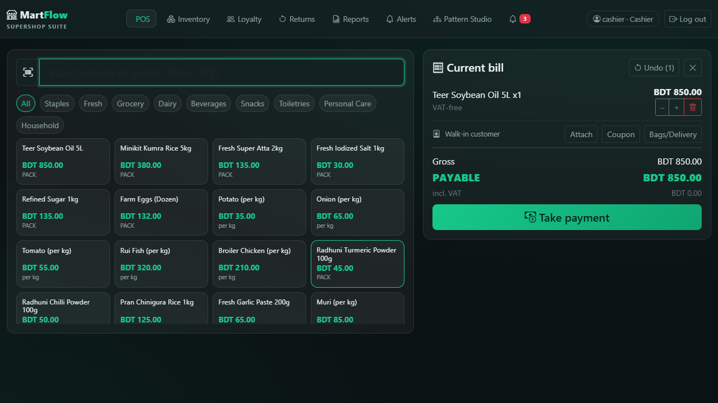
SLIDE 06 · PRODUCT TOUR 1/3
The Cashier's World — POS Billing
• Scan → sold. Barcode 8941234500011 pulls up Teer Oil 5L instantly; 8 name suggestions; 24-item quick-pick grid
• Weighed goods. Potato, fish, onion — weight prompt, 0.25 kg steps
• Split tender. Cash + card + bKash + Nagad + loyalty points in any mix, with live tendered / change
• Forgiving. One-tap Undo (10 levels), pencil-edit weight, clear bill
• Fast. Enter → print 320-px thermal receipt → next customer
localhost:8080/#/pos — cashier
MartFlow · Supershop Retail Management Suite
06 / 30 · MD Mahamudul Hasan
Notes:
This is the cashier's world — the POS screen. Scanning barcode 8941234500011 pulls up Teer Oil five-litre instantly. Weighed goods like potato or fish prompt for weight and step by 0.25 kilograms. The bill accepts split tenders — cash, card, bKash, Nagad, and loyalty points in any mix — with tendered and change amounts live. A mis-scan? One tap on Undo. When the customer pays, Enter prints the thermal receipt and moves to the next customer in under a second.

Slide 7
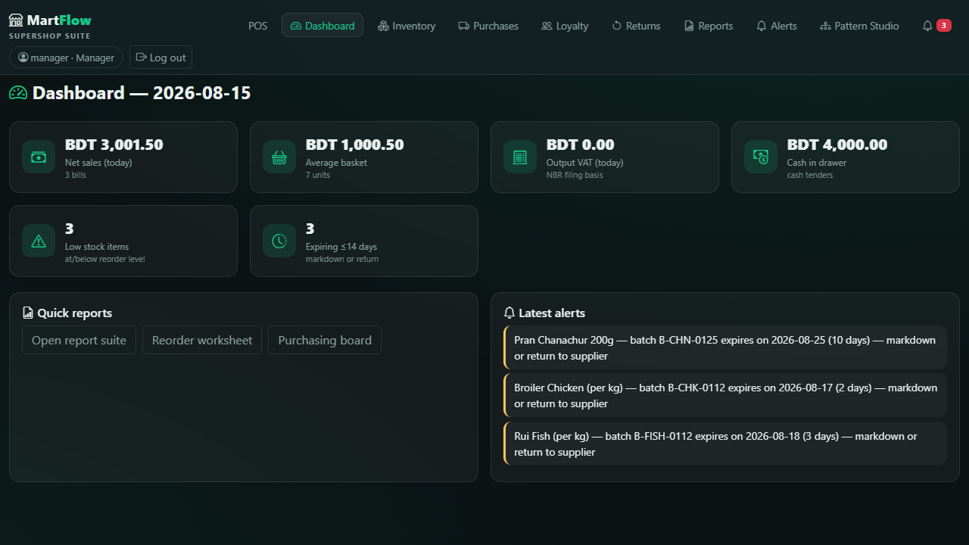
SLIDE 07 · PRODUCT TOUR 2/3
The Manager's Cockpit — Dashboard
SIX KPI TILES — THE PULSE
localhost:8080/#/dashboard — manager
Net Sales today, live
Average Basket today
Output VAT today, NBR-ready
Cash in Drawer running
Low Stock item count
Expiring ≤ 14 days watch list
Alerts feed refreshes every 8 s. The owner finds out today — not weeks late.
MartFlow · Supershop Retail Management Suite
07 / 30 · MD Mahamudul Hasan
Notes:
One level up is the manager's cockpit — the dashboard. Six KPI tiles give the pulse of the business at a glance: today's net sales, average basket, today's output VAT, cash in drawer, low-stock count, and items expiring within fourteen days. Below them, an alerts feed refreshes every eight seconds — low stock, expiry warnings, shrinkage, price changes. This is the 'owner finds out today, not weeks late' promise, delivered as a screen the manager actually keeps open.

Slide 8
SLIDE 08 · ACCESS CONTROL
Four Roles, Three Locks
Fraud prevention by design, not by trust — enforced server-side, twice.
CASHIER
Billing, returns, operational views
MANAGER
+ catalog, purchasing, promotions, reports, void, day close
ADMIN
+ staff accounts, password resets, item deletion
DEVELOPER
Till screens + Developer Mode — zero business power
EVERY WRITE PASSES THREE LOCKS
1 · UI hides it
2 · RoleGate rejects it (server)
3 · RoleGuardProxy blocks it at the data layer
UNDER THE HOOD
PBKDF2 password hashing · 32-byte (256-bit) random bearer tokens, 12 h sliding · ThreadLocal RoleContext — set on request, cleared in finally
MartFlow · Supershop Retail Management Suite
08 / 30 · MD Mahamudul Hasan
Notes:
MartFlow serves four roles — cashier, manager, admin, and a developer account for examiners — and security is enforced in three independent layers. The UI hides what a role shouldn't see. The server's RoleGate rejects forbidden calls. And critically, RoleGuardProxy re-checks permission at the data boundary itself — so even a buggy endpoint can't let a cashier edit the catalog. Passwords are PBKDF2-hashed, sessions use random 256-bit bearer tokens, and role context is thread-local, set and cleared on every request.

Slide 9
SLIDE 09 · UNDER THE HOOD
The Stack — Clean on Purpose
Spring carries the HTTP. The domain stays pure — and that's the point.
Language
Java 17 · Maven wrapper — no install needed
Backend
Spring Boot 3.4, web-starter only · 15 thin controllers
Domain
100% plain POJOs — zero framework annotations
Data
MongoDB Atlas — with zero-config in-memory fallback at startup
Frontend
Dependency-free vanilla JS SPA · 15 routes · dark / light theme
Money & Time
BigDecimal via one MoneyUtil choke point · TimeSource → Asia/Dhaka
~70 REST endpoints · domain never imports Spring · tests pin an invalid MONGODB_URI — fully hermetic, no DB can leak in
MartFlow · Supershop Retail Management Suite
09 / 30 · MD Mahamudul Hasan
Notes:
The stack is deliberately clean. Java 17 and Spring Boot, but Spring only touches thin controllers — the entire domain is one hundred percent plain POJOs with zero framework annotations, which keeps the patterns honest and the domain unit-testable. Data lives in MongoDB Atlas, with a zero-configuration in-memory fallback, chosen automatically at startup. The frontend is a dependency-free vanilla JavaScript single-page app with fifteen routes. Every amount is BigDecimal with one rounding choke point, and all clocks are pinned to Asia/Dhaka.

Slide 10
SLIDE 10 · SCOREBOARD
The Numbers — All Verifiable
18
GoF patterns · 4 creational · 5 structural · 9 behavioral
176
automated tests · in 31 test classes
~190
production files · ~17,000 lines of code
8
report types · on one Template Method
6
PO states · in the State machine
4
roles · behind 3 security layers
5
payment channels · behind one Adapter port
10
levels of undo · via Memento snapshots
NEXT → SUMYA SOMA — inside the engine room: how 18 patterns carry the money path
MartFlow · Supershop Retail Management Suite
10 / 30 · MD Mahamudul Hasan
Notes:
Before I hand over, the scoreboard. Eighteen design patterns — four creational, five structural, nine behavioral. One hundred seventy-six automated tests in thirty-one test classes. Around one hundred ninety production files, roughly seventeen thousand lines of code. Eight report types, six purchase-order states, four roles, three security layers. Every number on this slide is verifiable in the repository — and in the app's built-in Developer Mode. [HANDOVER] Now, Sumya will take you inside the engine room, where every one of those eighteen patterns does real work.

Slide 11
SLIDE 11 · SECTION 2 — SUMYA SOMA
The Engine Room: 18 Patterns, One Rule
"A pattern earns its place only by carrying a real feature. Nothing here is decoration — delete any pattern and a feature you saw on screen breaks."
CREATIONAL · 4
STRUCTURAL · 5
BEHAVIORAL · 9
Singleton
Adapter
Observer
Strategy
Factory Method
Decorator
Command
Template Method
Facade
Chain of Responsibility
Builder
Proxy
State
Visitor
Prototype
Composite
Memento
Iterator
PatternCatalog + drift-guard test: the build fails if a pattern card cites a class that doesn't exist.
MartFlow · Supershop Retail Management Suite
11 / 30 · Sumya Soma
Notes:
Thank you, Hasan. My section is the engine room: eighteen Gang-of-Four patterns, and our one rule — a pattern earns its place only by carrying a real feature. Four creational, five structural, nine behavioral. Nothing here is decoration; delete any pattern and a feature you saw on screen breaks. And this isn't just a claim — the app ships a Pattern Catalog with a drift-guard test that fails the build if a card cites a class that doesn't exist. Here they are by story, not by chapter.

Slide 12
SLIDE 12 · CREATIONAL × 4
How Objects Are Born
Every creation pattern answers a real shop-floor need.
SINGLETON One stock truth per process
InventoryCatalog is the single authority — two tills can never oversell the same shelf. DatabaseConnection owns the one shared client.
catalog/InventoryCatalog.java · persistence/DatabaseConnection.java
FACTORY METHOD One 'Add Item' path
ProductFactory validates shared input, then the subclass decides: UnitProductFactory for per-piece, WeighedProductFactory for per-kg.
catalog/ProductFactory.java
BUILDER No half-built purchase orders
PurchaseOrderBuilder assembles line by line (fluent); build() enforces ≥1 line and mints the PO number — incomplete POs cannot escape.
suppliers/PurchaseOrderBuilder.java
PROTOTYPE The weekly restock clone
StandingOrderTemplate.instantiate() clones the template into a fresh DRAFT PO — the weekly order is cloned, never retyped. 2 clicks instead of 15.
suppliers/StandingOrderTemplate.java
MartFlow · Supershop Retail Management Suite
12 / 30 · Sumya Soma
Notes:
First, creation. Singleton gives the whole process one stock truth — InventoryCatalog — so two tills can never oversell the same shelf. Factory Method gives one 'add item' path that creates per-piece or per-kilogram products — the manager never picks a class, the factory subclass does. Builder assembles a purchase order line by line and validates on build — a half-configured PO simply cannot escape. And Prototype is the weekly restock template: the standing order is cloned into a fresh draft — two clicks instead of fifteen.

Slide 13
SLIDE 13 · THE CHECKOUT GATE
Chain of Responsibility + Command
Six checks before money moves — then a tender that can undo itself.
CHAIN OF RESPONSIBILITY — VALIDATION
Bill not empty
Weighment done
Stock available
Promo eligible
Card valid
Tender enough
ValidationChain.validate() returns the FIRST failing rule — the cashier sees exactly what to fix, before money moves.
COMMAND — REVERSIBLE TENDER
Reserve Stock
Charge Tender
Award Points
Create Sale
declined card → reverse-order rollback: stock, points & sale restored
BillingInvoker runs four commands; on failure it unwinds them in reverse — the sale is atomic because every step can undo itself. No phantom sales. No lost stock.
MartFlow · Supershop Retail Management Suite
13 / 30 · Sumya Soma
Notes:
Now the money path. Before money moves, Chain of Responsibility runs six validations in order — bill not empty, weighed items weighed, stock available, promotion eligible, card valid, tender sufficient — and the cashier sees the exact first failing rule. Then Command executes the sale as four reversible commands: reserve stock, charge tender, award points, create sale. If the card declines, the invoker unwinds everything in reverse order. The sale is atomic because every step can undo itself.

Slide 14
SLIDE 14 · PRICING AT RUNTIME
Strategy + Decorator
Two patterns cooperate: one decides the price, the other applies it.
STRATEGY — WHO DECIDES THE PRICE
PromotionEngine.strategyFor(line, customer) picks per line, per day:
DECORATOR — HOW IT'S APPLIED
Each fee/discount is a transparent wrapper over the real line:
RegularPrice — no promotion
RoundOffAdjustment — cash rounding 223.75 → 224
CategorySale — date-windowed, e.g. Grocery −10%
CarryBagFee +5 — bags & delivery
MemberPrice — loyalty −5%
LineDiscount −10% — the promotion
Teer Oil 5L · 1,250 — the real line
Manager toggles a sale in the back office → the till follows at once. Billing code never changes.
Strategy returns a decorated line — the patterns compose instead of competing.
MartFlow · Supershop Retail Management Suite
14 / 30 · Sumya Soma
Notes:
Pricing is where two patterns cooperate. Strategy decides today's price for every line — regular price, category sale, or member price — chosen at runtime by the promotion engine. Decorator then wraps any line with discounts, carry-bag fees, delivery fees, and cash rounding — each a transparent layer over the original line. Together they deliver something the shopkeeper feels: a manager toggles a category sale in the back office, and the till's price changes live — without a single line of billing code changing.

Slide 15
SLIDE 15 · THE MONEY PORT
Adapter + Facade
Five vendor dialects behind one port — and one door into the whole pipeline.
FACADE — ONE DOOR
Every UI button is one call on BillingFacade, which hides sessions, pricing, validation, commands, channels and loyalty:
ADAPTER — ONE PORT, FIVE DIALECTS
PaymentChannel speaks BigDecimal (charge / refund). Billing never branches on tender type:
addLine()
CashAdapter
plain arithmetic
updateLine()
CardAdapter
terminal speaks doubles + int codes
setCustomer()
BkashAdapter
merchant API speaks poisha longs
setCoupon()
undo()
NagadAdapter
API speaks strings
tender()
PointsAdapter
loyalty points as tender
MartFlow · Supershop Retail Management Suite
15 / 30 · Sumya Soma
Notes:
Payments are messy in real life: the card terminal speaks doubles, bKash speaks poisha longs, Nagad speaks strings. Our Adapter puts all five channels — cash, card, bKash, Nagad, points — behind one PaymentChannel port speaking BigDecimal, so billing never branches on tender type. Facade then hides the entire pipeline — sessions, pricing, validation, commands, channels, loyalty — behind one-call operations like addLine, tender, and undo. Every UI button is one facade call.

Slide 16
SLIDE 16 · EVENT-DRIVEN STOCK
Observer + Iterator
The shelf announces; the back office reacts — and everyone walks it the same way.
OBSERVER — THE SHELF TALKS
Product implements StockSubject. On every stock move it fires a StockEvent:
ITERATOR — NAMED WALKS
Four re-iterable walks over the same shelf:
RESTOCK
LOW_STOCK
PRICE_CHANGE
EXPIRY_SOON
SHRINKAGE
InStockIterator — what can be sold now
→ AlertService — files it into the alerts feed
LowStockIterator — what needs reordering
→ ReorderSuggestionObserver — turns LOW_STOCK into restock hints
ExpiringSoonIterator — the 14-day watch list
→ ExpiryWatcher — sweeps batches about to expire
PriceRangeIterator — for price editing
New listener tomorrow = one new observer class, zero changes to Product.
The low-stock VIEW and the low-stock REPORT share one iterator — they can never disagree with each other.
MartFlow · Supershop Retail Management Suite
16 / 30 · Sumya Soma
Notes:
Inventory is event-driven. Every product is an Observer subject: when stock moves, it announces an event — restock, low stock, price change, expiry soon, shrinkage — and independent observers react: one files the alerts feed, one generates reorder suggestions, one sweeps expiring batches. A new listener tomorrow means a new observer class and zero changes to Product. Iterator adds named, re-iterable walks over the same shelf — so the low-stock view and report share one iterator and can never disagree.

Slide 17
SLIDE 17 · THE BILL ITSELF
Composite + Visitor
One line that stocks truthfully — and one traversal that feeds three outputs.
COMPOSITE — THE EID HAMPER
ComboProduct sells as ONE line — but stocks truthfully:
VISITOR — ONE TRAVERSAL, THREE OUTPUTS
BillItemVisitor — 8 visit() overloads, double dispatch, zero instanceof:
Eid Hamper (ComboProduct)
Teer Oil 1L · Pran Ghee 500g · Miner Water 1L — the components
→ VatVisitor — output VAT per NBR rate slab
→ ProfitVisitor — margin = net of VAT − COGS
getStock() → scarcest component
→ ReceiptFormatterVisitor — the 38-column thermal slip
consume() → fans out to every part
Same visitor also walks reloaded history — a reprint months later shows exactly what was charged.
Combo-in-combo rejected — the tree stays one level deep, on purpose.
MartFlow · Supershop Retail Management Suite
17 / 30 · Sumya Soma
Notes:
Two patterns shape the bill itself. Composite makes an Eid hamper sell as one line but stock truthfully — its availability is the scarcest component, and consuming it fans out to every part inside. Visitor then traverses the finished bill by double dispatch — one interface, eight overloads, three outputs: the VAT visitor computes output VAT per NBR slab, the profit visitor margins, the receipt visitor the thermal slip. One traversal — no instanceof chains anywhere.

Slide 18
SLIDE 18 · GOVERNANCE
Proxy + State
Who may write — and which transitions are even possible.
PROXY — THE ROLE WALL AT THE DATA LAYER
STATE — THE PO LIFECYCLE
The rules live INSIDE the state objects — illegal transitions don't exist as methods:
Cashier calls save()/delete()
DRAFT
ORDERED
PART. REC'D
RECEIVED
CLOSED
RoleGuardProxy<T> wraps Repository
ProductWritePolicy checks role
CANCELLED
✓
a DRAFT physically cannot be received
AccessDeniedException — before the data moves
✓
a CLOSED PO cannot be cancelled
Reads pass through untouched. Even a buggy controller can't let a cashier mutate the catalog.
✓
a terminal state stays terminal
Meanwhile a sale's status is a plain enum — sales have no per-status behavior. Honest asymmetry.
MartFlow · Supershop Retail Management Suite
18 / 30 · Sumya Soma
Notes:
Governance gets two patterns. Proxy — RoleGuardProxy — wraps the product repository and enforces write policy at the data boundary: reads pass through, saves and deletes are checked — a cashier cannot mutate the catalog even through a buggy endpoint. State guards the purchasing lifecycle — draft, ordered, partially received, received, closed, cancelled — with the rules living inside the state objects. A draft PO physically cannot be received; a closed one cannot be cancelled. Illegal transitions don't exist as methods.

Slide 19
SLIDE 19 · REPORTS & UNDO
Template Method + Memento
Eight reports from one skeleton — and a cashier safety net, ten deep.
TEMPLATE METHOD — ONE SKELETON, EIGHT REPORTS
AbstractReportGenerator.generate() is FINAL — pull sales in range, aggregate, format. Each report fills 3 hooks:
MEMENTO — THE UNDO BUTTON
Before every destructive edit, BillingSession snapshots the bill into an opaque BillMemento — a Deque, 10 deep:
name()
headers()
aggregate(List<Sale>)
snapshot #10
Daily Sales
Best Sellers
Profit
VAT Summary
snapshot #9
Returns
Staff Perf.
Low Stock
Expiry
snapshot #8
The invariant lives once: "VOIDED never counts as revenue" — decided in the base class, inherited by all 8.
snapshot #7
undo() → restoreInto(bill) — one tap, exact state
A new report is 3 hooks — never a copy-pasted loop.
The bill doesn't know how it's remembered — encapsulation is the point.
MartFlow · Supershop Retail Management Suite
19 / 30 · Sumya Soma
Notes:
Eight report types share one Template Method skeleton: the base class fixes the algorithm — pull sales, aggregate, format — and each report fills in three hooks. The one rule that must never vary, 'voided sales never count as revenue', is decided exactly once, in the base class. And the cashier's Undo button is a Memento: before every destructive edit, the session snapshots the bill — up to ten levels deep — so one tap restores the exact previous state.

Slide 20
SLIDE 20 · THE DISCIPLINE OF "NO"
Three Patterns We Refused
The most senior pattern skill is refusing one — on the record.
✗ REJECTED
Audit trail ≠ Observer
Audit events must carry actor + intent; stock events carry neither. Forcing Observer would lose the who and the why.
✗ REJECTED
Z-report ≠ Template Method
It must break the "VOIDED ≠ revenue" invariant — yesterday's void belongs in today's drawer math. Inheritance would inherit the wrong rule.
✗ REJECTED
Sale status ≠ State
Sales have no long-lived per-status behavior. A plain enum is honest; a State machine here would be theatre.
"Patterns follow the domain, not the syllabus."
Every rejection is written into the javadocs — the "why not" is part of the answer.
NEXT → ALFA SANY — what this buys
MartFlow · Supershop Retail Management Suite
20 / 30 · Sumya Soma
Notes:
The most important slide of my section is about the patterns we refused. The audit trail is not an Observer — audit events must carry actor and intent, which stock events don't. The Z-report is not a Template Method — it must break the 'voided isn't revenue' invariant. And a sale's status is a plain enum, not a State machine — sales have no per-status behavior. Every rejection is documented in the javadocs, because the 'why not' is part of the answer. [HANDOVER] Patterns follow the domain, not the syllabus. Alfa will show what this discipline buys.

Slide 21
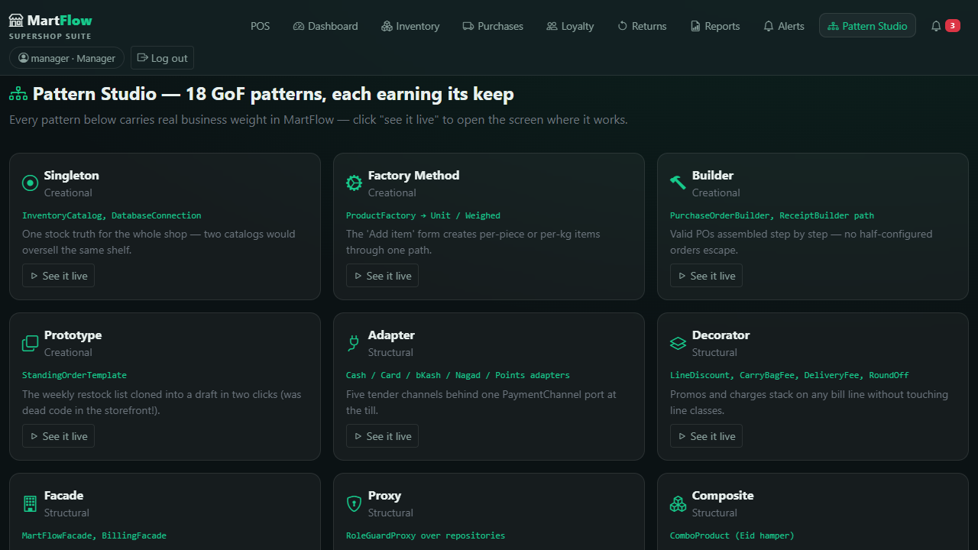
SLIDE 21 · SECTION 3 — ALFA SANY
Built for the Examiner — Developer Mode
• 18 pattern cards. Problem → why this pattern → the rejected alternative → real class & file → source snippet → proving test → "see it live"
• Live API explorer. Call endpoints with your own token — even the 403s are a feature
• Drift-guard test. PatternCatalogTest fails the build if a card cites a class that doesn't exist
• System diagnostics. Persistence mode, uptime, Dhaka clock, token in play
localhost:8080/#/patterns — developer only
MartFlow · Supershop Retail Management Suite
21 / 30 · Alfa Sany
Notes:
Thank you, Sumya. My section starts with something built just for this room. The developer account opens Developer Mode: eighteen pattern cards, each telling the full story — the problem, why this pattern, the rejected alternative, the real class and file, a source snippet, and the proving test. A drift-guard test fails the build if a card ever cites a class that doesn't exist. And a live API explorer lets you call endpoints with your own token — even the 403s are a feature.

Slide 22
SLIDE 22 · BUSINESS VALUE 1
Money Visibility — Nothing Hidden
NBR VAT SUMMARY
A genuine filing source: slab-wise 0% / 7.5% / 15%, back-calculated from inclusive prices — 115 @ 15% → VAT exactly 15.00, pinned by a test.
vat = net × rate ÷ (100 + rate)
PROFIT REPORT
Revenue vs cost snapshots captured at sale time — margins can never drift from what was actually paid.
receipt keeps a cost snapshot per line
PAYABLES
Exactly how much is owed to each supplier, across installments — the life-saver number for the owner.
ordered total − paid
Z-REPORT · DAY CLOSE
Per-tender split, expected vs counted cash, variance green at zero — the drawer reconciles by hand.
cashIn − changeOut − cashRefunds − voidCashOut
MartFlow · Supershop Retail Management Suite
22 / 30 · Alfa Sany
Notes:
Now the business case, starting with money visibility. The VAT summary is a genuine source for NBR filing: slab-wise rates of zero, seven-and-a-half, and fifteen percent, back-calculated from VAT-inclusive prices — one hundred fifteen taka at fifteen percent yields exactly fifteen taka VAT, pinned by a test. The profit report compares revenue against cost snapshots taken at sale time, so margins never drift. Payables show exactly what's owed to each supplier — a life-saver number. And the Z-report reconciles the drawer to the taka at day close.

Slide 23
SLIDE 23 · BUSINESS VALUE 2
Speed & Loss Prevention
Weekly templates
15 clicks → 2. Clone the standing order, adjust, submit.
1-tap Undo
10 levels deep — mis-scans cost nothing.
Enter → next customer
Under a second per receipt cycle.
Role walls
A cashier cannot reprice the till or read the margins — by design, not by trust.
Atomic rollback
Declined card → stock, points & sale all restored. No lost money, ever.
Audit trail
Every void, return, price edit, shrinkage — who, what, when. 500-entry filterable log.
The till is faster AND the till is safer — both at once, because of the architecture.
MartFlow · Supershop Retail Management Suite
23 / 30 · Alfa Sany
Notes:
Value also means speed and loss prevention. Weekly restock templates turn fifteen clicks into two. Undo forgives mis-scans instantly, and Enter moves to the next customer in under a second. Role walls mean a cashier physically cannot reprice the till or read the margins — fraud prevention by design, not by trust. And because the tender pipeline is a reversible command chain, a declined card rolls back stock, points, and the sale atomically — the shop never loses money to a half-finished transaction.

Slide 24
SLIDE 24 · QUALITY
Quality Is Enforced, Not Claimed
176 tests · 31 classes
Every pattern has a proving test — Command rollback, Memento depth, chain order, VAT math…
Fully hermetic
The harness pins an invalid MONGODB_URI — no live DB can ever leak into a test run.
Drift guard
PatternCatalogTest fails the build if a pattern card cites a ghost class.
API equality test
ApiCatalog ≡ Spring's registered routes — checked in both directions.
CI on every push
GitHub Actions · JDK 17 temurin · mvnw clean test.
Restart-proof
Kill the server mid-day: sales, stock, points & POs survive; reprints are byte-identical.
MartFlow · Supershop Retail Management Suite
24 / 30 · Alfa Sany
Notes:
Quality is enforced, not claimed. One hundred seventy-six automated tests across thirty-one classes run fully hermetic — the harness pins an invalid database URI so no live database can leak in. The drift-guard test keeps pattern documentation honest, and another asserts our API catalog equals Spring's registered routes in both directions. GitHub Actions runs the suite on every push. And durability is real: restart mid-day and everything survives — a reprinted receipt is byte-identical.

Slide 25
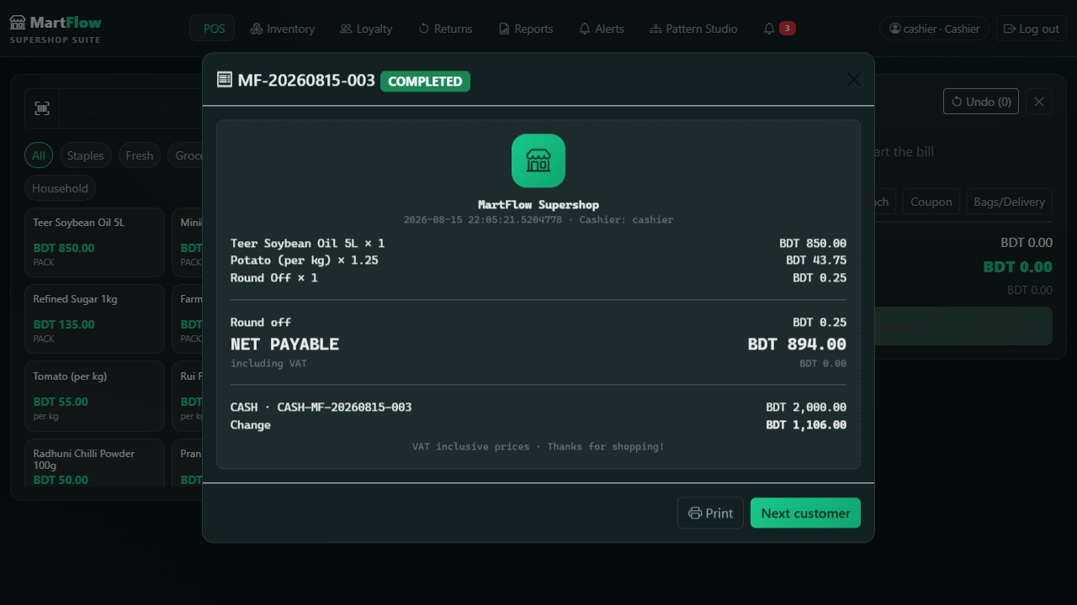
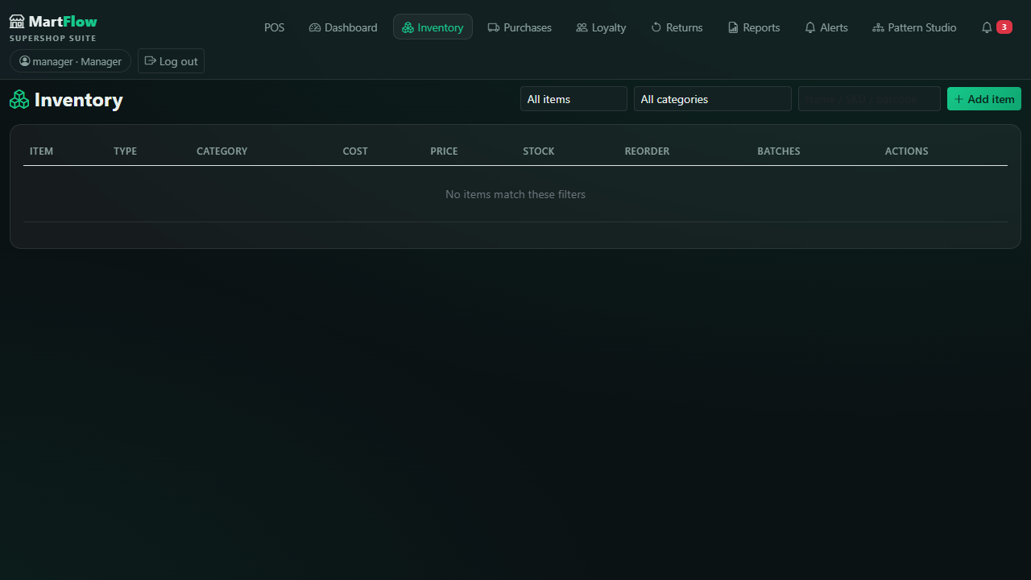
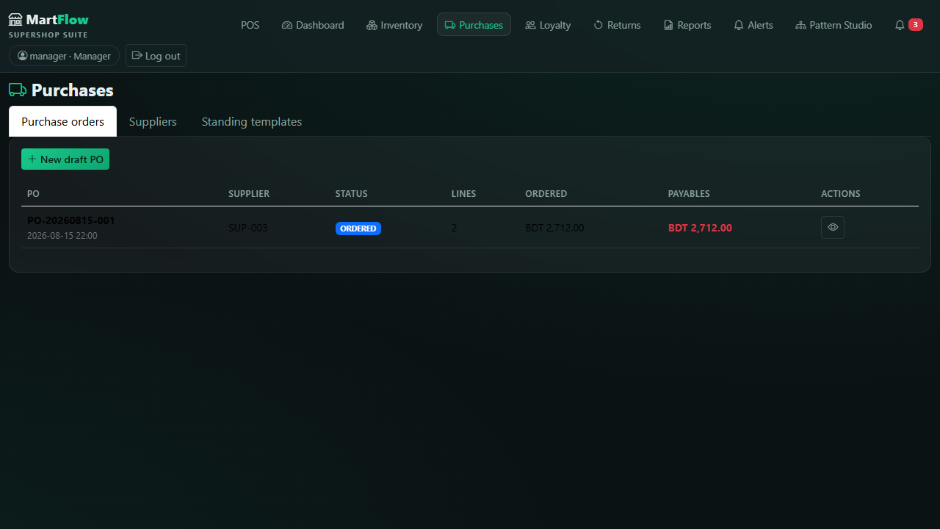
SLIDE 25 · PRODUCT TOUR 3/3
Operations — Where the Shop Lives
thermal receipt · SVG barcode
batches · expiry · shrinkage
PO lifecycle · GRN intake
Receipt = line-level charge snapshot — reprints never drift.
Restock, write-offs (DAMAGE/LOSS/THEFT/COUNT), price-edit alerts.
GRN lands stock + batch + updated cost in one move.
MartFlow · Supershop Retail Management Suite
25 / 30 · Alfa Sany
Notes:
A quick look at operations. The thermal receipt carries a generated SVG barcode and the exact line-level snapshot of what was charged. The inventory screen tracks batches and expiry dates, with restock and shrinkage write-offs for damage, loss, theft, and recounts. The purchasing screen walks the full lifecycle you saw as the State pattern — and when goods arrive, the GRN lands stock, batch, and updated cost in one move, with an immediate expiry check. This is the day-to-day surface the shop actually lives in.

Slide 26
SLIDE 26 · LIVE DEMO
The Demo Plan — Five Moments
One-tap demo chips on the login screen; every role pre-seeded.
Cashier bills a member
watch the 5% member price apply live & points accrue
admin
admin123
everything incl. staff
1
manager
manager123
catalog, POs, reports, day close
Manager toggles a promo
till price changes — zero redeploy
2
cashier
cashier123
billing & returns
Void with a required reason
stock, tender & points reversed; audit trail captures it
3
developer
developer123
pattern studio
Day close
Z-report reconciles the drawer to zero variance
4
RUN IT
.\mvnw.cmd spring-boot:run
→ http://localhost:8080 (in-memory, zero setup)
Developer Mode
the 18 pattern cards you've heard about all talk
5
MartFlow · Supershop Retail Management Suite
26 / 30 · Alfa Sany
Notes:
We're ready to demo live, and here's the arc. Login chips make it one tap. As cashier, I'll bill with a member attached — watch the member price apply live and points accrue. As manager, I'll toggle a category promotion and the till price changes without redeploying. I'll void a sale with a required reason and show the audit trail capture it. Then day close — the Z-report reconciling the drawer. Finally, the developer account and the pattern cards.

Slide 27
SLIDE 27 · ROADMAP
Honest About What's Next
Growth = new adapters & observers, not a rewrite.
Real bKash & Nagad
Simulated today — deliberately. The Adapter layer is 100% real and fully isolates the vendor shape: production swap is a one-connector change, the bill's code untouched.
payment/vendor/BkashMerchantApi.java → real SDK
Multi-branch
The Repository abstraction already separates storage from domain — per-branch catalogs on the same interfaces.
Repository<T> stays, wiring multiplies
Owner's mobile companion
KPIs, alerts and approvals on the go — the SPA's API is already clean enough to serve a second client.
~70 REST endpoints, ready
What's simulated today is isolated behind real interfaces — that's a design decision, not a shortcut.
MartFlow · Supershop Retail Management Suite
27 / 30 · Alfa Sany
Notes:
We're honest about what's next. The bKash and Nagad integrations are simulated today — deliberately, because the Adapter layer is one hundred percent real: the vendor shape is fully isolated, so connecting the real API is a one-connector swap and the billing code won't change a line. Beyond that: multi-branch support on the same repository abstraction, a mobile companion for owners, and purchase-order approvals. The architecture was built so growth means adding adapters and observers, not rewriting the core.

Slide 28
SLIDE 28 · RETROSPECTIVE
What We Learned
Patterns are tools, not decorations
Every one of the 18 exists because a feature demanded it. And the ones we rejected taught us as much as the ones we kept.
Domain purity pays
A POJO domain with zero framework annotations is exactly what kept the patterns visible, honest, and unit-testable.
The "why not" is part of the answer
A design document that only says yes has not made any decisions. We wrote our rejections down.
1
2
3
MartFlow · Supershop Retail Management Suite
28 / 30 · Alfa Sany
Notes:
Three lessons we'd share. First: patterns are tools, not decorations — every one of the eighteen exists because a feature demanded it, and the ones we rejected taught us as much as the ones we kept. Second: domain purity pays — keeping the domain free of framework annotations is exactly what made the patterns visible, honest, and unit-testable. Third: writing down the 'why not' is part of the answer — a design document that only says yes has not made any decisions.

Slide 29
SLIDE 29 · CONCLUSION
A Patterns Lab That Became a Product
Built for a real Bangladeshi problem — NBR-correct VAT, batch & expiry inventory, purchasing with payables, loyalty, returns, drawer reconciliation.
18 patterns, every one load-bearing
Every taka BigDecimal-exact
176 tests make every claim verifiable
We didn't just study design patterns. We shipped them.
MartFlow · Supershop Retail Management Suite
29 / 30 · Alfa Sany
Notes:
To conclude. MartFlow started as a patterns lab and became a product — a complete retail management suite for a real Bangladeshi problem, with NBR-correct VAT, batch and expiry inventory, purchasing with payables, loyalty, returns, and drawer reconciliation. Beneath it, eighteen design patterns carry the load, every taka is accounted for with exact decimal math, and one hundred seventy-six tests keep every claim in this presentation verifiable. We didn't just study design patterns. We shipped them.

Slide 30
MARTFLOW · SOFTWARE DESIGN PATTERN LAB FINAL
Thank You
Questions & Answers
github.com/MHMITHUN/MartFlow-Supershop-POS
.\mvnw.cmd spring-boot:run → localhost:8080
"MartFlow — where every pattern works for a living."
MD Mahamudul Hasan · Sumya Soma · Alfa Sany
Notes:
Thank you for listening. Everything you saw today is in the repository — the code, the tests, the CI pipeline, and a full Bengali documentation set. You can run it yourself in one command and explore all four roles with the demo credentials, including the developer's pattern studio. We're happy to answer questions — about the VAT math, the pattern choices, the security layers, or anything else. [CLOSING] MartFlow — where every pattern works for a living. Thank you.

