Slide 1
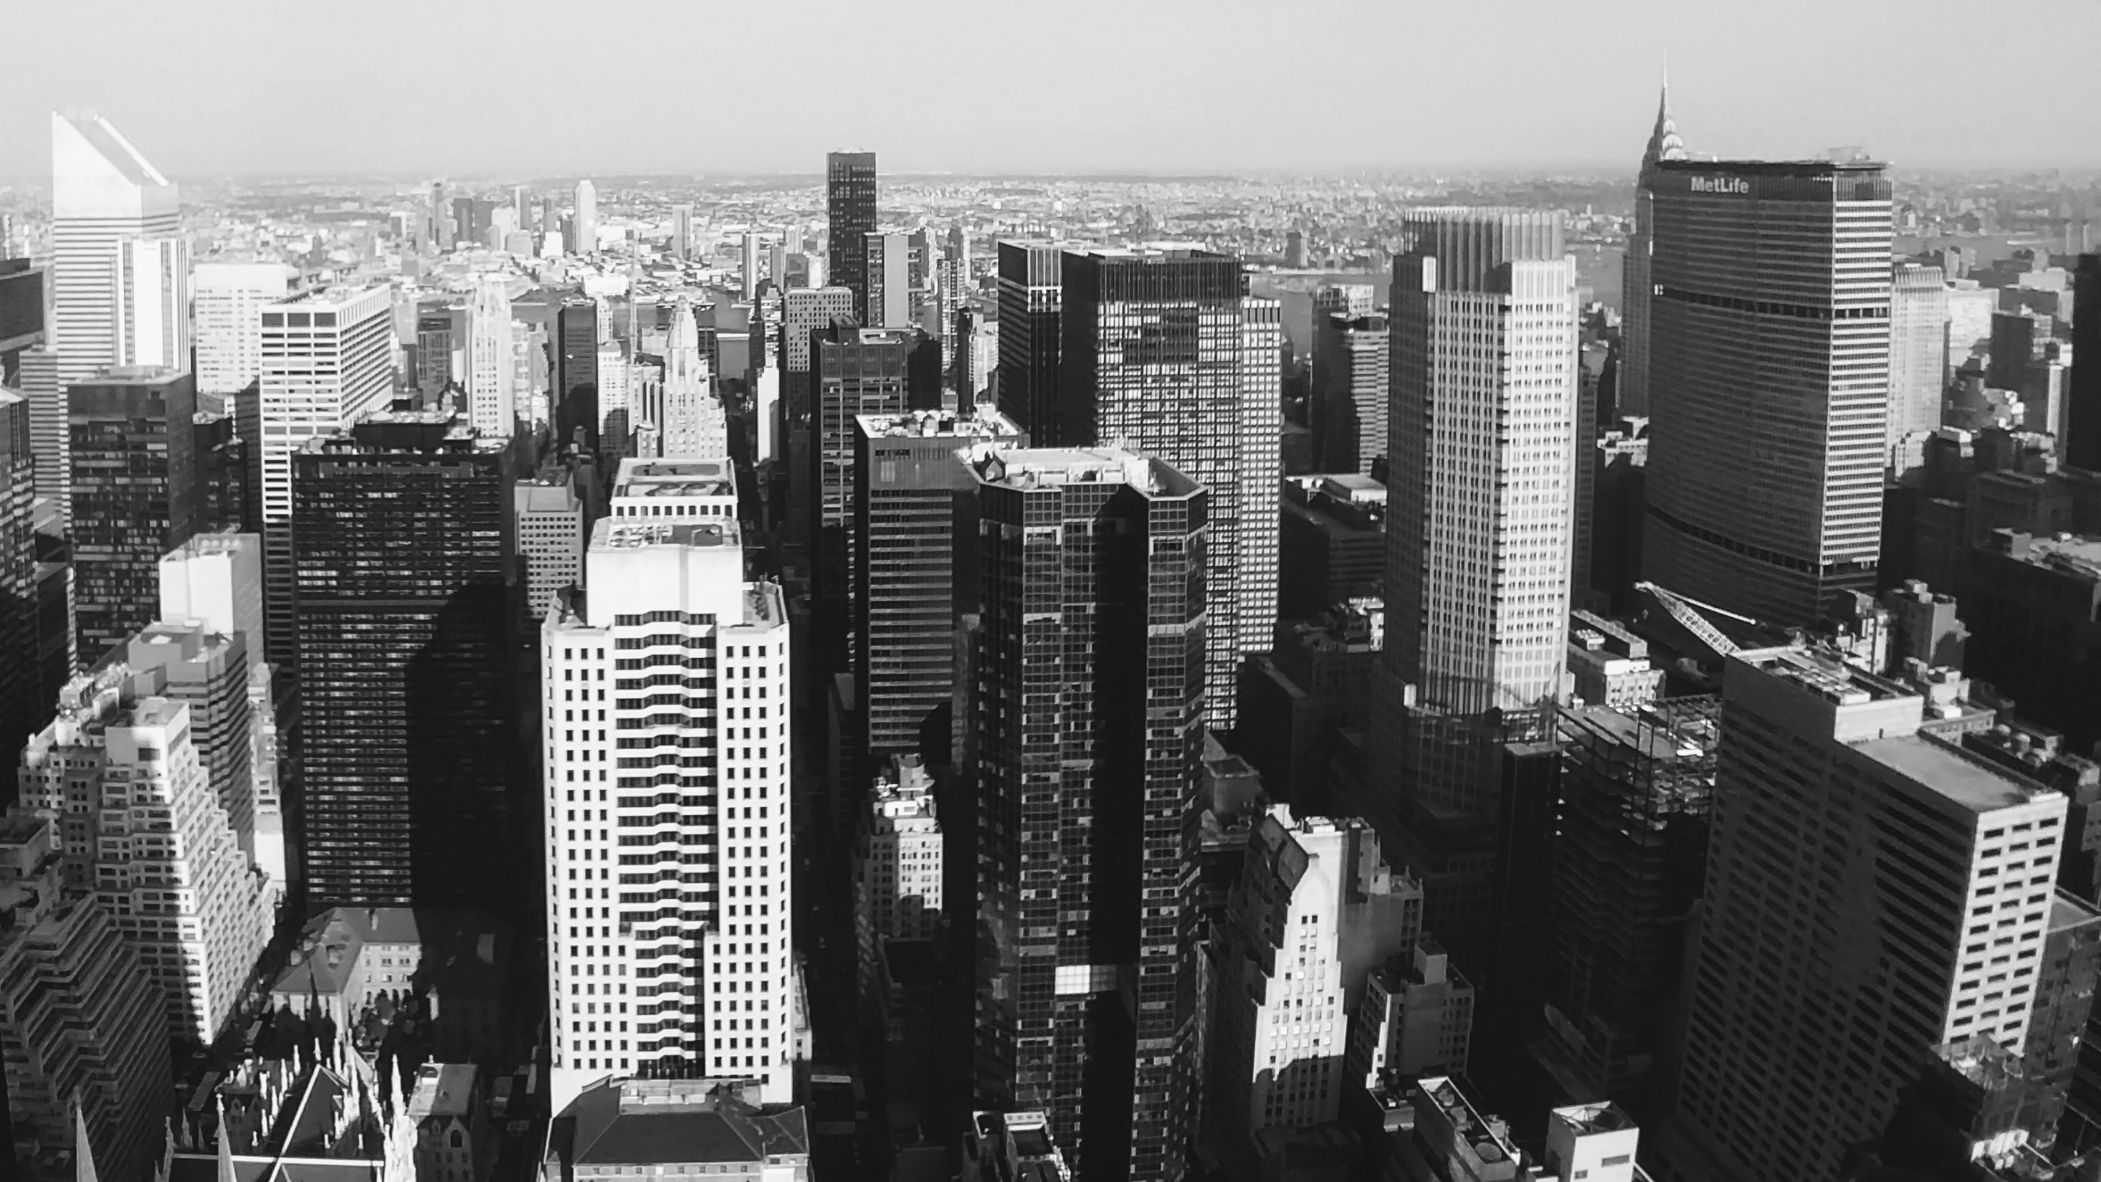
Slide 1
Data Analyst-Search
Mahmut COLAK

Slide 2
CLICKED ITEM INVESTIGATION
1-Calculate the CTR of each item. What is the overall avg CTR?
2-What is the distribution of clicks among the top 25 positions? What is the share of the first positions? On how many positions are approx. Half of the click-outs made?
3-Describe the relationship between the average displayed position and the clicked displayed position. What are your thoughts about the variance between the two?
4-In the dataset, we provided you with the average displayed position. What can be wrong with using averages?

Slide 3
Dataset Information = data.head(5)
trivago_data_analysis_case_study_part1.csv | item_id | impressions | clicks | clicked_displayed_positions | avg_impressed_position | num_users | num_sessions
0 | 5040 | 40 | 5 | 20;9;12;10;12 | 11.83 | 22 | 23
1 | 5053 | 83 | 3 | 2;3;0 | 7.88 | 43 | 52
2 | 5094 | 54 | 6 | 0;0;0;2;1;2 | 4.72 | 30 | 36
3 | 5101 | 30 | 2 | 5;3 | 4.97 | 17 | 20
4 | 5105 | 24 | 1 | 18 | 9.08 | 8 | 11
Dataset Statistics = data.describe()
trivago_data_analysis_case_study_part1_statistics | item_id | impressions | clicks | avg_impressed_position | num_users | num_sessions
count | 1.30E+05 | 130056 | 130056 | 130056 | 130056 | 130056
mean | 1.98E+06 | 278.031648 | 12.897452 | 11.223035 | 167.495417 | 185.832072
std | 1.88E+06 | 830.236049 | 52.592582 | 4.086324 | 493.278475 | 556.626846
min | 5.00E+03 | 1 | 1 | 0 | 1 | 1
25% | 1.50E+05 | 15 | 1 | 8.86 | 8 | 9
50% | 1.43E+06 | 55 | 2 | 11.75 | 32 | 35
75% | 3.14E+06 | 205 | 7 | 14.03 | 122 | 134
max | 7.17E+06 | 38569 | 2865 | 24 | 22576 | 25987

Slide 4
CLICK THROUGH RATES
1-Calculate the CTR of each item. What is the overall avg CTR?
data['CTR'] = (data.clicks)/(data.impressions)
data['CTR_overall'] = sum(data.clicks)/sum(data.impressions)
data.head(5)
click through rates | item_id | impressions | clicks | clicked_displayed_positions | avg_impressed_position | num_users | num_sessions | CTR | CTR_overall
0 | 5040 | 40 | 5 | 20;9;12;10;12 | 11.83 | 22 | 23 | 0.125 | 0.046388
1 | 5053 | 83 | 3 | 2;3;0 | 7.88 | 43 | 52 | 0.036145 | 0.046388
2 | 5094 | 54 | 6 | 0;0;0;2;1;2 | 4.72 | 30 | 36 | 0.111111 | 0.046388
3 | 5101 | 30 | 2 | 5;3 | 4.97 | 17 | 20 | 0.066667 | 0.046388
4 | 5105 | 24 | 1 | 18 | 9.08 | 8 | 11 | 0.041667 | 0.046388

Slide 5
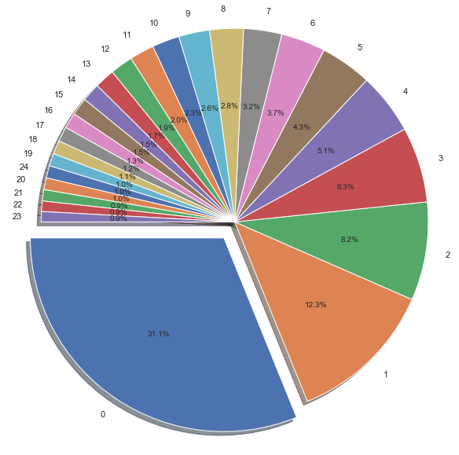
DISTRIBUTION OF CLICKS
share of the first position : % 31.1
2-What is the distribution of clicks among the top 25 positions? What is the share of the first positions? On how many positions are approx. Half of the click-outs made?
half of the click-outs made : First three positions= 0,1,2

Slide 6
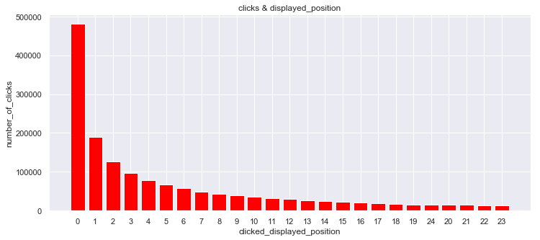
RELATIONSHIP BETWEEN THE DISPLAYED POSITION AND THE CLICKS
3-Describe the relationship between the average displayed position and the clicked displayed position. What are your thoughts about the variance between the two?

Slide 7
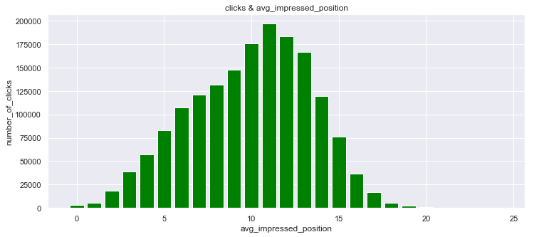
RELATIONSHIP BETWEEN THE AVG DISPLAYED POSITION AND THE CLICKS
3-Describe the relationship between the average displayed position and the clicked displayed position. What are your thoughts about the variance between the two?

Slide 8
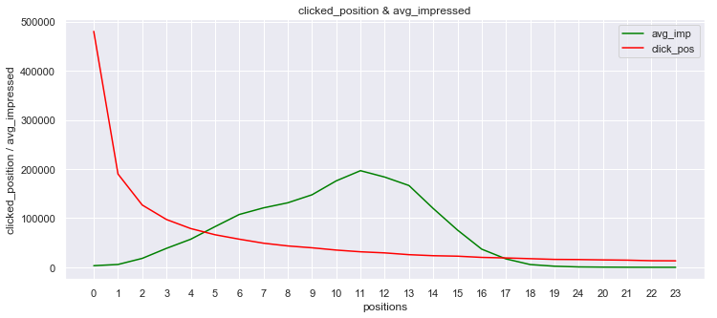
RELATIONSHIP BETWEEN THE AVG DISPLAYED POSITION AND THE CLICKED POSITION
3-Describe the relationship between the average displayed position and the clicked displayed position. What are your thoughts about the variance between the two?

Slide 9
RELATIONSHIP BETWEEN THE AVG DISPLAYED POSITION AND THE CLICKED POSITION
This analysis shows us clearly that there is not any direct relationship between "impressions" and "clicks".
Moreover, we can say that if you would like to increase the number of clicks you should stay in the first 3 positions on the list.
On the other hand, one of the important value is the impression. But impression says that your position should be between 6 and 14 for many clicks.
correlation table | avg_impressed | clicked_displayed
0 | 3335 | 480309
1 | 5830 | 189940
2 | 18224 | 126803
3 | 38640 | 97318
4 | 57204 | 78927
correlatin coefficient | avg_impressed | clicked_displayed
avg_impressed | 1 | -0.21347
clicked_displayed | -0.21347 | 1

Slide 10
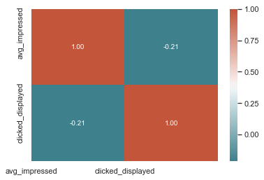
RELATIONSHIP BETWEEN THE AVG DISPLAYED POSITION AND THE CLICKED POSITION
As a result, we should think together, both clicked position and avg impressed position.
Your position can be at a different location on the list, but in general, it is in the first 3 positions when the hotel is clicked by users.
Your position depends on some filters or searches criteria.
In this time, your click chance is decreasing because of your avg impressed position calculating.
The last one, you should focus your "currently position" not "average impressed position".
Because you can slip down on the list and your avg impressed position can be changed, but it is normal and not vital.

Slide 11
WHAT CAN BE WRONG WITH USING AVERAGES
One of the most important questions that are how and why to calculate the avg result.
We analyzed avg output the above and this information is not helpful for the next step.
Because each customer wants to choose different features and filters.
Then sometimes your position drops behind because of ranking or filters, but this not mean you will not be selected by the customers.
Your "avg impressed position" can be increased because of all these factors. But when you are placed near the top, your click possibility can increase and not affects from avg impressed position.
4-In the dataset, we provided you with the average displayed position. What can be wrong with using averages?

Slide 12
SESSION INVESTIGATION
1-Describe the data set that you have received. Calculate the 5 most frequent values per column (with frequency). Can you find any suspicious results? If so, what are they? And how would you fix these for the analysis?
2-Which search type has the lowest average displayed position? What is the best sorting order for this search type? Which search type should be excluded for a statistical reason?
3-What are the top 10 “best” and “worst” performing items? Explain what metric you have chosen to evaluate the performance and why.
4-Describe and visualise the relationship between the average displayed position and the CTR among the top 1000 most clicked items.

Slide 13
DESCRIBE THE DATASET
Dataset Information = big_data.head(5)
Dataset Statistics = big_data.describe()

Slide 14

THE 5 MOST FREQUENT

Slide 15
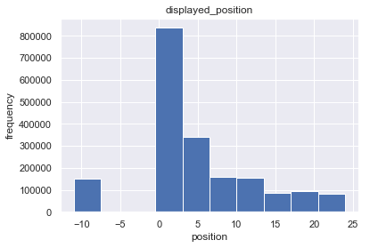
ANY SUSPICIOUS RESULTS - 1
# displayed_position should be in between 0 and 24, so -11 is incorrect,
# market share should be updated.
# we have enough data for analysis and -11 position data is not big, so no big affect to our analysis.
# On the other way if you want to use -11 position data, you need to find a pattern for each position.
# after that, you should change -11 position data with the most matched pattern values.

Slide 16
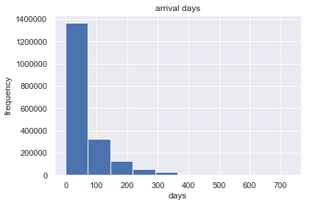
ANY SUSPICIOUS RESULTS - 2
# min arrival_days should be 0, the negative values are meaningless.
# -1 value frequency is very small into the arrival_days column.
# Then it does not affect our analysis and I can ignore and also I don't need to use it for analysis..

Slide 17
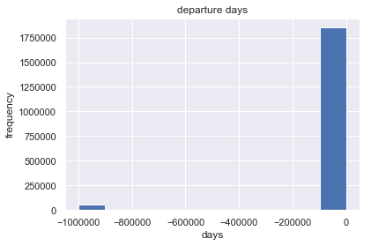
ANY SUSPICIOUS RESULTS - 3
# min departure_days should be 0, the negative values are meaningless.
# -1000000 value frequency is too small.
# Then it does not affect our analysis and I can ignore and also I don't need to use it for analysis.
# but if you want to use this data, you can do analysis with other columns and try to find a pattern by this means
# you can update the correct value. For example, departure_days = -1000000 we can use 0 instead of -1000000.
# in addition to that, you can create insight based on user behavior.
# thanks to behavior analysis, you can change with an ideal value

Slide 18
WHICH SEARCH TYPE HAS THE LOWEST AVERAGE DISPLAYED POSITION? WHAT IS THE BEST SORTING ORDER FOR THIS SEARCH TYPE?
THE LOWEST AVERAGE DISPLAYED POSITION :
BEST SORTING ORDER FOR THIS SEARCH TYPE :

Slide 19
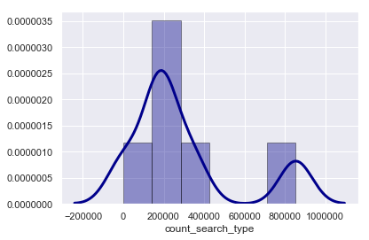
STATISTICAL REASON - 1
# Normally, we can decide to exclude search_id=2100.
# Because the search is done for two times using this type by users. It is too small.
# But we have to demonstrate as statistically.
# I want to use a confidence interval for deciding the importance level.
# I apply the central limit theorem to convert it to Gauss distribution
# because now our dataset doesn't have a normal distribution.

Slide 20
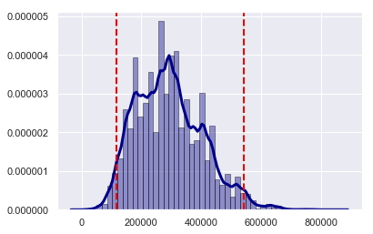
STATISTICAL REASON - 2
#confidence interval for p=0.05 : [115781.33333333 541351.16666667]
#search_type_2100_frequency : 2 search_type_2113_frequency : 854294
#search_type_2100 and search_type_2113 are out of confidence interval, because of
their frequency bigger frequency is the desired result, the opposite way smaller
#frequency is the undesired result big frequency means that this search type is used by the user, otherwise small frequency is not so we should exclude search_type_2100

Slide 21
TOP 10 BEST AND WORST PERFORMING ITEMS - 1
-Best performed hotel is the most chosen hotel. This means that is many people have chosen it.
-So, I think that the most important criteria are the number of clicks. -Contrary to best performance criteria, the worst performance hotel is the least chosen hotel.
-But we have many hotels one-clicked. Therefore, we should do extra analysis together with other columns.
-For example, all columns values seem perfect but it still is one-clicked, so in this case, shows us this type of hotels is worst than the other one-clicked hotels. For this analysis, we should use "displayed_position" and "page number". In addition to that, we can use "search type" and "sort_order" values.
-I calculated the coefficient for each column in order to measure hotel performance.

Slide 22
TOP 10 BEST AND WORST PERFORMING ITEMS - 2
TOP 10 BEST
TOP 10 WORST

Slide 23
RELATIONSHIP BETWEEN THE AVERAGE DISPLAYED POSITION AND THE CTR – 1
clicked_item_id | count_clicked_items | sum_displayed_position | avg_displayed_position | count_imp_item
2834772 | 2650 | 3662 | 1.38189 | 14885
1321090 | 2614 | 8609 | 3.29342 | 40142
12624 | 2346 | 4715 | 2.0098 | 18733
32940 | 2127 | 5925 | 2.78561 | 11883
1455251 | 2092 | 2752 | 1.31549 | 3455
clicked_item_id | count_clicked_items | sum_displayed_position | avg_displayed_position | count_imp_item | CTR
2834772 | 2650 | 3662 | 1.38189 | 14885 | 0.17803
1321090 | 2614 | 8609 | 3.29342 | 40142 | 0.06512
12624 | 2346 | 4715 | 2.0098 | 18733 | 0.12523
32940 | 2127 | 5925 | 2.78561 | 11883 | 0.179
1455251 | 2092 | 2752 | 1.31549 | 3455 | 0.6055
imp_item_id | count_imp_item
1321090 | 40142
47121 | 29460
12594 | 21297
3218556 | 20701
880913 | 20554

Slide 24
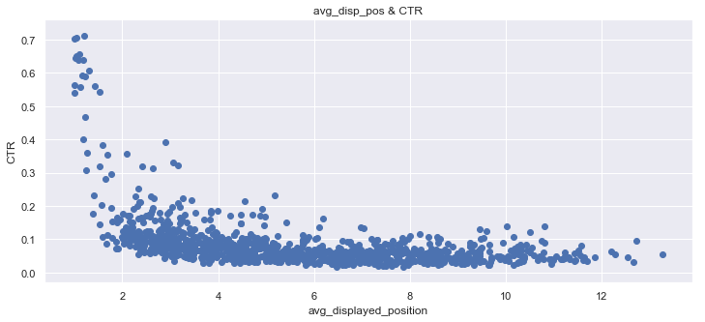
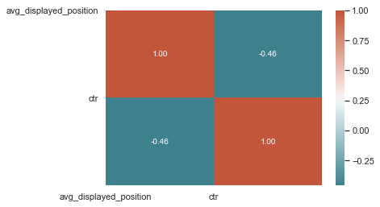
RELATIONSHIP BETWEEN THE AVERAGE DISPLAYED POSITION AND THE CTR – 2
CORRELATION TABLE | avg_displayed_position | ctr
clicked_item_id
2834772 | 1.38189 | 0.17803
1321090 | 3.29342 | 0.06512
12624 | 2.0098 | 0.12523
32940 | 2.78561 | 0.179
1455251 | 1.31549 | 0.6055
CORRELATION COEFFICIENT | avg_displayed_position | ctr
avg_displayed_position | 1 | -0.45688
ctr | -0.45688 | 1

Slide 25
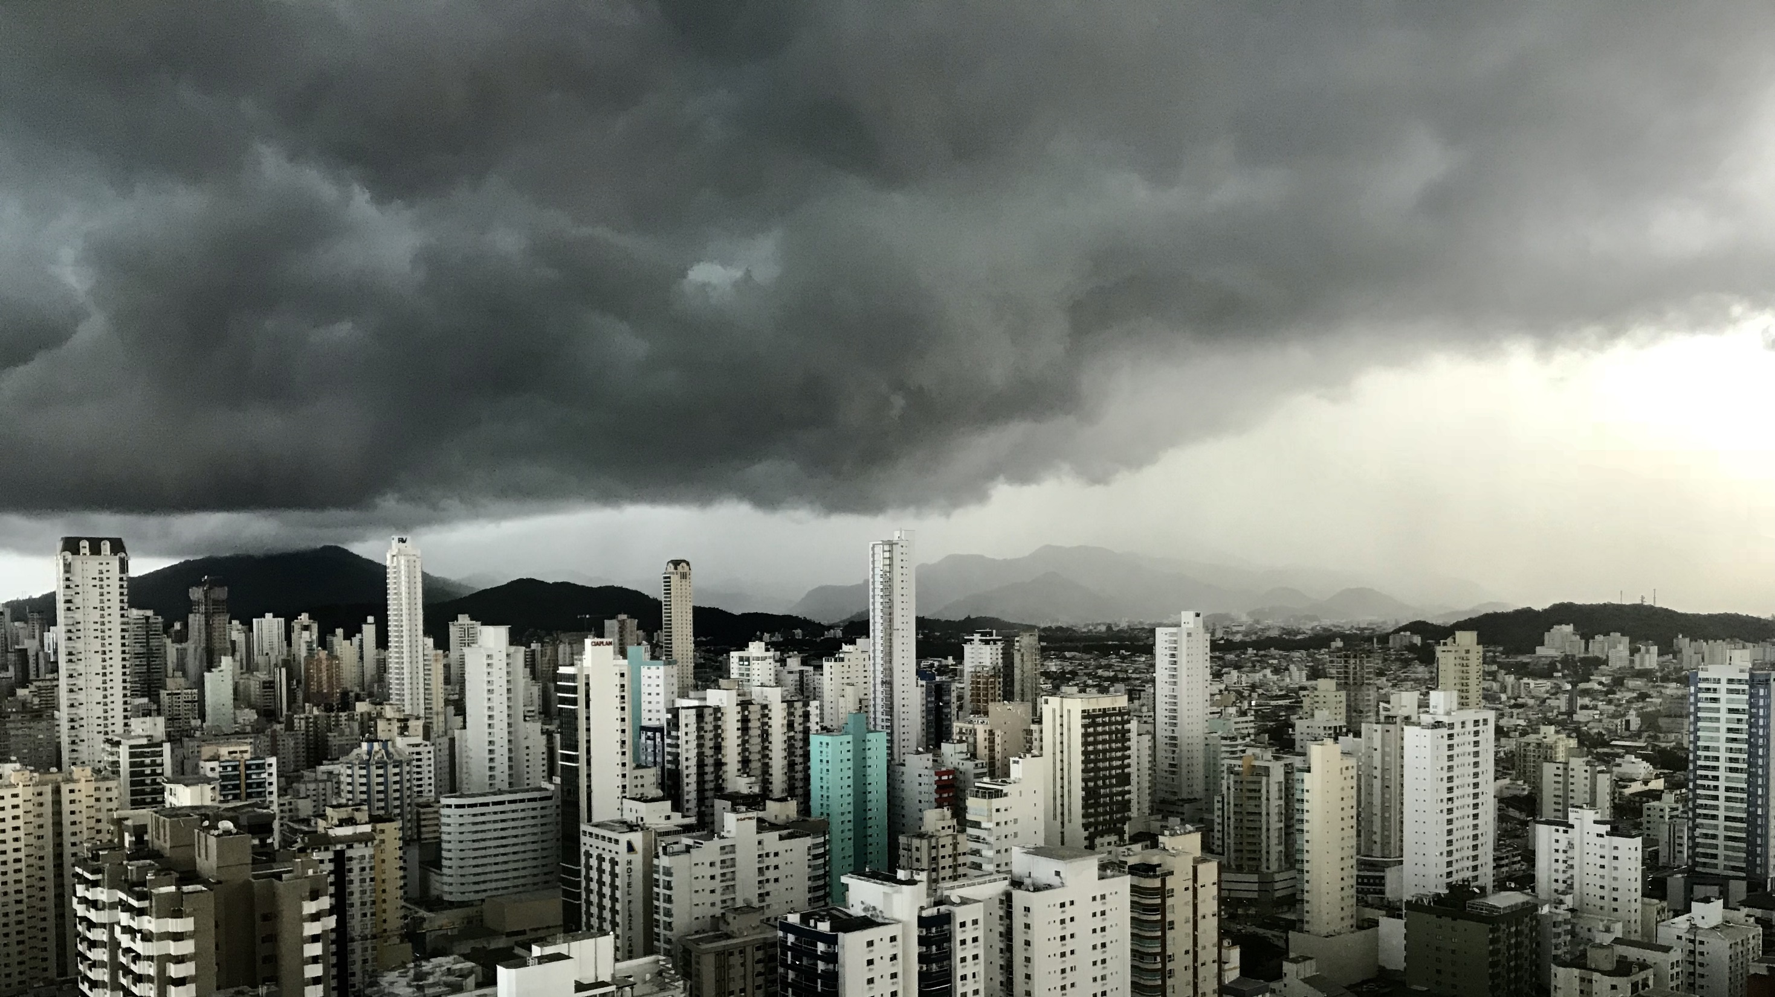
Slide 11
THANK YOU

