Slide 1
KMOU Division of Marine System Engineering
Introduction to
Internal Combustion Engine

Slide 2
Lesson content for each week
Ch0_Introduction to the Class | Ch6_Piston Fittings and Crankshaft
Ch1_Overview of the Internal Combustion Engine | Ch7_Lube Oil System
Ch2_Thermodynamics and Compressed Air System | Ch8_Cooling Water System
Ch3_Marine Fuels and Internal Fuel Oil System | Ch9_Introduction to the Main Engine
Ch4_Intake and Exhaust System | Ch10_Alternative Fuels and Alternative Fuel Systems
Ch5_Turbocharger | Ch11_Environmental Regulations and Exhaust Gas Aftertreatment Systems
Midterm | Ch12_Tools, Apprentice Engineer Duties, and Career Direction
 | Final Exam

Slide 3
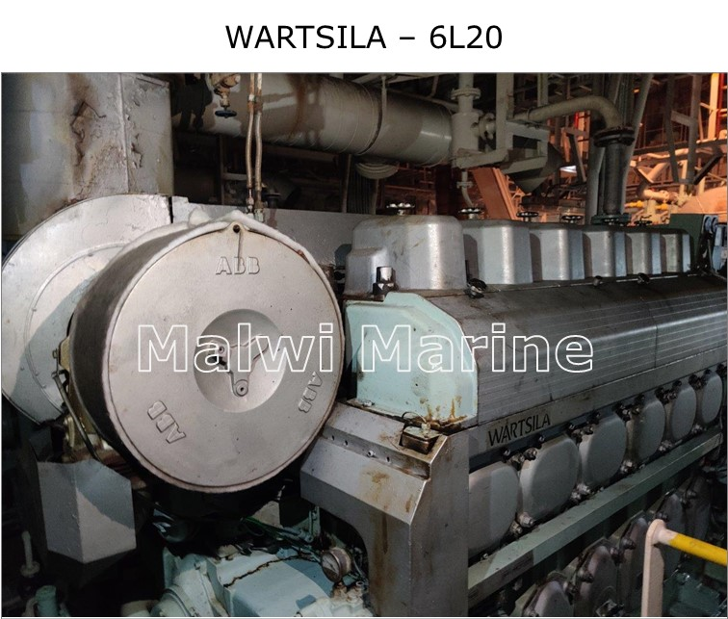

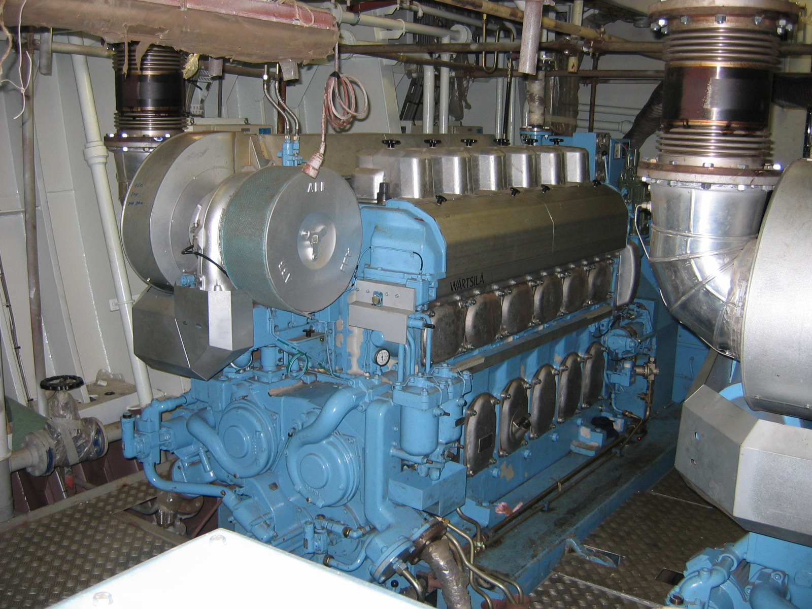
What is Turbocharger (T/C)?
Most of the G/E turbochargers used on ships are made by ABB.
Therefore, this chapter explains ABB's T/C.
T/Cs are intended for turbocharging internal combustion engines.
The T/C is used to generate the volume of air and the charging pressure required to operate the engine.

Slide 4
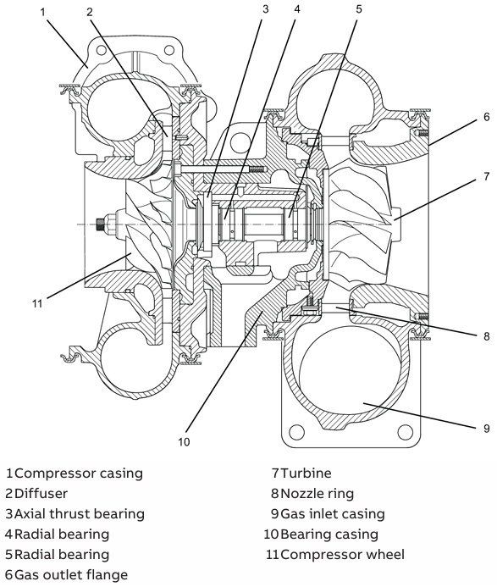
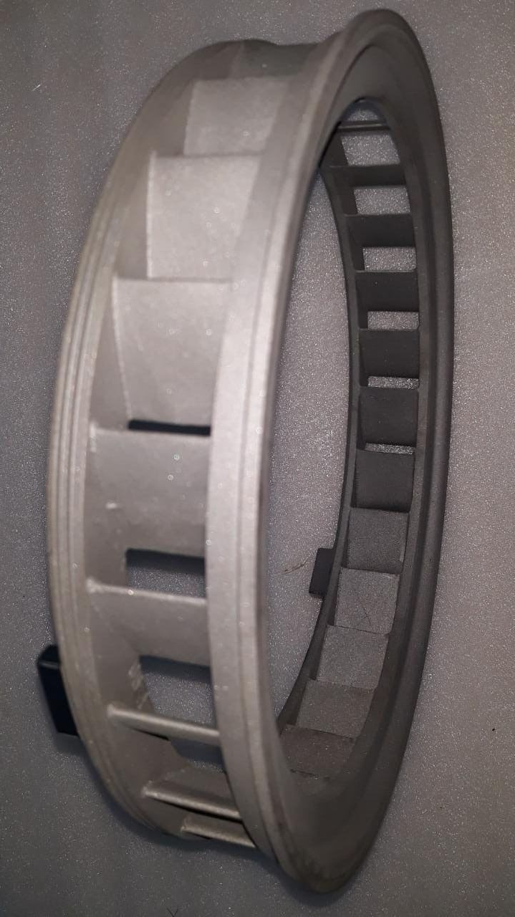
Turbocharger (T/C)
8
Nozzle ring
The T/C is a turbomachine consisting of the following main components:
O turbine
O compressor
These are mounted on a common shaft.
The exhaust gas from the diesel or gas engine flows through the gas inlet casing (9) and nozzle ring (8) to the turbine (7).
The turbine (7) uses the energy contained in the exhaust gas to drive the compressor wheel (11). The compressor draws in fresh air, compresses it and then forces it into the engine's cylinders.

Slide 5
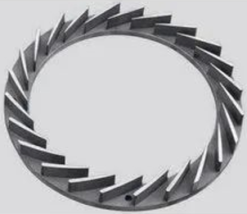
Turbocharger (T/C)
8
Exhaust gas flow
Nozzle ring
Nozzle ring
It is located just before the exhaust gas enters the turbine wheel.
The flow of exhaust gas is accelerated through the nozzle vane (blade) and guided to the turbine blade at the optimal angle of incidence.
It converts the pressure energy of the exhaust gas into kinetic energy to increase turbine efficiency.
Each of them is turbine blade
The nozzle increases the velocity of the fluid by making the outlet cross-sectional area smaller (contracting) than the inlet.
It is called a nozzle ring because it has multiple nozzles in a ring shape.
Exhaust
gas flow
Each of them is nozzle vane (blade)

Slide 6
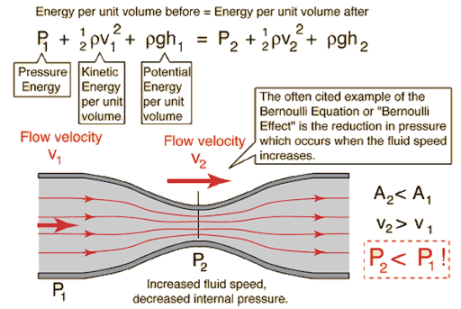
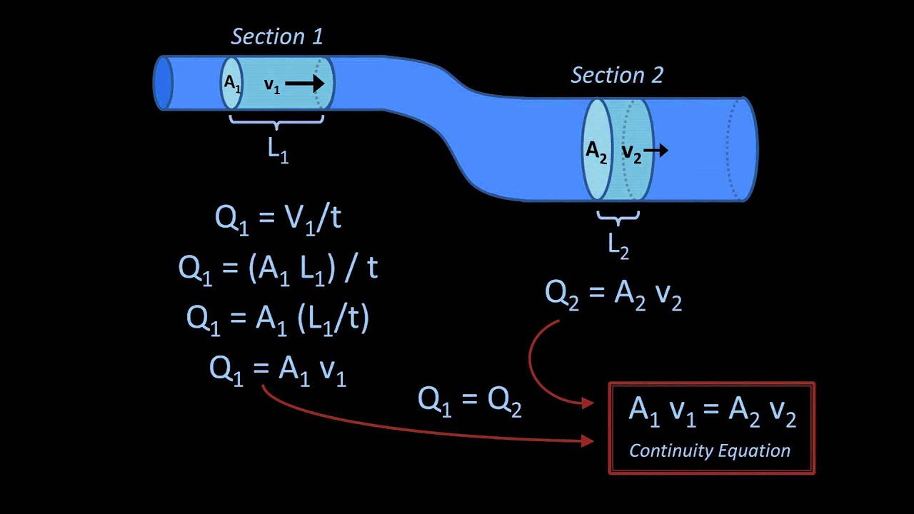
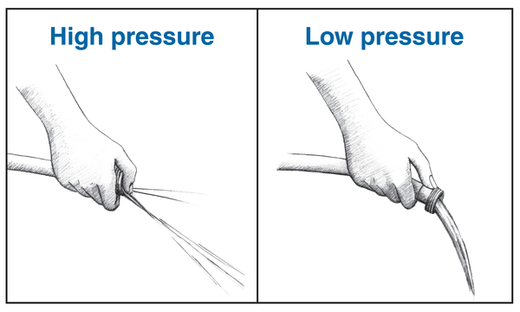
Turbocharger (T/C)
V: Volume
v: Velocity
Bernoulli’s equation
Continuity equation

Slide 7
Turbocharger (T/C)
This is just an animation to illustrate the exhaust gas passing through the nozzle ring to the turbine wheel (left) and the fresh air being compressed by the compressor wheel (right).
Not in marine T/C
Intake air side
Not in marine T/C
Exhaust side
Exhaust side
Intake air side

Slide 8
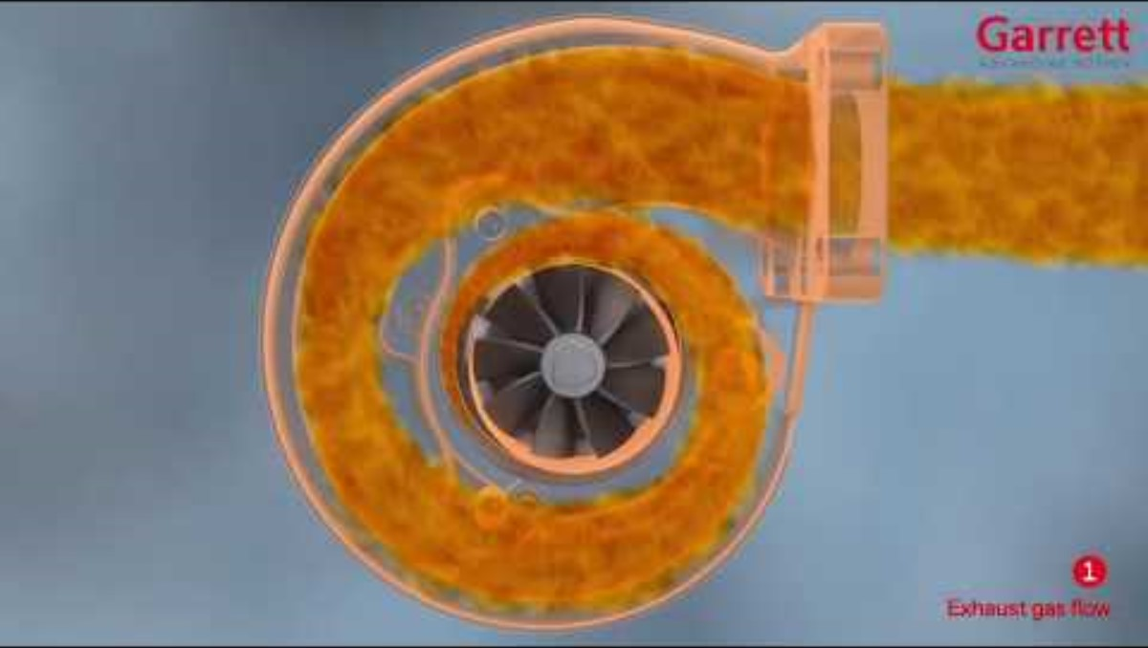
Turbocharger (T/C)

Slide 9
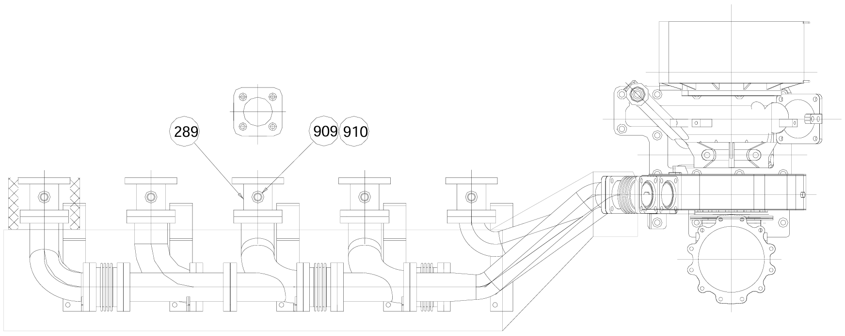
Turbocharger (T/C)
Suction outside air
Turbocharger
Compressor side of T/C
Turbine side of T/C
To the funnel

Slide 10
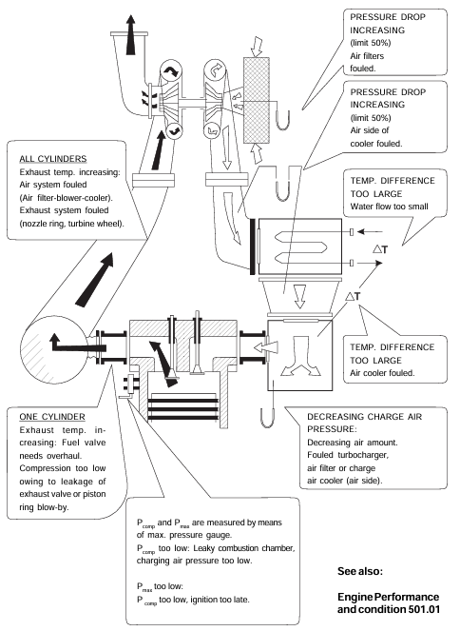
Turbocharger (T/C)
Turbine
Compressor
Turbocharger
Intake
valve
Exhaust manifold
Exhaust
valve
Air cooler
Piston

Slide 11
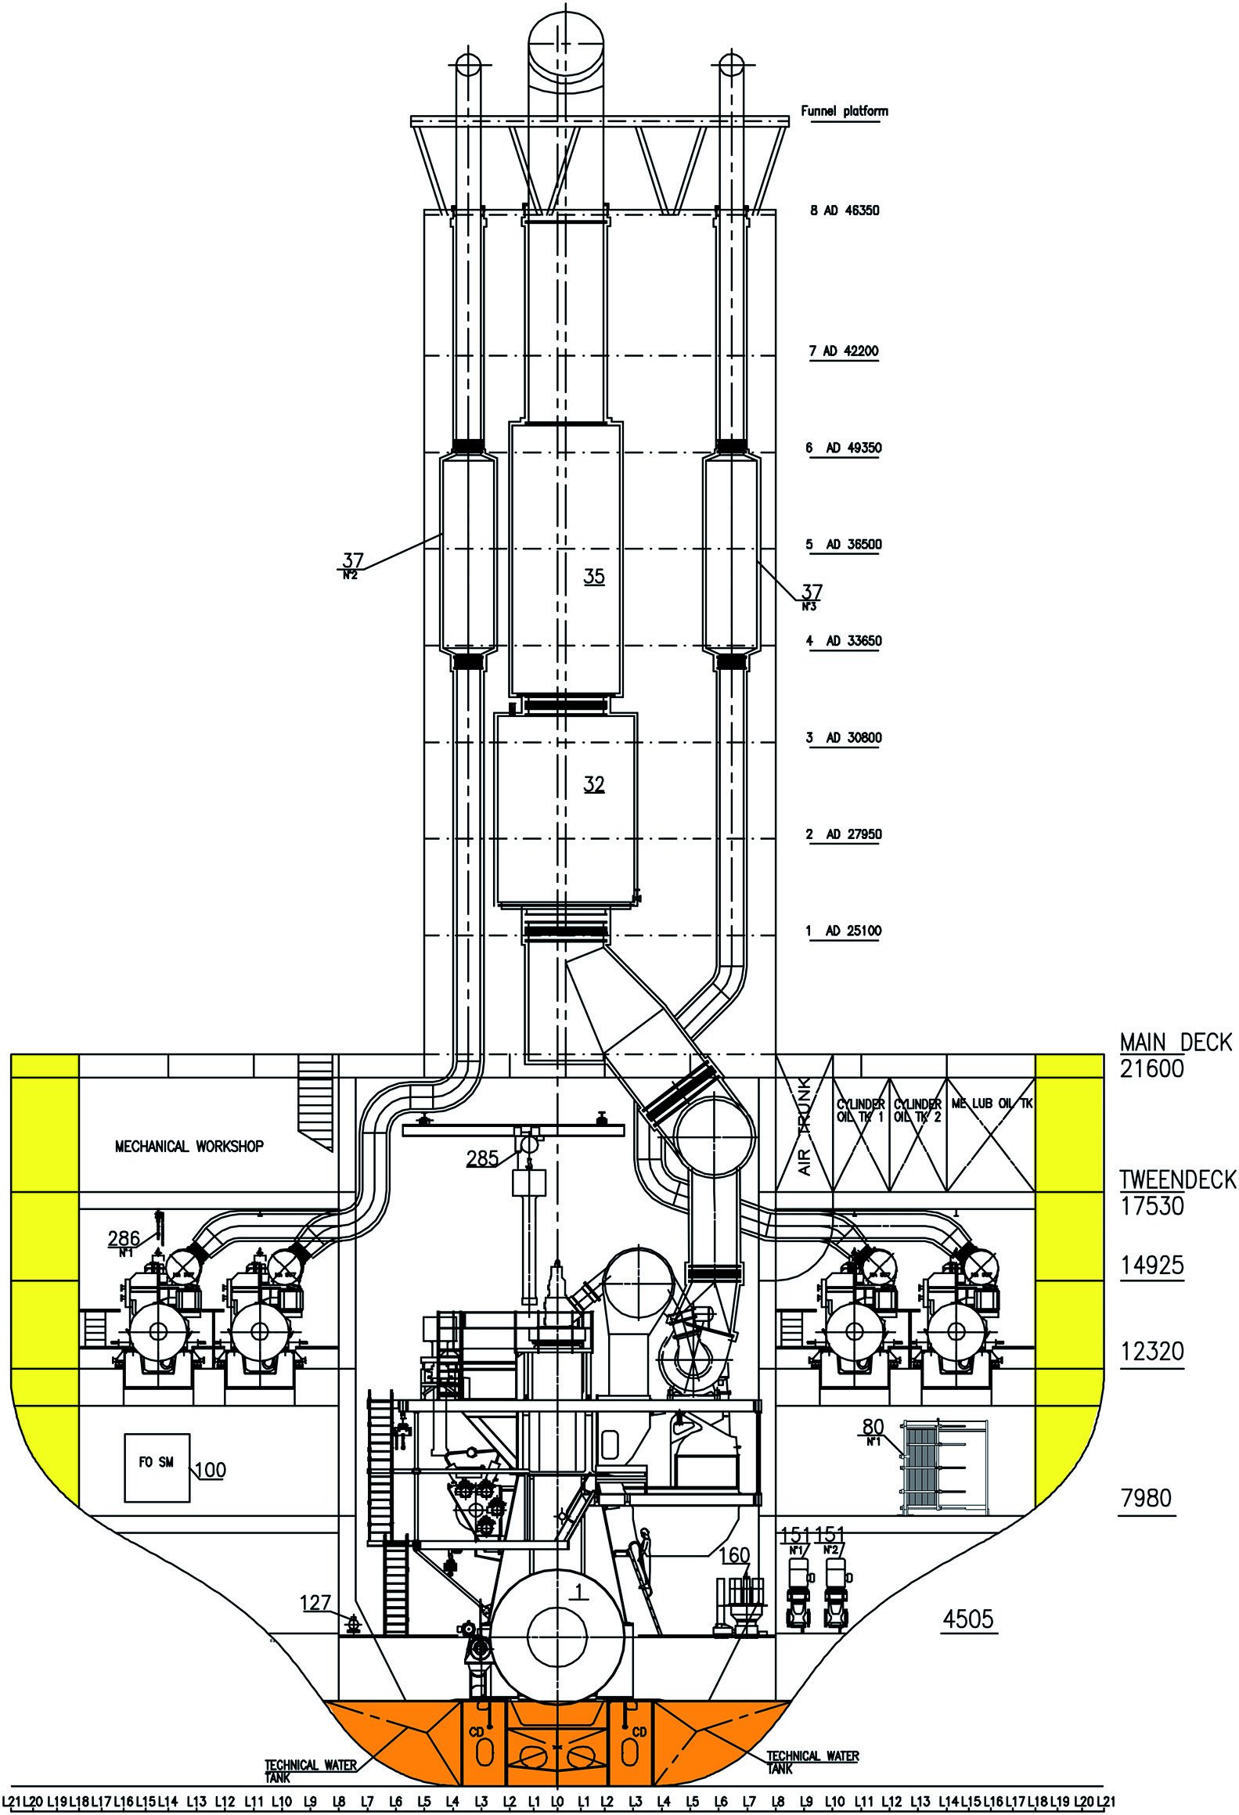
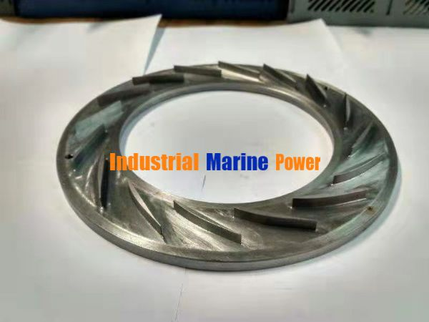
Turbocharger (T/C)
The exhaust gas escapes into the ambient air through the exhaust gas pipe, which is connected to the gas outlet flange (6).
The air, which is necessary for operation of the diesel or gas engine and which is compressed in the turbocharger, is drawn into the compressor wheel (11) through the suction branch or filter silencer or through an axial suction pipe. It then passes through the diffuser (2) and leaves the turbocharger through the outlet on the compressor casing (1).
4 G/Es
M/E
2

Slide 12
Turbocharger (T/C)
Diffuser
It is located between the compressor wheel outlet of the compressor and the compressor housing.
It converts the kinetic energy of the high-speed air exiting the compressor wheel into static pressure by slowing it down. In other words, the main pressure-increasing section of the compressor is the diffuser.
It increases the compressor discharge pressure to supply more air to the engine.
2
The diffuser has the same arrangement of vanes as the nozzle ring, with the outside being wider and the inside being narrower.
However, in the case of the nozzle ring, the exhaust gas enters from the outside, so the velocity increases, and in the case of the diffuser, the intake air exits from the inside to the outside, so the pressure increases.

Slide 13
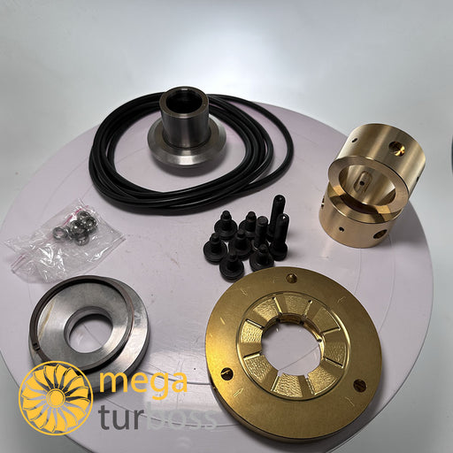
Turbocharger (T/C)
The rotor runs in two radial bearings (4/5) which are located in the bearing flange between the compressor and the turbine. The axial thrust bearing (3) is located at the compressor end.
The radial bearings are connected to a central lubricating oil duct which is fed with oil from the engine's lubricating oil circuit. The oil outlet is always at the lowest point of the bearing casing (10).

Slide 14
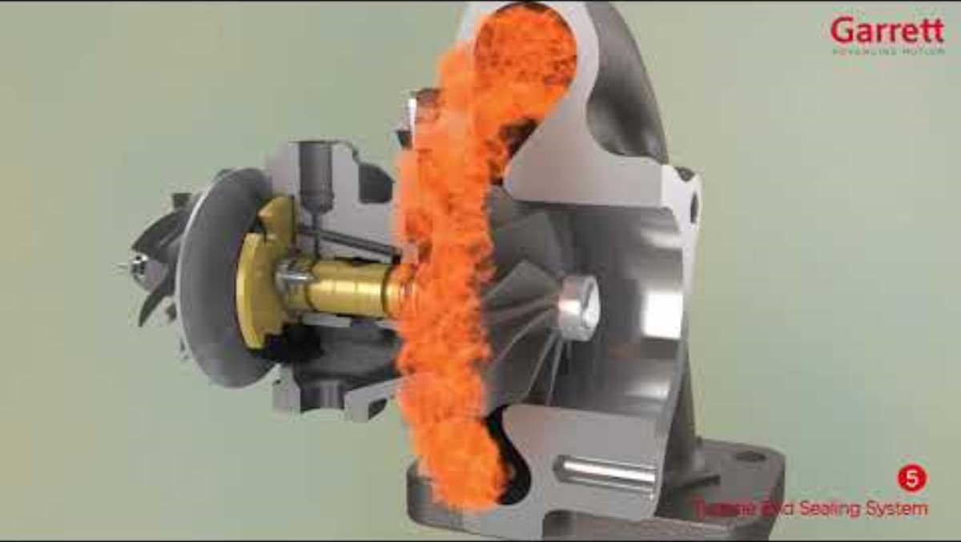
Lubricant flow in the Turbocharger (T/C)

Slide 15
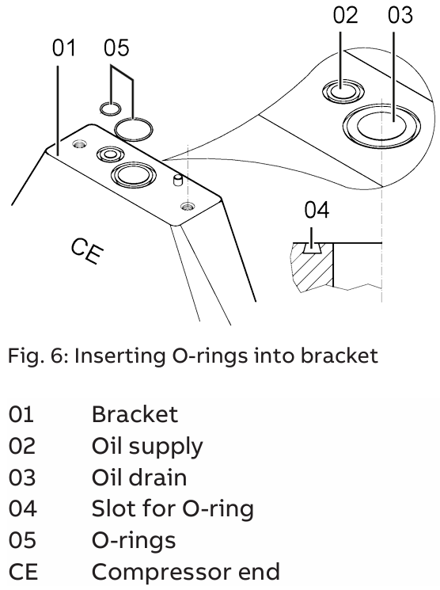
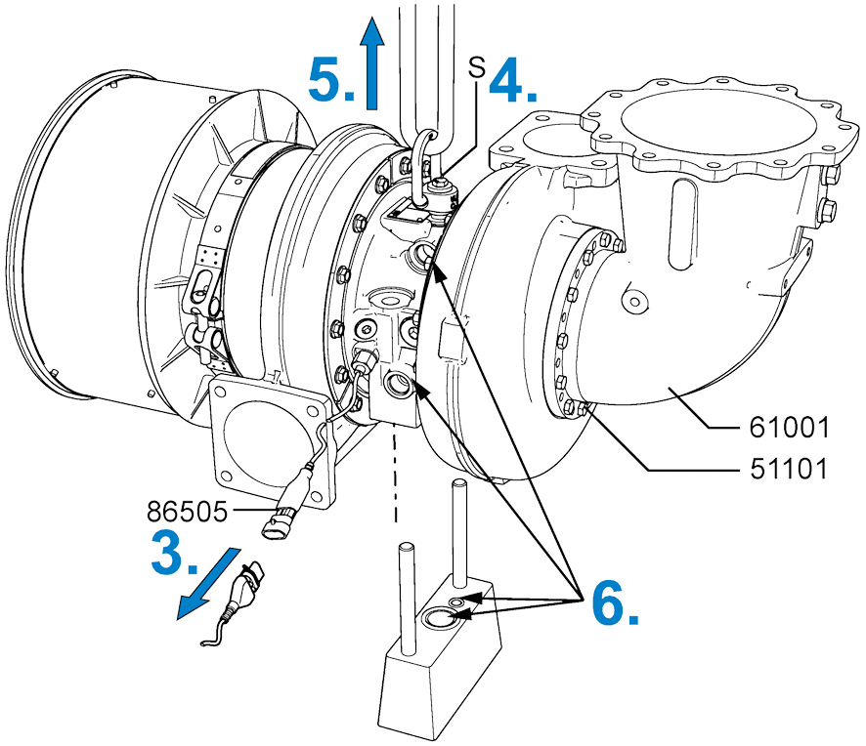
Turbocharger (T/C)

Slide 16
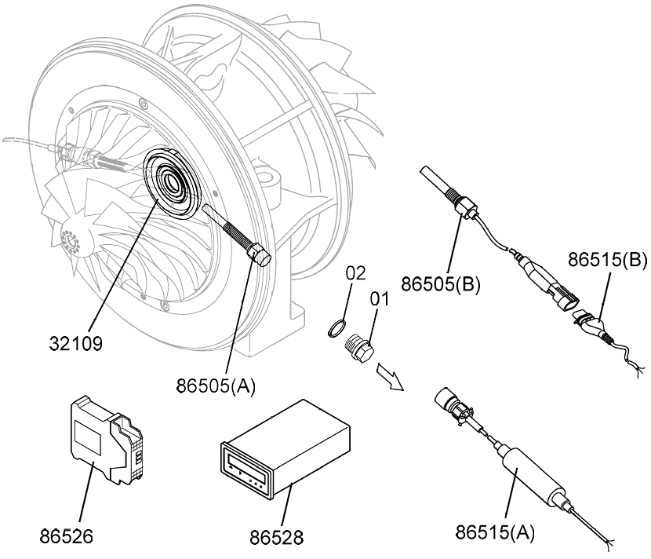
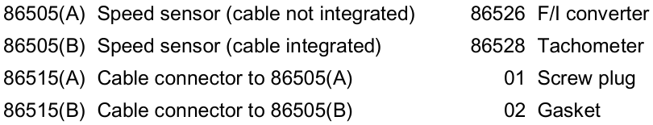
Turbocharger (T/C)
Speed measurement
A speed measuring system permits continuous monitoring of the turbocharger speed.

Slide 17
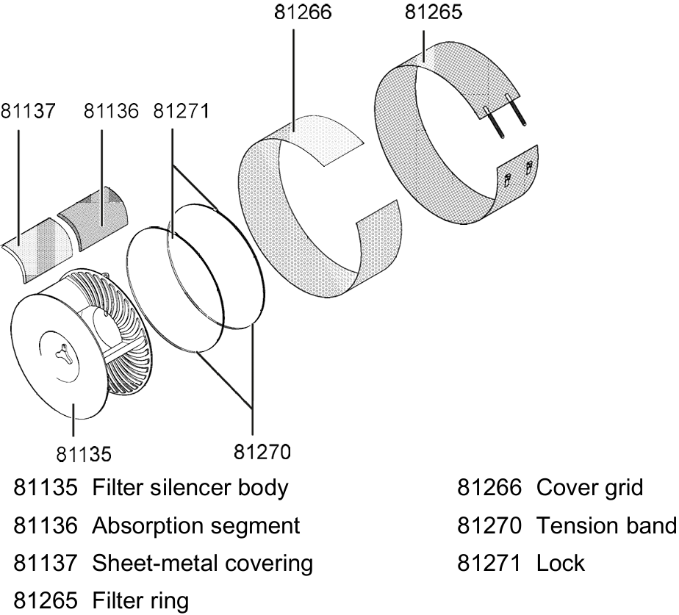
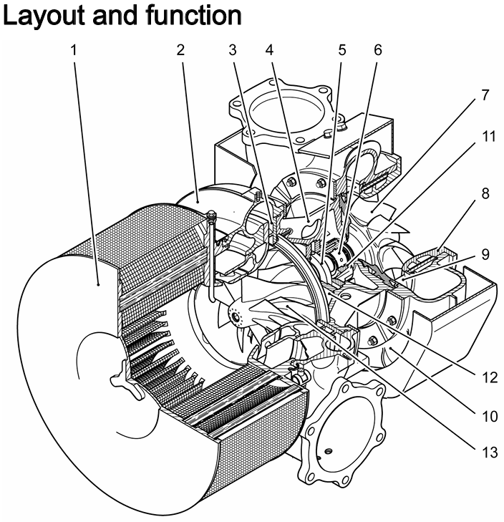
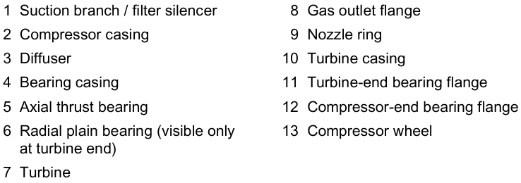
Components of T/C

Slide 18
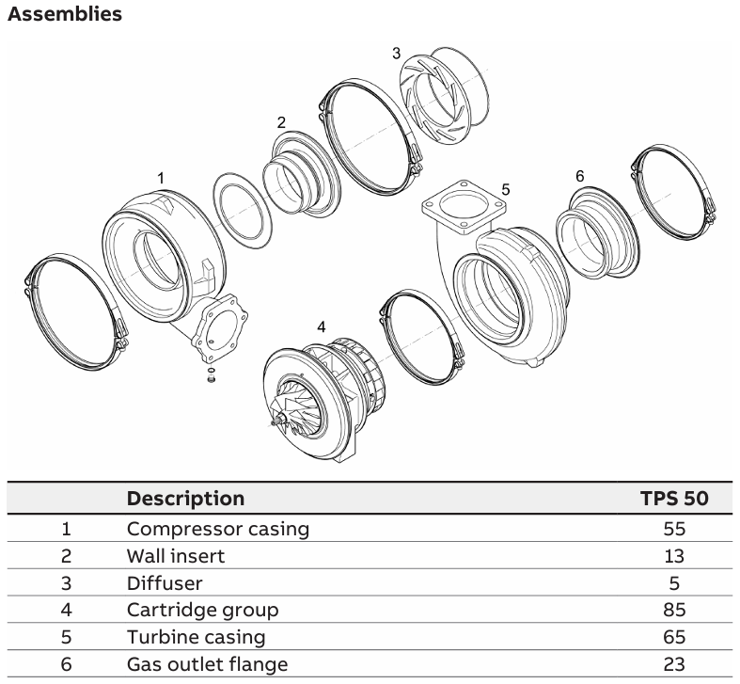
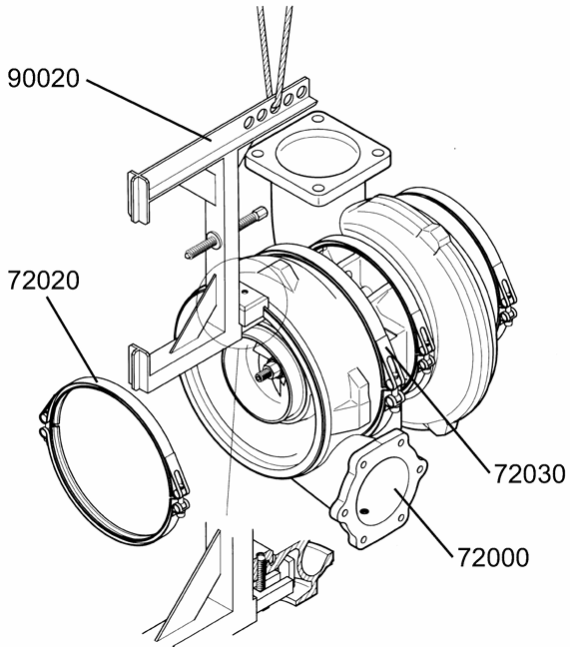
Components of T/C
V-clamp
V-clamp
Compressor casing

Slide 19
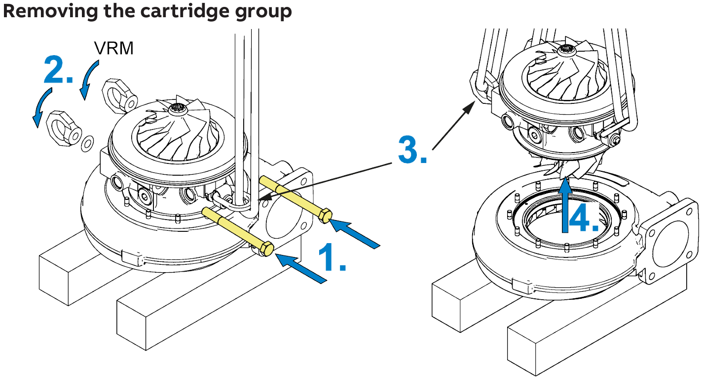
Components of T/C

Slide 20
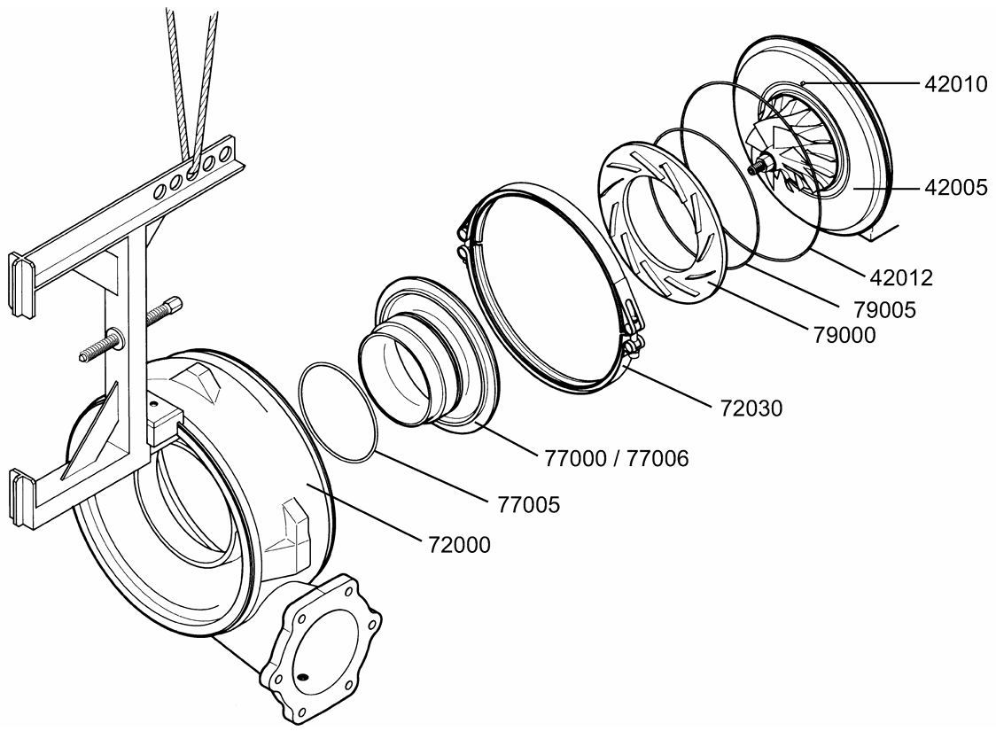
Components of T/C
Positioning
pin
Bearing flange
O-ring
O-ring
Diffuser
V-clamp
Wall insert
O-ring
Compressor casing

Slide 21
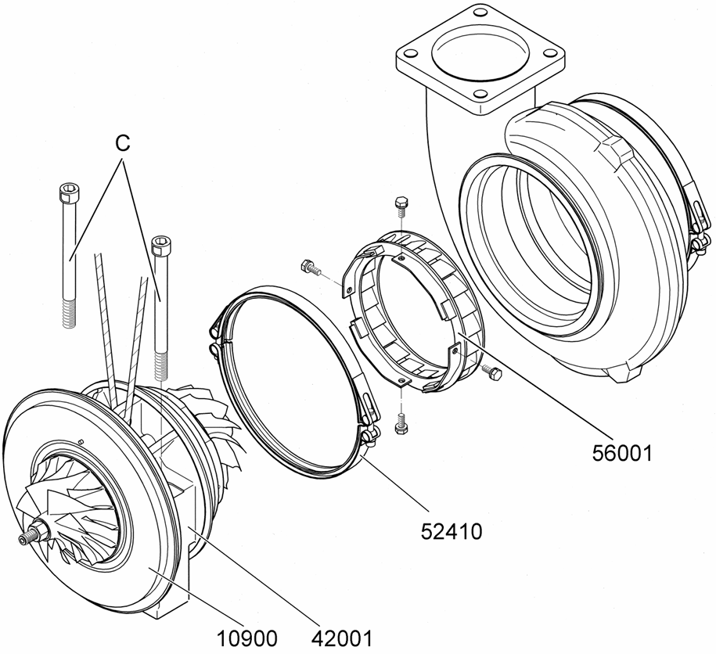
Components of T/C
Nozzle ring
V-clamp
Bearing casing
Bearing casing

Slide 22
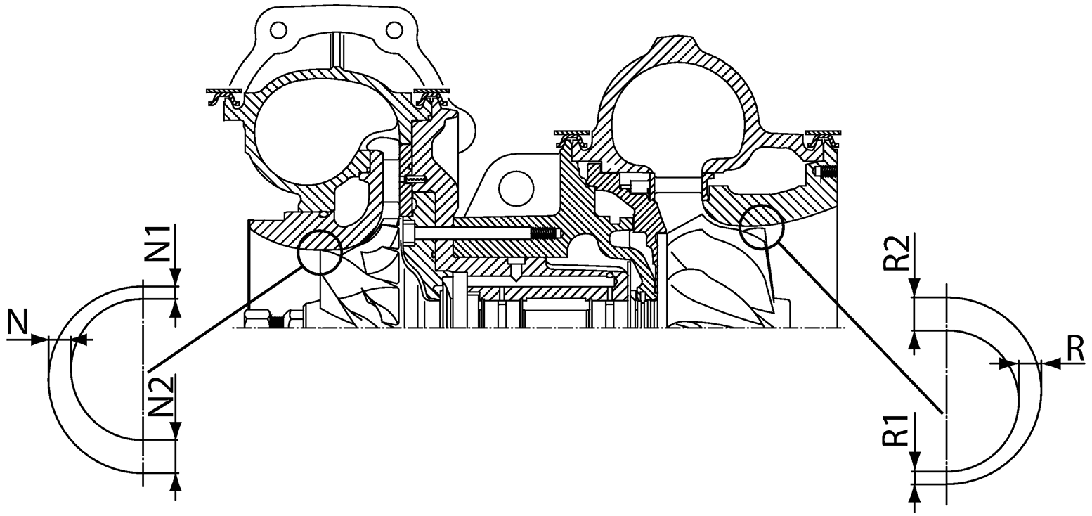
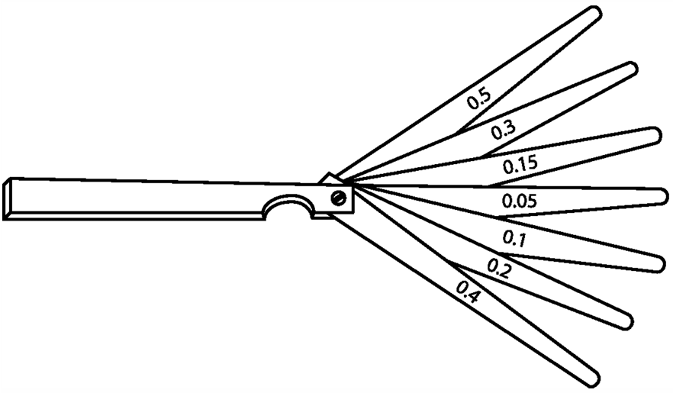

Radial clearances N and R for T/C
These are the theoretical values of the radial clearance between the compressor wheel and the wall insert and / or turbine wheel and the gas outlet flange.
The minimum and maximum values result from the manufacturing tolerances of the compressor wheel and turbine wheel or the wall insert and gas outlet flange.
N1 and N2 as well as R1 and R2 are each measured at the same time using two feeler gauges.

Slide 23
Radial clearances N and R for T/C
To measure N1 and N2, the feeler gauges must be pushed between the wall insert and the compressor wheel free of play, in each case above and below.
To measure R1 and R2, the feeler gauges must be pushed between the gas outlet flange and the turbine free of play, in each case above and below.

Slide 24
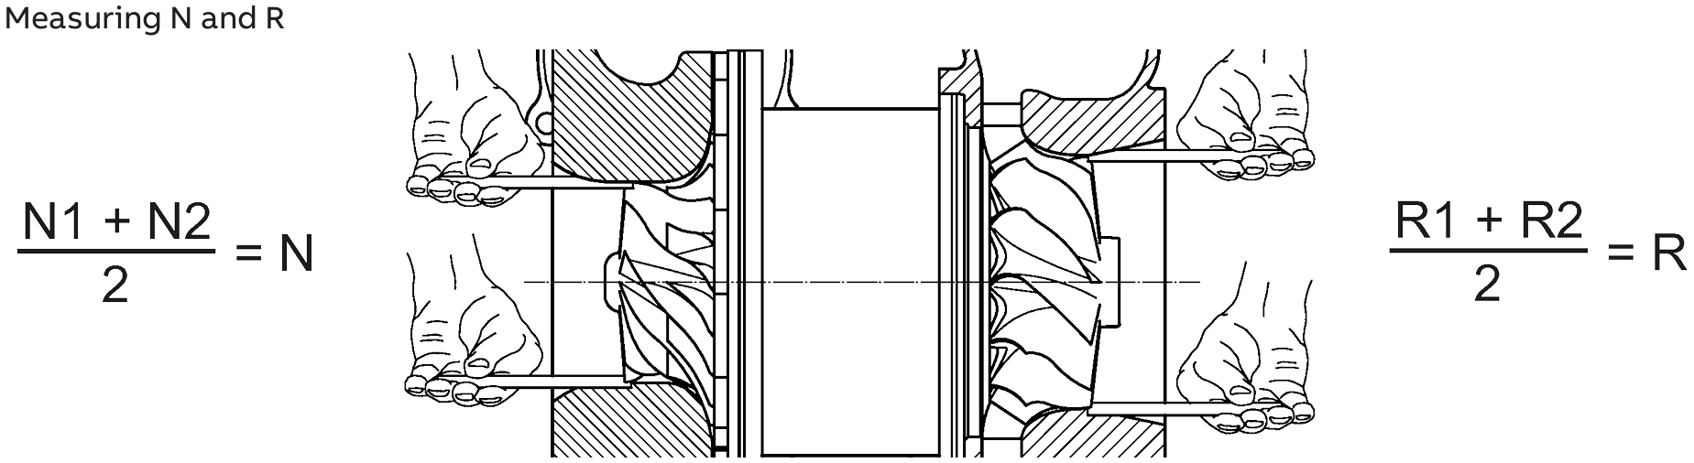
Components of T/C
The mean values measured must be within the permissible values of the radial clearance N and R.
Clearances out of tolerance and excessively worn components can be the cause of serious damage to machinery and property.

Slide 25
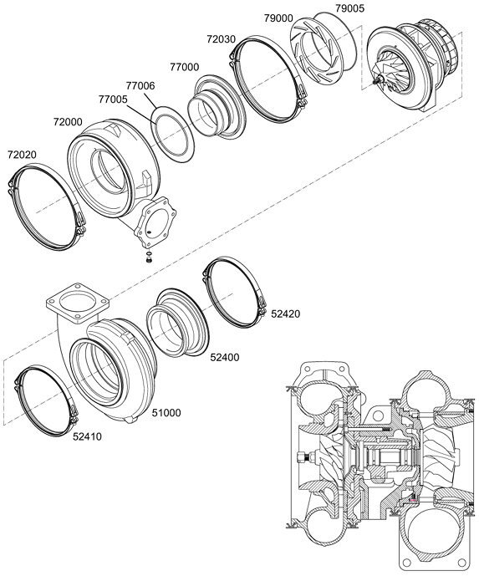
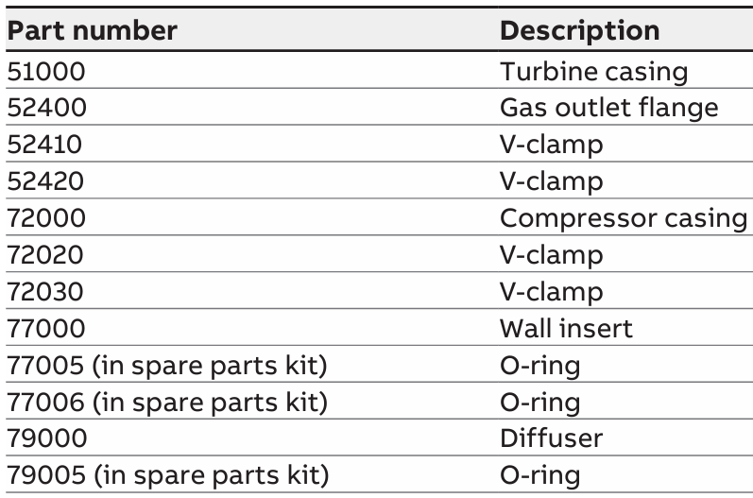
Components of T/C

Slide 26
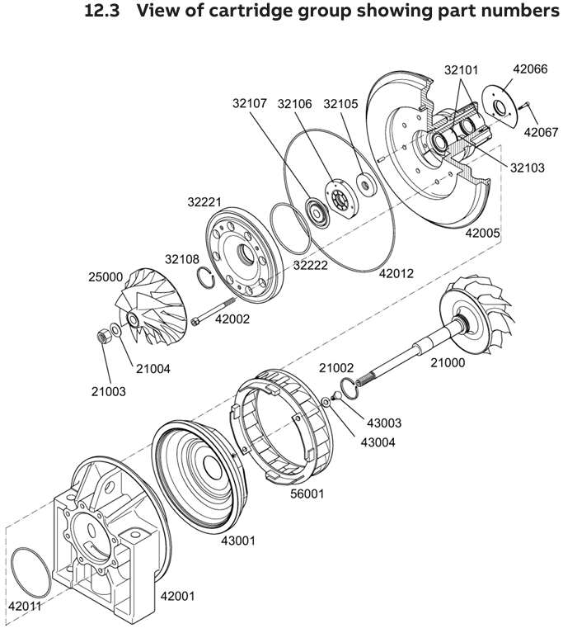
Plain bearing bush
Thrust bearing
Thrust ring
Orifice plate
Bearing bush
Hexagon socket screw
Bearing cover
Safety ring
Piston ring
Bearing flange
O-ring
Compressor wheel
O-ring
Hexagon socket screw
Piston ring
Lock nut
Cup spring
Shaft
Hexagon socket screw
Verbusripp washer
Nozzle ring
Partition wall
O-ring
Bearing casing

Slide 27
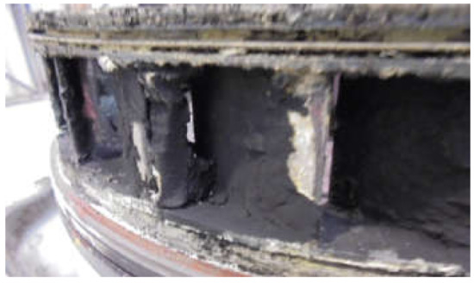
Cleaning of T/C
Regular cleaning of the exhaust turbine is essential to ensure optimum engine operation using HFO as fuel.
Depending on the quality of the fuel used, particularly hard deposits can be formed on the nozzle ring in conjunction with high exhaust gas temperatures.
Heavily contaminated turbine components, in particular a contaminated nozzle ring, lead to deterioration in turbine efficiency. Reduced engine power and poorer efficiency are the result.
Under certain circumstances, even the omission of only one turbine washing cycle can lead to a build-up of carbon residues that can no longer be removed with the next regular cleaning process. The resulting need for an early turbocharger service increases the operating costs of the engine plant.
Contaminated nozzle ring of T/C

Slide 28
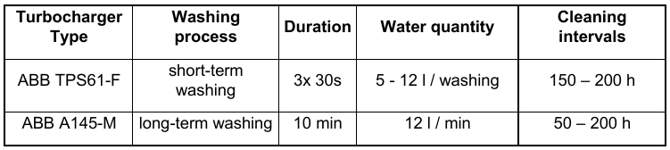
Cleaning of T/C
Turbine cleaning
Generally, there are two different washing processes for cleaning the turbine: short-term and long-term washing. Which washing process to use depends on the turbocharger type.
In short-term washing, water is introduced into the turbine several times for a short time. This leads to temperature shocks which cause the dirt to flake off.
The cleaning effect of long-term washing is based on dissolving the dirt with water. Thus, the 10 minute cleaning time should ensure that all dirty surfaces are wetted with water and that dirt is dissolved.

Slide 29
Cleaning of T/C
Despite regular turbine washing in compliance with the washing parameters, if the turbines and nozzle rings are dirty, manual cleaning of the components is necessary.
Chemical analyses show that usually deposits on turbines and nozzle rings are mainly oxidic vanadium compounds. If fuels with a high vanadium content are used, we recommend shortening the washing intervals.
Field experience and tests have shown improved cleaning results with the long-term washing procedure, therefore in case operators experience insufficient cleaning results with the short term water injection, ABB recommends changing to long-term washing.

Slide 30
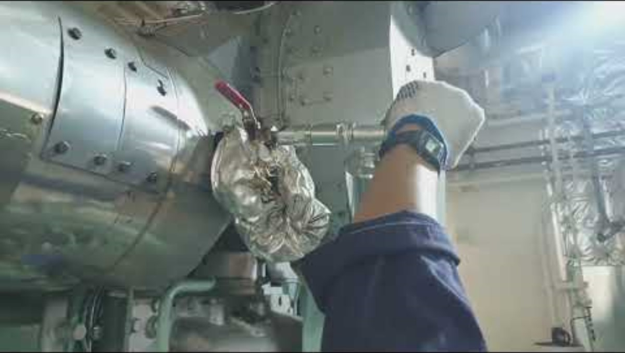
Dry cleaning of T/C turbine side

Slide 31
Water washing of T/C turbine side
https://www.youtube.com/watch?v=vzn5oku3xOo

Slide 32
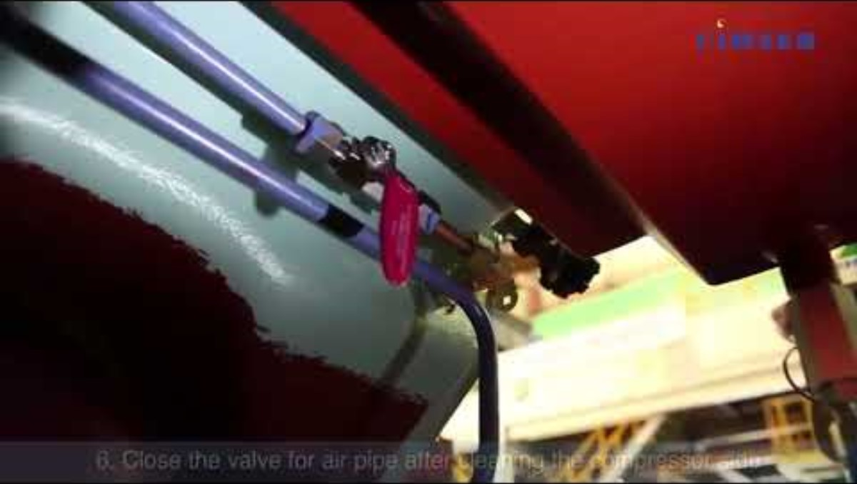
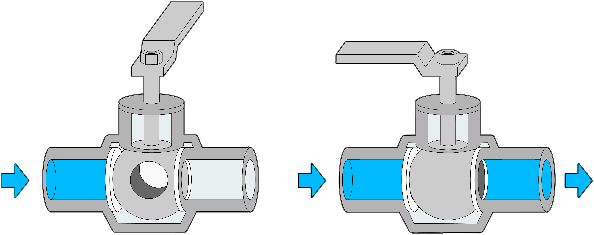
T/C cleaning for compressor and turbine sides
Ball valve

Slide 33
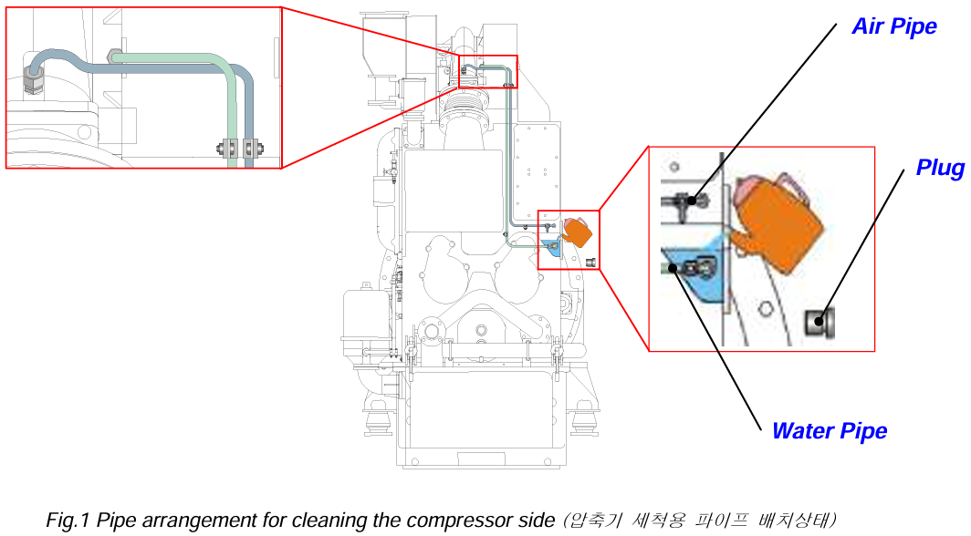
T/C cleaning for compressor

Slide 34
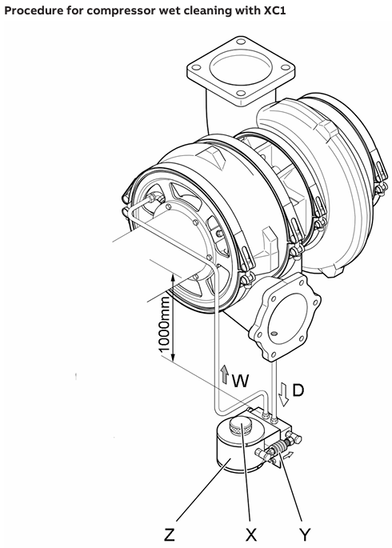
T/C cleaning for compressor
Operating state prerequisites for cleaning compressor with XC1
To be able to carry out a satisfactory cleaning process which has been tested and is recommended by ABB Turbocharging, the following prerequisites must be fulfilled:
1) Run engine at load from 50 … 85 %.
2) Start cleaning cycle according to following description Wet cleaning operation with XC1.
Water
Pressurized air
Screw plug
Container
Valve activator

Slide 35
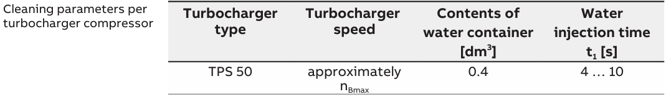
T/C cleaning for compressor
Operating state prerequisites for cleaning compressor with XC1
Operating the water pressure vessel
1) Remove the screw plug (X).
2) Fill the vessel with clean water.
3) Replace the screw plug.
4) Push the valve activator (Y) against the spring and hold it for 10 to 15 seconds until entire volume of water has been injected.
5) After cleaning, wait at least 5 minutes with the engine running to allow the turbocharger to dry.
6) The cleaning cycle may only be repeated after a stabilization period of at least 10 minutes has elapsed.
Water
Pressurized air
Screw plug
Container
Valve activator

Slide 36
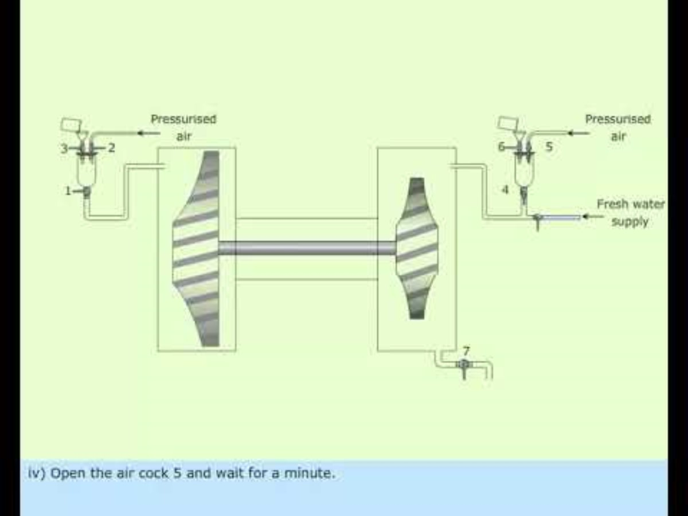
T/C cleaning for compressor and turbine sides

Slide 37
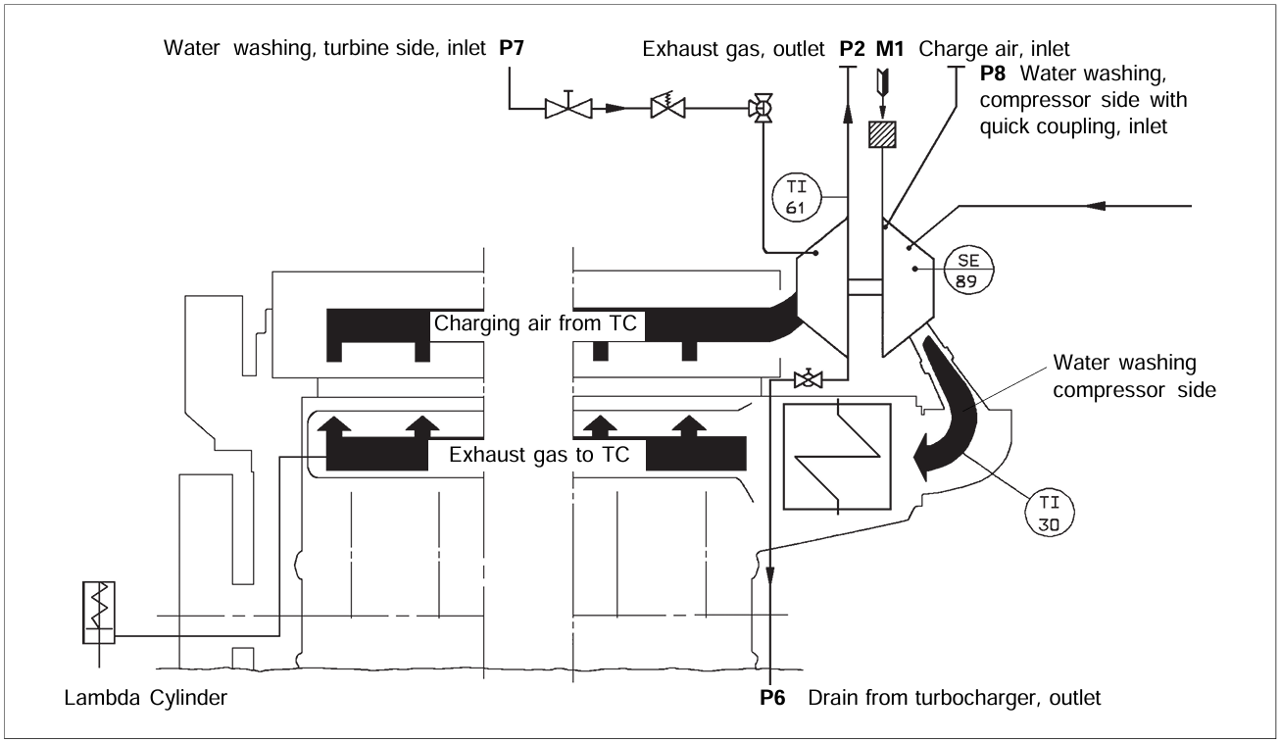


T/C system

Slide 38
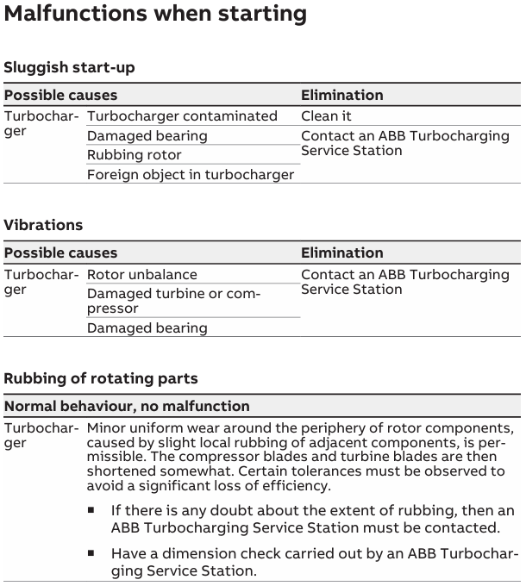
Troubleshooting for T/C
Notes:
periphery : (어떤 범위의) 주변
adjacent : 인접한, 가까운

Slide 39
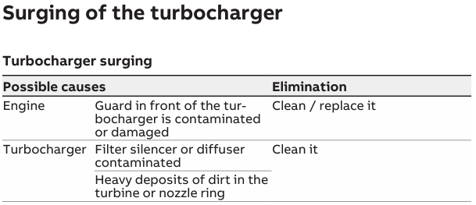
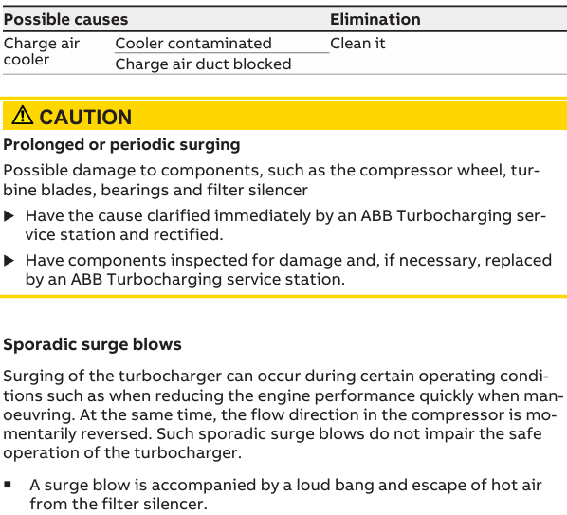
Troubleshooting for T/C
Notes:
sporadic : 산발적인, 이따금 발생하는
momentarily : 잠깐 (동안)
impair : 손상[악화]시키다

Slide 40
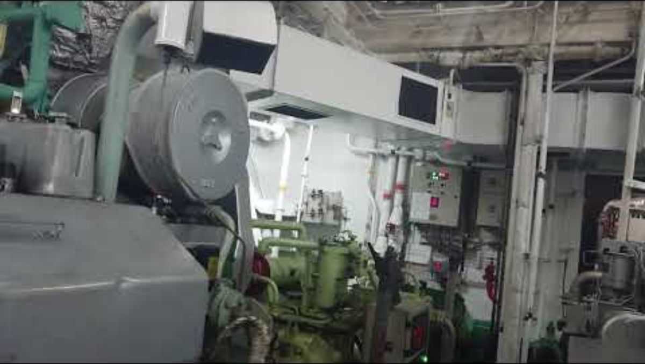
T/C surging on G/E

Slide 41
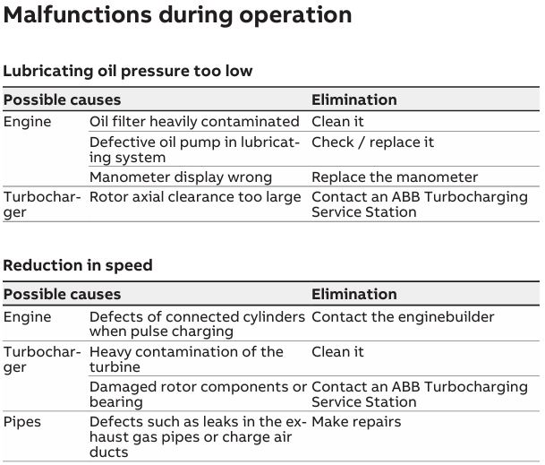
Troubleshooting for T/C

Slide 42
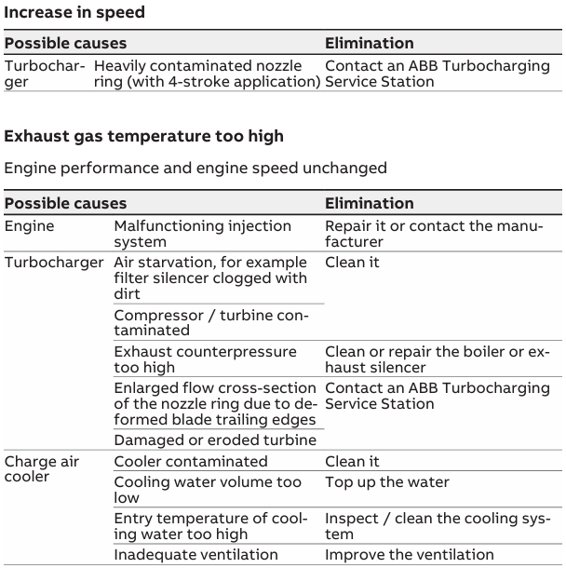
Troubleshooting for T/C

Slide 43
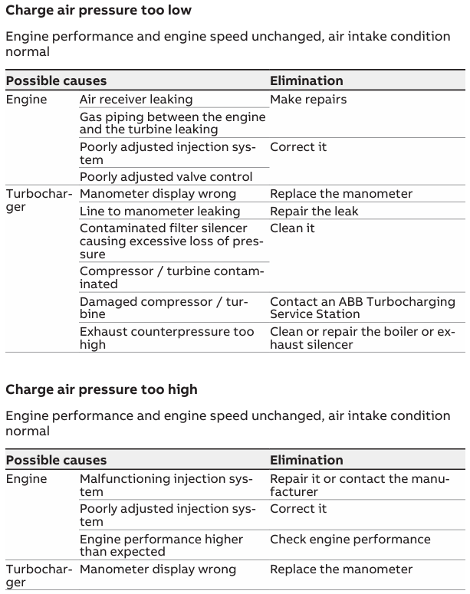
Troubleshooting for T/C

Slide 44

Troubleshooting for T/C

Slide 45
References
1) https://www.manualslib.com/download/2380893/Abb-Tps-50b01.html
2) https://www.manualslib.com/download/2258430/Abb-Tps48-F32.html
3) https://en.wikipedia.org/wiki/File:W%C3%A4rtsil%C3%A4_6L20.jpg
4) https://www.manuallib.com/download/2023-10-27/ABB%20%E6%B6%A1%E8%BD%AE%E5%A2%9E%E5%8E%8B%E5%99%A8%E6%93%8D%E4%BD%9C%E6%89%8B%E5%86%8C%20TPS44-H33%20HT588474.pdf
5) https://www.turbodynamics.co.uk/how-does-a-turbocharger-work
6) https://malwimarine.com/wartsila-6l20-complete-engine/
7) https://alsolmarine.ae/products/nozzle-ring
8) https://www.reddit.com/r/cars/comments/3v1c0z/animated_gif_of_a_turbocharged_engine/

Slide 46
References
9) https://www.wartsila.com/encyclopedia/term/engine-room-arrangement
10) https://dir.indiamart.com/impcat/turbocharger-parts.html?biz=10
11) http://hyperphysics.phy-astr.gsu.edu/hbase/pber.html
12) https://www.youtube.com/watch?v=wykn-JTnacE
13) https://www.niddk.nih.gov/news/media-library/17826
14) https://megaturboss.com.mx/products/kit-gigante
15) https://zeppelin-cat.dk/wp-content/uploads/2025/06/M32-008.pdf
16) https://zeppelin-cat.dk/wp-content/uploads/2025/06/M32-008.pdf
17) https://ko.wikipedia.org/wiki/ABB_%EA%B7%B8%EB%A3%B9
18) https://convalve.eu/language/en/how-ball-valves-work/
19) https://www.youtube.com/watch?v=ARFYhjszrpk

