Slide 1
MHRN VDW Work
Continue periodic descriptive analyses
Transition to ICD-10 diagnoses
Give everything away

Slide 2
ICD-10 Transition
Standard cross-walk and MHRN groupings available via GitHub
Findings so far
  No dramatic changes in rates for major diagnosis categories
  Significant changes in rates of definite (up) and possible (down) suicide attempt
  Some glitches in suicide attempt coding PRIOR to transition (be careful!)

Slide 3
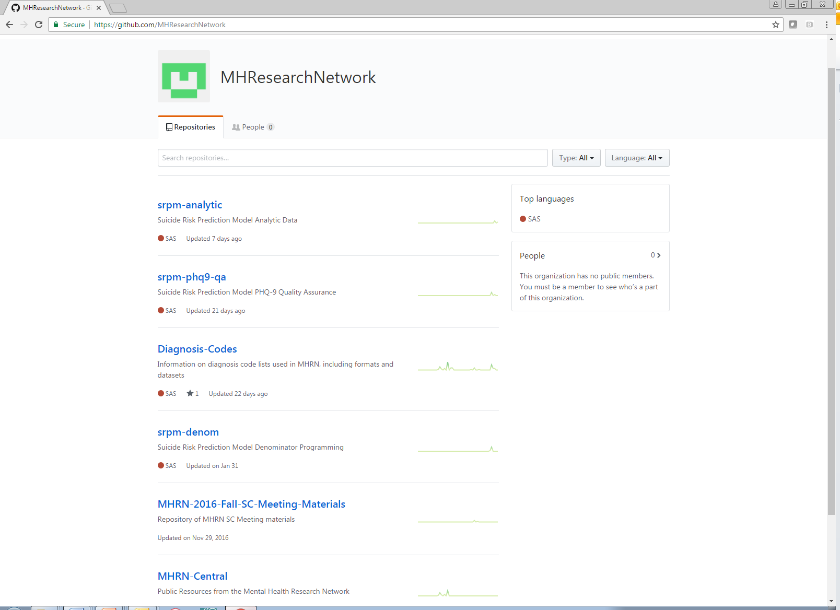

Slide 4
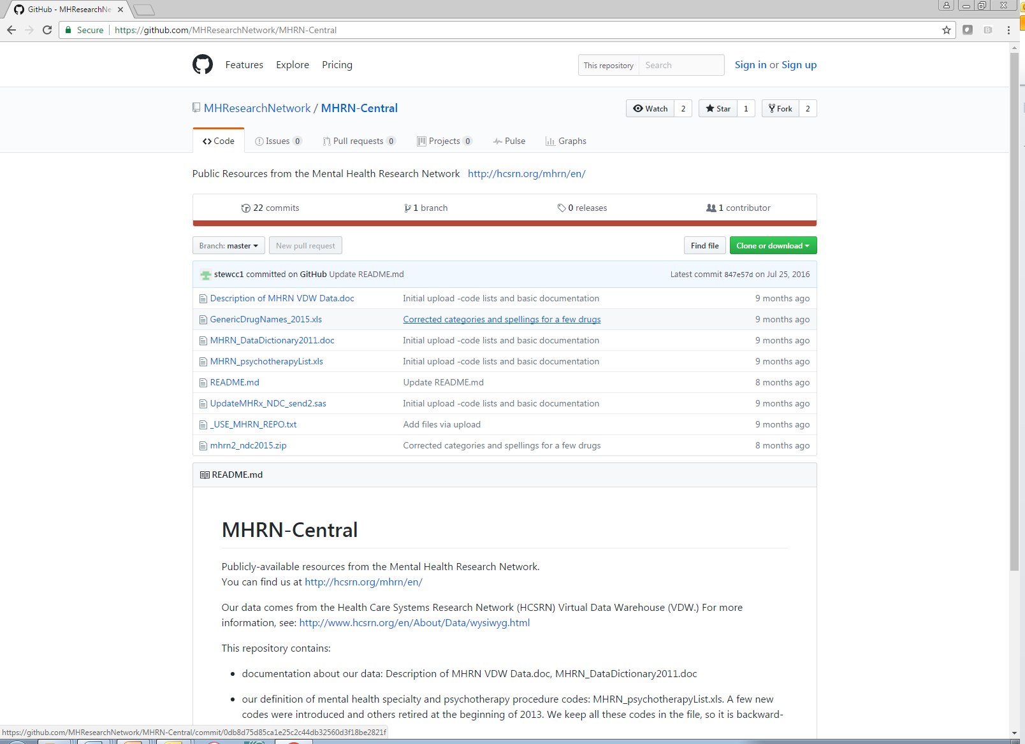

Slide 5
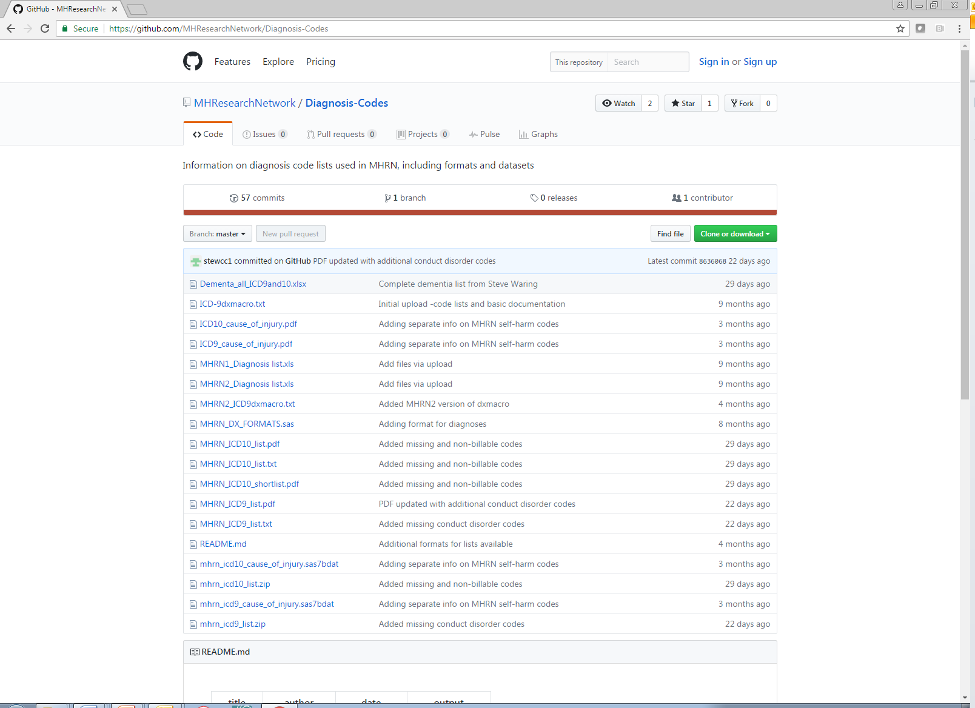

Slide 6
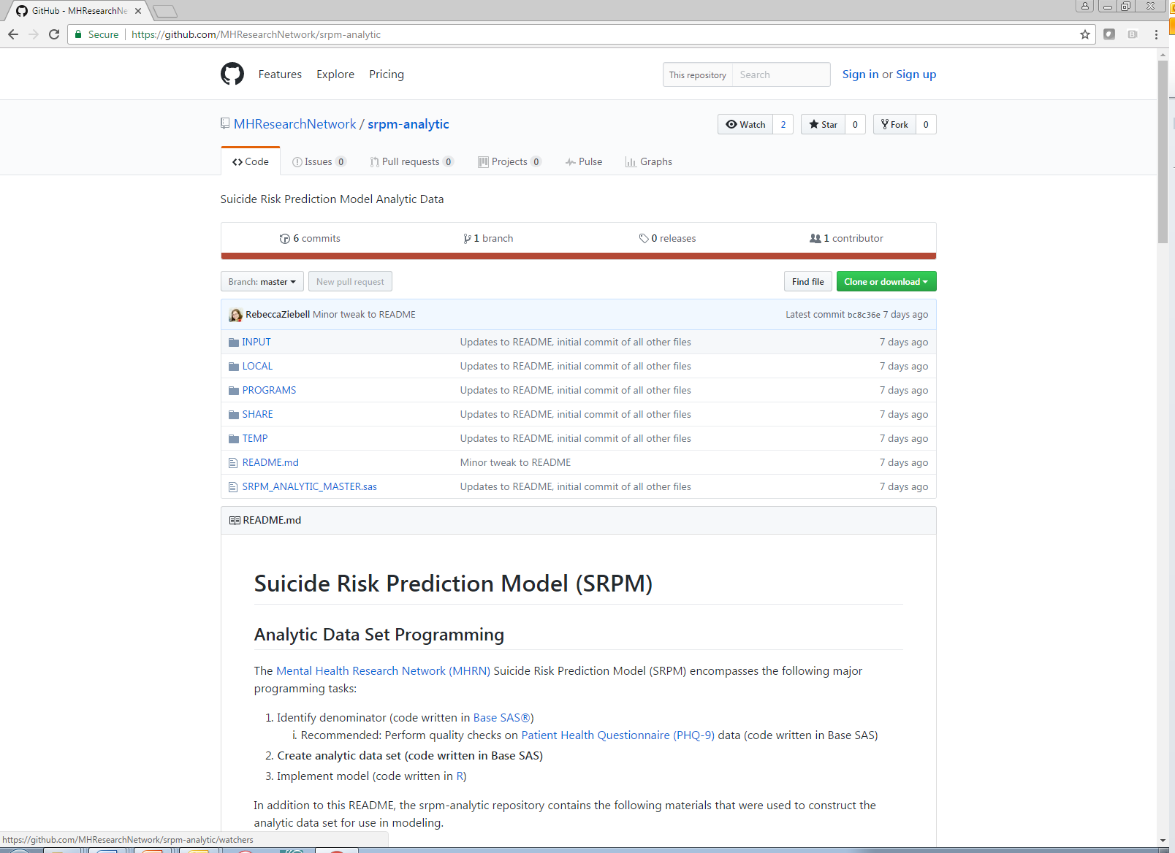

Slide 7
Some things to think about:
Research data vs. clinical/operational data
Can the VDW ever be timely enough?
Shift from hypothesis testing to estimation and prediction
Is our true product an answer or a method?

