Slide 1
Computer Game and simulation programming
By Yi Zhao, Jack Phillips and Ken pomeranz

Slide 2
Task
Middle school students
Starting at intern, progress to CEO
Develop competent business skills related to FBLA

Slide 3
Process
Content
Style/ Storyboard
Platform
Design and Development
Debugging

Slide 4
Content
Real world challenges
Charisma
Negotiation
Leadership
Time management
Learning

Slide 5
Style
Puzzle Platformer
Doodle Style
Storyboard

Slide 6


Platform
Adobe Flash
Github

Slide 7
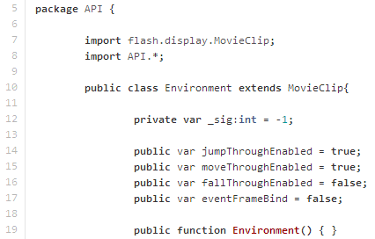
Development
API/ CODE
Actionscript
Designed API through Inheritance

Slide 8
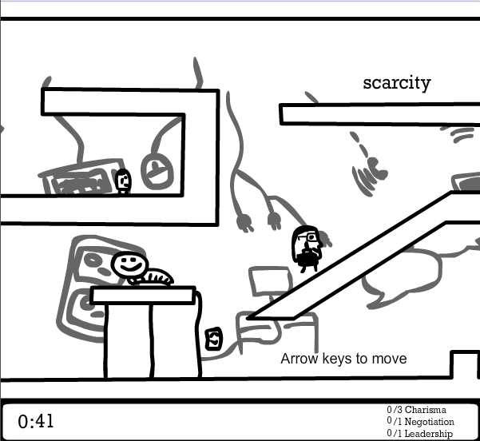
Design
Doodle style
Black and white
Real world working place
Backgrounds are business themed

Slide 9
Demo

