Slide 1
Computer Game and simulation programming
By Yi Zhao, Jack Phillips and Ken pomeranz

Slide 2
Task
Middle school students
Starting at intern, progress to CEO
Develop competent business skills related to FBLA

Slide 3
Process
Content
Style
Storyboard
Platform
Design and Development
Debugging

Slide 4
Real world challenges
Charisma
Negotiation
Leadership
Time management
Learning

Slide 5


Tools
Adobe Flash
Github

Slide 6
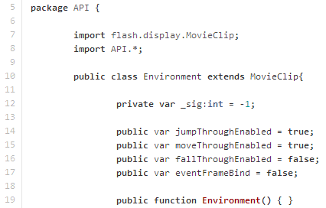
Api/Code
Actionscript
Designed API through Inheritance

Slide 7
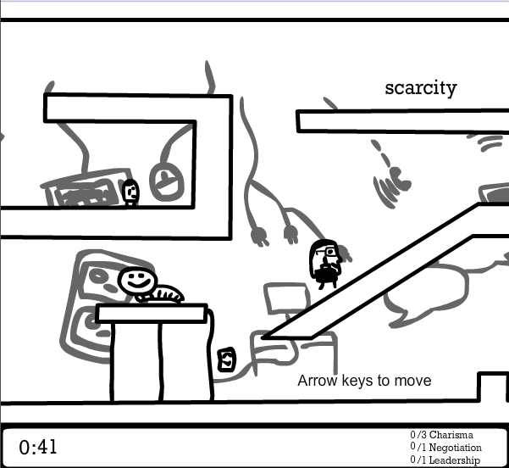
Design
Doodle style
Black and white
Real world working place
Backgrounds are business themed

Slide 8
Demo

