Slide 2
MHS Events
Mamaroneck High School

Slide 3
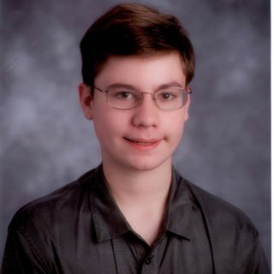
Who are we
Andrew Katz
Lead Developer
10th Grade Student
Mamaroneck High School
aakatz3@gmail.com
Sam
Assistant Developer
10th Grade Student
Mamaroneck High School
aakatz3@gmail.com

Slide 4
Your school has asked you to write a mobile application announcing activities at your school including dates, times, and contact information. With this app include an events list that retrieves events starting at the current day and extending into the next few months. Include a banner image scroller to this application.
The prompt

Slide 5
Our Solution
Our app’s icon is our school’s logo
The front page of the app has a banner of images
The front page has a list of events
When an event is clicked on, it is brought up in more detail
The details view allows emailing the organizer (if available), sharing the event, and adding to calendar.

Slide 6
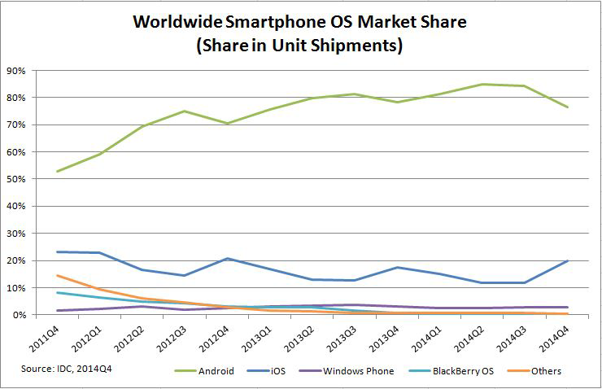

Why android?

Slide 7
Design Process
Interface Design
Implement Basic Functionality
Debug
Expand Functionality
Debug
Release
Testing

Slide 8


Tools Used
Android Studio
Github

Slide 9
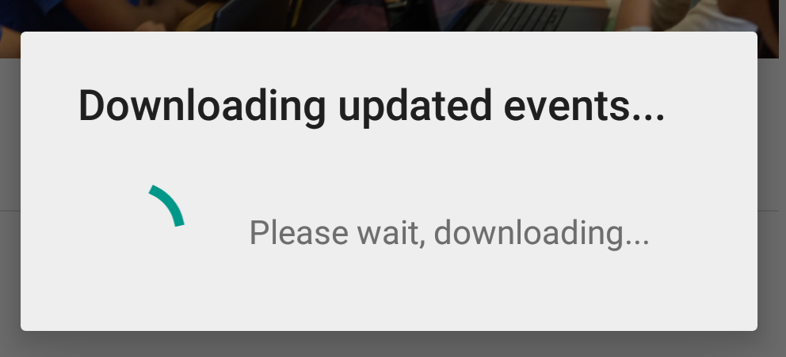
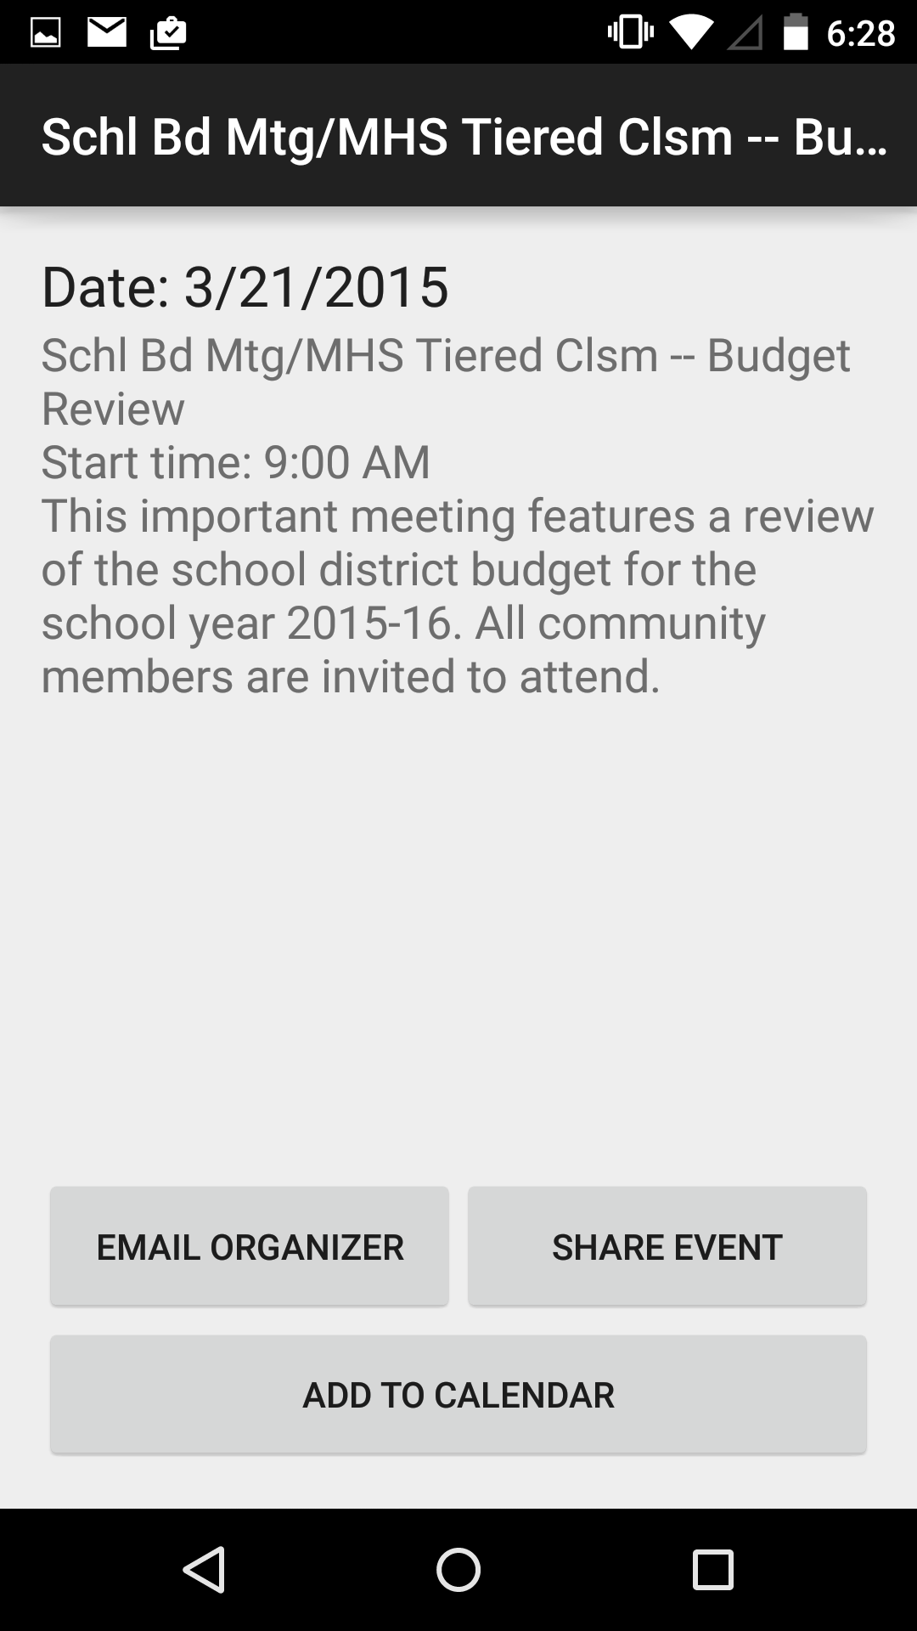
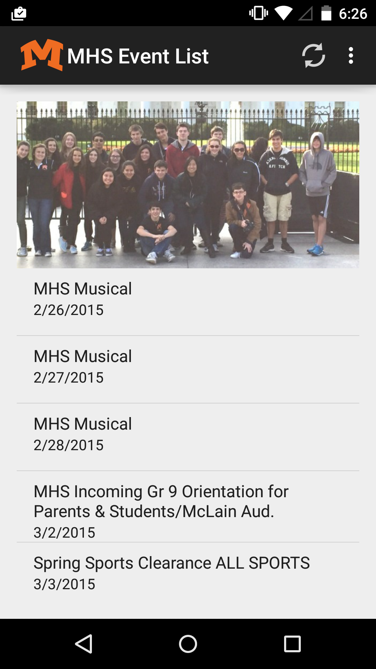
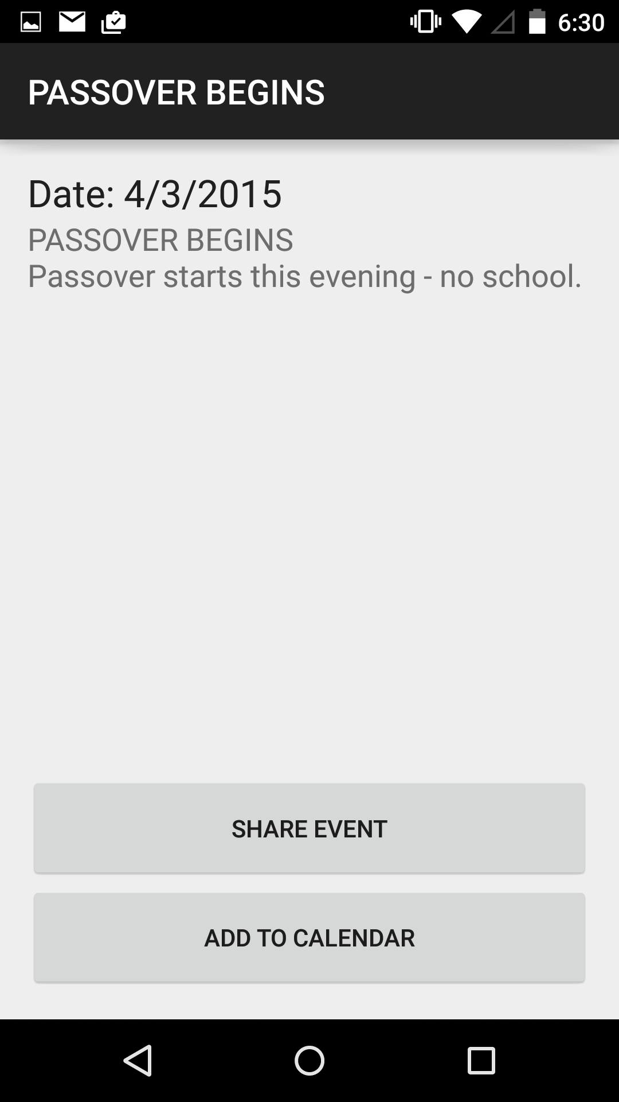
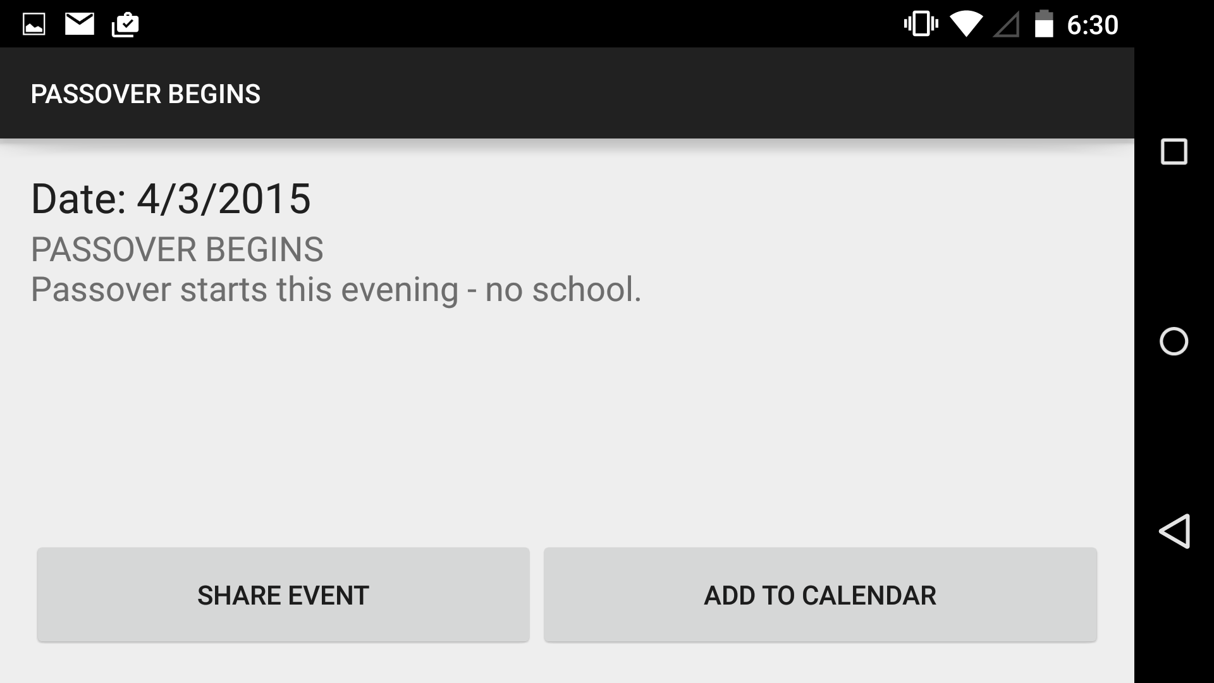
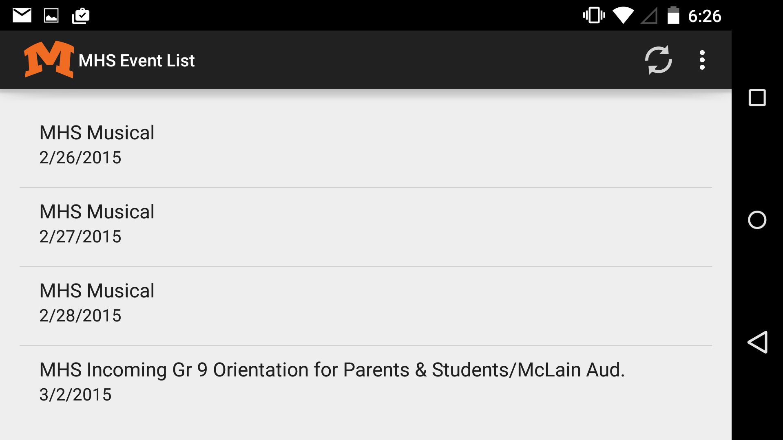
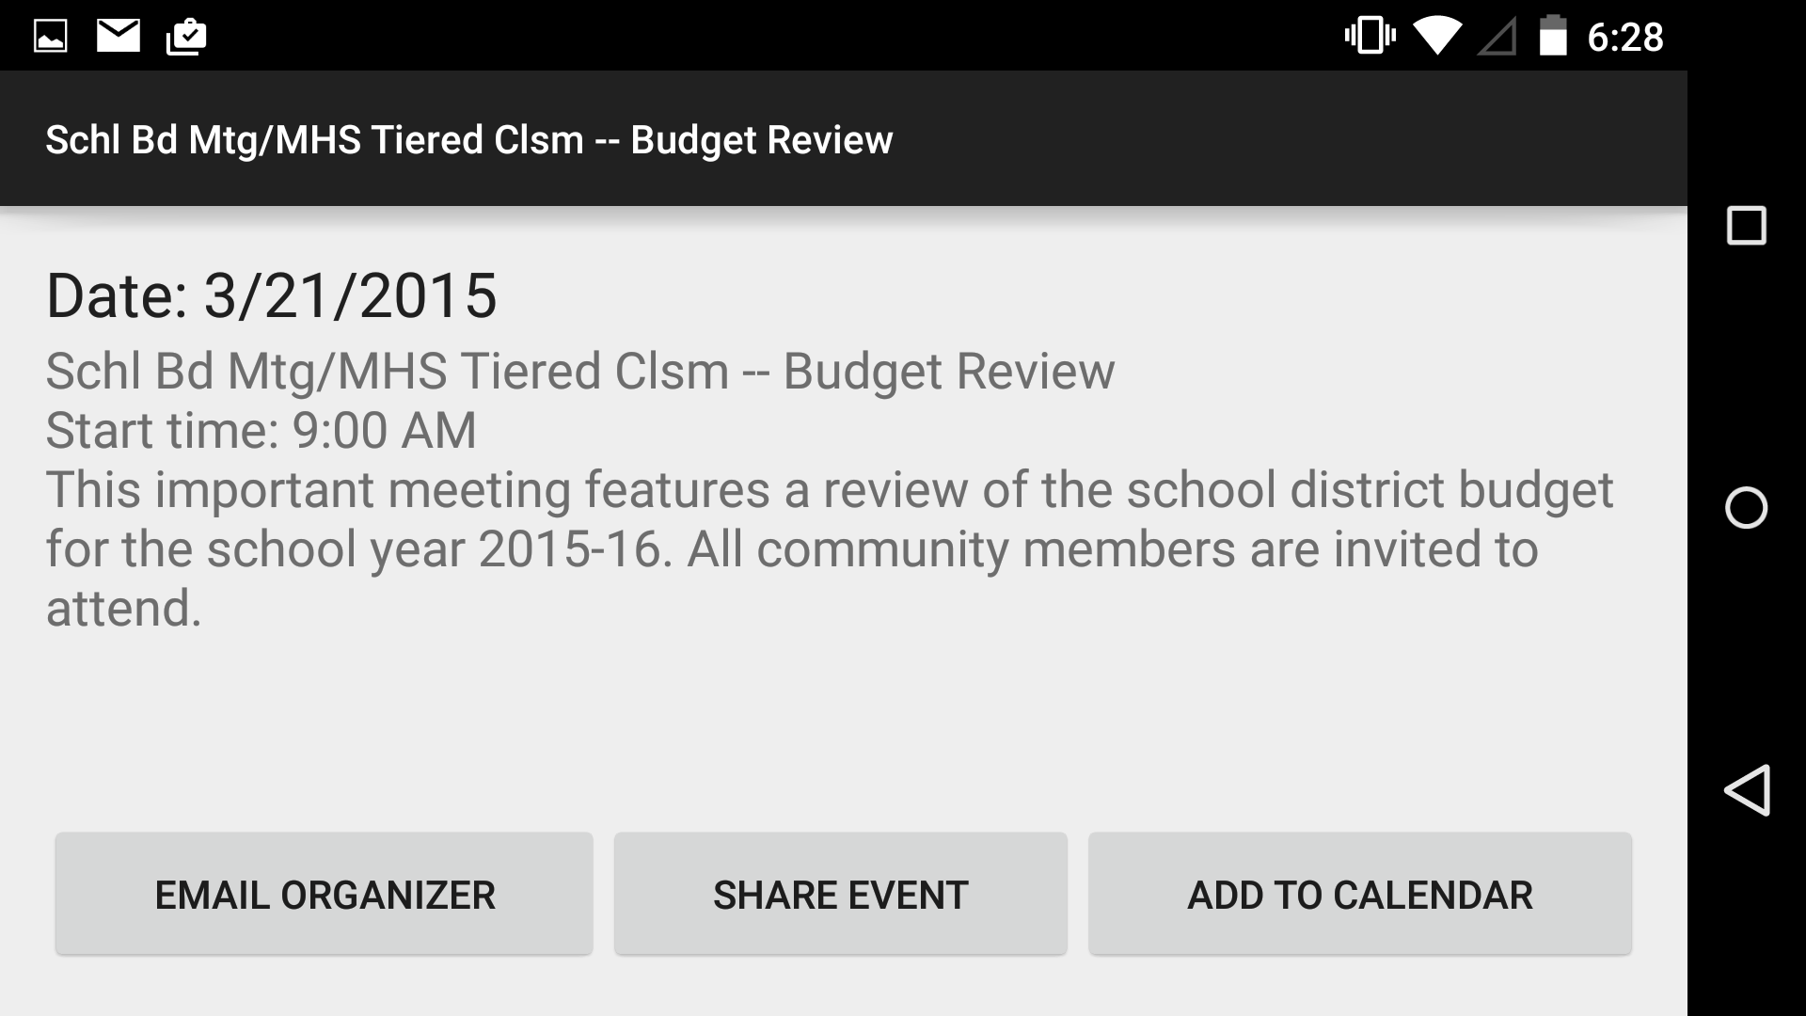

Screenshots

Slide 10
Live Demo
Please wait a few seconds while we switch the projector to the phone…

Slide 11
Video demo

Slide 12
Thank you.
Are there any questions?

