Slide 2
MHS Events
Mamaroneck High School

Slide 3
Who are we

Slide 4
PROMPT HERE
The prompt

Slide 5
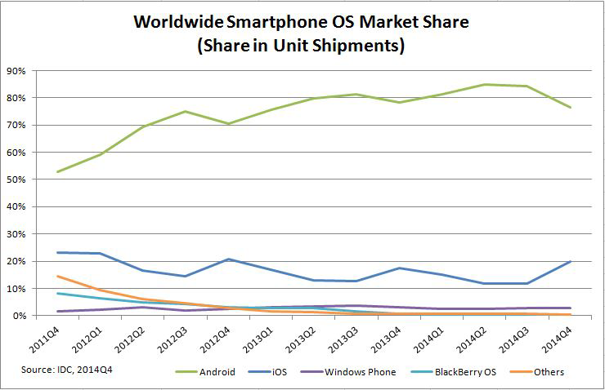
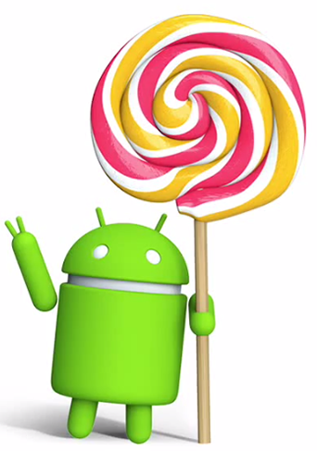
Why android?

Slide 6
Design Process
Interface Design
Implement Basic Functionality
Debug
Expand Functionality
Debug
Release
Testing

Slide 7


Tools Used
Android Studio
Github

Slide 8
Screenshots
Layer the pictures here, use fast animations

Slide 9
Live Demo
Please wait a few seconds while we switch the projector to the phone…

Slide 10
Video demo
Do a video demo on this slide

Slide 11
Thank you very much

Slide 12
Thank you.
Are there any questions?

