Slide 1
Unpacking the Invisible Barriers: A Mixed-Methods Usability
Evaluation of Learning Management Systems in Bangladeshi Universities
Supervisor: Md. Sabbir Ahmed
Co-Supervisor: Dr. S M Taiabul Haque
Department of Computer Science and Engineering
BRAC University
A presentation by Thesis Group ID: T2520849 -
S.M Shuraim (21201725)
Jannat Zarin (22101131)
Afif Jabir Atanu (24241363)
Mahmudul Hassan Taseen (22301531)
Enamul Haque Shafin (21201653)

Slide 2
Background : The LMS Paradox
Learning Management Systems (LMS) are now the central hub for content delivery and communication in higher education - Moodle alone reports ~291 million users across 241 countries.
Asia's e-learning market is growing ~17.3% per year; COVID-19 forced universities online almost overnight.
The paradox: LMS platforms are extensively adopted but not fully exploited - often used as a digital file library, not a learning environment.
Adoption ≠ meaningful use. The root cause is the quality of the user experience, not the availability of technology.
In resource-constrained settings like Bangladesh, minor usability problems are compounded by unreliable internet, limited devices, and uneven digital literacy.

Slide 3
Problem Statement & Research Gap
LMS platforms in Bangladeshi universities are underutilized - treated as file repositories, not interactive learning environments.
Poor usability drives this: unintuitive navigation, cluttered layouts, no reliable search, weak collaboration tools.
Infrastructural realities - unreliable internet, limited devices, uneven digital literacy - amplify every flaw.
Affects everyone: students lack search & feedback; faculty lack training & support.
Studied Globally
MISSING FOR BANGLADESH
Standardized scores (SUS, UEQ)
Western-centric models
Single platform / single stakeholder
Problems documented
Pedagogical & sociocultural usability
Context-specific, low-resource framework
Fragmented multi-platform reality
Findings carried into real solutions

Slide 4
Research Objectives
Identify and examine the key usability issues in LMS platforms - interface design, navigation, accessibility, and collaboration - from both student and faculty perspectives.
Examine the relationship between usability deficits and LMS adoption rates, learner engagement, and teaching methods.
Assess the impact of institutional support, professional development, and digital literacy on successful LMS use in resource-limited contexts.
Produce evidence-based recommendations and implementation guidelines for more usable, interactive LMS environments.

Slide 5
Literature Review: What Prior Work Found
Standardized measurement - Scores conflict and miss context: Berényi found high Moodle usability (SUS 85.04) yet ignored notifications/collaboration; Koca & Özcan found only moderate faculty usability (SUS 63.85) due to poor support & training; multi-method testing (Alkoblan & Al-Wadud) exposed 31 defects - ~3× more than single-method.
Pedagogy & sociocultural design - UI is a pedagogical tool, not cosmetics (Faghih et al.); unappealing design and low-quality content sink otherwise useful systems (Al-Fraihat et al.); Moodle is widely seen as a file repository with no training (Simon et al.).
Low-resource settings - Rural Bangladeshi students hit internet problems ~2× as often (Karim et al.); poor tech access linked to e-learning stress (Hasan et al.); private-university online learning broadly dissatisfying (Saarmean et al.).

Slide 6
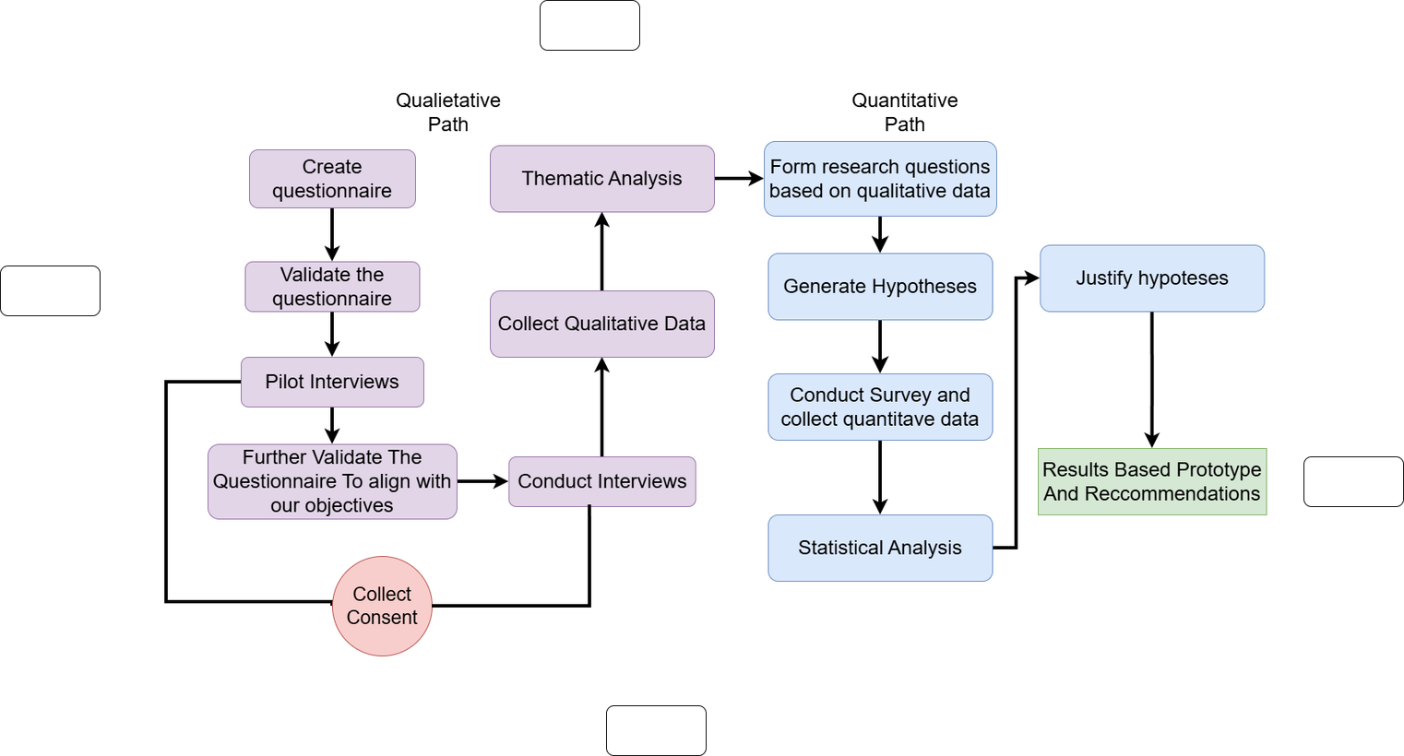
Research Design: Exploratory Sequential Mixed Methods
Mixed-Methods design :
Qualitative first, Quantitative second
Qualitative:
Semi-structured interviews →thematic analysis → seven usability themes. These themes are converted into research questions and 7 hypotheses.
Quantitative:
A structured survey tests the severity of each themes at scale. The findings are then merged into context-specific design solutions and a working prototype. Paradigm: pragmatism - method chosen to fit the problem, not the reverse.
Figure : Workflow

Slide 7
Methodology
01
Qualitative
02
Quantitative
15-20 min Semi-structured interviews (physical + online)
Four thematic areas :
(1) usability concerns,
(2) impact on adoption,
(3) institutional support,
(4) recommendations.
Iterative coding by 4 raters where
K-value is 0.9
Structured survey derived from the qualitative themes.
15 variable questions mapped to 7 hypotheses.
Mixed item formats : analyzed with One-Tailed T-Tests and Chi-Square Tests
(one item via thematic analysis).

Slide 8
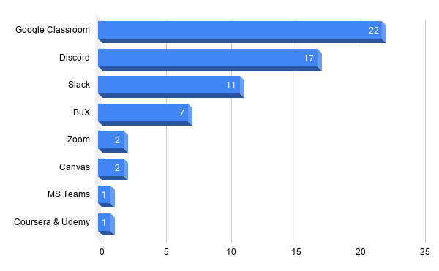
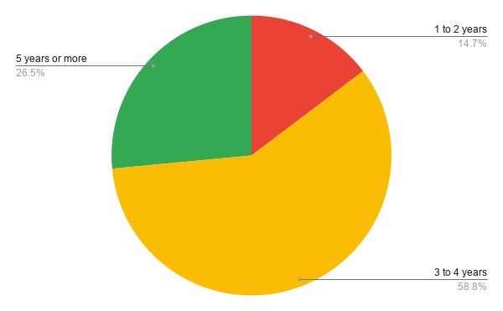
Qualitative Dataset Demographic (n=34)
Figure : LMS Platform Usage Patterns-1
Figure : LMS Usage timeline

Slide 9
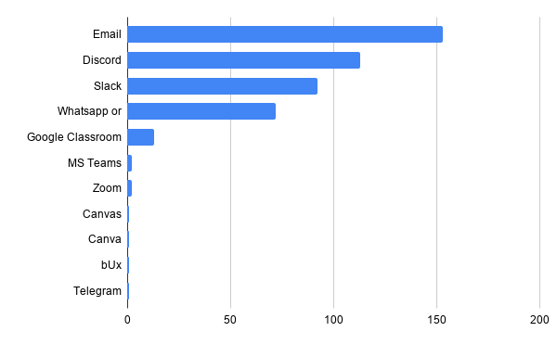
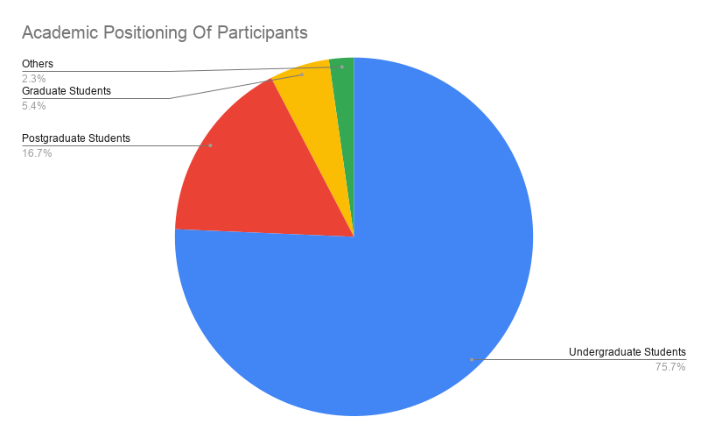
Quantitative Dataset Demographic (n=222)
Figure : LMS Platform Usage Patterns-2
Figure : Academic Positioning

Slide 10
Qualitative Research Design
Research Questions
RQ1: What are the contextual factors unique to our higher education environment that shape how students and faculty perceive and interact with LMS platforms?
RQ2: How do students and faculty describe the role of the LMS in supporting collective and communicative dimensions of their academic experience?
RQ3: What improvements do LMS users prioritize, and how do their suggested changes reflect their unmet academic and pedagogical needs?
Interview Questionnarie
Conduct Interviews
Themes Generation

Slide 11
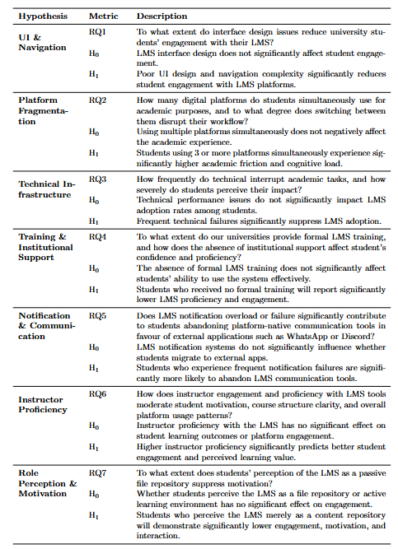
Quantitative Research Design
Tests were conducted based on categorical/multi-select questions and one-sample t-tests for Likert items tested against the neutral midpoint. With directional tails assigned per hypothesis. Since each hypothesis had two complementary indicators measuring the same construct, a significant result on either was sufficient to reject H₀ (α = 0.05).
With n = 222, the tests were well-powered to detect even small effect sizes.
Null
Hypotheses
(H₀)
Research Themes
Hypotheses
Survey
Questionnarie
Alternative Hypothesis
(H₁)
Result Anlysis
Figure : Hypothesis

Slide 12
Seven Interconnected Usability Themes
Platform Fragmentation
Students juggle 3-7 disconnected tools. Many explicitly want consolidation.
"I think it would be better to use one core LMS and integrate other platforms with it."
- A5
UI & Findability
Materials are disorganized; no search; endless scrolling.
"The main issue is needing to scroll through long lists of content."
- J2
Notification & Communication
Either too slow or overwhelming - pushing students to external apps.
"I muted the notifications and many messages get lost."
- T6
Training Deficiencies
Proficiency comes from self-teaching, not institutions.
"I did not receive formal training. I watched YouTube videos and learned on my own."
- J2

Slide 13
Seven Interconnected Usability Themes
Notification & Communication Effectiveness
Notification overload leads to mute channels and miss key updates
"For Discord, I feel liket here are too many notifications. I muted the notifications and many messages get lost as all the students message and use Discord forqueries."
-T6
Instructor Proficiency & Its Impact
Limited faculty proficiency causes disorganized materials.
"I have seen new faculty members who cannot use Discord or Slack properly... In another course, the instructor used WhatsApp instead of email or LMS tools."
-A3
Role Perception & Motivation
Lack of interactivity making it mostly viewed as a content repository rather than an active earning space.
"Mainly as a content repository."
-A2

Slide 14
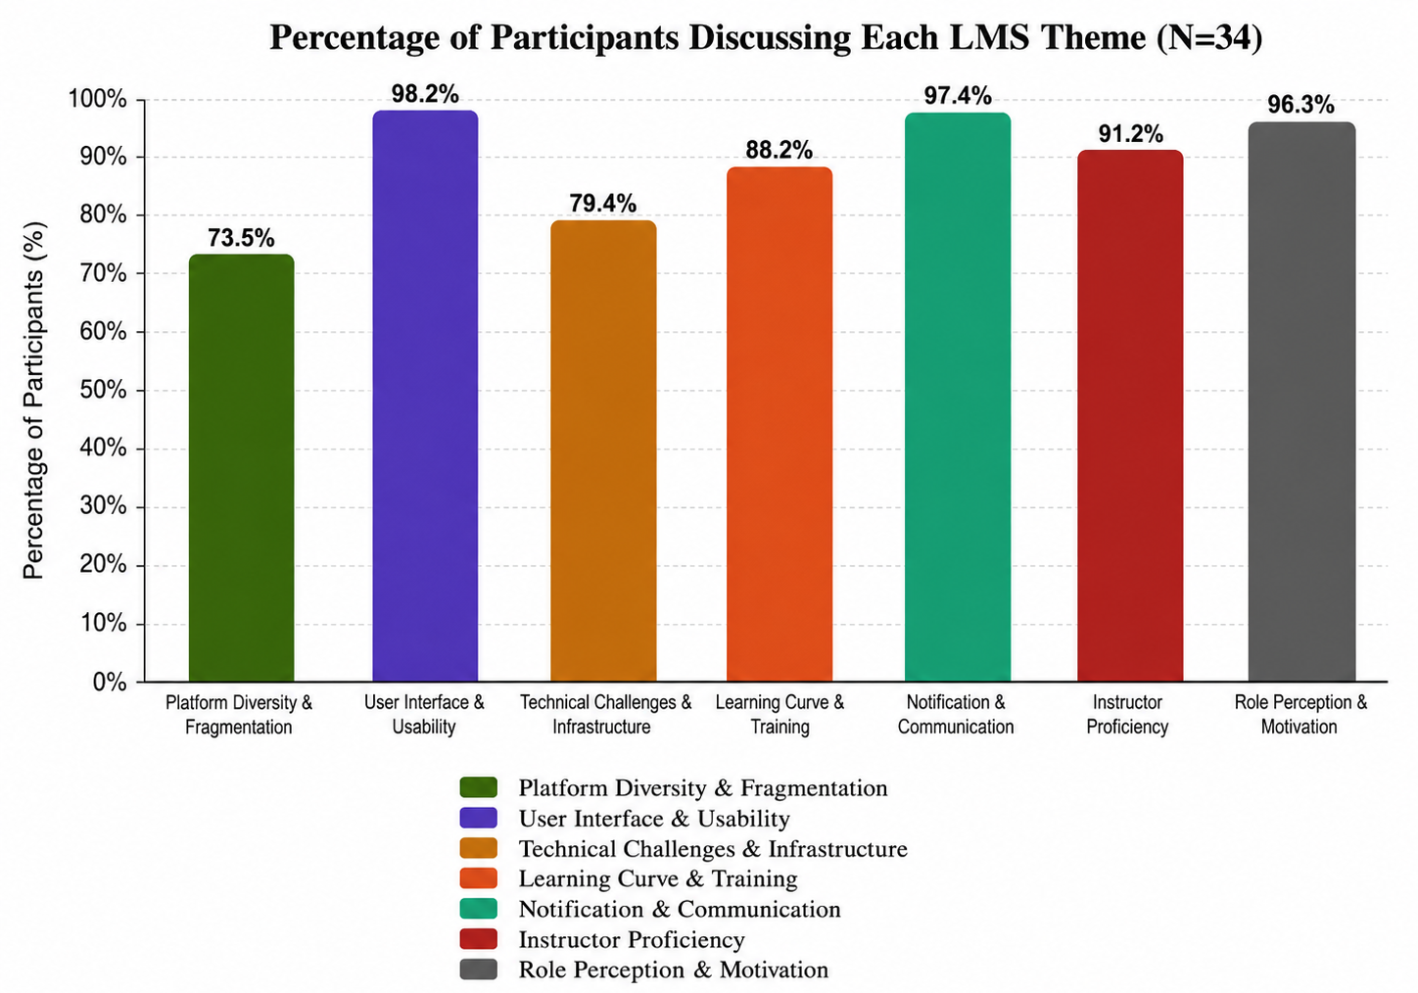
Qualitative Findings (n=34)
Krippendorff's α = 0.92 confirms very high inter-rater agreement.
All 7 themes emerged bottom-up from clustered verified codes, grounded entirely in participant responses, not pre-existing frameworks, making findings authentic to real LMS experiences.
UI & Usability (98.2%), Notification & Communication (97.4%), and Role Perception were flagged by virtually every participant, regardless of institution, platform, or user role. These are consensus problems, not outliers.
88.2% raised training gaps relying on various sources to learn. Structured institutional onboarding is largely absent across the sampled universities.
7 themes span interface design, pedagogy, infrastructure, and institutional support, meaning this is a multi-layered problem with no single fix.
Figure : Qualitative Analysis Results

Slide 15
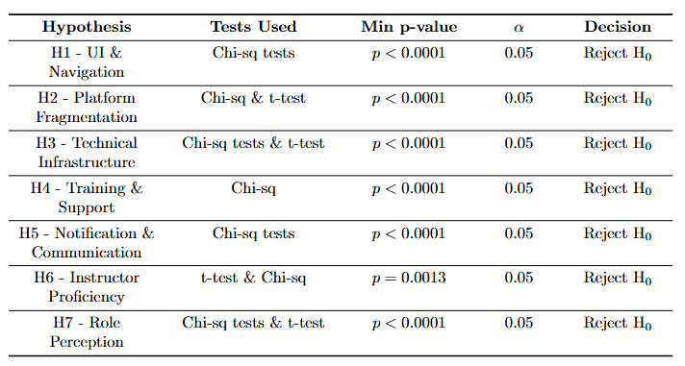
Quantitative Data Analysis (n=222)
All 7 hypotheses reject H₀ findings are statistically consistent across every dimension tested.
Chi-square dominates the evidence: non-uniform distributions confirmed in UI issues, platform use, training methods, notifications, and role perception.
The two t-tests (H3, H6, H7) all sit above or below the neutral midpoint - not just significant, but directionally meaningful.
H2 is the nuanced outlier: t-test non-significant (p = 0.453), yet chi-square still rejects H₀ - students are objectively fragmented across platforms even if disruption feels normalized.
Lowest significance: H6 (p = 0.001) still strong, but instructor proficiency has the weakest effect relative to the rest.
Qualitative themes (cluttered navigation, informal self-learning, LMS-as-repository) are directly corroborated by the quantitative results.
Figure : Hypothesis Testing Summary

Slide 16
From Findings to a Working Prototype
A fully functioning LMS (not a mockup), built with html, css, js, and php. It’s grounded in Norman's Design Principles and Universal Design.
Every feature traces back to a finding - no speculative design.
Usability Problem
Prototype Feature
Platform fragmentation
UI / findability
Notification overload
Weak communication
Training gaps
Instructor inconsistency
Technical / session issues
Accessibility
Unified dashboard, consistent top nav, tabbed course hub, global search
Materials tab with scoped search, filter chips, inline preview, pinning
Notifications center, priority tabs, per-type/per-course preferences, color-coded deadlines
In-course discussion: channels, mentions, threads, pins, search
4-step onboarding tour + video tutorial, FAQ
Role switching (student ↔ faculty), faculty dashboard + grading
Persistent "Session: Active" indicator, friendly re-auth cues
English ⇄ Bangla toggle, dyslexia font, high-contrast, keyboard nav, guest browsing

Slide 17
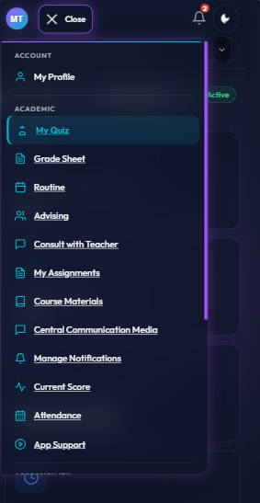
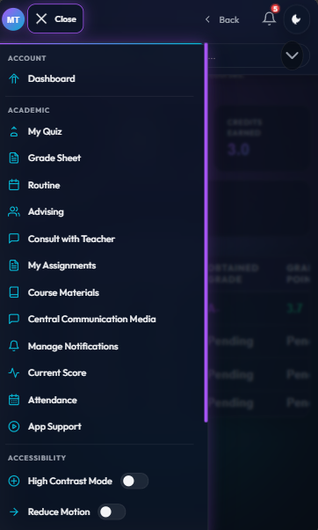
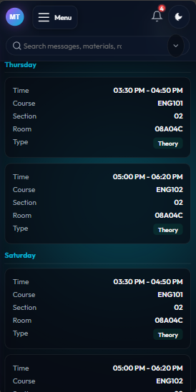
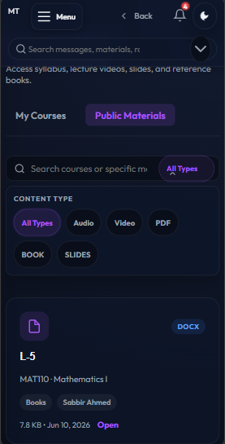
Prototype
This slide displays the primary mobile interfaces of the student portal, including the consolidated course landing page, sidebar navigation drawer, and daily timetable routine. While not pictured here, the full desktop dashboard and specialized top navigation headers ensure a consistent and responsive experience across all user devices. Additionally, a guest browsing module is supported to display public course materials to external users, while locking and blurring institution-private content.
Figure: Student Dashboard
Figure: Student Drawer
Figure: Routine
Figure: Materials Repository

Slide 18
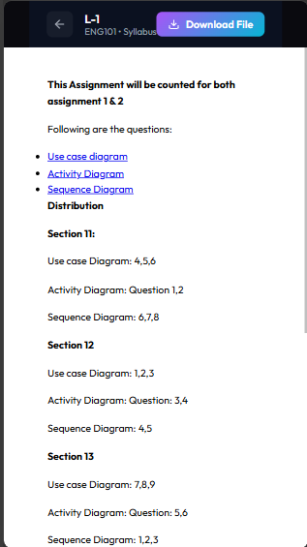
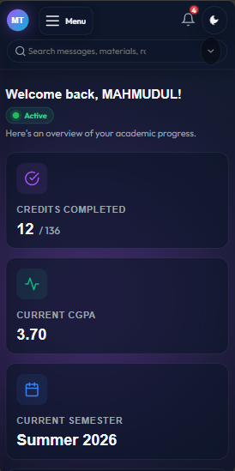
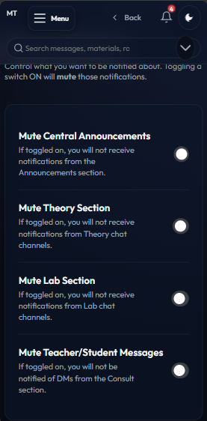
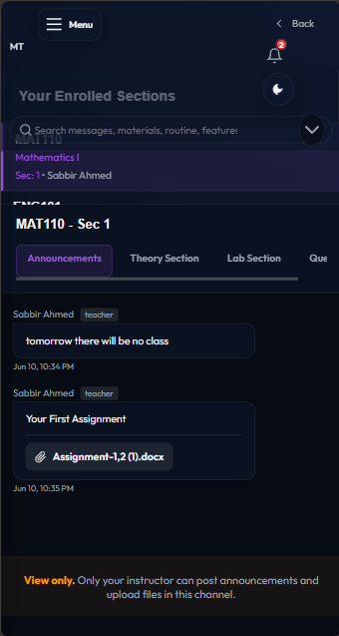
Prototype
Here, we present the prototype's core usability enhancements, showcasing inline document previews, the omni-search panel, and granular notification preferences. The interface also supports visual accessibility settings such as instant light-theme styling and compact layout density controls that are not displayed in these selections. These are supported by advanced notification menus that separate high-priority deadline alerts from secondary chat messages to prevent cognitive clutter.
Figure: Inline Preview
Figure: Global Search
Figure: Notification Settings
Figure: Cummunication Tab

Slide 19
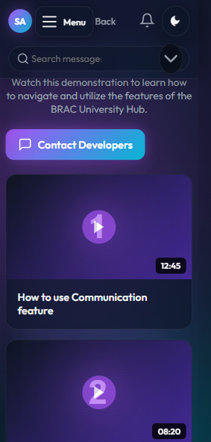
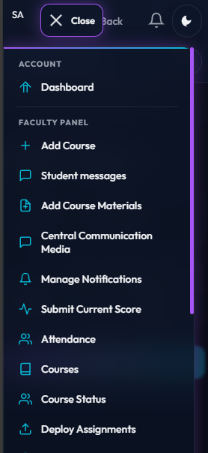
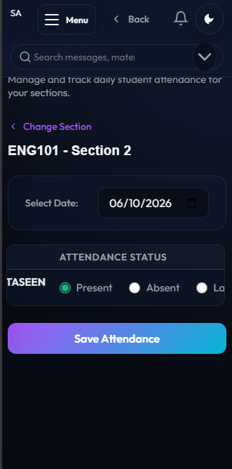
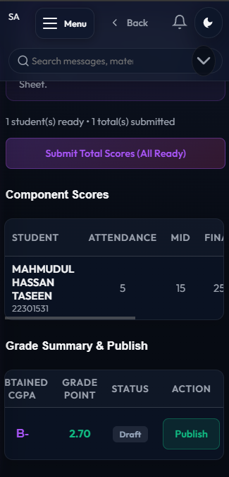
Prototype
This slide demonstrates the self-service video onboarding page alongside the core administrative views of the teacher's grading and attendance portals. Behind these screens lie active faculty-student chat histories, course creation forms, and material uploading menus that streamline routine class coordination. Furthermore, a persistent session indicator is embedded across both portals to prevent unexpected user logouts during grading or quiz deployments.
Figure: Tutorials and App Support
Figure: Teacher Drawer
Figure: Roster Attendence
Figure: Grade Submissions

Slide 20
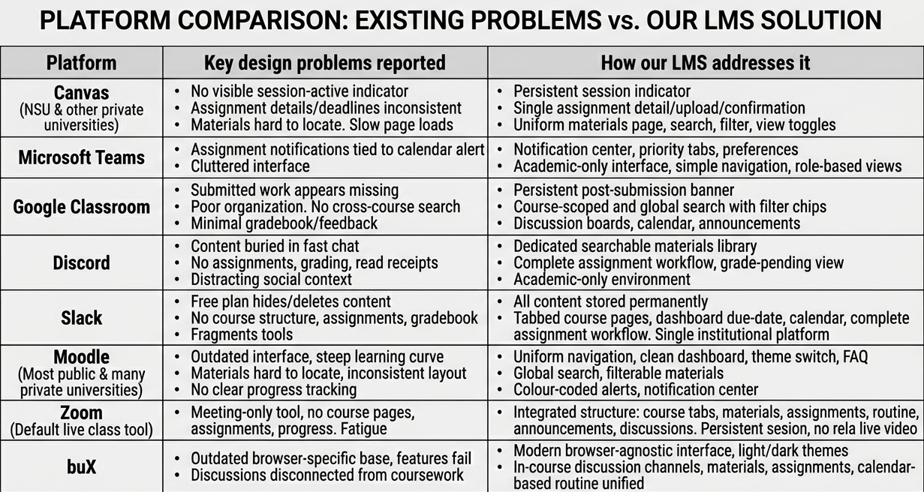
Comparisons

Slide 21
Discussion
Systemic, not incidental - the seven themes interlock and reinforce each other
Design, not unfamiliarity - 85%+ had 3+ years' use, yet still struggled
Confirms prior work - but reframes it - fragmentation here is governance failure, not user choice
Extends Lu / Schmidt / Shin - reliability and support outrank interface polish
Aesthetics ≠ usability - architecture and instructor behaviour decide it
Implications - consolidate + train · consistent practice · lightweight design

Slide 22
Conclusion
What we set out to do: uncover the hidden usability barriers in Bangladeshi university LMS platforms and act on them.
What we found: seven interconnected, quantitatively validated barriers - driven by design and institutional practice, not user unfamiliarity (even 5+ year users struggle).
What it means: poor LMS design doesn't level the playing field - it widens the divide for students with weaker devices, connectivity, or digital literacy.
Our contribution: a context-grounded, mixed-methods evaluation plus a working, evidence-based prototype proving better LMS experiences are achievable with modest resources.
The barriers are invisible - but they are designable, and they are solvable.

Slide 23
Future Work
Longitudinal study tracking LMS adoption and usability over time.
Scalable mixed-methods replication across other Bangladeshi institutions and comparable developing nations.
Actionable design interventions - move from documentation to iterative testing of the evidence-based recommendations proposed here.
Culturally adapted usability scales - develop or validate instruments beyond SUS that account for pedagogical and sociocultural context in Global South settings.
Infrastructure-aware LMS design - research optimizing platforms specifically for low-bandwidth, low-device, low-digital-literacy environments.
Longitudinal student feedback integration - build mechanisms so student voices are systematically incorporated into LMS development cycles.

Slide 24
Key References
Lu, J., Schmidt, M., & Shin, J. (2025). Beyond technological usability: exploratory factor analysis of the comprehensive assessment of usability scale for learning technologies (CAUSLT). arXiv preprint arXiv:2501.18754.
Koca, P. P., & Özcan, H. (2025). Usability in learning management systems: A mixed-method analysis. International Journal of Pioneering Technology and Engineering, 4(01), 17-25.
Simon, Patricia & Jiang, Juming & Fryer, Luke & King, Ronnel & Frondozo, Cherry. (2024). An Assessment of Learning Management System Use in Higher Education: Perspectives from a Comprehensive Sample of Teachers and Students. Technology, Knowledge and Learning. 30. 741-767. 10.1007/s10758-024-09734-5.
Berényi, L. (2025). Usability analysis of the Moodle system. GRADUS, 12(1), 1-6.
Al-Fraihat, D., Alshahrani, A. M., Alzaidi, M., Shaikh, A. A., Al-Obeidallah, M., & Al-Okaily, M. (2025). Exploring students’ perceptions of the design and use of the Moodle learning management system. Computers in human behavior reports, 18, 100685.
Faghih, B., Azadehfar, D. M. R., & Katebi, P. (2014). User interface design for e-learning software. arXiv preprint arXiv:1401.6365.
Karim, S. S., Parvin, S., Ahmed, C. B. U., & Hossain, M. T. (2025). Teachers’ and students’ perceptions of online education in Bangladesh: challenges and solutions. Discover Education, 4(1), 234.
Saarmean, R., Hossain, M. Z., & Mahadi, K. A. A study on the effectiveness of online learning system during Covid-19 in private universities of Bangladesh..
Hasan, M. K., Tonmon, T. T., Kabir, H., Masud, S. B., Hasan, M. A., Das, B., ... & Mitra, D. K. (2021). Availability and use of technology for e-learning: to what extent do these impact Bangladeshi university students? A cross-sectional study. F1000Research, 10, 1285.
Dzandu, M. D., & Tang, Y. (2015). Beneath a learning management system-understanding the human information interaction in information systems. Procedia Manufacturing, 3, 1946-1952.
Almusharraf, A. I. (2024). An investigation of university students’ perceptions of learning management systems: Insights for enhancing usability and engagement. Sustainability, 16(22), 10037.

Slide 25
Thank You !!!
Any Questions?
Codebook:
URL
Prototype:
URL

