Slide 1
BS COMPUTER SCIENCE | CAPSTONE EVALUATION
01 Structured Ingestion
PyMuPDF text/bounds + optional Tesseract OCR across ACORD 25 COIs and endorsements.
SubGuard AI
A Contractor Insurance Compliance Evaluation and
Field-Level Evidence Traceability System
02 Deterministic Rules
Python integer-cent thresholds, date checks, entity suffixes, and cross-document graph checks.
CORE ARCHITECTURAL PRINCIPLE
"AI extracts information. Deterministic Python rules evaluate it. Humans resolve uncertainty."
03 Auditable Governance
Field-level quote citations, fail-closed escalation, and append-only human review logs.
System Scope: FastAPI + Jinja2 Compliance Prototype (SQLite Local Persistence)
Demonstration Mode: Controlled Localhost Evaluation (Offline Mock Extraction Provider)
Notes:
Presenter Notes (Slide 1): Welcome the supervisor and evaluation panel. Introduce SubGuard AI as a contractor insurance compliance prototype built around strict separation of concerns: extraction is decoupled from deterministic compliance rules and human review. Clarify upfront that the controlled demonstration runs locally on localhost using the offline mock extraction provider.

Slide 2
Problem Statement & Motivation
02 / CONTEXT
General contractors must verify subcontractor Certificates of Insurance (ACORD 25) and endorsements prior to site mobilization.
Manual Review Bottleneck
Manual cross-checking across multi-page ACORD 25 forms is slow.
Repeats across dozens of subcontractors and policy renewals.
High administrative cost for project coordinators.
Silent Compliance Gaps
Expired or inverted policy terms missed under time pressure.
Corporate suffix mismatches conflated (e.g., Apex LLC vs Inc).
COI checkbox claims accepted without endorsement verification.
Audit & Provenance Blind Spots
Ad hoc spreadsheet tracking leaves weak claim defense.
Hard to prove which document page backed an approval.
Prior attribution bug risk: linking occurrence quotes to aggregate limits.
Why Unconstrained AI Fails
LLMs cannot reliably enforce strict contractual thresholds alone.
Free-text pass/fail judgments hide uncertainty and hallucinations.
High-stakes compliance requires fail-closed determinism.
Core Design Requirement: Automate structured extraction and deterministic checks while surfacing every ambiguity, missing citation, or unverified endorsement for qualified human resolution.
SubGuard AI | Contractor Insurance Compliance & Evidence Traceability
Offline Mock Mode (Localhost) | Slide 2 / 10
Notes:
Presenter Notes (Slide 2): Explain why manual COI review scales poorly and why naïve AI automation is even more dangerous. Point out concrete domain hazards verified in this project: legal suffix differences (LLC vs Inc), COI checkboxes without attached endorsements, and cross-field citation bugs.

Slide 3
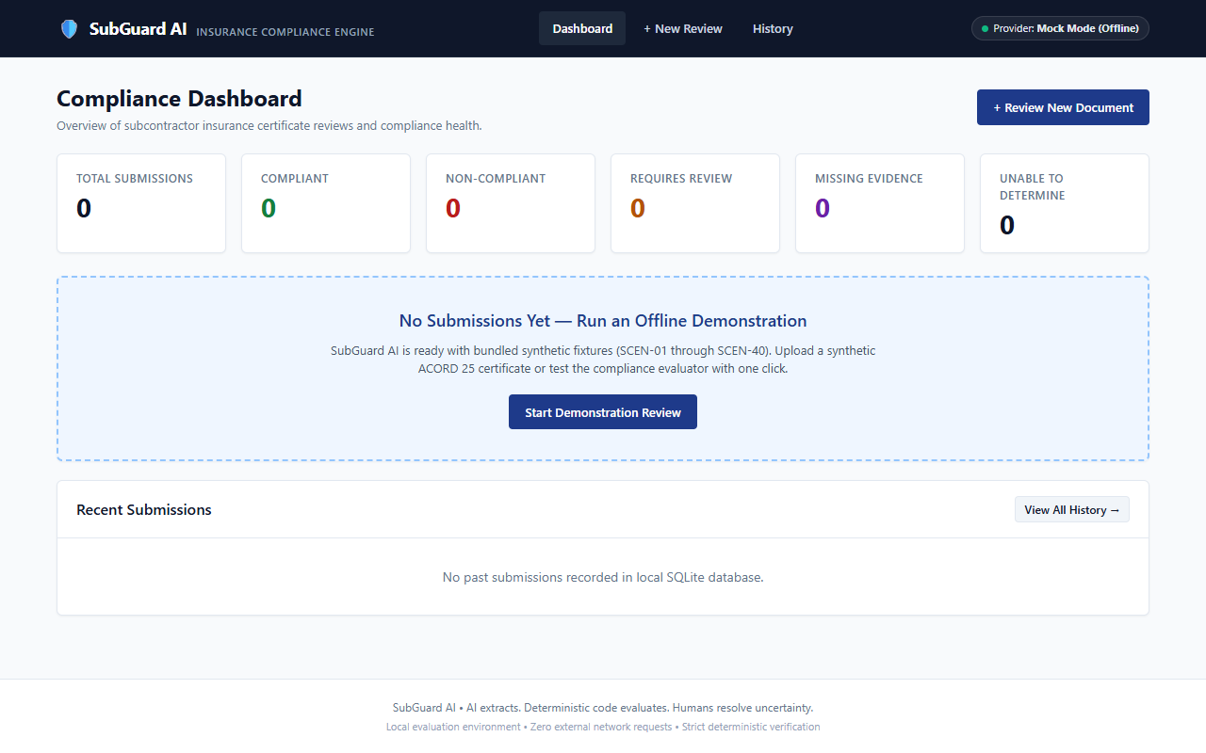
Proposed Solution & Project Objectives
03 / OBJECTIVES
1. Automated PDF Ingestion
Extract native-digital spans (PyMuPDF) and scanned pages (Tesseract interface) with page bounding boxes.
Implemented Web Interface (GET /dashboard)
2. Strict Rule Determinism
Normalize monetary limits to integer cents and evaluate rules in pure Python with zero LLM pass/fail calls.
3. Field-Level Evidence Grounding
Require verbatim substring support per extracted limit/date field; block fallback to unrelated quotes.
4. Fail-Closed Human Governance
Surface four core overall statuses plus finding-level MISSING_EVIDENCE with server review guardrails.
FOUR CORE OVERALL COMPLIANCE STATUSES
COMPLIANT | NON_COMPLIANT | REQUIRES_HUMAN_REVIEW | UNABLE_TO_DETERMINE
Finding / Review Condition (MISSING_EVIDENCE): Surfaced when required fields or citations are absent; routes to human review under review-first policy.
Verified screenshot from browser acceptance tests showing aggregate SQLite counts, offline Mock Mode header badge, and localhost notice. Prototype only.
SubGuard AI | Contractor Insurance Compliance & Evidence Traceability
Offline Mock Mode (Localhost) | Slide 3 / 10
Notes:
Presenter Notes (Slide 3): Summarize the four implemented objectives and walk through the Dashboard screenshot. Clearly distinguish the four core overall compliance statuses (COMPLIANT, NON_COMPLIANT, REQUIRES_HUMAN_REVIEW, UNABLE_TO_DETERMINE) from MISSING_EVIDENCE, which acts as a finding and review-first escalation condition when required coverage or evidence citations are absent.

Slide 4
System Architecture & Processing Workflow
04 / ARCHITECTURE
1. PDF Ingestion
2. Extraction
3. Normalization
4. Reconciliation
5. Rule Engine
6. Governance
PDFProcessor
Provider Abstraction
ExtractionPipeline
Reconciliation Engine
ComplianceEvaluator
SQLite + Human UI
Validates %PDF & 15 MB limit
Extracts digital text spans
Detects scanned/rotated pages
Optional Tesseract OCR layer
Demo uses Mock provider
HonestApplicationMockProvider
Gemini & OpenRouter clients
RawInsuranceExtraction JSON
Dollars -> integer cents
MM/DD/YYYY -> ISO dates
Verbatim quote verification
Field-level semantic checks
Entity & contractual roles
5-tier policy ID matching
REPLACES / AMENDS graph
Cross-doc contradictions
7 deterministic rule types
Confidence gate (>= 0.70)
Mandatory evidence checks
Produces ComplianceReviewResult
WAL SQLite + local PDFs
Evidence Trace viewer
Human Review guardrails
Append-only review_records
EXTRACTION BOUNDARY (Stages 1–2)
Unverified provider output never decides compliance. Controlled demo uses offline mock extraction.
DETERMINISTIC & HUMAN GOVERNANCE ZONE (Stages 3–6)
Pure Python normalization, substring/semantic support checks, cross-document reconciliation, rule evaluation, and fail-closed human review workflows run locally with zero LLM judgment.
SubGuard AI | Contractor Insurance Compliance & Evidence Traceability
Offline Mock Mode (Localhost) | Slide 4 / 10
Notes:
Presenter Notes (Slide 4): Walk left-to-right across the six implemented pipeline modules inside DocumentReviewService. Emphasize the hard architectural trust boundary: Stages 1-2 extract raw candidates (mocked offline in the demo), while Stages 3-6 execute purely deterministic Python verification, reconciliation, evaluation, and auditable persistence.

Slide 5
Technology Stack: Implemented vs. Planned
05 / TECH STACK
Implemented Prototype Stack
Planned Architecture (Future Only)
Layer | Implemented Stack | Verified Role
API & UI | Python 3.12 · FastAPI · Jinja2 | Single-server REST API & web UI
Contracts | Pydantic v2 | Typed schemas & validation
PDF & OCR | PyMuPDF · pypdf · Tesseract | Digital text, BBoxes & scanned OCR
Extraction | HonestMock (Gemini/OpenRouter) | Demo runs Mock; live parity unverified
Storage | SQLite (WAL) · Local disk | 3 tables + uploaded PDF files
Testing | Pytest · Playwright · httpx | Unit, OCR, E2E browser & cohorts
Frontend: Next.js, TypeScript, Tailwind (not built).
Database: PostgreSQL with Row-Level Security.
Async Jobs: Redis + ARQ worker queue.
Storage: Cloudflare R2 presigned URLs.
Security: User auth, RBAC & rate limiting.
Prototype Boundary: Localhost single-node monolith with SQLite and zero auth.
SubGuard AI | Contractor Insurance Compliance & Evidence Traceability
Offline Mock Mode (Localhost) | Slide 5 / 10
Notes:
Presenter Notes (Slide 5): Clearly separate implemented components from planned design targets. Point out that while ARCHITECTURE.md outlines Next.js, PostgreSQL, Redis, and Cloudflare R2 for a future cloud deployment, the evaluated working codebase is Python 3.12, FastAPI, Jinja2, PyMuPDF, and SQLite.

Slide 6
Deterministic Compliance Evaluation Engine
06 / RULE ENGINE
7 Deterministic Rule Categories
Coverage Limit: Integer cents ($1M = 100,000,000).
Policy Dates: Effective & expiration vs. eval_date.
Named Insured: Strict legal suffixes (LLC != Inc).
Endorsements: Form IDs, scope & restrictions.
Duration & Set: Coverage continuity & packet checks.
Scenario A Run: sub_0b63275de448 (eval_date: 2025-06-15)
SCEN-01 Native-Digital PDFs (No OCR) | Mock Provider | Custom 6 Rules
Requirement | Outcome | Reason Code
REQ_NAMED_INSURED | COMPLIANT | NAMED_INSURED_EXACT_MATCH
REQ_GL_EACH_OCC ($1M) | COMPLIANT | LIMIT_MEETS_OR_EXCEEDS_MINIMUM
REQ_GL_GEN_AGG ($2M) | COMPLIANT | LIMIT_MEETS_OR_EXCEEDS_MINIMUM
REQ_GL_EFFECTIVE_DATE | COMPLIANT | EFFECTIVE_DATE_VALID
REQ_GL_EXPIRATION | COMPLIANT | POLICY_ACTIVE_AND_CURRENT
REQ_ADDL_INSURED | REVIEW | MANUSCRIPT_VERIFICATION_UNSUPPORTED
Fail-Closed & Reconciliation Guards
Confidence < 0.70 or ambiguous dates escalate.
5-tier policy ID matching & REPLACES / AMENDS checks.
Pipeline errors always block COMPLIANT overall status.
Overall -> REQUIRES_HUMAN_REVIEW: 5 verified rules passed; unverified manuscript scope blocks automated pass.
SubGuard AI | Contractor Insurance Compliance & Evidence Traceability
Offline Mock Mode (Localhost) | Slide 6 / 10
Notes:
Presenter Notes (Slide 6): Explain how ComplianceEvaluator and reconciliation work without calling an LLM. Walk through Scenario A (sub_0b63275de448) executed on the localhost demo server: five checks passed, and REQ_ADDL_INSURED triggered REQUIRES_HUMAN_REVIEW. Explicitly note that SCEN-01 PDFs are native-digital, so Tesseract OCR was not invoked in Scenario A.

Slide 7
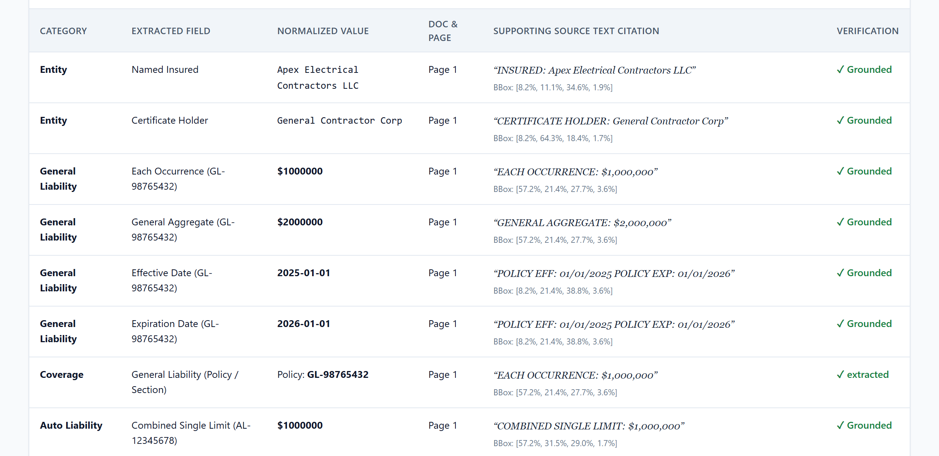
Field-Level Evidence Traceability
07 / PROVENANCE
Field-Specific Evidence Binding
MoneyValue & DateValue store distinct EvidenceReferences per field.
Occurrence quotes cannot be reused as General Aggregate or Expiration citations.
Coverage provenance displays separately as Policy / Section.
Scenario A Evidence Trace (/submissions/sub_0b63275de448/evidence)
Trust Boundary: Quotations != Semantic Truth
Page substring match confirms text presence on Page 1.
Separate semantic check validates values (QUOTE_PRESENT_UNVERIFIED_SUPPORT on mismatch).
Verified Scenario A Source Quotations (Native-Digital PDF, Page 1):
Named Insured: "INSURED: Apex Electrical Contractors LLC" | Each Occ ($1M): "EACH OCCURRENCE: $1,000,000"
Gen Aggregate ($2M): "GENERAL AGGREGATE: $2,000,000" | Dates: "POLICY EFF: 01/01/2025 POLICY EXP: 01/01/2026"
Scenario A Source & BBox Caveat
Native-digital PDFs (not OCR-extracted). PyMuPDF grouped Occurrence and Aggregate under identical BBox coords [57.2%, 21.4%]; BBox coords are not independently verified.
SubGuard AI | Contractor Insurance Compliance & Evidence Traceability
Offline Mock Mode (Localhost) | Slide 7 / 10
Notes:
Presenter Notes (Slide 7): Show the actual Evidence Trace table captured from Scenario A submission sub_0b63275de448 (cropped below card banner). Point out the distinct verified quotes for Named Insured, Each Occurrence ($1,000,000), General Aggregate ($2,000,000), Effective Date (2025-01-01), and Expiration Date (2026-01-01). Explicitly clarify: (1) Scenario A PDFs are native-digital, not OCR-extracted; (2) Each Occurrence and General Aggregate display identical PyMuPDF BBox coordinates [57.2%, 21.4%, 27.7%, 3.6%] and bounding-box coordinates are not independently verified; (3) verbatim quotations alone do not prove semantic correctness.

Slide 8
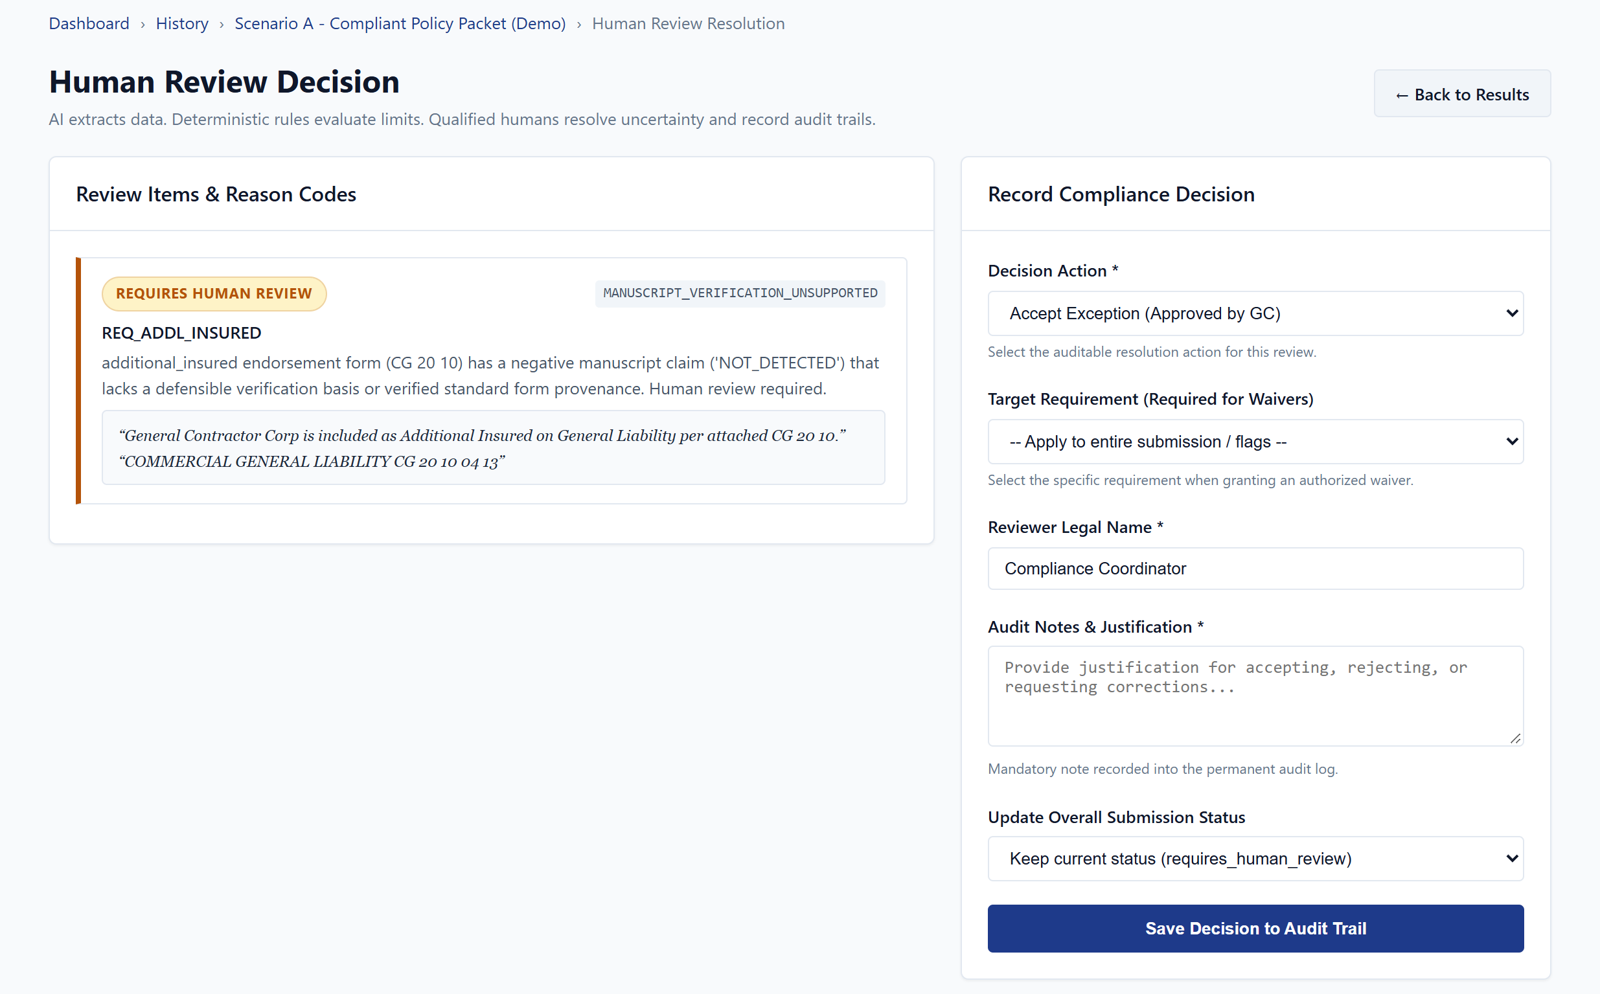
Human-in-the-Loop Review & Guardrails
08 / HUMAN REVIEW
Scenario A Review Page (/submissions/sub_0b63275de448/review)
Auditable Review Actions (/api/v1/submissions/{id}/review)
accepted_exception: Approve flag when no hard failures exist.
deficiency_notice_required: Issue correction notice to sub.
waived: Target rule waiver (waivable rules only).
rejected: Reject non-compliant submission.
Server-Enforced Guardrails (HTTP 422 on Violation)
Mandatory reviewer identity and non-empty audit notes.
Blanket approval blocked when any non_compliant finding exists.
Waivers require explicit rule_id; POLICY_EXPIRATION, POLICY_EFFECTIVE_DATE & NAMED_INSURED are non-waivable.
Append-only SQLite review_records; automated result_json preserved.
Escalated REQ_ADDL_INSURED (MANUSCRIPT_VERIFICATION_UNSUPPORTED) with COI & CG 20 10 quotes and review controls. Rehearsal note: no decision was saved.
SubGuard AI | Contractor Insurance Compliance & Evidence Traceability
Offline Mock Mode (Localhost) | Slide 8 / 10
Notes:
Presenter Notes (Slide 8): Show the actual Scenario A review queue screen (/submissions/sub_0b63275de448/review). Highlight REQ_ADDL_INSURED flagged as MANUSCRIPT_VERIFICATION_UNSUPPORTED alongside its supporting COI and CG 20 10 endorsement quotes and available decision controls. Explain explicitly that the system escalated the requirement for human review and no reviewer decision was recorded during this rehearsal, keeping the submission untouched.

Slide 9
Testing, Benchmark Results & Limitations
09 / EVALUATION
40 Scenarios
40/40 completed (0 failed)
Mock runner (0.71s)
0% FCR
False Compliance Rate
(0 / 10 compliant GT)
0% UCR
Unsafe Compliance Rate
(0 / 30 unsafe GT)
50% Acc
Overall Classification
(20 / 40 exact status)
70% Review
Human-Review Rate
(28 / 40 escalated)
12.5% Unable
Unable-to-Determine
(5 / 40 degraded)
Verified Automated Test Suites (Offline / Mock)
578 Backend Tests: Passed (+ 9 subtests) across 21 regression suites.
50 Hybrid OCR Tests: Passed (rotation, deskew, adaptive PSM & UI).
6 / 6 Browser Tests: Passed (Playwright + Chrome on isolated server).
Mandatory Limitations & Disclosures
Mock Provider Only: Controlled demo & cohort benchmark run offline; live AI parity is unverified.
Safety vs. Throughput: 50% accuracy & 70% review rate trade automation for 0% unsafe passes.
Endorsement Scope: Manuscript & blanket additional-insured clauses still require human inspection.
No Auth or RBAC: Localhost demonstration only; lacks multi-tenant isolation.
Non-Production: Not ready for unsupervised commercial or legal use.
Cohort Benchmark Metric (Mock) | Observed Value
Macro F1 | Auto-Pass Rate | Rejection Rate | 0.4521 | 0.00% | 17.50%
Finding Status Accuracy | Reason Code Accuracy | 88.93% (249/280) | 89.29%
Claim Support (CESR) | Exact Quote Match | 98.59% (70/71) | 100%
Cohort v1 Manifest Check | Valid (0 errors)
SubGuard AI | Contractor Insurance Compliance & Evidence Traceability
Offline Mock Mode (Localhost) | Slide 9 / 10
Notes:
Presenter Notes (Slide 9): Report the exact benchmark figures and test results transparently. Highlight the core safety-vs-automation trade-off: 0% False Compliance and 0% Unsafe Compliance across 40 scenarios, achieved with 50% exact submission accuracy, 70% human-review routing, and 12.5% unable-to-determine rate under the offline mock provider. Explicitly state that live AI parity is unverified and the system is not production-ready.

Slide 10
Conclusion & Future Improvements
10 / CONCLUSION
Implemented Capstone Contributions
Decoupled Architecture: Proved reliable separation between extraction, deterministic compliance rules, and human judgment.
Field-Level Traceability: Resolved cross-field attribution gaps by binding EvidenceReferences to individual MoneyValue/DateValue fields.
Cohort Evaluation Result: Observed 0% False Compliance Rate (0/10) and 0% Unsafe Compliance Rate (0/30) on the 40-scenario mock evaluation cohort (cohort-specific mock results, not a universal guarantee).
Reproducible Engineering: Verified across 578 backend, 50 OCR, and 6 browser acceptance tests plus repeatable localhost runbook.
Planned Future Improvements (Not Yet Implemented)
Live Multimodal Benchmarking: Validate Gemini & OpenRouter extraction parity on diverse real-world broker PDFs and noisy scans.
Semantic Endorsement NLP: Reduce the 70% escalation rate via verified clause-level exclusion & endorsement classification.
Production SaaS Infrastructure: Add authentication/RBAC, PostgreSQL with RLS, Redis + ARQ workers, and cloud object storage.
Operational Workflows: Automated renewal tracking, certificate-holder notifications, and Next.js frontend separation.
Thank You | Questions & Technical Discussion
Core Principle: "AI extracts information. Deterministic Python rules evaluate it. Humans resolve uncertainty."
SubGuard AI | Contractor Insurance Compliance & Evidence Traceability
Offline Mock Mode (Localhost) | Slide 10 / 10
Notes:
Presenter Notes (Slide 10): Summarize the implemented capstone outcomes cleanly: observed 0% False Compliance Rate (0/10) and 0% Unsafe Compliance Rate (0/30) on the 40-scenario mock evaluation cohort, emphasizing that these are cohort-specific offline mock metrics rather than a universal guarantee. Reinforce what remains future work (live AI parity benchmarking, authentication/RBAC, PostgreSQL/Redis scaling, and deeper endorsement clause verification) before inviting supervisor and panel questions.

