Slide 1
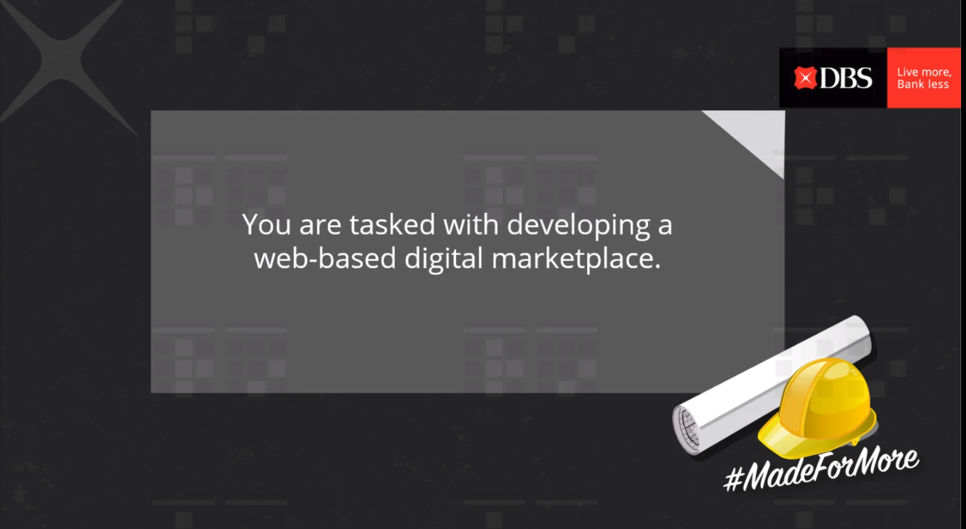

Slide 2
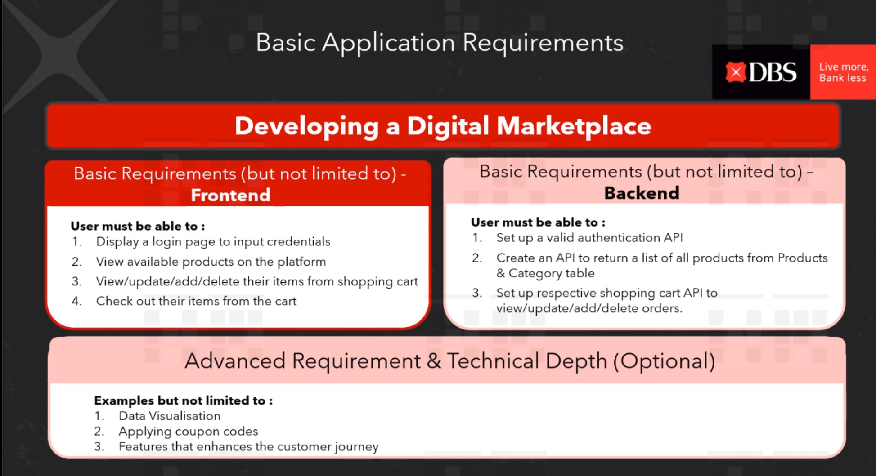

Slide 3


Slide 4
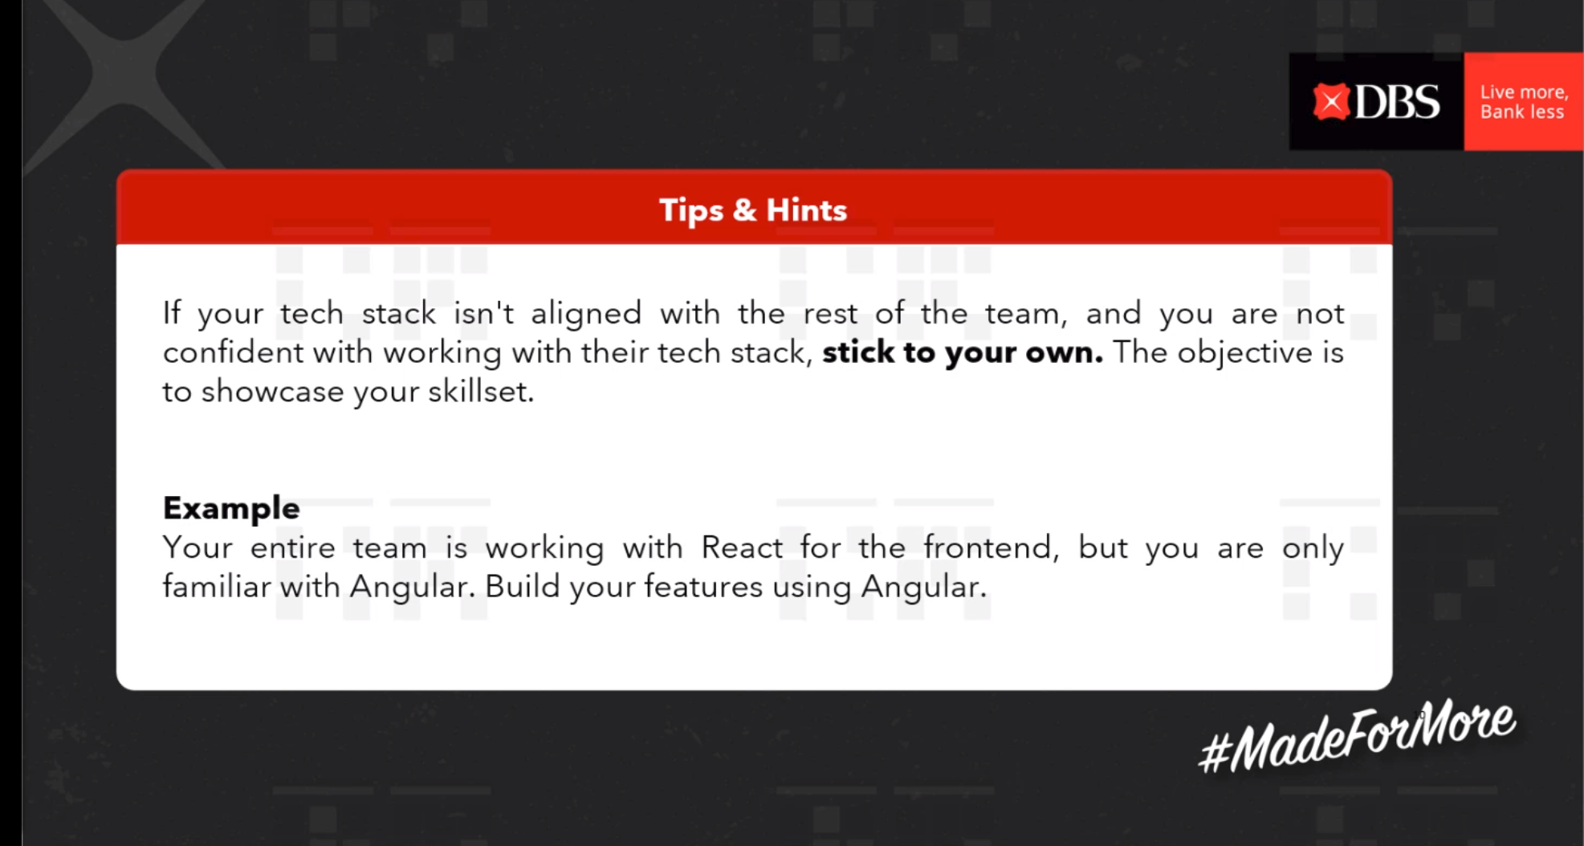

Slide 5
Frontend
Backend
Login page
- User must be able to login [1]
You must set up a valid authentication API − Server must be able to authenticate a user's identity [1]
• You must have an API to return a list of all products from Products and Category table [2]
• You must set up the respective shopping cart API with the following functionalities: − Insert products added from frontend cart into database [3]
− Return a list of all products from the OrderItem table [4]
− Delete from the OrderItem table [5]
− Update the Orders, Products, and OrderItem table [6]
Product page
- User must be able to view all products [2]
- User must be able to add products and its quantity to their cart [3]
Shopping cart component
- User must be able to view products added to their cart (You are to display the product’s name and quantity) [4]
- User must be able to remove products from their cart [5]
- Users must be able to checkout their cart. (Validation of sufficient balance is not required to purchase the items in the cart. You may add it in as an advance feature.) [6]

Slide 7

My account
(dashboard)
Homepage
My Account
Log in
If not logged in
If logged in
Cart
Cart list
Available items for purchase
(from JSON)

Slide 8



/home
Platform name
Search here…
Sort by
My account
Dropdown bar
Cat 1
Cat 2
Cat 3
Item 1
Item 1
Item 1
Item 2
Item 2
Item 2
Display by alphabetical order
Item 3
Item 3
Item 3
Item 4
Item 4
Item 4
Item 5
Item 5
Item 5
Item 6
Item 6
Item 6

Slide 9
/home/item-id
Platform name
Search here…
Sort by
My account
Dropdown bar
Cat 1
Cat 2
Cat 3
Item name
Item price
Item quantity
Item image
Item has been added!
Item description
Add to cart

Slide 10
/login
Platform name
Search here…
My account
Login
username
password
Log In
Don't have an account? Sign up here

Slide 11
/shopping-list
Platform name
Search here…
Sort by
My account
Funds:
Total price for this item
Item 1 image
Individual Price
quantity
Total price for this item
Item 1 image
Individual Price
quantity
Total price:

Slide 12
Platform name
Search here…
Sign Up
email
password
password
I agree to the terms & condition
Sign Up
Don't have an account? Sign up here

