Slide 1
Chapter 24
Distributed DBMSs - Concepts and Design
Pearson Education © 2009

Slide 2
Chapter 24 - Objectives
Concepts.
Advantages and disadvantages of distributed databases.
Functions and architecture for a DDBMS.
Distributed database design.
Levels of transparency.
Comparison criteria for DDBMSs.
Pearson Education © 2009

Slide 3
Concepts
Distributed Database
  A logically interrelated collection of shared data (and a description of this data), physically distributed over a computer network.
Distributed DBMS
  Software system that permits the management of the distributed database and makes the distribution transparent to users.
Pearson Education © 2009

Slide 4
Concepts
Collection of logically-related shared data.
Data split into fragments.
Fragments may be replicated.
Fragments/replicas allocated to sites.
Sites linked by a communications network.
Data at each site is under control of a DBMS.
DBMSs handle local applications autonomously.
Each DBMS participates in at least one global application.
Pearson Education © 2009

Slide 5
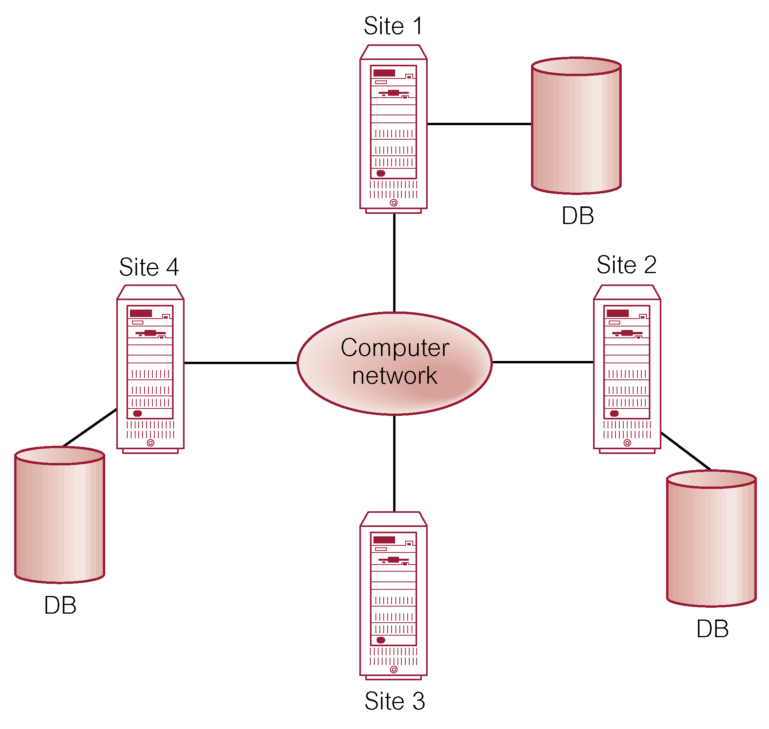
Distributed DBMS
Pearson Education © 2009

Slide 6
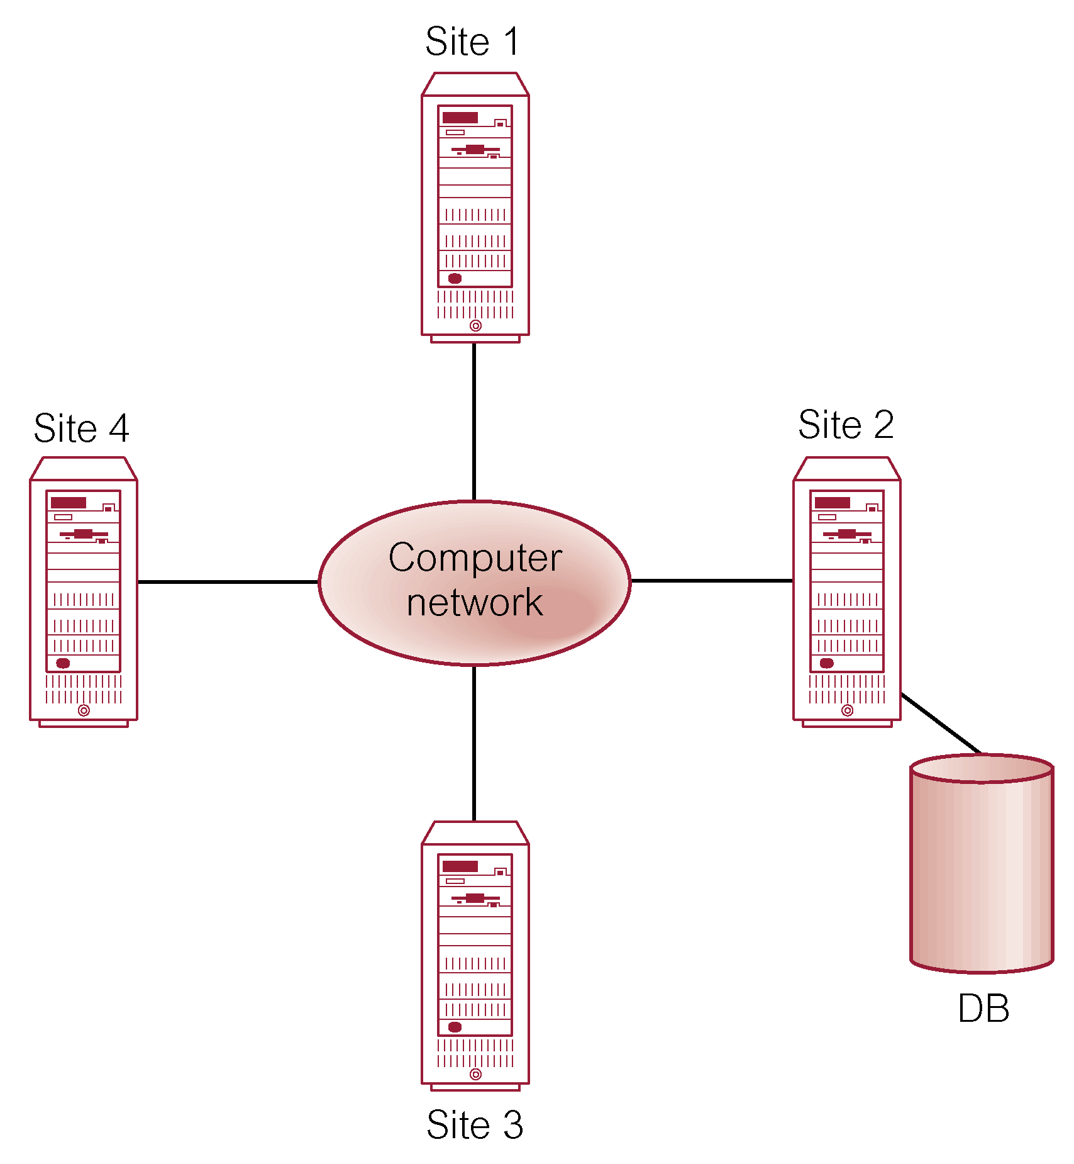
Distributed Processing
A centralized database that can be accessed over a computer network.
Pearson Education © 2009

Slide 7
Parallel DBMS
A DBMS running across multiple processors and disks designed to execute operations in parallel, whenever possible, to improve performance.
Based on premise that single processor systems can no longer meet requirements for cost-effective scalability, reliability, and performance.
Parallel DBMSs link multiple, smaller machines to achieve same throughput as single, larger machine, with greater scalability and reliability.
Pearson Education © 2009

Slide 8
Parallel DBMS
Main architectures for parallel DBMSs are:
  Shared memory,
  Shared disk,
  Shared nothing.
Pearson Education © 2009

Slide 9
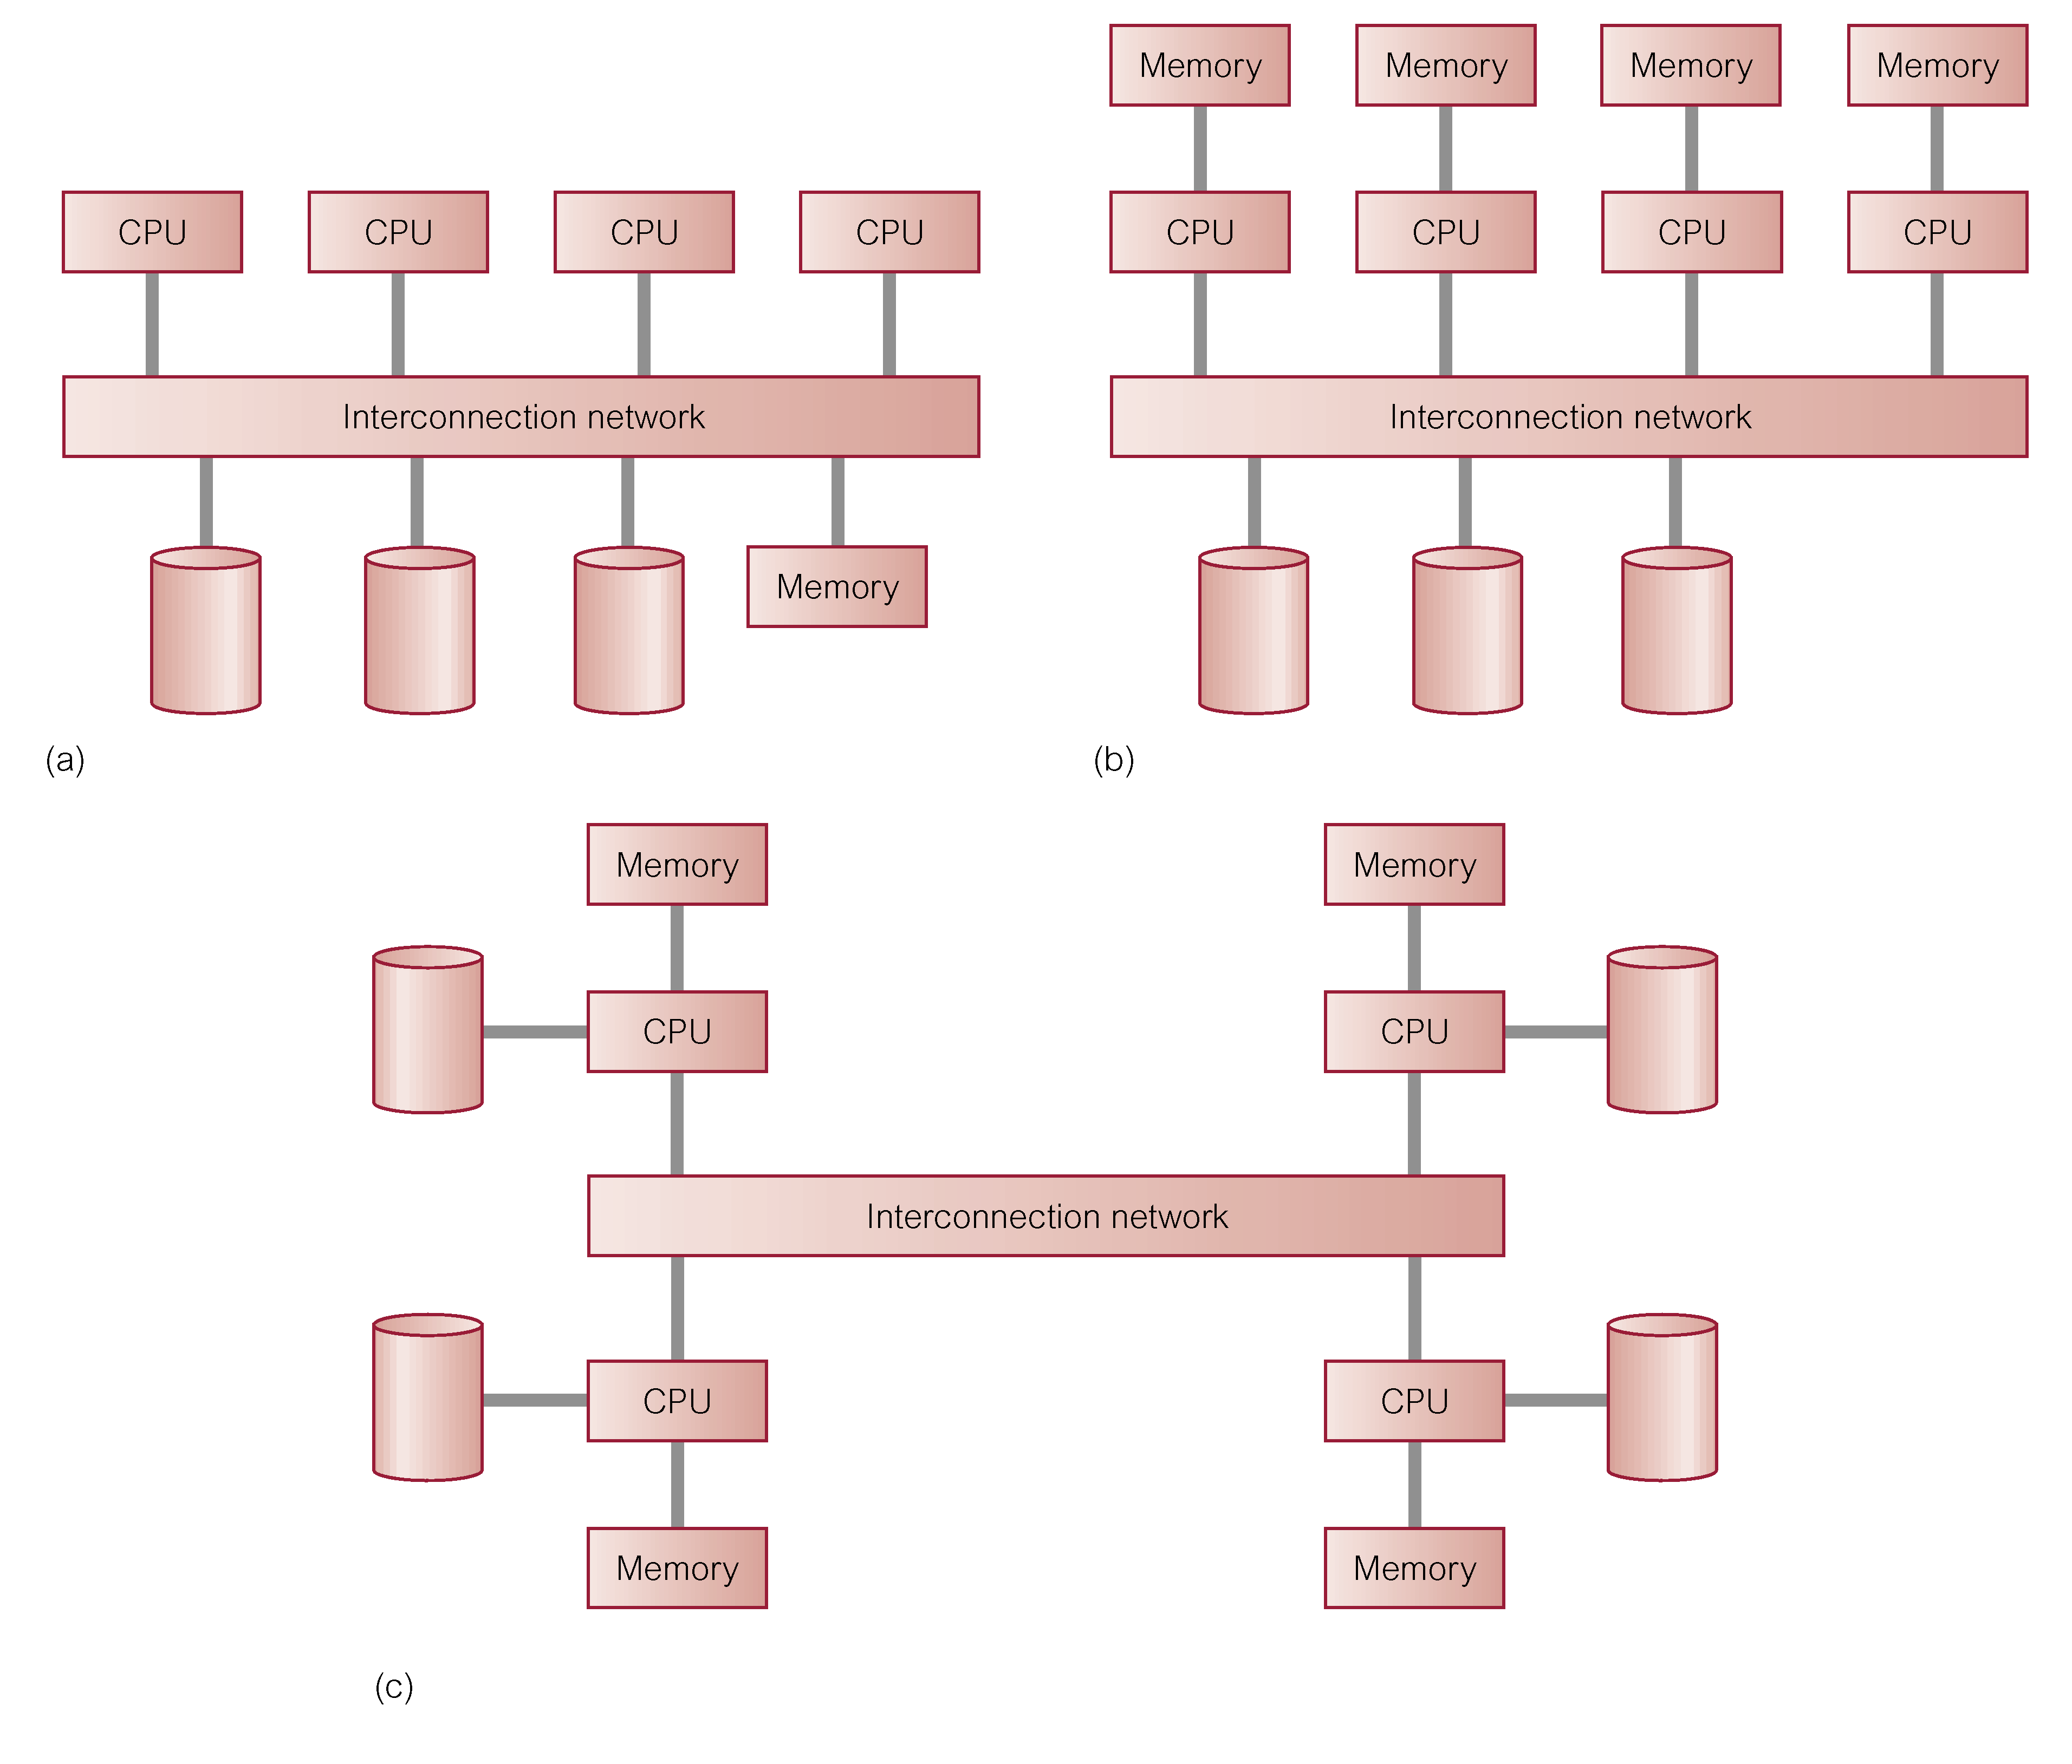
Parallel DBMS
(a) shared memory
(b) shared disk
(c) shared nothing
Pearson Education © 2009
Pearson Education © 2009

Slide 10
Advantages of DDBMSs
Reflects organizational structure
Improved shareability and local autonomy
Improved availability
Improved reliability
Improved performance
Economics
Modular growth
Pearson Education © 2009

Slide 11
Disadvantages of DDBMSs
Complexity
Cost
Security
Integrity control more difficult
Lack of standards
Lack of experience
Database design more complex
Pearson Education © 2009

Slide 12
Types of DDBMS
Homogeneous DDBMS
Heterogeneous DDBMS
Pearson Education © 2009

Slide 13
Homogeneous DDBMS
All sites use same DBMS product.
Much easier to design and manage.
Approach provides incremental growth and allows increased performance.
Pearson Education © 2009

Slide 14
Heterogeneous DDBMS
Sites may run different DBMS products, with possibly different underlying data models.
Occurs when sites have implemented their own databases and integration is considered later.
Translations required to allow for:
  Different hardware.
  Different DBMS products.
  Different hardware and different DBMS products.
Typical solution is to use gateways.
Pearson Education © 2009

Slide 15
Open Database Access and Interoperability
Open Group formed a Working Group to provide specifications that will create a database infrastructure environment where there is:
  Common SQL API that allows client applications to be written that do not need to know vendor of DBMS they are accessing.
  Common database protocol that enables DBMS from one vendor to communicate directly with DBMS from another vendor without the need for a gateway.
  A common network protocol that allows communications between different DBMSs.
Pearson Education © 2009

Slide 16
Open Database Access and Interoperability
Most ambitious goal is to find a way to enable transaction to span DBMSs from different vendors without use of a gateway.
Group has now evolved into DBIOP Consortium and are working in version 3 of DRDA (Distributed Relational Database Architecture) standard.
Pearson Education © 2009

Slide 17
Multidatabase System (MDBS)
DDBMS in which each site maintains complete autonomy.
DBMS that resides transparently on top of existing database and file systems and presents a single database to its users.
Allows users to access and share data without requiring physical database integration.
Unfederated MDBS (no local users) and federated MDBS.
Pearson Education © 2009

Slide 18
Overview of Networking
Network - Interconnected collection of autonomous computers, capable of exchanging information.
Local Area Network (LAN) intended for connecting computers at same site.
Wide Area Network (WAN) used when computers or LANs need to be connected over long distances.
WAN relatively slow and less reliable than LANs. DDBMS using LAN provides much faster response time than one using WAN.
Pearson Education © 2009

Slide 19
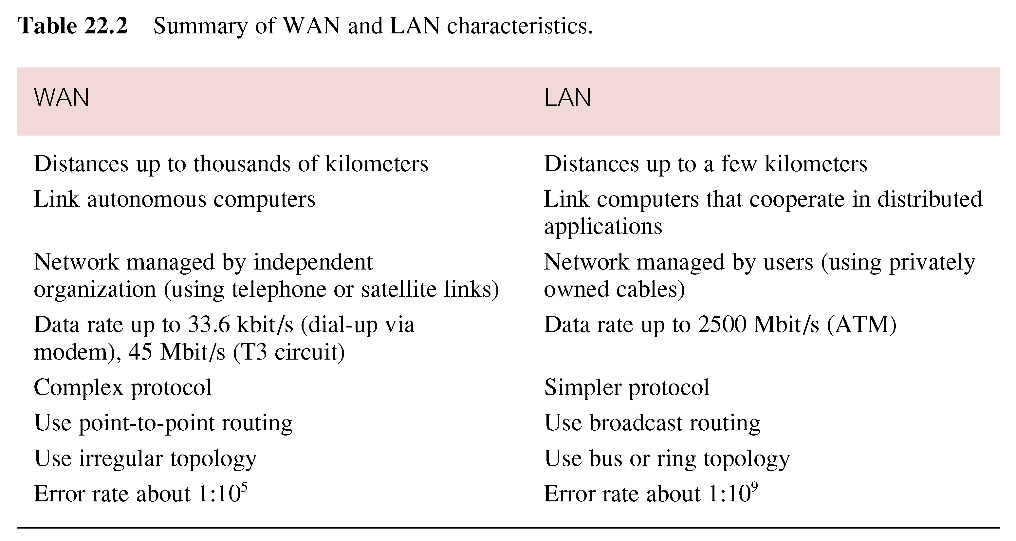
Overview of Networking
Pearson Education © 2009

Slide 20
Functions of a DDBMS
Expect DDBMS to have at least the functionality of a DBMS.
Also to have following functionality:
  Extended communication services.
  Extended Data Dictionary.
  Distributed query processing.
  Extended concurrency control.
  Extended recovery services.
Pearson Education © 2009

Slide 21
Reference Architecture for DDBMS
Due to diversity, no accepted architecture equivalent to ANSI/SPARC 3-level architecture.
A reference architecture consists of:
  Set of global external schemas.
  Global conceptual schema (GCS).
  Fragmentation schema and allocation schema.
  Set of schemas for each local DBMS conforming to 3-level ANSI/SPARC.
Some levels may be missing, depending on levels of transparency supported.
Pearson Education © 2009

Slide 22
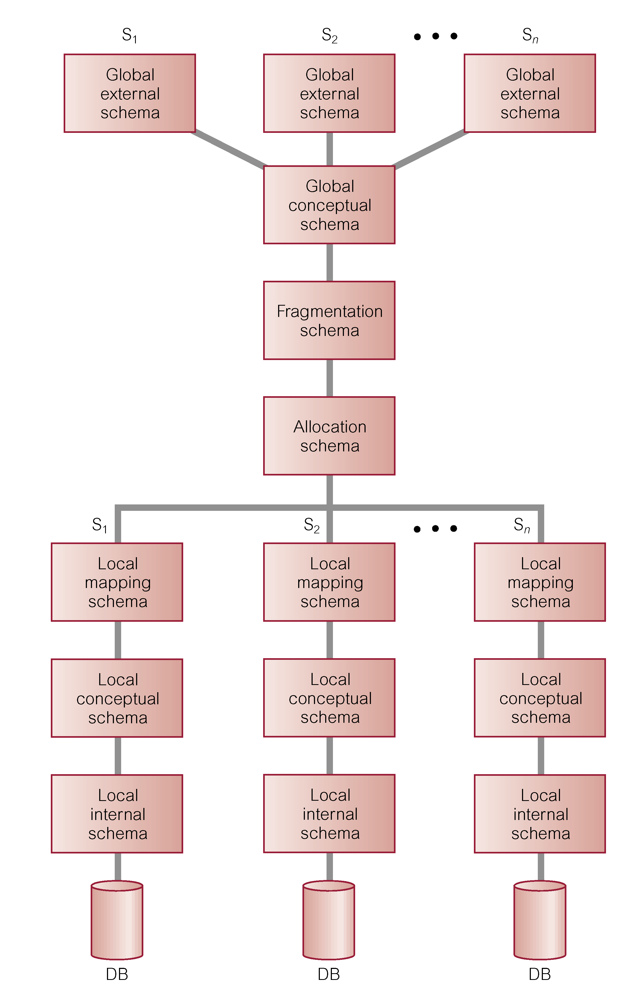
Reference Architecture for DDBMS
Pearson Education © 2009

Slide 23
Reference Architecture for MDBS
In DDBMS, GCS is union of all local conceptual schemas.
In FMDBS, GCS is subset of local conceptual schemas (LCS), consisting of data that each local system agrees to share.
GCS of tightly coupled system involves integration of either parts of LCSs or local external schemas.
FMDBS with no GCS is called loosely coupled.
Pearson Education © 2009

Slide 24
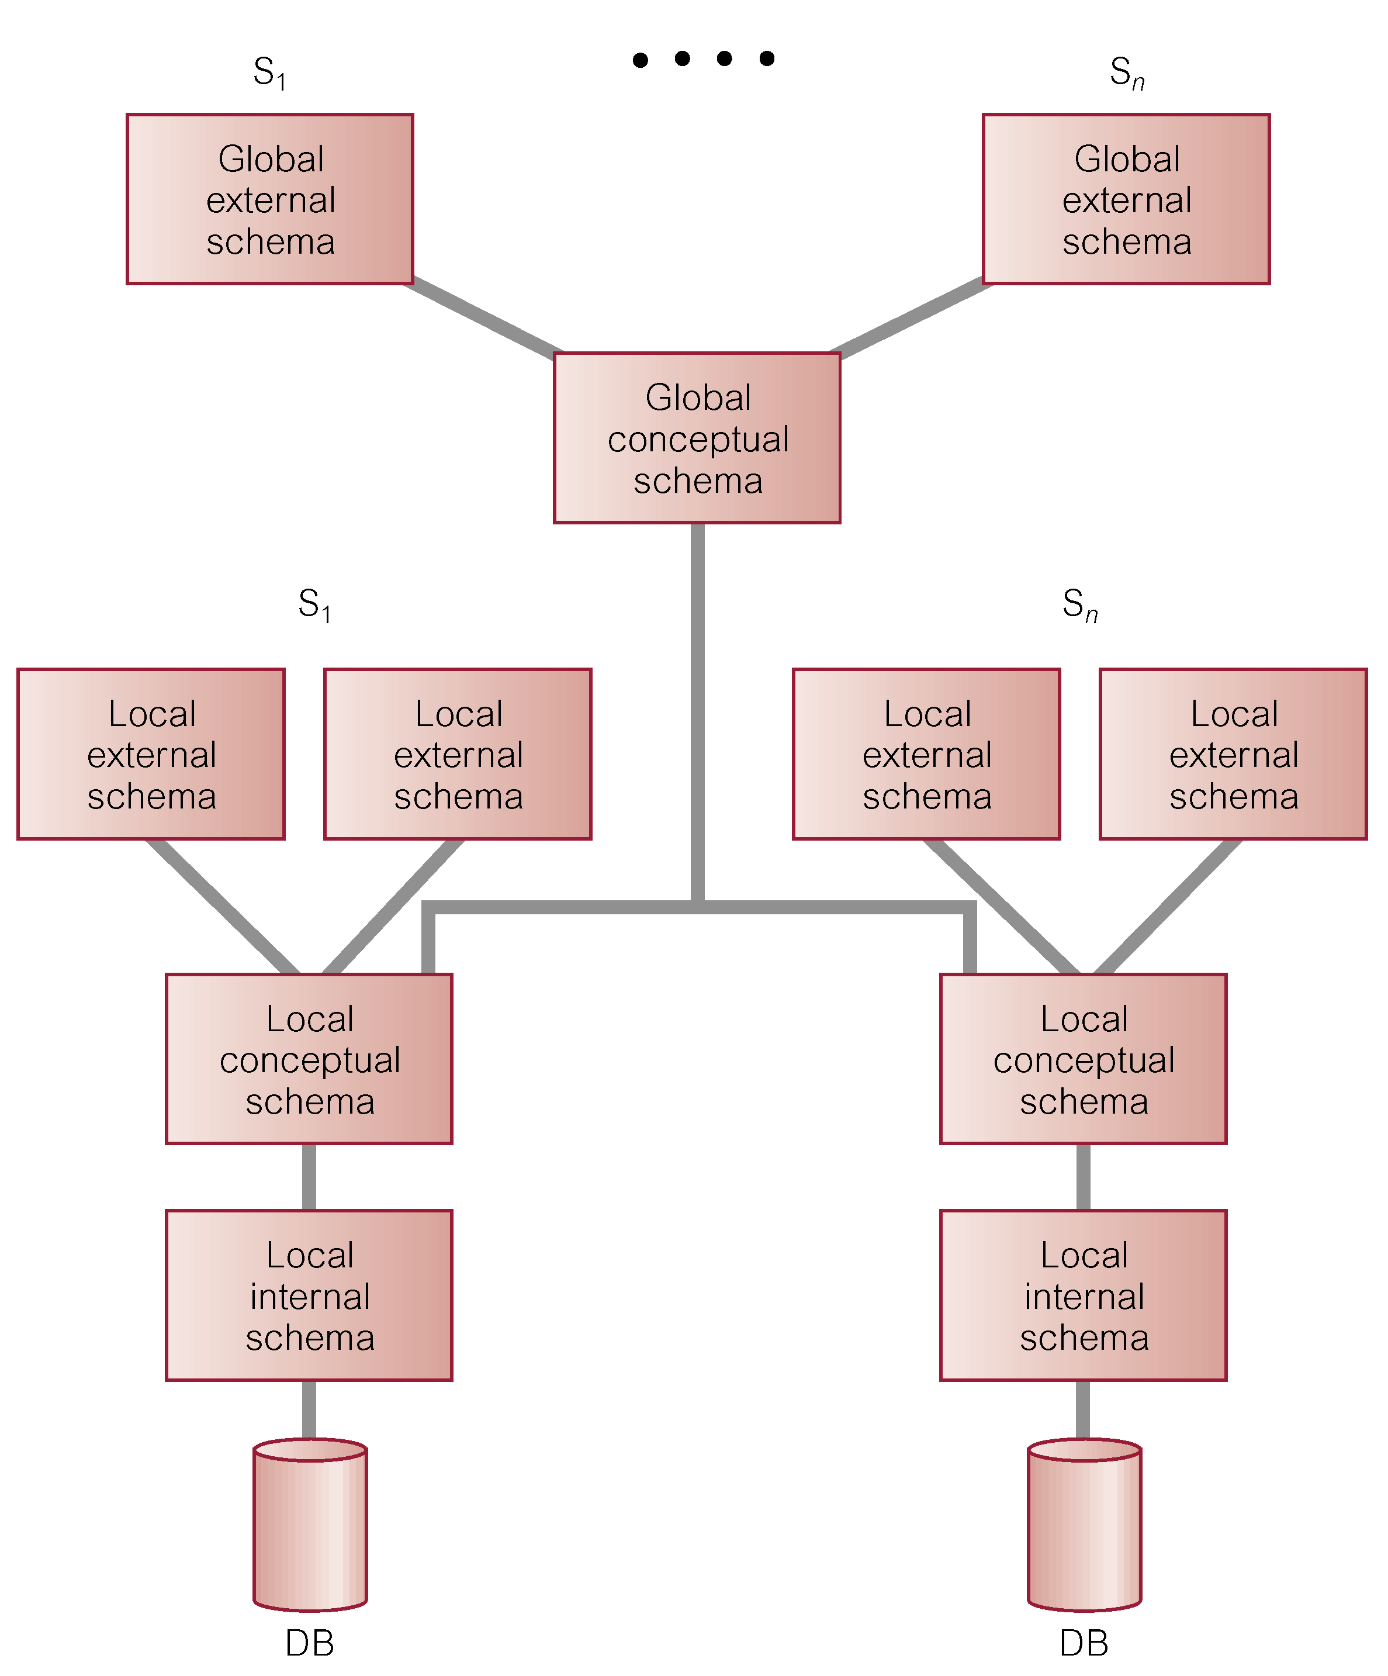
Reference Architecture for Tightly-Coupled FMDBS
Pearson Education © 2009

Slide 25
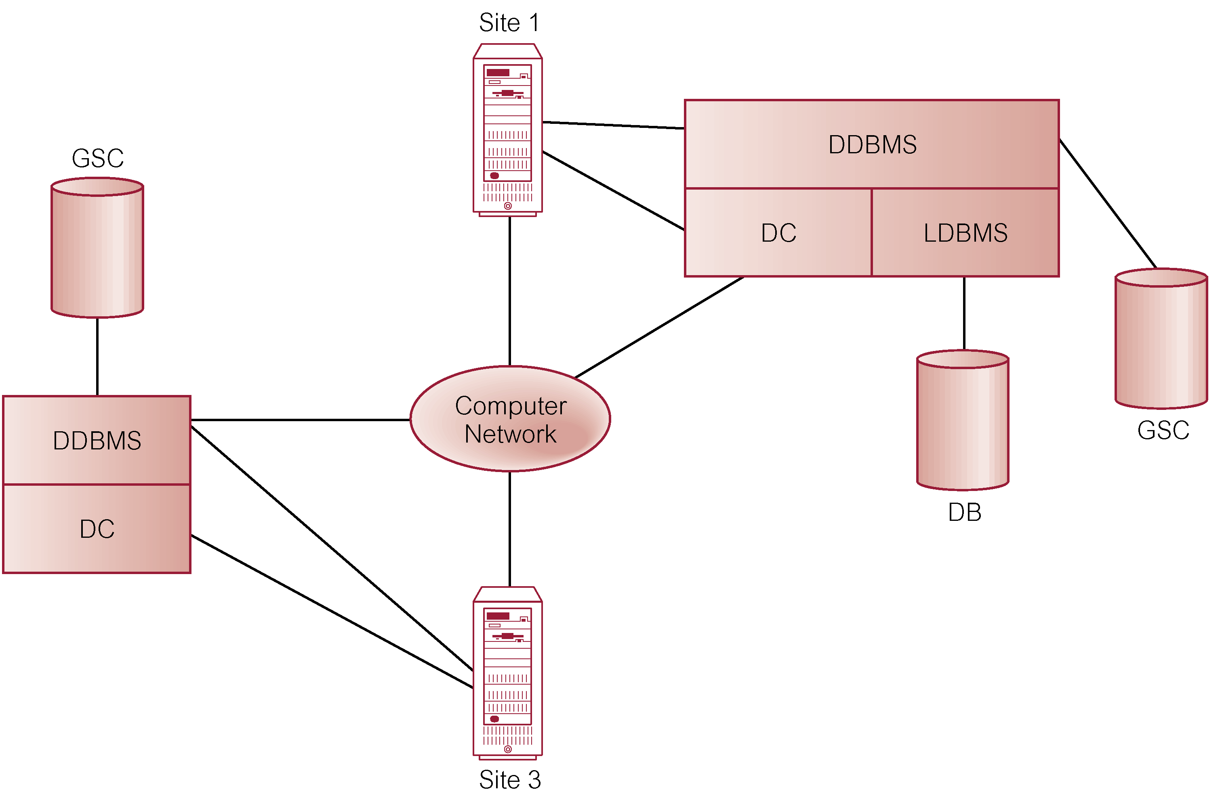
Components of a DDBMS
Pearson Education © 2009

Slide 26
Distributed Database Design
Three key issues:
  Fragmentation,
  Allocation,
  Replication.
Pearson Education © 2009

Slide 27
Distributed Database Design
  Fragmentation
  Relation may be divided into a number of sub-relations, which are then distributed.
  Allocation
  Each fragment is stored at site with “optimal” distribution.
  Replication
  Copy of fragment may be maintained at several sites.
Pearson Education © 2009

Slide 28
Fragmentation
Definition and allocation of fragments carried out strategically to achieve:
  Locality of Reference.
  Improved Reliability and Availability.
  Improved Performance.
  Balanced Storage Capacities and Costs.
  Minimal Communication Costs.
Involves analyzing most important applications, based on quantitative/qualitative information.
Pearson Education © 2009

Slide 29
Fragmentation
Quantitative information may include:
  frequency with which an application is run;
  site from which an application is run;
  performance criteria for transactions and applications.
Qualitative information may include transactions that are executed by application, type of access (read or write), and predicates of read operations.
Pearson Education © 2009

Slide 30
Data Allocation
Four alternative strategies regarding placement of data:
  Centralized,
  Partitioned (or Fragmented),
  Complete Replication,
  Selective Replication.
Pearson Education © 2009

Slide 31
Data Allocation
Centralized: Consists of single database and DBMS stored at one site with users distributed across the network.
Partitioned: Database partitioned into disjoint fragments, each fragment assigned to one site.
Complete Replication: Consists of maintaining complete copy of database at each site.
Selective Replication: Combination of partitioning, replication, and centralization.
Pearson Education © 2009

Slide 32
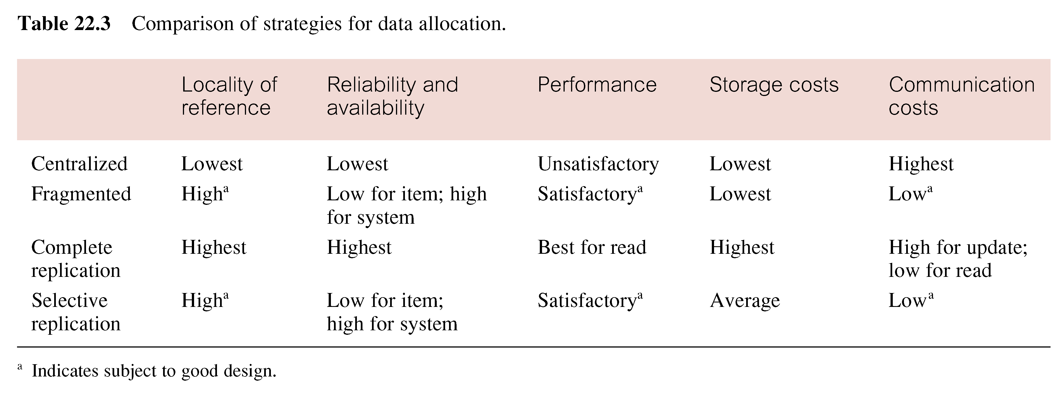
Comparison of Strategies for Data Distribution
Pearson Education © 2009

Slide 33
Why Fragment?
Usage
  Applications work with views rather than entire relations.
Efficiency
  Data is stored close to where it is most frequently used.
  Data that is not needed by local applications is not stored.
Pearson Education © 2009

Slide 34
Why Fragment?
Parallelism
  With fragments as unit of distribution, transaction can be divided into several subqueries that operate on fragments.
Security
  Data not required by local applications is not stored and so not available to unauthorized users.
Pearson Education © 2009

Slide 35
Why Fragment?
Disadvantages
  Performance,
  Integrity.
Pearson Education © 2009

Slide 36
Correctness of Fragmentation
Three correctness rules:
  Completeness,
  Reconstruction,
  Disjointness.
Pearson Education © 2009

Slide 37
Correctness of Fragmentation
Completeness
  If relation R is decomposed into fragments R₁, R₂, ... R_{n}, each data item that can be found in R must appear in at least one fragment.
Reconstruction
Must be possible to define a relational operation that will reconstruct R from the fragments.
Reconstruction for horizontal fragmentation is Union operation and Join for vertical .
Pearson Education © 2009

Slide 38
Correctness of Fragmentation
Disjointness
If data item d_{i} appears in fragment R_{i}, then it should not appear in any other fragment.
Exception: vertical fragmentation, where primary key attributes must be repeated to allow reconstruction.
For horizontal fragmentation, data item is a tuple.
For vertical fragmentation, data item is an attribute.
Pearson Education © 2009

Slide 39
Types of Fragmentation
Four types of fragmentation:
  Horizontal,
  Vertical,
  Mixed,
  Derived.
Other possibility is no fragmentation:
  If relation is small and not updated frequently, may be better not to fragment relation.
Pearson Education © 2009

Slide 40

Horizontal and Vertical Fragmentation
Pearson Education © 2009

Slide 41
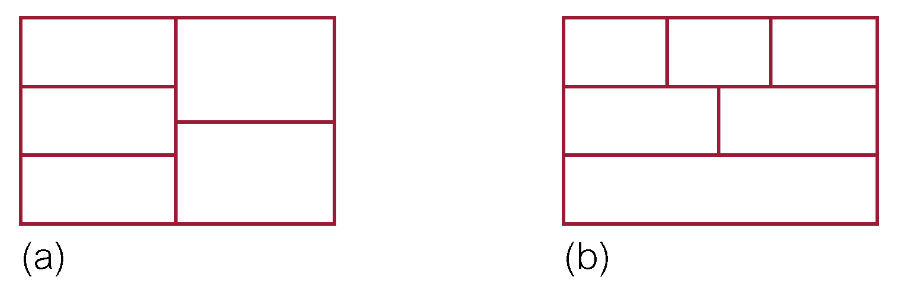
Mixed Fragmentation
Pearson Education © 2009

Slide 42
Horizontal Fragmentation
Consists of a subset of the tuples of a relation.
Defined using Selection operation of relational algebra:
  σ_{p}(R)
For example:
  P₁ = σ _{type=‘House’}(PropertyForRent)
  P₂ = σ _{type=‘Flat’}(PropertyForRent)
Pearson Education © 2009

Slide 43
Horizontal Fragmentation
This strategy is determined by looking at predicates used by transactions.
Involves finding set of minimal (complete and relevant) predicates.
Set of predicates is complete, if and only if, any two tuples in same fragment are referenced with same probability by any application.
Predicate is relevant if there is at least one application that accesses fragments differently.
Pearson Education © 2009

Slide 44
Vertical Fragmentation
Consists of a subset of attributes of a relation.
Defined using Projection operation of relational algebra:
  ∏_{a1, ... ,an}(R)
For example:
  S₁ = ∏staffNo, position, sex, DOB, salary(Staff)
  S₂ = ∏staffNo, fName, lName, branchNo(Staff)
Determined by establishing affinity of one attribute to another.
Pearson Education © 2009

Slide 45
Mixed Fragmentation
Consists of a horizontal fragment that is vertically fragmented, or a vertical fragment that is horizontally fragmented.
Defined using Selection and Projection operations of relational algebra:
  σ _{p}(∏_{a1, ... ,an}(R)) or
  ∏_{a1, ... ,an}(σ_{p}(R))
Pearson Education © 2009

Slide 46
Example - Mixed Fragmentation
S₁ = ∏staffNo, position, sex, DOB, salary(Staff)
S₂ = ∏staffNo, fName, lName, branchNo(Staff)
S₂₁ = σ _{branchNo=‘B003’}(S₂)
S₂₂ = σ _{branchNo=‘B005’}(S₂)
S₂₃ = σ _{branchNo=‘B007’}(S₂)
Pearson Education © 2009

Slide 47
Derived Horizontal Fragmentation
A horizontal fragment that is based on horizontal fragmentation of a parent relation.
Ensures that fragments that are frequently joined together are at same site.
Defined using Semijoin operation of relational algebra:
  R_{i} = R _{F} S_{i}, 1 ≤ i ≤ w
Pearson Education © 2009

Slide 48
Example - Derived Horizontal Fragmentation
S₃ = σ _{branchNo=‘B003’}(Staff)
S₄ = σ _{branchNo=‘B005’}(Staff)
S₅ = σ _{branchNo=‘B007’}(Staff)
Could use derived fragmentation for Property:
P_{i} = PropertyForRent _{branchNo} S_{i}, 3 ≤ i ≤ 5
Pearson Education © 2009

Slide 49
Derived Horizontal Fragmentation
If relation contains more than one foreign key, need to select one as parent.
Choice can be based on fragmentation used most frequently or fragmentation with better join characteristics.
Pearson Education © 2009

Slide 50
Distributed Database Design Methodology
Use normal methodology to produce a design for the global relations.
Examine topology of system to determine where databases will be located.
Analyze most important transactions and identify appropriateness of horizontal/vertical fragmentation.
Decide which relations are not to be fragmented.
Examine relations on 1 side of relationships and determine a suitable fragmentation schema. Relations on many side may be suitable for derived fragmentation.
Pearson Education © 2009

Slide 51
Transparencies in a DDBMS
Distribution Transparency
  Fragmentation Transparency
  Location Transparency
  Replication Transparency
  Local Mapping Transparency
  Naming Transparency
Pearson Education © 2009

Slide 52
Transparencies in a DDBMS
Transaction Transparency
  Concurrency Transparency
  Failure Transparency
Performance Transparency
  DBMS Transparency
DBMS Transparency
Pearson Education © 2009

Slide 53
Distribution Transparency
Distribution transparency allows user to perceive database as single, logical entity.
If DDBMS exhibits distribution transparency, user does not need to know:
  data is fragmented (fragmentation transparency),
  location of data items (location transparency),
  otherwise call this local mapping transparency.
With replication transparency, user is unaware of replication of fragments .
Pearson Education © 2009

Slide 54
Naming Transparency
Each item in a DDB must have a unique name.
DDBMS must ensure that no two sites create a database object with same name.
One solution is to create central name server. However, this results in:
  loss of some local autonomy;
  central site may become a bottleneck;
  low availability; if the central site fails, remaining sites cannot create any new objects.
Pearson Education © 2009

Slide 55
Naming Transparency
Alternative solution - prefix object with identifier of site that created it.
For example, Branch created at site S₁ might be named S1.BRANCH.
Also need to identify each fragment and its copies.
Thus, copy 2 of fragment 3 of Branch created at site S₁ might be referred to as S1.BRANCH.F3.C2.
However, this results in loss of distribution transparency.
Pearson Education © 2009

Slide 56
Naming Transparency
An approach that resolves these problems uses aliases for each database object.
Thus, S1.BRANCH.F3.C2 might be known as LocalBranch by user at site S₁.
DDBMS has task of mapping an alias to appropriate database object.
Pearson Education © 2009

Slide 57
Transaction Transparency
Ensures that all distributed transactions maintain distributed database’s integrity and consistency.
Distributed transaction accesses data stored at more than one location.
Each transaction is divided into number of subtransactions, one for each site that has to be accessed.
DDBMS must ensure the indivisibility of both the global transaction and each of the subtransactions.
Pearson Education © 2009

Slide 58
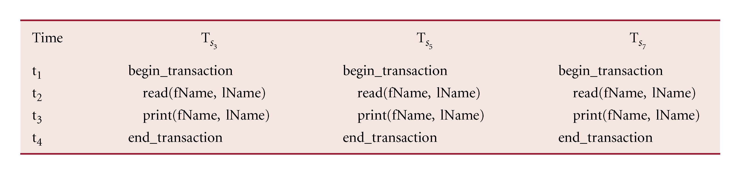
Example - Distributed Transaction
T prints out names of all staff, using schema defined above as S₁, S₂, S₂₁, S₂₂, and S₂₃. Define three subtransactions T_{S3}, T_{S5}, and T_{S7} to represent agents at sites 3, 5, and 7.
Pearson Education © 2009

Slide 59
Concurrency Transparency
All transactions must execute independently and be logically consistent with results obtained if transactions executed one at a time, in some arbitrary serial order.
Same fundamental principles as for centralized DBMS.
DDBMS must ensure both global and local transactions do not interfere with each other.
Similarly, DDBMS must ensure consistency of all subtransactions of global transaction.
Pearson Education © 2009

Slide 60
Classification of Transactions
In IBM’s Distributed Relational Database Architecture (DRDA), four types of transactions:
  Remote request
  Remote unit of work
  Distributed unit of work
  Distributed request.
Pearson Education © 2009

Slide 61
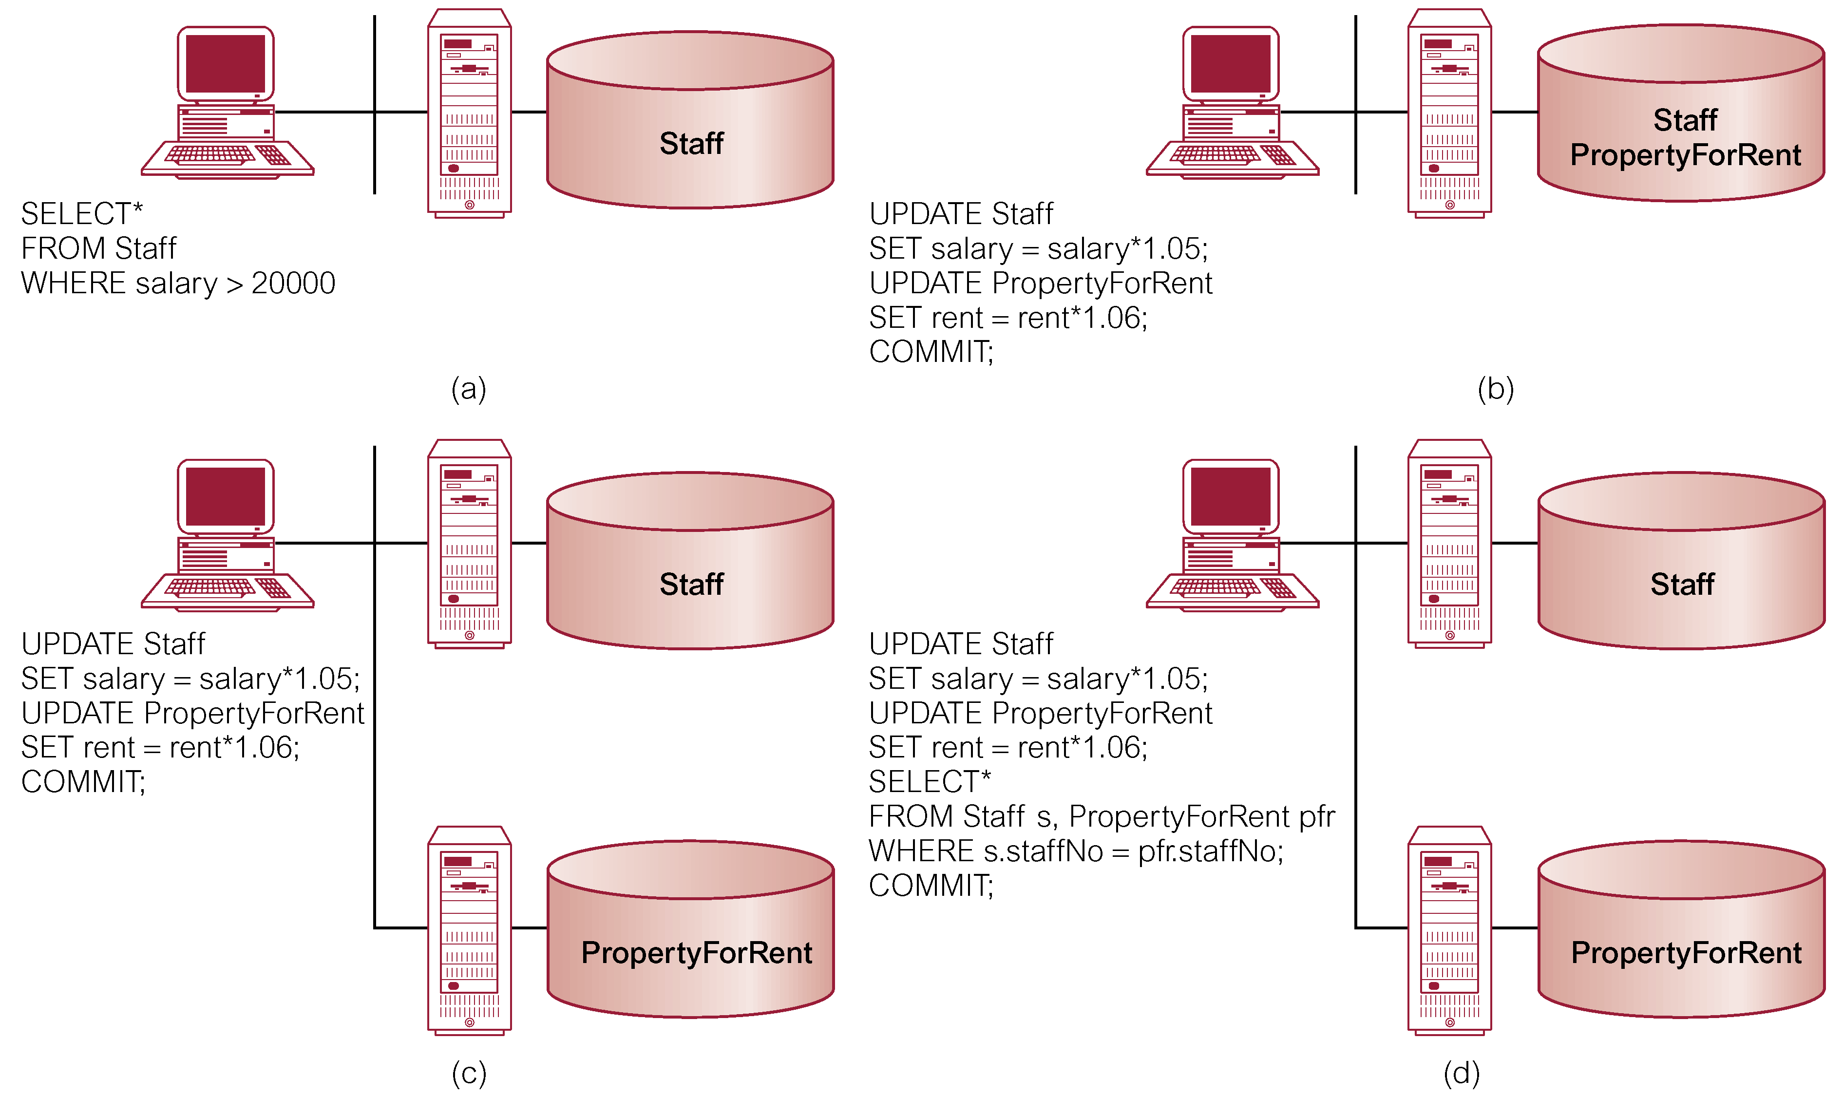
Classification of Transactions
Pearson Education © 2009

Slide 62
Concurrency Transparency
Replication makes concurrency more complex.
If a copy of a replicated data item is updated, update must be propagated to all copies.
Could propagate changes as part of original transaction, making it an atomic operation.
However, if one site holding copy is not reachable, then transaction is delayed until site is reachable.
Pearson Education © 2009

Slide 63
Concurrency Transparency
Could limit update propagation to only those sites currently available. Remaining sites updated when they become available again.
Could allow updates to copies to happen asynchronously, sometime after the original update. Delay in regaining consistency may range from a few seconds to several hours.
Pearson Education © 2009

Slide 64
Failure Transparency
DDBMS must ensure atomicity and durability of global transaction.
Means ensuring that subtransactions of global transaction either all commit or all abort.
Thus, DDBMS must synchronize global transaction to ensure that all subtransactions have completed successfully before recording a final COMMIT for global transaction.
Must do this in presence of site and network failures.
Pearson Education © 2009

Slide 65
Performance Transparency
DDBMS must perform as if it were a centralized DBMS.
  DDBMS should not suffer any performance degradation due to distributed architecture.
  DDBMS should determine most cost-effective strategy to execute a request.
Pearson Education © 2009

Slide 66
Performance Transparency
Distributed Query Processor (DQP) maps data request into ordered sequence of operations on local databases.
Must consider fragmentation, replication, and allocation schemas.
DQP has to decide:
  which fragment to access;
  which copy of a fragment to use;
  which location to use.
Pearson Education © 2009

Slide 67
Performance Transparency
DQP produces execution strategy optimized with respect to some cost function.
Typically, costs associated with a distributed request include:
  I/O cost;
  CPU cost;
  communication cost.
Pearson Education © 2009

Slide 68
Performance Transparency - Example
Property(propNo, city) 10000 records in London
Client(clientNo,maxPrice) 100000 records in Glasgow
Viewing(propNo, clientNo) 1000000 records in London
SELECT p.propNo
FROM Property p INNER JOIN
(Client c INNER JOIN Viewing v ON c.clientNo = v.clientNo)
ON p.propNo = v.propNo
WHERE p.city=‘Aberdeen’ AND c.maxPrice > 200000;
Pearson Education © 2009

Slide 69
Performance Transparency - Example
Assume:
Each tuple in each relation is 100 characters long.
10 renters with maximum price greater than £200,000.
100 000 viewings for properties in Aberdeen.
Computation time negligible compared to communication time.
Pearson Education © 2009

Slide 70
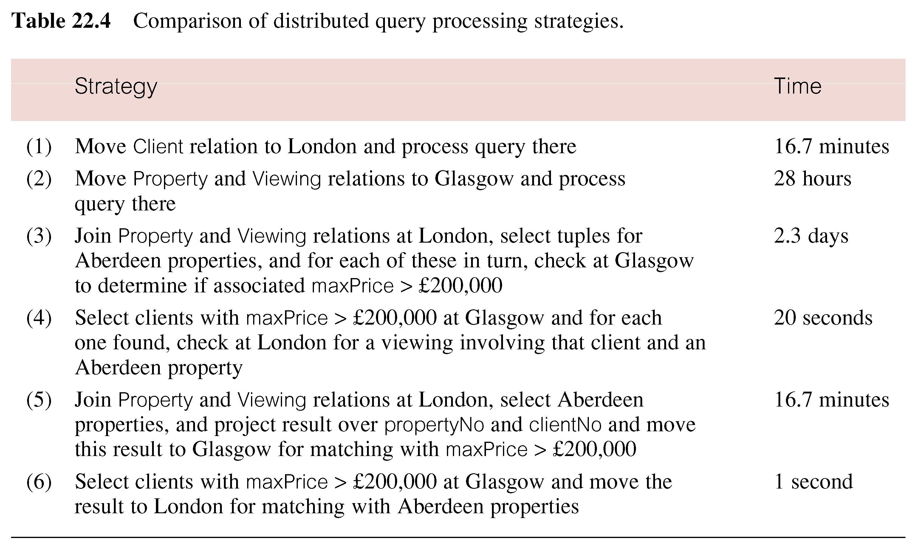
Performance Transparency - Example
Pearson Education © 2009

Slide 71
Date’s 12 Rules for a DDBMS
0. Fundamental Principle
  To the user, a distributed system should look exactly like a nondistributed system.
1. Local Autonomy
2. No Reliance on a Central Site
3. Continuous Operation
4. Location Independence
5. Fragmentation Independence
6. Replication Independence
Pearson Education © 2009

Slide 72
Date’s 12 Rules for a DDBMS
7. Distributed Query Processing
8. Distributed Transaction Processing
9. Hardware Independence
10. Operating System Independence
11. Network Independence
12. Database Independence
Last four rules are ideals.
Pearson Education © 2009

