Slide 1
Implementation of Cloud Computing Infrastructures: CloudSim
Session-2
Hima Nikafshan Rad
Implementation of Cloud Computing Infrastructures: CloudSim

Slide 2
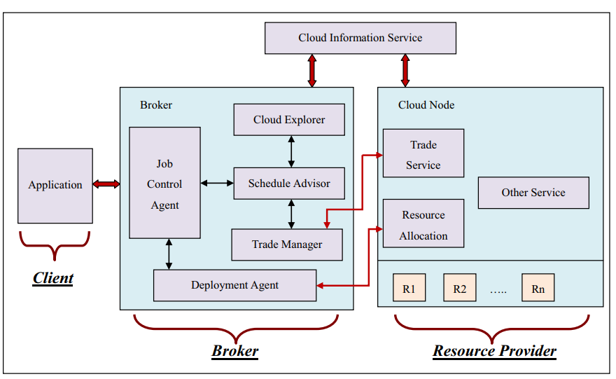
CloudSim
1/4
CloudSim
Implementation of Cloud Computing Infrastructures: CloudSim

Slide 3
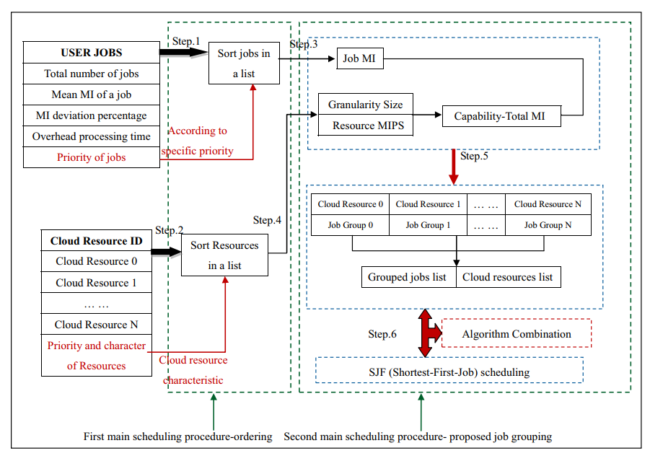
CloudSim
2/4
CloudSim
Implementation of Cloud Computing Infrastructures: CloudSim

Slide 4
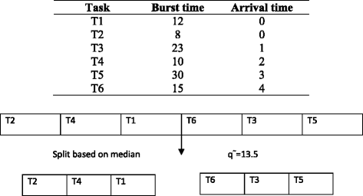
CloudSim
3/4
CloudSim
Implementation of Cloud Computing Infrastructures: CloudSim

Slide 5
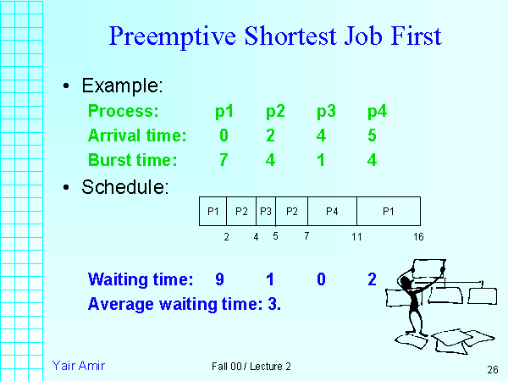
CloudSim
4/4
CloudSim
Implementation of Cloud Computing Infrastructures: CloudSim

Slide 6
Thank you
?
Hima Nikafshan Rad
Implementation of Cloud Computing Infrastructures: CloudSim

