Slide 1
Traffic Models
CSCE 654
Computer Communication Networks
Maj Scott R. Graham
Department of Electrical and Computer Engineering
Air Force Institute of Technology
(Material from Dr. Barry Mullins & Dr. Scott Midkiff is gratefully acknowledged)

Slide 2
Outline
Motivation
Continuous time models
Discrete time models
Burstiness
Self-similarity
ATM source models

Slide 3
Reading
T. Robertazzi, Computer Networks and Systems, 3rd edition, Chapter 7.

Slide 4
Additional Resources
W. Stallings, High Speed Networks: TCP/IP and ATM Design Principles, Prentice-Hall, 1998.
W. E. Leland, et al., “On the Self-Similar Nature of Ethernet Traffic,” ACM SIGComm, San Francisco, CA, September 1993.

Slide 5
Traffic Models
All performance techniques must make some assumptions regarding traffic or workload
  Queuing models: arrival and service processes
  Simulation: traffic generators
  Experimental: work load generators
Assumptions are captured in traffic models

Slide 6
Developing Traffic Models (1)
What is the basis for traffic models?
Select from a constrained set
  Analytical techniques limit the types of models that can be utilized, e.g., Markovian
  Specific model may be based more on “tradition” than reality
  Important to understand limitations and inaccuracies of such traffic assumptions

Slide 7
Developing Traffic Models (2)
Analysis of trace data
  A trace is captured from a “live” network
  Normally want to statistically characterize the trace to build a model, but may be able to use the trace directly
  Live traffic may not exist, e.g., for a new network or application
  How do we know our sample is typical or large enough?
Use insight into applications
  Models based on expert knowledge of the system

Slide 8
Continuous Time Models (1)
Events (arrivals and departures) can occur at any instant of time in continuous time models
Poisson Process (PP or M)
  Appropriate if there is a large number of independent users and each generates Poisson traffic and no source dominates
  Poisson arrival process basis of standard queuing models (M/M/1, M/D/1, M/M/m/m, etc.)
  Basis for some other continuous time models

Slide 9
Continuous Time Models (2)
Generally Modulated Poisson Process (GMPP)
  A Poisson arrival process, but with time-varying arrival rate, λ(t)
  The arrival rate λ(t) is a stochastic process known as the modulating process determines
  GMPP …
    Doubly stochastic process
    Switched Poisson process
Markov Modulated Poisson Process (MMPP)
  A GMPP where the modulating process has a Markov chain
  More …

Slide 10
Markov Modulated Poisson Process
1-q₀₁
q₀₁
0
1
q₁₀
1-q₁₀
Rate is λ₀
Rate is λ₁
Rate is controlled by the modulating process (two-state Markov chain here, but could be more states)
The arrival process is Poisson for given rate

Slide 11
Continuous Time Models (3)
Switched Poisson Process (SPP)
  Special case of a MMPP where the modulating process is a two-state Markov chain
  Rate is λ₀ when system is in state 0 and rate is λ₁ when system is in state 1
Interrupted Poisson Process (IPP)
  Special case of a SPP where rate λ₀ = 0 and rate λ₁ > 0

Slide 12
MMPP, SPP, and IPP (1)
1-q₀₁
q₀₁
0
1
q₁₀
1-q₁₀
Rate is λ₀ = 0
Rate is λ₁ > 0
This modulated Markov Poisson process (MMPP) is also a switched Poisson process (SPP) and an interrupted Poisson process (IPP)

Slide 13
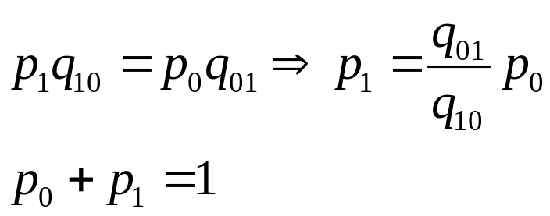
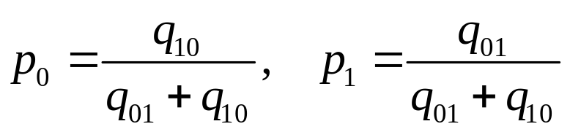
MMPP, SPP, and IPP (2)
The following equations describe the chain, where p_{i} is the equilibrium probability of state i
The equilibrium probabilities are …

Slide 14
In-Class Exercise 1
Consider the example chain
(a) What is the average arrival rate assuming a switched Poisson process (SPP) model? Your answer should be in terms of q₀₁, q₁₀, λ₀, and λ₁.
(b) What is the average arrival rate assuming the interrupted Poisson process (IPP) model?

Slide 15
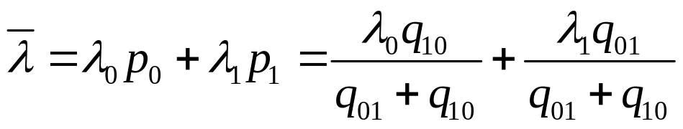
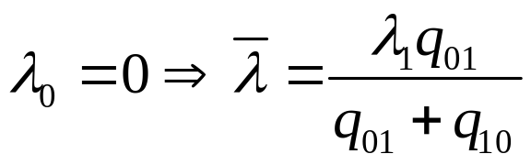
In-Class Exercise 1 (Solutions)
(a) Average arrival rate for SPP model …
(b) Average arrival rate for IPP model …

Slide 16
Continuous Time Models (4)
Markov Arrival Process (MAP)
  Based on a finite-state Markov chain
  Arrival occurs with some probability for each transition in the Markov chain
Autoregressive Moving Average Model (ARMA)
  Can be used to model video traffic
  Determines the number of cells to arrive during a given interval

Slide 17
Continuous Time Models (5)
Fluid Flow Approximation Model (FFA)
  Packet model replaced by course-grained continuous flow
  Methods exist that allow tractable analysis for FFA models
Self-Similar Source Model (SSS)
  With self-similarity, the traffic behaves similarly over many time scales
  More later …

Slide 18
Continuous Time Models (6)
Renewal Process (RP, GI)
  Generalization of the Poisson Process in that interarrival times are independent and identically distributed (i.i.d)
  Also known as a general independent (GI) point process
Semi-Markov Process (SMP)
  More general interarrival time distribution

Slide 19
Discrete Time Models (1)
Events (arrivals and departures) occur at slot times
  Often assumes that one packet (cell) can be transmitted in a single slot, as in ATM
Deterministic Process (DP)
  Events occur at fixed multiples of the basic slot, e.g., transmission of an ATM cell requires one slot
Bernoulli Process (BP)
  Discrete time counterpart to the Poisson Process
  Tractable first-cut model for discrete time systems

Slide 20
Discrete Time Models (2)
Batch Bernoulli Process (BBP)
  Up to N arrivals can occur per slot
  Superposition of N i.i.d. Bernoulli Processes
Generally Modulated Deterministic Process (GMDP)
  Arrivals occur at a fixed rate for some duration
  Fixed rate determined by a modulating process that is a finite-state stochastic process
Markov Modulated Deterministic Process (MMDP)
  GMDP where the modulating process is a discrete-time, finite-state Markov chain

Slide 21
Discrete Time Models (3)
Switched Deterministic Process (SDP)
  Special case of the MMDP with two states and, hence, two arrival rates
Interrupted Deterministic Process (IDP)
  Special case of the SDP where the two states are “on” and “off”
  The rate in the “off” state is 0 and the rate in the “on” state is greater than 0
  Sometimes called …
    On/off source
    Burst/silence model
    Talkspurt/silence model (voice)

Slide 22
Discrete Time Models (4)
Discrete Time Markovian Arrival Process (DMAP)
  Some transitions in a Markov chain cause events (arrivals)
Discrete Renewal Process (DRP)
  Interarrival times are i.i.d
  Generalization of the Bernoulli process

Slide 23
Burstiness (1)
A bursty source generates traffics in random clusters
Deterministic traffic is not bursty
Poisson process (in continuous time) and Bernoulli process (in discrete time) are bursty as single processes
Burstiness of Poisson and Bernoulli processes removed for aggregated traffic sources
Other traffic sources exhibit more burstiness

Slide 24
Burstiness (2)
Self-similar traffic is not smoothed through aggregation
  Maintains its burstiness at any time scale
Burstiness is important
  Peak traffic demands on buffer resources can lead to overflow and lost traffic
  Peak demands may create quality of service (QoS) problems in a network
  Need to characterize burstiness for traffic sources in a QoS environment
“Peak busy hour” approach can deal with long-term burstiness

Slide 25
Characterizing Burstiness (1)
What is the best way to characterize the burstiness of a source?
  Ratio of peak rate to mean rate
  Coefficient of variation of traffic load
  Index of dispersion
Ratio of peak rate to mean rate
  Simple measure to express burstiness of a source, but is not ideal
  But, how long should be measured to determine “peak” traffic
  Does not capture length of idle periods for on/off (IDP and IPP models)

Slide 26
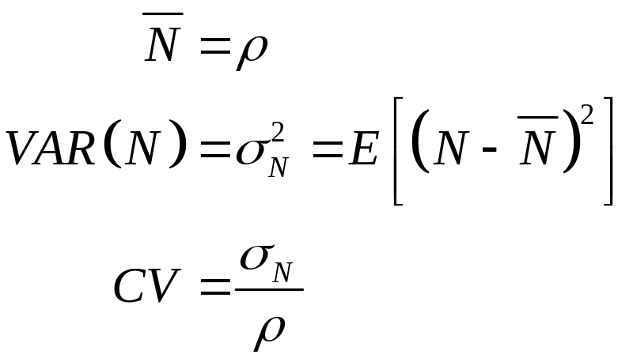
Characterizing Burstiness (2)
Coefficient of variation
  Coefficient of variation (N transmissions per unit time)
  Measures variation of traffic (in normalized form), but not, directly, the burstiness

Slide 27
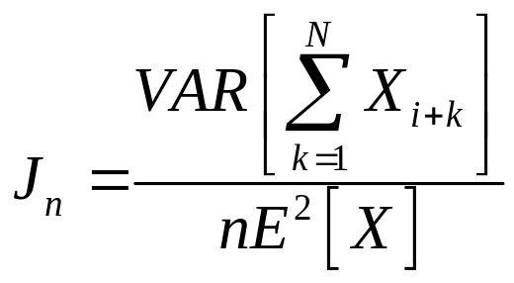
Characterizing Burstiness (3)
Index of dispersion — index of dispersion of intervals (IDI) or time between packets
  For n arrival intervals and interarrival times X_{i} …

Slide 28
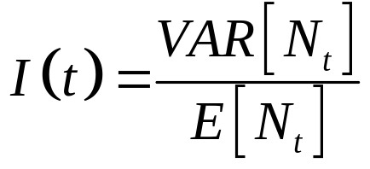
Characterizing Burstiness (4)
Index of dispersion — index of dispersion of count (IDC) or number of arrivals in an interval
  Associated with N_{t}, the count of the number of arrivals in an interval of length t
  Ratio of variance to the mean number of arrivals over the same interval

Slide 29
Characterizing Burstiness (5)
Other methods
  Spectral (frequency) characteristics
  Statistical characterization of buffer underload and overload periods
  Stochastic process entropy rate

Slide 30
Self-Similar Phenomena
“The unifying concept underlying fractals, chaos and power laws is self-similarity.
Self-similarity, or invariance against changes in scale or size, is an attribute of many laws of nature and innumerable phenomena in the world around us.
Self-similarity is, in fact, one of the decisive symmetries that shape our universe and our efforts to comprehend it”
— Manfred Schroeder

Slide 31
Basic Concepts for Self-Similarity
A phenomenon that is self-similar looks or behaves the same when viewed at different degrees of “magnification” or different scales on a dimension (time or space)
We are concerned with time series and stochastic processes that exhibit
self-similarity with respect to time
Notes:
- Denote the number of nodes in graph G as |G|
- V = {A, B, C, D, E, F}
- E = {(A,B), (A,C), (A,D), (B,C), (B,D), (C, D), (C,E), (C,F), (D,E), (E,F)}

Slide 32
Aggregated Time Series Example (1)
A time series
Aggregated
time
series
Aggregated
again
Notes:
Q1 : 3; 2
Q2: Yes; No

Slide 33
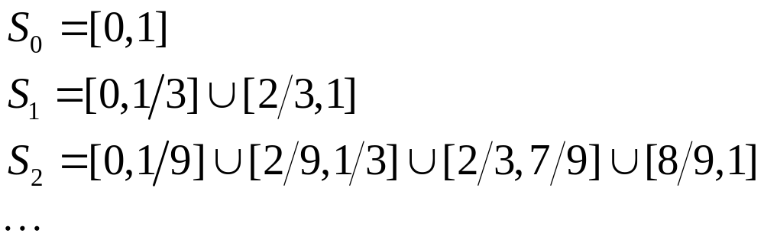
Aggregated Time Series Example (2)
Can be constructed as a Cantor set
  Begin with closed interval [0,1] represented by a line segment
  Remove the middle third of the line
  At each step, remove the middle third of the segments created by the previous step
Notes:
Q : {(A,B), (B,D), (D,A)}

Slide 34
Properties
Self-similar phenomena have structure at arbitrarily small scales
  Contrast with a smooth continuous curve
A self-similar structure contains smaller replicas of itself at all scales
  For real phenomena, properties do not hold indefinitely; however, they hold over a large range of scales

Slide 35
Why Do We Care?
If network traffic is self-similar, there is significant amount of clustering at all time scales, requiring more buffering
Contrast with Poisson traffic, where clustering occurs in the short term but traffic “smoothes out” over the long term
Notes:
Q : 2 components C1={v1,v3,v5,…} and C2={v2,v4,v6,…}

Slide 36
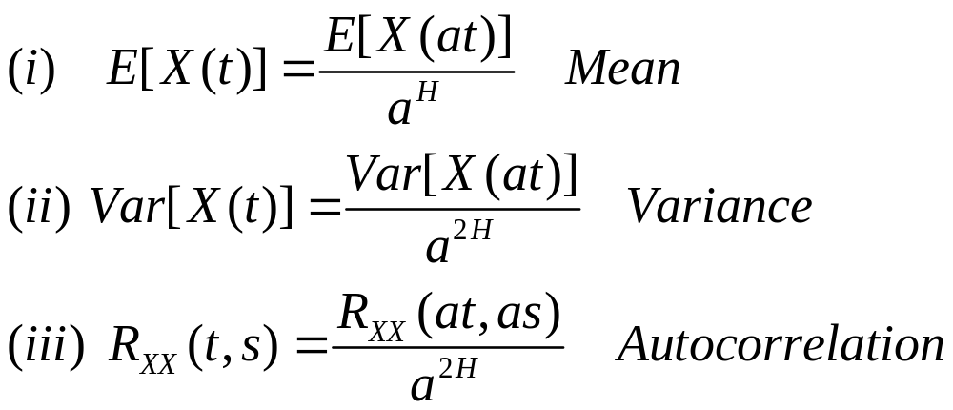
Continuous-Time Definition
A stochastic process X(t) is statistically
self-similar with parameter H (0.5 ≤ H ≤ 1) if for any real a > 0:

Slide 37
The Hurst Parameter
H is the Hurst parameter, a key measure of self-similarity
  0.5 ≤ H ≤ 1
H = 0.5 indicates the absence of
self-similarity
H closer to 1 indicates a higher degree of persistence of long-range dependence

Slide 38
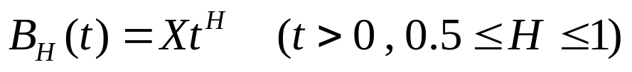
Fractional Brownian Motion Example
A fractional brownian motion (FBM) process B_{H}(t) can be defined as …
… where X is a zero-mean, unit-variance normally-distributed random variable

Slide 39
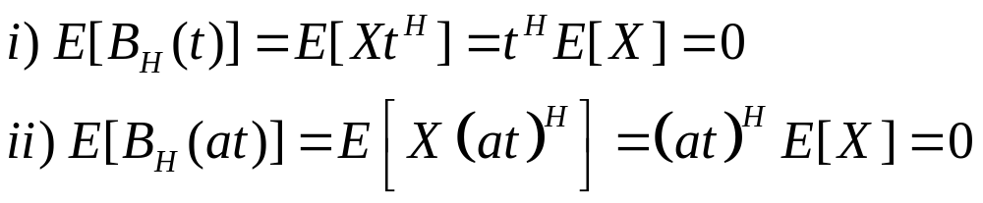
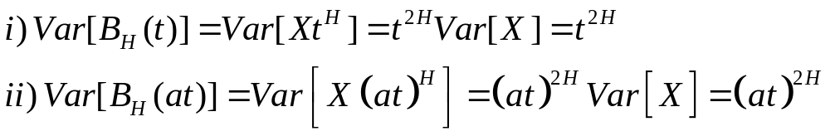
Example: Mean and Variance
Mean
Variance

Slide 40
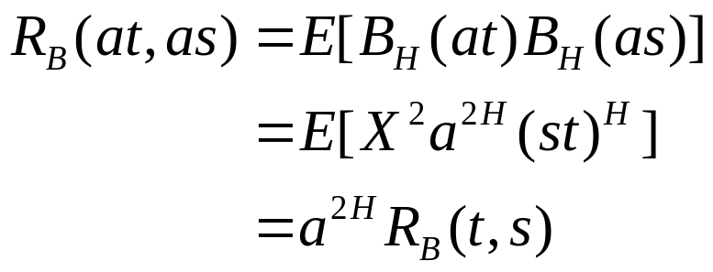
Example: Autocorrelation
Autocorrelation
  It can be shown that, for H > 0.5, past increments are correlated with present increments
  This violates common assumption that events become uncorrelated as Δt goes to infinity.

Slide 41
Long-Range Dependence
In many processes (e.g., Poisson), the autocovariance rapidly decays with t
  Short-range dependent processes, covariance decays at least exponentially
A long-range dependent process has a hyperbolically decaying autocovariance
Long-range dependence reflects the existence of clustering and bursty characteristics at all time scales in
self-similar processes

Slide 42
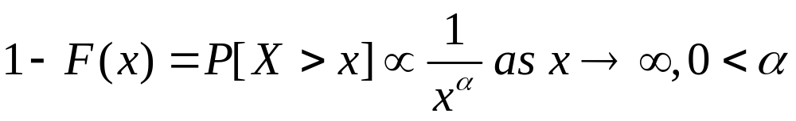
Heavy-tailed Distributions
The distribution of a random variable X is said to be heavy tailed if …
A r.v. with a heavy-tailed distribution exhibits a high or even infinite variance

Slide 43
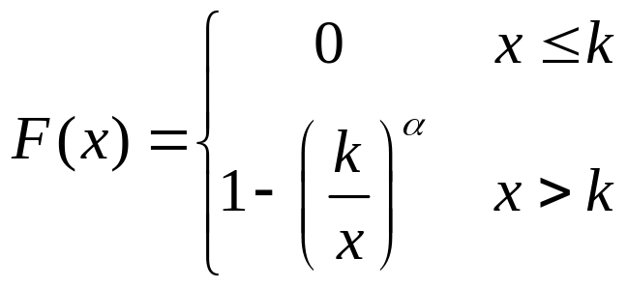
The Pareto Distribution (1)
Pareto distribution with parameters k, α > 0

Slide 44
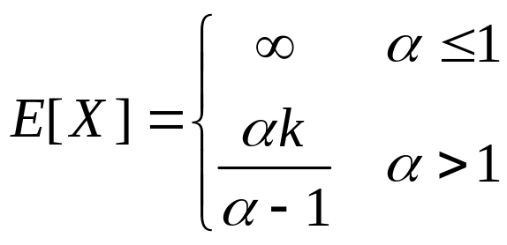
The Pareto Distribution (2)
If α ≤ 2, the distribution has infinite variance
The tail of the Pareto distribution decays much more slowly than for the exponential distribution

Slide 45
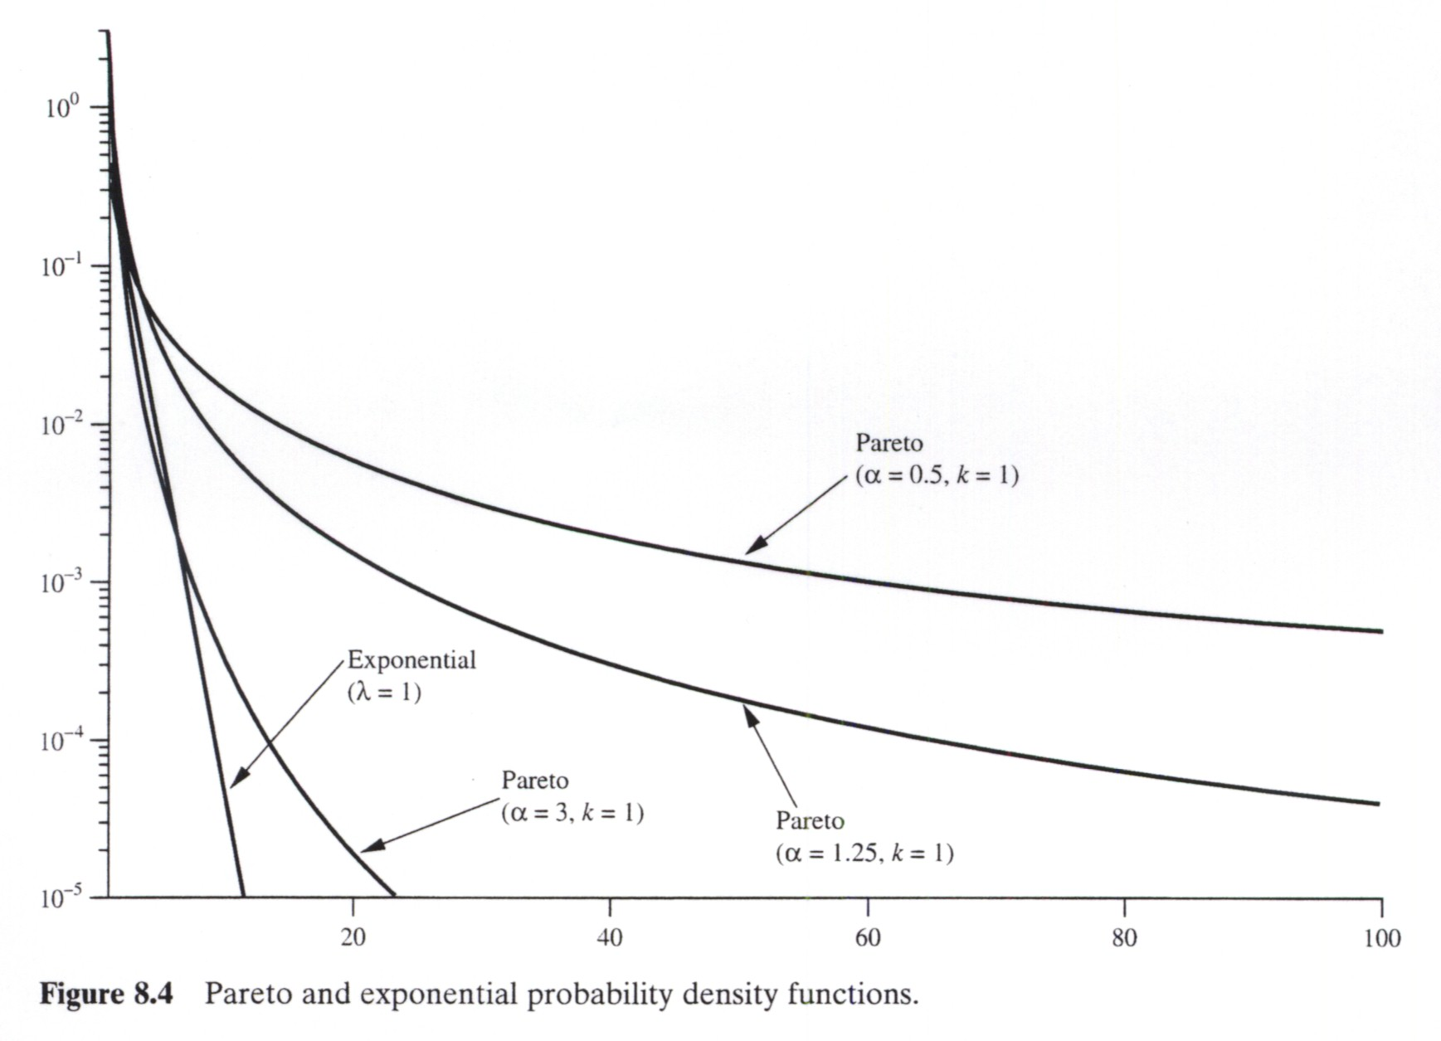
The Pareto Distribution (3)
Source: W. Stallings, High Speed Networks: TCP/IP and ATM Design Principles, Prentice-Hall, 1998.
Notes:
Q : 2 components C1={v1,v3,v5,…} and C2={v2,v4,v6,…}

Slide 46
Application to Data Traffic
Data traffic is often well-modeled as a
self-similar process in many practical networking situations
  Ethernet traffic (basis for original paper)
  WWW traffic
  SS7 traffic
  TCP traffic
  FTP and Telnet traffic
  VBR video

Slide 47
Self-Similarity of Ethernet Traffic (1)
Leland, et al., “On the Self-Similar Nature of Ethernet Traffic”
Straight-forward queuing analysis using Poisson traffic assumptions inadequate to model Ethernet traffic
Triggered a flood of research into
self-similarity
Notes:
Q : 2 components C1={v1,v3,v5,…} and C2={v2,v4,v6,…}

Slide 48
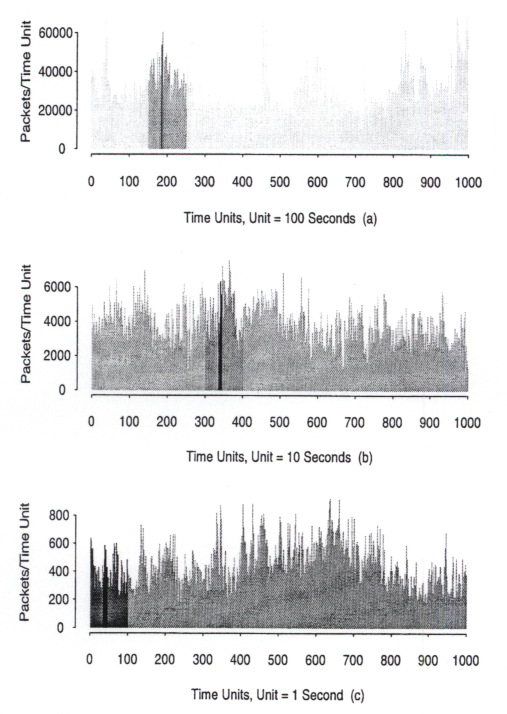
Self-Similarity of Ethernet Traffic (2)
Pictorial proof …
Source: W. E. Leland, et al., “On the Self-Similar Nature of Ethernet Traffic,” ACM SIGComm’93.
Notes:
Q : 2 components C1={v1,v3,v5,…} and C2={v2,v4,v6,…}

Slide 49
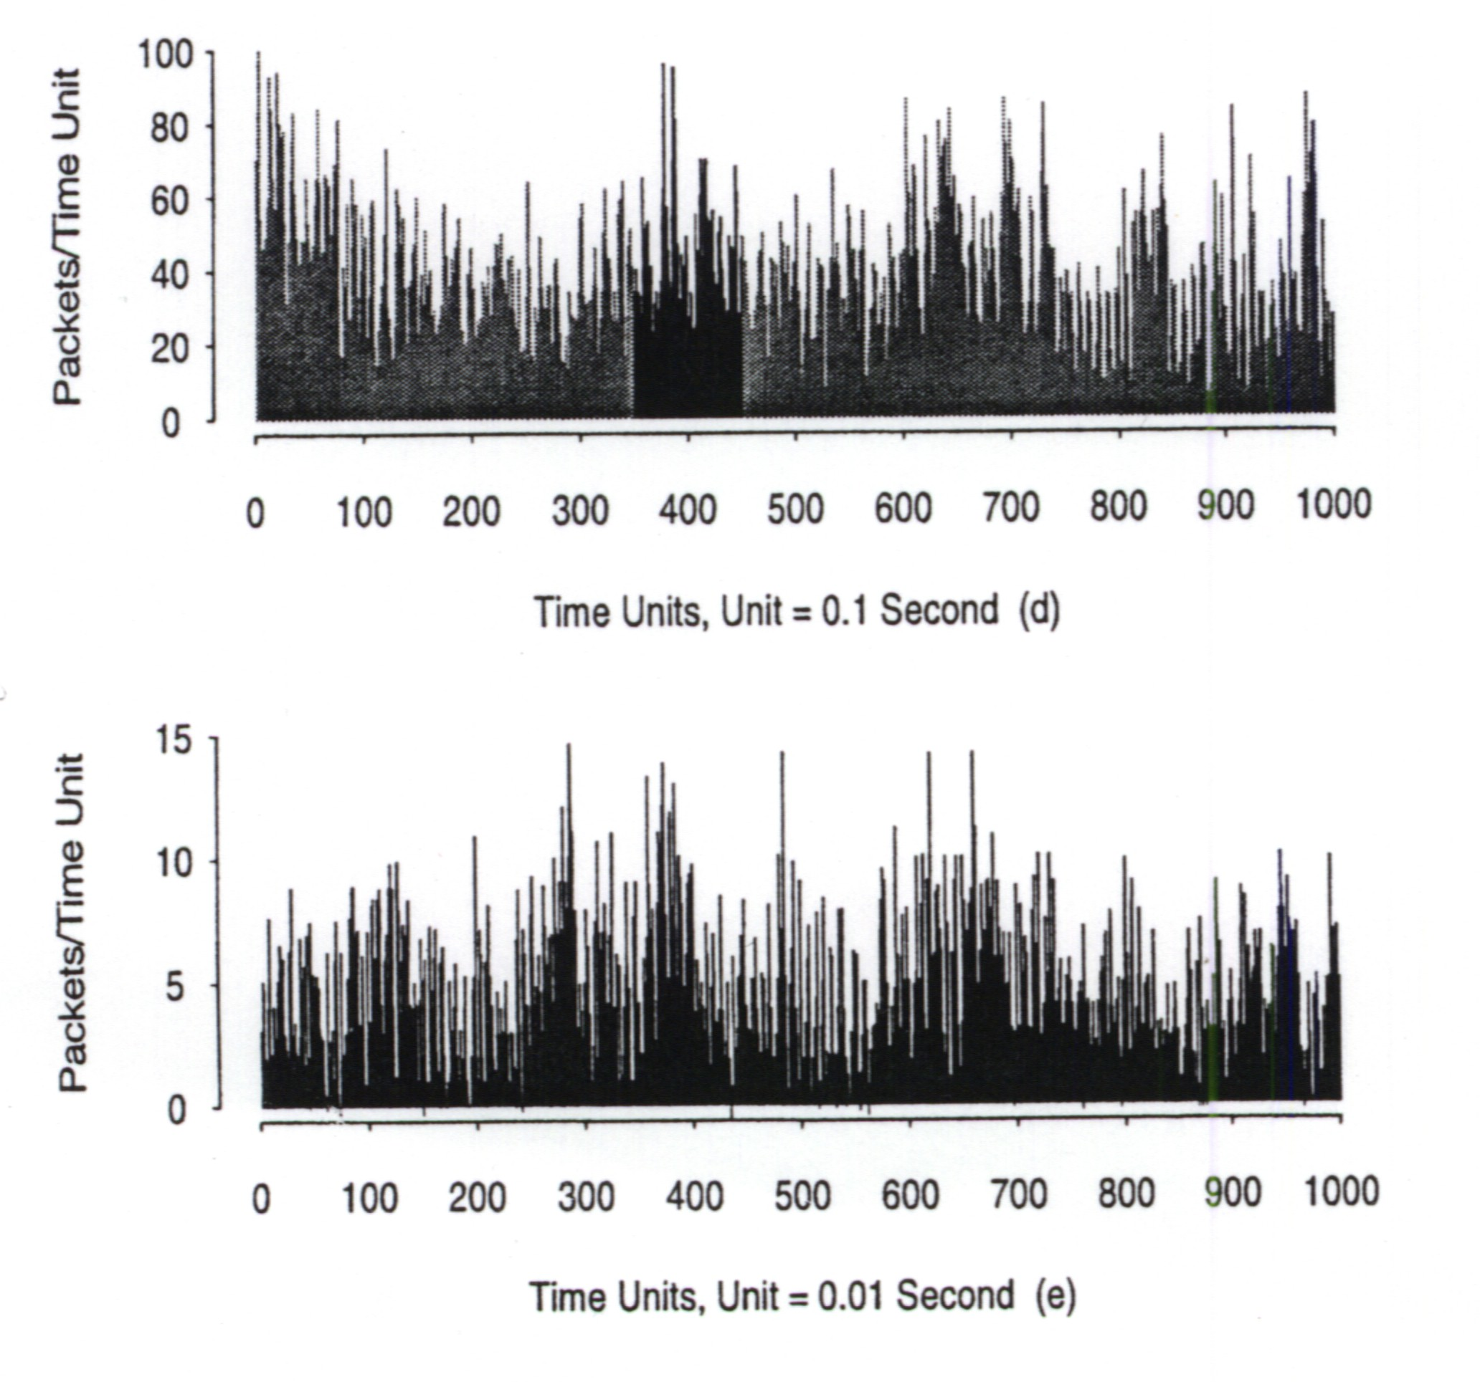
Self-Similarity of Ethernet Traffic (3)
Pictorial proof (continued) …
Source: W. E. Leland, et al., “On the Self-Similar Nature of Ethernet Traffic,” ACM SIGComm’93.
Notes:
Q : 2 components C1={v1,v3,v5,…} and C2={v2,v4,v6,…}

Slide 50
Self-Similarity of Ethernet Traffic (4)
Authors estimated Hurst parameter of
H = 0.9
  The higher the load, the higher H
Aggregating several streams does not remove self-similarity
We know that Poisson is not a good model in this case. But what is?
  Superposition of many Pareto-like ON/OFF sources
Notes:
Q : 2 components C1={v1,v3,v5,…} and C2={v2,v4,v6,…}

Slide 51
Self-Similarity of Ethernet Traffic (5)
Each source alternates between “ON” and “OFF” states
  In ON, a burst of packets is transmitted
  OFF period is idle period
Model the ON/OFF time periods with distributions of infinite variance
  Pareto distribution with parameter α between 1 and 2
  For Ethernet model, typical source had α of 1.2, resulting in H of 0.9
Notes:
Q : 2 components C1={v1,v3,v5,…} and C2={v2,v4,v6,…}

Slide 52
World Wide Web Traffic
Crovella and Bestavros studied over 0.5 M requests for web documents at BU
Traffic generated by browsers was
self-similar
  Good fit by modeling each browser as an on/off source with a Pareto distribution
Size distribution of files available over the web is heavy-tailed
Source: Crovella and Bestavros, “Self-similarity in World-Wide Web Traffic: Evidence and Possible Causes,” ACM Sigmetrics, May 1996.
Notes:
Q : 2 components C1={v1,v3,v5,…} and C2={v2,v4,v6,…}

Slide 53
SS7 Traffic
Signaling System Number 7 (SS7) is the control signal protocol for digital telecommunication networks such as ISDN
Duff, et al. studied 170 million signaling messages from different SS7-controlled networks
Self-similar traffic models produced a better fit to data than Poisson models
Source: Duffy, et al., “Statistical Analysis of CCSN/SS7 Traffic Data from Working CCS Subnetworks,” IEEE JSAC, April 1994.
Notes:
Q : 2 components C1={v1,v3,v5,…} and C2={v2,v4,v6,…}

Slide 54
TCP, FTP, and Telnet (1)
Poisson models underestimate the burstiness of TCP traffic under a wide range of time scales
For Telnet, connection arrivals are
well-modeled as Poisson, but Poisson assumption for packet arrivals is not warranted
Source: Paxson and Floyd, “Wide Area Traffic: The Failure of the Poisson Model,” IEEE/ACM Transactions on Networking, June 1995.
Notes:
Q : 2 components C1={v1,v3,v5,…} and C2={v2,v4,v6,…}

Slide 55
TCP, FTP, and Telnet (2)
FTP session arrivals are well-modeled as Poisson, but packet arrivals much more bursty
For FTP, the distribution of number of bytes in each burst has a heavy upper tail
Notes:
Q : 2 components C1={v1,v3,v5,…} and C2={v2,v4,v6,…}

Slide 56
Variable Bit Rate Video
JPEG video
  Variable-length frames due to compression and encoding algorithm
Experiments with “Star Wars” and other content
  Video transmission exhibits self-similarity
  Frame length conforms to Pareto distribution (at least in the tail of distribution)
Notes:
Q : 2 components C1={v1,v3,v5,…} and C2={v2,v4,v6,…}

Slide 57
Performance Implications
If actual data is more bursty than originally modeled, then the original models underestimate average delay and blocking
  Self-similarity leads to higher delays and higher blocking probabilities
In other words, self-similarity leads to a poor fit with traditional queuing theory results

Slide 58
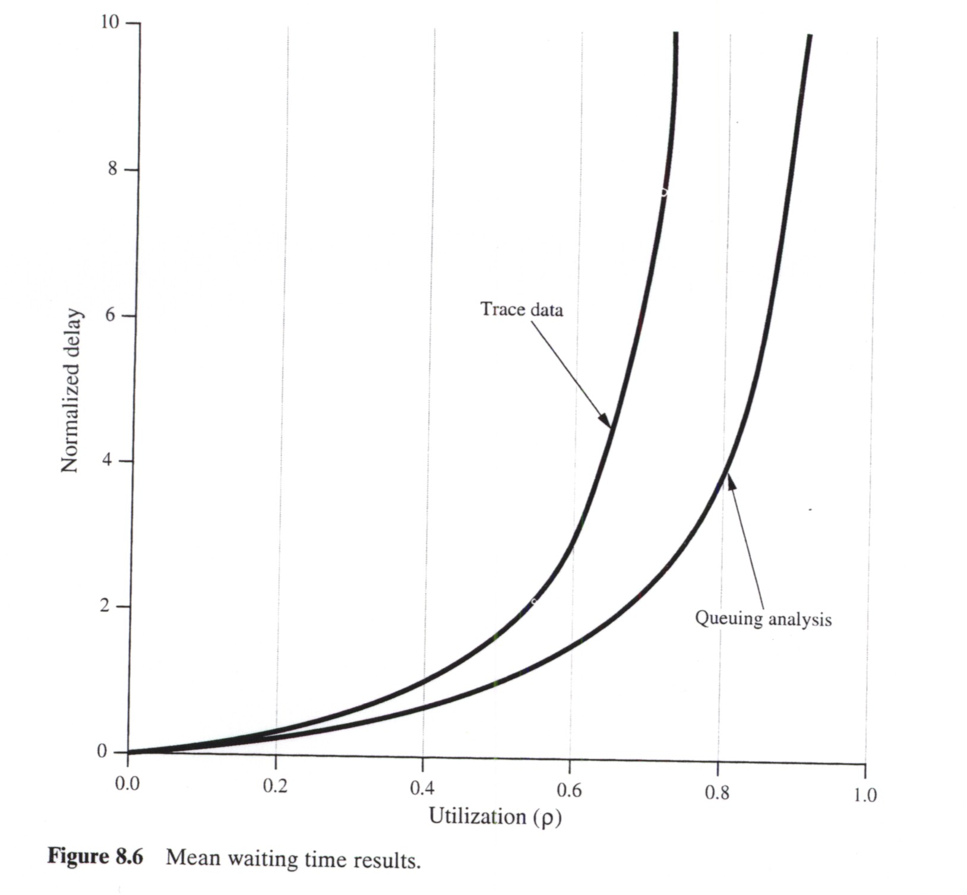
Mean Waiting Time Results
Source: W. Stallings, High Speed Networks: TCP/IP and ATM Design Principles, Prentice-Hall, 1998.
Notes:
Q : 2 components C1={v1,v3,v5,…} and C2={v2,v4,v6,…}

Slide 59
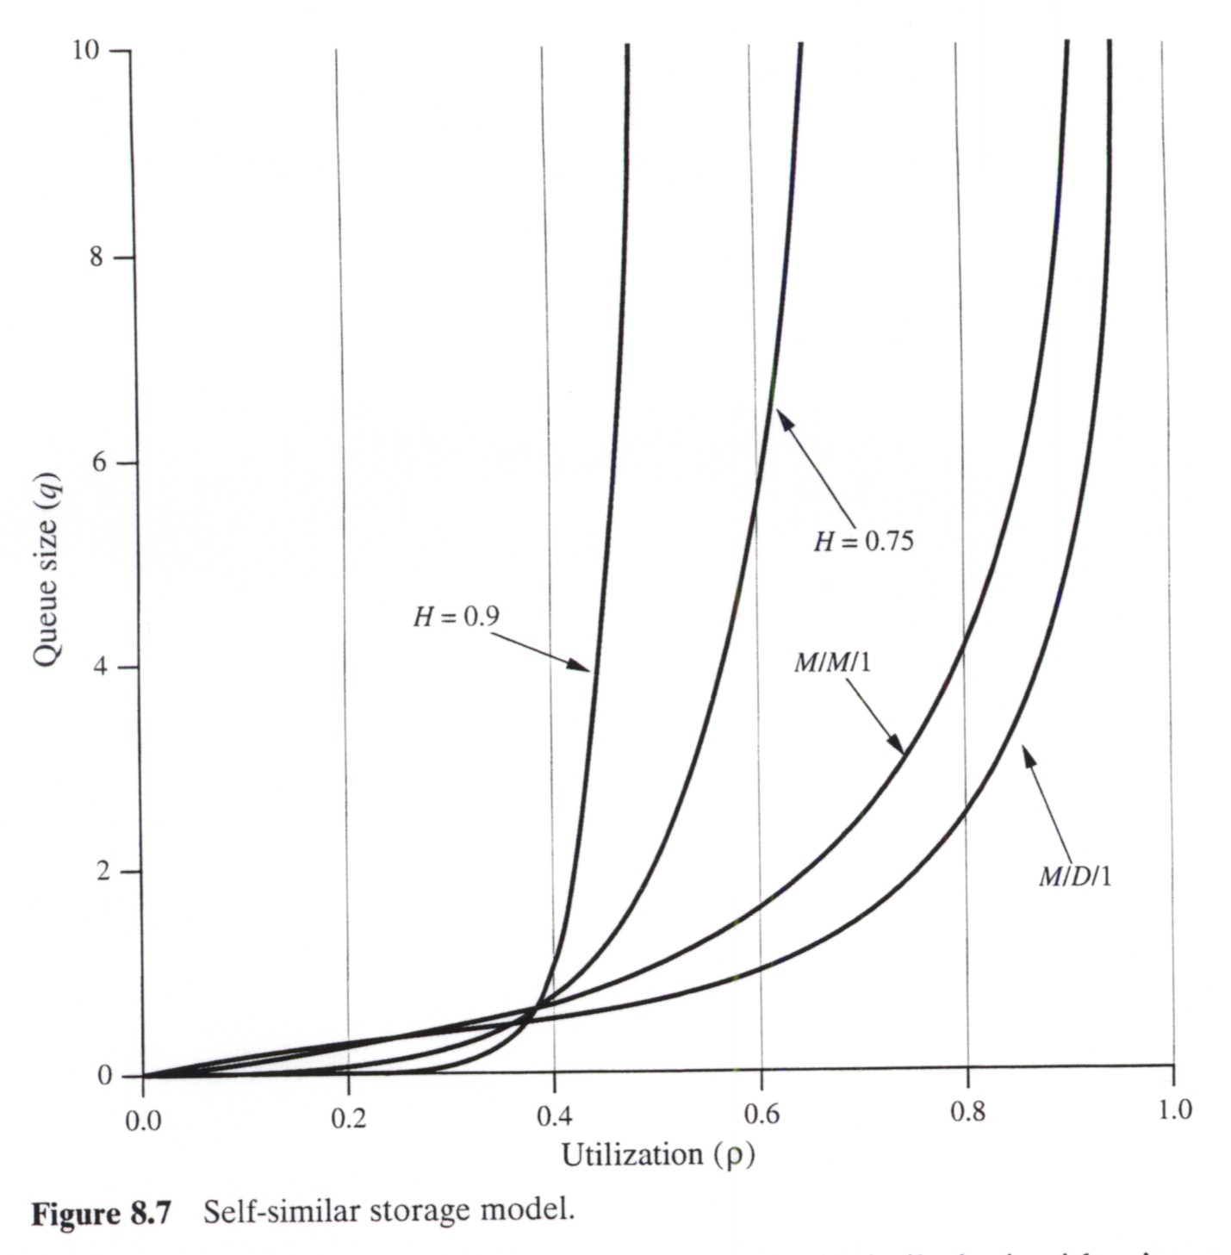
Queue Occupancy Results
Source: W. Stallings, High Speed Networks: TCP/IP and ATM Design Principles, Prentice-Hall, 1998.
Notes:
Q : 2 components C1={v1,v3,v5,…} and C2={v2,v4,v6,…}

Slide 60
Comments on Self-Similarity
Traditional queuing theory underestimates delay and blocking
These are important results that are applicable to the design of ATM, frame relay, 100BASET switches, WAN routers, etc.
Some progress in obtaining analytical results
Note the distinction between
application-level self-similarity versus network-level self-similarity
Notes:
Q : 2 components C1={v1,v3,v5,…} and C2={v2,v4,v6,…}

Slide 61

Overview of Source Models for ATM
Want Traffic Characterization Here
R_{S}(t)
R_{a}(t)
Information
Source
ATM Cell
Assembly
ATM
Source Generation Rate
ATM Access Link Rate

Slide 62
Bernoulli Sources
Independent Cell Arrivals
  Probability of a cell arrival in slot is a
  Not a bursty model
Recall discussion from discrete time queuing lecture
  Cell burst length has geometric distribution
  Silence duration (in slots) has geometric distribution
Notes:
Q : 2 components C1={v1,v3,v5,…} and C2={v2,v4,v6,…}

Slide 63
Constant Bit Rate (CBR) Sources
Rate
R_{s}
Time
Packetization
Rate
R_{a}
Time
Data is accumulated during one slot and then sent as a packet (or cell)
Application: Some voice and video coders
Notes:
Q : 2 components C1={v1,v3,v5,…} and C2={v2,v4,v6,…}

Slide 64
In-Class Exercise 2
Assumptions: R_{s} = 64 Kbps, OC-3 (155 Mbps) access link, 4-byte AAL header (per cell)
  a) Periodic Rate = _________ cells/s
  b) Cell Generation Period = Voice Packetization Delay = _________ ms
  c) Slot Rate = __________ slots/s
  d) How many voice sources can we have sharing the link? ________
Notes:
Q : 2 components C1={v1,v3,v5,…} and C2={v2,v4,v6,…}

Slide 65
In-Class Exercise 2 (Solutions)
a) Period rate
  Allowing for a 4-byte AAL header in each cell, there are 44 bytes (352 bits) per cell
  For 64-Kbps source, the periodic cell rate is (64,000 bits/s) ÷ (352 bits/cell) = 182 slots/s
b) Cell generation period
  1/(182 cells/s) = 5.5 ms
c) Slot rate
  53 bytes (424 bits) per cell (slot)
  Slot rate is (155 Mbps) ÷ (424 bits/cell) = 366,000 slots/s
d) 366,000 ÷ 182 = 2,008 sources can share

Slide 66
Variable Bit Rate (VBR) Sources
scene change
Rate
action
R_{s}(t)
dialog
Time
Rate
R_{a}
Time
Variable rate plus packetization
Application: some voice and video coders
Notes:
Q : 2 components C1={v1,v3,v5,…} and C2={v2,v4,v6,…}

Slide 67
VBR Sources
Silence times are non-zero unless R_{S}(t) exceeds R_{a}
  Buffering in ATM cell assembler
Simple approximate model
  Markov-modulated Bernoulli source
  Discrete-time Markov chain controls Bernoulli Rate
  Value of probability a adjusted to match source rate
Notes:
Q : 2 components C1={v1,v3,v5,…} and C2={v2,v4,v6,…}

Slide 68
Markov-Modulated Bernoulli Source
a₁₃
a_{ik}= transition probabilities
a₁₂
a₂₃
R_{s1}
R_{s2}
a₃₂
R_{s3}
a₂₁
a₃₁
States represent “dialog,” “scene change,” “action,” etc.
When in a given state, generate at the corresponding (constant) rate

Slide 69
On/Off Sources
Rate
silence
R_{s}(t)
talkspurt
Time
Rate
R_{a}
Time
Application: voice with speech detection
Notes:
Q : 2 components C1={v1,v3,v5,…} and C2={v2,v4,v6,…}

Slide 70
On/Off CBR
1-β
α
1-α
On
Off
β
In the ON state, cells are generated periodically
Model does not capture inter-burst correlation

Slide 71
Multiplexed Traffic Performance
Multiplexed CBR sources
  Queuing pattern also periodic
  M/D/1 analysis is pessimistic
Multiplexed On/Off CBR sources
  Many models, mostly emphasizing voice
  M/D/1 analysis is optimistic
Multiplexed “bursty” sources
  Many models in the literature
Notes:
Q : 2 components C1={v1,v3,v5,…} and C2={v2,v4,v6,…}

Slide 72
You should now be able to … (1)
Discuss continuous and discrete time models for traffic and their applicability
Analyze simple switched Poisson process (SPP) and interrupted Poisson process (IPP) models
Discuss the importance of burstiness and methods to characterize burstiness
Explain self-similarity, how it applies to data traffic models, and the consequences for network performance evaluation

Slide 73
You should now be able to … (2)
Describe popular models for ATM traffic and discuss their applicability

