Slide 1
Multiaccess Communication—
Probability and Queuing Theory
IN ACTION
CSCE 654
Computer Communication Networks
Maj Scott R. Graham
Department of Electrical and Computer Engineering
Air Force Institute of Technology
(Material from Dr. Barry Mullins & Dr. Scott Midkiff is gratefully acknowledged)

Slide 2
Multiaccess Communication Objectives
For each student to:
  comprehend the function of the medium access control (MAC) sublayer
  comprehend methods of access
    random
    time-based
    frequency-based
  comprehend slotted-access techniques
    pros/cons
    collisions and retransmissions
    delay
  comprehend carrier-sensing techniques
    pros/cons
    collisions and retransmissions

Slide 3
Multiaccess Communication
Many networks are configured such that the received signal at one node depends on the transmitted signal at two or more other nodes
  Satellite systems
  Radio networks
  Multi-tap bus systems
Such multiaccess media are communication media where the received signal is the sum of attenuated transmitted signals plus the effects of delay, distortion, and noise
Examples:
Multitap bus (Ethernet)
Radio (wireless) network

Slide 4
Medium Access Control (MAC)
With multiaccess media, a protocol is needed to coordinate the sharing of the media
The medium access control (MAC) performs this function
  MAC is a sublayer between the data link control (DLC) layer and the physical layer (usually grouped with DLC)
DLC
DLC provides “virtual bit pipe”
MAC coordinates access to shared media
Physical provides hardware interface
MAC
physical

Slide 5
Multiaccess Protocols
In queuing terms, the shared media is a single server, and each node has its own queue of packets for transmission
The server cannot treat the individual queues as a common queue since there is no single point of global knowledge – knowledge is distributed
Global Queue
Separate Queues
☒
☑

Slide 6
Strategies for Multiaccess Communication
“Free-for-all” approach
  Nodes transmit new packets as they are available, without concern for other traffic on the media
    Hope for no collisions
  Issue: How are packets retransmitted when a collision occurs?
Scheduled approach
  Nodes follow a schedule that is either fixed or “negotiated” in advance of packet transmission
  Issues:
    Scheduling order?
    Length of reservation interval?
    How do nodes know it is their turn?

Slide 7
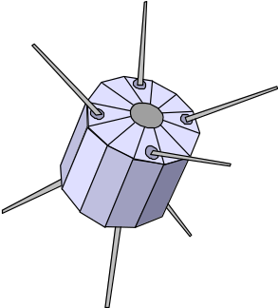
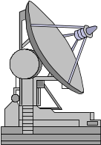
(Geosynchronous) Satellite Channels
Multiple ground stations transmit packets to a common satellite receiver
Satellite retransmits packets back to ground stations

Slide 8
Satellite Channels (continued)
A satellite channel can be used as a collection of point-to-point links
  Techniques include
    Separate antenna beams
    Frequency division multiplexing (FDM)
    Time division multiplexing (TDM)
  Suffer from poor utilization and increased delay
“On demand” use of channels (similar to statistical multiplexing)
  Can improve performance
  Earth stations not instantly aware of traffic demands at other stations, so more difficult than statistical multiplexing on a point-to-point link

Slide 9
Multitapped Bus
A
A
B
C
received
signal
B
∑
C
Each node receives all signals sent on the bus
  Unlike satellite system in that all nodes can receive any transmission (no relaying needed)
If multiple transmissions coincide, the received signal is garbled
  this is a collision
Examples
  Ethernet is a multi-tapped bus
  Ring networks may have similar properties

Slide 10
Packet Radio Networks
Each node receives transmissions of a subset of the other nodes and can transmit to a subset of the other nodes
This complicates end-to-end communication and medium access control
B
A
C
D
A transmits to B and C
A receives from B and D

Slide 11
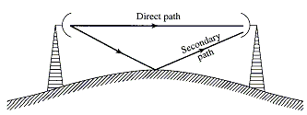
Packet Radio Networks (continued)
Physical channel properties create difficulties
  Due to time-varying noise conditions, a subset that can receive transmissions from a given node may not be the same as the subset that can transmit to that node
  Multiple transmission paths with varying propagation delays lead to multi-path distortion
  Mobile radio is particularly complex due to dynamic configuration of the network, fading, etc.

Slide 12
Multiaccess Reservations
The issue is how to coordinate use of the channel so only one node is transmitting at any time
Consider long data packets
  Each collision or idle slot wastes a substantial amount of the channel’s capacity
  Instead of wasting long slots, use short slots to reserve transmission slots for the longer packets
  Efficient use of capacity, as long as the time to make a reservation is short compared to the data packet transmission time (slot length)
Reservations can be made via
  Multiaccess contention for reservation slots
  Allocated reservation slots, e.g., with TDM or FDM

Slide 13
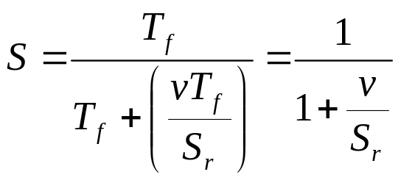
Efficiency of Reservation Schemes
Assume:
  Data packets take time T_{f} to transmit
  Reservation slots are of length vT_{f}, where v << 1
  Throughput of reservation slots is S_{r}
  Each successful reservation slot leads to a reservation for one data packet transmission
Time needed to send one packet is T_{f} + (vT_{f} /S_{r})
System throughput is

Slide 14
Efficiency of Reservation Schemes (continued)
The throughput of multiaccess reservation depends on
  S_{r} (reservation throughput)
  v (reservation slot length)
The reservation throughput (S_{r}) depends on the multiaccess scheme used for making reservations
Best case
  Slotted Aloha: 1/e
  TDM: 1

Slide 15
Satellite Reservation Systems
Multiaccess reservation system for satellite networks
  Each of the m nodes in the network has its own reservation slot using TDM (FDM also possible)
  Let the average transmission time of a data packet be 1, then reservation slots are of length v << 1
  Length of reservation period is A = mv
frame
...
1
2
3
m
...
1
2
3
...
m
...
reservation
interval
data interval

Slide 16
Satellite Reservation Systems (continued)
Reservation information must be received at all nodes before the reserved data slots can begin
  This presents a problem in satellite systems since the propagation delay is very large
  Solution is to transmit reservations one frame ahead
propagation delay > 2β
resv
data
resv
data
resv
reservation applies one frame later

Slide 17
Slotted Multiaccess
Multiaccess communication problem
  If two or more nodes transmit, reception is garbled
  If no nodes transmit, the channel is idle
  Need to have exactly one node transmitting, at least for most of the time
Slotted multiaccess model focuses on the problem of dealing with contention when two or more nodes attempt to transmit simultaneously
Slotted multiaccess is a highly idealized model
  Concepts can be extended to improve utilization
  Idealized model provides insight into more practical extensions

Slide 18
Idealized Slotted Multiaccess Model
Model multiaccess system as:
  m transmitters (senders)
  1 receiver
  Can be extended to m listeners, as in multitapped system, with consideration for propagation delay
1
2
∑
R
...
m
receiver
transmitters

Slide 19
Assumptions of Slotted Multiaccess Model
1) Slotted system
  A slot is the time to transmit one packet
  All packets are the same size (all slots are the same size)
  All m transmitters are synchronized (slots begin and end at the same time at all nodes)
Implication
  The system is a discrete-time system
  Carrier sensing and early detection of collisions are precluded
  Synchronization can be achieved
t

Slide 20
Assumptions of Slotted Multiaccess Model
2) Poisson arrivals
  Arrivals at each node are Poisson with rate λ/m
  Thus, λ is the arrival rate for the m-node system
Implication
  Poisson arrivals are reasonable for single packet messages, but not for multipacket messages (which are more “bursty” in nature)

Slide 21
Assumptions (continued)
3) Each slot with a transmission is either a collision or a perfect reception
  If two or more nodes transmit in a slot, a collision occurs with no information being transferred
  If one node transmits, the packet is correctly received
Implication
  Collision or perfect reception assumption ignores transmission errors and precludes “capture” techniques (to discern data despite multiple transmissions)

Slide 22
Assumptions (continued)
4) There is immediate feedback, so at the end of each slot each node knows the outcome:
  0 packets were transmitted,
  1 packet was transmitted, or
  2 or more packets were transmitted
    denoted as outcome “e” for error
Implication
  Immediate feedback cannot be achieved
    Especially unrealistic for satellite and other systems with long propagation delays

Slide 23
Assumptions (continued)
5) Packets that collide are retransmitted in a later slot
  Packets are retransmitted until it is successfully received
  Nodes with a packet to be retransmitted are backlogged
Implication
  Requiring retransmission is reasonable

Slide 24
Assumptions (continued)
6) Two buffering options are possible:
  No buffering: nodes have no buffering; nodes can only hold one packet that is either awaiting transmission or is colliding
    Arriving packets are discarded
  Infinite nodes (m=∞): There are an infinite number of nodes and each arriving packet always finds an “idle” sender
Implication
  Buffering
  No buffering is unrealistic
    For small λ and large μ, effect is minimal
    Normally finite buffering with flow control
  Infinite buffering gives worst-case delay since a large number of packets contend for the media

Slide 25
Aloha
ALOHA NET was developed at the University of Hawaii in the early 1970’s
  Provided communication between central computer and remote terminals
  Packets transmitted immediately – original Aloha not slotted

Slide 26
Slotted Aloha Operation
The slotted Aloha multiaccess approach is an improvement over the scheme originally used in the ALOHA NET
If no new packet arrives, then do not transmit
If there is no backlogged packet and a new packet arrives, then transmit that packet in the next slot
  If the transmission results in a collisions, backlog the packet (for retransmission)
  Otherwise, transmission is successful
When a packet is backlogged due to a collision, wait a random number of slots and then retransmit (to avoid repeated collisions among transmitters)
  If another collision occurs, again wait a random number of slots and retransmit

Slide 27
Simple Analysis of Slotted Aloha
Assume:
  Number of nodes is infinite (m = ∞)
  Arrival rate for new packets is λ
The total arrival process includes new packets plus backlogged packets
  If retransmissions are randomized, then total arrival process can be approximated as a Poisson process
  Let G be the total arrival rate (new and backlogged packets)
    the mean number of attempted transmissions per slot
    G > λ

Slide 28

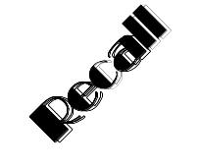
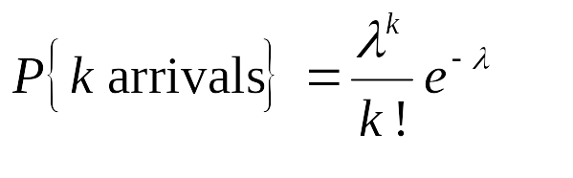
Simple Analysis of Slotted Aloha (continued)
The probability of a successful transmission in a single slot is
This is the departure rate from the system
For a Poisson process with rate λ,

Slide 29
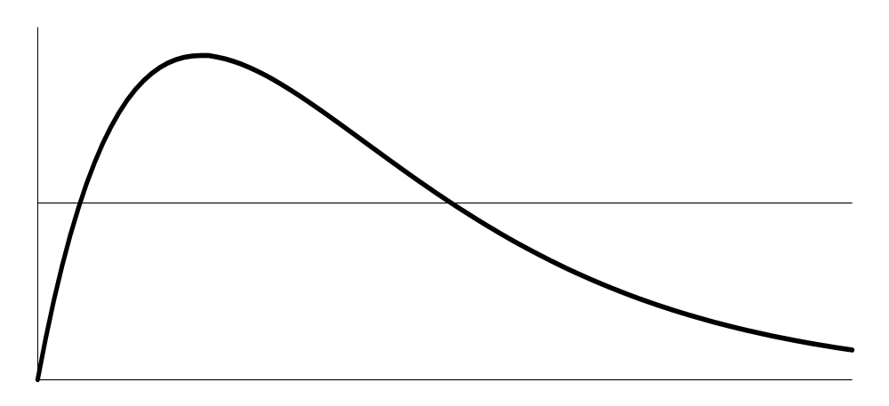
Simple Analysis of Slotted Aloha (continued)
In equilibrium, the rate of arrivals to the system must equal the rate of departures from the system
  m = ∞ ensures that no packets are discarded
Maximum departure rate: G = e⁻¹ ≈ 0.37 → at most 37% of the slots can be used successfully
e⁻¹
Departure rate = Ge^{-G}
Arrival rate = λ
λ
Throughput (S)
equilibrium
G=0
G=1
G (attempted transmission rate)
too many idle slots
too many collisions
attempting one transmission per slot

Slide 30
Simple Analysis of Slotted Aloha (continued)
This analysis ignores system dynamics
  As the number of backlogged packets changes, G changes
  As G changes, the probability of a collision changes, thus changing the number of backlogged packets

Slide 31
Detailed Analysis of Slotted Aloha
Assume
  The number of nodes, m, is finite
  Arrival rate of new packets at each node is λ/m
Need to consider the probability that a node attempts to retransmit a backlogged packet
so

Slide 32
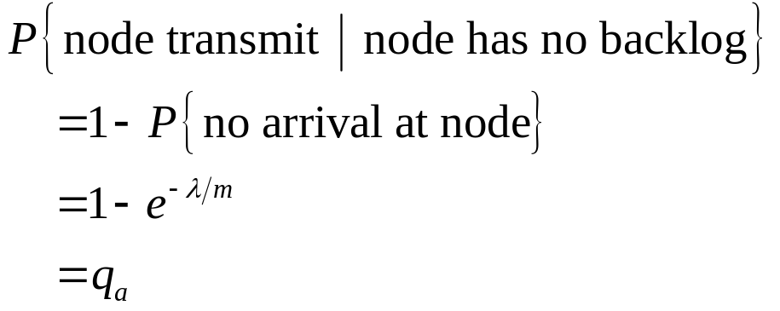
Detailed Analysis of Slotted Aloha (continued)
For a node with no backlog,
For a Poisson process with rate λ,

Slide 33
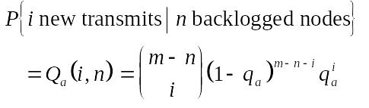
Detailed Analysis (continued)
Let Q_{a}(i,n) be the probability that i unbacklogged nodes transmit packets in a given slot
  n backlogged nodes
  m total nodes
m-n-i do not transmit
combination of m-n nodes taken i at a time
i transmit

Slide 34
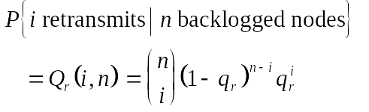
Detailed Analysis (continued)
Let Q_{r}(i,n) be the probability of i retransmission attempts
  n backlogged nodes
  m total nodes
n-i do not transmit
combination of n nodes taken i at a time
i transmit

Slide 35
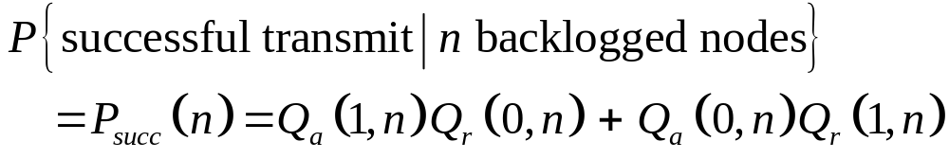
Detailed Analysis (continued)
A successful transmission occurs when
  1 new transmission and no retransmissions
  0 new transmissions and 1 retransmission
1 new transmission,
no backlog transmissions
no new transmissions, 1 backlog transmitted

Slide 36
Markov Chain Model of Slotted Aloha
The slotted Aloha system can be modeled as a discrete-time Markov chain
  State is n, the number of backlogged nodes
  System is discrete because slots are discrete
Recall that P_{i,j} is the probability of a transition from state i (i nodes with a backlog) to state j
State changes:
  Number of backlogs can decrease by at most 1 since there is at most 1 successful transmission
  Number of backlogs can increase by 1 or more since multiple new packets can arrive in one slot

Slide 37


Transition Probabilities
Number of backlogged nodes increases by one if:
  There is one new transmission, and
  There are one or more attempts to retransmit
Number of backlogs increases by i > 1 if there are more than 1 new transmissions
  Let i be such that 2 ≤ i ≤ (m-n), where m is the total number of nodes

Slide 38

Transition Probabilities (continued)
The number of backlogs decreases by 1 if
  there is no new transmission, and
  exactly one retransmission
There will be no change in the number of backlogs if
  1 new transmission and no retransmissions, or
  No new transmissions and either 0 or 2 or more retransmissions

Slide 39
State Transition Diagram
P₀₄
P₀₃
P₀₂
P₁₂
P₂₃
P₃₄
P₄₅
0
1
2
3
4
P₁₀
P₂₁
P₃₂
P₄₃
P₅₄
P₀₀
P₁₁
P₂₂
P₃₃
P₄₄

Slide 40
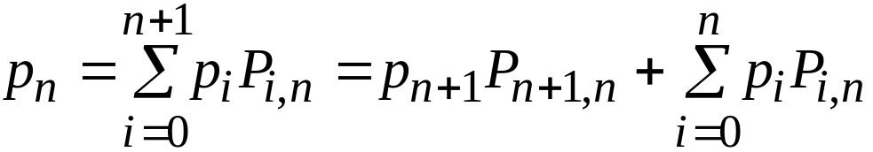
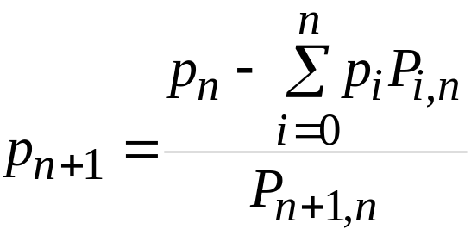
Stationary Distribution
Since state n can be reached from states 0,..., n, n+1,
p_{n+1} can be found in terms of p₀, ..., p_{n},
N (average number of backlogs) and, using Little’s Theorem, T (average delay per packet) can be found

Slide 41

Slotted Aloha Dynamics
The stationary distribution and averages N and T do not provide insight into the dynamics of the system
The attempted transmission rate, G, depends on the number of backlogged nodes, n
Trade-off:
  Want q_{r} large to avoid large delays after collisions (works well if arrival rate is small)
  If n becomes large, nq_{r} >> 1 and collisions nearly always occur and backlogged nodes remain backlogged for a long period of time

Slide 42


Slotted Aloha Dynamics (continued)
The dynamics can be quantified as the drift in state n (D_{n})
  the expected change in the backlog (from n) over one slot
  Number of new arrivals
  Less the number of successful transmissions
  where
If q_{a} and q_{r} are small,

Slide 43
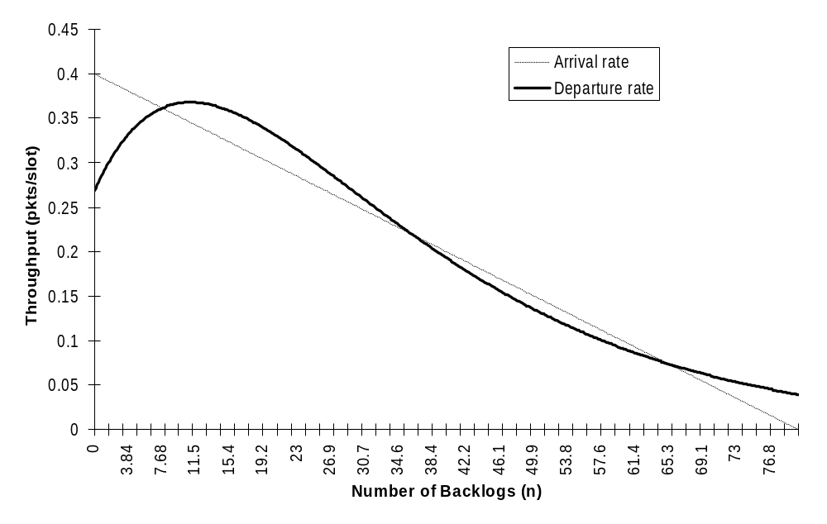
Throughput of Slotted Aloha and Dynamics
desirable stable point
mq_{a}
unstable equilibrium
undesirable
stable point
m = 80 nodes
q_{a} = 0.005 (200 slots/pkt)
q_{r} = 0.06 (17 slots/attempt)

Slide 44
System Equilibrium Points
Equilibrium achieved when arrival rate equals departure rate
  There are three such points
  Two equilibrium points are stable
    Drift moves system back to stable points
  One equilibrium point is unstable
    Drift moves system away from unstable point
One stable point is desirable (highest throughput)
Other parameter values may lead to
  Single stable point
  One stable point and an unstable equilibrium point
  No stable point

Slide 45
Drift and Stability
stable
mq_{a}
unstable
D_{n} < 0
D_{n} > 0
stable

Slide 46
Implications of Dynamic Behavior
The maximum departure rate is the maximum value of P_{succ}(n) which is G_{max} = Ge^{-G} = 1/e ≈ .37 for large m
The departure rate is very low if the system is at the “undesirable” stable point
Problems:
  Limited throughput
  Stability
  Achieving stability at a desirable point

Slide 47
Stabilized Slotted Aloha
Approaches to stabilize slotted Aloha:
  Restart the system by discarding all backlogs (making n = 0) when n becomes too large
  Maintain G(n) = 1, i.e., keep the optimal attempt rate at 1 per slot by dynamically adjusting q_{r}
    Increase q_{r} after idle slots
    Decrease q_{r} after collisions
  Along with adjusting q_{r}, also backlog new arrivals
To optimally adjust q_{r}, n must be known
  Feedback must be used to estimate n
  Also advantageous to not require knowledge of m

Slide 48
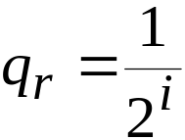
Binary Exponential Backoff
Binary exponential backoff is a strategy for adjusting q_{r} that is used in Ethernet
Assumes feedback for a given node available only when the node transmits
  The node’s transmission was successful
  The node’s transmission collided
Strategy
  New packets transmitted immediately in next slot
  After i failures, probability of retransmitting in successive slots is

Slide 49
Binary Exponential Backoff (continued)
Rationale is that successive collisions indicate larger backlog
  q_{r} is decreased
As q_{r} is decreased, there is less feedback (due to fewer transmission attempts), so the backlog estimate is increased by larger and larger (doubled) amounts with each collision
As the number of nodes, m, approaches infinity, binary exponential backoff is unstable for all non-zero arrival rates

Slide 50
Carrier Sensing
In some multiaccess systems (e.g., a multitap bus) it is possible for nodes to detect transmission after some delay
A
B
C
A
B
T_{p}: propagation delay
T_{d}: “detection” delay
T_{p}
T_{d}
transmission
detected by B

Slide 51
Carrier Sensing Example: Ethernet
Detection of transmission by the MAC layer requires appropriate signaling at the physical layer
IEEE 802.3 (Ethernet)
  10 Mbps local area network
  Multitapped bus
Ethernet uses carrier sensing (plus collision detection)
The encoding used at the physical layer ensures that a detectable carrier is present on the coaxial cable if any node is transmitting

Slide 52
Ethernet Manchester Encoding
Bit encoding (high = 0 V, low = -2.05 V)
  0: high-to-low transition
  1: low-to-high transition
Ensures a signal transition in every bit cell
bit cell
1
1
0
1
0
0
1
high (quiescent)
low
b=100 ns
Carrier present if a transition .75b to 1.25b after last transition

Slide 53
Carrier Sense Multiple Access (CSMA)
Carrier Sense Multiple Access (CSMA) is a strategy where
  Idle periods are detected quickly by nodes (by any means, not necessarily through the use of a carrier signal)
  Packet transmissions can begin after detection of idle periods
The time to detect the carrier affects the performance of CSMA
  Faster detection leads to better performance

Slide 54
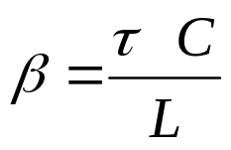
Carrier Sense Multiple Access (continued)
Let β be the detection delay – in units of average packet transmission times
  Let τ be the detection time (seconds)
  Let C be the channel capacity (bits per second)
  Let L be the expected length of a data packet (bits)
An increase in β degrades performance of CSMA
  Due to an
    Increase in τ,
    Increase in C, or
    Decrease in L

Slide 55
Slotted Multiaccess Model with CSMA
The slotted multiaccess model can be modified to use carrier sensing
  An idle slot is terminated after β time units, i.e., after all nodes detect that the slot is idle
  Eliminate assumption of all packets being the same length (normalize so that expected packet length is 1 time unit)
  Feedback is not instantaneous
    0, 1, or e (error) feedback, as before
    Feedback delay is β time units
  Assume infinite nodes with overall arrival rate λ

Slide 56
Slotted Multiaccess with CSMA (continued)
Idle slots are terminated after β time units:
Multiaccess schemes can be modified to incorporate CSMA
  CSMA slotted Aloha
  CSMA unslotted Aloha
busy
idle
β

Slide 57
CSMA Slotted Aloha
Differences from standard slotted Aloha
  Idle slots with CSMA have length β
  When a new packet arrives:
    If medium is idle, attempt to transmit in next slot
    If medium is busy (carrier detected), backlog the packet
Variations
  Non-persistent CSMA: as described above
  Persistent CSMA (1-persistent CSMA): new packets that find medium busy are transmitted in the following slot
  P-persistent CSMA: collided packets and new packets waiting for idle use different transmit probabilities

Slide 58
Analysis of CSMA Slotted Aloha
Markov chain model
  State is n, number of backlogged nodes
  Transitions occur at the end of idle slots
    transmissions only after an idle slot
Assume all packets have length 1
Times between state transitions:
  If idle slot, then time between transitions is β
  If busy slot followed by an idle, time is β+1
β+1
β
β+1

Slide 59

CSMA Slotted Aloha Drift
Modify drift D_{n} from that for standard slotted Aloha
  Recall that the drift is the expected change in state for a given n
  For standard slotted Aloha:
(m finite)
New arrivals to the system at idle nodes
Departures (successful transmission)
(m infinite)

Slide 60

CSMA Slotted Aloha Drift (continued)
In state n, the probability of the next slot being idle
  Length of previous idle slot is β
  Arrival rate to system is Poisson with rate λ
  Probability that a backlogged node transmits is q_{r}
Probability of no arrivals during the idle slot of length β
Probability that n backlogged nodes do not transmit
For a Poisson process with rate λ,

Slide 61
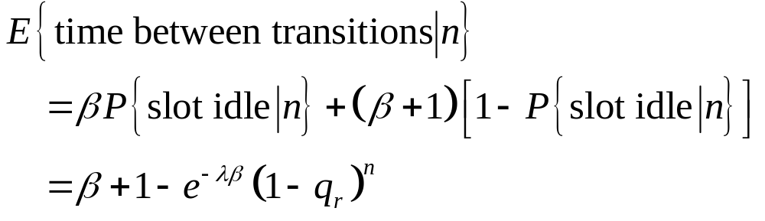
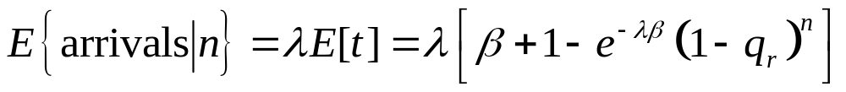
CSMA Slotted Aloha Drift (continued)
Expected time between state transitions (given in state n)
Expected number of arrivals between transitions
  Expect λt in time t, so

Slide 62
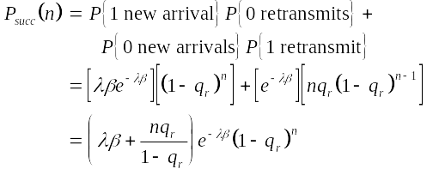
CSMA Slotted Aloha Drift (continued)
Probability of a successful transmission
  1 new arrival during the idle slot of length β and 0 transmissions by backlogged nodes, or
  0 new arrivals during the idle slot and exactly 1 retransmission attempt
For a Poisson process with rate λ,

Slide 63
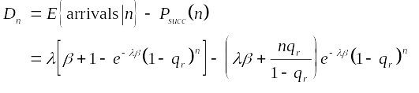
CSMA Slotted Aloha Drift (continued)
The drift, which is the number of arrivals minus the number of departures between state transitions,

Slide 64

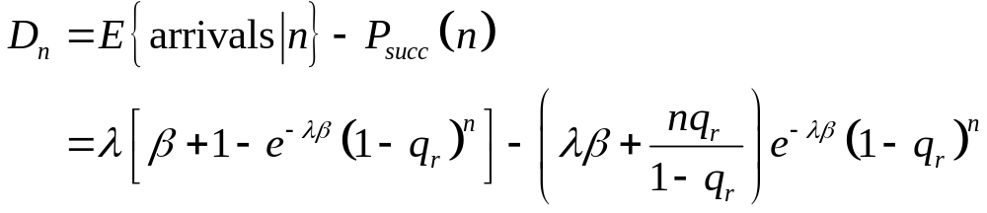
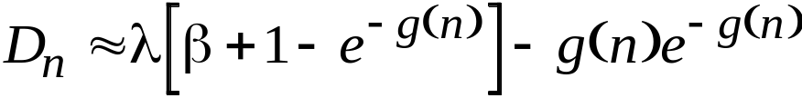

CSMA Slotted Aloha Drift (continued)
Let g(n) be the attempted transmission rate in state n
From previous slide, we know
Assume that q_{r} is small, then the drift is approximated by
new arrivals
retransmits
Expected departures per transition period
Expected length of transition period
For q_{r} << 1:

Slide 65
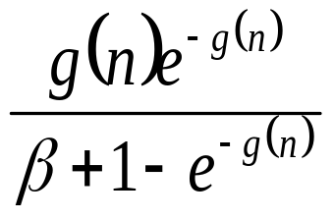
CSMA Slotted Aloha Departure Rate
The expected number of departures per unit of time is the departure rate or throughput:

Slide 66
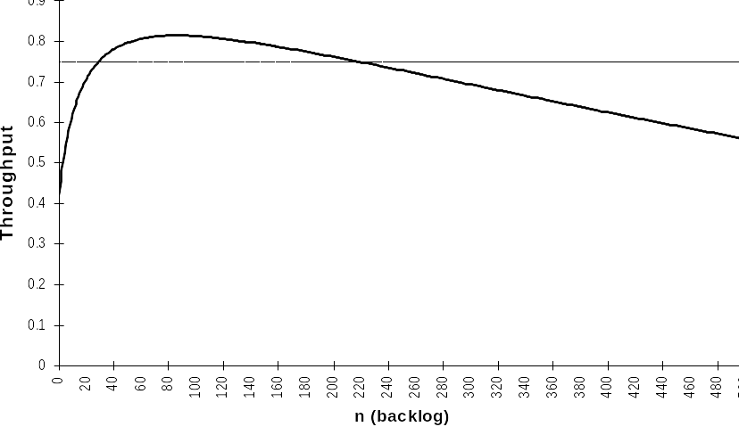
Stability of CSMA Slotted Aloha
D_{n} < 0
D_{n} > 0
arrival rate, λ
stable
equilibrium
unstable
equilibrium
departure
rate
Like slotted ALOHA, CSMA slotted Aloha has stability problems

Slide 67
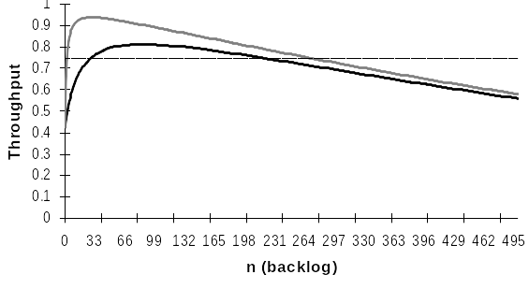
Effect of β on CSMA Slotted Aloha
β=0.002
λ
β=0.02
Performance improves as β decreases
  Faster carrier detection
  Shorter idle slots

Slide 68
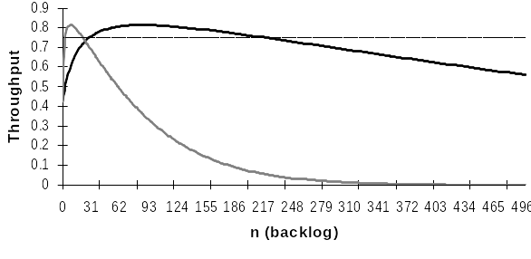
Effect of q_{r} on CSMA Slotted Aloha
q_{r}=0.002
λ
q_{r}=0.02
Increasing q_{r} decreases stability
Departure rate quickly goes to 0
q_{r} can be smaller than for standard slotted Aloha

Slide 69
Carrier Sense Multiple Access/Collision Detect
For local area networks, propagation delay is very small
  Long propagation delays ⇒ make reservations well in advance
  Short propagation delays ⇒ make reservations for the immediate future
Short propagation delays can simplify reservation scheme
Carrier sense multiple access with collision detection (CSMA/CD) is a multiaccess reservation scheme for networks with relatively small propagation delays
  Used in IEEE 802.3 (Ethernet)

Slide 70
CSMA/CD (continued)
Nodes can listen to the medium (even if transmitting)
  Detect data 0, 1 (can receive data)
  Detect idle (can sense carrier)
  Detect collision (when two or more nodes transmit)
First part of transmission serves as a reservation
  If no collision, then medium is reserved for the remainder of the frame transmission time
  If collision, the reservation fails and another attempt must be made at a later time

Slide 71
CSMA/CD (continued)
Let β be the maximum propagation delay (between end nodes), including detection time
  Any collision is detected within time β
  Reservation period is at most β in length
Node A transmit
t
A
B
Node B transmit
t
≤ β
Node A receive
t
collision

Slide 72
Slotted CSMA/CD
For analysis, we view CSMA/CD in terms of “minislots” of duration β
  Signals propagate from one end of the cable to the other and are detected in time β
  Minislots are synchronized at all nodes
Successful transmission in first minislot reserves all subsequent minislots needed to transmit the frame
  If only one node transmits in a minislot, all other nodes can detect this within time β and will not attempt to transmit in subsequent minislots
  If two or more nodes transmit in the same minislot, a collision is detected and the transmitting nodes stop transmission and will wait to retransmit

Slide 73
Slotted CSMA/CD (continued)
I
C
I
S
R
R
R
I
S
R
R
I
C
I
I
S
R
β
I: Idle
C: Collision
S: Success
R: Reserved
packet
transmission
If a packet arrives during an idle slot, it will attempt to transmit during the next slot
If a packet arrives during a busy slot (carrier sensed), it will backlog
Backlogged packets will attempt transmission with probability q_{r} after an idle slot

Slide 74
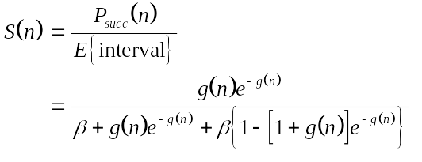
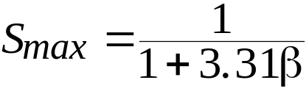
Slotted CSMA/CD Throughput
Departure rate (throughput) in state n:
The departure rate is maximized at n = 0.77, where
  As with CSMA, want β small

Slide 75
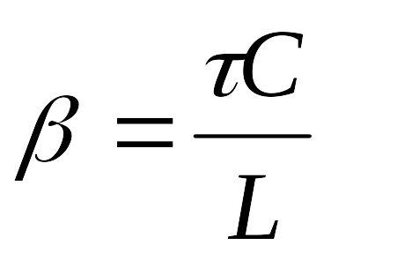
CSMA/CD Performance Depends on β
Increasing bus length degrades the performance of CSMA/CD
  Propagation delay τ increases with bus length, this increases the normalized value of β
  Ethernet standard imposes a maximum length
Increasing the data rate increases the normalized value of β
Decreasing the packet length increases the normalized value of β

Slide 76
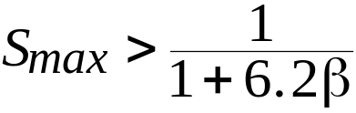
Unslotted CSMA/CD
Unslotted CSMA/CD is used in Ethernet
  Eliminates the need to synchronize minislots
  Can take advantage of shorter than maximum propagation delays to detect collisions
Analysis of unslotted CSMA/CD is difficult
Conservative lower bound on maximum throughput for unslotted CSMA/CD
Performs better than slotted CSMA/CD in practice

Slide 77
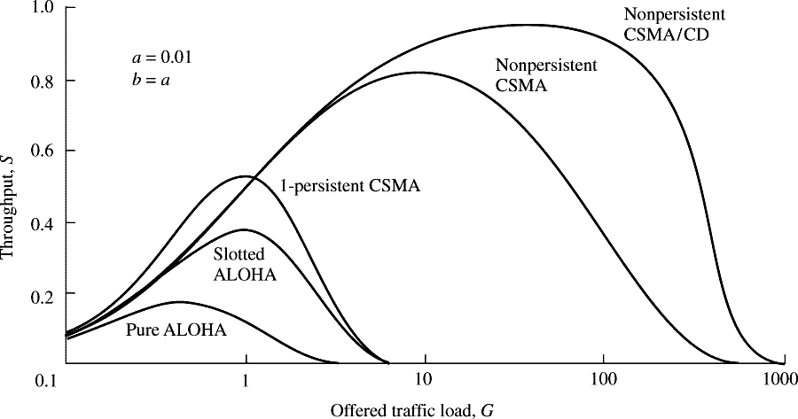
Performance Comparisons
a = β = propagation delay / packet transmission time
b = jamming signal duration

Slide 78
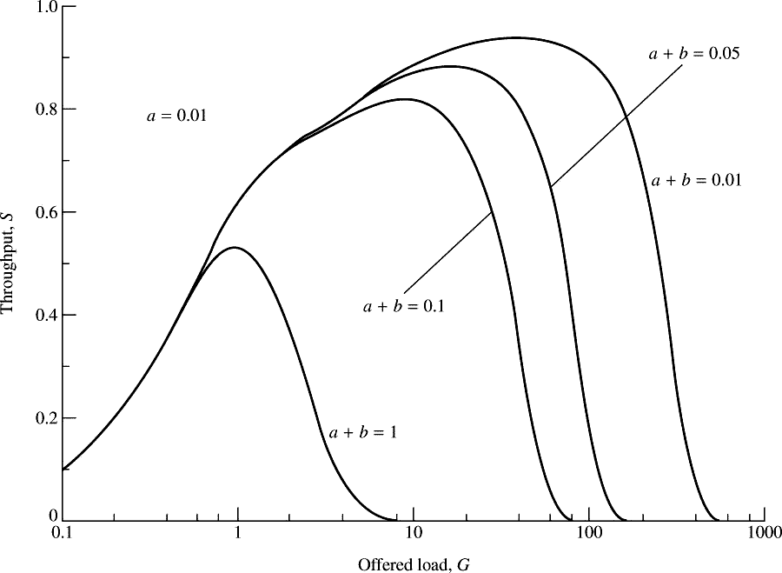
1-persistent CSMA/CD Performance
a = β = propagation delay / packet transmission time
b = jamming signal duration

