Slide 1
Networks of Queues
CSCE 654
Computer Communication Networks
Dr. Scott Graham
Department of Electrical and Computer Engineering
Air Force Institute of Technology
(Material from Maj Tom Dube, Maj Ryan Thomas, Maj Scott R. Graham, Dr. Barry Mullins & Dr. Scott Midkiff is gratefully acknowledged)

Slide 2
Outline
Motivation and analytical difficulties
Open versus closed networks of queue
Product form solutions
Jackson’s Theorem
Kleinrock Independence Approximation
Burke’s Theorem
Closed networks of queues

Slide 3
Reading
T. G. Robertazzi, Computer Networks and Systems, 3rd edition, Sections 3.1-3.2.

Slide 4
Networks of Queues
Single queues might represent a single transmission line, channel, connection, session, etc.
Data networks consist of many transmission lines or channels
We need to model networks as a network of interacting queues, not as a single queue

Slide 5
Networks of Queues: Simple Example (1)
Simple network with two transmission lines (1 and 2) and three nodes (a, b, and c)
Arrivals can occur at nodes a and b
Departures can occur at nodes b and c
λ_{a}
λ_{b}
1
2
a
b
c

Slide 6
Networks of Queues: Simple Example (2)
Queuing model
Each link is a queue in the network
Need to know routing probabilities
λ_{a}
λ_{b}
λ₁
λ₂
a
μ₁
b
μ₂
c
How many packets from node a depart the system at node b?

Slide 7
Networks of Queues: Another Example
Arriving traffic at each queue (transmission line) may include:
Internal traffic that has departed from one or more other queues
External traffic that is entering the network
4
a
b
1
2
3
c
d
5

Slide 8
Analytical Difficulties: Part 1 (1)
Consider two tandem transmission lines (queues) with equal capacity (service rates)
Arrivals to the system are Poisson
Packets are of equal length, i.e. fixed service times
With these assumptions, the first queue is an M/D/1 queue
P-K formula gives average packet delay
μ
μ
λ
M/D/1

Slide 9
Analytical Difficulties: Part 1 (2)
What about the second queue?
Interarrival times, τ_{n}, are not Poisson
μ
μ
λ
M/D/1
M/D/1
For Poisson arrivals:

Slide 10
Analytical Difficulties: Part 1 (3)
Consider the second queue
Interarrival time, τ_{n}, the time between arrivals of packets n and n+1
Service time for packet n, s_{n}
Remember that τ_{n} is only equal to s_{n} under a heavy load (ρ→1)
Note that s_{n} ≤ τ_{n}, so packet n+1 never queues
N < 1 N_{Q} = 0 T = 1/μ W = 0
Second queue is clearly not M/D/1
n
τ_{n}
n+1
s_{n}

Slide 11
Analytical Difficulties: Part 2 (1)
Consider what should be a “cleaner” version of the tandem queues -- Poisson arrivals and exponential packet lengths (service times)
First queue is M/M/1
Second queue is not M/M/1 since interarrival times at the second queue are correlated with packet service times
μ
μ
λ
M/M/1

Slide 12
Analytical Difficulties: Part 2 (2)
At the second queue
Interarrival time between packet n and n+1 is greater than or equal to the transmission time for packet n+1, i.e., τ_{n} ≥ s_{n+1}.
A long packet that arrives at the second queue is more likely to find fewer customers in queue
n
n+1
s_{n}
s_{n+1}
Queue 1
Arrivals to queue 1
Queue 2
Arrivals to queue 2
n-1
n
n+1
τ_{n}

Slide 13
Product Form Solutions
Let the state of an M-queue network be defined by a vector
(n₁, n₂,…, n_{M})
n_{i} is the number of “customers” in queue or in service at queue i.
Product form solutions
Joint state probabilities expressed as the product of probabilities associated with the individual queues
P(n₁, n₂,…, n_{M}) = P(n₁) P(n₂) … P(n_{M})
Queues act as though they are independent
At a specific point in time, the number of customers in one queue is independent of the number of customers in another queue
Not independent at two different close times

Slide 14
Open vs Closed Networks
Open networks of queues,
Customers arrive and depart from the network
For example, packets in a network
Closed networks of queues
A fixed number of customers circulate within the network
For example, processing jobs in a computing system

Slide 15
Closed Networks of Queues
Fixed number of jobs circulate between queues
Job returns to CPU with probability p
Job require I/O with probability 1-p
We’ll discuss closed networks later
p
μ₁
μ₂
1-p
CPU
I/O

Slide 16
Notation for Open Networks of Queues
λ: total mean arrival rate to the network
μ_{i}: mean service rate of i-th server
r_{sj}: probability that a customer arriving from the source will be routed to queue j
r_{jd}: probability that a customer departing from queue j will be routed to the destination (and depart the system)
r_{jk}: probability that a customer departing from queue j will be routed to queue k

Slide 17
Open Networks of Queues
Customers enter and leave the system, but take a path through zero or more queues
Our initial focus
r₁₁
μ₁
r_{s1}
r_{1d}
Q₁
r₁₂
r₂₁
λ
μ₂
λ
r_{s2}
r_{2d}
Q₂
r₂₂
r₂₃
source
r₃₂
destination
μ₃
r_{s3}
r_{3d}
Q₃
r₃₃

Slide 18
Example: Tandem Queues
μ₁
μ₂
μ₃
λ
S
D
Q1
Q2
Q3
r_{s1} = 1
r₁₂ = 1
r₂₃ = 1
r_{3d} = 1

Slide 19
Example: Multi-Stage Network
Stage 1
Stage 2
Stage 3
λ
S
D
r_{jk} > 0 only between adjacent stages

Slide 20
Example: General Topology
λ
S
D

Slide 21
Average Throughput
Let θ_{i} be the average throughput through queue i
Mean rate of entering (leaving) a particular queuing system
Traffic equations …

Slide 22
In-Class Exercise 1
Find the average throughput, θ₁ and θ₂, for each queue in the following network of queues (as a function of λ).
1/4
λ
Q1
Q2
1/2

Slide 23
In-Class Exercise 1: Solution
Find the average throughput, θ₁ and θ₂, for each queue in the following network of queues (as a function of λ).
Solving yields …

Slide 24
State Description of the System
The state of a system with M queues can be defined as an M-element vector, where n_{i} is the number of customers in the i-th queuing system (in queue and in service)
Our goal is to find the pmf of n

Slide 25
Global Balance Equations (1)
Global balance equations …
Rate of arrival from any queue must equal rate of departure to any queue
Let π(n) be the probability of being in state n
What is the rate of leaving state n?
Arrival to any queue
from outside
Departure from any
queue

Slide 26
Notation: The i-th Unit Vector
i-th position

Slide 27
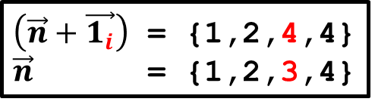
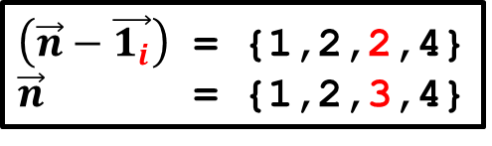
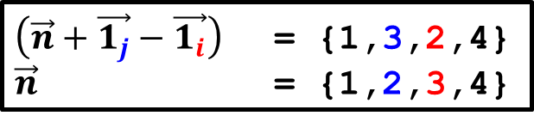
Global Balance Equations (2)
What is the rate of entering state n?
External arrival
External departure
Movement from j to i

Slide 28
Global Balance Equations (3)
Rate in must equal rate out …
=

Slide 29
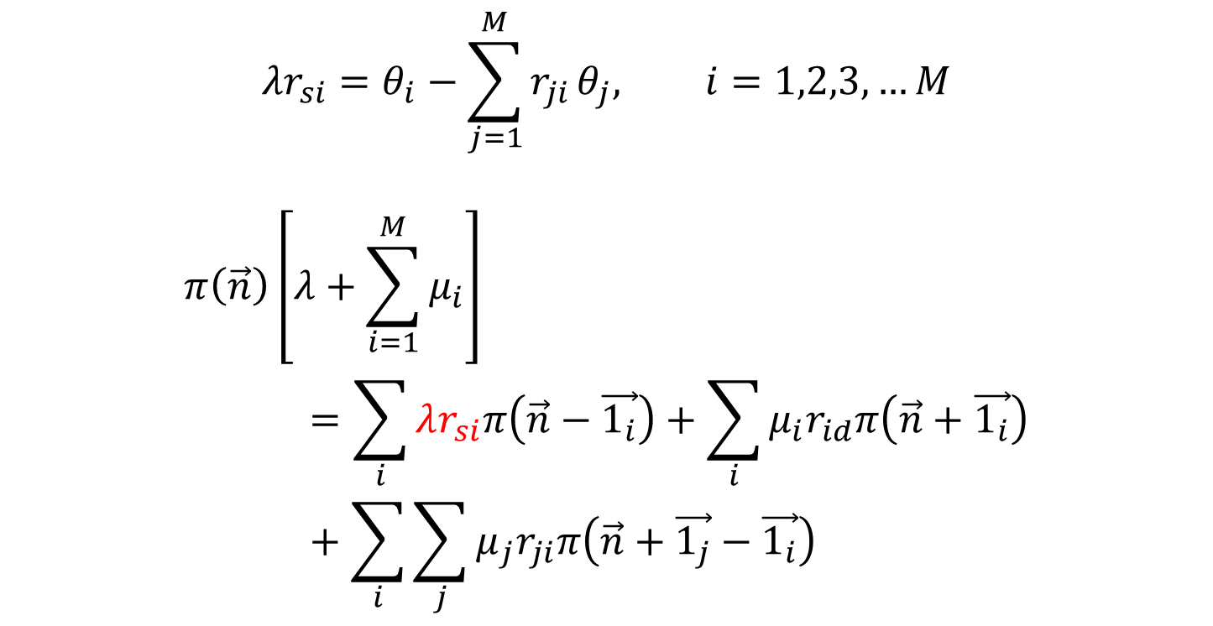
Solving for Product Form Solution (1)
Substituting traffic equations into global balance equation…

Slide 30
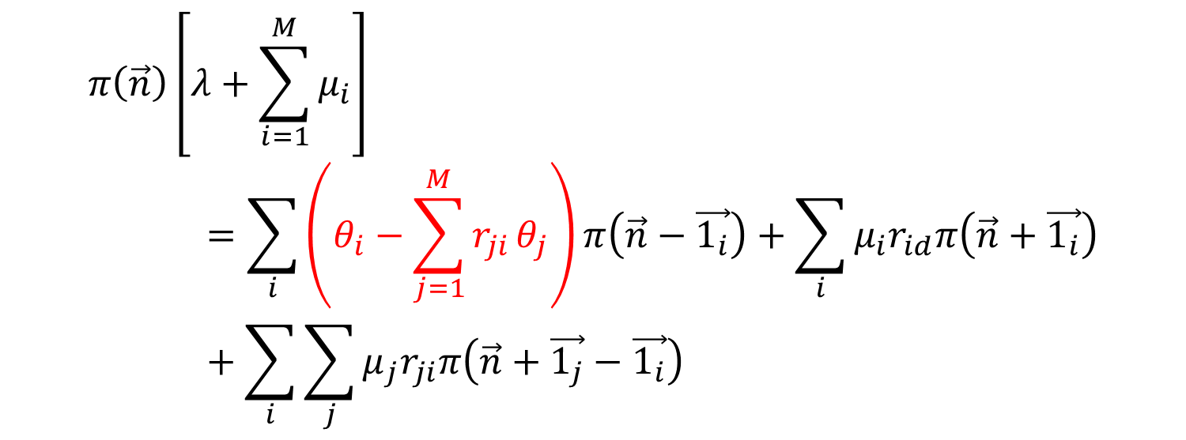
Solving for Product Form Solution (2)

Slide 31
Local Balance Equations
Local balance equations are generalizations of the balance equations from the M/M/1 queue
Local balance equations, plus global balance equations and traffic equations, provide product form solution

Slide 32
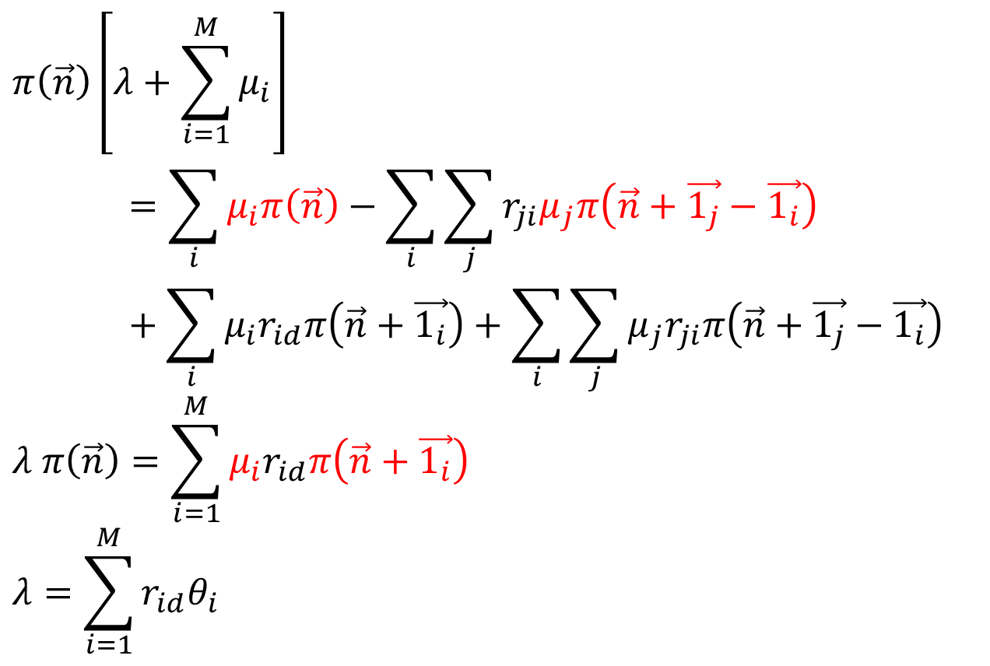
Solving for Product Form Solution (3)
Traffic flow into network related to flow out of network (in equilibrium).

Slide 33
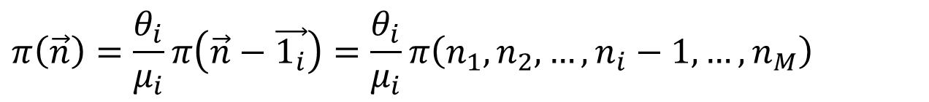
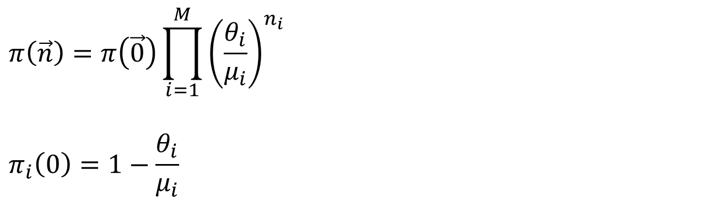
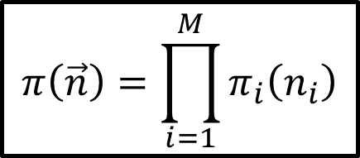
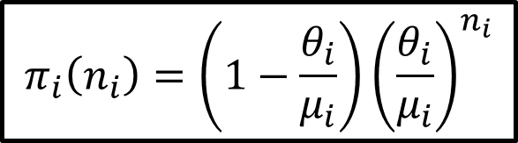
Solving for Product Form Solution (4)
Taken further…
Recursing until i^{th} element is zeroed out yields this equation.
Probability that i^{th} queue is empty.

Slide 34
Product Form Solution
Look familiar?
Joint pmf
Network behaves as if all queues were statistically independent!

Slide 35
In-Class Exercise 2
In the network of queues from the previous exercise, assume Poisson arrivals at an average rate of 1,000 packets/s and average service times at each queue of 0.2 ms.
What is the probability of no packets being in the system?
1/4
λ
Q1
Q2
1/2

Slide 36
In-Class Exercise 2: Solution
What is the probability of no packets being in the system?

Slide 37
Marginal pmf
Due to the product form, the marginal pmf of n_{i} customers in the i-th queuing system is …
Borrowing from analysis of M/M/1 queue …

Slide 38
Customers and Delay in the Network
Results for the full network …
Fraction of packets at queue i
Delay at queue i

Slide 39
In-Class Exercise 3
For the network in the two previous exercises, what is …
(a) the average number of packets in the network?
(b) the average delay through the network?
1/4
λ
Q1
Q2
1/2

Slide 40
In-Class Exercise 3: Solutions
What is …
(a) the average number of packets in the network?
(b) the average delay through the network?

Slide 41
Jackson’s Theorem: Overview
Jackson’s Theorem was the first to show the product form solution for networks of queues
Jackson’s Theorem indicates that the average number of customers in the system can be derived by treating each queue as an M/M/1 queue
Correlation between transmission times and interarrival times eliminated
Randomization divides traffic among different routes

Slide 42
Jackson’s Theorem: Assumptions (1)
Poisson arrivals to the system and exponential service times
Note that arrivals to individual queues will, in general, not be Poisson
Independence of interarrival times and packet lengths
λ₃
λ₂
λ₄
λ₁
Network
λ₅
λ_{m}
...
λ₆
λ₇

Slide 43
Jackson’s Theorem: Assumptions (2)
Stream splitting is randomized using probabilities r_{ij} which apply to all packets departing from queue i
Different streams may not have different routing probabilities
Jackson’s Theorem may be extended to account for different classes of customers

Slide 44
Jackson’s Theorem (1)
The state of the system is a vector,
Jackson’s Theorem: Assuming ρ_{j} < 1, j = 1,..., M, then for all n₁, n₂,..., n_{M},
where and

Slide 45
Jackson’s Theorem (2)
Jackson’s Theorem states:
The number of customers in each queue in the system is distributed as if each queue is M/M/1
The number of customers in each queue is independent of the number in other queues
The total arrival process at each queue need not be Poisson!

Slide 46
Approximate Models
Product forms do not apply to many networks of interest, so approximations and/or simulation are often necessary
Independence between arrival rate and service times is lost at the second of two tandem queues
μ
μ
λ

Slide 47
Approximate Models
The Kleinrock independence approximation (KIA) provides an approach to analyze delay in networks carrying multiple packet streams
Based on the assumption that merging packet streams from several sources “restores” the independence of interarrival times and packet lengths
Allows networks to be analyzed as multiple queues, e.g., as multiple M/M/1 or M/G/1 queues
λ
μ
...
+

Slide 48
Approximate Models
Good approximation for systems with …
Poisson stream arrivals at the entry points
Packet lengths that are approximately exponentially distributed
High degree of network connectivity
Moderate-to-heavy traffic
System can be analyzed assuming that each transmission line is treated as an M/M/1 queue
Similar results can be derived for non-exponential packet lengths using the P-K formula for the M/G/1 queue model

Slide 49
KIA: Network Model (1)
Consider a set of packet streams
Packets from each stream enter the network at a source node, follow a fixed and unique path, and depart from the network at their destination
Let x_{S} be the arrival rate (in packets/second) for stream S
Each link in the network carries packets from all streams whose path includes that link
Arrival rate for link (i,j) connecting nodes i and j

Slide 50
KIA: Network Model (2)
x₁
λ₁₂=x₁+x₂+x₃
1
2
x₂
λ₄₁=x₃
λ₂₃=x₂+x₃
x₃
x₄
4
λ₃₄=x₄
3

Slide 51
KIA: Network Model (3)
This model is appropriate for virtual circuit networks
Each stream represents a separate virtual circuit
Packets follow a fixed path through the network

Slide 52
KIA: Network Model (4)
Can be adapted to model datagram networks
Packets from the same stream may take different paths through the network
Let f_{ij}(s) be the fraction of stream s packets that go over link (i,j)
Link arrival rate is

Slide 53
Analysis Using KIA (1)
Recall that for link (i, j),
Let 1/μ_{ij} be the average packet transmission time for link (i, j)
Using the M/M/1 model, the average number of packets in queue or in service at link (i, j), N_{ij} is

Slide 54
Analysis Using KIA (2)
The average number of customers in the system is obtained by summing the number at each link …

Slide 55
Analysis Using KIA (3)
Let γ be the total arrival rate for the system, where x_{S} is the packet arrival rate for stream S
x₁
x₂
x₃
x₄
x₅

Slide 56
Analysis Using KIA (4)
Using Little’s Law, the average delay per packet in the system is

Slide 57
Analysis Using KIA (5)
This can be rewritten as where T_{ij} is the delay at link (i, j), and α_{ij} is the fraction of the system traffic going over link (i, j)

Slide 58
Analysis Using KIA (6)
The average delay per packet can be adjusted to account for processing and propagation delay d_{ij} at link (i, j)
The average processing and propagation delay due to link (i, j) is
The modified delay is

Slide 59
Analysis Using KIA (7)
The average delay per packet of a stream following path p:
W_{ij} is the waiting time at link (i, j)
ρ_{ij} is the utilization of link (i, j), ρ_{ij} = λ_{ij} /μ_{ij}

Slide 60
KIA Application: Delay (1)
Consider a 4-node network with 8 links
There are 4 connections, each with a pair links in the forward and reverse directions
There are 10 packet streams with Poisson arrivals
Packet lengths are exponentially distributed

Slide 61
KIA Application: Delay (2)
F
B
1
2
R
R
F
R
A
3
D
R
F
4
F
C

Slide 62
KIA Application: Delay (3)

Slide 63
KIA Application: Delay (4)

Slide 64
KIA Application: Delay (5)
The greatest contributor to delay is the delay on link 2 because of the relatively high arrival rate
Approaches to reducing delay …
Routing: Reduce the arrival rate at link 2 by more evenly distributing traffic (cannot be done here)
Capacity Assignment: Decrease transmission times on heavily used links
Topology: Change the network topology to allow alternate paths that routing can use to distribute traffic
Consider reassigning capacity

Slide 65
KIA Application: Delay (6)
Increase Link 2 (2F and 2R) capacity by 50% from 10 to 15 units

Slide 66
KIA Application: Delay (7)
With Link 2 capacity 1.5 times greater

Slide 67
Burke’s Theorem (1)
Because of the property of time reversibility, “forward” and “reversed” systems are statistically indistinguishable
Burke’s Theorem: Consider an M/M/1, M/M/m, or M/M/∞ queue in steady state with arrival rate λ
a) The departure process is Poisson with rate λ
b) At each time t, the number of customers in the system is independent of the sequence of departure times prior to t

Slide 68
Burke’s Theorem (2)
Forward Chain Arrivals, A(t) Departures, D(t)
Reverse Chain Departures, D*(t) Arrivals, A*(t)

Slide 69
Burke’s Theorem: Comments (1)
Part b of Burke’s Theorem is, perhaps, not intuitive
If we have just observed a burst of departures, we might expect that there are presently a large number of customers in the system
However, the number of customers in the system is independent of the burst of prior departures
Note that Burke’s Theorem does not address the number of customers in the system prior to the burst of departures

Slide 70
Burke’s Theorem: Comments (2)
Burke’s Theorem holds for general acyclic networks of queues with Poisson arrivals and independent, exponentially distributed service times

Slide 71
Acyclic Networks (1)
Queue j is a downstream neighbor of queue i if there is a positive probability that a departure from queue i will next enter queue j
Queue k is downstream of queue i if there is a sequence of queues from i to k where each of the queues in the sequence is a downstream neighbor of its predecessor
A network is acyclic if there are no two queues i and k s.t. i is downstream of k and k is downstream of i

Slide 72
Acyclic Networks (2)
A counter-example — a cyclic network …
k is downstream of I
i is downstream of k
i
j
k

Slide 73
Burke’s Theorem: Application (1)
Consider two tandem transmission lines modeled as M/M/1 queues
Assume that a given packet’s transmission times on the first and second links are independent (as though packets are “resized” at each link)
Arrival rate is λ
Service rates are μ₁ and μ₂ at the first and second queues, respectively
μ₁
μ₂
λ

Slide 74
Burke’s Theorem: Application (2)
Utilizations: ρ₁ = λ/μ₁ < 1, ρ₂ = λ/μ₂ < 1
The first queue is clearly M/M/1, so
Arrivals to the second queue are Poisson with rate λ (due to Burke’s Theorem) and service times are independent from arrivals (by assumption), so the second queue is also M/M/1

Slide 75
Burke’s Theorem: Application (3)
From Part b of Burke’s Theorem:
The number of customers presently in queue 1 is independent of prior departures from queue 1 (and thus prior arrivals to queue 2)
The number of customers presently in queue 1 is independent of the number of customers presently in queue 2
Given this independence,

Slide 76
Routing in a Network of Queues (1)
Three factors that affect network performance …
Routing
Capacity assignment
Topology
In the KIA analysis example, we examined capacity assignment
Capacity assignment and topology design will be covered more later in the class
Let’s take a (simple) look at routing using a network of queues

Slide 77
Routing in a Network of Queues (2)
Static routing
Routes are fixed, i.e., selection is predetermined
Virtual circuit routing — based on source and destination of virtual circuit
Datagram routing — based on destination of datagram
Routing probabilities are fixed
Dynamic routing
Goal is to adjust routing to respond to changes in load
Take advantage of short-term variability
Cope with long-term non-stationary traffic
Routing probabilities are state-dependent

Slide 78
Static Routing (1)
Consider the very simple “network”
Packets arrive with rate λ
Service rates are μ₁ and μ₂ on links 1 and 2, respectively
Packets is routed on link 1 (with probability p) or on link 2 (with probability 1-p) … what value of p is best?
λ₁
μ₁
p
λ
S
D
1-p
μ₂
λ₂

Slide 79
Static Routing (2)
Want to minimize delay …
λ₁
μ₁
p
λ
S
D
1-p
μ₂
λ₂

Slide 80
Static Routing (2)
Would like to choose p = p* such that T is minimized
In general, delay T is a complex function of the routing probabilities and numerical methods are needed to find the optimal set
T
0
p*
1

Slide 81
In-Class Exercise 4
Suppose you observe two queues, 1 and 2, and estimate that E[n₁] < E[n₂], i.e., that queue 1 is shorter. Should you chose to submit a job (route a packet) to queue 1 or to queue 2?
Trick question …
Little’s Law tells us that E[T] = E[n]/λ.
Knowing just E[n] does not provide enough information to determine delay. The shorter line is faster only if the arrival rate (or departure rate) is sufficiently high.

Slide 82
Closed Networks of Queues
p
μ₁
μ₂
1-p
CPU
I/O

Slide 83
Model of a Closed Network of Queues
Closed networks of queues can be used to model different types of systems
In reality, system is open
Number of customers in the system at any time is a fixed value N

Slide 84
Applications
Finite population models (M/M/s/s/K)
Each of K users can have at most 1 call active at a time
Maximum number of calls is K
Systems under heavy loads
Multi-stage packet switches with a finite number of packets allowed in, and a new packet is always ready to enter when one leaves
Window-based flow control
Maximum number of packets in transit at any time

Slide 85
Traffic Equations
Traffic equations for a closed network …
Like traffic equation for open networks, except no term for sources (λr_{si})
Unlike open networks, these do not have a unique solution

Slide 86
Global Balance Equations
Net flow out of state n
=
Net flow out to state n
(customers change from queue j to i)

Slide 87
Closed Network Product Form Solution
G(M,N) is a normalization constant

Slide 88
Closed Network Example (1)
Computer system allows two active jobs at any given time
Each job requires CPU and I/O processing
p
μ₁
μ₂
1-p
CPU
I/O

Slide 89
Closed Network Example (2)
When a job leaves the CPU, there are two possibilities …
The job finishes and is instantly replaced by another job (with probability p)
The job requires I/O, then more CPU (with probability 1–p)
p
μ₁
μ₂
1-p
CPU
I/O

Slide 90
In-Class Exercise 5
Let the system state (n₁, n₂) indicate that there are n₁ jobs in the CPU and n₂ jobs in I/O.
Enumerate the possible states.
List the traffic equations (two equations).
p
μ₁
μ₂
1-p
CPU
I/O

Slide 91
In-Class Exercise 5: Solution
Let the system state (n₁, n₂) indicate that there are n₁ jobs in the CPU and n₂ jobs in I/O.
Enumerate the possible states.
List the traffic equations (two equations).
Three states: (2,0), (1,1), (0,2)

Slide 92
Closed Network Example (3)
Product form solution for the example …

Slide 93
Closed Network Example (4)
Normalization factor …
State (2,0)
State (0,2)
State (1,1)

Slide 94
Comments on Normalization Factor
This method for finding the normalization constant is impractical for a large system
Algorithms for numerical computation can be used to determine G(M,N)
For example, the convolution algorithm for closed networks

Slide 95
Closed Network Example (5)
Steady-state probability for state (2,0) …

Slide 96
In-Class Exercise 6
Determine the steady-state probabilities for states (0,2) and (1,1) — as a function of service rates and routing probabilities.
Equations, but in terms of θ’s and G(2,2) …

Slide 97
In-Class Exercise 6 (Solutions 1)
Recall that …
Normalization constant …

Slide 98
In-Class Exercise 6 (Solutions 2)
Steady-state probability for state (0, 2) …

Slide 99
In-Class Exercise 6 (Solutions 3)
Steady-state probability for state (1, 1) …

Slide 100
Utilization
Utilization ρ_{i} is the proportion of time that server i is busy
Let θ_{i}’ be the actual arrival rate to queue i
The utilization of queue i is …
Other methods are available
For the example, queue i is busy if it is occupied by n_{i} > 0 jobs …

Slide 101
In-Class Exercise 7
Use the same example network. Let …
μ₁ = 4 jobs/s
μ₂ = 1 job/s
p = 1/3
(a) Calculate the state probabilities.
(b) Calculate the utilization at each queue.
(c) Calculate the average number of customers in each queuing system.
(d) Calculate the average delay through each queuing system.

Slide 102
In-Class Exercise 7: Solution (a-1)
(a) Calculate the state probabilities.

Slide 103
In-Class Exercise 7: Solution (a-2)
(a) Continued …

Slide 104
In-Class Exercise 7: Solution (a-3)
(a) Continued …
Or …
π([1,1]) = 1 - π([2,0]) - π([0,2]) = 1 - .66 - .093 = .247

Slide 105
In-Class Exercise 7: Solution (b)
(b) Calculate the utilization at each queue.

Slide 106
In-Class Exercise 7: Solution (c)
(c) Calculate the average number of customers in each queuing system.

Slide 107
In-Class Exercise 7: Solution (d)
(d) Calculate the average delay through each queuing system.

Slide 108
You should now be able to … (1)
Explain why networks of queues are more difficult to analyze than single queues
Define closed and open networks of queues
Use product form solutions and Jackson’s Theorem to analyze an open network of queues in terms of delay, number of customers, and utilization
Apply the Kleinrock independence approximation to analyze a network of queues

Slide 109
You should now be able to … (2)
Calculate state probabilities, average number in system and average delay for closed networks of queues

