Slide 1
Network Design:
Access Networks
CSCE 654
Computer Communication Networks
Maj Scott R. Graham
Department of Electrical and Computer Engineering
Air Force Institute of Technology
(Material from Dr. Barry Mullins & Dr. Scott Midkiff is gratefully acknowledged)

Slide 2
Outline
Introduction to access network design
One-speed, one-center design
Multi-speed access designs
Multi-center local access designs
Improving local access designs

Slide 3
Reference
Robert S. Cahn, Wide Area Network Design: Concepts and Tools for Optimization, Morgan Kaufmann, 1998, Chapters 5, 6, and 7.

Slide 4
Introduction
Access networks: The “ends” or “tails” of networks that connect the smallest sites to the network
  Access networks must be attached to a backbone network to function
Local access often represents most of the total network cost
  For example, local loop in the public switched telephone network (PSTN), insurance companies, Automatic Teller Machines

Slide 5
Traffic Matrix
A traffic matrix specifies traffic between all source-destination pairs
Specifies network requirements and is independent of the network design
Entry T_{s,d} specifies the traffic from source s to destination d
  Source and destinations may be networks, LAN, or host
  Based on peak busy-hour or similar measure
Destinations
T_{s,d}
Sources

Slide 6
Cost Matrix
A cost matrix specifies the cost of a link of some particular capacity between two nodes i and j
  Part of the design environment
Can be viewed as a 2- or 3-dimensional array
  Assume fixed capacity, then C_{i,j} is the cost of a link of that capacity between nodes i and j
  Assume variable capacity, then C_{W,i,j} is the cost of a link of capacity w between nodes i and j
Specified in some measure of cost, e.g., dollars ($)

Slide 7
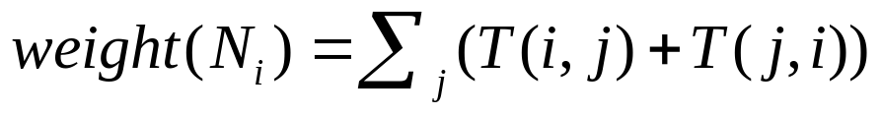
Weight of a Site
Definition: Given a set of nodes N_{i} and a traffic matrix T( i, j ), the weight of node N_{i}
is …
  The weight of a site is the sum of all traffic in and out of the site
  This traffic demand must be matched to access capacity, e.g., weight must be no more than 50% of the capacity (maximum utilization is 50%)

Slide 8
Notes on Weights and Design
The sites’ weights can indicate if any sites are natural traffic centers or if the network is “flat”
It is acceptable for “small” nodes to route their traffic via “big” nodes, but is not desirable for traffic between “big” nodes to be routed through “small” ones
Divide design problem into 2 parts
  Access design (our focus here)
  Backbone design (coming attraction)

Slide 9
A Quick Example (1)
Want to connect { N₁, N₂, N₃, N₄ } to N₀ given
  Weight (traffic) at each node
  Capacity of a link between any pair of nodes
    Fixed
    Variable
  Cost of a link between any pair of nodes for given capacity
Need to …
  Meet capacity requirements
  Minimize cost (sum of link costs)
  Minimize delay (especially number of hops)
  Maximize reliability
  Possibly meet other conflicting requirements

Slide 10
A Quick Example (2)
N₀
w₄ = 5
N₀
w₄ = 5
w₁ = 100
w₁ = 100
N₄
N₄
N₁
N₁
N₃
N₃
N₂
N₂
w₃ = 50
w₃ = 50
w₂ = 10
w₂ = 10
Low Delay,
High Cost
Low Cost,
High Delay

Slide 11
A Quick Example (3)
N₀
w₄ = 5
w₁ = 100
N₄
N₁
N₃
N₂
w₃ = 50
w₂ = 10
Optimal?
Need more algorithmic approach …

Slide 12
One-Speed, One-Center Design
Problem: We wish to connect a large number of sites to a hub, with all links having the same capacity
  A “hub” can be any centralized hub, router, or switch
HUB
HUB
OR
?

Slide 13
Possible Solutions (1)
Shortest path tree (using Dijkstra’s Algorithm)
  Low link utilization (extra links)
  Expensive (wasted capacity)
Minimal spanning tree (using Kruskal’s Algorithm)
  More cost-effective than fewer long links
  May have high delays due to long path lengths
Compromise (using Prim-Dijkstra Algorithm)
  Better results
  Higher complexity of calculation

Slide 14
Possible Solutions (2)
Exhaustive Search
  Cayley’s Theorem: Given n nodes, there exist n^{n-2} distinct spanning trees
  Infeasible for real-world problems
Other methods?

Slide 15
CMST Problem (1)
Capacitated Minimum Spanning Tree (CMST) problem
  Given
    A central node (N₀),
    A set of other nodes (N₁, …, N_{n}),
    A set of weights (w₁, …, w_{n}) for each node,
    The capacity of a link (W), and
    A cost matrix C_{ij}
  Find
    A set of trees T₁, …, T_{k}
  Such that … (continued)

Slide 16
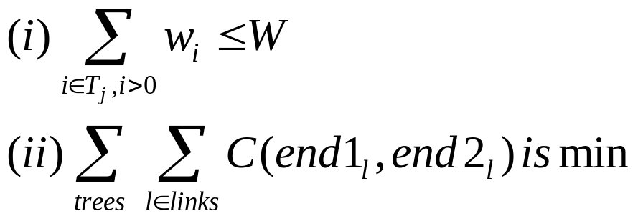
CMST Problem (2)
  Such that …
    Each node N_{i} (i ≠ 0) belongs to exactly one T_{j} , each T_{j} contains N₀, and
    The following relationships hold

Slide 17
CMST Problem Formulation (1)
N₀
w₄ = 5
w₁ = 100
N₄
N₁
T₁
N₃
N₂
w₃ = 50
T₂
w₂ = 10
Constraints:
w₁ = 100 < W = Capacity of (N₀, N₁)
w₂ + w₃ + w₄ = 65 < W = Capacity of (N₀, N₃)

Slide 18
CMST Problem Formulation (2)
N₀
w₄ = 5
w₁ = 100
N₄
N₁
N₃
N₂
w₃ = 50
w₂ = 10
Objective:
Minimize cost for the links,
Cost = C(N₀,N₁) + C(N₀,N₃) + C(N₂,N₃) + C(N₃,N₄)

Slide 19
Esau-Williams Algorithm
Each node starts off in a tree with 1 node
Compute the tradeoff function for each
node …
  Tradeoff( N_{k} ) = min_{j} Cost( N_{k}, N_{j} )
  – Cost( Comp(N_{k}), Center )
If the tradeoff is negative, a merge is attractive
  The more negative, the more attractive
Merge is allowed if …
  Weight( Comp( N_{k} ) ) + Weight( Comp( N_{j} ) ) ≤ W

Slide 20
Comments on Esau-Williams Algorithm
Tradeoff for merging components A and B computes the potential savings of going to a neighbor instead of going to the center node
Algorithm terminates when all tradeoffs are positive or the list of possible merges is exhausted
Heuristic algorithm — it does not guarantee an optimal solution
Guarantees that the trees meet the capacity constraint

Slide 21
Esau-Williams Example (1)
Assume …
  A topology (next slide), with 0 as the central node
  Weight of each individual node is 1, except for nodes 4 and 5, which have a weight of 2
  Cost function C( i, j ) is given by the physical distance between nodes i and j (using “Manhattan” rules)
  Capacity of a link is W = 3
Goals …
  Design a capacitated access tree using the Esau-Williams algorithm
  Determine the total cost for the design

Slide 22
Esau-Williams Example (2)
Topology
Tradeoff function for node 1
  Tradeoff( N₁ ) = 0 (connection to 0 is same cost as connection to 2 or 4)
  Connect 1 directly to node 0
0
1
2
1
Hub
3
4
5
W_{i} = 1
1
W_{i} = 2
6
7
8
1
1

Slide 23
Esau-Williams Example (3)
Trade-off function for node 2
  Tradeoff( N₂ ) = -1 (connection to 0 has cost 2, connection to 1 or 5 has cost 1)
  Weight( 2 ) + Weight( Comp( 1 ) ) = 1 + 1 ≤ W = 3 ☑
  Connect 2 to node 1 (or 5)
0
1
2
1
3
4
5
1
6
7
8
1
1

Slide 24
Esau-Williams Example (4)
Trade-off function for node 3
  Tradeoff( N₃ ) = 0 (connection to 0 has same cost as connection to 4 or 6)
  Connect 3 directly to node 0
0
1
2
1
3
4
5
1
6
7
8
1
1

Slide 25
Esau-Williams Example (5)
Trade-off function for node 4
  Tradeoff( N₄ ) = -1 (connection to 0 has cost 2, connection to 1, 3, 5, or 7 has cost 1)
  Weight( 4 ) + Weight( Comp( 1 ) ) = 2 + 2 > W = 3 ☒
  Weight( 4 ) + Weight( Comp( 3 ) ) = 2 + 1 ≤ W = 3 ☑
0
1
2
1
3
4
5
1
6
7
8
1
1

Slide 26
Esau-Williams Example (6)
Trade-off function for node 5
  Tradeoff( N₅ ) = -2 (connection to 0 has cost 3, connection to 2, 4, or 8 has cost 1)
  Weight( 5 ) + Weight( Comp( 8 ) ) = 2 + 1 ≤ W = 3 ☑
0
1
2
1
3
4
5
1
6
7
8
1
1

Slide 27
Esau-Williams Example (7)
Trade-off function for node 6
  Tradeoff( N₆ ) = -1 (connection to 0 has cost 2, connection to 3 or 7 has cost 1)
  Weight( 6 ) + Weight( Comp( 7 ) ) = 1 + 1 ≤ W = 3 ☑
0
1
2
1
3
4
5
1
6
7
8
1
1

Slide 28
Esau-Williams Example (8)
Trade-off function for node 7
  Tradeoff( N₇ ) = -1 (connection to 0 has cost 2 via 6, connection to 4 or 8 has cost 1)
  Neither is feasible
  Connect component of 7 directly to 0 (via 6)
0
1
2
1
3
4
5
1
6
7
8
1
1

Slide 29
Esau-Williams Example (9)
Trade-off function for node 8
  Tradeoff( N₈ ) = -2 (connection to 0 has cost 3 via 5, connection to 7 has cost 1)
  Connection to 7 is not feasible
  Connect component of 8 directly to 0 (via 5)
0
1
2
1
3
4
5
1
6
7
8
1
1

Slide 30
Esau-Williams Example (10)
Total cost is 11
  6 links of cost 1
  1 link of cost 2
  1 link of cost 3
0
1
2
1
3
4
5
1
6
7
8
1
1

Slide 31
Esau-Williams Example (11)
The previous solution is not optimal
A better (optimal) solution with cost 10 …
0
1
2
1
3
4
5
1
6
7
8
1
1

Slide 32
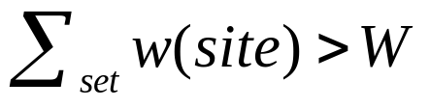
Sharma’s Algorithm
Compute angles θ_{s} from each site S to central site C
Sort the angles θ_{s}
Beginning at site S₁, create a set of nodes by moving clockwise from it
  A set is complete when adding the next node would cause …
  Next set starts with that node
Build an MST on each set with the addition of the central node C

Slide 33
Comments on Sharma’s Algorithm
Theorem: If the angles are distinct and the cost function is a piecewise linear metric, Sharma’s algorithm builds CMSTs without crossings provided that all the central angles are less than π.
Sharma versus Esau-Williams
  Esau-Williams produces a better design in most cases

Slide 34
Sharma’s Algorithm Example (1)
Apply Sharma’s Algorithm to the example topology
  Node 0 is the central site
  All nodes have weight 1 except 4 and 5 that have weight 2
0
1
2
1
3
4
5
1
6
7
8
Increasing θ
1
1

Slide 35
Sharma’s Algorithm Example (2)
Solution, but not optimal …
0
1
2
1
3
4
5
1
6
7
8
1
1
Cost is 11

Slide 36
Multi-speed Access Designs
What happens if we allow multiple link types, i.e., different capacities
We replace the “capacitated MST problem” with a “multi-speed MST problem”
Intuitively, the tree should have “thin” (small-capacity) links at the ends and become “fatter” (higher capacity) towards the center of the network

Slide 37
Predecessor Function
Definition: A tree T rooted at node Root can be represented uniquely by a predecessor function pred: V → V on the set of vertices
Predecessor function …
  pred( Root ) = Root
  pred( N ) ≠ N for N ≠ Root
For any node N, ∃ n > 0 such that
pred^{n}( N ) = Root
A tree is defined by the set of vertices V and edges (V, pred( V ))

Slide 38
Ancestors
Definition: Given a tree T and the associated predecessor function, the ancestors of node N are all the nodes N’ such that pred^{n}( N’ ) = N for some n > 0
0
Ancestors( 1 ) = { 4 }
Ancestors( 2 ) = { 5, 6 }
Ancestors( 6 ) = { }
1
2
3
4
5
6
A misnomer?

Slide 39
Notation
Set of nodes: N₀, N₁, …, N_{n}
Set of weights: w₁, w₂, …, w_{n}
Set of link types: L₁, L₂, …, L_{m}
Capacities: W₁, W₂, …, W_{m}
Cost matrix C( i, j,k ) representing the cost of link of type L_{k} between nodes N_{i} and N_{j}

Slide 40
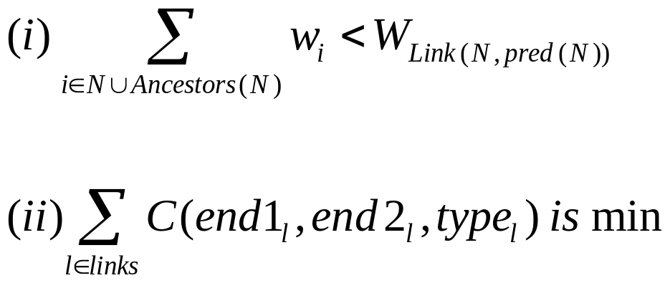
Multi-speed CMST
Definition: The multi-speed CMST problem is to find the tree rooted at node N₀ and the link assignments such that …

Slide 41
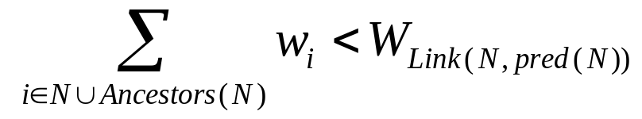
Multi-speed CMST: Constraint
w₄ + w₅ + w₆ < W_{(1,4)}
⇒ Capacity of “upstream” link
can accommodate demand of
“downstream” nodes
N₀ = 0
0
1
2
Link( N, pred(N) )
3
4
N = 4
5
6
Ancestors(4) = {5, 6}

Slide 42
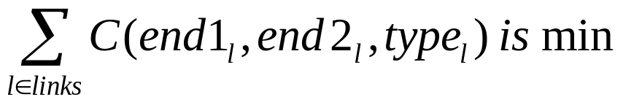
Multi-speed CMST: Objective
0
a
b
1
2
c
d
Minimize:
cost(a) + cost(b) + … + cost(c)
3
4
e
f
5
6

Slide 43
Cahn’s MSLA Algorithm (1)
Assign each node the smallest link l possible to connect it to the center
For each node n, compute
spare_capacity( n ) = W_{l} – w_{n} and set
pred( n ) = 0
Calculate tradeoffs — savings from linking site n to k rather than to the center
  Tradeoff_{n}(k) = C( n, k, l ) +
  Upgrade( k, w_{n} ) – C( n, 0, l )
  Tradeoff( n ) = min_{k}( Tradeoff_{n}( k ) )
MSLA ≡ Multi-Speed Local Access

Slide 44
Cahn’s MSLA Algorithm (2)
Tradeoffs (continued)
  Upgrade( ) calculates the cost of adding some amount of units to the links that connect k and 0 by following back the predecessors
  Need to add max( 0, w_{n} - spare_capacity(k) )
Add the edges as long as tradeoffs are less than or equal to 0
Build a tree and assign each edge to its link type

Slide 45
Cahn’s MSLA Algorithm: Example (1)
Design a connected topology that connects nodes 1, …, 4 to center 0
Weights and link types …
Node
Weight
Link
Type
Capacity
(50% utilization)
1
20,000
2
2,400
0
4.8 Kbps
3
9,600
1
28 Kbps
4
4,800
2
64 Kbps

Slide 46
Cahn’s MSLA Algorithm: Example (2)
Link costs …
0
1
2
3
4
0
1
2
3
4
0
1
2
3
4
0
-
5
7
5
7
0
-
10
15
10
15
0
-
20
25
20
25
1
5
-
7
6
6
1
10
-
10
12
12
1
20
-
20
22
22
2
7
7
-
5
6
2
15
10
-
12
10
2
25
20
-
22
20
3
5
6
5
-
5
3
10
12
12
-
10
3
20
22
22
-
20
4
7
6
6
5
-
4
15
12
10
10
-
4
25
22
20
20
-
l = 0
(4.8 Kbps)
l = 1
(28 Kbps)
l = 2
(64 Kbps)

Slide 47
Cahn’s MSLA Algorithm: Example (3)
Initial state …
4
w₄ = 4,800
l = 0 (4.8K)
Excess = 0
3
w₃ = 9,600
l = 1 (28K)
Excess = 18.4K
2
w₂ = 2,400
0
l = 0 (4.8K)
Excess = 2.4K
1
w₁ = 20,000
l = 1 (28K)
Excess = 8K
Cost = 10 + 7 + 10 + 7 = 34

Slide 48
Cahn’s MSLA Algorithm: Example (4)
Consider connecting 4 through 3 …
4
w₄ = 4,800
l = 0 (4.8K)
Excess = 0
3
w₃ = 9,600 (14,400)
l = 1 (28K)
Excess = 13.6K
☺
2
w₂ = 2,400
0
l = 0 (4.8K)
Excess = 2.4K
1
w₁ = 20,000
l = 1 (28K)
Excess = 8K
Cost = 10 + 7 + 10 + 5 = 32

Slide 49
Cahn’s MSLA Algorithm: Example (5)
And connecting 4 through 2 …
4
w₄ = 4,800
l = 0 (4.8K)
Excess = 0
3
w₃ = 9,600
l = 1 (28K)
Excess = 18.4K
2
w₂ = 2,400 (7,200)
0
l = 1 (28K)
Excess = 20.8K
1
w₁ = 20,000
☹
l = 1 (28K)
Excess = 8K
Cost = 10 + 15 + 10 + 6 = 41

Slide 50
Cahn’s MSLA Algorithm: Example (6)
Tradeoff₄(3) = C( 4,3,0 ) + Upgrade( 3,0 ) – C( 4,0,0 )
= 4 + 0 - 7 = -3 ⇒ Good! ☺
  No need to upgrade link (3,0)
Tradeoff₄(2) = C( 4,2,0 ) + Upgrade( 2,0 ) – C( 4,0,0 )
= 6 + 8 - 7 = +7 ⇒ Not good! ☹
  Need to upgrade link (2,0) from type 0 (4.8K) to type 1 (28K)
  Upgrade(2,0) = C(2,0,1) - C(2,0,0) = 15 - 7 = 8
Tradeoff₄(1) = -1 ⇒ Good, but not as good as connecting through node 3

Slide 51
Cahn’s MSLA Algorithm: Example (7)
Final result (?) …
4
w₄ = 4,800
l = 0 (4.8K)
3
w₃ = 9,600 (16,800)
l = 1 (28K)
l = 0 (4.8K)
2
w₂ = 2,400
0
1
w₁ = 20,000 (36,800)
l = 1 (28K)
Cost = 10 + 5 + 10 + 5 = 30

Slide 52
Multicenter Local Access Designs
What happens if there are multiple centers?
  Must build a forest instead of a tree
Definition: A forest F = ( V, E ) is a simple graph without cycles
  A forest need not be connected

Slide 53
Notation
Set of backbone sites B = { B₀, B₁, …, B_{m} }
Set of access nodes N = { N₁, N₂, …, N_{n} }
Set of weights (traffic demand) w₁, w₂, …, w_{n} for access nodes
Capacity of a link W (single speed)
Cost matrix C( i, j ) represents the cost between each backbone-access pair

Slide 54
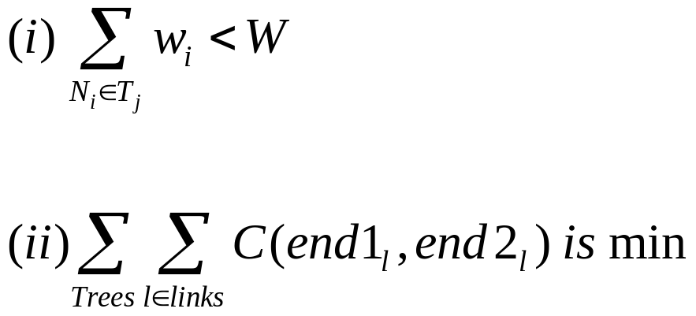
Multicenter Local Access Problem
Definition: The multicenter local access problem is to find a set of trees T₁, …, T_{k} such that exactly one backbone site belongs to a tree and

Slide 55
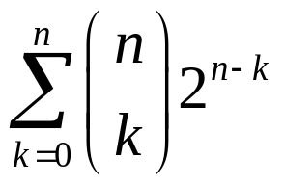
Comments
This problem is much more complex than the single-center design problem
If we have n access access nodes that we want to partition into 3 sets, the number of possible partitions is …
For partitioning, must still solve 3 MST design problems
k nodes in
set 1
ways for n-k
nodes to be
in sets 1 and 2

Slide 56
Nearest Neighbor Algorithm
For each b in B, let
S_{b} = { n ∈ N | C(n,b) < C(n,b’) for all b’ ∈ B }
If n is equidistant to several backbone sites, add it to one of the sets S_{b} at random
Use Esau-Williams to construct a capacitated MST on each set b ∪ S_{b}
Also known as the “nearest neighbor Esau Williams” (NNEW) algorithm

Slide 57
NNEW Example (1)
Assume …
  Topology shown on next slide
    3 backbone nodes, B = { 9, 10, 11 }
    9 access nodes N = { 0, 1, …, 8 }
  Weight of each individual node is 1, except for nodes 4 and 5, which have a weight of 2
  Cost function C( i, j ) is given by the physical distance between nodes i and j
  Capacity of a link is W = 3
Steps …
  Partition into three sets of nodes
  Perform EW to find capacitated MSTs for each set

Slide 58
NNEW Example (2)
Step 1: Identify sets based on nearest neighbor measure …
1
1
Backbone
nodes
9
10
11
1
Example (node 3):
C(3,9) = 2
C(3,10) = 3
C(3,11) = 4
⇒ S₉ = { … 3 … }
0
1
2
1
3
4
5
1
6
7
8
S₉
S₁₀
S₁₁

Slide 59
NNEW Example (3)
Step 2: Build capacitated MST (e.g., using EW algorithm) …
Backbone
nodes
9
10
11
0
1
2
3
4
5
6
7
8

Slide 60
Kershenbaum-Chou Algorithm (1)
This is a variation of the original
Esau-Williams algorithm (the Multicenter Esau-Williams algorithm)
Recall … in EW, we calculated the tradeoff
  Tradeoff( N_{j} ) = min_{k} Cost( N_{j}, N_{k} )
  – Cost( Comp(N_{j}), Center )
  The savings in linking N_{j} to N_{k} instead of linking it directly to the center
Now we must consider …
  Tradeoff( N_{j} ) = min_{k} Cost( N_{j}, N_{k} )
  – Cost( Comp(N_{j}), Center(N_{j}) )

Slide 61
Kershenbaum-Chou Algorithm (2)
Initially set Center( N_{j} ) to be the closest center and when we merge N_{j} with N_{k} we update Center(N_{j}) = Center(N_{k}).
It turns out there is only a slight cost advantage of using MCEW versus NNEW
  Advantage disappears as the average size of a cluster decreases

Slide 62
Improving Local Access Designs
Algorithms are not written in stone
Not difficult to get rid of some common shortcomings of access design

Slide 63
Branches contain too many nodes
EW tests only if the combined weight does not exceed some threshold
Fix: Do not allow the merger of two components that exceed some limit on number of nodes

Slide 64
Access trees contain too many hops
Fix: Limit the depth of the tree built by EW
Each site maintains a value depth[v_{i}]
Initially set to 1; update when merging components; compare against threshold

Slide 65
Sites contain too many links
Fix: Institute a “valence” constraint
Initialize the valence of each site to 1; update when merging; do not accept merges that violate the constraint

Slide 66
Central site contains too many links (1)
Related to the previous problem, but not really the same
Fix: Modify EW algorithm, providing an added incentive in the tradeoff function

Slide 67
Central site contains too many links (2)
Suppose we have a single center and EW generates a tree with too many links to the center
Encourage mergers by changing the tradeoff function …
  Tradeoff( N_{j}, N_{k} ) = Cost( N_{j}, N_{k} )
  – α × Cost( Comp(N_{j}), Center(N_{j}) )
  Use α > 1
  The chosen value of α governs the degree of the central site

Slide 68
A given site fails too often
If a given site is known to have availability problems, it should not be an interior point
Fix: Mark node as not being allowed to serve as a predecessor

Slide 69
You should now be able to …
Employ Esau-Williams’ and Sharma’s algorithms to build a capacitated minimum spanning tree (CMST)
Employ Cahn’s algorithm to solve the
multi-speed CMST problem
Employ NNEW and MCEW to solve the multi-center local access problem
Critique and adapt the above algorithms to deal with different constraints

