Slide 1
Queuing Theory: Other Queues
CSCE 654
Computer Communication Networks
Dr. Scott R. Graham
Department of Electrical and Computer Engineering
Air Force Institute of Technology
(Material from Dr. Barry Mullins & Dr. Scott Midkiff is gratefully acknowledged)

Slide 2
Outline
Other “Markovian” queues (M/M/… queues)
State-dependent M/M/1 queuing system
M/M/1/N queue
M/M/∞ queue
M/M/m queue
M/M/m/m queue
Multi-channel call concentration
M/G/1 queue
Priority queuing

Slide 3
Reading
T. G. Robertazzi, Computer Networks and Systems, 3rd edition, Sections 2.4-2.13.

Slide 4
State-Dependent M/M/1 Queues (1)
The standard M/M/1 queue assumes that the arrival rate and the service rate are constant
In some systems, the arrival rate and/or the service rate may depend on the number of customers in the system
Such a system is a state-dependent

Slide 5
State-Dependent M/M/1 Queues (2)
n
λ(n)
μ(n)
λ(0)
λ(1)
λ(n-1)
λ(n)
0
1
2
n-1
n
n+1
μ(1)
μ(2)
μ(n)
μ(n+1)

Slide 6
State-Dependent M/M/1 Queues (3)
Analyze using local balance equations
λ(n-1)
n-1
n
μ(n)

Slide 7
State-Dependent M/M/1 Queues (4)
Results

Slide 8
State-Dependent M/M/1 Queues (5)
Performance measures
Throughput
Average number in system
Utilization

Slide 9
Other Markov Queuing Systems
A number of other queuing systems are similar to the M/M/1 queue
Poisson arrival process
Exponential service times
Similar systems:
M/M/1/N: finite buffer (system capacity = N)
M/M/m: m servers (rather than 1)
M/M/∞: infinite number of servers (no queuing)
M/M/m/m: m servers without queuing

Slide 10
M/M/1/N Queue (1)
Features of the M/M/1/N queue
Poisson arrival process
Exponential service times
Single server
Finite capacity of N customers in the system
λ
μ
finite capacity N

Slide 11
M/M/1/N Queue (2)
Markov chain model
Terminates with N in the system
Local balance equations yield …
λ
λ
λ
λ
0
1
2
N-2
N-1
N
μ
μ
μ
μ

Slide 12
M/M/1/N Queue (3)
The steady state solution (for ρ = λ/μ < 1) …

Slide 13
M/M/1/N Queue (4)
Blocking probability is an important performance measure for systems with finite capacity
The blocking probability is the probability that an arriving customer will find the system full, i.e., that there are N customers in the system
Blocking probability: p_{N}
Rate of rejected customers: λ p_{N}

Slide 14
Exercise 1
Suppose that messages arrive according to a Poisson process at a rate of one message every 4 ms, and that message transmission times are exponentially distributed with mean 3 ms.
The system maintains buffers for 4 messages, including the one being served.
(a) What is the blocking probability?
(b) What is the average number of messages in the system?

Slide 15
Exercise 1 Solutions
(a) What is the blocking probability?
(b) What is the average number of messages in the system?

Slide 16
M/M/∞ Queue
The M/M/∞ queue is a special case of the M/M/m queue with an infinite number of servers (m=∞)
Every arriving customer is put into service
E.g., a swimming pool, or other self-service activity
No queuing delay, only service time
λ
λ
λ
λ
0
1
2
n-1
n
n+1
?
?
?
?
μ
2 μ
n μ
(n+1) μ

Slide 17
M/M/∞ Queue: Derivation of p_{n}

Slide 18
M/M/∞ Queue: Derivation of p₀

Slide 19
M/M/∞ Queue: Results
Using the values for p_{n} and p₀:
Valid for 0 ≤ λ/μ < ∞ (I.e., always stable)
There are an infinite number of servers
The number in the system for the M/M/∞ is Poisson distributed with parameter λ/μ
The expected number in the system is N = λ/μ
Little’s Theorem gives the average delay per customer
T = N/λ = 1/μ
This is as expected. It is the service time… there is no queuing

Slide 20
M/M/m Queue (1)
Identical to the M/M/1 queue except that there are m servers
(E.g., m channels)
Any arriving customer (packet) is routed to any server that is available; if none available, the packet enters a single queue
μ
μ
m servers
λ
...
μ

Slide 21
M/M/m Queue (2)
For n≤m, there are n customers in service, any one of which may depart (time until the next departure is exponentially distributed with rate nμ)
For n>m, there are m customers in service, any one of which may depart (time until the next departure is exponentially distributed with rate mμ)
Use results from state-dependent M/M/1 systems, with …
λ
λ
λ
λ
0
1
2
m-1
m
m+1
μ
2 μ
m μ
m μ

Slide 22
M/M/m Queue (3)
Balance equations:
Probability of n customers in system, for
Probability of 0 customers in system (idle)
preview
preview

Slide 23
M/M/m Queue: Derivation of p_{n}
Balance equations give:

Slide 24
M/M/m Queue: Derivation of p_{n} (continued)
n ≤ m:
n=1
n=2
n=3
n
m

Slide 25
M/M/m Queue: Derivation of p_{n} (continued)
n > m:
recall
n=m+1
n=m+2
n

Slide 26
M/M/m Queue: Derivation of p₀

Slide 27
M/M/m Queue (4)
What is the probability that an arriving packet will find all m channels busy?
This is the probability that the packet will queue
Note that an arriving packet finds the system in a “typical” state
“Erlang C” Formula (widely used in telephony and circuit switching systems)

Slide 28
M/M/m Queue (5)
The expected number of customers in queue, but not in service is …

Slide 29
M/M/m Queue (6)
Little’s Law gives the expected time in queue …
Expected delay per customer (queuing and service) …

Slide 30
M/M/m Queue (7)
Expected number in the system (using Little’s Law) …

Slide 31
M/M/m Statistical Multiplexing (1)
Consider two options for statistical multiplexing
1) Use a single channel (as discussed previously)
2) Share m channels (note that any packet may use any channel, so this is not true TDM or FDM)
Assume
Poisson arrivals with overall rate λ
Exponentially distributed services times
Rate mμ for the single channel case
rate μ for each of the m separate channels
The single channel case is an M/M/1 queue, the m-channel case is an M/M/m queue

Slide 32
M/M/m Statistical Multiplexing (2)
Case 1: Single channel with service rate μm (M/M/1 queue)
Note that P_{Q,1} is the probability of an arriving packet finding the single server busy, so P_{Q,1} = ρ = λ/mμ (remember: ρ is the proportion of time the server is busy)

Slide 33
M/M/m Statistical Multiplexing (3)
Case 2: m channels, each with service rate μ (M/M/m queue)

Slide 34
M/M/m Statistical Multiplexing (4)
Consider a lightly loaded system
ρ = λ/mμ << 1 (utilization is very low)
P_{Q,1} ≈ 0 and P_{Q,m} ≈ 0
☞ The m sub-channels lead to m times the delay of the single channel under light loading conditions because the propagation delay for one of the single sub-channels is m times greater.

Slide 35
M/M/m Statistical Multiplexing (5)
Consider a heavily loaded system
ρ = λ/mμ → 1 (utilization is nearly 100%)
P_{Q,1} ≈ 1, P_{Q,m} ≈ 1, 1/mμ < 1/μ << 1/(mμ-λ)
☞ The single channel and the m sub-channels yield similar delays under heavy loading conditions

Slide 36
M/M/m/m Queue (1)
The M/M/m/m queue is known as the “m-Server Loss system”
There are m servers (like the M/M/m queue)
The last “m” in M/M/m/m denotes that the system capacity is limited to m customers
Queuing is not allowed, so a customer that arrives at a system with all servers busy is lost

Slide 37
M/M/m/m Queue (2)
Example: A transmission line in a circuit-switched network that consists of m circuits
The m circuits are m servers for connections
The service time, 1/μ, is the connection hold time
Connection requests beyond m are blocked (lost)
Blocking probability is clearly an important performance measure
μ
λ
μ
m servers
...
no queuing
μ

Slide 38
M/M/m/m Queue (3)
Analyze using the state-dependent M/M/1 results
λ
λ
λ
λ
0
1
2
m-2
m-1
m
μ
2 μ
(m-1) μ
m μ

Slide 39
M/M/m/m Queue: Derivation of p_{n}

Slide 40
M/M/m/m Queue: Derivation of p₀

Slide 41
M/M/m/m Queue (4)
The blocking probability is the probability that an arriving packet will find all servers (circuits) busy and will, therefore, be lost or “blocked”
The blocking probability is p_{m}, the probability that all m servers are busy

Slide 42
M/M/m/m Queue (5)
Blocking probability
Can be shown to hold for the M/G/m/m system (general service times)
Also known as the Erlang B formula or the Erlang-Loss formula
Widely used to evaluate blocking probability in telephone systems

Slide 43
Multi-Channel Call Concentration (1)
ISDN
Scenario
C
O
N
C
E
N
T
R
A
T
O
R
M digital phones
64 kb/s
1 B-channel each
Access Link
(384-Kbps H0 channel)
N fast fax machines
128 kb/s
2 B-channels each

Slide 44
Multi-Channel Call Concentration (2)
Circuit-switched applications
Concentration of calls into a high-speed channel
In the example, applications require either 1 or 2 ISDN B channels (64 kbps for each B channel)
Applications are concentrated into 1 H0 ISDN channel (384 kbps or 6 B channels)
Assume that call arrivals are Poisson and that call duration is exponentially distributed

Slide 45
Call Concentration: Notation (1)
K: Number of different types of calls (need different number of base channels)
In the example, K = 2
v_{L}: Number of channels required for type-L calls
In the example, v₁ = 1 and v₂ = 2
m_{L}: Number of terminals generating type-L calls
For the example, let m₁ = 8 and m₂ = 4
S: Total number of channels of access link
In the example, S = 6

Slide 46
Call Concentration: Notation (2)
λ_{L}: Arrival rate of type-L calls from each terminal
μ_{L}: Service rate of type-L calls from each terminal

Slide 47
Call Concentration: Markov Chain (1)
We can describe this problem using a two-dimensional Markov chain
State (a, b) represents a type-1 (phone) calls and b type-2 (fax) calls currently in progress
Analysis after K. Miyake
K. Miyake, “Traffic Study on High Speed/Multiplexed ISDN User-Network Interface,” Traffic Engineering for ISDN Design and Planning, Elsevier, 1988.

Slide 48
Call Concentration: Markov Chain (2)
Exercise 2
Fill in the transition rates
0,3
Note that: m₁ = 8 and m₂ = 4
0,2
1,2
2,2
0,1
1,1
2,1
3,1
4,1
0,0
1,0
2,0
3,0
4,0
5,0
6,0

Slide 49
Call Concentration: Markov Chain (3)
Exercise 2 Solutions (1)
Transition rates
0,3
2λ₂
3μ₂
0,2
Note that: m₁ = 8 and m₂ = 4
2μ₂
3λ₂
…
0,1
μ₂
4λ₂
8λ₁
7λ₁
6λ₁
5λ₁
4λ₁
3λ₁
0,0
1,0
2,0
3,0
4,0
5,0
6,0
μ₁
2μ₁
3μ₁
4μ₁
5μ₁
6μ₁

Slide 50
Call Concentration: Markov Chain (4)
Exercise 2 Solutions (2)
Transition rates
0,3
3λ₂
0,2
1,2
2,2
2μ₂
0,1
1,1
2,1
3,1
4,1
0,0
1,0
2,0
3,0
4,0
5,0
6,0

Slide 51
Call Concentration: Balance Equations (1)
Let π_{k,j} be the steady-state probability of state (k, j)
Let π_{0,0} = C
First go “horizontal”…
2,2
2,1
0,0
1,0
2,0

Slide 52
Call Concentration: Balance Equations (2)
Now go “vertical”…
2,2
2,1
0,0
1,0
2,0
One can calculate all π’s

Slide 53
Call Concentration: Blocking (1)
The blocking probability for type-L calls is the probability of being in a terminal state for that type of call
Terminal state for a type-L call is one where the number of remaining channels is less than v_{L}

Slide 54
Call Concentration: Blocking (2)
P[blocking] for type-1 calls (telephone)
P[blocking] for type-2 calls (fax)

Slide 55
M/G/1 Queue: Motivation (1)
M/M/… systems are tractable due to the memoryless property of the interarrival and service times
However, exponential service times may not be a good assumption, for example …
Service times are deterministic in an ATM network
There are limits on packet sizes
Poisson arrival assumption somewhat better due to aggregation of arrival streams

Slide 56
M/G/1 Queue: Motivation (2)
The M/G/1 queue, like the M/M/1 queue, has a Poisson arrival process, but it allows general distributions of service times
Still assume that service times are …
Identically distributed
Mutually independent
Independent of interarrival times

Slide 57
M/G/1 Queue as a Markov Chain? (1)
We would need to include enough state information so that that future state transitions would depend only on the present state (the state information)
Number in the system, N(t), is not enough
Service time is not memoryless, so we need to know how long the current customer has been in service — call it s₀(t)
Would need to use state pairs { n(t), s₀(t) }

Slide 58
M/G/1 Queue as a Markov Chain? (2)
Significant problems affecting tractability …
Two-dimensional state
s₀(t) is a continuous state process, i.e., the state space is no longer discrete
The Pollaczek-Khinchin formula (or just the “P-K formula”) provides results for the M/G/1 queue
One analysis is based on residual service times
We’ll just present results after a brief look at the residual service time

Slide 59
M/G/1 Queue: Residual Service Time
Let s₁, s₂, … be the iid sequence of service times in an M/G/1 system
When an arriving customer finds the server busy, the residual service time is the remaining service time for the customer now in service
s₁
s₂
...
s_{j}
time
arrival
t
R(t) = residual service time

Slide 60
Exercise 3
(a) What is the mean residual service time of a system with exponential service times with mean m? Does this make sense?
(b) What is the mean residual service time of a system with constant service time m?
m — This is due to the memoryless property of the system.
m/2 — The residual time is uniformly distributed between 0 and m.

Slide 61
M/G/1 Queue: P-K Formula (1)
Let X_{i} be the service time of the i-th customer, e.g., the transmission time of the i-th packet
{X₁, X₂, ...} are independent and identically distributed (i.i.d.) random variables and are independent of the interarrival times
Average service time
Second moment of service time

Slide 62
M/G/1 Queue: P-K Formula (2)
The Pollaczek-Khinchin formula gives the expected waiting time in queue for the M/G/1 queue
where ρ is the utilization:
Only the first and second moments of the service time distribution must be known!

Slide 63
M/G/1 Queues: Results (1)
The expected total time in the system, in queue and in service is
The P-K formula and Little’s Law give the expected number of customers in queue, N_{Q}

Slide 64
M/G/1 Queues: Results (2)
The expected total number of customers in the system, N can also be determined using Little’s Law

Slide 65
M/G/1 Queues: Special Cases (1)
The M/M/1 queue has exponentially distributed service times
P-K Formula:
✓

Slide 66
M/G/1 Queues: Special Cases (2)
The M/D/1 queue has deterministic service times,
i.e., X₁ = X₂ =...= X_{i} = … = 1/μ
P-K Formula:

Slide 67
Exercise 4
Consider two systems having Poisson arrivals and i.i.d. service times. Both systems have identical arrival rates and mean service times. One system has exponentially distributed service times. The other system has fixed service times.
Do we expect the number in queue to be larger for the system with exponentially distributed or fixed service times?
By what factor?

Slide 68
Exercise 4 (Solutions)
Do we expect the number in queue to be larger for the system with exponentially distributed or fixed service times?
By what factor?
Exponential. Since N_{Q}=λW, N_{Q,M/D/1} < N_{Q,M/M/1}
By a factor of 2.

Slide 69
Queuing Theory Problems
Students arrive at the university computer center in a Poisson manner at an average rate of 10 per hour. Each student spends an average of 20 minutes at the terminal, and the time can be assumed to be exponentially distributed. The center currently has five terminals. Some students have been complaining that waiting times are too long. Analyze the center usage using a queuing model.
Model the center as an M/M/5 queuing system
arrival rate is λ = 1/6 per minute
service rate is μ = 1/20 per minute
traffic intensity or utilization is ρ = λ/(mμ) = 0.167/(5*0.05) = 0.67
probability of all terminals being idle is
probability of all terminals being busy is

Slide 70
Queuing Theory Problems
Students arrive at the university computer center in a Poisson manner at an average rate of 10 per hour. Each student spends an average of 20 minutes at the terminal, and the time can be assumed to be exponentially distributed. The center currently has five terminals. Some students have been complaining that waiting times are too long. Analyze the center usage using a queuing model.
average number of students in center (system) is
average number of students in queue is
average number of students using the terminals is

Slide 71
Queuing Theory Problems
Students arrive at the university computer center in a Poisson manner at an average rate of 10 per hour. Each student spends an average of 20 minutes at the terminal, and the time can be assumed to be exponentially distributed. The center currently has five terminals. Some students have been complaining that waiting times are too long. Analyze the center usage using a queuing model.
mean time spent in the center (system) is
mean time spent in the queue (waiting for a terminal) is

Slide 72
M/G/1: Delay in Go-Back n ARQ (1)
Consider a “go-back n” ARQ scheme…
Packets arrive at the transmitter according to a Poisson process with rate λ
All frames take 1 time unit to transmit, but some packets must be retransmitted so the effective service time is greater than 1 time unit
The transmitter waits at most n-1 frames (n-1 time units) before retransmitting a packet (and all subsequent packets)
...
...
...
1
2
n
1
2
3
n+1
n+2
3
3
4
ý
þ
þ
ý
ý
þ
*ARQ = Automatic Repeat Request, basis of “sliding window”, used in TCP

Slide 73
M/G/1: Delay in Go-Back n ARQ (2)
Two causes of packet retransmission …
Packet error
A packet in frame i at the receiver is rejected due to errors
The transmitter will first send new packets in frames i+1, i+2, ..., i+n-1 (if available)
Then the error packet will be retransmitted in frame i+n
Lost (or delayed) acknowledgement
An acknowledgment is not received back at the transmitter by the time frame i+n-1 completes transmission
Could be due to errors, propagation delays, or long reverse direction frames

Slide 74
M/G/1: Delay in Go-Back n ARQ (3)
To simplify …
Only consider errors in the forward direction (Tx → Rx)
Independent of others, frames are in error with probability p
So, service times for packets modeled as follows:
Errors | Probability | Service time
0 | 1-p | 1 | Successful transmission
1 | (1-p)p | n + 1 | One error followed by successful transmission
k | (1-p)p^{k} | kn + 1 | Multiple errors, then successful transmission

Slide 75
M/G/1: Delay in Go-Back n ARQ (4)
Example
Service time of packet 1: X₁ = 1+n
Service time of packet 2: X₂ = 1
Service time of packet 3: X₃ = 1+kn
X₁
X₂
X₃
...
...
...
1
2
n
1
2
3
n+1
n+2
3
3
4
ý
þ
þ
ý
ý
þ
ý Error
þ Success

Slide 76
M/G/1: Delay in Go-Back n ARQ (5)
Transmitter behaves like an M/G/1 queue
Poisson arrivals at rate λ
Distribution of service times:
Service times are identically and independently distributed
Service times and arrival times are independent

Slide 77
M/G/1: Delay in Go-Back n ARQ (7)
Service time, first moment:
Summations
&

Slide 78
M/G/1: Delay in Go-Back n ARQ (8)
Service time, second moment:
Summations
&

Slide 79
M/G/1: Delay in Go-Back n ARQ (9)
Results using the P-K formula

Slide 80
Delay in Go-Back-n ARQ (continued)
λ = 0.1
n = 4
n = 2
n = 1 (Stop-and-Wait)

Slide 81
M/G/1 Queue with Priority
Consider customers with priority
Non-preemptive: Priority affects next customer to be served, but customer in service stays in service through completion
Non-preemptive operation
Input
HIGH priority
Queue
LOW priority

Slide 82
M/G/1 Queue with Priority: Model
K priority classes of customers
Non-preemptive operation
Type-k customers
arrive according to Poisson process of rate λ_{k}
service times with pdf f_{s,k}(x) and mean E[s_{k}]
Distinct queues for each priority,
when server becomes available (current customer departs), select from the highest-priority non-empty queue

Slide 83
M/G/1 Queue with Priority: Utilization
Server utilization for type-k customers:
Total utilization:
Highest
priority
Lowest
priority

Slide 84
M/G/1 Queue with Priority: Results
Expected time in queue for type-k customers
Expected time in system for type-k customers

Slide 85
Queuing Theory Application
Consider a trunked radio system
trunking allows a large number of users to share a relative small number of channels
access is on a per call basis
demanded from a pool of available channels
trunking is derived from the analogy of a large number of branches and leaves of a tree connected to a single trunk

Slide 86
Trunked Radio System Terminology
blocking: denying access to the system
grade of service (GOS): measure of the ability of a particular user to access the system during the system’s busiest hour
5-6 p.m. on Thursday or Friday
benchmark of system performance
typically given as the probability of blockage (P_{m}) or waiting longer than a specified time
Erlang: measure of traffic intensity of a channel (A) (dimensionless)
average number of calls arriving during the average holding time
Holding time: average duration of a call (h)
load: traffic intensity across the entire trunked radio system
request rate: average number of call requests per unit time (λ)

Slide 87
Trunked Radio System Application
The traffic intensity offered by each user is given by:
A_{u} = λh
Two types of trunked systems commonly used
no queuing of call requests (Erlang B) (M/M/m/m)
queuing of call requests (Erlang C) (M/M/m)

Slide 88
Trunked Radio System Application
Example
Calling rate averages 20 calls/minute (λ = 20)
Average holding time is 3 minutes (h= 3)
Average number of circuits or servers required
A = λh → A = 60
So a switch with capacity of 120 would be half utilized

Slide 89
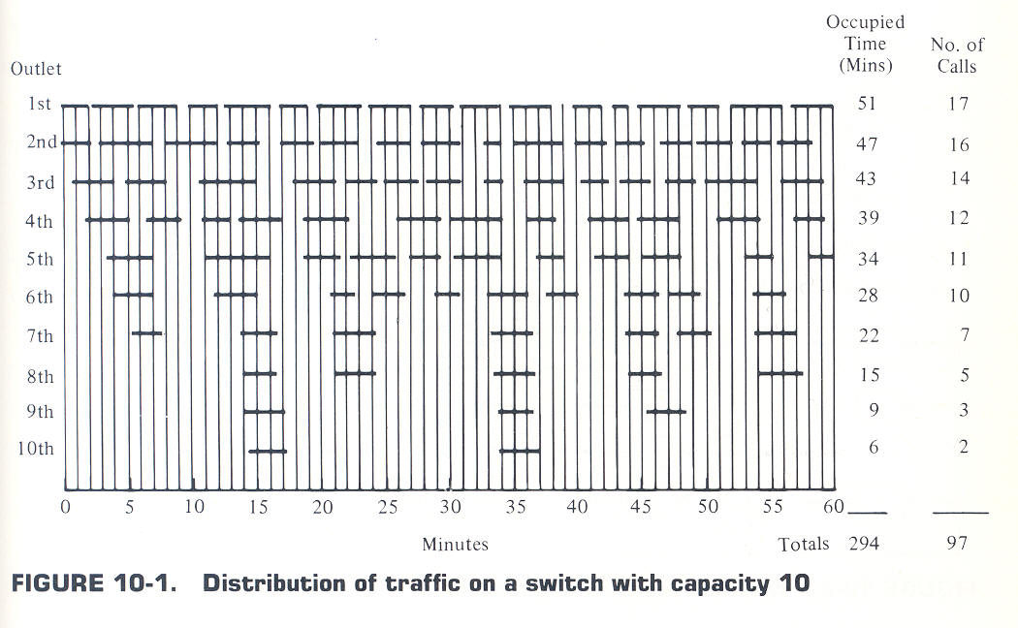
Trunked Radio System Application
Example
Figure shows pattern of activity on a switch of capacity 10 circuits
Rate of calls is λ = 97 / 60 mins = 1.616 calls / min
Average hold time is h = 294 mins / 97 calls = 3.03 mins
Mean number of calls in progress is A = λh = 4.9 erlangs

Slide 90
Trunked Radio System Application
Recall for M/M/m/m system, the probability of blockage (no queuing) was given by:
Substituting previously defined trunked radio terms yields this equation assuming blocked calls are dropped (lost):

Slide 91
Trunked Radio System Application
Similarly, for the trunked system which queues blocked calls:
The average delay D for all calls in a queued system is given by

Slide 92
Trunked Radio System Application
The Erlang B (lost calls cleared—blocked) and Erlang C (calls delayed—queued) formulas have been plotted graphically to allow for ease and rapid determination of GOS for a given type system
Computer simulations still required to determine transient behaviors experienced by given users
Following two slides are taken from Stallings’ text Local Networks, 2nd Edition

Slide 93
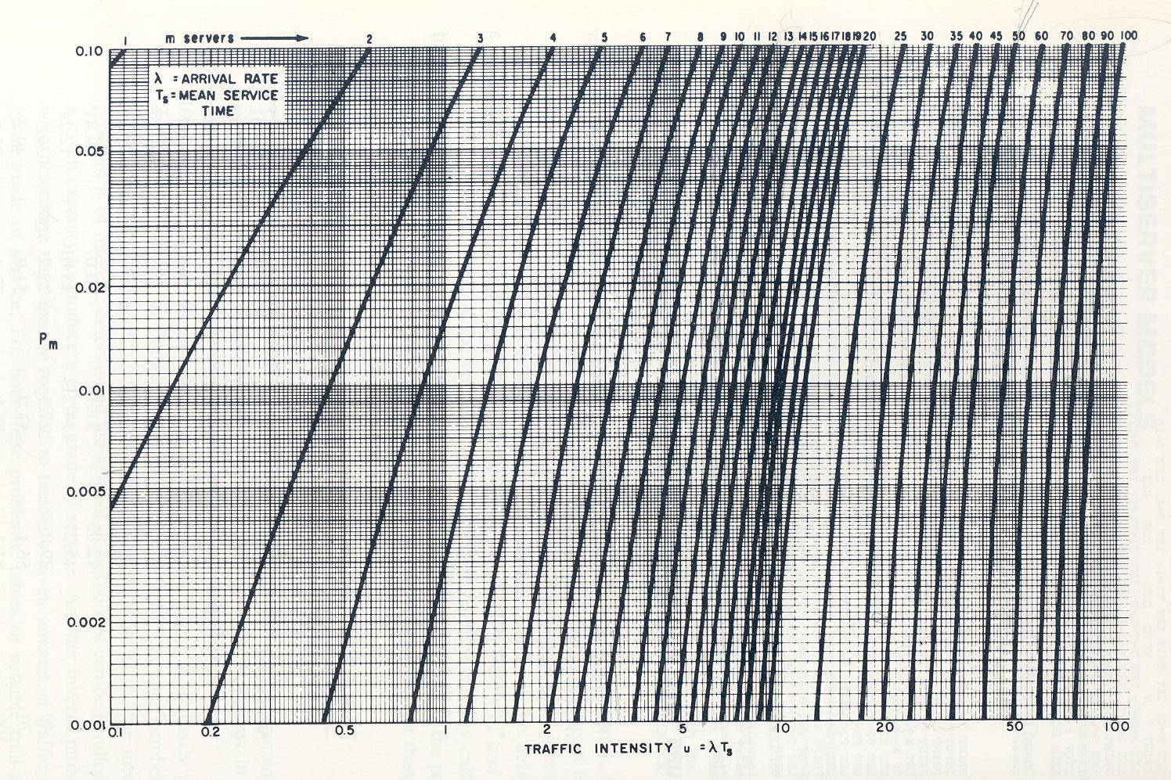
Trunked Radio System Application Erlang B graph
Prob of loss
A
erlangs

Slide 94
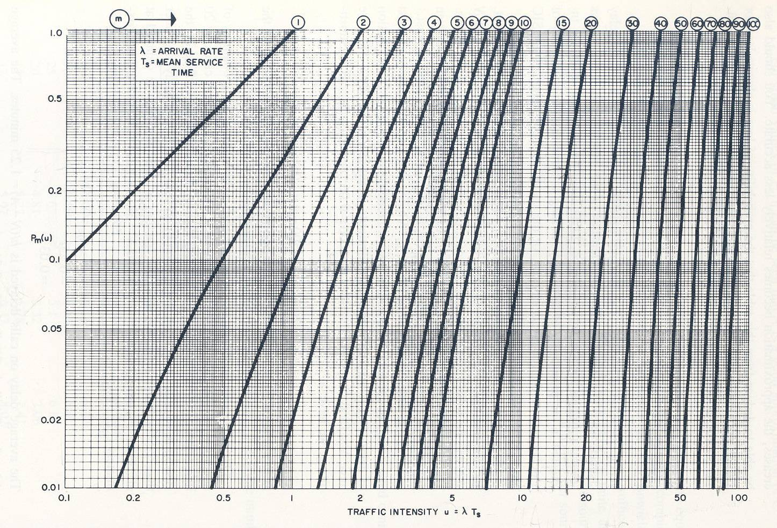
Trunked Radio System Application Erlang C graph
Prob of delay
P_{Q}
A
erlangs

Slide 95
Trunked Radio System Application
Sizing example
you are now a telephone requirements manager
office needs 150 phones
desired GOS of 1%
every phone used on average 5 times per hour
average call duration of 3 minutes
Your job rides on the correct response to the following question:
How many dedicated phone lines should be allocated from the PSTN (Public Switched Telephone Network) to your office?

Slide 96
Trunked Radio System Application
Assume no queuing: Erlang B – why?
People hang up if they get a busy signal
A = λh = 5*3 / 60 = 0.25 offered traffic for each phone (traffic intensity)
Entire office offers 150 * 0.25 = 37.5 erlangs
For 1% GOS – P_{m} = 0.01
need to look for line that intersects 37.5 erlangs and P_{m} = 0.01
that is the m = 50 line
So, we need 50 lines (circuits)
50 lines are much more cost effective than 150
Note: if we keep the 50 lines, but our offered load goes up to 50 erlangs because increase in number and/or length of calls, P_{m} = 0.1 or 10%

Slide 97
Trunked Radio System Application Erlang B graph
Prob of loss
erlangs

Slide 98
You should now be able to … (1)
Model M/M/… queues with Markov chains
Derive and apply results for various M/M/… systems
Identify which of the models studied applies to a particular practical problem
Apply Markov-chain techniques to extend the results from M/M/… systems into the multichannel call concentration problem

Slide 99
You should now be able to … (2)
Utilize the Pollaczek-Kinchin results to analyze an M/G/1 system
Obtain delay results for different customer types in a priority queuing system

