Slide 1
Network Design: Theoretical Approach
CSCE 654
Computer Communication Networks
Dr. Scott R. Graham
Department of Electrical and Computer Engineering
Air Force Institute of Technology
(Material from LTC Bob McTasney, Maj Tom Dube, Maj Ryan Thomas, Maj Scott R. Graham, Dr. Barry Mullins & Dr. Scott Midkiff is gratefully acknowledged)

Slide 2
Outline
Network design problem
Topology design problem
Capacity
Delay
Reliability
Cost
General capacity assignment problem
A brief review of queuing theory

Slide 3
Packet-Switched Network Design (1)
Given
Node locations
Peak-hour traffic rate between nodes
A
J
B
H
D
C
Source
…
A
B
C
G
I
A
0
3
30
F
Dest
E
B
8
0
5
C
20
25
0
…

Slide 4
Packet-Switched Network Design (2)
Design variables …
Network topology
Channel capacity
Routing policy
Performance metrics …
End-to-end delay
Throughput
Reliability
Cost
A
J
B
H
D
C
G
I
F
E

Slide 5
Classical Formulation
Minimize total line cost
Subject to constraints …
Link capacity must exceed some minimum
Average packet delay cannot exceed maximum
A certain level of reliability must be provided
Variations
Minimize average packet delay given maximum network cost
Maximize throughput given maximum delay and cost
The topology design problem is the optimization problem to be solved

Slide 6
Topology Design Problem
Topology design problem is very complex
It is not feasible to determine an optimal solution for real-world problems
Decomposition and heuristics are needed
Problem decomposed into sub-problems
Topology design to determine network topology
Capacity assignment to determine the topology and the capacity of each link
Flow assignment to determine the routing of traffic over the topology

Slide 7
“Tools” for Network Design
Requirements analysis (still to come)
Graph theory (still to come)
Optimization (still to come)
Performance evaluation (already covered)
Queuing models
Simulation
Network management (still to come)

Slide 8
Management, Performance, and Design
Performance
Evaluation/Analysis
Network
Design
Network
Management

Slide 9
Simplified Design Process
generate topology
determine routing
determine cost
check capacity
check reliability
check delay

Slide 10
Capacity Constraint
Given a topology and routing, the capacity can be checked for feasibility
For Link ( i, j ),
Assigned capacity is C_{ij}
Traffic arrival rate is F_{ij}
Require that C_{ij} > F_{ij}
If violated, delay on the link will go to infinity
This condition will violate delay constraint
So, capacity constraint can be ignored
check capacity

Slide 11
Delay Analysis (1)
Given a topology and routing, the delay can be estimated
Let γ_{sd} be the average packet rate from source s to destination d, then the total network traffic, γ, is …
check delay

Slide 12
Delay Analysis (2)
Using the Kleinrock Independence Approximation, the delay over each link, T_{ij}, is …
Average delay in the network, T, is …

Slide 13
Delay Analysis (3)
Average delay for each source-destination pair, Z_{sd}, can also be determined by summing link delays on the path …

Slide 14
Network Reliability (1)
Reliability is a measure of the topology’s ability to withstand node and link failures
Given a topology, the reliability, can be evaluated
Topology can be required to be “k-connected”
Topology can be required to be connected with some probability
check reliability

Slide 15
Network Reliability (2)
Nodes i, j ∈ N in graph G = {N, A} are k-connected if all subgraphs G’ that can be formed by deleting at most k-1 nodes, but not nodes i or j, contain a path from node i to node j
1
3
Nodes 1 and 2, 3, 4 are 2-connected
Nodes 1 and 5 are not 2-connected
5
2
4

Slide 16
Network Reliability (3)
Graph G = {N, A} is k-connected if all subgraphs G’ that can be formed by deleting at most k-1 nodes are connected
Every pair of nodes is k-connected
Network will not fail unless k nodes or links fail
1
2
1
2
1
2
3
4
3
4
3
4
5
6
5
6
5
6
1-connected
2-connected
3-connected

Slide 17
Network Cost (1)
Given a topology, the network cost can be evaluated
The cost of each link depends on a number of factors
Tariffs
Service provider
Capacity (C_{ij})
Length
Technology
Location
Environment
determine
cost

Slide 18
Network Cost (2)
Given that we will have a link from i to j, capacity is the primary design variable
Cost is a function of capacity C_{ij}
For cost function f_{ij}, network cost, D, is
f_{ij}
f_{ij}
f_{ij}
C_{ij}
C_{ij}
C_{ij}
Simple
Non-Linear
Discrete

Slide 19
Network Cost (3)
The form of cost function f_{ij} affects the solution technique
Function f_{ij} is usually complex
Non-linear
Contains steps, discontinuities
This just considers the fixed costs
Topological design may affect other cost factors
Life-cycle costs should be considered
Operation
Maintenance
Capital investment …

Slide 20
General Capacity Assignment Problem
Given:
Topology and flows, θ_{i}
Minimize:
Some function of delay, f (E[τ_{net}])
With respect to:
Link capacities, C_{i}
Under constraint:
Cost function, D

Slide 21
Model
Simple delay function
Packet network, with …
L_{i} ≡ mean packet length at queue i (in bits)
C_{i} ≡ link capacity out of queue i (in bps)
Cost constraint, with link costs proportional to capacity

Slide 22
Mean Offered Load (1)
Expected delay on link i …
Mean traffic (offered load) through queue i in bits per second
⇒

Slide 23
Mean Offered Load (2)
Expressing mean delay in terms of mean offered load
Link …
Network …

Slide 24
Minimization Problem
Minimize …
With respect to …
Under constraint …

Slide 25
Solution to Minimization Problem (1)
Let’s use Lagrange multipliers
Incorporate the constraint and minimize the following with respect to { C_{i} } and α for M links …
Lagrange
multiplier
Constraint
(0 if satisfied)

Slide 26
Solution to Minimization Problem (2)
M equations
1 equation (constraint)
M+1 (non-linear) equations in M+1 unknowns
Can be solved

Slide 27
Solution to Minimization Problem (3)

Slide 28
Interpreting this Result
r_{i} is the absolute minimum C_{i}
Since ρ_{i} = r_{i} / C_{i} < 1
(C – Σ r_{i} ) is the “excess” network-wide capacity to be distributed among links
This result tells us to distribute the excess capacity in proportion to square root of traffic
 | r_i | C | C_i | % Excess
 | 5 | 50 | 8.69 | 18.5%
 | 5 |  | 8.69 | 18.5%
 | 10 |  | 15.22 | 26.1%
 | 5 |  | 8.69 | 18.5%
 | 5 |  | 8.69 | 18.5%
Totals | 30 | 50 | 50 | 100.0%

Slide 29
Average Delay
If λ is the total arrival rate to the network, then the average delay for the network is …
Where the network-wide traffic intensity, ρ, is …

Slide 30
Design Procedure
Simple procedure …
1. From input flows and routing information, find r_{i} using traffic equations
2. Assign C_{i} according to square root rule

Slide 31
Example 1: Star Network
Several statistical multiplexers homing on a central host
θ₂
θ₁
C₂
C₃
HOST
C₁
θ₃

Slide 32
Example 1: Numerical Values
Three offices connected to central database
Main office: 20 terminals
Branch office: 5 terminals
Satellite office: 1 terminal
All user terminals have identical statistics
Mean packet length of 128 bytes
Mean arrival rate of 2,000 packets per second from each terminal
Total available capacity: 64 Mbps

Slide 33





Example 1: Results (Exercise 1)
Exercise 1: Complete the results for the Branch office.
Office
Main
40
40.96
6400
47.2
0.164
Branch
10
10.24
3200
13.44
0.328
Satellite
2
2.048
1431
3.443
0.734
KPkts/ second
Mbps
bps^{1/2}
Mbps
ms

Slide 34
Example 1: Average Delay
Average delay of a packet through the network is 0.218 ms
Sum of delays per source weighted by fraction of traffic

Slide 35
Example 1: Notes on the Results
The largest arrival rates (Main office) get smallest delays — Is this fair?
Main: 0.164 ms (40 KPkts/s)
Branch: 0.328 ms (10 KPkts/s)
Satellite: 0.734 ms (2 KPkts/s)
Need to extend results to apply to a general topology — here just a simple star topology
Do we really want to minimize mean delay? Or, are there other options?

Slide 36
General Capacity Assignment Problem
Want to extend to general topologies
Previous example considered a star topology
Traffic on each link, { θ_{i} }, determined by …
Source-destination traffic
Network topology
Routing in the network

Slide 37
Example 2: General Mesh Topology
Chicago
4
D
Denver
7
DC
B
1
5
E
LA
3
A
6
2
C
Dallas
C = 48 Kbps
Average packet length = 1000 bits

Slide 38
Example 2: Traffic Matrix
Destination
A
B
C
D
E
A
—
0.75
0.61
2.4
2.94
B
0.75
—
0.13
0.63
0.61
Source
C
0.61
0.13
—
0.82
0.94
D
2.4
0.63
0.82
—
9.34
E
2.94
0.61
0.94
9.34
—
Specifies average rate from source to destination in packets per second

Slide 39
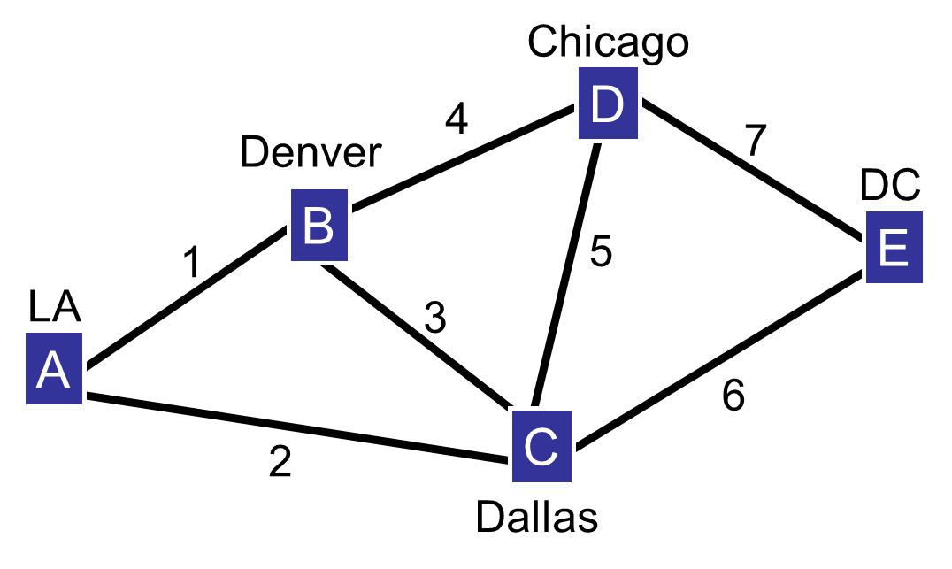
Example 2: Routing Information
All source-destination flows follow the same route (static routing)
Traffic routed on the direct link (single hop) if possible
If no direct link exists …
A to/from D routed through B
A to/from E routed through C
B to/from E routed through D
There is no re-circulation (no routing loops)

Slide 40
Example 2: Calculating Throughput
Links are bi-directional, but symmetry ensures capacities are the same in both directions, so let us consider only one direction (“L to R”)
…

Slide 41





Example 2: Link Table (1)
Link
1:
3.15
3150
56.12
6546
0.294
2:
3.55
3550
59.58
7155
0.277
3:
0.13
130
11.4
820
1.45
4:
3.64
3640
60.3
7291
0.274
Pkts/ second
bps
bps^{1/2}
bps
seconds

Slide 42
Example 2: Link Table (2)
Link
5:
0.82
820
28.64
2553
0.577
6:
3.88
3880
62.29
7649
0.265
7:
9.95
9950
99.75
15986
0.166
Σ, Avg:
25.12
25120
378.11
48000
0.249
Pkts/ second
bps
bps^{1/2}
bps
seconds

Slide 43
Min-Max Capacity Assignment
The previous examples (Example 1 and Example 2) minimize average delay, but favor link with high arrival rates
Alternative solution is to minimize the maximum delay … min-max optimization

Slide 44
Min-Max Solution
Must make delays equal for all links
Any other allocation raises delay for one or more links
Make the following equal for all i …

Slide 45
General Min-Max Capacity Assignment
Rule is to assign excess capacity in proportion to mean packet lengths …

Slide 46
Example 2: Using Min-Max
Repeat Example 2 using min-max assignment
Link
C_{i} (bps)
τ_{i} (s)
C_{i} (bps)
τ_{i} (s)
1
6,418.6
0.306
6,546
0.294
2
6,818.6
0.306
7,155
0.277
3
3,398.6
0.306
820
1.449
4
6,908.6
0.306
7,291
0.274
5
4,088.6
0.306
2,553
0.577
6
7,148.6
0.306
7,649
0.265
7
13,218.6
0.306
15,986
0.166
Total/Avg
48,000
?
48,000
0.249

Slide 47
Other Cost Functions
Previous cost function was simple
For example, did not consider distance
More realistic constraint
Fixed cost per link, a_{i}
Distance-based or other variable factor per link, d_{i}
Fixed cost
Dependence on i allows
distance model

Slide 48
Available or “Excess” Cost (1)
In previous cases, we looked at “excess capacity”
In an analogous manner, let us define “available cost,” D_{a} …
Results are analogous to those previously derived using excess capacity

Slide 49
Available or “Excess” Cost (2)
Results: minimum average delay
Results: min-max delay

Slide 50
Example 3: Star Network, Again
Same topology and load, but use a more complex cost function
a: fixed cost per link ($)
B: cost of capacity per mile ($/bps/mile)
θ₂
θ₁
C₂
C₃
HOST
C₁
θ₃

Slide 51
Example 3: Cost Parameters
Cost
Variable: B = $0.002 per bit per second per mile
Fixed: a_{i} = a = $1000 per link
Distances:
Main: 10 miles
Branch: 30 miles
Satellite: 30 miles
Allowed cost: D = $4M

Slide 52
Example 3: Load Parameters
Packet length: L_{i} = L = 128 bytes
2000 packets per second for each terminal
Number of terminals
Main: 20
Branch: 20
Satellite: 1
⇨ Loading different than in Example 1

Slide 53
Example 3: Results — Load and Cost
θ_{i}
r_{i}
d_{i}
Link
1:
40
40.96
0.02
2:
40
40.96
0.06
3:
2
2.048
0.06
Σ:
82
400
—
KPkts/s
Mbps
$/bps

Slide 54
Example 3: Results — Minimum Average
d_{i} r_{i}
C_{i}
E[τ]
D_{i}
Link
1:
0.8192
905.1
50.53
0.107
1.01
2:
2.4576
1567.7
46.49
0.185
2.79
3:
0.1229
350.5
3.28
0.828
0.20
Σ, Avg:
3.4000
2823.3
100.30
0.163
4.00
M$
$^{1/2}
Mbps
ms
M$

Slide 55
Example 3: Results — Min-Max
d_{i}L
C_{i}
E[τ]
D_{i}
Link
1:
20.48
45.23
0.240
0.91
2:
61.44
45.23
0.240
2.71
3:
61.44
6.31
0.240
0.38
Σ, Avg:
143.36
96.77
0.240
4.00
$•s
Mbps
ms
M$

Slide 56
You should now be able to …
Define the topology design and capacity assignment problems and solution approaches
Analyze cost, capacity, delay, and reliability (k-connectedness) for a network
Apply “excess capacity” and “excess cost” results to determine optimal capacity assignment assuming …
Minimization of average delay
Minimization of maximum delay (min-max)

