Slide 1
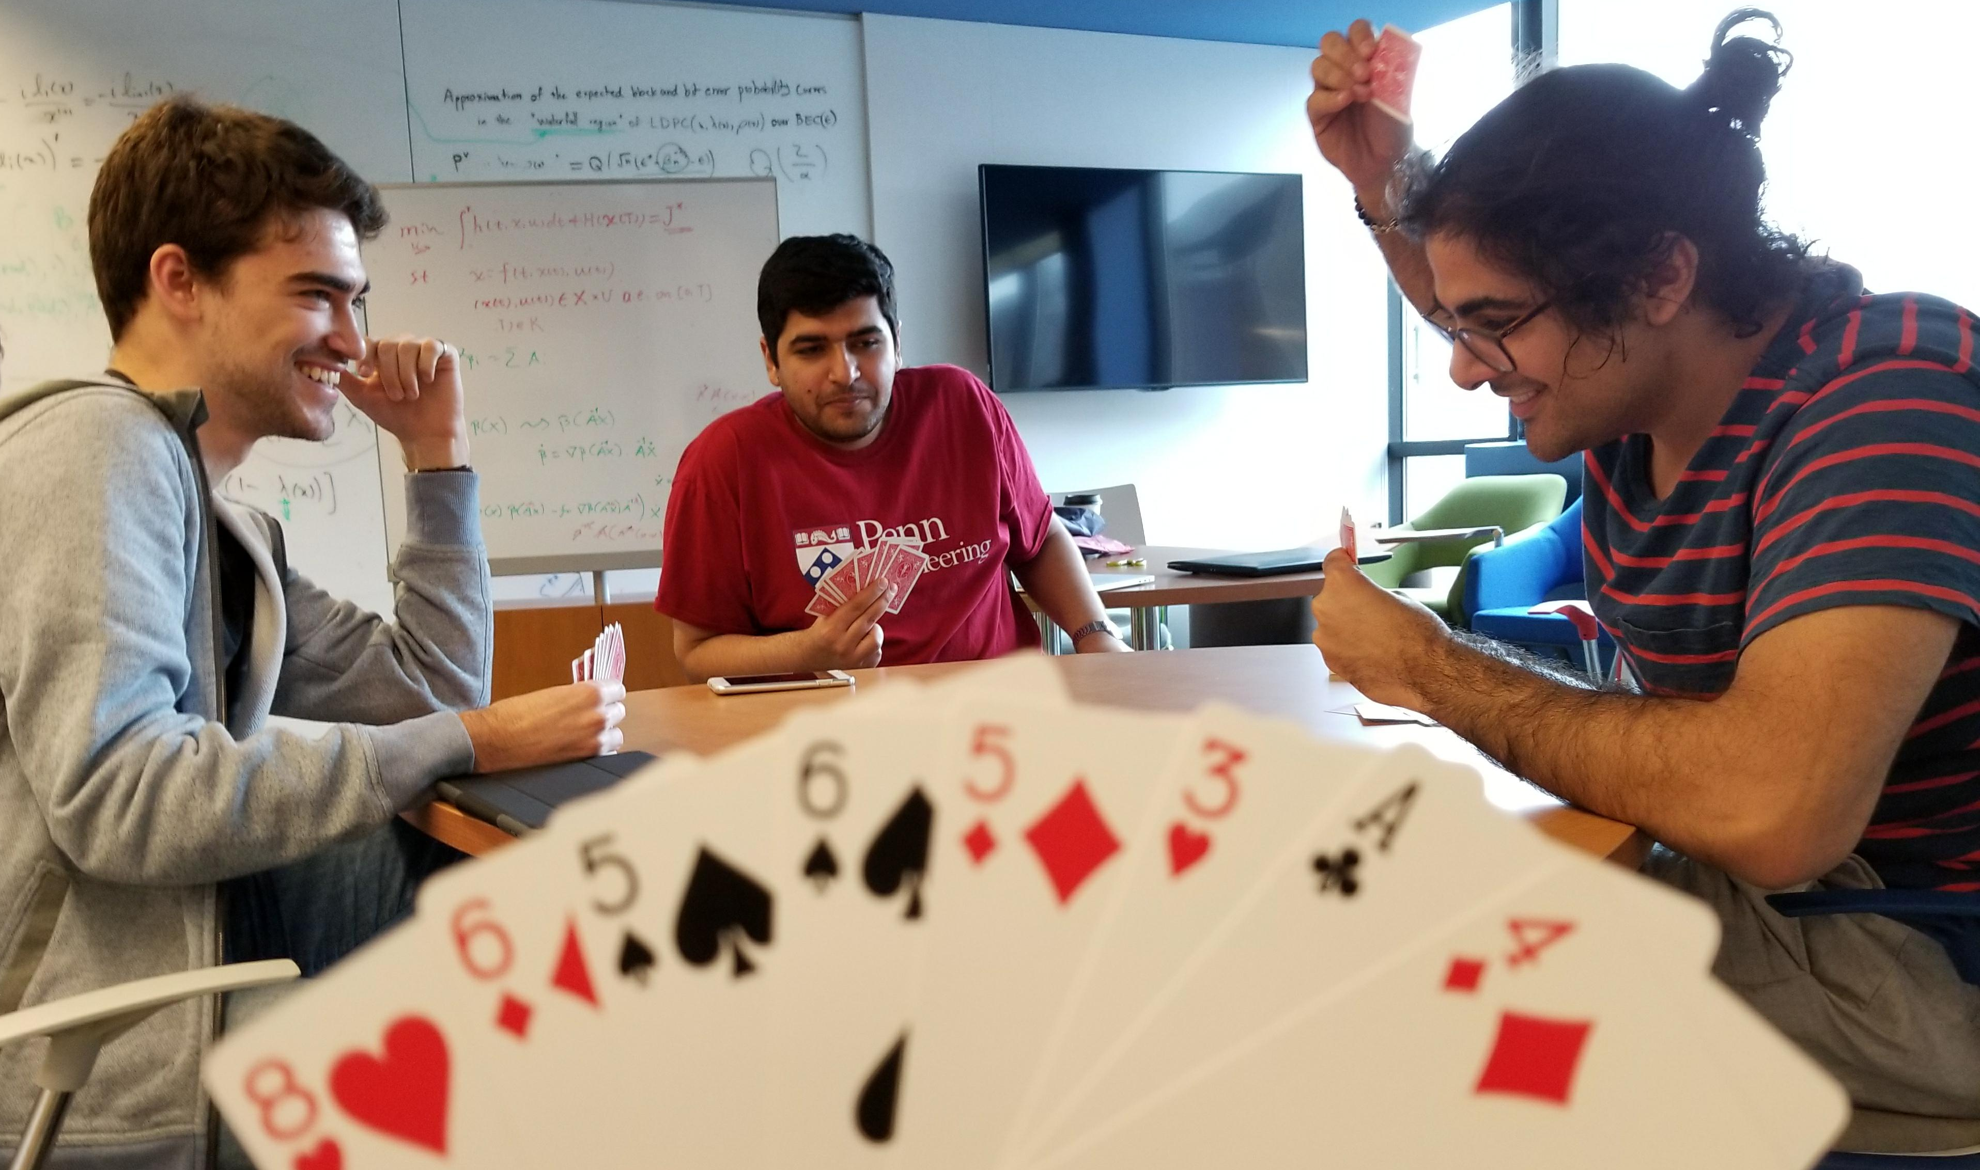
It’s over 400: Cooperative reinforcement learning through self play
CIS 520 Final Project
Hadi Elzayn, Mohammad Fereydounian, Mikhail Hayhoe, Harshat Kumar

Slide 2
BETTING
PLAYING

