Slide 1
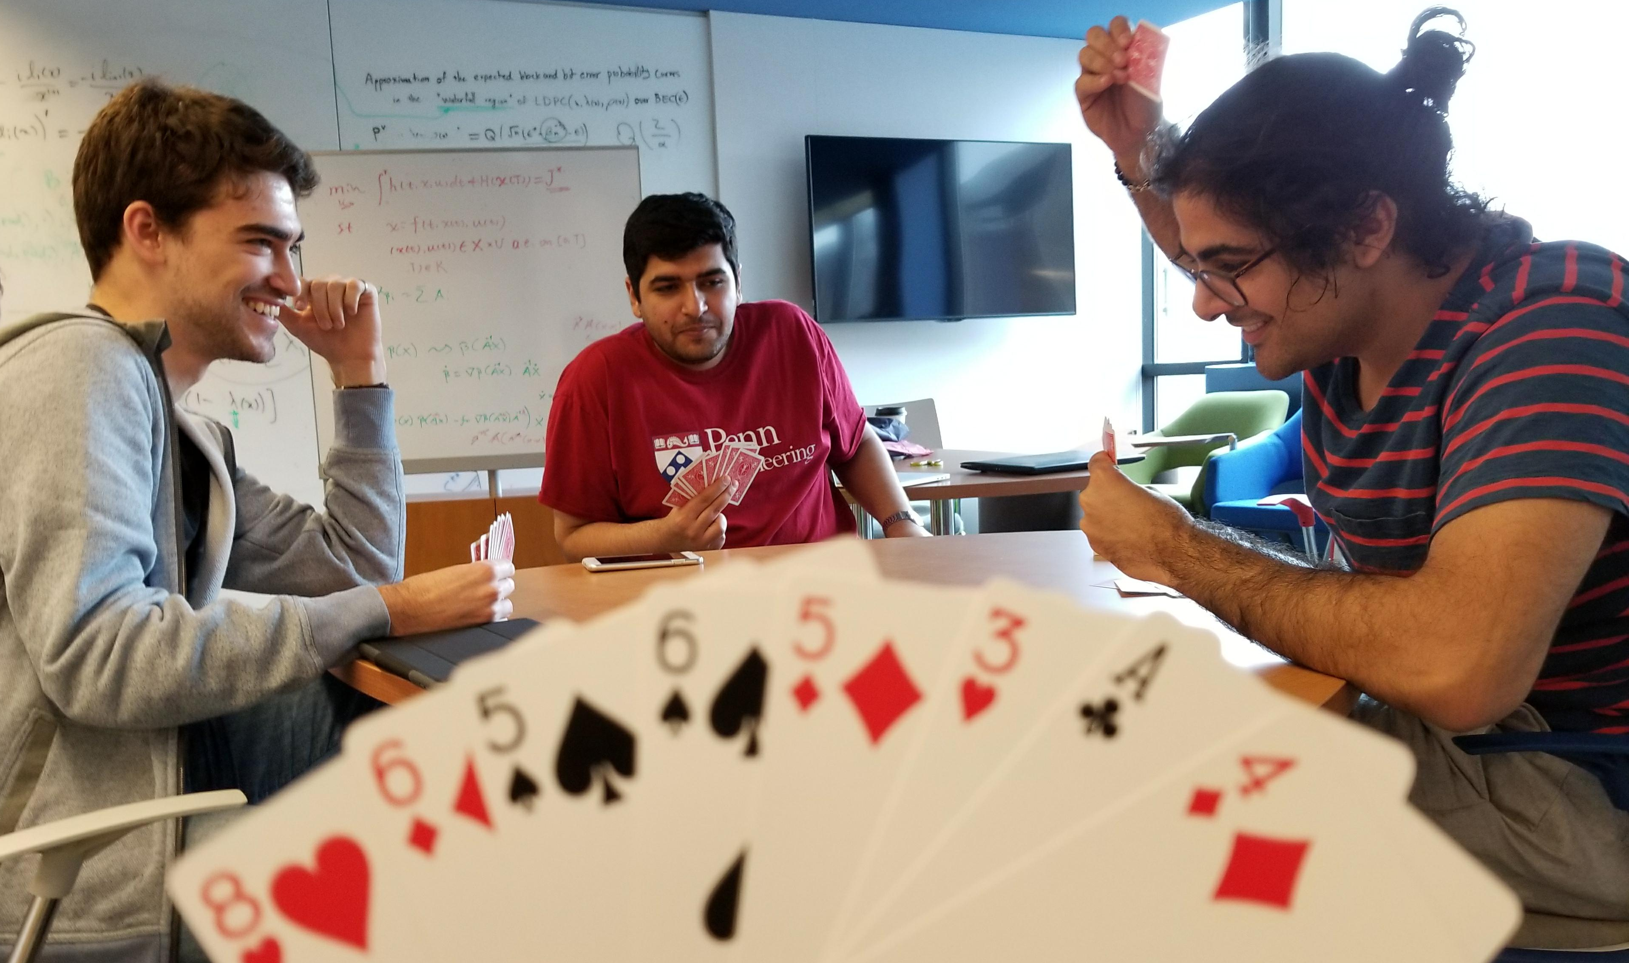
It’s over 400: Cooperative reinforcement learning through self play
CIS 520 Final Project
Hadi Elzayn, Mohammad Fereydounian, Mikhail Hayhoe, Harshat Kumar

Slide 2
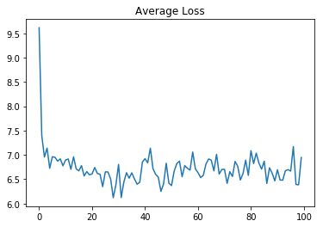
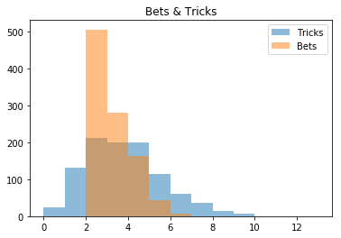
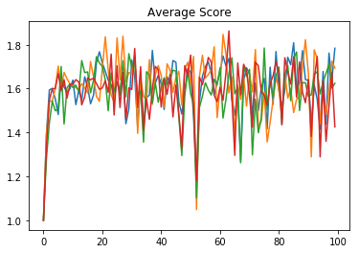
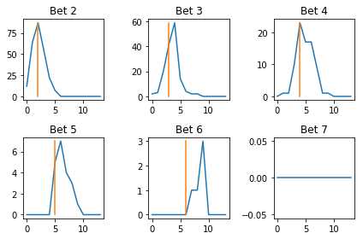
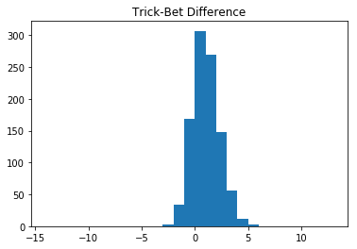
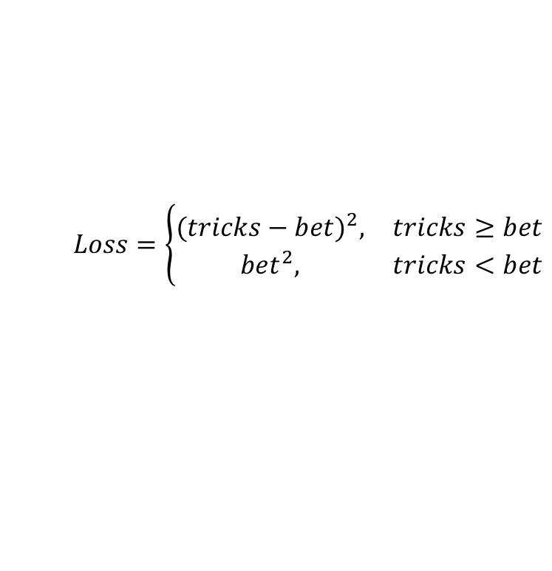
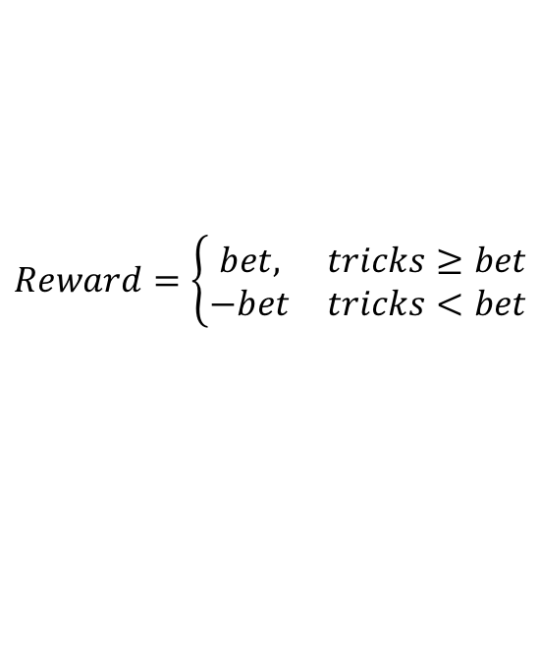
BETTING
PLAYING
$$Loss=\left\{\begin{matrix}{(tricks−bet)}^{2}, & tricks≥bet \\ {bet}^{2}, & tricks<bet\end{matrix}\right.$$
$$Reward=\left\{\begin{matrix}bet, & tricks≥bet \\ −bet & tricks<bet\end{matrix}\right.$$
 | Random | Greedy* | Heuristic* | NN + RL
Heuristic* Win % | 100 | 100 |  | 10.5
NN + RL Win % | 100 | 100 | 89.5
Incorrect
Prediction
Penalties
Potential
Score
Wasted
*Bets made with a strategy-specific NN

