Slide 1
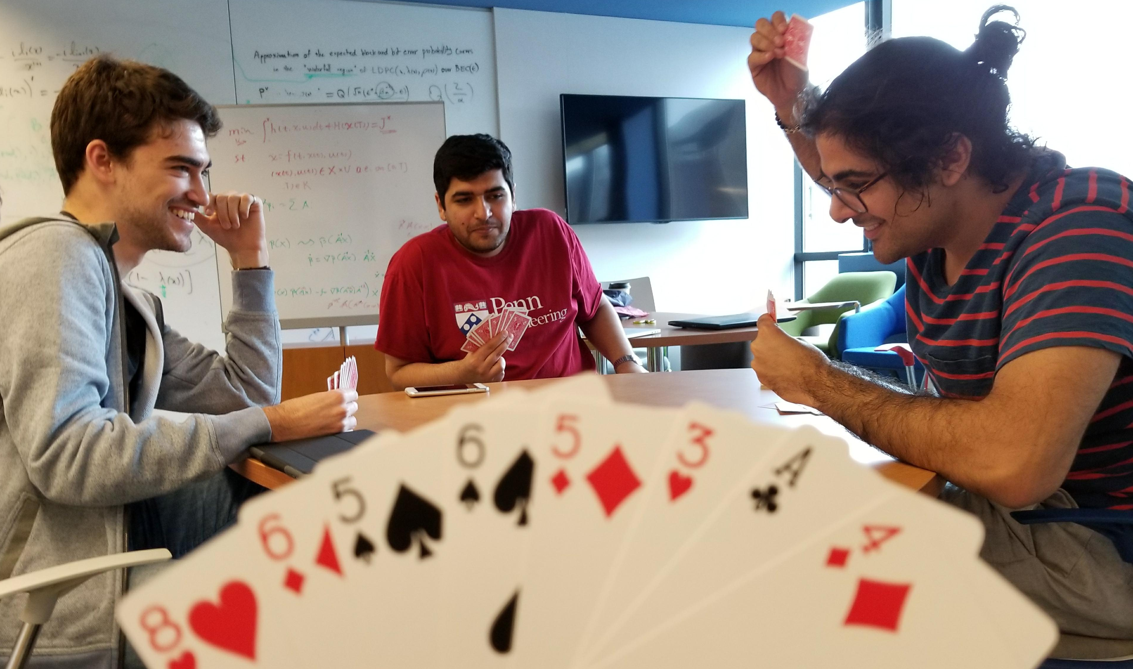
It’s over 400: Cooperative reinforcement learning through self play
CIS 520 Final Project
Hadi Elzayn, Mohammad Fereydounian, Mikhail Hayhoe, Harshat Kumar

Slide 2
BETTING
PLAYING
Bet distributions
Histogram
Tricks – Bets (conservatism)
Table of GAME wins for everyone
Some kind of learning curve? Avg Score? Learns to bet according to play
Figure of NNs if we have space

